Slide 1
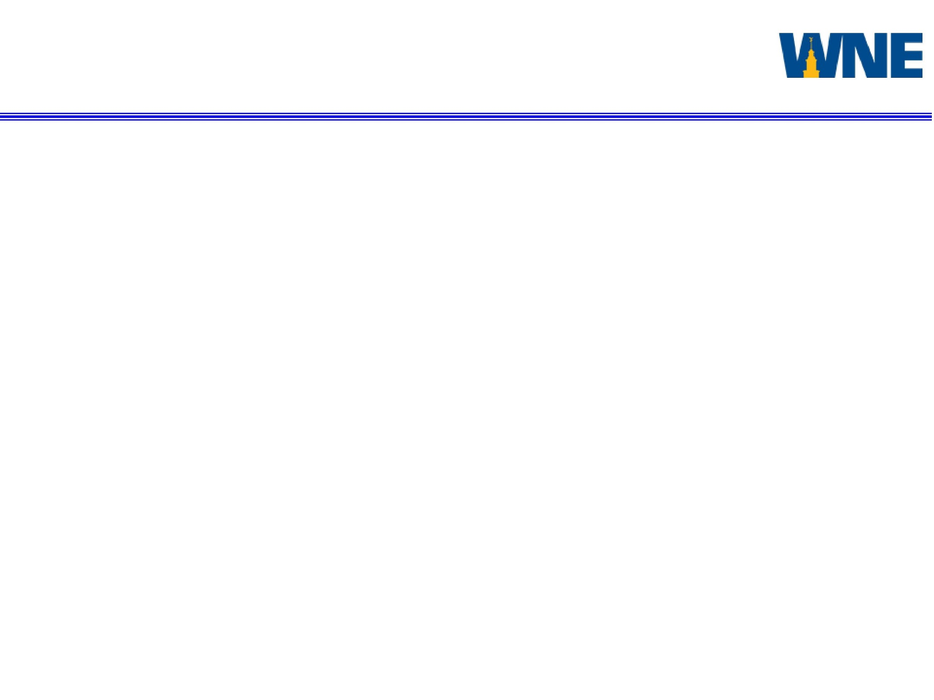

Design Project 3
Western New England University
College of Engineering
EE 456 RF & mm-Wave Active Circuits
Steven Placzek
Matching Network Synthesis Techniques Using
Chebyshev Polynomials

Slide 2
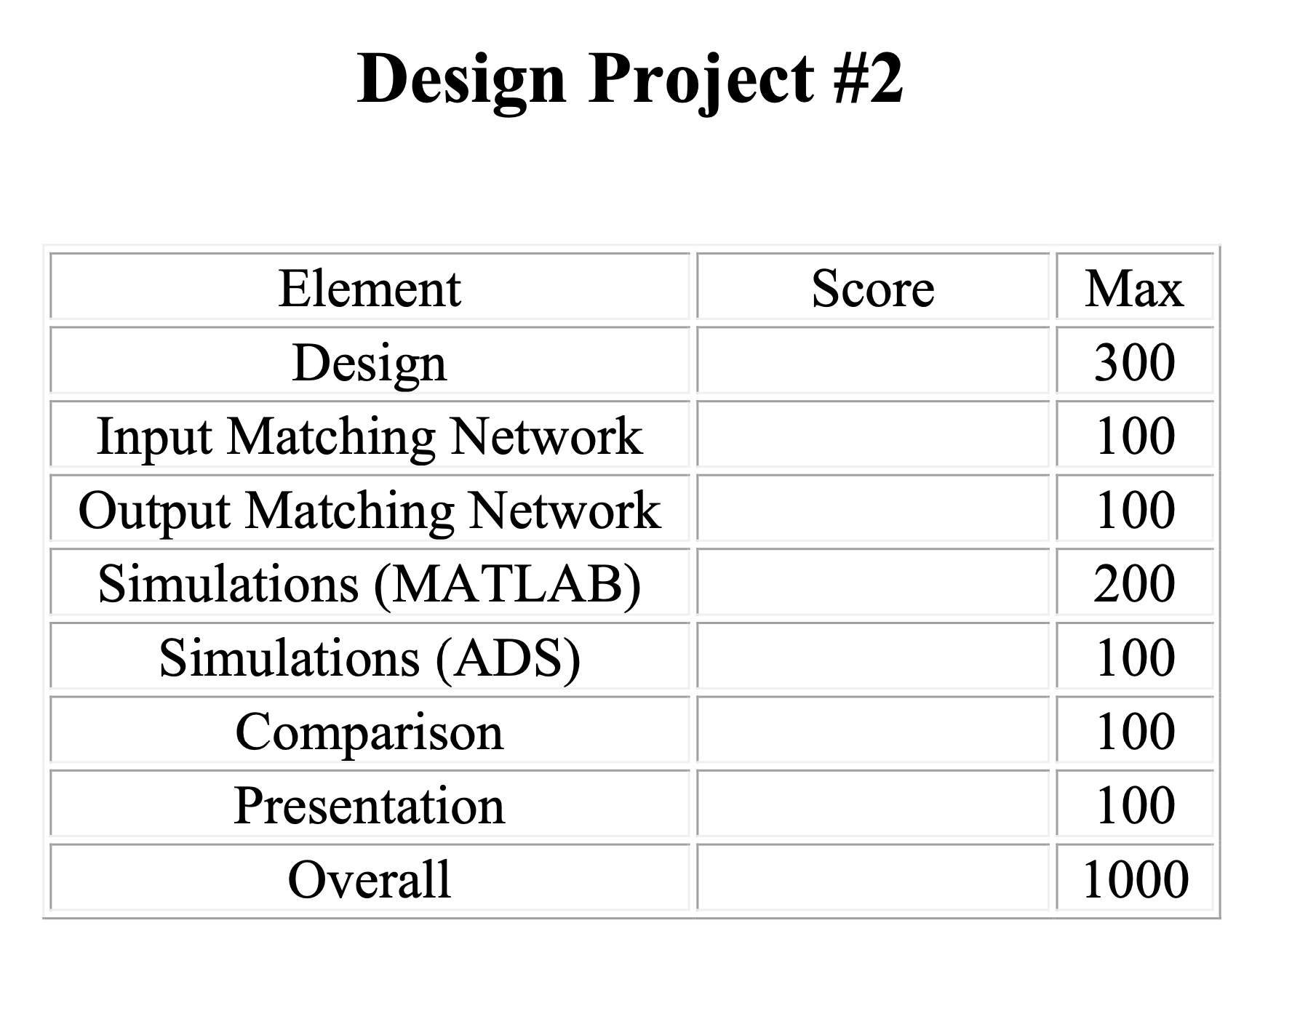
EE 456
RF & mm-Wave Active Circuits
Design Project 3

Slide 3
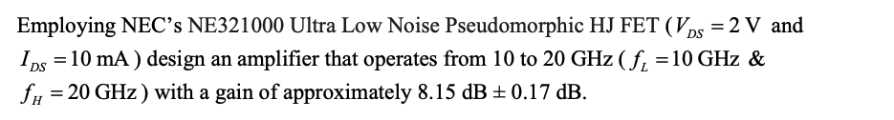
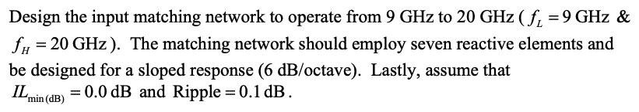
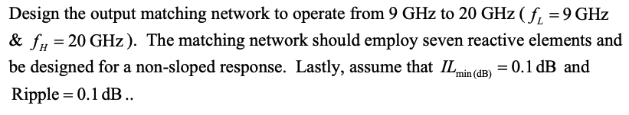
EE 456
RF & mm-Wave Circuits
Design Project 3
Design Project Objective

Slide 4
Design and Simulation Results
EE 456
RF & mm-Wave Active Circuits
Design Project 3
Parameter | Value | Unit | Connection
Z0 | 50 | Ω | Termination
Li7 | 852.9341 | pH | Shunt
Ci6 | 58.435 | fF | Shunt
Ci5 | 288.7183 | fF | Series
Ci4 | 208.6043 | fF | Shunt
Li3 | 459.9278 | pH | Shunt
Li2 | 673.0577 | pH | Series
Ci1 |  |  | Series
FET Gate
FET Drain
Co1 |  |  | Series
Lo2 | 742.7129 | pH | Series
Co3 | 297.2859 | fF | Shunt
Lo4 | 40.0358 | pH | Shunt
Lo5 | 433.3263 | pH | Series
Lo6 | 535.4052 | pH | Shunt
Co7 | 245.9962 | fF | Series
Z0 | 50 | Ω | Termination
Table 1

Slide 5
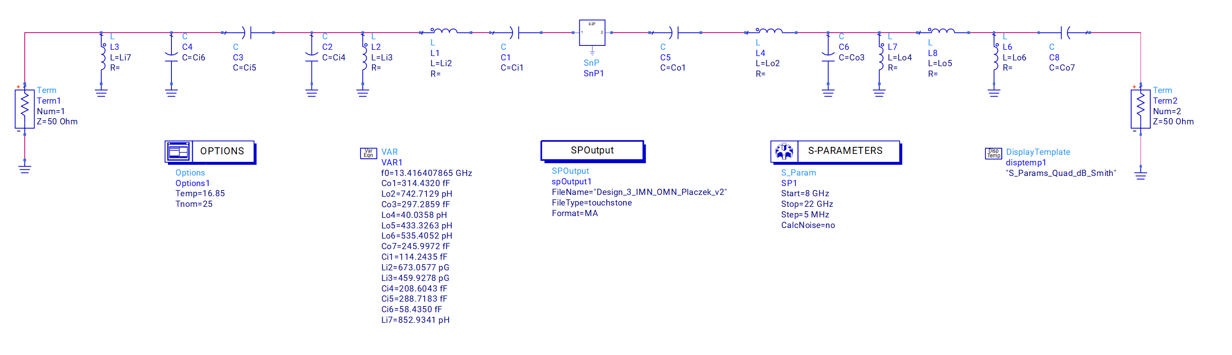
ADS Schematic of Design

Slide 6
EE 456
RF & mm-Wave Circuits
Design Project 3
Design Verification
ADS & MATLAB Simulations

Slide 7
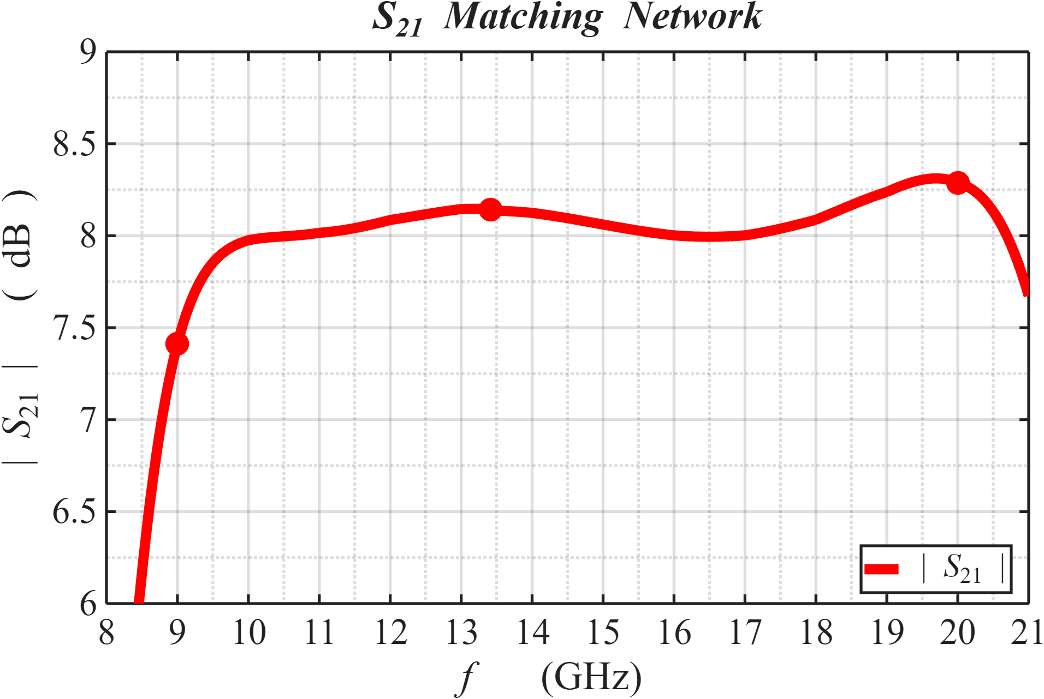
EE 456
RF & mm-Wave Circuits
Design Project 3
Matlab Simulation

Slide 8
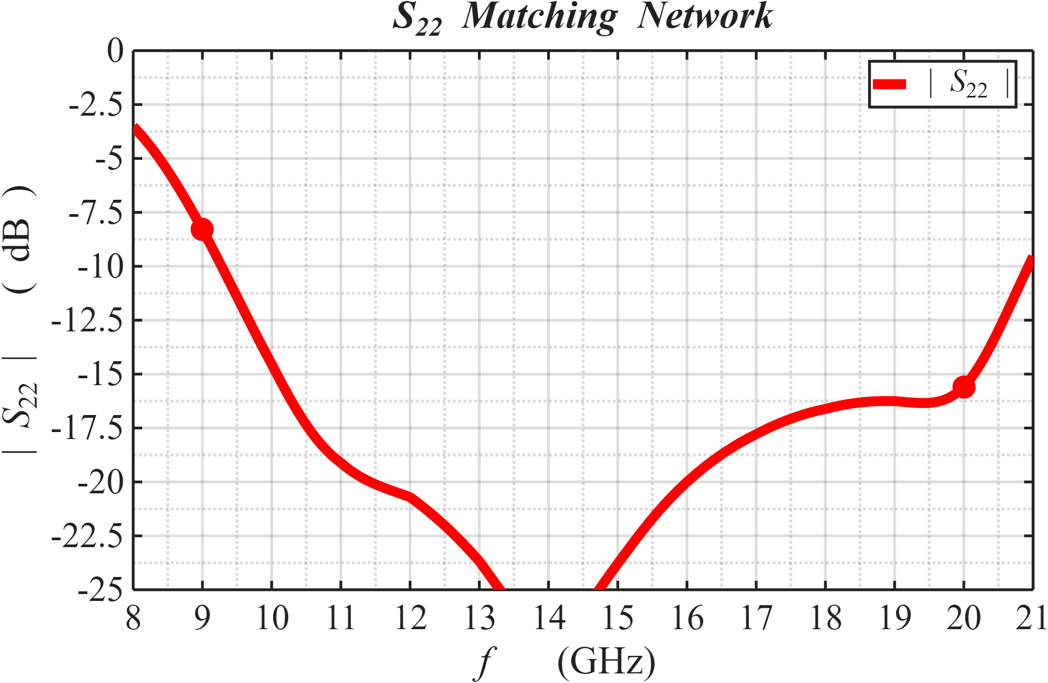
EE 456
RF & mm-Wave Circuits
Design Project 3
Matlab Simulation

Slide 9
EE 456
RF & mm-Wave Circuits
Design Project 3
Matlab Simulation

Slide 10
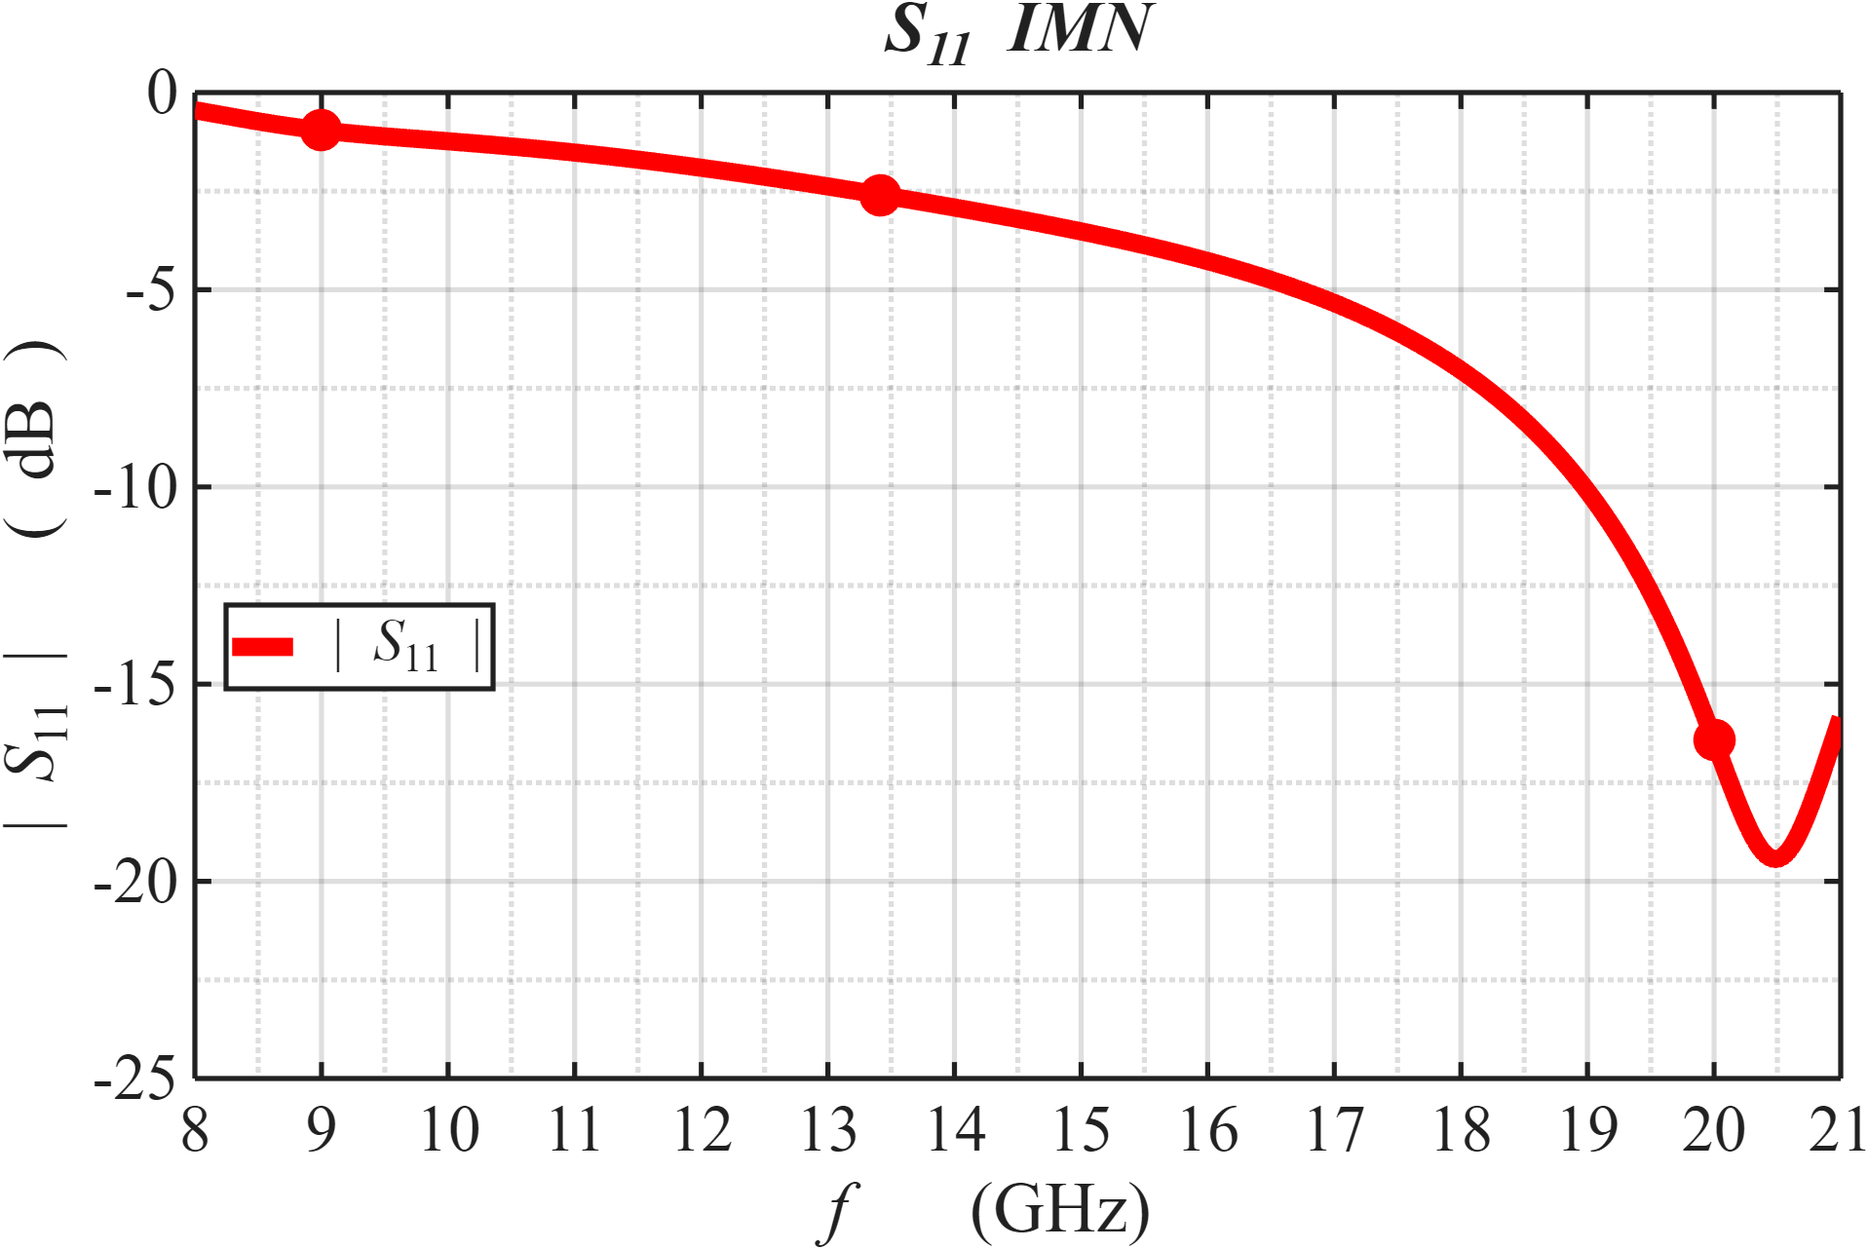
EE 456
RF & mm-Wave Circuits
Design Project 3
Matlab Simulation

Slide 11
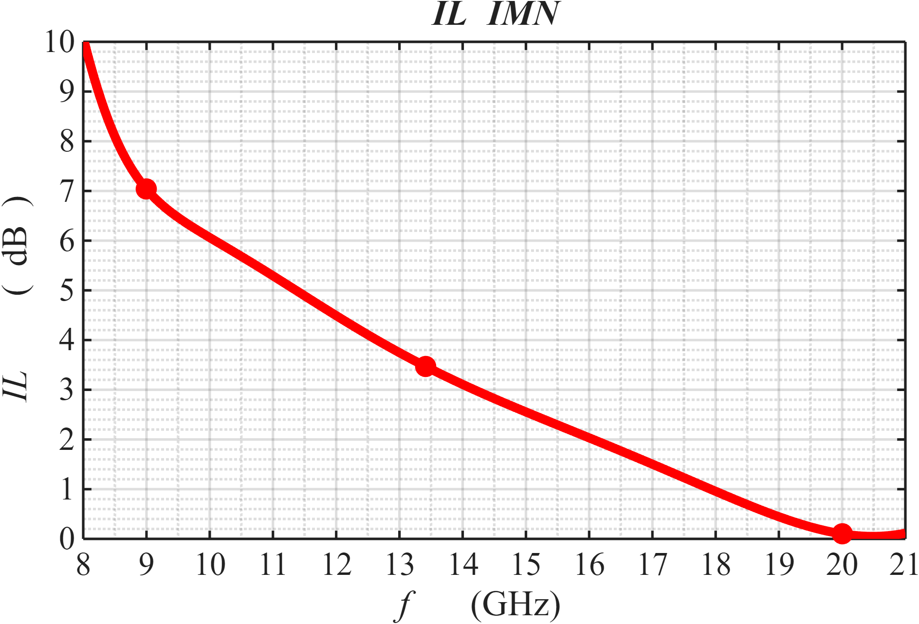
EE 456
RF & mm-Wave Circuits
Design Project 3
Matlab Simulation

Slide 12
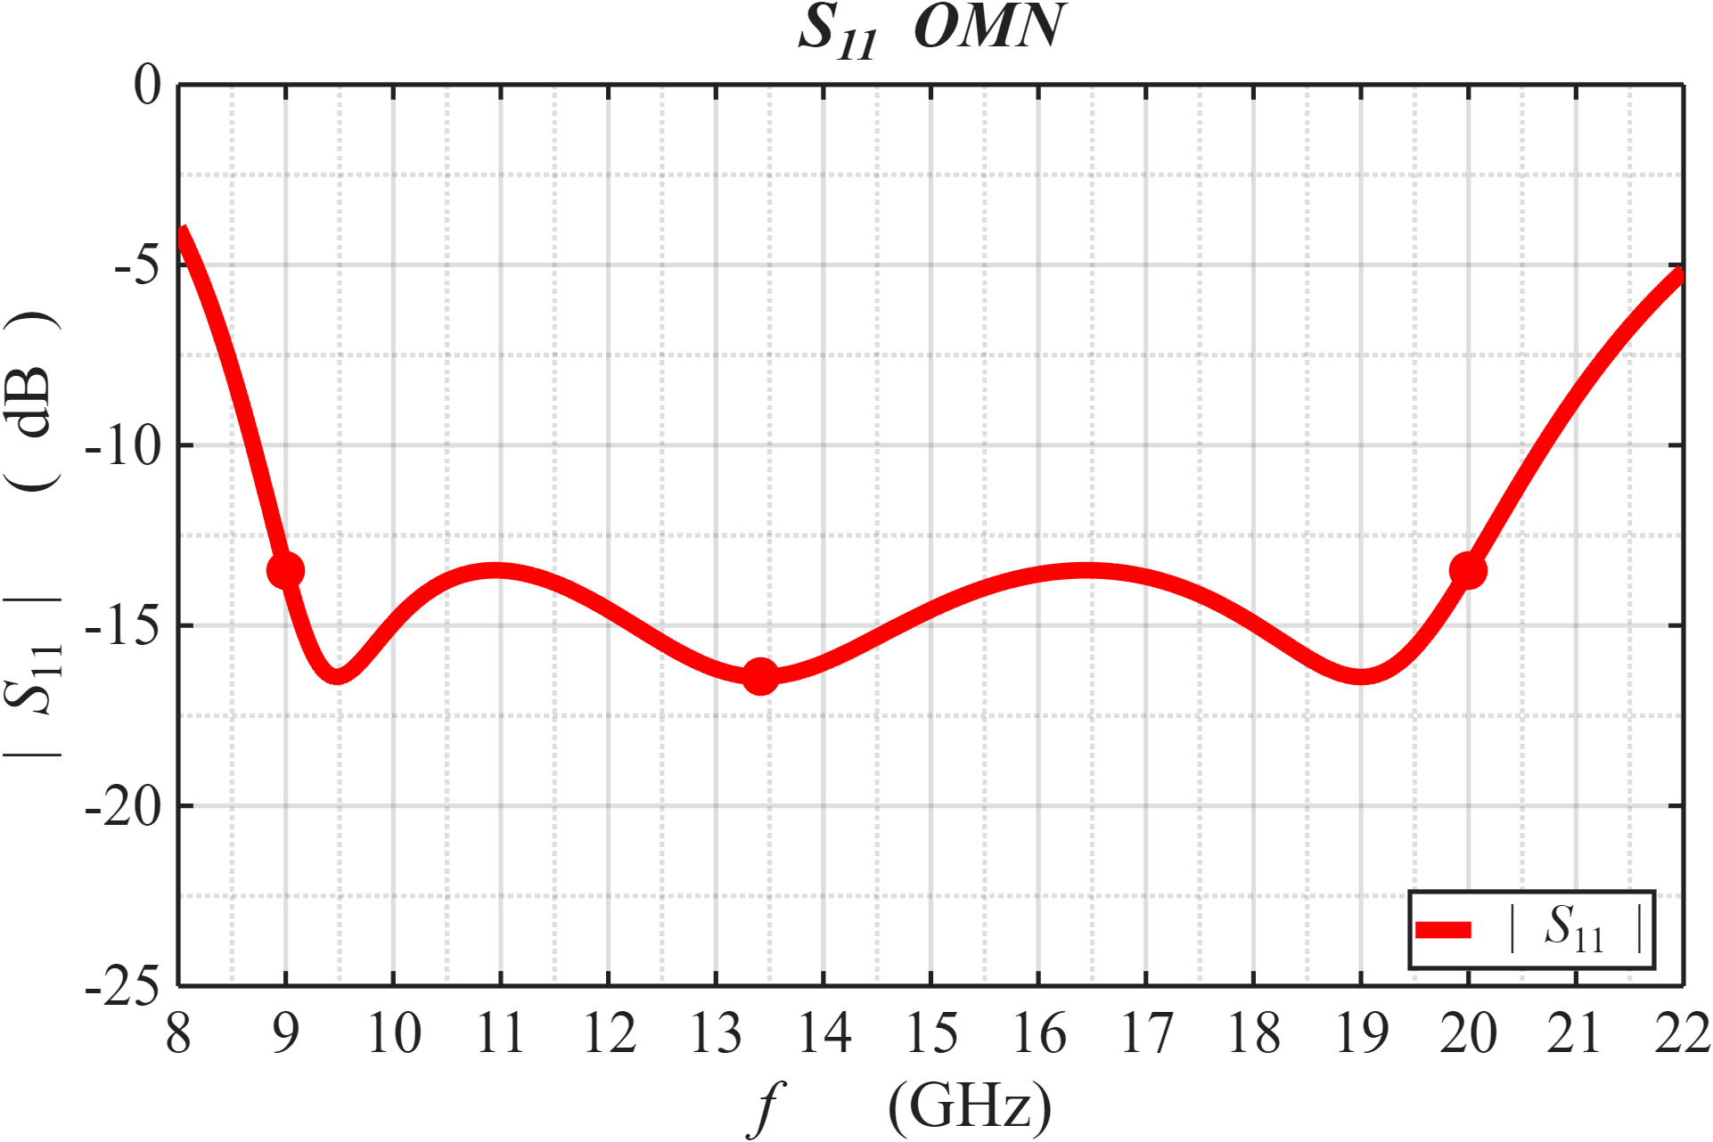
EE 456
RF & mm-Wave Circuits
Design Project 3
Matlab Simulation

Slide 13
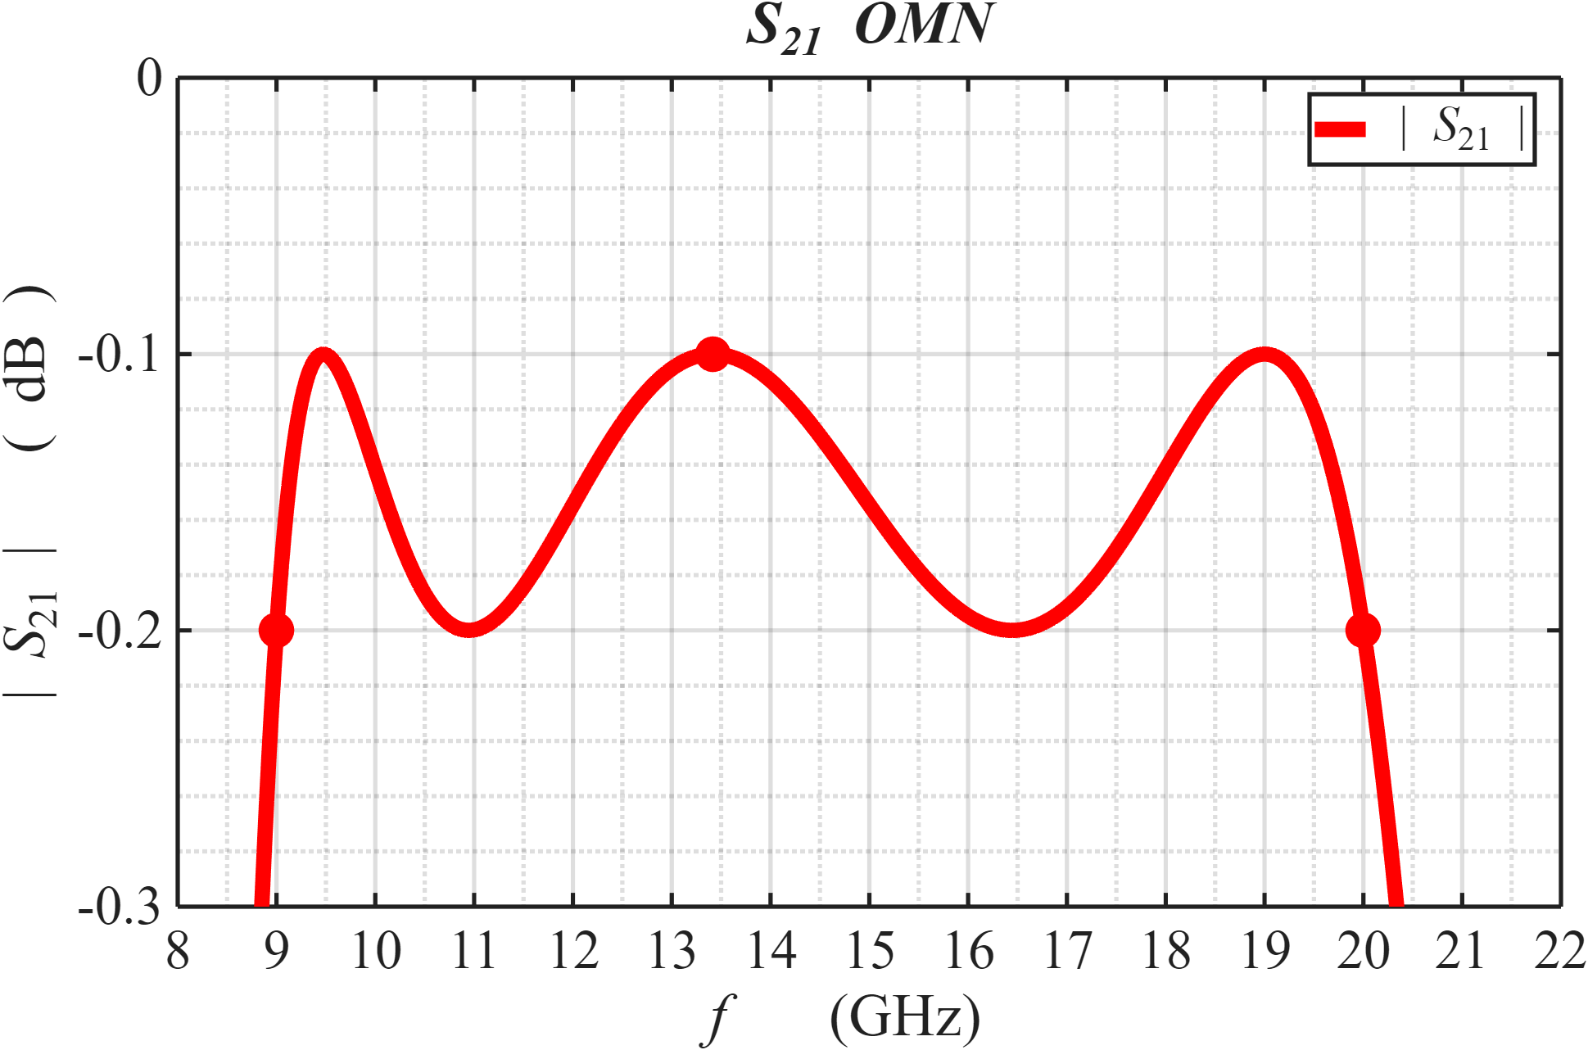
EE 456
RF & mm-Wave Circuits
Design Project 3
Matlab Simulation

Slide 14
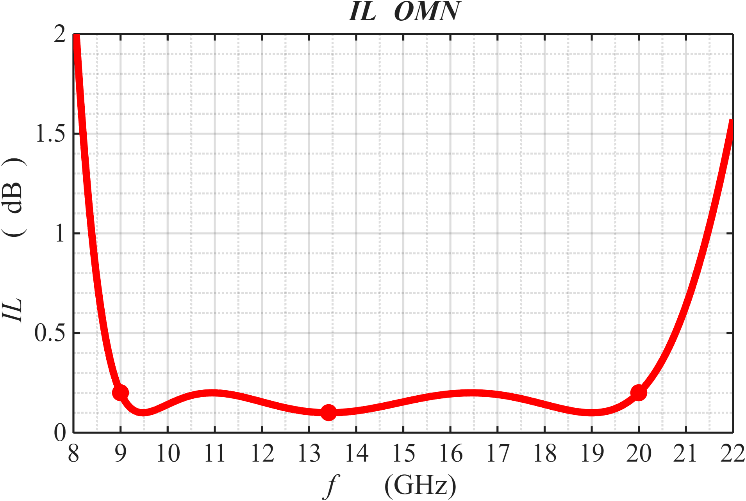
EE 456
RF & mm-Wave Circuits
Design Project 3
Matlab Simulation

Slide 15
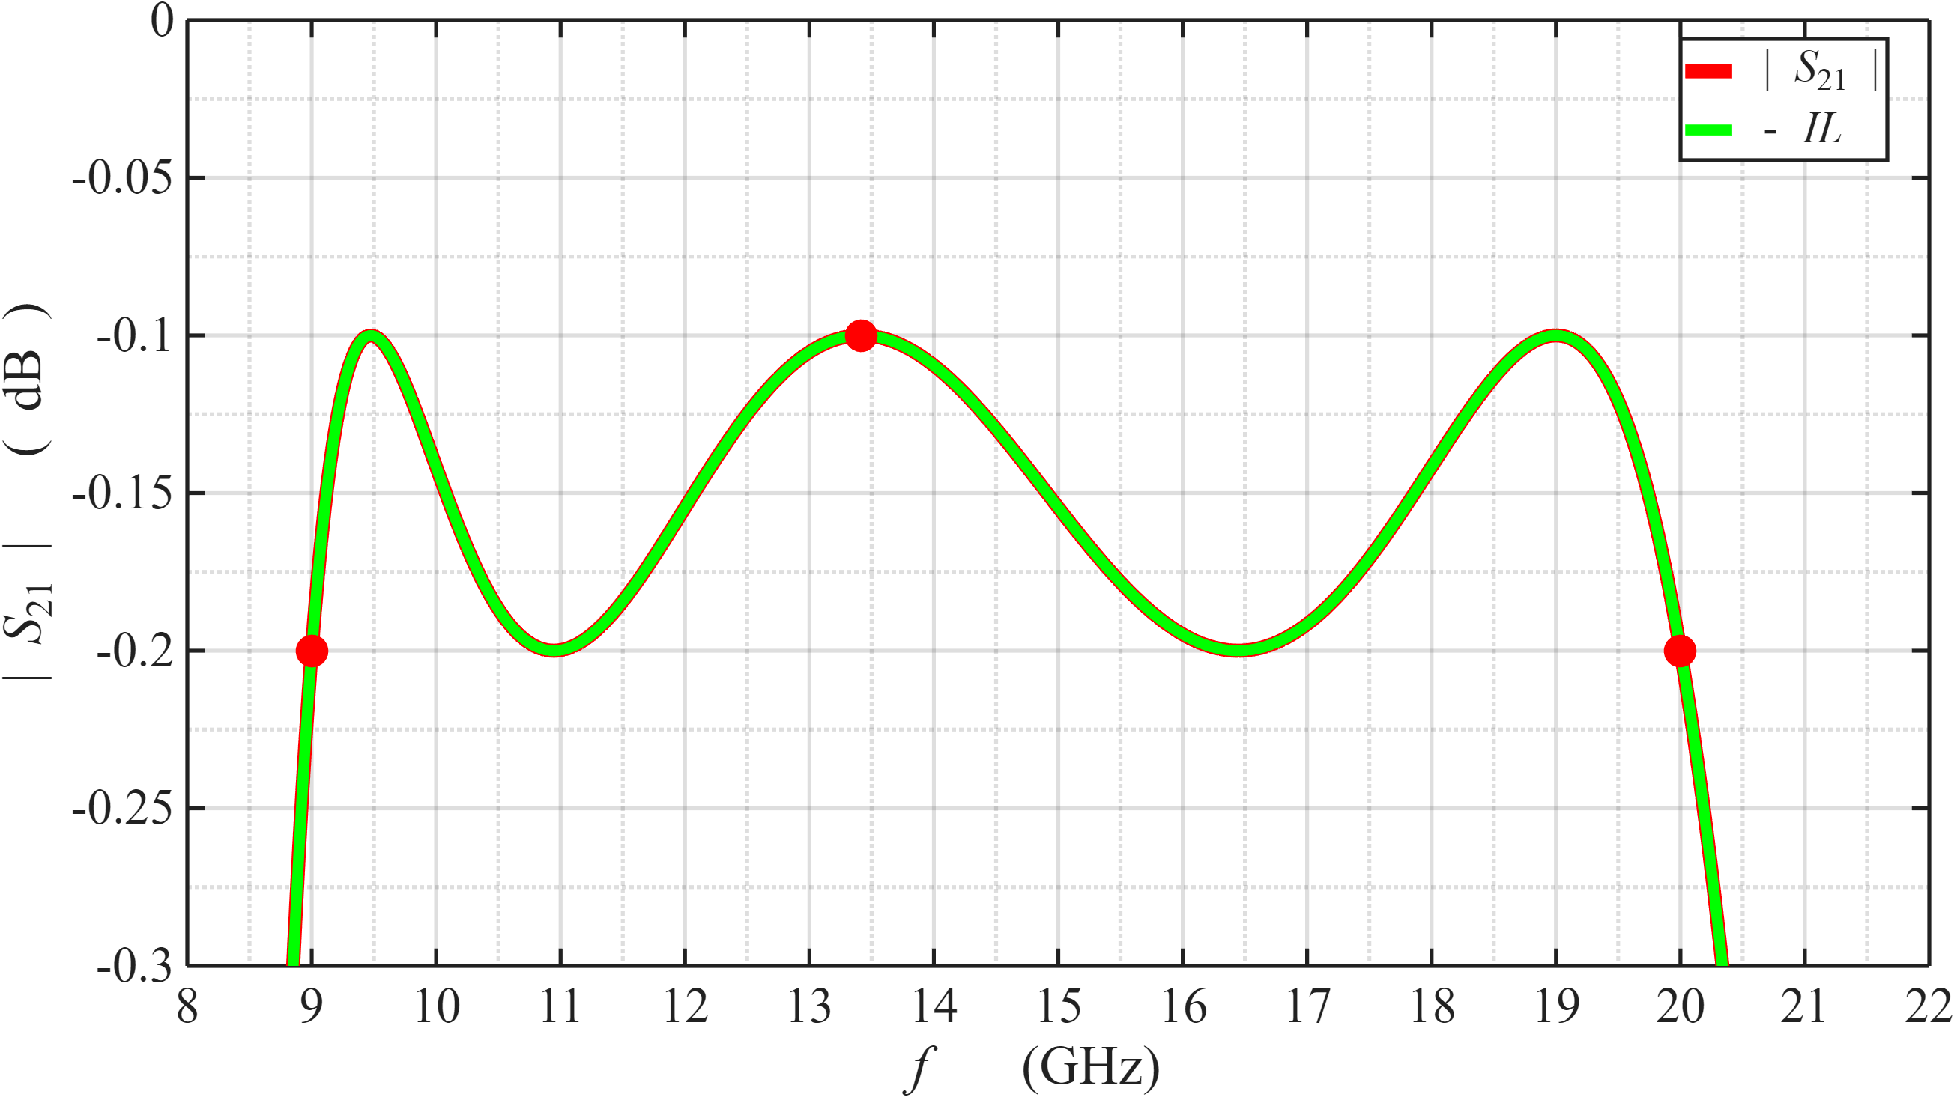
EE 456
RF & mm-Wave Circuits
Design Project 3
Matlab vs ADS Simulations

Slide 16
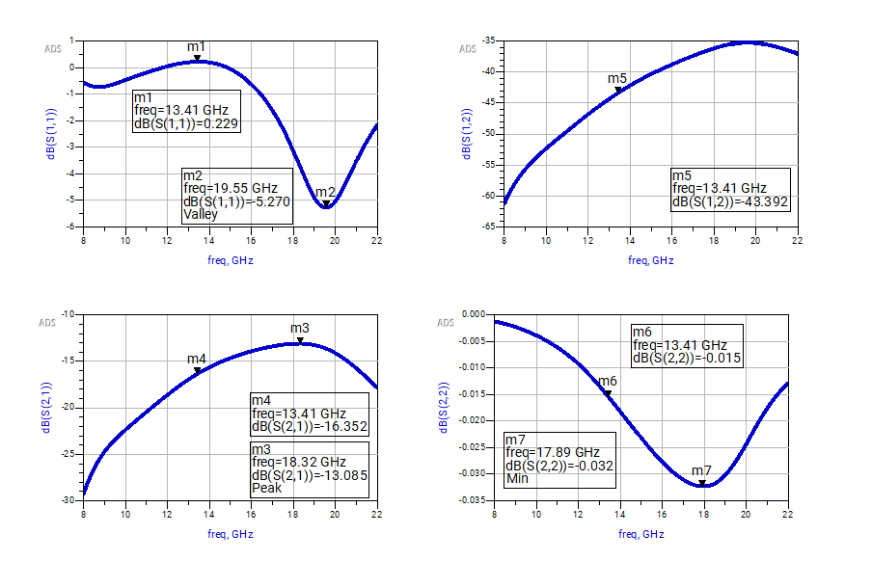
EE 456
RF & mm-Wave Circuits
Design Project 3
ADS Simulations

Slide 17
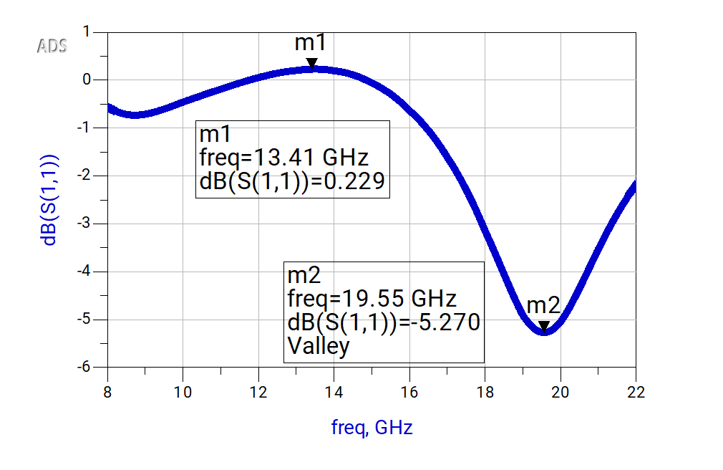
EE 456
RF & mm-Wave Circuits
Design Project 3
ADS Simulations

Slide 18
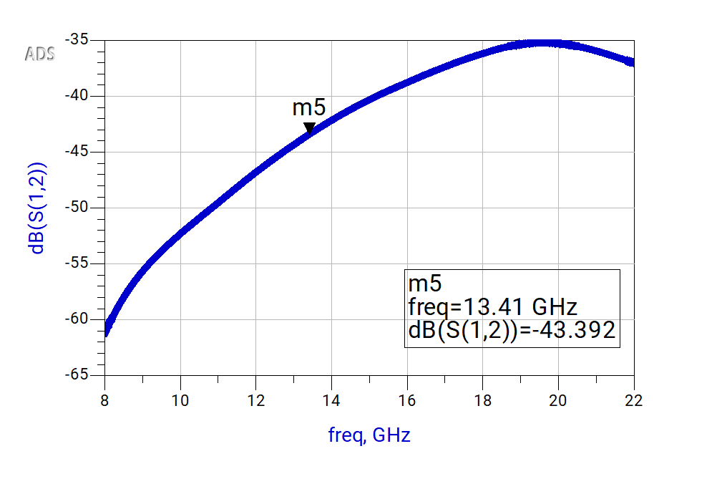
EE 456
RF & mm-Wave Circuits
Design Project 3
ADS Simulations

Slide 19
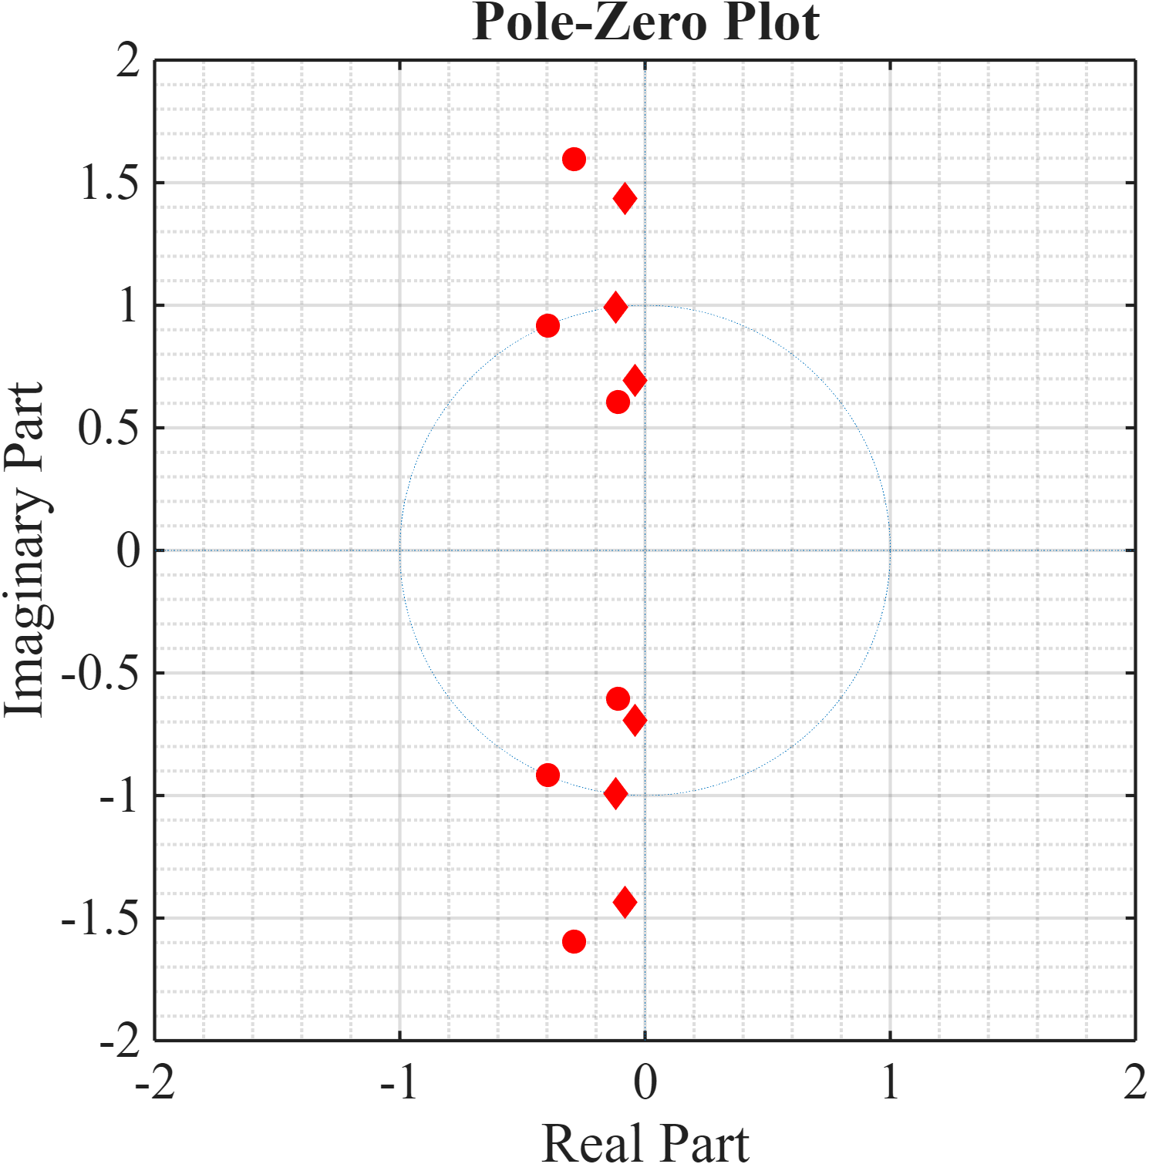
EE 456
RF & mm-Wave Circuits
Design Project 3
MATLAB Simulations

Slide 20
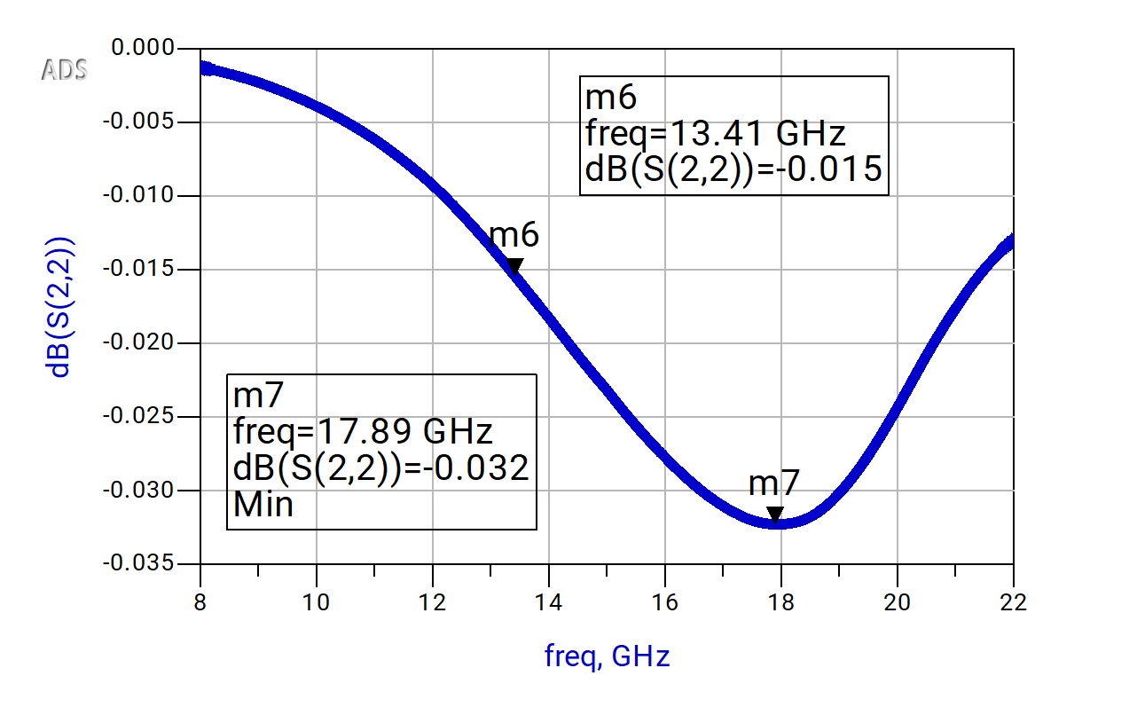
EE 456
RF & mm-Wave Circuits
Design Project 3
ADS Simulations

Slide 21
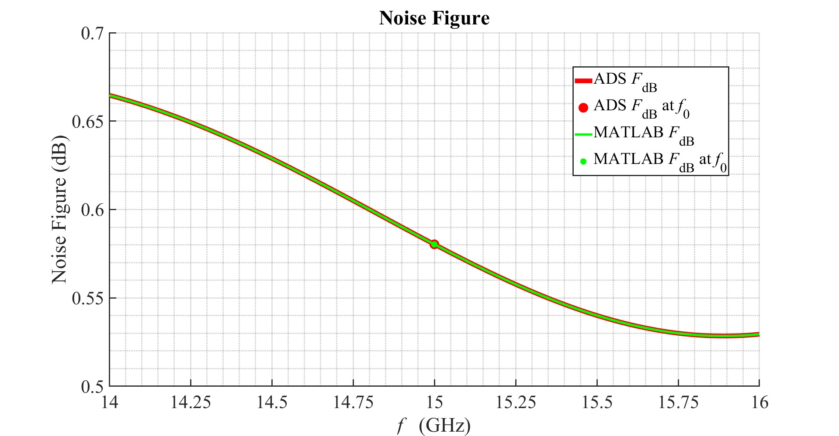
EE 456
RF & mm-Wave Circuits
Design Project 3
ADS & MATLAB Simulations

Slide 22
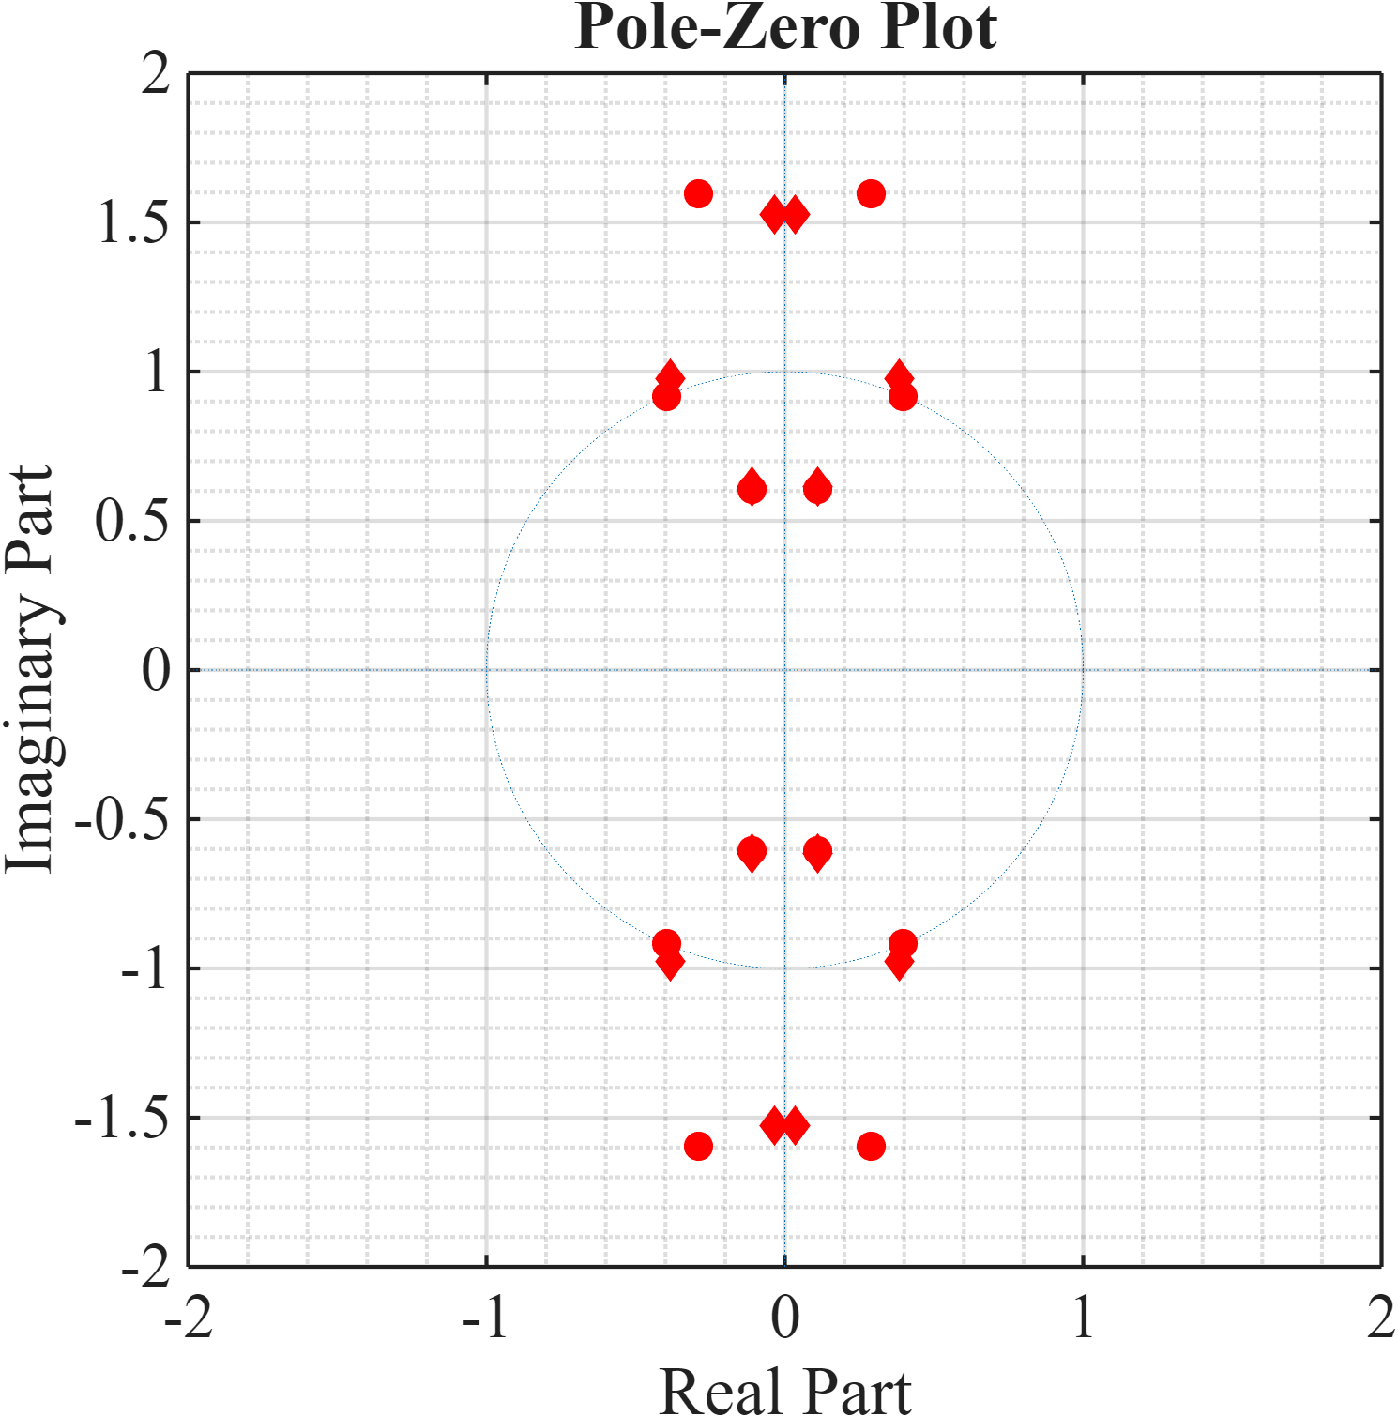
EE 456
RF & mm-Wave Circuits
Design Project 3
MATLAB Simulations

Slide 23
EE 456
RF & mm-Wave Circuits
Design Project 3
MATLAB Simulations

Slide 24
Additional Material Submitted to Kodiak: - Excel - Matlab Code - ADS Files - Scans / Screenshots
EE 456
RF & mm-Wave Circuits
Design Project 3
Steven Placzek
End of Design Project 3 Presentation

Slide 25
END
EE 456
RF & mm-Wave Circuits

Slide 26
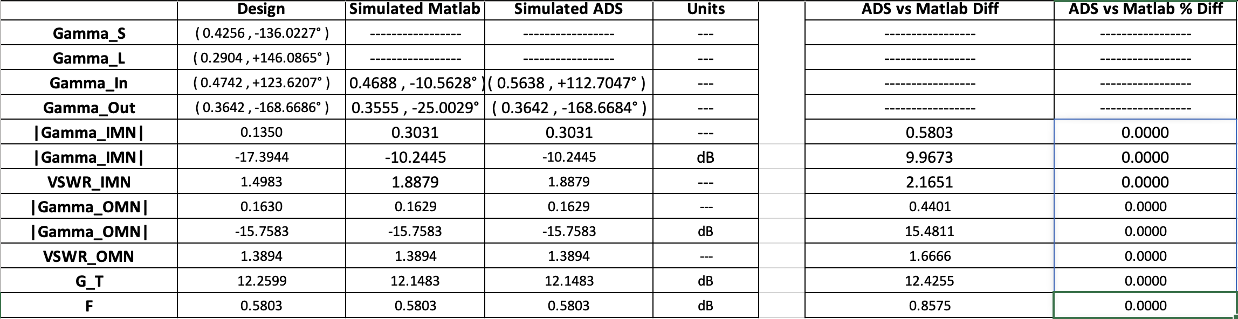
Appendix I — Excel Spreadsheets
EE 456
RF & mm-Wave Circuits

Slide 27
EE 456
RF & mm-Wave Circuits
Design Project 3
Simulation Comparison
This LNA configuration succeeded in meeting all the specifications which the design required.
Both the MATLAB and the ADS simulations provide the same values for the LNA.
MATLAB and ADS provided simulated values for the parameters listed in table 1,
these values are essentially the same, showing an excellent match:
— there is less than a 0.0001 percent difference between MATLAB and ADS values.
The noise figure could be lower, however overall gain provided by this design
isn’t as lacking as many of the other designs solutions which were considered before this one.

