Slide 1
OWASP Geneva –
Spring 09 meeting
April 23rd. 2009

Slide 2
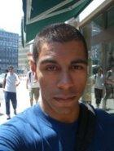

Who am I?
8 years developer experience
5 years infosec/appsec experience (CSSI 2004 ;)
Lead Application Security Program,
  New Access SA, Geneva – Switzerland
OWASP Geneva chapter founder
CWE Top 25 Programming Errors contributor
Monblog.ch founder and architect
  Free swiss community blogging platform
  > 13mio. pageviews/monthly

Slide 3

Agenda
OWASP Foundation
OWASP Projects
Tonight’s meeting

Slide 4

The OWASP foundation
Open Web Application Security Project
International, non-profit organization
Funding:
  Volunteers time
  OWASP memberships and sponsors
  OWASP conference fees
Participation and projects are free and open to everyone

Slide 5
OWASP Mission
“Enabling organizations to develop, purchase, and maintain applications that can be trusted.”

Slide 6
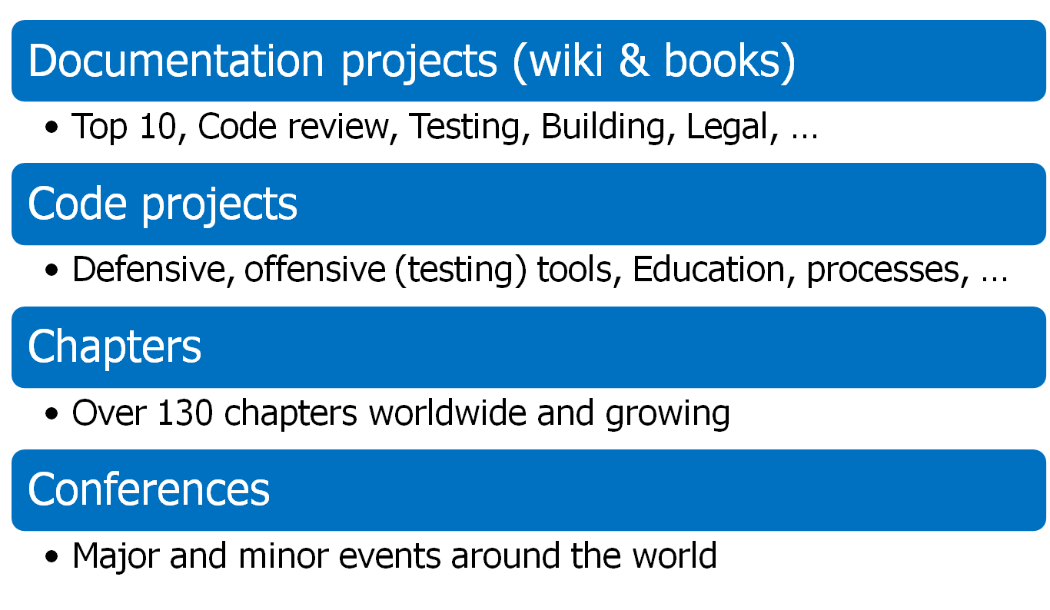
OWASP Community

Slide 7
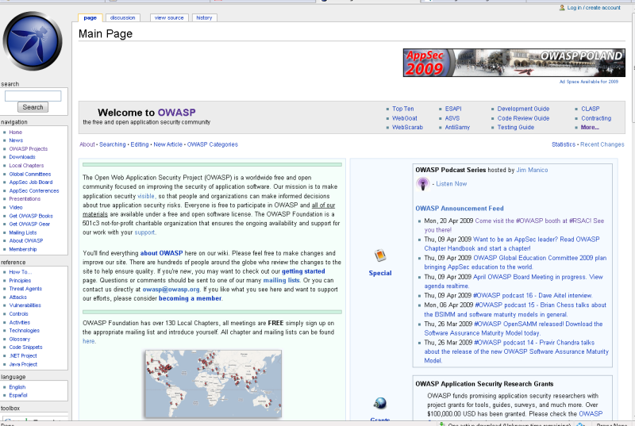
www.owasp.org

Slide 8
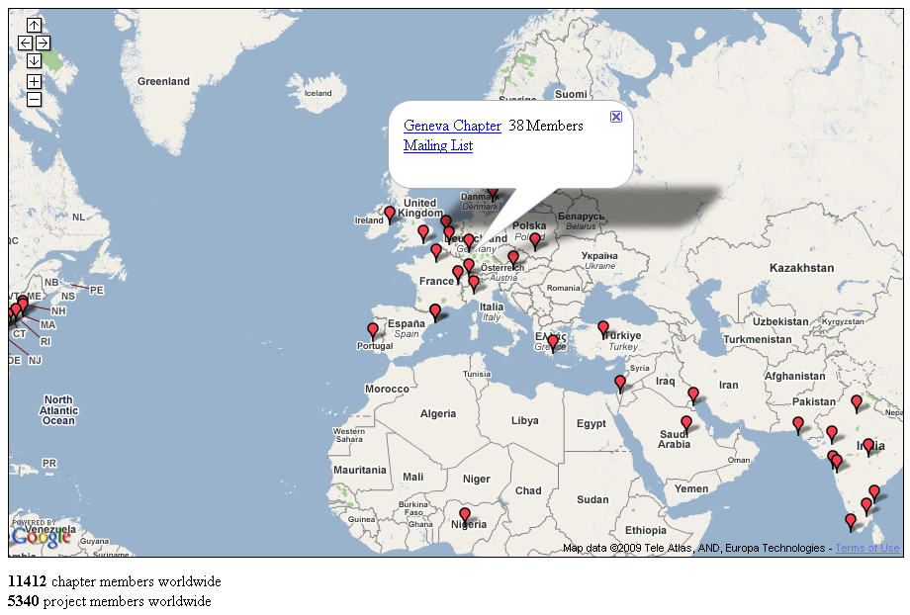
130+ Chapters worldwide

Slide 9
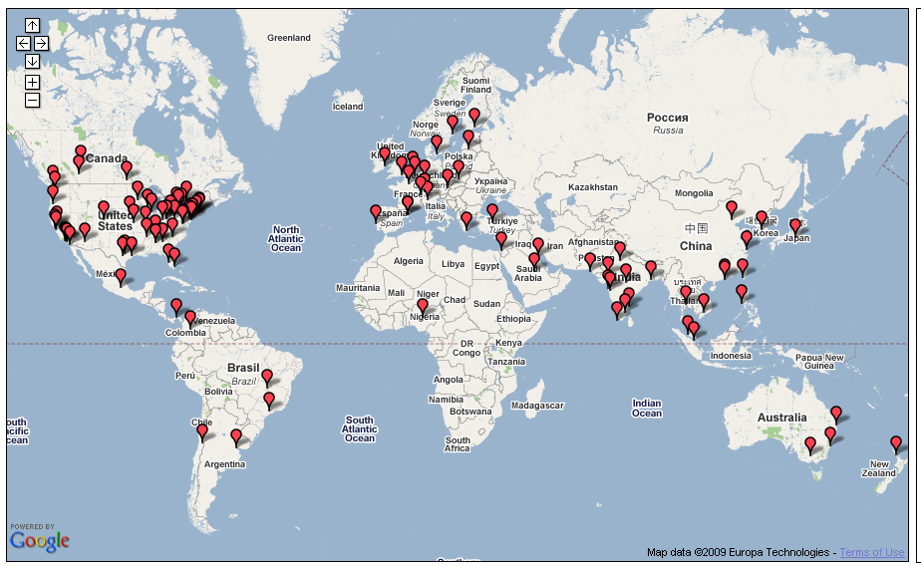
OWASP Conferences
Germany
Nov 2008
Minnesota
Oct 2008
Brussels
May 2008
Poland
May 2009
Denver
Spring 2009
NYC
Sep 2008
Portugal
Nov 2008
San Jose?
Sep 2009
Israel
Sep 2008
Taiwan
Oct 2008
India
Aug 2008
Gold Coast
Feb 2008
+2009

Slide 10
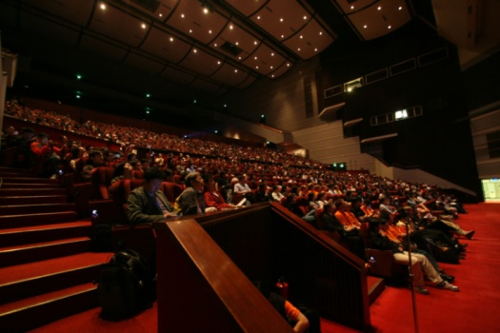
OWASP Conferences
Next:
  11th-14th May 09: Krakow, Poland (Appsec Europe)
  June 09: Dublin (Appsec)
  Oct. 09: Washington D.C. (Appsec USA)

Slide 11
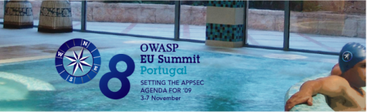
OWASP EU Summit
2009 Focus
  80+ application security experts from 20+ countries during one week
A fantastic and high standing SPA right at the beach!
New projects:
  outreach program: technology vendors, framework providers, and standards bodies
  educational program: new program to provide free one- day seminars at universities and developer conferences worldwide
  new global committee structure: education, chapters, conferences, industry, projects and tools, membership
Actually, we didn't have time to go the beach...once in the week!
And...a new local chapter was created.

Slide 12
Agenda
OWASP Foundation
OWASP Projects
Tonight’s meeting

Slide 13
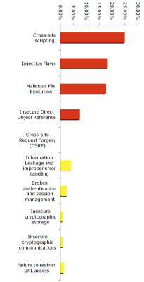
OWASP Top 10
The Ten Most Critical Web Application Security Vulnerabilities
Current: 2007 Release
2009 release in progress
A reference, but not a standard (yet?)

Slide 14

Big 4 (not to be confused with…)
Building Guide
Code Review Guide
Testing Guide
Application Security Desk Reference (ASDR)

Slide 15
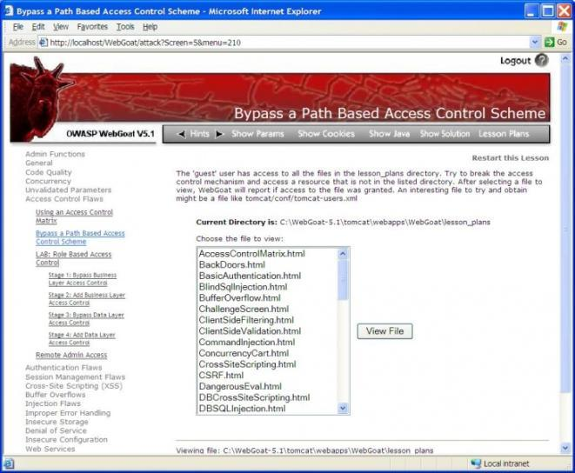
Education: Webgoat

Slide 16
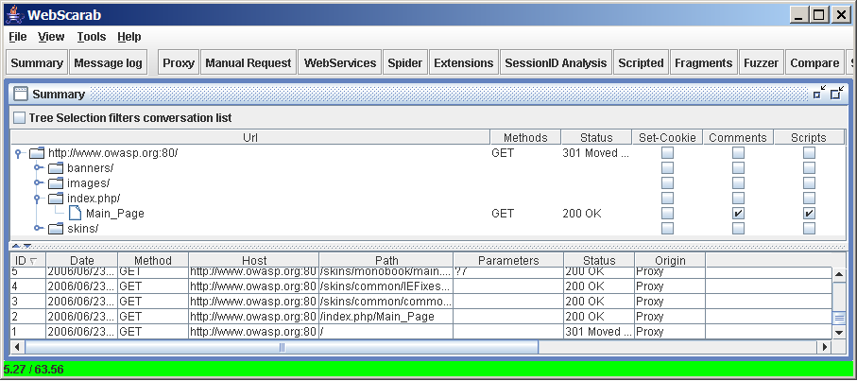
Testing: Webscarab

Slide 17
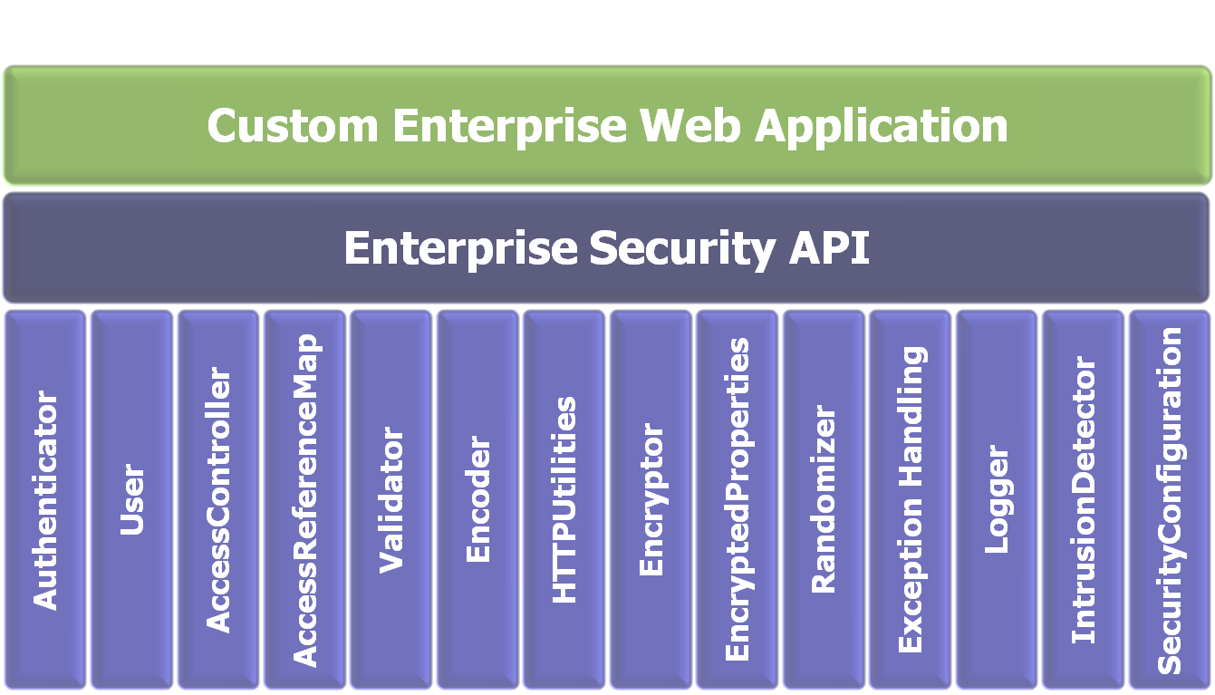

Reference libraries: OWASP ESAPI

Slide 18
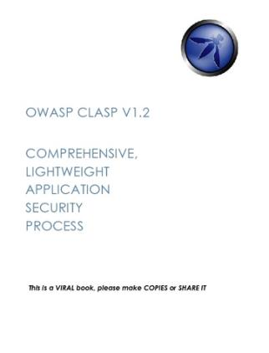
Methods and processes: CLASP
Comprehensive, Lightweight Application Security Process
  Centered around 7 AppSec Best Practices
  Prescriptive and Proactive
  Covers the entire software lifecycle
  (not just for developers)
Adaptable to any development process
  CLASP defines roles across the SDLC
  24 role-based process components
  You can start small

Slide 19


Quality and coaching: Seasons of Code

Slide 20
Deliverables
OWASP .NET Project
OWASP ASDR Project
OWASP AntiSamy Project
OWASP AppSec FAQ Project
OWASP Application Security Assessment Standards Project
OWASP Application Security Metrics Project
OWASP Application Security Requirements Project
OWASP CAL9000 Project
OWASP CLASP Project
OWASP CSRFGuard Project
OWASP CSRFTester Project
OWASP Career Development Project
OWASP Certification Criteria Project
OWASP Certification Project
OWASP Code Review Project
OWASP Communications Project
OWASP DirBuster Project
OWASP Education Project
OWASP Encoding Project
OWASP Enterprise Security API
OWASP Flash Security Project
OWASP Guide Project
OWASP Honeycomb Project
OWASP Insecure Web App Project
OWASP Interceptor Project
OWASP JBroFuzz
OWASP Java Project
OWASP LAPSE Project
OWASP Legal Project
OWASP Live CD Project
OWASP Logging Project
OWASP Orizon Project
OWASP PHP Project
OWASP Pantera Web Assessment Studio Project
OWASP SASAP Project
OWASP SQLiX Project
OWASP SWAAT Project
OWASP Sprajax Project
OWASP Testing Project
OWASP Tools Project
OWASP Top Ten Project
OWASP Validation Project
OWASP WASS Project
OWASP WSFuzzer Project
OWASP Web Services Security Project
OWASP WebGoat Project
OWASP WebScarab Project
OWASP XML Security Gateway Evaluation Criteria Project
OWASP on the Move Project

Slide 21
Agenda
OWASP Foundation
OWASP Projects
Tonight’s meeting

Slide 22
Who is sitting (or standing) in this room?

Slide 23
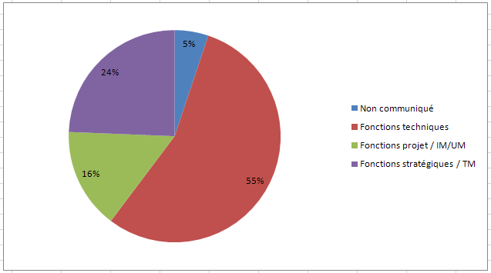
Audience (1/3)

Slide 24
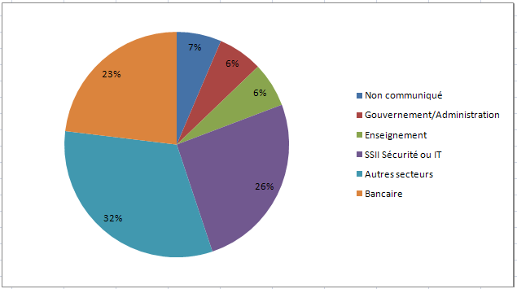
Audience (2/3)

Slide 25
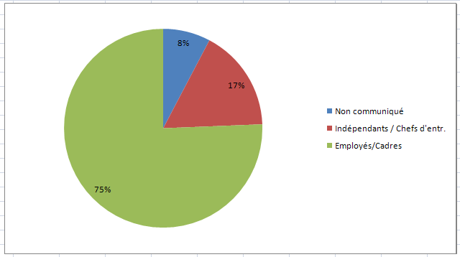
Audience 3/3

Slide 26
Agenda
18h00: Accueil
18h15: OWASP Top 10
Sebastien Gioria, Chapter Leader - OWASP France
19h05: Pause (5 minutes)
19h10: La sécurité dans le cycle de vie développement d’une application web: de la théorie à la pratique
Gilbert K. Agopome (CISSP, CSSI 2004, CISA)
20h00: Cocktail offert par HEC Genève
21h00: Fin de la manifestation

Slide 27

Geneva’s Chapter and you
Next meeting: June 2009 (well, will try…)
Join the list!
  Post your (Web)AppSec questions
  Keep up to date
  Contribute to discussions
Become an OWASP member!
  Or even a sponsor (told you!)

Slide 28


THANK YOU!
http://www.owasp.org
http://www.owasp.org/index.php/Geneva
antonio.fontes@owasp.org
Tonight’s sponsors:

Slide 29
Copyright notice:
Some pictures and content included in this presentation are copied from the document :
« OWASP Germany 2008 Conference », by Sebastien Deleersnyder
http://www.owasp.org/index.php/Image:Germany_2008_Conference_OWASP_Introduction_v1.pptx
Other content and pictures included in this presentation are free for reuse except slide number
2 (my bio) : don’t change it or remove it, please. Thank you. - AF

