Slide 1
OpenSAMM Best Practices, Lessons from the Trenches
Seba Deleersnyder seba@owasp.org
OpenSAMM project co-leaders
Bart De Win bart.dewin@owasp.org
AppSec Europe 2014 Project Talk
Notes:
SEBA
Managing all application security activities as part of development and deployment of applications can be an overwhelming challenge. OWASP OpenSAMM gives you a structural and measurable blueprint to integrate OWASP best practices in your software life cycle. This OWASP framework allows you to formulate and implement a strategy for software security that is tailored to the risk profile of your organisation.
During this talk Bart and Sebastien will get you up to speed on the OpenSAMM framework and share their important challenges they faced in implementing the framework within various organisations. Important topics that will be covered during this presentation are:
What is the optimal OpenSAMM maturity level for your organisation?
At which level to implement OpenSAMM in the organisation: at company, business unit or development team level?
How to integrate OpenSAMM activities in agile development?
How to apply OpenSAMM on suppliers or outsourced development?
What metrics does OpenSAMM provide to manage your secure development life cycle?
Practical lessons learned and use cases from the trenches that make OWASP OpenSAMM a valuable methodology and which you should apply for your secure development life cycle!
Prior to the conference we organise a full day training on OpenSAMM, make sure to reserve your seat at this free OWASP training. After the conference the OpenSAMM project team comes together for their first OpenSAMM summit in Cambridge. If you want to contribute to this flagship project, stay and join us at the summit. More details on www.opensamm.org.

Slide 2
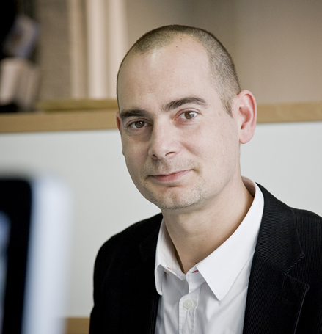
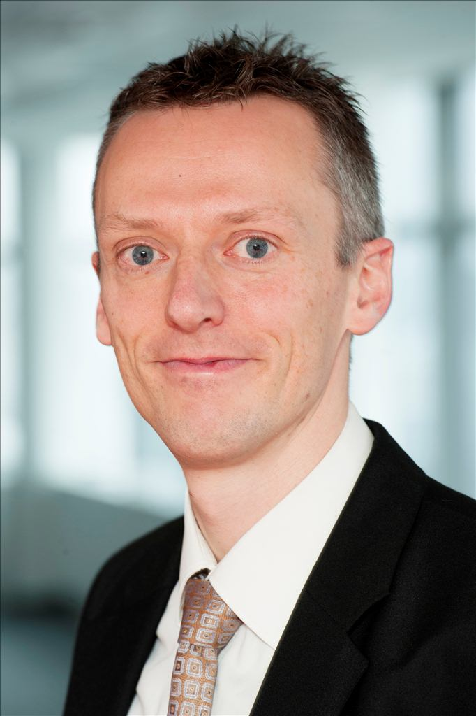


Bart / Seba ?
Sebastien Deleersnyder
15+ years developer / information security experience
Belgian OWASP chapter founder
OWASP volunteer
Co-organizer www.BruCON.org
Application security specialist Toreon
Bart De Win, Ph.D.
15+ years experience in secure software development
Belgian OWASP chapter co-leader
Author of >60 publications
Security consultant PwC
Notes:
BART <=> SEBA

Slide 3
Agenda
Integrating software assurance?
OpenSAMM
Quick Start
Lessons Learned
Resources & Self-Assessment
OpenSAMM Road Map
Notes:
SEBA
fixme:
how much time do we have? 50 totaal.
how much time to spend per topic?
who does which slides?

Slide 4
“Build in” software assurance
proactive
reactive
security
requirements /
threat modeling
coding guidelines code reviews static test tools
security testing dynamic test
tools
vulnerability
scanning -
WAF
Design
Build
Test
Production
Secure Development Lifecycle
(SAMM)
● 4 
Notes:
SEBA
go to the “left”

Slide 5

We need a Maturity Model
An organization’s behavior changes slowly over time
Changes must be iterative while working toward long-term goals
There is no single recipe that works for all organizations
A solution must enable risk-based choices tailored to the organization
Guidance related to security activities must be prescriptive
A solution must provide enough details for non-security-people
Overall, must be simple, well-defined, and measurable
OWASP Software Assurance Maturity Model (SAMM)
Notes:
SEBA

Slide 6

SAMM users
Dell Inc
KBC
ING Insurance
Gotham Digital Science
HP Fortify
ISG ...
Notes:
BART
Considerable number of companies that use OpenSAMM.
Listed some, many others.
We are setting up a measurement system to have more specific (anonymized) data
Show of hands in the audience?

Slide 7
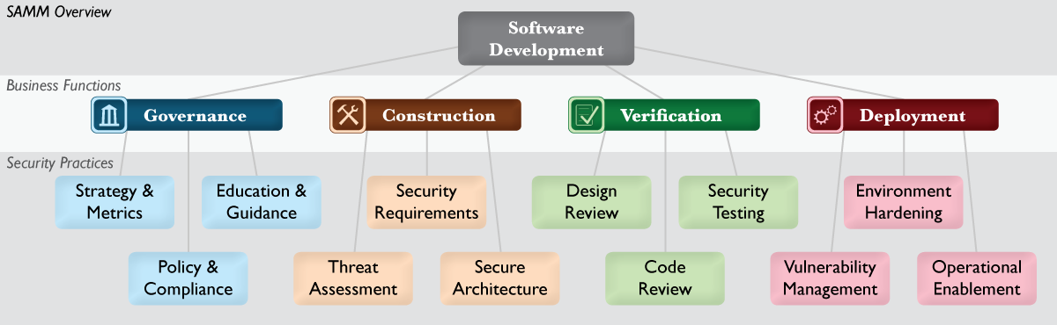
SAMM Security Practices
From each of the Business Functions, 3 Security Practices are defined
The Security Practices cover all areas relevant to software security assurance
Each one is a ‘silo’ for improvement
Notes:
BART
OpenSAMM is defined in different levels.
At the highest levels, divided in four tasks or concerns to take into account while developing or using software.
They align well with a typical organisational structure, and this is how software security typically ties into an organisation.
Remark not only about development …
At a lower level, a number of security practices are defined that should be considered for improving software security.
This is where the organisation and software assurance are linked together.
At the lowest level, every security practice consists of a set of activities, ordered in maturity levels.

Slide 8
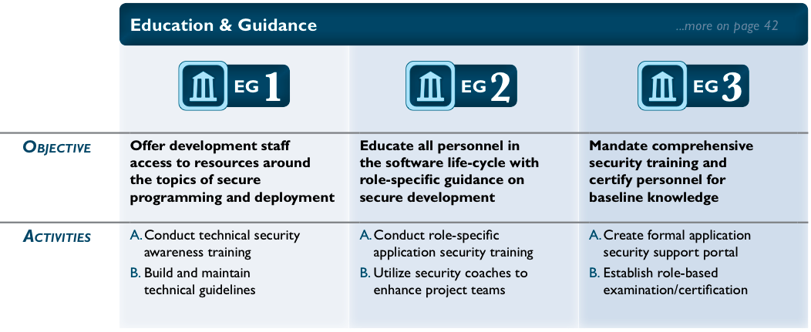
Example: Education & Guidance
Notes:
BART
Briefly explain levels and activities
Link to People - Process - Knowledge - Tools

Slide 9
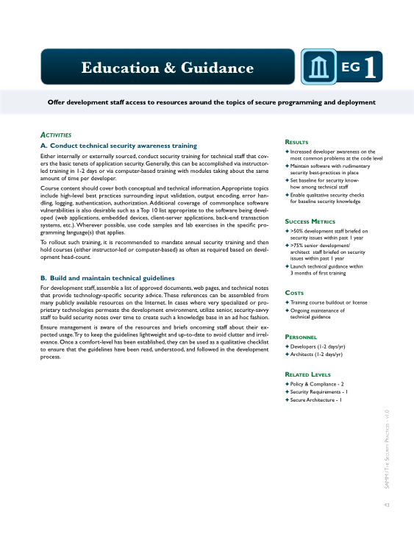
Per Level, SAMM defines...
Objective
Activities
Results
Success Metrics
Costs
Personnel
Related Levels
Notes:
BART
This information is important for applying OpenSAMM into organisations, as you will see later during this presentation.

Slide 10
SAMM Quick Start
ASSES
questionnaire
GOAL gap analysis
PLAN roadmap
IMPLEMENT
OWASP resources
Notes:
SEBA
Use 4 step improvement iterations:
Measure levels => assessment QA
Set goals => gap analysis
Plan => Roadmap
Implement => with other OWASP material
And go back to 1)

Slide 11
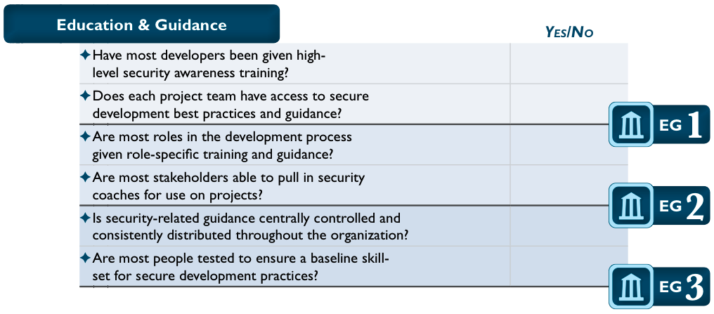
Assess
SAMM includes assessment worksheets for each Security Practice
Notes:
SEBA

Slide 12
Lessons Learned – Organisation Specific
Pre-screen general software development maturity
Define assessment scope in organisation:
Organisation wide
Selected Business Units
Development Groups (internal, supplier)
IT infrastructure Groups (hosting internal, cloud)
Involve key stakeholders
Invaluable for awareness & education
Apply CONSISTENT (same interviewers) within same organisation
Notes:
SEBA

Slide 13
Lessons Learned – Interview / Scoring
Adapt & select subset questionnaire per profile (risk management, development, IT infrastructure, …)
Try different formats: interview style, workshops
Capture more details:
“Adjusted” scoring
Ask percentage instead of Yes/No
If Yes: request CMM level for activity
Ask about strengths & weaknesses
Validate results:
Repeat questions to several people
Lightweight vs full approach
Anonymous interviews
Aggregate gathered information
Notes:
SEBA

Slide 14
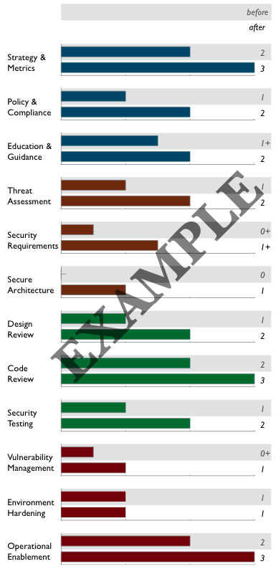
Goal
Gap analysis
Capturing scores from detailed assessments versus expected performance levels
Demonstrating improvement
Capturing scores from before and after an iteration of assurance program build-out
Ongoing measurement
Capturing scores over consistent time frames for an assurance program that is already in place
Notes:
BART
Important step in software assurance program. Here you want to move from ad-hoc efforts to a more structured approach.
OpenSAMM gives you a structured foundation to reason about this.
Long-term (3 to 5 years) vs. per iteration
Scorecard
Scorecards can be used at distinct phases in a software assurance program.

Slide 15
Goal – Lessons Learned
Link to the organisational context
Specific Business Case (ROI)
Organisation objectives / risk profile
Think carefully about selection
So you want to achieve all 3’s. Hmm. Who are you, NSA ?
Link to industry level
Respect practice dependencies
It can make sense not to include particular low-level activities, or to lower a current level
Notes:
BART

Slide 16
Goal – Lessons Learned
Get consensus, management support
Be ready for budget questions (linked to Plan phase)
MD, CAPEX, OPEX
General stats about %’s
Create & reuse own organisation template
Notes:
BART

Slide 17
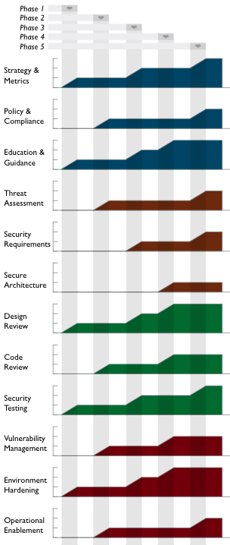
Plan
Roadmaps: to make the “building blocks” usable
Roadmaps templates for typical kinds of organizations
Independent Software Vendors
Online Service Providers
Financial Services Organizations
Government Organizations
Tune these to your own targets / speed
Notes:
BART
The way in which you’re going to reach the goals that you’ve set earlier, by planning concrete improvement steps into a roadmap.
Length of phases is 3 to 6 months, sometimes up to a year.

Slide 18
Plan – Lessons Learned
Identify quick wins (focus on success cases)
Start with awareness / training
Adapt to upcoming release cycles / key projects
Spread effort & “gaps to close” over realistic iterations
Spread work, roles & responsibilities
SW security competence centre, development, security, operations
For instance service portfolio and guidelines: when and who ?
Take into account dependencies
Be ready to adapt planning
Notes:
BART

Slide 19
Plan – Budgeting
Average budget impact 5%-15% on project
Cost of tooling
Central procurement vs per development group
Cost of training
Do not forget internal/external time spent
Cost of external suppliers / outsourcing
Different technology stacks will impact budget
Notes:
BART

Slide 20
Implement: 150+ OWASP resources
PROTECT
Tools: Enterprise Security API (ESAPI), CSRFGuard, AppSensor, ModSecurity Core Rule Set Project
Docs: Development Guide, Cheat Sheets, Secure Coding Practices - Quick Reference Guide
DETECT
Tools: OWTF, Broken Web Applications Project, Zed Attack Proxy
Docs: Code Review Guide, Testing Guide, Top Ten Project
LIFE CYCLE
SAMM, Application Security Verification Standard, Legal Project, WebGoat, Education Project, Cornucopia
Notes:
SEBA

Slide 21
Implement – Lessons Learned
Adapt & reuse SAMM to your organisation
Categorize applications: High, Medium, Low based on risk: e.g. Internet facing, transactions, …
Recheck progress & derive lessons learned at each iteration
Create & improve reporting dashboard
Application & process metrics
Treat new & legacy code bases differently
Agile: differentiate between Every Sprint, Bucket & one-time AppSec activities
Balance planning on people, process, knowledge and tools
Notes:
SEBA

Slide 22
Lessons Learned – AppSec Competence Centre
Inject & spread best practices
“market & promote” – do not become risk/audit function
Do not become operational bottle-neck
Spread/hand-over knowledge to champions throughout organisation
Create & nurture AppSec community
Notes:
SEBA

Slide 23
SAMM Resources www.opensamm.org
Presentations
Quick Start (to be released)
Assessment worksheets / templates
Roadmap templates
Translations (Spanish, Japanese, …)
SAMM mappings to ISO/EIC 27034 – BSIMM – PCI (to be released)
NEW: Training material
Notes:
SEBA

Slide 24
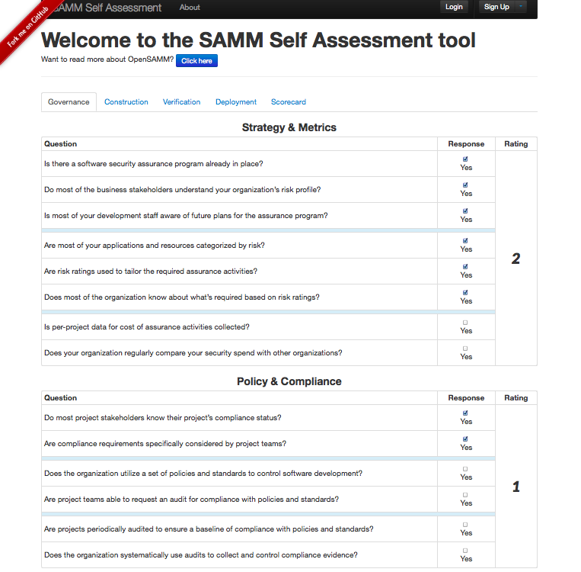
NEW: Self-Assessment Online
https://ssa.asteriskinfosec.com.au
Notes:
SEBA

Slide 25
SAMM Roadmap
Build the SAMM community:
Grow list of SAMM adopters
Workshops at conferences
Dedicated SAMM summit
V1.1:
Incorporate Quick Start / tools / guidance / OWASP projects
Revamp SAMM wiki
V2.0:
Revise scoring model
Model revision necessary ? (12 practices, 3 levels, ...)
Application to agile
Roadmap planning: how to measure effort ?
Presentations & teaching material
…
Notes:
SEBA

Slide 26

Get involved
Project mailing list / work packages
Use and donate (feed)back!
Donate resources
Sponsor SAMM
Notes:
BART

Slide 27
Critical Success Factors
Get initiative buy-in from all stakeholders
Adopt a risk-based approach
Awareness / education is the foundation
Integrate security in your development / acquisition and deployment processes
Measure: Provide management visibility
Notes:
BART

Slide 28
Measure & Improve!
OpenSAMM.org
Notes:
BART

Slide 29
Mapping Projects / SAMM
Notes:
SEBA
49 Flagship and Labs projects mapped on SAMM practices (copy email?)
Mostly on one practice
Sometimes covers several practices (e.g. ASVS)
Sometimes no mapping possible

Slide 30
OWASP Projects Coverage
Notes:
SEBA Some areas need more love / projects!

Slide 31
SDLC Cornerstones (recap)
Process
Activities
Control Gates
Knowledge
Standards & Guidelines
Tools & Components
Deliverables
Transfer methods
People
Roles & Responsibilities
Compliance
Development support
Assessment tools
Management tools
Risk
Training
SecAppDev 2013
Notes:
BART
Cfr. current E2E process, this is more extensive.
31

