Slide 1

Programming
Using Processing
Department of Computing and Mathematics
setu.ie

Slide 2

Introduction to Processing

Slide 3

What is Processing?
Processing is a
programming language, development environment, and online community
…can be used to develop static or interactive online material and data visualisations.
…is often used by visual artists.
…produces visual and interactive representations of programming code.

Slide 4
What is Processing?
Different programming languages can be used with Processing e.g. :
Java: ver 4 uses Java 17, ver 3 uses Java 8.
JavaScript (p5.js)
Python
It can be used on different platforms :
Windows, OSX, Linux and now Android

Slide 5
Why are we using Processing?
Processing is increasingly used
to teach computer
programming fundamentals (https://processing.org/overview/)
Notes:
Can visually the result of your programming code.
Visual confirmation that your code is correct.
Little “ceremony” around getting a piece of code to work…simple IDE and you can have a program with only one line of code if you wish.
Helps with understanding flow of control e.g. sequence, selection (if), iteration (loops)

Slide 6
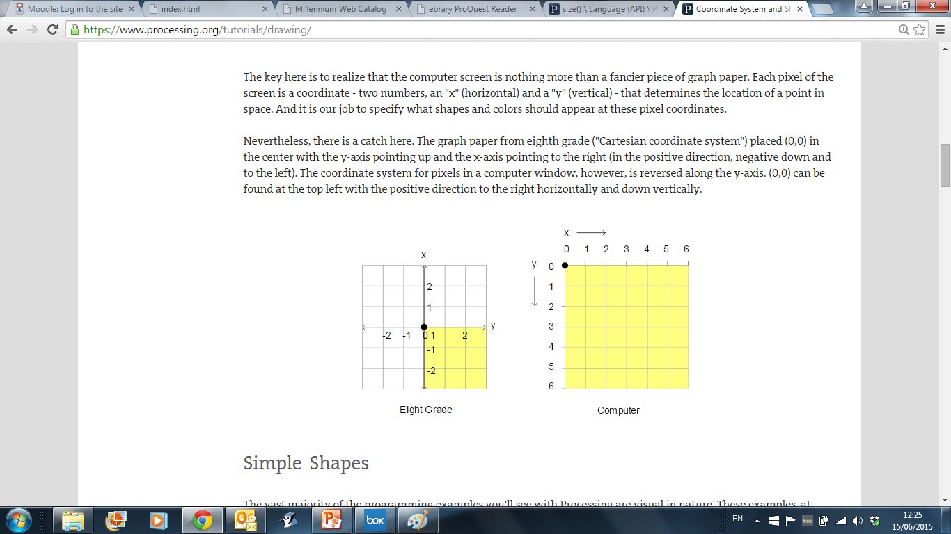
Coordinate System in Computing
In Geometry,
we use this type of
coordinate system:
point (0,0) is in the centre.
In Computing, we use this type of coordinate system to represent the screen:
point (0,0) is in the top left hand corner. Each number is a pixel.
https://processing.org/

Slide 7
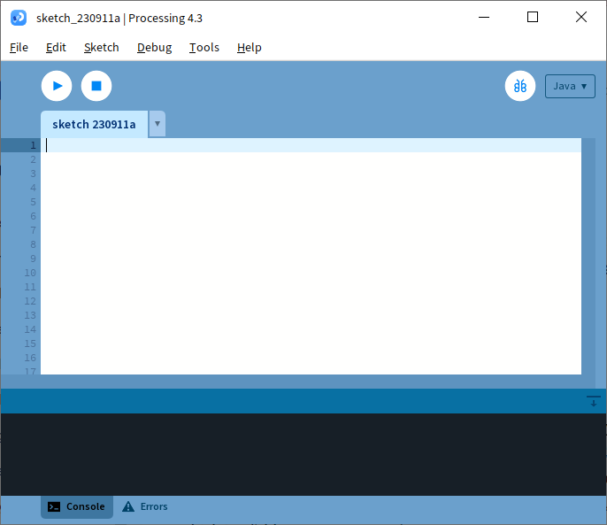
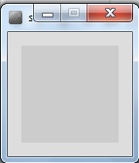
Coordinate System in Computing
Run button
So how does this relate to Processing?
When you open Processing and click on the run button, a display window pops up.
Display window

Slide 8
Coordinate System in Computing
The display window is where your code is run/ displayed.
It follows the rules of the Computing coordinate system i.e. the top left hand corner is (0,0).
A point (10,20) is 10 pixels to the right of (0,0) and 20 pixels below (0,0).
(0,0)
Display window

Slide 9
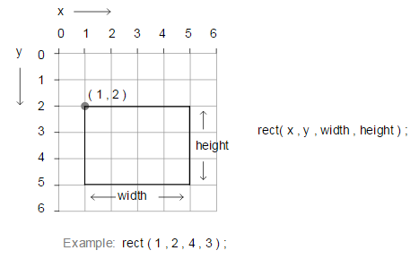
rect()
https://processing.org/

Slide 10
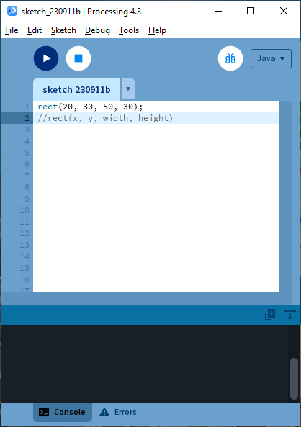
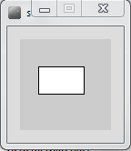
rect() – Drawing a Rectangle

Slide 11
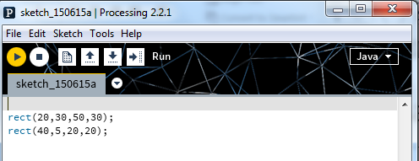
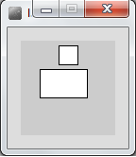
rect() – Drawing a Square
Note how each line of code has a semi-colon (;) at the end of it. This is called a statement terminator and must be included.

Slide 12
rect() – Syntax
rect(x, y, w, h)
x = x-coordinate of the upper left corner of the rectangle
y = y-coordinate of the upper left corner of the rectangle
w = width of the rectangle
h = height of the rectangle
The rect function above defines four parameters i.e. x, y, w, h.
When you call rect, you are expected to pass four numbers to it. These actual numbers are called arguments.
rect uses these four numbers to render the rectangle on the display window.
To draw a square, the width and height must be the same value.

Slide 13
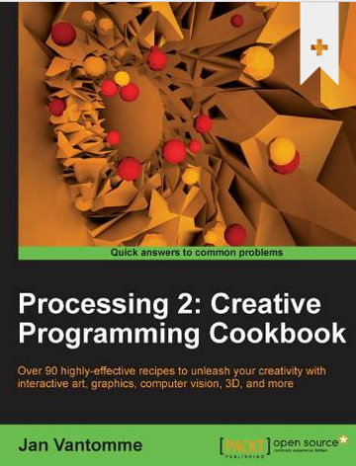
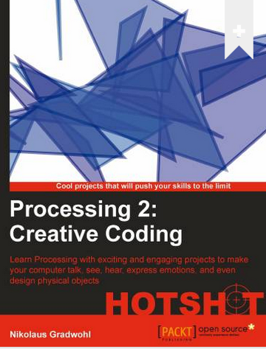
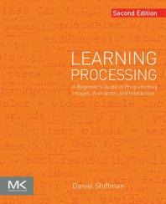
Some eBooks in WIT library
https://library.wit.ie/Resources/ebooks

Slide 14
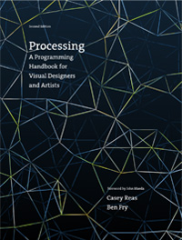
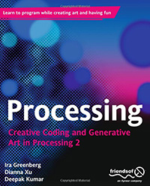
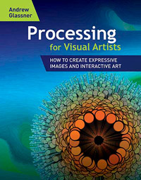
Processing Books
https://processing.org/books/

Slide 15

Questions?

