Slide 1

Programming Fundamentals
An Introduction to the module
Produced by:
Ms. Mairead Meagher
Ms. Siobhan Roche
Department of Computing and Mathematics
setu.ie

Slide 2
Agenda
Lecturers / Tutors
Module Structure & Delivery
Technologies
Module Assessment (Assignments)
Troubleshooting
Ethos

Slide 3
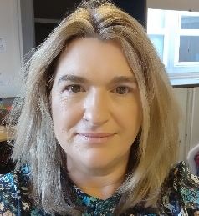
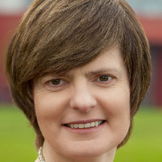
Introducing your lecturers / tutors
Siobhan Roche
Profile: https://www.setu.ie/staff/siobhan-roche
Email: siobhan.roche@setu.ie
Mairead Meagher
Profile:https://www.wit.ie/about_wit/contact_us/staff_directory/Mairead_meagher
Email: mairead.meagher@setu.ie

Slide 4



Programming Technologies
Notes:
These technologies are the software development technologies/approaches that we will teach in the course.

Slide 5
Assignments
100% Continuous Assessment (CA).
All Individual assignments
(no team-based ones).
Submit via Moodle assignment dropboxes.
Hard deadlines; extensions only permitted if mitigating circumstances apply.
Interviews

Slide 6
What to do if you don’t know what to do…
Ask in Class or at labs: Just put your hand up or wait until the end of the class, its up to you but asking during the class really helps all the students
Message your lecturer in Slack: You can always send us a private message and we will respond before the end of the next college day.
We encourage classmates to help each other (peer learning), if you know the answer to another student’s issue, please do respond.
Post the issue in Slack; think of it as asking a question in a classroom. Include any screen shots, screen recordings, etc. you think might help with solving the problem.

Slide 7
Ethos
Self-directed learning outside of lectures / labs.
Inquisitive and motivated.
Help your peers (use #Slack!).
Engagement and staying current with the module.
All work submitted must be your own work.
all code/approaches given in the module by us can be re-used / re-purposed in your assignments.

Slide 8

Introduction to Processing

Slide 9

What is Processing?
Processing is a
programming language, development environment, and online community
…can be used to develop static or interactive online material and data visualisations.
…is often used by visual artists.
…produces visual and interactive representations of programming code.

Slide 10
What is Processing?
Different programming languages can be used with Processing e.g. :
Java: ver 4 uses Java 17, ver 3 uses Java 8.
JavaScript (p5.js)
Python
It can be used on different platforms :
Windows, OSX, Linux and now Android

Slide 11
Why are we using Processing?
Processing is increasingly used
to teach computer
programming fundamentals (https://processing.org/overview/)
Notes:
Can visually the result of your programming code.
Visual confirmation that your code is correct.
Little “ceremony” around getting a piece of code to work…simple IDE and you can have a program with only one line of code if you wish.
Helps with understanding flow of control e.g. sequence, selection (if), iteration (loops)

Slide 12
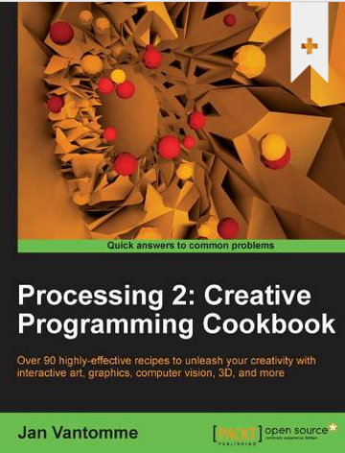
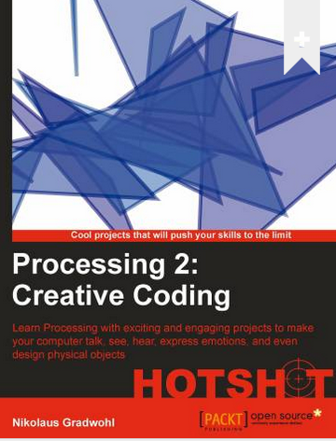
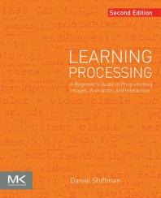
Some eBooks in WIT library
https://library.wit.ie/Resources/ebooks

Slide 13
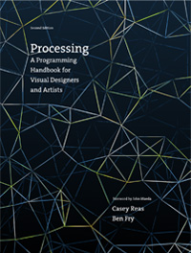
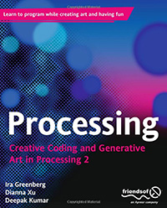
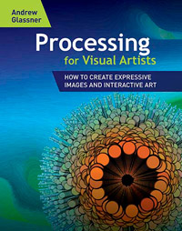
Processing Books
https://processing.org/books/

Slide 14

Questions?

