Slide 1

Programming
Using Processing
Department of Computing and Mathematics
setu.ie

Slide 2

What Is Programming?
Telling a computer what to do, step by step
Like giving instructions to a very literal friend
Computers are fast, powerful… but zero common sense
You: “Make tea.”
Computer: Error: no instructions for picking up kettle.”

Slide 3
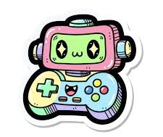
Why Learn Programming (fun reasons)?
Build games, apps, music generators, animations
Control robots, drones, LEDs, VR worlds
Make your own cheats/tools/mods
Create stuff nobody has ever made before
It’s like magic, but real

Slide 4

Why Learn Programming(serious reasons)?
Every industry needs developers
High-paying, flexible jobs
Huge shortage of skilled programmers in Ireland & worldwide
Great for problem-solving and thinking clearly
Opens doors to AI, cybersecurity, gaming, data science, engineering, etc.

Slide 5
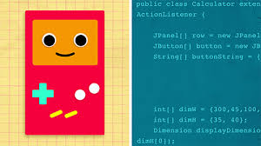
Where Is Programming Used?
Netflix recommendations
Snapchat filters
Spotify playlists
Instagram stories
Self-driving cars
Games (Fortnite, FIFA, Minecraft)
Even toaster ovens & traffic lights

Slide 6
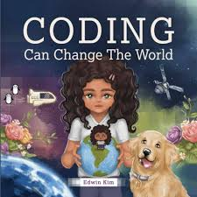
How Programming Changes the World
Apps built by students - TikTok started by college-age developers
Websites and Mobile Apps - over 1.7 billion websites on the internet
Digital Assistants - Siri, Alexa, Google Assistant
Exploring Space - Artemis program, where Python is being used to get a better idea of the moon
Solving Business Challenges
Transportation & Accommodation – Uber, booking.com

Slide 7

What You’ll Do Today
Today, you’ll become programmers.
  Use Processing (Java)Draw shapes & animations
  Make something move

Slide 8

Introduction to Processing

Slide 9

What is Processing?
Processing is a
programming language, development environment, and online community
  …can be used to develop static or interactive online material
  and data visualisations.
  …is often used by visual artists.
  …produces visual and interactive representations of programming code.

Slide 10
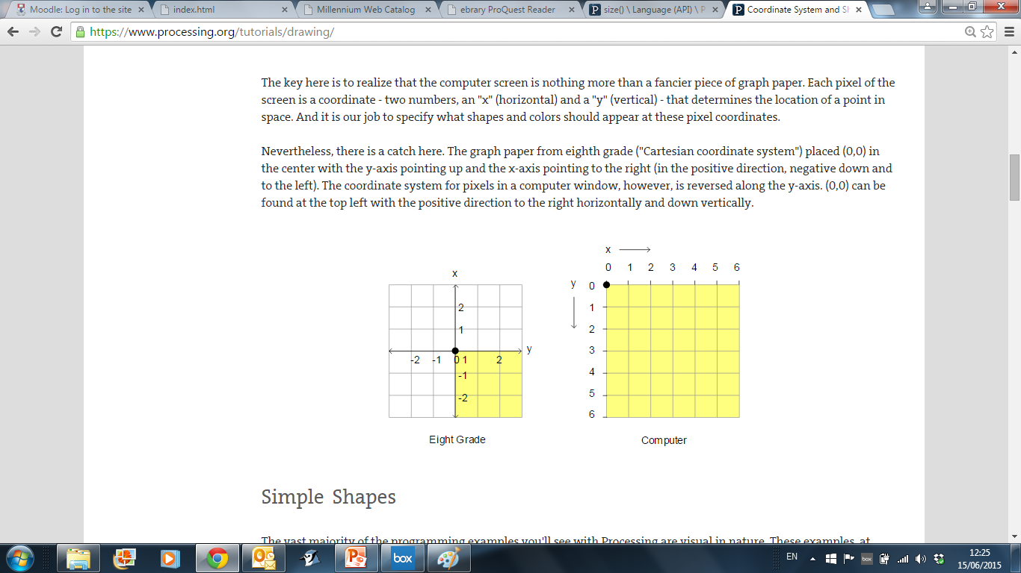
Coordinate System in Computing
In Geometry,
we use this type of
coordinate system:
point (0,0) is in the centre.
In Computing, we use this type of coordinate system to represent the screen:
point (0,0) is in the top left hand corner. Each number is a pixel.
https://processing.org/

Slide 11
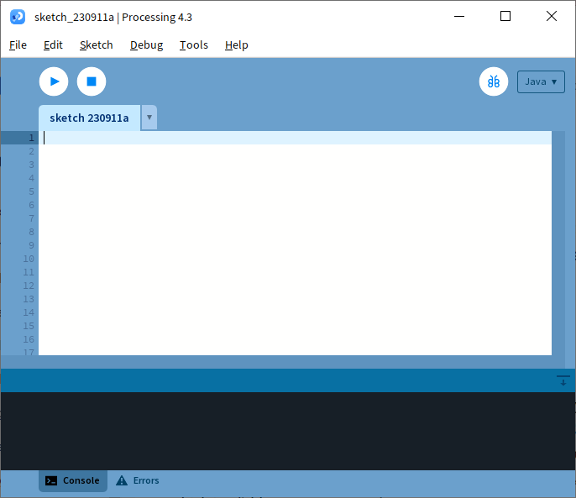
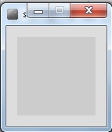
Coordinate System in Computing
Run button
So how does this relate to Processing?
When you open Processing and click on the run button, a display window pops up.
Display window

Slide 12
Coordinate System in Computing
The display window is where your code is run/ displayed.
It follows the rules of the Computing coordinate system i.e. the top left hand corner is (0,0).
A point (10,20) is 10 pixels to the right of (0,0) and 20 pixels below (0,0).
(0,0)
Display window

Slide 13
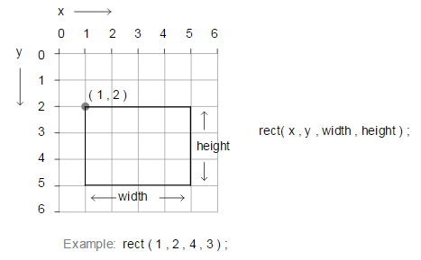
rect()
https://processing.org/

Slide 14
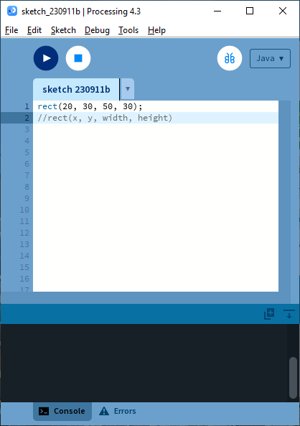
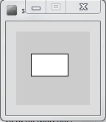
rect() – Drawing a Rectangle

Slide 15
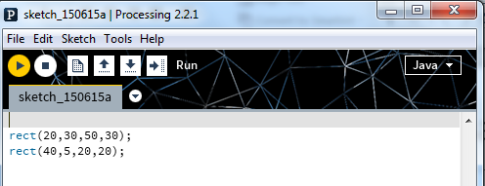
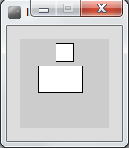
rect() – Drawing a Square
Note how each line of code has a semi-colon (;) at the end of it. This is called a statement terminator and must be included.

Slide 16
rect() – Syntax
rect(x, y, w, h)
  x = x-coordinate of the upper left corner of the rectangle
  y = y-coordinate of the upper left corner of the rectangle
  w = width of the rectangle
  h = height of the rectangle
The rect function above defines four parameters i.e. x, y, w, h.
When you call rect, you are expected to pass four numbers to it. These actual numbers are called arguments.
rect uses these four numbers to render the rectangle on the display window.
To draw a square, the width and height must be the same value.

Slide 17

Questions?

