Slide 1

Customer Shopping Behavior Analysis
Uncovering insights from 3,900 transactions across product categories to guide strategic business decisions.

Slide 2
Dataset at a Glance
3,900 Rows
Demographics
18 columns of transactional data
Age, Gender, Location, Subscription Status
Purchase Details
Behavior
Category, Amount, Season, Size, Color
Discounts, Frequency, Ratings, Shipping
Note: 37 missing values in Review Rating column — handled via median imputation.

Slide 3


Exploratory Data Analysis — Python
Load & Explore
pandas df.info() and .describe()
Clean & Impute
Median imputation for Review Rating; dropped redundant promo_code_used
Feature Engineering
Added age_group and purchase_frequency_days
Database Integration
Loaded cleaned data into PostgreSQL for SQL analysis

Slide 4
SQL Analysis — Key Business Questions
1
Revenue by Gender
Male vs. female total revenue compared
2
High-Spend Discount Users
Customers using discounts yet spending above average
3
Top 5 Products by Rating
Highest average review ratings identified
4
Shipping Type Comparison
Standard vs. Express average purchase amounts
5
Subscribers vs. Non-Subscribers
Average spend and total revenue by subscription status
1
Discount-Dependent Products
Top 5 products with highest % of discounted purchases
2
Customer Segmentation
New, Returning, and Loyal segments by purchase history
3
Top 3 per Category
Most purchased products within each category
4
Repeat Buyers & Subscriptions
Do customers with >5 purchases subscribe more?
5
Revenue by Age Group
Total revenue contribution per age segment

Slide 5
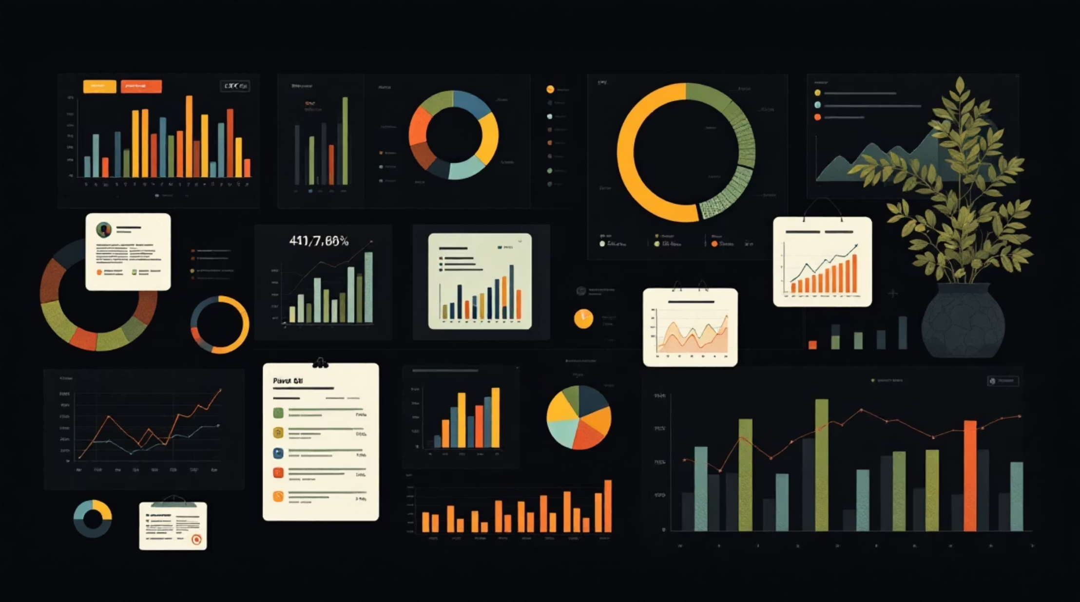
Power BI Dashboard
An interactive dashboard was built in Power BI to present all insights visually — enabling stakeholders to explore segments, categories, and revenue drivers at a glance.
Segment Filters
Revenue Views
Product Performance
Drill into New, Returning, and Loyal customers
By gender, age group, and subscription status
Top-rated and most purchased items by category

Slide 6
Business Recommendations
Boost Subscriptions
Loyalty Programs
Review Discount Policy
Promote exclusive subscriber benefits
Reward repeat buyers to reach "Loyal" status
Balance sales boosts with margin control
Targeted Marketing
Product Positioning
Focus on high-revenue age groups and express-shipping users
Highlight top-rated and best-selling items in campaigns

