Slide 1


| Tech Management, SRI-B
CLASH OF THE
CLAWS
MSRIT_THREESTRIKERS
Clear priorities, better productivity
Shreya Mishra
Sontam Prekshitha
Pruthvi P

Slide 2

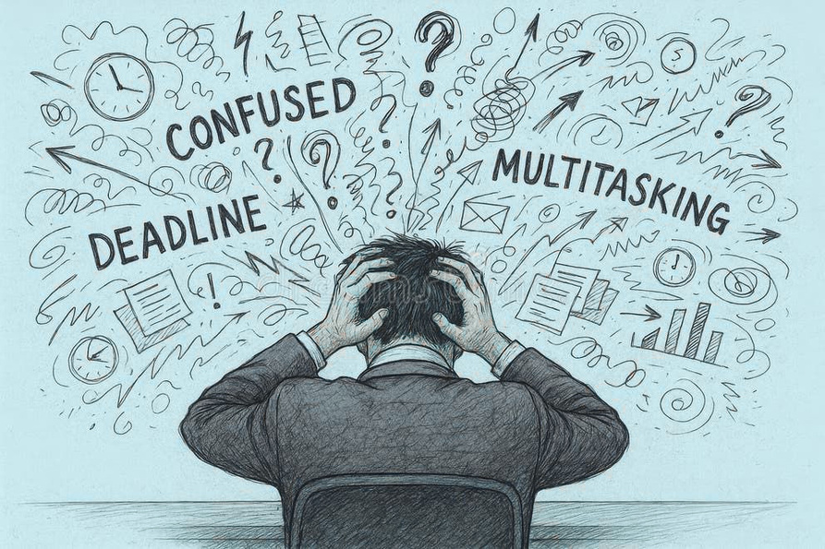
ADAPTIVE PRODUCTIVITY HUB
Problem Statement
Users often manage multiple tasks, but struggle to decide what to do next
Important tasks get delayed due to poor prioritisation
Students and professionals frequently deal with multiple competing tasks
Existing tools focus on task storage rather than decision support
A significant amount of time is spent deciding instead of executing
Notes:
2

Slide 3

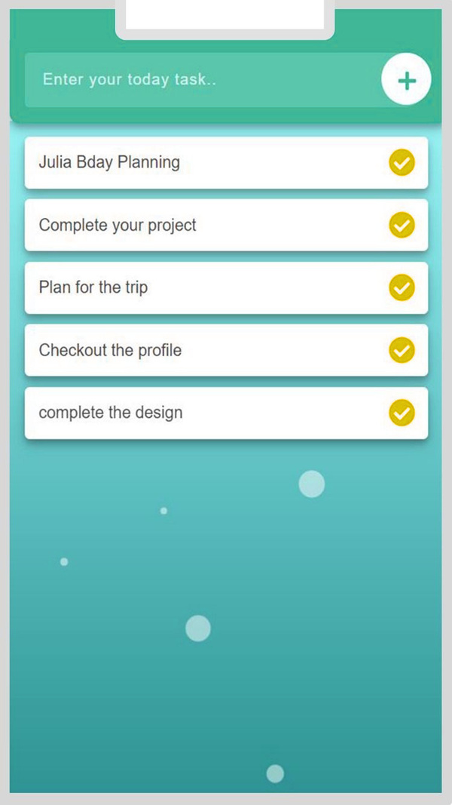
ADAPTIVE PRODUCTIVITY HUB
Current Solution & Gaps
To-do list applications help organise tasks, but do not guide execution
Task prioritisation is usually manual and inconsistent
No clear system to evaluate urgency and importance together
Users are left to make decisions on their own
There is a need for a system that not only manages tasks
but also provides clear direction on what to do next
Notes:
3

Slide 4
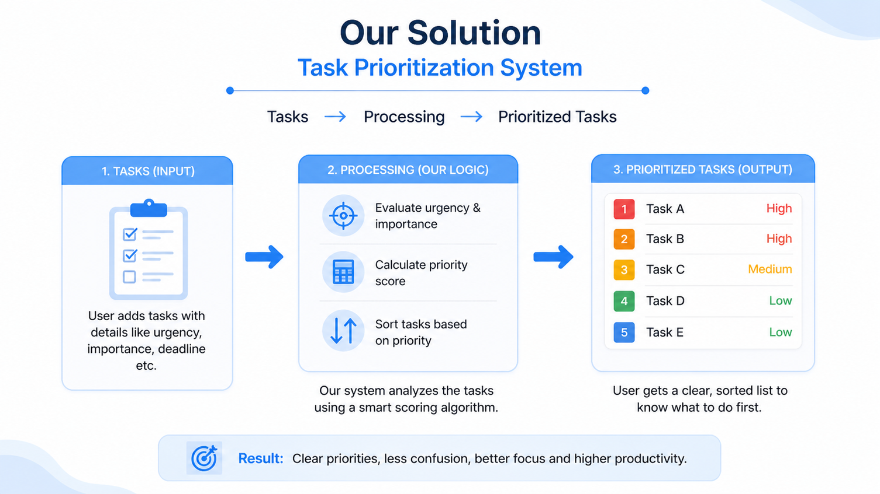
ADAPTIVE PRODUCTIVITY HUB
Our Solution
Task prioritisation system with frontend and backend processing
Converts task lists into a clear priority order
Helps users identify what to do next
Uses deadline urgency and task importance
Displays tasks in a structured and actionable format
Notes:
4

Slide 5
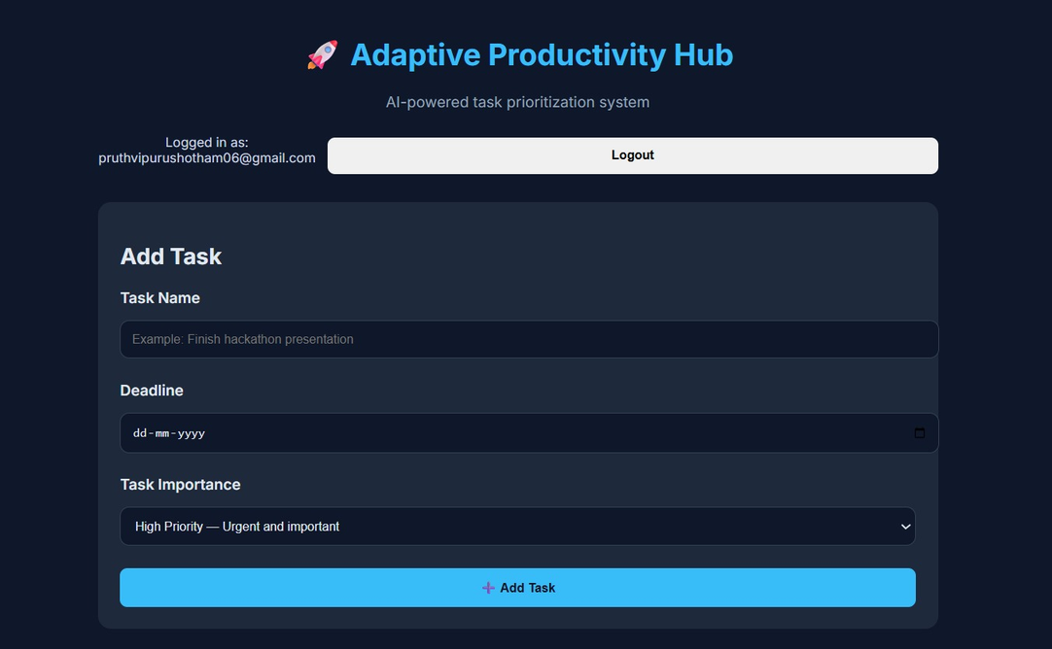
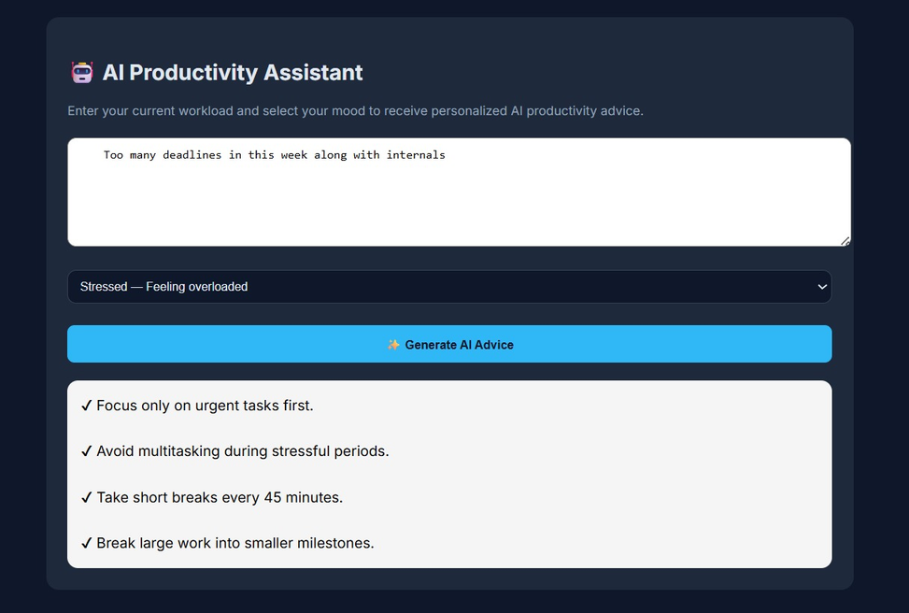
ADAPTIVE PRODUCTIVITY HUB
Demo/Product Walkthrough
User enters task name, deadline, and priority through the interface
The frontend sends task data to the backend via API request
The backend processes tasks using prioritisation logic
Tasks are evaluated based on urgency and importance
The system returns a prioritised list of tasks
The highest priority task is displayed at the top
Users can view, update, or manage tasks easily
Workflow: Login → Task Management → AI Productivity Guidance
Notes:
5

Slide 6
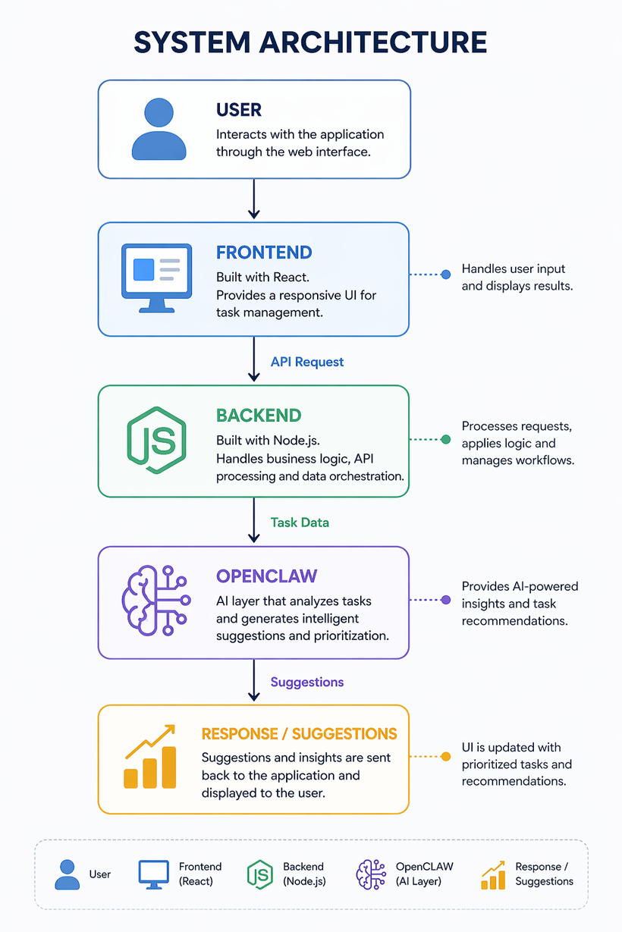
ADAPTIVE PRODUCTIVITY HUB
Tech & Architecture
Frontend developed using HTML, CSS, and JavaScript
Provides an interface for task input and visualisation
Backend developed using Node.js
Handles task processing and prioritisation logic
Communication between frontend and backend via API requests
Uses rule-based prioritisation logic inspired by AI decision-making
Evaluates tasks based on priority level and deadline urgency
System Flow:
User Input → API Request → Processing → Prioritised Output
Notes:
6

Slide 7
ADAPTIVE PRODUCTIVITY HUB
Impact & Use cases
Helps students manage assignments and deadlines more effectively
Assists individuals in organising daily tasks with better clarity
Supports professionals handling multiple responsibilities
Enables users to quickly identify what to do next
Reduces decision fatigue and improves task execution
Applicable across different users and productivity needs
Supports scalable task handling across different users
Notes:
7

Slide 8
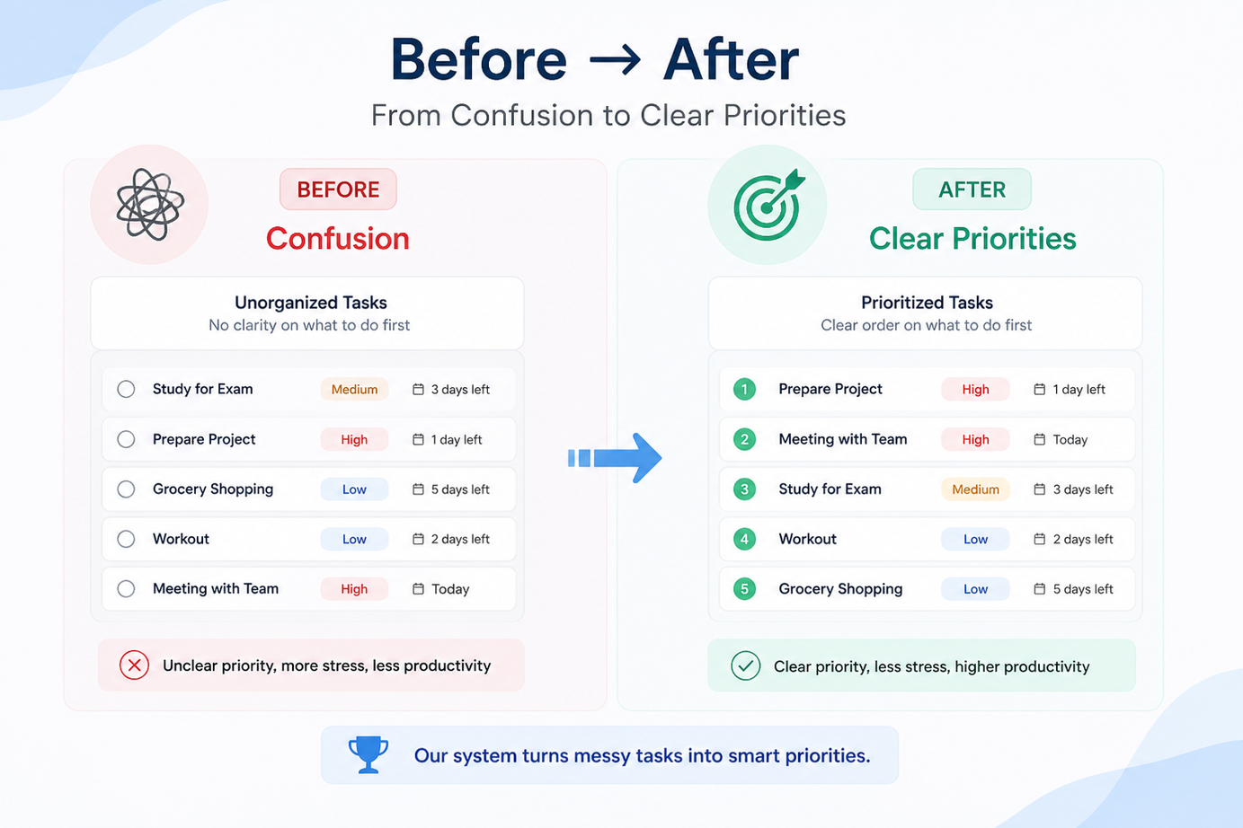
ADAPTIVE PRODUCTIVITY HUB
Differentiation
Focuses on decision making rather than just task storage
Provides a clear and actionable priority order
Helps users quickly identify what to do next
Reduces manual effort in planning and task selection
Simple, fast, and easy to use
Designed for immediate practical use without complexity
Strong advantage: delivers clear prioritisation without overwhelming the user
Notes:
8

Slide 9
ADAPTIVE PRODUCTIVITY HUB
Demo Link
GitHub Repo : https://github.com/SPrekshitha/MSRIT_ThreeStrikes
Demo Link : https://drive.google.com/file/d/1E8o8_r-NaRc3GC93z-A7DjBi9de3H0bl/view?usp=drivesdk
Document submitted : https://docs.google.com/document/d/1N84n74HwsHVffZMuEs6nTRuUperrvCzZ/edit?usp=drivesdk&ouid=103594828396681684762&rtpof=true&sd=true
Notes:
9

Slide 10

ADAPTIVE PRODUCTIVITY HUB
Future Scope & Enhancements
Can be extended with calendar and reminder integration
Scope for personalised task prioritisation based on user patterns
Potential to include smart notifications and scheduling support
Can evolve into a complete productivity assistant
Designed to remain simple while expanding functionality
Can support backend based extensions for advanced features
Notes:
10

