Slide 1
React-Router

Slide 2
Introduction
React Router enables "client side routing".
In traditional websites, the browser requests a document from a web server, downloads and evaluates CSS and JavaScript assets, and renders the HTML sent from the server. When the user clicks a link, it starts the process all over again for a new page.
It allows you to create complex, multi-page web applications that feel like traditional websites while still being single-page applications (SPAs) under the hood.
With React Router, you can define and manage routes, enabling users to navigate through different views of your application without having to request a new HTML page from the server.

Slide 3
How to install
Write the Following Command in the terminal:
npm install react-router-dom

Slide 4
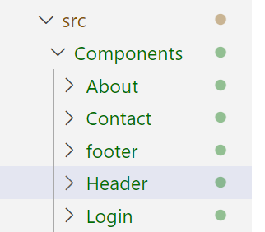
Now Create Different Pages which you want to use for Navigation.
For Example: Home, About, Contact, Login, Help
For a better Practice create a Folder Named as Component and add all these component Inside that

Slide 5
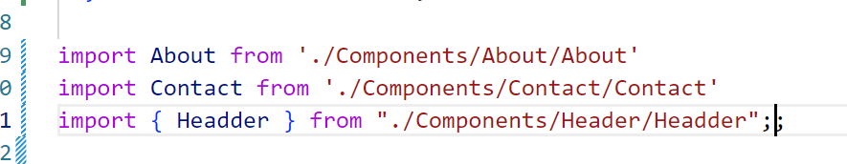
Now import All These Files in your App.js

Slide 6
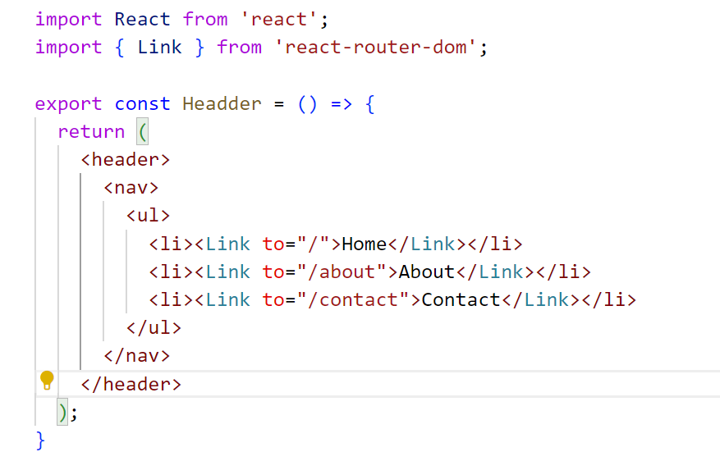
Header file

Slide 7
First Step
Import the following from React-router-dom in your App.js
import {
createBrowserRouter,
RouterProvider,
Route,
Link,
} from "react-router-dom";

Slide 8
Key Concept
CreateBrowserRouter : The createBrowserRouter method receives an array that contains information on which components must be rendered on which path. BrowserRouter is a router implementation that uses the HTML5 history API (pushstate, replacestate, and popstate events) to keep your UI in sync with the URL.
Router Provider: The Router Provider in React Router is similar to the traffic controller of our React apps. It helps us monitor how users move between pages and objects in a single-page application (SPA).
Route: Route is the conditionally shown component that renders some UI when its path matches the current URL.
Link: The link component is used to create links to different routes and implement navigation around the application

Slide 9
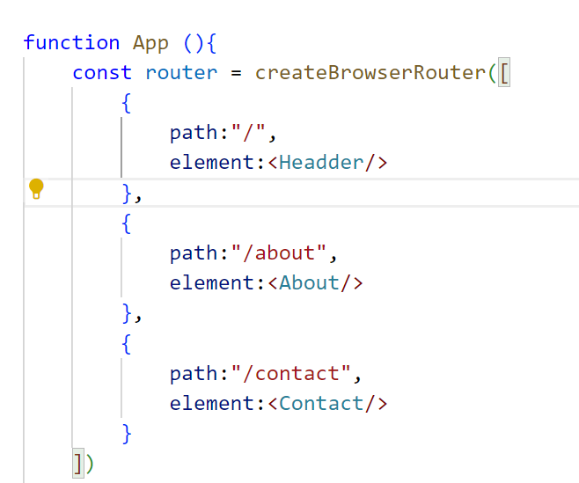

Slide 10
path represents the URL path to the component it represents.
element describes the component that the path points to.

Slide 11
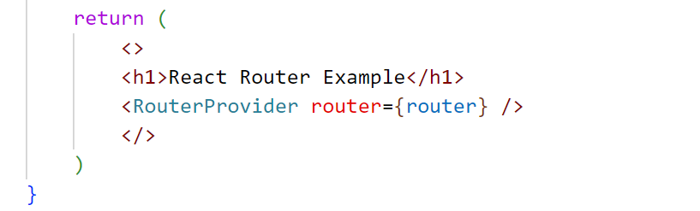
Now Return the following

