Slide 1
Computing Technology
Notes:
OMG Python!
-new language
-low level high level
-Ecosystem of packages and popularity...
-continual learning

Slide 2
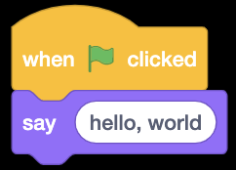
Notes:
Scratch

Slide 3
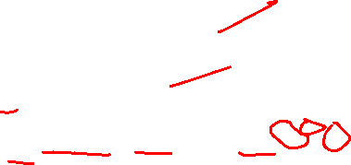
#include <stdio.h>
int main(void) {
printf("hello, world\n");
}
Notes:
C low level

Slide 4

print("hello, world")
Notes:
Python high level

Slide 5

make hello
./hello
Notes:
Running C

Slide 6
clang -o hello hello.c -lcs50
./hello
Notes:
Compile, run

Slide 7
python hello.py
Notes:
Interpreted versus compiled
1 command!
Possibly compare dictionary.c to dictionary.py
Check out blur.py in notes as well
1/hello0.py
6/speller/dictionary.py
6/filter/{blur,edges}.py

Slide 8
compiled, interpreted

Slide 9
functions

Slide 11
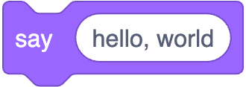
printf("hello, world");
Notes:
https://scratchblocks.github.io/#?style=scratch3&script=say%20%5Bhello%2C%20world%5D

Slide 12
printf("hello, world\n");;

Slide 13
print("hello, world");
Notes:
Better language!!
No ;
No \n
No printf()

Slide 14
libraries
Notes:
MOOAR powerful

Slide 15
modules, packages

Slide 16
#include <cs50.h>

Slide 17
import cs50
Notes:
Brief library

Slide 18
from cs50 import get_string

Slide 19
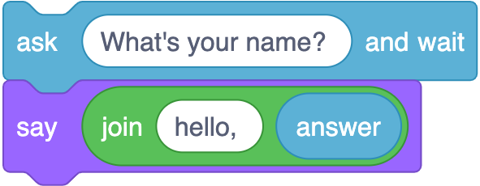
string answer = get_string("What's your name?\n");
printf("hello, %s\n", answer);
Notes:
https://scratchblocks.github.io/#?style=scratch3&script=ask%20%5BWhat's%20your%20name%3F%20%5D%20and%20wait%0Asay%20(join%5Bhello%2C%20%5D%20(answer)%0A

Slide 20
string answer = get_string("What's your name? ");
printf("hello, %s\n", answer);

Slide 21
answer = get_string("What's your name? ")
print("hello, " + answer)

Slide 22
answer = get_string("What's your name? ")
print("hello,", answer)

Slide 23
answer = get_string("What's your name? ")
print(f"hello, {answer}")
Notes:
Format string, “fstring”

Slide 24
answer = input("What's your name? ")
print(f"hello, {answer}")
Notes:
hello{1,2,3}.py

Slide 25
positional parameters
Notes:
“ordered” parameters

Slide 26
named parameters
Notes:
hello4.py
Provide the name of a parameter in the function, and its value

Slide 27
docs.python.org

Slide 28
docs.python.org/3/library/functions.html

Slide 29
https://docs.python.org/3/library/functions.html#print

Slide 30
print(*objects, sep=' ', end='\n', file=None, flush=False)

Slide 31
print(*objects, sep=' ', end='\n', file=None, flush=False)

Slide 32
print(*objects, sep=' ', end='\n', file=None, flush=False)

Slide 33
print(*objects, sep=' ', end='\n', file=None, flush=False)
Notes:
Mention single quotes and double quotes (they are the same in Python)

Slide 34
variables

Slide 35
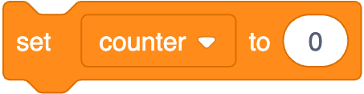
int counter = 0;
Notes:
https://scratchblocks.github.io/#?style=scratch3&script=set%20%5Bcounter%20v%5D%20to%20(0)

Slide 36
int counter = 0;

Slide 37
counter = 0

Slide 38
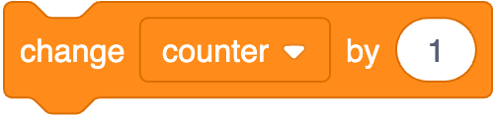
counter = counter + 1;
Notes:
https://scratchblocks.github.io/#?style=scratch3&script=change%20%5Bcounter%20v%5D%20by%20(1)

Slide 39
counter = counter + 1;

Slide 40
counter = counter + 1

Slide 41
counter += 1

Slide 42
types

Slide 43
bool
char
double
float
int
long
string
...

Slide 44
bool
float
int
str
...
Notes:
calculator{0,1}.py

Slide 45
range sequence of numbers
list sequence of mutable values
tuple sequence of immutable values
dict collection of key-value pairs
set collection of unique values
...

Slide 46
get_char
get_double
get_float
get_int
get_long
get_string
...
Notes:
Cs50 c library

Slide 47
get_float
get_int
get_string
Notes:
Cs50 python library

Slide 48
from cs50 import get_float from cs50 import get_int from cs50 import get_string

Slide 49
from cs50 import get_float, get_int, get_string
Notes:
Or import cs50

Slide 50
conditionals

Slide 51
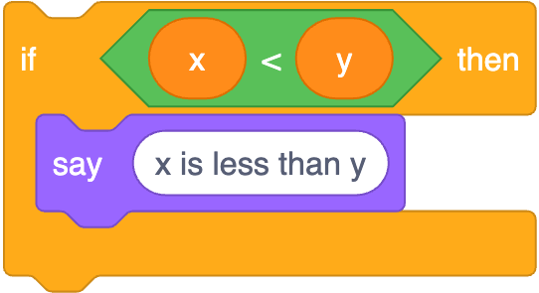
if (x < y) {
printf("x is less than y\n");
}
Notes:
https://scratchblocks.github.io/#?style=scratch3&script=if%20%3C(x)%20%3C%20(y)%3E%20then%0Asay%20%5Bx%20is%20less%20than%20y%5D

Slide 52
if (x < y) {
printf("x is less than y\n");
}

Slide 53
if x < y:
print("x is less than y")
Notes:
Simpler, but colon
NB indentation matters! (4 spaces)

Slide 54
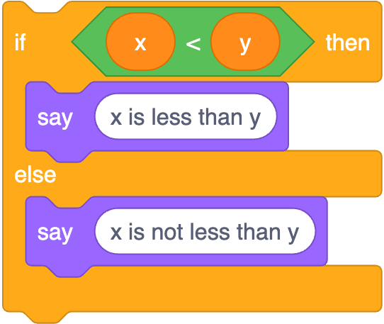
if (x < y) {
printf("x is less than y\n");
}
else
{ printf("x is not less than y\n");
}
Notes:
https://scratchblocks.github.io/#?style=scratch3&script=if%20%3C(x)%20%3C%20(y)%3E%20then%0Asay%20%5Bx%20is%20less%20than%20y%5D%0Aelse%0Asay%20%5Bx%20is%20not%20less%20than%20y%5D

Slide 55
if (x < y) {
printf("x is less than y\n");
}
else
{ printf("x is not less than y\n");
}

Slide 56
if x < y:
print("x is less than y")
else: print("x is not less than y")
Notes:
In python

Slide 57
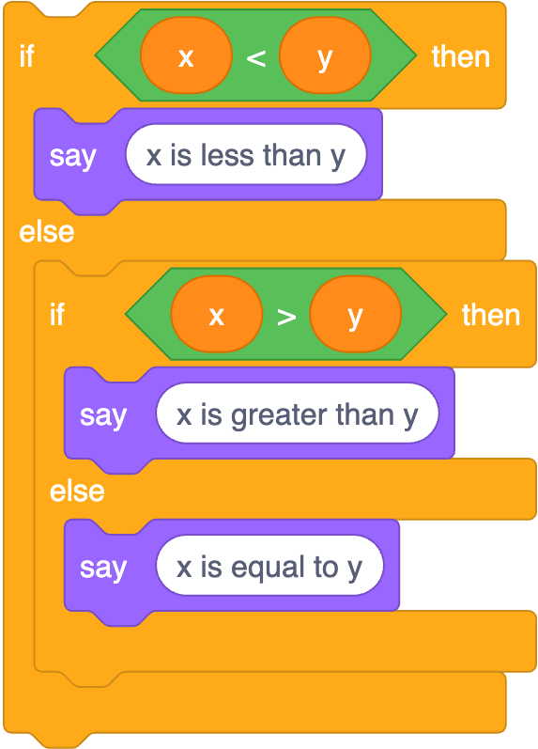
if (x < y) {
printf("x is less than y\n");
}
else if (x > y)
{ printf("x is greater than y\n");
}
else
{ printf("x is equal to y\n");
}
Notes:
https://scratchblocks.github.io/#?style=scratch3&script=if%20%3C(x)%20%3C%20(y)%3E%20then%0Asay%20%5Bx%20is%20less%20than%20y%5D%0Aelse%0Aif%20%3C(x)%20%3E%20(y)%3E%20then%0Asay%20%5Bx%20is%20greater%20than%20y%5D%0Aelse%0Asay%20%5Bx%20is%20equal%20to%20y%5D

Slide 58
if (x < y) {
printf("x is less than y\n");
}
else if (x > y)
{ printf("x is greater than y\n");
}
else
{ printf("x is equal to y\n");
}

Slide 59
if x < y:
print("x is less than y")
elif x > y: print("x is greater than y")
else: print("x is equal to y")
Notes:
1/compare3.py

Slide 60
str
Notes:
4/compare.py
1/agree{0,1}.py
Notes and examples

Slide 61
object-oriented programming
Notes:
“OOP”
Instead of structs in c you have objects of a particular class
Implements structs with functionality as an element of good style
If functions in python are associated with particular data, they are called “methods”, like s.lower()

Slide 62
OOP

Slide 63
docs.python.org/3/library/stdtypes.html#string-methods
Notes:
1/agree2.py
4/copy.py
2/uppercase{0,1}.py

Slide 64
loops

Slide 65
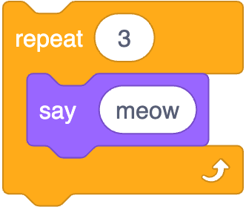
int i = 0;
while (i < 3)
{
printf("meow\n");
i++;
}
Notes:
https://scratchblocks.github.io/#?style=scratch3&script=repeat%20%5B3%5D%0Asay%5Bmeow%5D

Slide 66
int i = 0;
while (i < 3)
{
printf("meow\n");
i++;
}

Slide 67
i = 0
while i < 3:
print("meow")
i += 1

Slide 68
for (int i = 0; i < 3; i++)
{
printf("meow\n");
}

Slide 69
for (int i = 0; i < 3; i++)
{
printf("meow\n");
}

Slide 70
for i in [0, 1, 2]:
print("meow")
Notes:
Problem with lots of iterations!

Slide 71
for i in range(3):
print("meow")

Slide 72
for _ in range(3):
print("meow")
Notes:
Underscore style if not actually using loop var

Slide 73
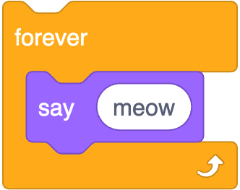
while (true)
{
printf("meow\n");
}
Notes:
https://scratchblocks.github.io/#?style=scratch3&script=forever%0Asay%5Bmeow%5D

Slide 74
while (true)
{
printf("meow\n");
}

Slide 75
while True:
print("meow")
Notes:
meow{0,1,2,3,4,5,6}.py

Slide 76
truncation
Notes:
calculator2.py, with 1/3
not an issue with /
Division with ints and floats mathematical outcomes – no truncation!!!

Slide 77
floating-point imprecision
Notes:
calculator3.py, with 1/3

Slide 78
exceptions
Notes:
integer{0,1,2,3,4}.py
Try:
Except ValueError:

Slide 79
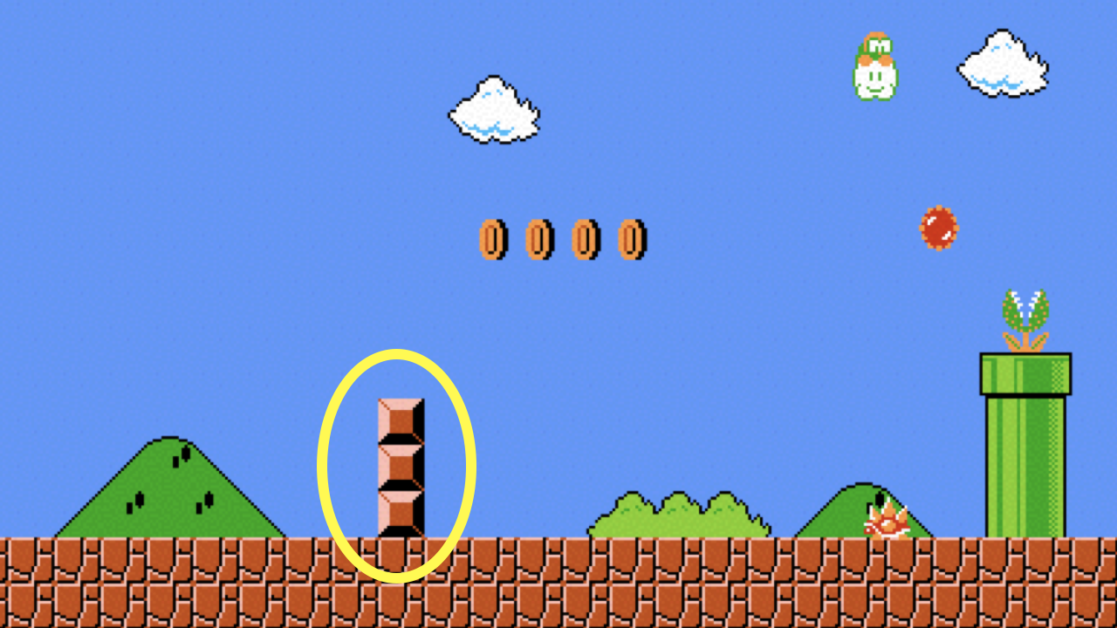
Notes:
mario{0,1}.py

Slide 80
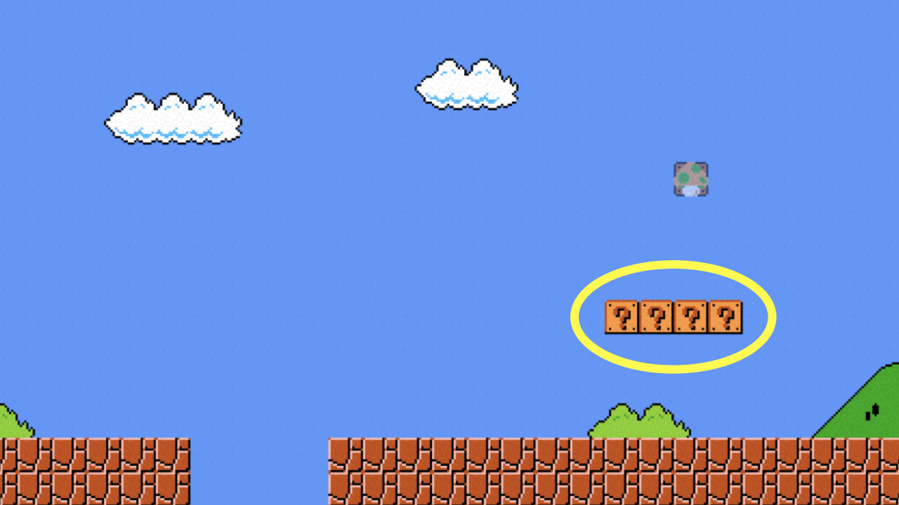
Notes:
mario{2,3}.py

Slide 81
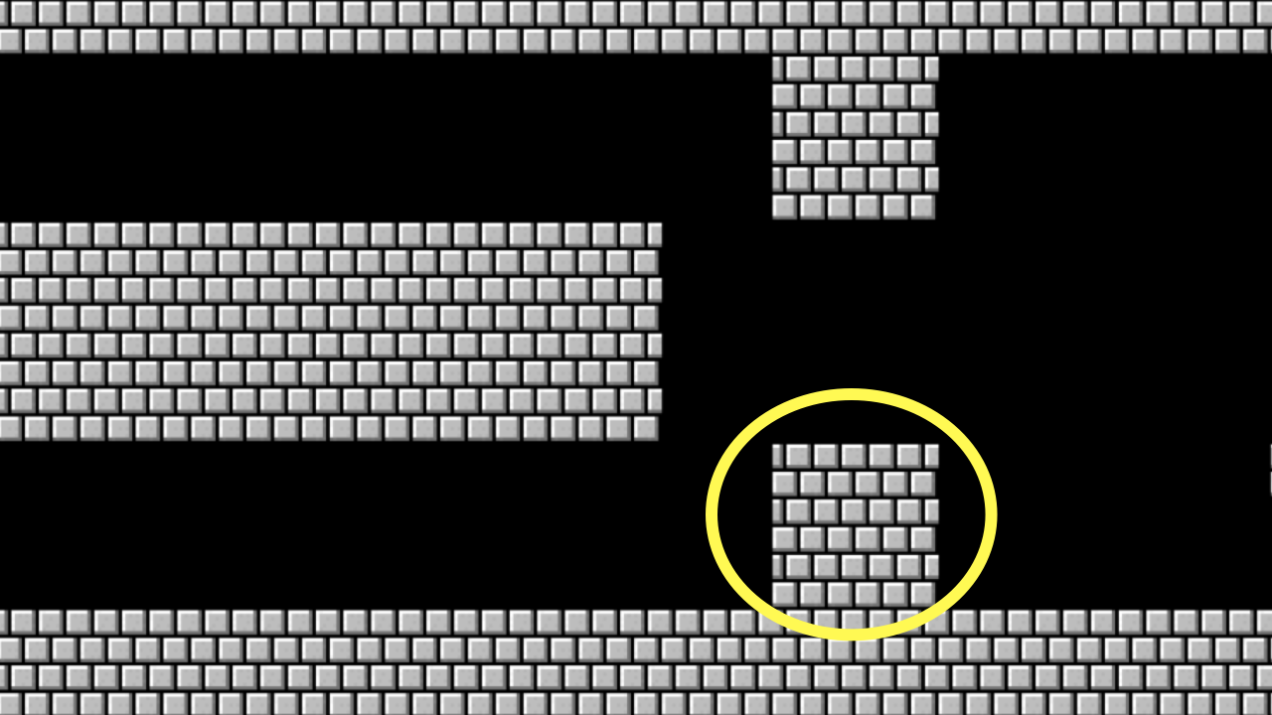
Notes:
mario{4,5}.py

Slide 82
list
Notes:
Automatic linked lists!

Slide 83
docs.python.org/3/library/stdtypes.html#sequence-types-list-tuple-range

Slide 84
len

Slide 85
docs.python.org/3/library/functions.html#len
Notes:
2/scores{0,1,2}.py
3/phonebook{0,1}.py

Slide 86
dict

Slide 87
key | value

Slide 88
docs.python.org/3/library/stdtypes.html#mapping-types-dict
Notes:
phonebook{2,3,4}.py

Slide 89
sys

Slide 90
docs.python.org/3/library/sys.html
Notes:
2/greet{0,1,2}.py
2/exit.py

Slide 91
csv

Slide 92
docs.python.org/3/library/csv.html
Notes:
4/phonebook{0,1,2}.py

Slide 93
pip
Notes:
pip install cowsay
moo{0,1}.py
pip install qrcode
qr.py

Slide 94
Computing Technology

