Slide 1
Computing Technology

Slide 2
flat-file database

Slide 3
CSV
Notes:
favorites{0,1,2,3,4}.py
Check these out to handle data in csv

Slide 4
key | value
Notes:
favorites{5,6,7,8}.py
Check these out to look at dictionary use

Slide 5
relational database
Notes:
Store data; relate data to other data ;D

Slide 6
SQL
Notes:
Structured query language

Slide 7
C
R
U
D

Slide 8
CREATE
READ
UPDATE
DELETE

Slide 9
CREATE
SELECT
UPDATE
DELETE
Notes:
(READ) is actually SELECT, the others are the same!!

Slide 10
CREATE, INSERT
SELECT
UPDATE
DELETE

Slide 11
CREATE, INSERT
SELECT
UPDATE
DELETE, DROP

Slide 12
CREATE, INSERT
SELECT
UPDATE
DELETE, DROP
...

Slide 13
CREATE TABLE table (column type, ...);
Notes:
Think of a “spreadsheet”
In SQL a table is a sheet

Slide 14
sqlite3
Notes:
Lite SQL version
Runs from a file does not need server software running
Use as a command line programme – other aspects the same as different versions of SQL

Slide 15
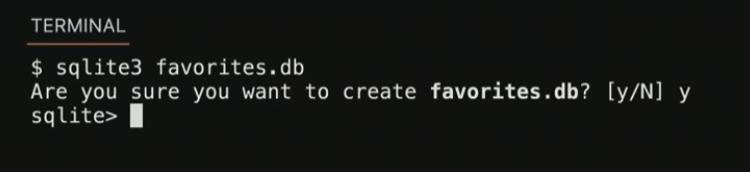
sqlite3 FILE

Slide 16
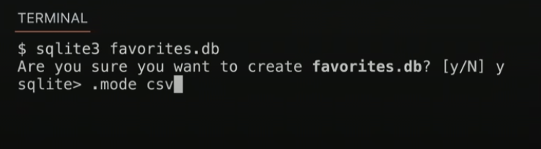
.mode csv
.import FILE TABLE
.quit
Notes:
favorites.csv

Slide 17
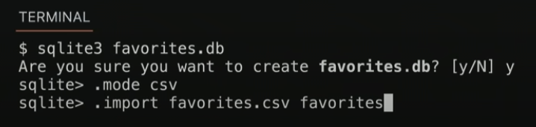
.mode csv
.import FILE TABLE
.quit
Notes:
favorites.csv

Slide 18
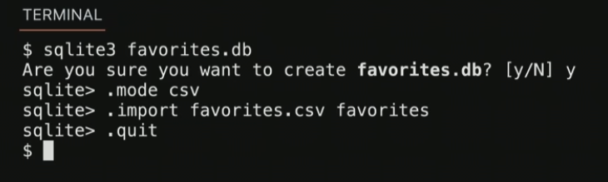
.mode csv
.import FILE TABLE
.quit
Notes:
favorites.csv

Slide 19
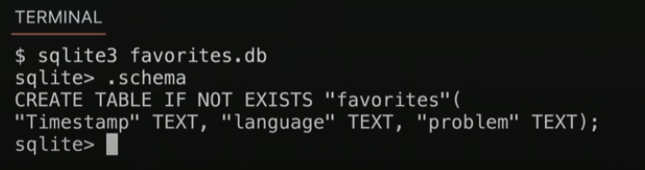
.schema

Slide 20
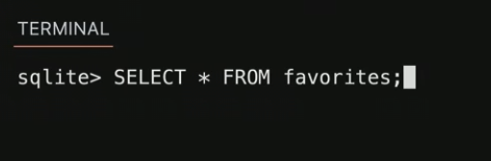
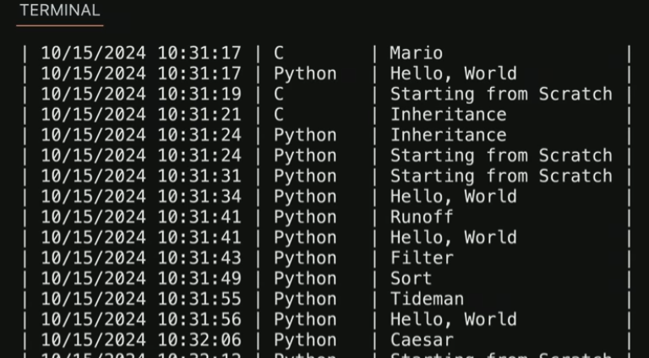
SELECT columns FROM table;
...
Notes:
SELECT * FROM favorites;
SELECT language FROM favorites;
Reads data from the database

Slide 21
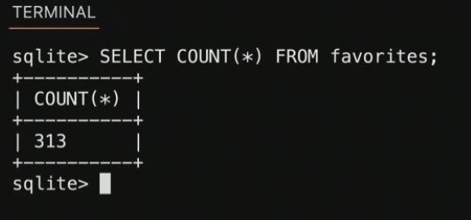
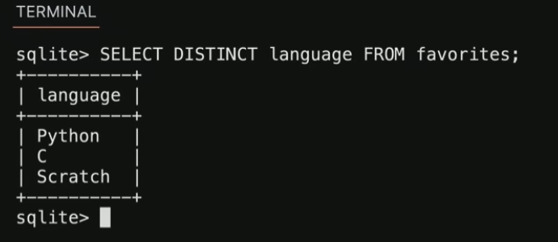
AVG
COUNT
DISTINCT
LOWER
MAX
MIN
UPPER
...
Notes:
SELECT COUNT(*) FROM favorites;
SELECT DISTINCT language FROM favorites;
SELECT COUNT(DISTINCT language) FROM favorites;

Slide 22
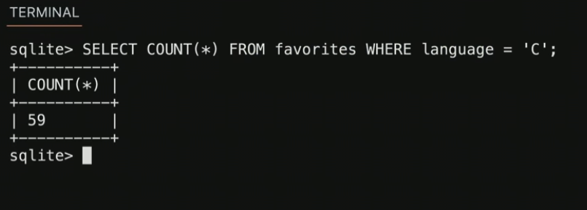
GROUP BY
LIKE
LIMIT
ORDER BY
WHERE
...
Notes:
SELECT COUNT(*) FROM favorites WHERE language = 'C';
SELECT COUNT(*) FROM favorites WHERE language = 'C' AND problem = 'Hello, World';
SELECT COUNT(*) FROM favorites WHERE language = 'C' AND (problem = 'Hello, World' OR problem = 'Hello, It''s Me');
SELECT COUNT(*) FROM favorites WHERE language = 'C' AND problem LIKE 'Hello, %';

Slide 23
language
C
Python
Python
SQL
Python
SQL
Notes:
SELECT language, COUNT(*) FROM favorites GROUP BY language;

Slide 24
language
C
Python
Python
SQL
Python
SQL

Slide 25
language
C
Python
Python
SQL
Python
SQL

Slide 26
language
C
Python
Python
SQL
Python
SQL

Slide 27
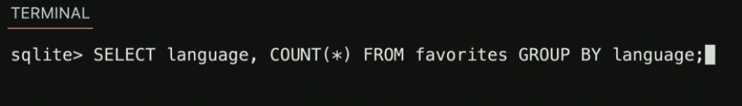
language | COUNT(*)
C | 1
Python | 3
SQL | 2

Slide 28
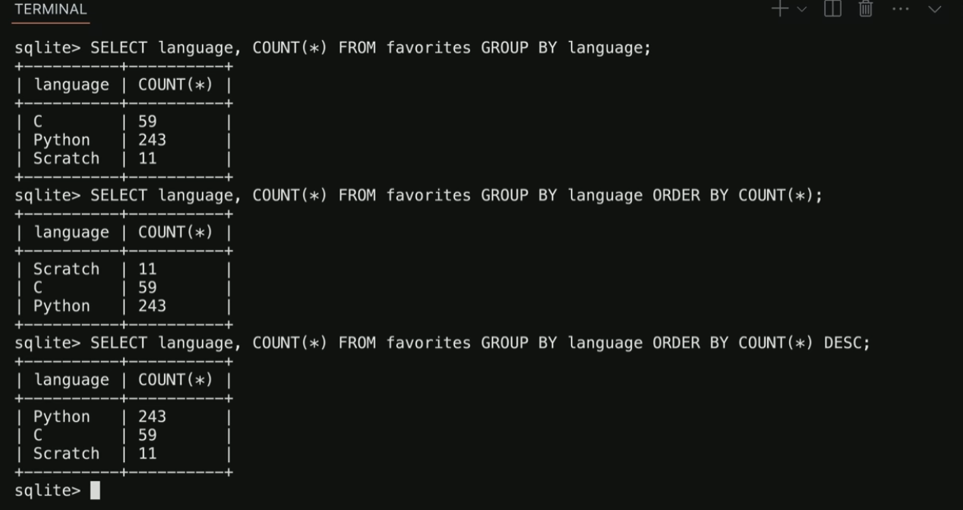
language | COUNT(*)
C | 1
Python | 3
SQL | 2

Slide 29
GROUP BY
LIKE
LIMIT
ORDER BY
WHERE
...
Notes:
SELECT language, COUNT(*) FROM favorites GROUP BY language ORDER BY COUNT(*) DESC;
SELECT language, COUNT(*) AS n FROM favorites GROUP BY language ORDER BY n DESC;
SELECT language, COUNT(*) AS n FROM favorites GROUP BY language ORDER BY n DESC LIMIT 1;
Think of these as BUILDING BLOCKS for builting queries

Slide 30
INSERT INTO table (column, ...) VALUES(value, ...);
Notes:
How to add data
INSERT INTO favorites (language, problem) VALUES('SQL', 'Fiftyville');
SELECT * FROM favorites;

Slide 31
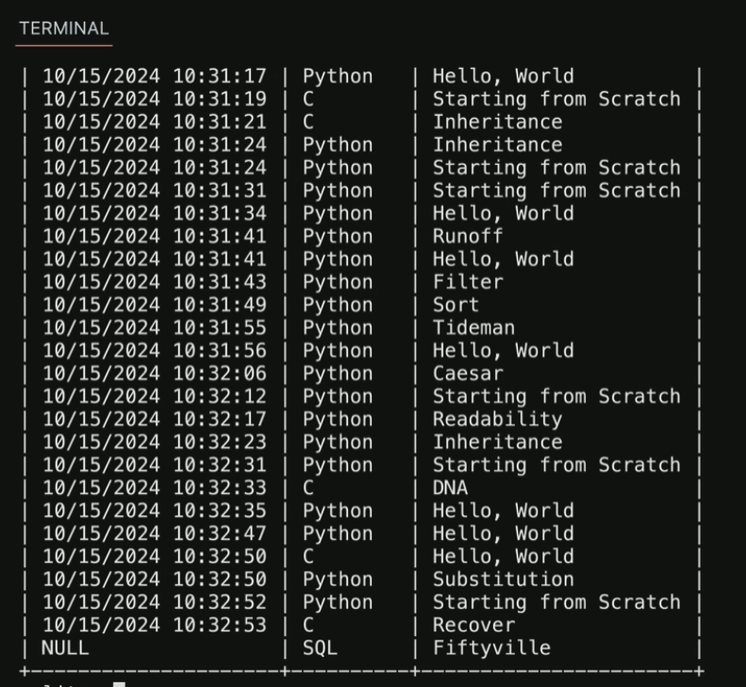
NULL
Notes:
After INSERT – timestamp absence

Slide 32
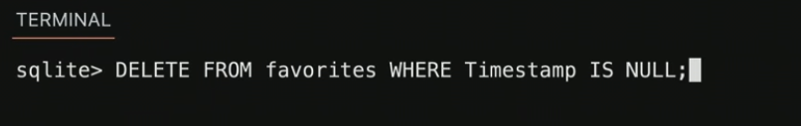
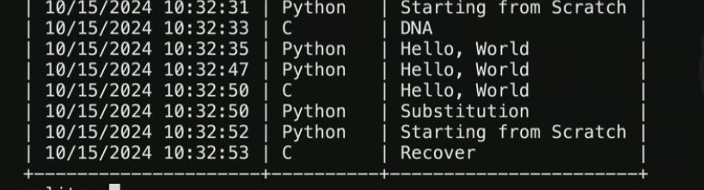
DELETE FROM table WHERE condition;
Notes:
DELETE FROM favorites WHERE Timestamp IS NULL;

Slide 33
UPDATE table SET column = value WHERE condition;
Notes:
UPDATE favorites SET language = 'SQL', problem = 'Fiftyville';
SELECT * FROM favorites;
DELETE FROM favorites;
SELECT * FROM favorites;

Slide 34
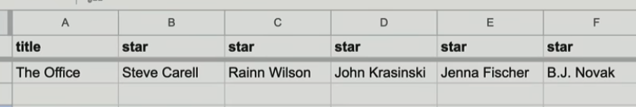
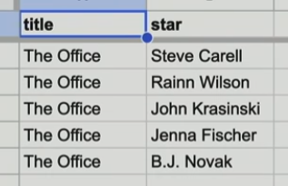
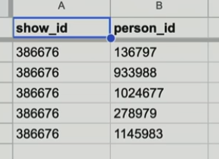
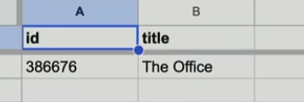
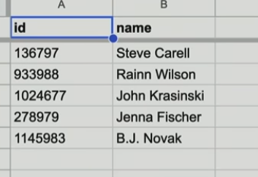
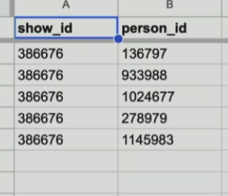
IMDb
Shows
People
Stars
Notes:
https://docs.google.com/spreadsheets/d/15g5bRE3WF2PgkCm9LhKn2hdOmTxhk9aX_U06TMYcu0A/edit?usp=sharing
https://docs.google.com/spreadsheets/d/1tETwE0k0tERu1p1aOt8Rfitot1k3f77ywS8kicBPqdg/edit?usp=sharing
https://docs.google.com/spreadsheets/d/1Ey_E4W1LsHYp2MPWMqv8Q8IFNDcoAth_hUQNx3j3uV8/edit?usp=sharing

Slide 35
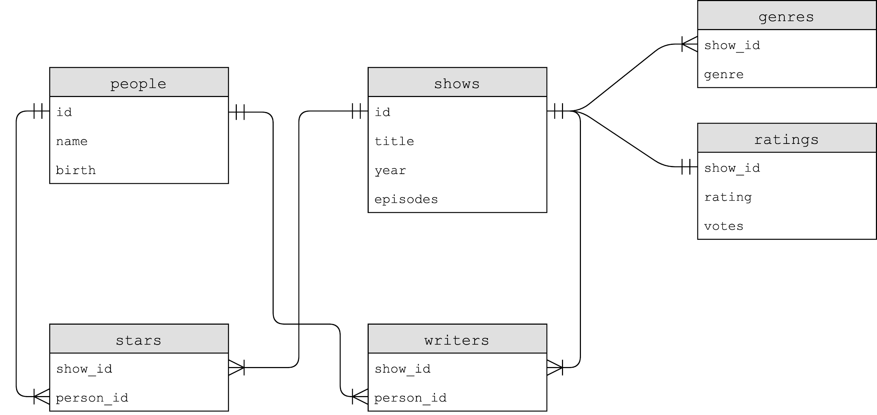
Notes:
SCHEMA

Slide 36
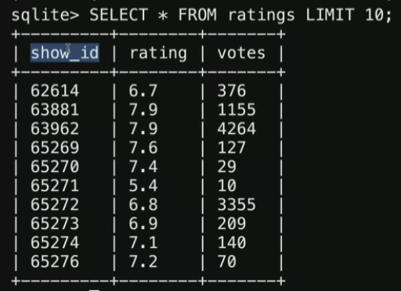
Notes:
SELECT * FROM shows LIMIT 10;
SELECT * FROM ratings LIMIT 10;

Slide 37
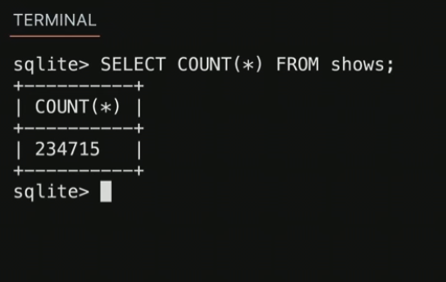
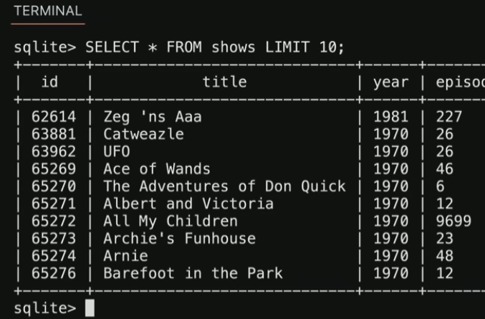
one-to-one

Slide 38
one-to-one

Slide 39
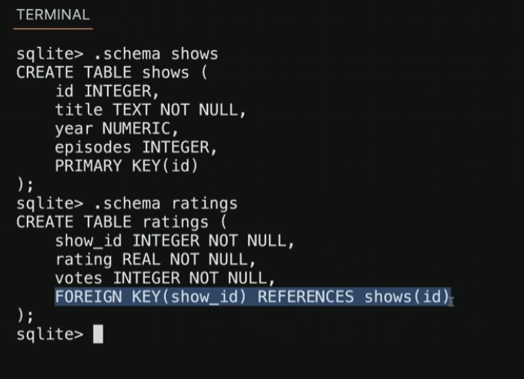
Notes:
Primary key – unique identifier in a table
Foreign key – a primary key that appears ina different table
.schema shows
.schema ratings

Slide 40
INTEGER
NUMERIC
REAL
TEXT
BLOB
Notes:
Data types
Blob Binary Large Object

Slide 41
NOT NULL
UNIQUE
Notes:
Data protection
A call “can’t be null”, “must be unique” etc.

Slide 42
PRIMARY KEY
FOREIGN KEY
Notes:
SELECT * FROM ratings WHERE rating >= 6.0 LIMIT 10;
SELECT show_id FROM ratings WHERE rating >= 6.0 LIMIT 10;
SELECT * FROM shows WHERE id IN (SELECT show_id FROM ratings WHERE rating >= 6.0) LIMIT 10;
SELECT title FROM shows WHERE id IN (SELECT show_id FROM ratings WHERE rating >= 6.0) LIMIT 10;

Slide 43
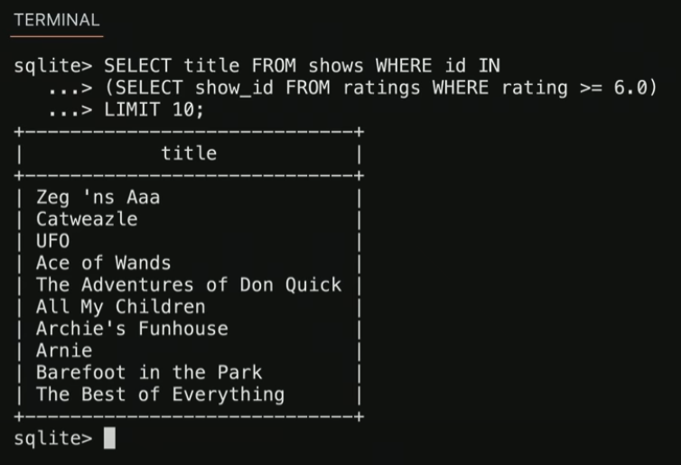
PRIMARY KEY
FOREIGN KEY
Notes:
SELECT * FROM ratings WHERE rating >= 6.0 LIMIT 10;
SELECT show_id FROM ratings WHERE rating >= 6.0 LIMIT 10;
SELECT * FROM shows WHERE id IN (SELECT show_id FROM ratings WHERE rating >= 6.0) LIMIT 10;
SELECT title FROM shows WHERE id IN (SELECT show_id FROM ratings WHERE rating >= 6.0) LIMIT 10;

Slide 44
JOIN

Slide 45
id | title
386676 | The Office
show_id | rating
386676 | …

Slide 46
title | id
The Office | 386676
show_id | rating
386676 | …

Slide 47
title | id
The Office | 386676
show_id | rating
386676 | …
Notes:
SELECT * FROM shows JOIN ratings ON shows.id = ratings.show_id WHERE rating >= 6.0 LIMIT 10;

Slide 48
title | id
The Office | 386676
show_id | rating
386676 | …

Slide 49
title | id
The Office | 386676
rating
…

Slide 50
title
The Office
rating
…
Notes:
SELECT title, rating FROM shows JOIN ratings ON shows.id = ratings.show_id WHERE rating >= 6.0 LIMIT 10;

Slide 52
Notes:
SELECT * FROM genres LIMIT 10;
SELECT * FROM shows WHERE id = 63881;

Slide 53
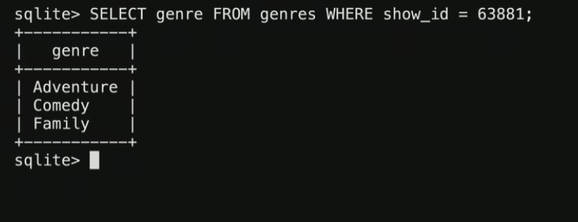
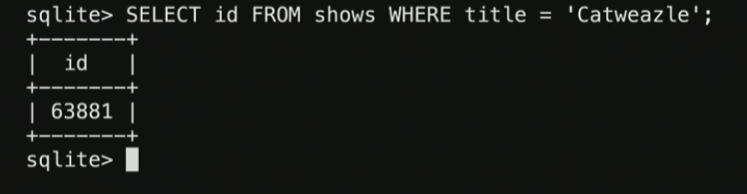
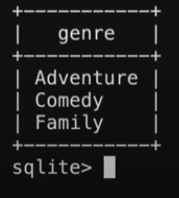
one-to-many
Notes:
E.g. one show has many genres associated with it
.schema genres
SELECT genre FROM genres WHERE show_id = 63881;
SELECT genre FROM genres WHERE show_id = (SELECT id FROM shows WHERE title = 'Catweazle');

Slide 54
id | title
63881 | Catweazle
show_id | genre
63881 | Adventure
63881 | Comedy
63881 | Family

Slide 55
title | id
Catweazle | 63881
show_id | genre
63881 | Adventure
63881 | Comedy
63881 | Family

Slide 56
title | id
Catweazle | 63881
show_id | genre
63881 | Adventure
63881 | Comedy
63881 | Family
Notes:
SELECT * FROM shows JOIN genres ON shows.id = genres.show_id WHERE id = 63881;

Slide 57
title | id
Catweazle | 63881
show_id | genre
63881 | Adventure
63881 | Comedy
63881 | Family

Slide 58
title | id
Catweazle | 63881
Catweazle | 63881
Catweazle | 63881
show_id | genre
63881 | Adventure
63881 | Comedy
63881 | Family

Slide 59
title | id
Catweazle | 63881
Catweazle | 63881
Catweazle | 63881
genre
Adventure
Comedy
Family

Slide 60
title
Catweazle
Catweazle
Catweazle
genre
Adventure
Comedy
Family
Notes:
SELECT title, genre FROM shows JOIN genres ON shows.id = genres.show_id WHERE id = 63881;

Slide 61
genre
Adventure
Comedy
Family
Notes:
SELECT genre FROM shows JOIN genres ON shows.id = genres.show_id WHERE id = 63881;

Slide 63
Notes:
One show has many stars
Each star is in many shows

Slide 64
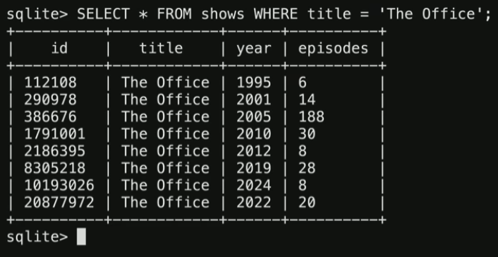
many-to-many
Notes:
SELECT * FROM shows WHERE title = 'The Office';
SELECT * FROM shows WHERE title = 'The Office' AND year = 2005;
SELECT name FROM people WHERE id IN
(SELECT person_id FROM stars WHERE show_id =
(SELECT id FROM shows WHERE title = 'The Office' AND year = 2005));
SELECT title FROM shows WHERE id IN
(SELECT show_id FROM stars WHERE person_id =
(SELECT id FROM people WHERE name = 'Steve Carell'));
SELECT title FROM shows
JOIN stars ON shows.id = stars.show_id
JOIN people ON stars.person_id = people.id
WHERE name = 'Steve Carell';
SELECT title FROM shows, stars, people WHERE shows.id = stars.show_id
AND people.id = stars.person_id
AND name = 'Steve Carell';

Slide 65
“join” table
Notes:
.schema writers

Slide 66
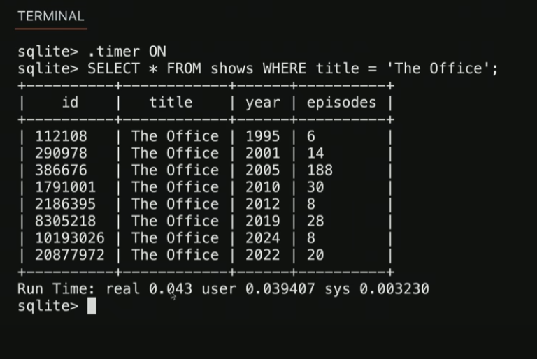
indexes
Notes:
Indexes speed up queries
.timer ON
SELECT * FROM shows WHERE title = 'The Office';

Slide 67
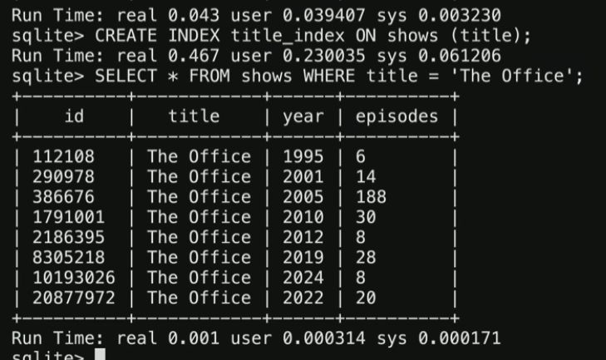
CREATE INDEX name ON table (column, ...);
Notes:
CREATE INDEX title_index ON shows (title);
SELECT * FROM shows WHERE title = 'The Office';

Slide 68
B-trees
Notes:
When you create an index

Slide 69
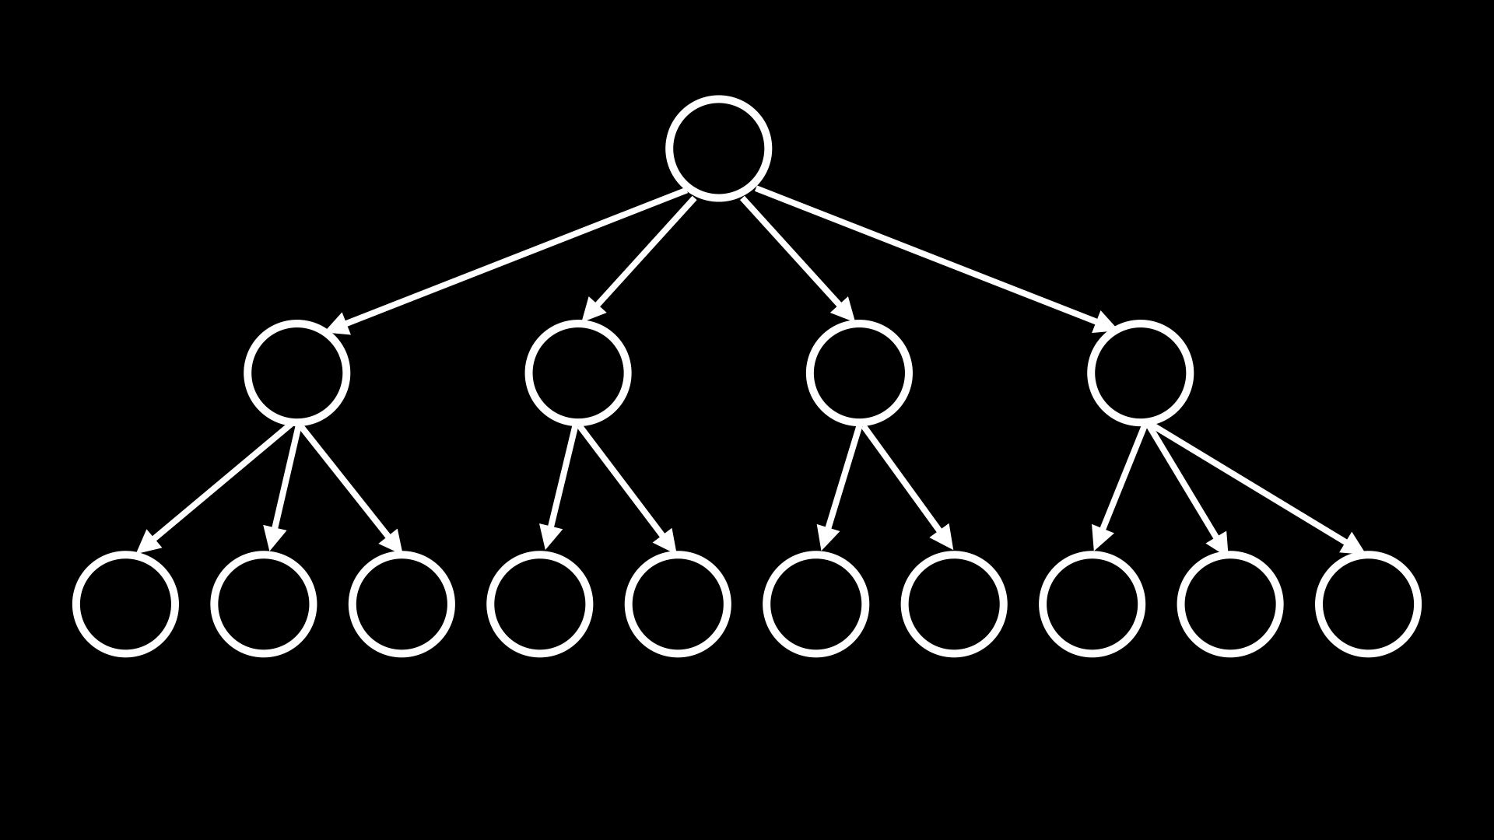
Notes:
SELECT title FROM shows, stars, people
WHERE shows.id = stars.show_id
AND people.id = stars.person_id
AND name = 'Steve Carell';
SELECT title FROM shows WHERE id IN
(SELECT show_id FROM stars WHERE person_id =
(SELECT id FROM people WHERE name = 'Steve Carell'));
CREATE INDEX name_index ON people (name);
CREATE INDEX person_index ON stars (person_id);
SELECT title FROM shows WHERE id IN
(SELECT show_id FROM stars WHERE person_id =
(SELECT id FROM people WHERE name = 'Steve Carell'));

Slide 70
Use SQL inside Python!
from cs50 import SQL

Slide 71
cs50.readthedocs.io/libraries/cs50/python/#cs50.SQL
Notes:
favorites8.py

Slide 72
race conditions
Notes:
MILK STORY (lock or note)

Slide 73

Notes:
https://www.instagram.com/p/CmUv48DLvxd/
Lots of likes problem

Slide 74
rows = db.execute("SELECT likes FROM posts WHERE id = ?", id);
likes = rows[0]["likes"]
db.execute("UPDATE posts SET likes = ? WHERE id = ?", likes + 1, id);
Notes:
What if there are many almost simultaneous transactions happen?

Slide 75
BEGIN TRANSACTION
COMMIT
ROLLBACK

Slide 76
db.execute("BEGIN TRANSACTION")
rows = db.execute("SELECT likes FROM posts WHERE id = ?", id);
likes = rows[0]["likes"]
db.execute("UPDATE posts SET likes = ? WHERE id = ?", likes + 1, id);
db.execute("COMMIT")
Notes:
Like note on the fridge – I went to buy milk. Wait til I come back to decide if you want to buy milk

Slide 77
SQL injection attacks

Slide 78
rows = db.execute("SELECT * FROM users WHERE username = ? AND password = ?", username, password)
if rows:
...

Slide 79
rows = db.execute("SELECT * FROM users WHERE username = ? AND password = ?", username, password)
if rows:
...

Slide 80
rows = db.execute("SELECT * FROM users WHERE username = ? AND password = ?", username, password)
if rows:
...

Slide 81
rows = db.execute(f"SELECT * FROM users WHERE username = '{username}' AND password = '{password}'")
if rows:
...

Slide 82
rows = db.execute(f"SELECT * FROM users WHERE username = 'malan@harvard.edu'--' AND password = '{password}'")
if rows:
...

Slide 83
rows = db.execute(f"SELECT * FROM users WHERE username = 'malan@harvard.edu'--' AND password = '{password}'")
if rows:
...

Slide 84
rows = db.execute(f"SELECT * FROM users WHERE username = 'malan@harvard.edu'--' AND password = '{password}'")
if rows:
...

Slide 85
rows = db.execute(f"SELECT * FROM users WHERE username = 'malan@harvard.edu''--' AND password = '{password}'")
if rows:
...
Notes:
You COULD use escape char

Slide 86
rows = db.execute("SELECT * FROM users WHERE username = ? AND password = ?", username, password)
if rows:
...
Notes:
Beter to use placeholders

Slide 87
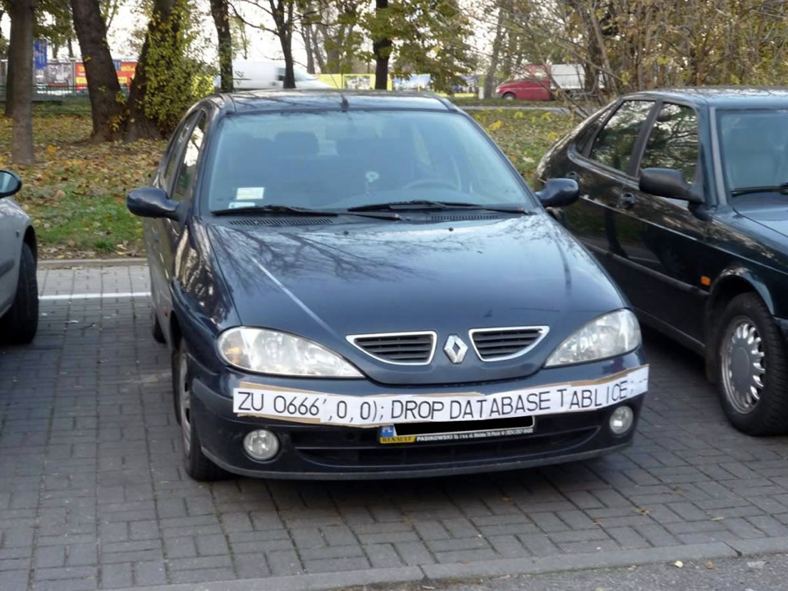
Notes:
Can you drop the licence database table????!!!!!

Slide 88
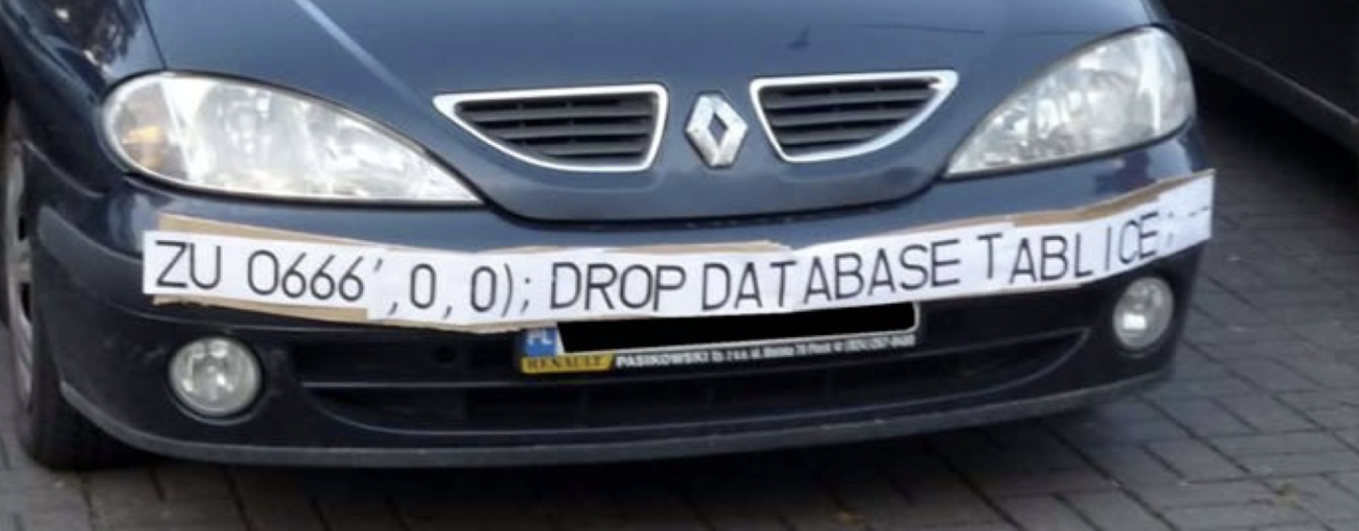

Slide 89
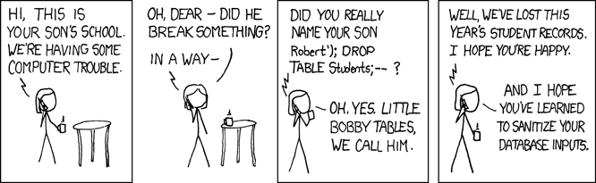
Notes:
https://xkcd.com/327/

Slide 90
Computing Technology

