Slide 1
Computing Technology
Notes:
Reload codespace
Uncheck VS Code tabs

Slide 2

Notes:
https://www.youtube.com/watch?v=cZB_EBsnc8c

Slide 3

Notes:
https://apps.apple.com/us/app/contacts/id1069512615#?platform=iphone
In Week 0, intuitive algorithms…
John Harvard

Slide 4
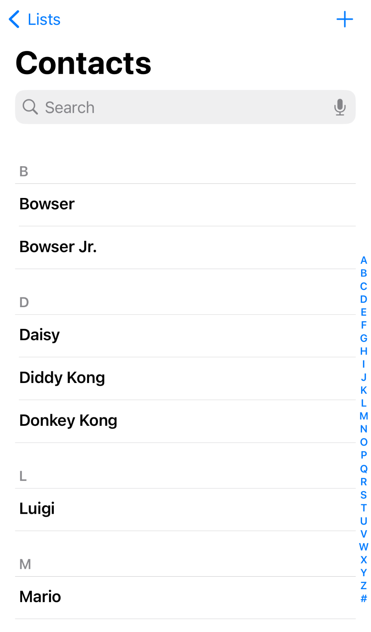
Notes:
https://nintendo.fandom.com/wiki/Nintendo_characters#Mario_series_(including_sub-franchises)

Slide 5
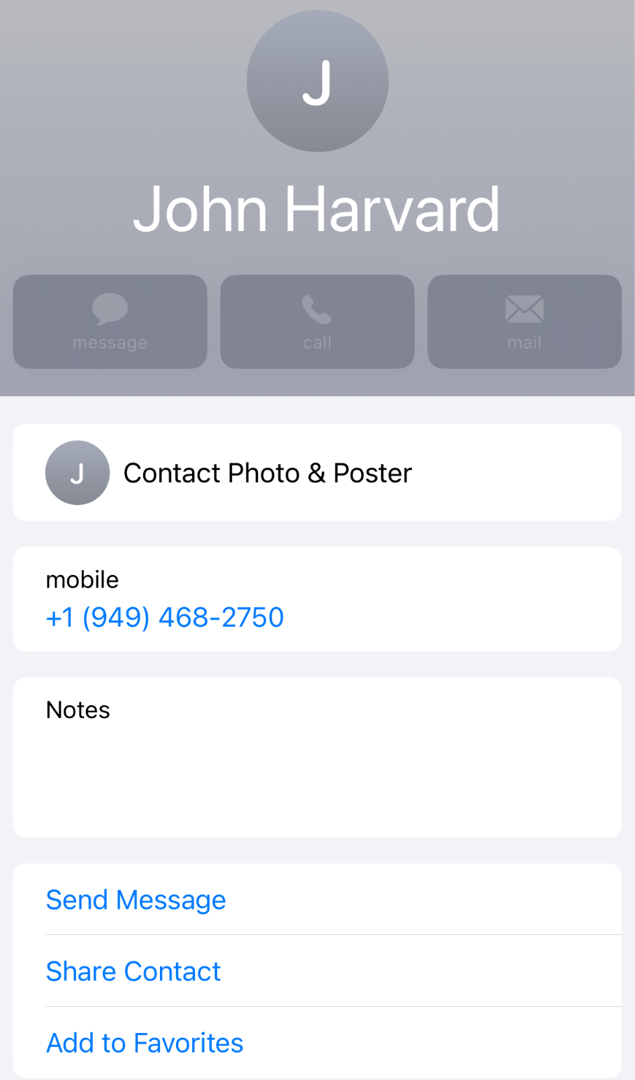

Slide 6
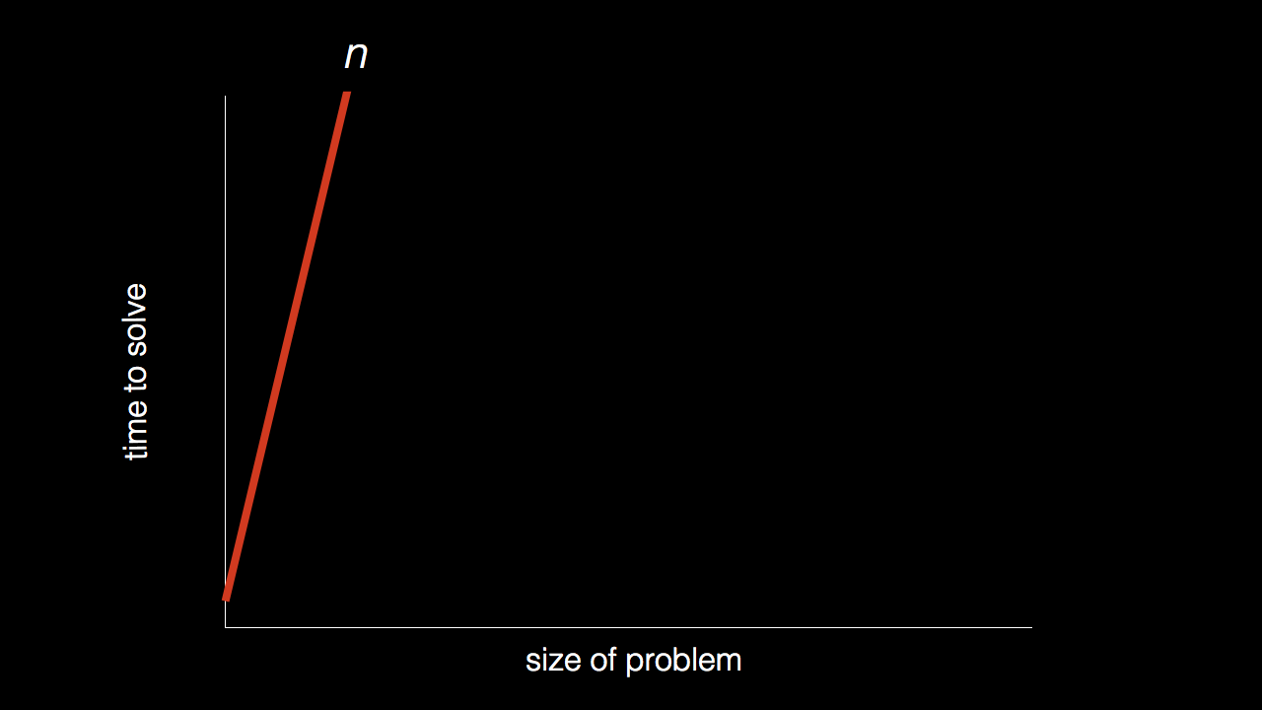
n

Slide 7
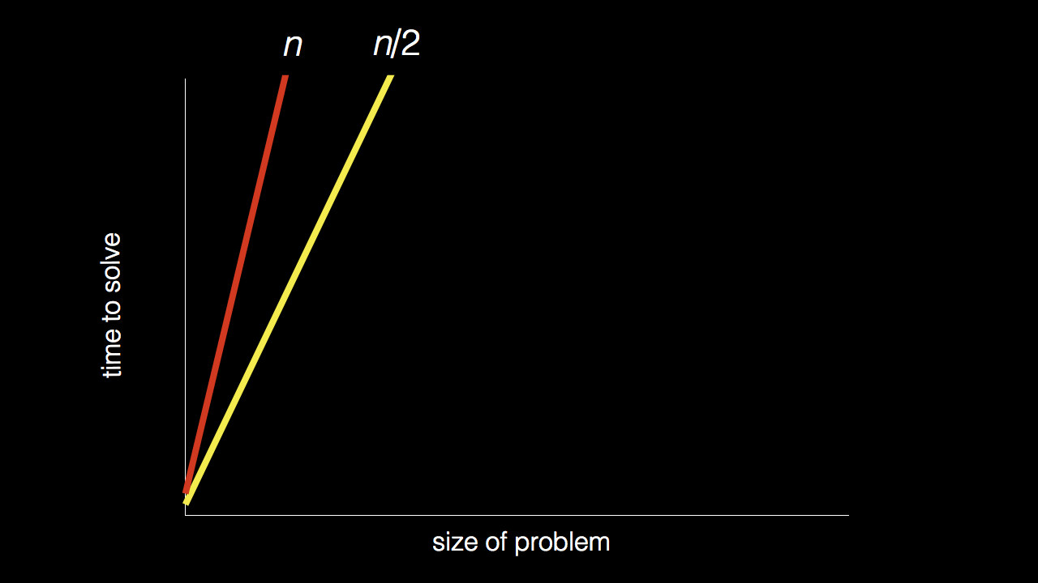
n
n/2

Slide 8
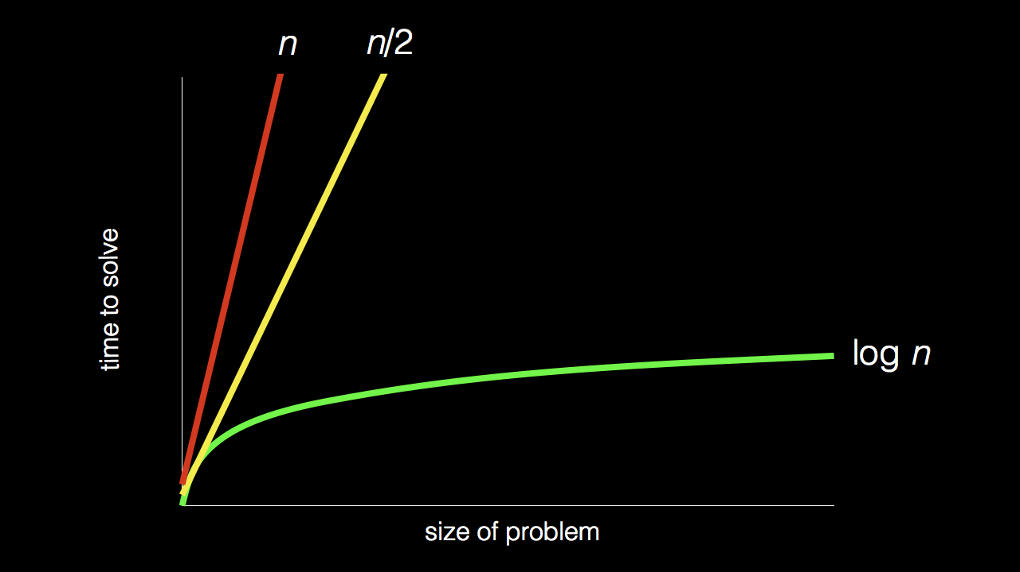
n
n/2
log₂ n

Slide 9
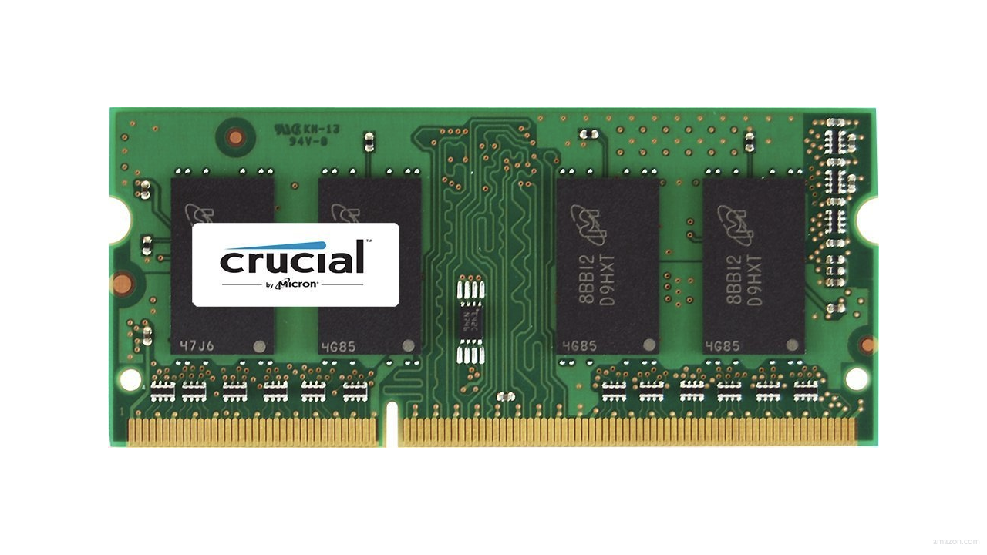
Notes:
Google, when data gets big how do we handle it?

Slide 12
Notes:
Linear layout, contiguous

Slide 13
 | 1 | 5 | 10 | 20 | 50 | 100 | 500
Notes:
Array of numbers – how do computers find a specific number, like “50”?

Slide 14
Notes:
Treat this like little boxes the computer has to “look in”

Slide 15
 | [0] | [1] | [2] | [3] | [4] | [5] | [6]

Slide 16
searching

Slide 17
input →
→ output

Slide 18

→
→ output

Slide 19
→
→ bool

Slide 20
algorithm

Slide 21

Notes:
https://www.etsy.com/listing/926075105/monopoly-money-vintage-fabric-half-yard

Slide 22
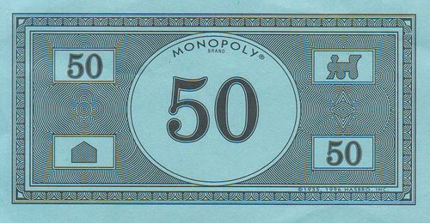
Notes:
https://www.pinterest.com/pin/525443481522247447/

Slide 23
linear search
Notes:
Sear one at a time in order, in a “linear” fashion, simple but inefficient
20 500 10 5 100 1 50

Slide 24
For each door from left to right
If 50 is behind door
Return true
Else
Return false

Slide 25
For each door from left to right
If 50 is behind door
Return true
Return false

Slide 26
For i from 0 to n-1
If 50 is behind doors[i]
Return true
Return false

Slide 27
Notes:
https://www.pinterest.com/pin/525443481522247447/

Slide 28
binary search
Notes:
-numbers sorted
Start in midles, move higher or lower, goto next middle door
MUCH better efficiency
1 5 10 20 50 100 500

Slide 29
If 50 is behind middle door
Return true
Else if 50 < middle door
Search left half
Else if 50 > middle door
Search right half

Slide 30
If no doors left
If 50 is behind middle door
Return true
Else if 50 < middle door
Search left half
Else if 50 > middle door
Search right half

Slide 31
If no doors left
Return false
If 50 is behind middle door
Return true
Else if 50 < middle door
Search left half
Else if 50 > middle door
Search right half

Slide 32
If no doors left
Return false
If 50 is behind doors[middle]
Return true
Else if 50 < doors[middle]
Search doors[0] through doors[middle - 1]
Else if 50 > doors[middle]
Search doors[middle + 1] through doors[n - 1]

Slide 33
running time
Notes:
Measure of algorithm “efficiency”

Slide 34
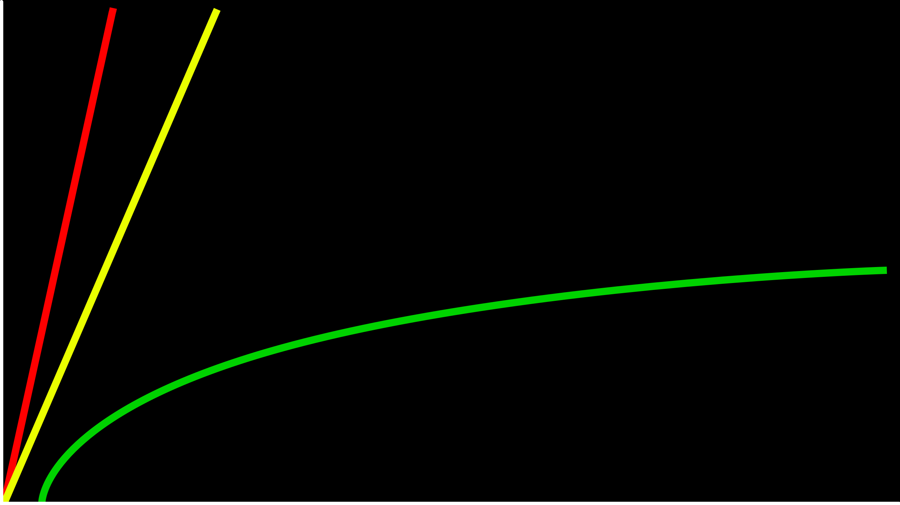
time to solve
size of problem

Slide 35
O(n)
O(n/2)
time to solve
O(log₂n)
size of problem

Slide 36
O(n)
O(n/2)
time to solve
O(log₂n)
size of problem
Notes:
O for on the “order” of this many steps

Slide 37
O(n)
O(n)
time to solve
O(log n)
size of problem
Notes:
Whole constants usually dropped because they are similar in shape and magnitude

Slide 38
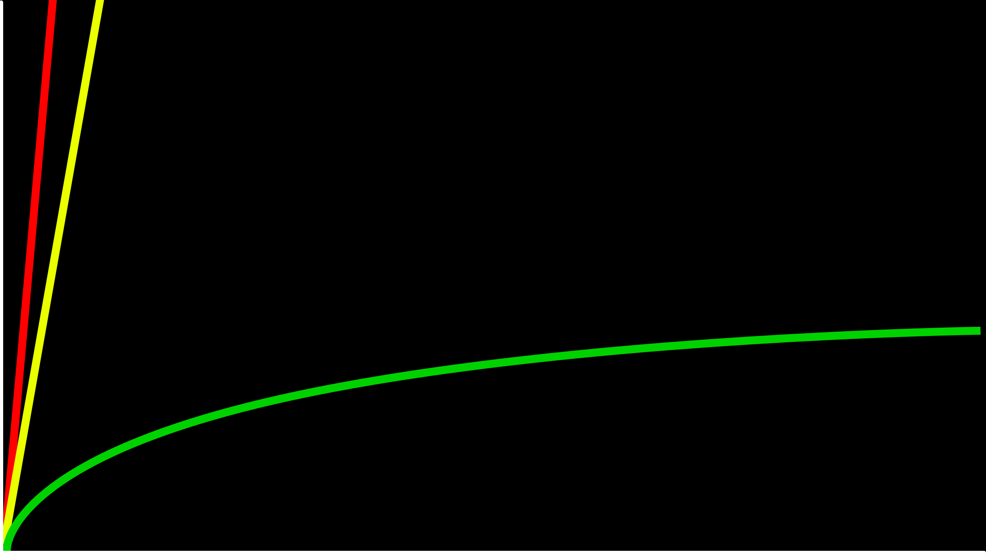
O(n)
time to solve
O(log n)
size of problem
Notes:
Zoomed out you see the pattern

Slide 39
O
Notes:
Refer to this as “big O notation”

Slide 40
O(n²)
O(n log n)
O(n)
O(log n)
O(1)
Notes:
List of possibilities (amongst others)
linear? binary?

Slide 41
O(n²)
O(n log n)
O(n) linear search
O(log n)
O(1)
Notes:
Linear search is worst case scenario

Slide 42
O(n²)
O(n log n)
O(n) linear search
O(log n) binary search
O(1)
Notes:
Binary much faster (by an order of magnitude)

Slide 43
Ω
Notes:
Big Omega is lower bound of algorithm “possible” efficiency

Slide 44
Ω(n²)
Ω(n log n)
Ω(n)
Ω(log n)
Ω(1)
Notes:
linear? binary?

Slide 45
Ω(n²)
Ω(n log n)
Ω(n)
Ω(log n)
Ω(1) linear search

Slide 46
Ω(n²)
Ω(n log n)
Ω(n)
Ω(log n)
Ω(1) linear search, binary search

Slide 47
Θ
Notes:
Big theta when big O and big omega are the same
-are there algorithms where this is true...?

Slide 48
Θ(n²)
Θ(n log n)
Θ(n)
Θ(log n)
Θ(1)
Notes:
There are some situations when this is true, possibly we will eventually encounter some

Slide 49
asymptotic notation
Notes:
search{0,1}.c
Asymptotic notation is a mathematical way to describe the efficiency of algorithms, especially how their running time or space requirements grow as the input size (n) becomes large.
In the context of search algorithms (like linear search, binary search, etc.), asymptotic notation helps us compare how fast or slow algorithms are — not in exact seconds, but in terms of how they scale with data size.

Slide 50
linear search
Notes:
search{0,1}.c

Slide 51
string.h
Notes:
The string.h library in C provides functions for handling and manipulating strings, such as copying, concatenation, comparison, and finding string length.

Slide 52
manual.cs50.io/#string.h

Slide 53
strcmp
Notes:
phonebook0.c
The strcmp() function compares two strings character by character and returns 0 if they are equal, a positive value if the first is greater, or a negative value if the first is smaller.

Slide 54
data structures

Slide 55
person people[]

Slide 56
string name;
string number;

Slide 57
typedef struct
{
string name;
string number;
}
person;

Slide 58
typedef struct
{
string name;
string number;
} person;
Notes:
phonebook1.c
we'll see a way to save phonebook eventually

Slide 59
sorting

Slide 60
input →
→ output

Slide 61
unsorted →
→ output

Slide 62
unsorted →
→ sorted

Slide 63
→
→ sorted
7 2 5 4 1 6 0 3

Slide 64
→
→
7 2 5 4 1 6 0 3
0 1 2 3 4 5 6 7

Slide 65
7 2 5 4 1 6 0 3
Notes:
Bubble sort is a simple sorting algorithm that repeatedly steps through a list, compares adjacent elements, and swaps them if they are in the wrong order, continuing until no more swaps are needed.

Slide 66
selection sort
Notes:
https://www.cs.usfca.edu/~galles/visualization/ComparisonSort.html
Selection sort is a simple sorting algorithm that repeatedly selects the smallest (or largest) element from the unsorted portion of a list and swaps it with the first unsorted element until the entire list is sorted.

Slide 67
 | [0] | [1] | [2] | ... | [n-3] | [n-2] | [n-1]

Slide 68
For i from 0 to n-1
Find smallest number between numbers[i] and numbers[n-1]
Swap smallest number with numbers[i]

Slide 69
7 2 5 4 1 6 0 3

Slide 70
7 2 5 4 1 6 0 3
[i]

Slide 71
7 2 5 4 1 6 0 3
[i]
[i]
[n-1]

Slide 72
7 2 5 4 1 6 0 3
[i]
[i]
[n-1]

Slide 73
7 2 5 4 1 6 0 3
[i]
[i]
[n-1]

Slide 74
7 2 5 4 1 6 0 3
[i]
[i]
[n-1]

Slide 75
7 2 5 4 1 6 0 3
[i]
[i]
[n-1]

Slide 76
7 2 5 4 1 6 0 3
[i]
[i]
[n-1]

Slide 77
0 2 5 4 1 6 7 3
[i]
[i]
[n-1]

Slide 78
0 2 5 4 1 6 7 3
[i]
[i]
[n-1]

Slide 79
0 2 5 4 1 6 7 3
[i]
[i]
[n-1]

Slide 80
0 2 5 4 1 6 7 3
[i]
[n-1]

Slide 81
(n – 1)

Slide 82
(n – 1) + (n – 2)

Slide 83
(n – 1) + (n – 2) + (n – 3)

Slide 84
(n – 1) + (n – 2) + (n – 3) + ... + 1

Slide 85
(n – 1) + (n – 2) + (n – 3) + ... + 1
n(n – 1)/2

Slide 86
(n – 1) + (n – 2) + (n – 3) + ... + 1
n(n – 1)/2
(n² – n)/2

Slide 87
(n – 1) + (n – 2) + (n – 3) + ... + 1
n(n – 1)/2
(n² – n)/2
n²/2 – n/2

Slide 88
(n – 1) + (n – 2) + (n – 3) + ... + 1
n(n – 1)/2
(n² – n)/2
n²/2 – n/2
O(n²)

Slide 89
O(n²)
O(n log n)
O(n)
O(log n)
O(1)

Slide 90
O(n²) selection sort
O(n log n)
O(n)
O(log n)
O(1)

Slide 91
For i from 0 to n-1
Find smallest number between numbers[i] and numbers[n-1]
Swap smallest number with numbers[i]
Notes:
what about lower bound?

Slide 92
 | [0] | [1] | [2] | ... | [n-3] | [n-2] | [n-1]

Slide 93
Ω(n²)
Ω(n log n)
Ω(n)
Ω(log n)
Ω(1)

Slide 94
Ω(n²) selection sort
Ω(n log n)
Ω(n)
Ω(log n)
Ω(1)

Slide 95
Θ(n²)
Θ(n log n)
Θ(n)
Θ(log n)
Θ(1)

Slide 96
Θ(n²) selection sort
Θ(n log n)
Θ(n)
Θ(log n)
Θ(1)

Slide 97
bubble sort
Notes:
https://www.cs.usfca.edu/~galles/visualization/ComparisonSort.html

Slide 98
 | [0] | [1] | [2] | ... | [n-3] | [n-2] | [n-1]

Slide 99
Repeat n times
For i from 0 to n-2
If numbers[i] and numbers[i+1] out of order
Swap them

Slide 100
Repeat n-1 times
For i from 0 to n-2
If numbers[i] and numbers[i+1] out of order
Swap them

Slide 101
7 2 5 4 1 6 0 3

Slide 102
7 2 5 4 1 6 0 3
[i] [i+1]

Slide 103
2 7 5 4 1 6 0 3
[i] [i+1]

Slide 104
2 7 5 4 1 6 0 3
[i] [i+1]

Slide 105
2 5 7 4 1 6 0 3
[i] [i+1]

Slide 106
2 5 7 4 1 6 0 3
[i] [i+1]

Slide 107
2 5 4 7 1 6 0 3
[i] [i+1]

Slide 108
2 5 4 7 1 6 0 3
[i] [i+1]

Slide 109
2 5 4 1 7 6 0 3
[i] [i+1]

Slide 110
2 5 4 1 7 6 0 3
[i] [i+1]

Slide 111
2 5 4 1 6 7 0 3
[i] [i+1]

Slide 112
2 5 4 1 6 7 0 3
[i] [i+1]

Slide 113
2 5 4 1 6 0 7 3
[i] [i+1]

Slide 114
2 5 4 1 6 0 7 3
[i] [i+1]

Slide 115
2 5 4 1 6 0 3 7
[i] [i+1]

Slide 116
2 5 4 1 6 0 3 7
[i] [i+1]

Slide 117
Repeat n-1 times
For i from 0 to n-2
If numbers[i] and numbers[i+1] out of order
Swap them

Slide 118
Repeat n-1 times n-1
For i from 0 to n-2
If numbers[i] and numbers[i+1] out of order
Swap them

Slide 119
Repeat n-1 times n-1
For i from 0 to n-2 n-1
If numbers[i] and numbers[i+1] out of order
Swap them

Slide 120
Repeat n-1 times n-1
For i from 0 to n-2 n-1
If numbers[i] and numbers[i+1] out of order 1
Swap them

Slide 121
Repeat n-1 times n-1
For i from 0 to n-2 n-1
If numbers[i] and numbers[i+1] out of order 4
Swap them

Slide 122
Repeat n-1 times n-1
For i from 0 to n-2 n-1
If numbers[i] and numbers[i+1] out of order
Swap them

Slide 123
(n – 1) × (n – 1)

Slide 124
(n – 1) × (n – 1)
n² – 1n – 1n + 1

Slide 125
(n – 1) × (n – 1)
n² – 1n – 1n + 1
n² – 2n + 1

Slide 126
(n – 1) × (n – 1)
n² – 1n – 1n + 1
n² – 2n + 1
O(n²)

Slide 127
O(n²)
O(n log n)
O(n)
O(log n)
O(1)

Slide 128
O(n²) bubble sort
O(n log n)
O(n)
O(log n)
O(1)

Slide 129
Repeat n-1 times
For i from 0 to n-2
If numbers[i] and numbers[i+1] out of order
Swap them

Slide 130
Repeat n-1 times
For i from 0 to n-2
If numbers[i] and numbers[i+1] out of order
Swap them
If no swaps
Quit
Notes:
Add efficiency – if already sorted, could be omega of n

Slide 131
Ω(n²)
Ω(n log n)
Ω(n)
Ω(log n)
Ω(1)

Slide 132
Ω(n²)
Ω(n log n)
Ω(n) bubble sort
Ω(log n)
Ω(1)

Slide 133
recursion
Notes:
A function is recursive if it “calls” itself

Slide 134
If no doors left
Return false
If number behind middle door
Return true
Else if number < middle door
Search left half
Else if number > middle door
Search right half

Slide 135
If no doors left
Return false
If number behind middle door
Return true
Else if number < middle door
Search left half
Else if number > middle door
Search right half
Notes:
These parts use the same algorithm just on different parts of the array

Slide 136
1 Pick up phone book
2 Open to middle of phone book
3 Look at page
4 If person is on page
5 Call person
6 Else if person is earlier in book
7 Open to middle of left half of book
8 Go back to line 3
9 Else if person is later in book
10 Open to middle of right half of book
11 Go back to line 3
12 Else
13 Quit
Notes:
Pseudocode from first week

Slide 137
1 Pick up phone book
2 Open to middle of phone book
3 Look at page
4 If person is on page
5 Call person
6 Else if person is earlier in book
7 Open to middle of left half of book
8 Go back to line 3
9 Else if person is later in book
10 Open to middle of right half of book
11 Go back to line 3
12 Else
13 Quit

Slide 138
1 Pick up phone book
2 Open to middle of phone book
3 Look at page
4 If person is on page
5 Call person
6 Else if person is earlier in book
7 Open to middle of left half of book
8 Go back to line 3
9 Else if person is later in book
10 Open to middle of right half of book
11 Go back to line 3
12 Else
13 Quit

Slide 139
1 Pick up phone book
2 Open to middle of phone book
3 Look at page
4 If person is on page
5 Call person
6 Else if person is earlier in book
7 Search left half of book
8
9 Else if person is later in book
10 Search right half of book
11
12 Else
13 Quit

Slide 140
1 Pick up phone book
2 Open to middle of phone book
3 Look at page
4 If person is on page
5 Call person
6 Else if person is earlier in book
7 Search left half of book
8 Else if person is later in book
9 Search right half of book
10 Else
11 Quit
Notes:
This is recursive

Slide 141

Notes:
http://ian-albert.com/games/super_mario_bros_maps/
“recursive” structure

Slide 142

Notes:
iteration.c

Slide 143


Slide 144


Slide 145

Notes:
iteration.c

Slide 146

Notes:
recursion.c

Slide 147
google.com/search?q=recursion
Notes:
Google Easter Egg

Slide 148
merge sort

Slide 149
Sort left half of numbers
Sort right half of numbers
Merge sorted halves

Slide 150
If only one number
Quit
Else
Sort left half of numbers
Sort right half of numbers
Merge sorted halves

Slide 151
If only one number
Quit
Else
Sort left half of numbers
Sort right half of numbers
Merge sorted halves

Slide 152
1 3 4 6 0 2 5 7
Notes:
shelves

Slide 153
If only one number
Quit
Else
Sort left half of numbers
Sort right half of numbers
Merge sorted halves
Notes:
https://www.cs.usfca.edu/~galles/visualization/ComparisonSort.html

Slide 154
6 3 4 1 5 2 7 0
Notes:
shelves

Slide 155
6 | 3 | 4 | 1 | 5 | 2 | 7 | 0

Slide 156
6 | 3 | 4 | 1 | 5 | 2 | 7 | 0

Slide 157
 |  |  |  | 5 | 2 | 7 | 0
6 | 3 | 4 | 1

Slide 158
 |  |  |  | 5 | 2 | 7 | 0
 |  | 4 | 1
6 | 3

Slide 159
 |  |  |  | 5 | 2 | 7 | 0
 |  | 4 | 1
 | 3
6

Slide 160
 |  |  |  | 5 | 2 | 7 | 0
 |  | 4 | 1
6
3

Slide 161
 |  |  |  | 5 | 2 | 7 | 0
 |  | 4 | 1
3
6

Slide 162
 |  |  |  | 5 | 2 | 7 | 0
 |  | 4 | 1
3 | 6

Slide 163
 |  |  |  | 5 | 2 | 7 | 0
3 | 6
4 | 1

Slide 164
 |  |  |  | 5 | 2 | 7 | 0
3 | 6
 | 1
4

Slide 165
 |  |  |  | 5 | 2 | 7 | 0
3 | 6
4
1

Slide 166
 |  |  |  | 5 | 2 | 7 | 0
3 | 6
1
4

Slide 167
 |  |  |  | 5 | 2 | 7 | 0
3 | 6
1 | 4

Slide 168
 |  |  |  | 5 | 2 | 7 | 0
1
3 | 6
 | 4

Slide 169
 |  |  |  | 5 | 2 | 7 | 0
1 | 3
 | 6
 | 4

Slide 170
 |  |  |  | 5 | 2 | 7 | 0
1 | 3 | 4
 | 6

Slide 171
 |  |  |  | 5 | 2 | 7 | 0
1 | 3 | 4 | 6

Slide 172
1 | 3 | 4 | 6
5 | 2 | 7 | 0

Slide 173
1 | 3 | 4 | 6
 |  | 7 | 0
5 | 2

Slide 174
1 | 3 | 4 | 6
 |  | 7 | 0
 | 2
5

Slide 175
1 | 3 | 4 | 6
 |  | 7 | 0
5
2

Slide 176
1 | 3 | 4 | 6
 |  | 7 | 0
2
5

Slide 177
1 | 3 | 4 | 6
 |  | 7 | 0
2 | 5

Slide 178
1 | 3 | 4 | 6
2 | 5
7 | 0

Slide 179
1 | 3 | 4 | 6
2 | 5
 | 0
7

Slide 180
1 | 3 | 4 | 6
2 | 5
7
0

Slide 181
1 | 3 | 4 | 6
2 | 5
0
7

Slide 182
1 | 3 | 4 | 6
2 | 5
0 | 7

Slide 183
1 | 3 | 4 | 6
0
2 | 5
 | 7

Slide 184
1 | 3 | 4 | 6
0 | 2
 | 5
 | 7

Slide 185
1 | 3 | 4 | 6
0 | 2 | 5
 | 7

Slide 186
1 | 3 | 4 | 6
0 | 2 | 5 | 7

Slide 187
0
1 | 3 | 4 | 6
 | 2 | 5 | 7

Slide 188
0 | 1
 | 3 | 4 | 6
 | 2 | 5 | 7

Slide 189
0 | 1 | 2
 | 3 | 4 | 6
 |  | 5 | 7

Slide 190
0 | 1 | 2 | 3
 |  | 4 | 6
 |  | 5 | 7

Slide 191
0 | 1 | 2 | 3 | 4
 |  |  | 6
 |  | 5 | 7

Slide 192
0 | 1 | 2 | 3 | 4 | 5
 |  |  | 6
 |  |  | 7

Slide 193
0 | 1 | 2 | 3 | 4 | 5 | 6
 |  |  | 7

Slide 194
0 | 1 | 2 | 3 | 4 | 5 | 6 | 7

Slide 195
0 | 1 | 2 | 3 | 4 | 5 | 6 | 7

Slide 196
O(n²)
O(n log n)
O(n)
O(log n)
O(1)

Slide 197
6 | 3 | 4 | 1 | 5 | 2 | 7 | 0
6 | 3 | 4 | 1
5 | 2 | 7 | 0
6 | 3
4 | 1
5 | 2
7 | 0
6
3
4
1
5
2
7
0

Slide 198
6 | 3 | 4 | 1 | 5 | 2 | 7 | 0
6 | 3 | 4 | 1
5 | 2 | 7 | 0
6 | 3
4 | 1
5 | 2
7 | 0
6
3
4
1
5
2
7
0
Notes:
How efficient is it?

Slide 199
log₂ n
Notes:
Turns out this is how many times we chop up the elements

Slide 200
log₂ 8
Notes:
Log base 2 of 8 is 3 (the number of levels of chopping

Slide 201
log₂ 2³

Slide 202
3

Slide 203
6 | 3 | 4 | 1 | 5 | 2 | 7 | 0
6 | 3 | 4 | 1
5 | 2 | 7 | 0
6 | 3
4 | 1
5 | 2
7 | 0
6
3
4
1
5
2
7
0

Slide 204
n log₂ n

Slide 205
n log n

Slide 206
O(n²)
O(n log n) merge sort
O(n)
O(log n)
O(1)

Slide 207
Ω(n²)
Ω(n log n) merge sort
Ω(n)
Ω(log n)
Ω(1)

Slide 208
Θ(n²)
Θ(n log n) merge sort
Θ(n)
Θ(log n)
Θ(1)

Slide 209
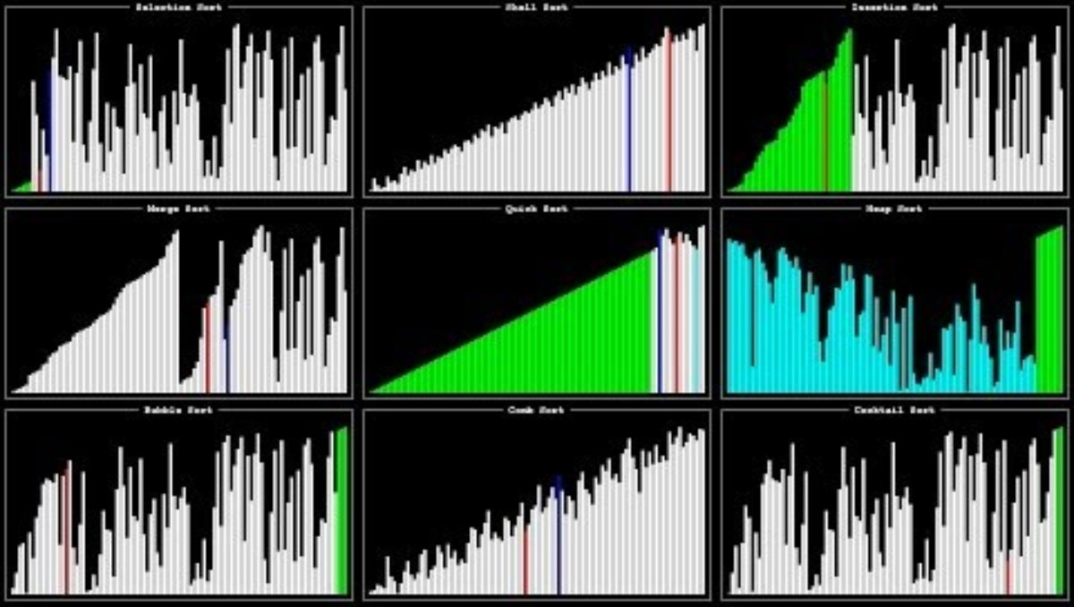
Notes:
Source: https://www.youtube.com/watch?v=ZZuD6iUe3Pc
https://www.youtubeeducation.com/watch?v=3WDWH59k1q4

Slide 210
Computing Technology
Notes:
Reload codespace
Uncheck VS Code tabs

