Slide 1
Computing Technology

Slide 2
souvenir photo

Slide 3
Computing Technology

Slide 4
internet

Slide 5
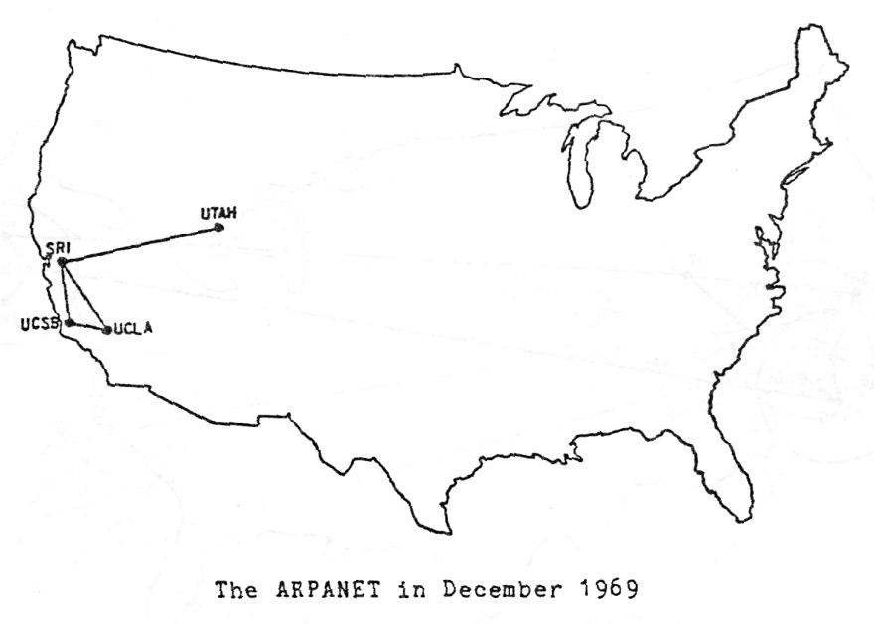
Notes:
http://mercury.lcs.mit.edu/~jnc/tech/arpageo.html

Slide 6
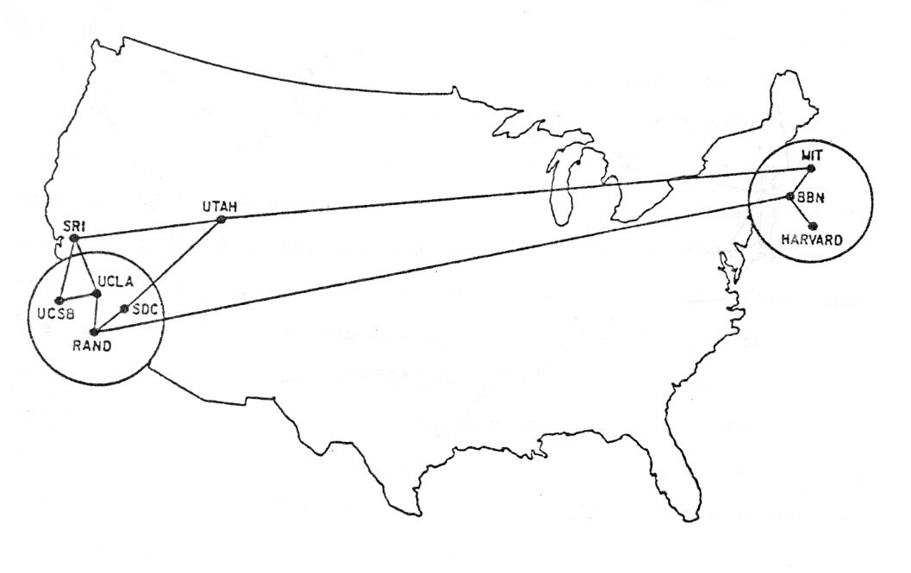
Notes:
http://mercury.lcs.mit.edu/~jnc/tech/arpageo.html

Slide 7
routers

Slide 8
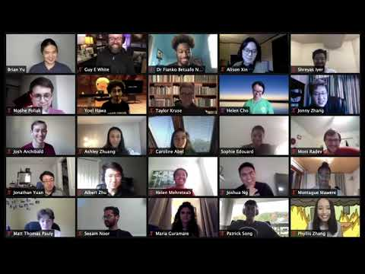
Notes:
https://www.youtube.com/watch?v=cUJlRNRguAM

Slide 9
TCP/IP

Slide 10
IP

Slide 11
#.#.#.#

Slide 12
0 1 2 3
0 1 2 3 4 5 6 7 8 9 0 1 2 3 4 5 6 7 8 9 0 1 2 3 4 5 6 7 8 9 0 1
+-+-+-+-+-+-+-+-+-+-+-+-+-+-+-+-+-+-+-+-+-+-+-+-+-+-+-+-+-+-+-+-+
|Version| IHL |Type of Service| Total Length |
+-+-+-+-+-+-+-+-+-+-+-+-+-+-+-+-+-+-+-+-+-+-+-+-+-+-+-+-+-+-+-+-+
| Identification |Flags| Fragment Offset |
+-+-+-+-+-+-+-+-+-+-+-+-+-+-+-+-+-+-+-+-+-+-+-+-+-+-+-+-+-+-+-+-+
| Time to Live | Protocol | Header Checksum |
+-+-+-+-+-+-+-+-+-+-+-+-+-+-+-+-+-+-+-+-+-+-+-+-+-+-+-+-+-+-+-+-+
| Source Address |
+-+-+-+-+-+-+-+-+-+-+-+-+-+-+-+-+-+-+-+-+-+-+-+-+-+-+-+-+-+-+-+-+
| Destination Address |
+-+-+-+-+-+-+-+-+-+-+-+-+-+-+-+-+-+-+-+-+-+-+-+-+-+-+-+-+-+-+-+-+
| Options | Padding |
+-+-+-+-+-+-+-+-+-+-+-+-+-+-+-+-+-+-+-+-+-+-+-+-+-+-+-+-+-+-+-+-+
Example Internet Datagram Header
Notes:
https://datatracker.ietf.org/doc/html/rfc791

Slide 13
TCP

Slide 14
ports

Slide 15
80 HTTP
443 HTTPS
...

Slide 16
0 1 2 3
0 1 2 3 4 5 6 7 8 9 0 1 2 3 4 5 6 7 8 9 0 1 2 3 4 5 6 7 8 9 0 1
+-+-+-+-+-+-+-+-+-+-+-+-+-+-+-+-+-+-+-+-+-+-+-+-+-+-+-+-+-+-+-+-+
| Source Port | Destination Port |
+-+-+-+-+-+-+-+-+-+-+-+-+-+-+-+-+-+-+-+-+-+-+-+-+-+-+-+-+-+-+-+-+
| Sequence Number |
+-+-+-+-+-+-+-+-+-+-+-+-+-+-+-+-+-+-+-+-+-+-+-+-+-+-+-+-+-+-+-+-+
| Acknowledgment Number |
+-+-+-+-+-+-+-+-+-+-+-+-+-+-+-+-+-+-+-+-+-+-+-+-+-+-+-+-+-+-+-+-+
| Data | |U|A|P|R|S|F| |
| Offset| Reserved |R|C|S|S|Y|I| Window |
| | |G|K|H|T|N|N| |
+-+-+-+-+-+-+-+-+-+-+-+-+-+-+-+-+-+-+-+-+-+-+-+-+-+-+-+-+-+-+-+-+
| Checksum | Urgent Pointer |
+-+-+-+-+-+-+-+-+-+-+-+-+-+-+-+-+-+-+-+-+-+-+-+-+-+-+-+-+-+-+-+-+
| Options | Padding |
+-+-+-+-+-+-+-+-+-+-+-+-+-+-+-+-+-+-+-+-+-+-+-+-+-+-+-+-+-+-+-+-+
| data |
+-+-+-+-+-+-+-+-+-+-+-+-+-+-+-+-+-+-+-+-+-+-+-+-+-+-+-+-+-+-+-+-+
TCP Header Format
Notes:
https://www.ietf.org/rfc/rfc793.txt

Slide 17
DNS

Slide 18
Fully Qualified Domain Name | IP Address

Slide 19
Fully Qualified Domain Name | IP Address

Slide 20
DHCP

Slide 21
HTTP

Slide 22
HTTPS

Slide 23
https://www.example.com

Slide 24
https://www.example.com/

Slide 25
https://www.example.com/path

Slide 26
https://www.example.com/file.html

Slide 27
https://www.example.com/folder/

Slide 28
https://www.example.com/folder/file.html

Slide 29
https://www.example.com/folder/file.html

Slide 30
https://www.example.com/folder/file.html

Slide 31
https://www.example.com/folder/file.html

Slide 32
https://www.example.com/folder/file.html

Slide 33
https://www.example.com/folder/file.html

Slide 34
GET
POST
...

Slide 35
GET / HTTP/2
Host: www.harvard.edu
...
Notes:
curl -I https://www.harvard.edu/

Slide 36
HTTP/2 200
Content-Type: text/html
...

Slide 37
developer tools

Slide 38
HTTP/2 301
Location: https://www.harvard.edu/
…

Slide 39
GET / HTTP/2
Host: harvard.edu
...
Notes:
curl -I https://harvard.edu/

Slide 40
HTTP/2 404
Content-Type: text/html
...

Slide 41
200 OK 301 Moved Permanently 302 Found 304 Not Modified 307 Temporary Redirect 401 Unauthorized 403 Forbidden 404 Not Found 418 I'm a Teapot 500 Internal Server Error 503 Service Unavailable ...

Slide 42
GET / HTTP/1.1
Host: safetyschool.org
...
Notes:
curl -I http://safetyschool.org/

Slide 43
HTML

Slide 44
tags
attributes

Slide 45
<!DOCTYPE html>
<html lang="en">
<head>
<title>
hello, title
</title>
</head>
<body>
hello, body
</body>
</html>
Notes:
hello0.html

Slide 46
http-server

Slide 47
<!DOCTYPE html>
<html lang="en">
<head>
<title>
hello, title
</title>
</head>
<body>
hello, body
</body>
</html>

Slide 48
<!DOCTYPE html>
<html lang="en">
<head>
<title>
hello, title
</title>
</head>
<body>
hello, body
</body>
</html>

Slide 49
<!DOCTYPE html>
<html lang="en">
<head>
<title>
hello, title
</title>
</head>
<body>
hello, body
</body>
</html>

Slide 50
<!DOCTYPE html>
<html lang="en">
<head>
<title>
hello, title
</title>
</head>
<body>
hello, body
</body>
</html>

Slide 51
<!DOCTYPE html>
<html lang="en">
<head>
<title>
hello, title
</title>
</head>
<body>
hello, body
</body>
</html>

Slide 52
<!DOCTYPE html>
<html lang="en">
<head>
<title>
hello, title
</title>
</head>
<body>
hello, body
</body>
</html>

Slide 53
<!DOCTYPE html>
<html lang="en">
<head>
<title>
hello, title
</title>
</head>
<body>
hello, body
</body>
</html>

Slide 54
<!DOCTYPE html>
<html lang="en">
<head>
<title>
hello, title
</title>
</head>
<body>
hello, body
</body>
</html>

Slide 55
<!DOCTYPE html>
<html lang="en">
<head>
<title>
hello, title
</title>
</head>
<body>
hello, body
</body>
</html>

Slide 56
<!DOCTYPE html>
<html lang="en">
<head>
<title>
hello, title
</title>
</head>
<body>
hello, body
</body>
</html>

Slide 57
<!DOCTYPE html>
<html lang="en">
<head>
<title>
hello, title
</title>
</head>
<body>
hello, body
</body>
</html>

Slide 58
<!DOCTYPE html>
<html lang="en">
<head>
<title>
hello, title
</title>
</head>
<body>
hello, body
</body>
</html>

Slide 59
<!DOCTYPE html>
<html lang="en">
<head>
<title>
hello, title
</title>
</head>
<body>
hello, body
</body>
</html>

Slide 60
<!DOCTYPE html>
<html lang="en">
<head>
<title>
hello, title
</title>
</head>
<body>
hello, body
</body>
</html>

Slide 61
<!DOCTYPE html>
<html lang="en">
<head>
<title>
hello, title
</title>
</head>
<body>
hello, body
</body>
</html>

Slide 62
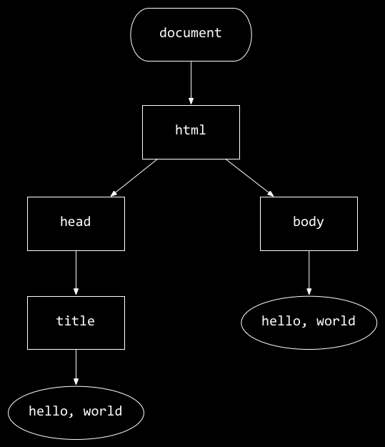
<!DOCTYPE html>
<html lang="en">
<head>
<title>
hello, title
</title>
</head>
<body>
hello, body
</body>
</html>
hello, body
hello, title
Notes:
hello0.html
paragraphs.html
headings.html
list{0,1}.html
table.html
image.html
video.html
link0.html
meta{0,1}.html

Slide 63
https://www.example.com

Slide 64
https://www.example.com/path?key=value

Slide 65
https://www.example.com/path?key=value&key=value
Notes:
https://www.google.com/search?q=cats
search{0,1}.html
register0.html

Slide 66
regular expressions

Slide 67
regexes

Slide 68
developer.mozilla.org/en-US/docs/Web/JavaScript/Guide/Regular_expressions

Slide 69
. any single character (except line terminators)
* zero or more times
+ one or more times
? 0 or 1 time
{n} n occurrences
{n,m} at least n occurrences, at most m occurrences
…
Notes:
https://developer.mozilla.org/en-US/docs/Web/JavaScript/Guide/Regular_expressions

Slide 70
[0123456789] any one of the enclosed characters
[0-9] any one of the range of characters
\d any digit
\D any character that is not a digit
…
Notes:
https://developer.mozilla.org/en-US/docs/Web/JavaScript/Guide/Regular_expressions
register1.html

Slide 71
^[a-zA-Z0-9.!#$%&'*+\/=?^_`{|}~-]+@[a-zA-Z0-9](?:[a-zA-Z0-9-]{0,61}[a-zA-Z0-9])?(?:\.[a-zA-Z0-9](?:[a-zA-Z0-9-]{0,61}[a-zA-Z0-9])?)*$
Notes:
https://html.spec.whatwg.org/multipage/input.html#valid-e-mail-address
register2.html

Slide 72
developer tools

Slide 73
validator.w3.org

Slide 74
CSS

Slide 75
properties

Slide 76
type selector
class selector
ID selector
attribute selector
...
Notes:
https://developer.mozilla.org/en-US/docs/Web/CSS/CSS_Selectors

Slide 77
<!DOCTYPE html>
<html lang="en">
<head>
<title>
hello, title
</title>
</head>
<body>
hello, body
</body>
</html>

Slide 78
<!DOCTYPE html>
<html lang="en">
<head>
<title>
hello, title
</title>
</head>
<body>
hello, body
</body>
</html>

Slide 79
<!DOCTYPE html>
<html lang="en">
<head>
<style>
</style>
<title>
hello, title
</title>
</head>
<body>
hello, body
</body>
</html>

Slide 80
<!DOCTYPE html>
<html lang="en">
<head>
<style>
</style>
<title>
hello, title
</title>
</head>
<body>
hello, body
</body>
</html>

Slide 81
<!DOCTYPE html>
<html lang="en">
<head>
<title>
hello, title
</title>
</head>
<body>
hello, body
</body>
</html>

Slide 82
<!DOCTYPE html>
<html lang="en">
<head>
<link href="styles.css" rel="stylesheet">
<title>
hello, title
</title>
</head>
<body>
hello, body
</body>
</html>
Notes:
home{0,1,2,3,4,5,6}.html
home7.{html,css}
link{2,3,4}.html
phonebook{0,1}.html
search2.html

Slide 83
frameworks
Notes:
https://getbootstrap.com/

Slide 84
Bootstrap

Slide 85
getbootstrap.com

Slide 86
developer tools

Slide 87
JavaScript

Slide 88
<!DOCTYPE html>
<html lang="en">
<head>
<title>
hello, title
</title>
</head>
<body>
hello, body
</body>
</html>
hello, body
hello, title

Slide 89
conditionals

Slide 90
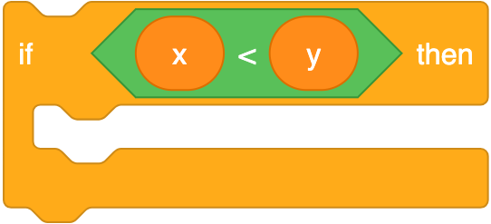
if (x < y) {
}
Notes:
https://scratchblocks.github.io/#?style=scratch3&script=if%20%3C(x)%20%3C%20(y)%3E%20then

Slide 91
if (x < y) {
}

Slide 92
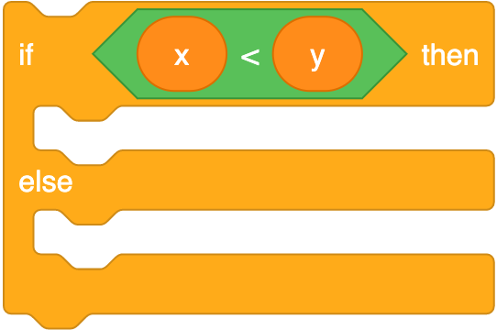
if (x < y) {
}
else
{
}
Notes:
https://scratchblocks.github.io/#?style=scratch3&script=if%20%3C(x)%20%3C%20(y)%3E%20then%0A%0Aelse

Slide 93
if (x < y) {
}
else
{
}

Slide 94
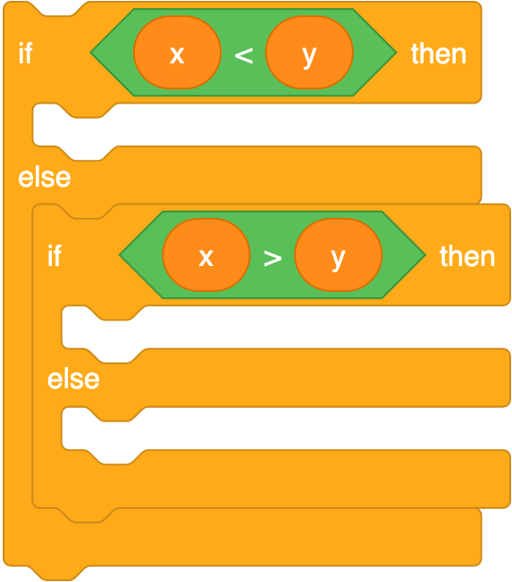
if (x < y) {
}
else if (x > y)
{
}
else
{
}
Notes:
https://scratchblocks.github.io/#?style=scratch3&script=if%20%3C(x)%20%3C%20(y)%3E%20then%0A%0Aelse%0A%0Aif%20%3C(x)%20%3E%20(y)%3E%20then%0A%0Aelse

Slide 95
if (x < y) {
}
else if (x > y)
{
}
else
{
}

Slide 96
variables

Slide 97
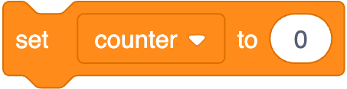
let counter = 0;
Notes:
https://scratchblocks.github.io/#?style=scratch3&script=set%20%5Bcounter%20v%5D%20to%20%5B0%5D

Slide 98
let counter = 0;

Slide 99

counter = counter + 1;
Notes:
https://scratchblocks.github.io/#?style=scratch3&script=change%20%5Bcounter%20v%5D%20by%20%5B1%5D

Slide 100
counter = counter + 1;

Slide 101
counter += 1;

Slide 102
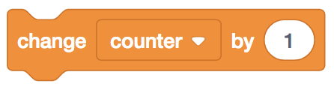
counter++;

Slide 103
loops

Slide 104
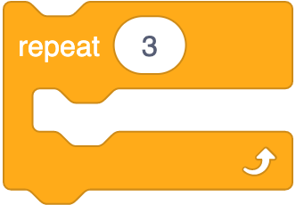
for (let i = 0; i < 3; i++)
{
}
Notes:
https://scratchblocks.github.io/#?style=scratch3&script=repeat%20%5B3%5D

Slide 105
for (let i = 0; i < 3; i++)
{
}

Slide 106

while (true)
{
}
Notes:
https://scratchblocks.github.io/#?style=scratch3&script=forever

Slide 107
while (true)
{
}

Slide 108
<!DOCTYPE html>
<html lang="en">
<head>
<title>
hello, title
</title>
</head>
<body>
hello, body
</body>
</html>

Slide 109
<!DOCTYPE html>
<html lang="en">
<head>
<script>
</script>
<title>
hello, title
</title>
</head>
<body>
hello, body
</body>
</html>

Slide 110
<!DOCTYPE html>
<html lang="en">
<head>
<script src="scripts.js"></script>
<title>
hello, title
</title>
</head>
<body>
hello, body
</body>
</html>

Slide 111
<!DOCTYPE html>
<html lang="en">
<head>
<title>
hello, title
</title>
</head>
<body>
hello, body
<script>
</script>
</body>
</html>

Slide 112
<!DOCTYPE html>
<html lang="en">
<head>
<title>
hello, title
</title>
</head>
<body>
hello, body
<script src="scripts.js"></script>
</body>
</html>

Slide 113
blur change click drag focus keyup load mousedown mouseover mouseup submit touchmove unload ...
Notes:
hello{1,2,3}.html
hello4.{html,js}
hello{5,6}.html
favorites{0,1,2}.html
background.html
blink.html
autocomplete.html

Slide 114
Bootstrap Table

Slide 115
bootstrap-table.com

Slide 116


Slide 117
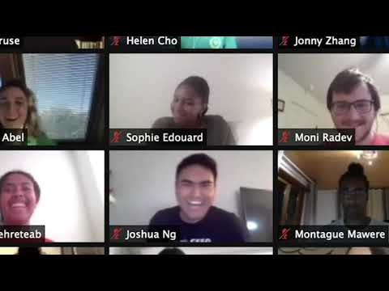
Notes:
https://www.youtube.com/watch?v=mofAEZ6fWLc

