Slide 1
Computing Technology

Slide 2
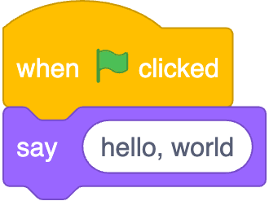
Notes:
https://scratchblocks.github.io/#?style=scratch3&script=when%20green%20flag%20clicked%0Asay%20%5Bhello%2C%20world%5D

Slide 3
#include <stdio.h>
int main(void) {
printf("hello, world\n");
}

Slide 4
#include <stdio.h>
int main(void) {
printf("hello, world\n");
}

Slide 5
source code

Slide 6
01111111 01000101 01001100 01000110 00000010 00000001 00000001 00000000 00000000 00000000 00000000 00000000 00000000 00000000 00000000 00000000 00000010 00000000 00111110 00000000 00000001 00000000 00000000 00000000 10110000 00000101 01000000 00000000 00000000 00000000 00000000 00000000 01000000 00000000 00000000 00000000 00000000 00000000 00000000 00000000 11010000 00010011 00000000 00000000 00000000 00000000 00000000 00000000 00000000 00000000 00000000 00000000 01000000 00000000 00111000 00000000 00001001 00000000 01000000 00000000 00100100 00000000 00100001 00000000 00000110 00000000 00000000 00000000 00000101 00000000 00000000 00000000 01000000 00000000 00000000 00000000 00000000 00000000 00000000 00000000 01000000 00000000 01000000 00000000 00000000 00000000 00000000 00000000 01000000 00000000 01000000 00000000 00000000 00000000 00000000 00000000 11111000 00000001 00000000 00000000 00000000 00000000 00000000 00000000 11111000 00000001 00000000 00000000 00000000 00000000 00000000 00000000 00001000 00000000 00000000 00000000 00000000 00000000 00000000 00000000 00000011 00000000 00000000 00000000 00000100 00000000 00000000 00000000 00111000 00000010 00000000 00000000 00000000 00000000 00000000 00000000 ...

Slide 7
machine code

Slide 8
input →
→ output
Notes:
starting today, no green flag

Slide 10
source code →

Slide 11
source code →
→ machine code

Slide 12
compiler
source code →
→ machine code

Slide 13
Visual Studio Code
The Sandbox
Notes:
where to write, compile code

Slide 14
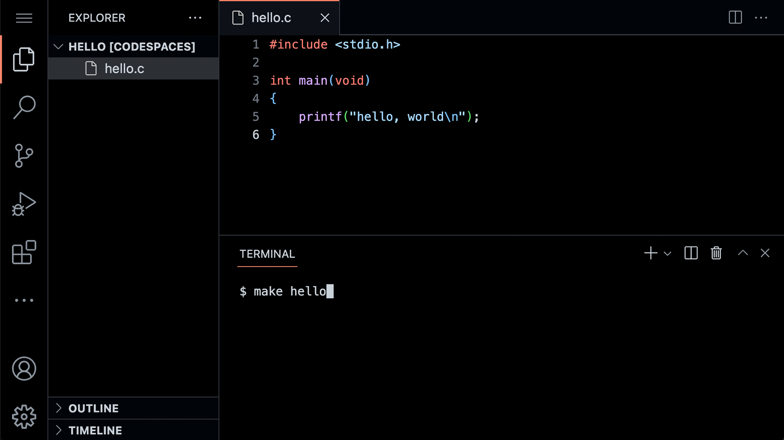

Slide 20
graphical user interface

Slide 21
GUI

Slide 23
command-line interface

Slide 24
CLI

Slide 26
#include <stdio.h>
int main(void) {
printf("hello, world\n");
}
Notes:
hello0.c

Slide 27
code hello.c
make hello
./hello

Slide 28
Notes:
https://scratchblocks.github.io/#?style=scratch3&script=when%20green%20flag%20clicked%0Asay%20%5Bhello%2C%20world%5D

Slide 29
#include <stdio.h>
int main(void) {
printf("hello, world\n");
}

Slide 30
#include <stdio.h>
int main(void) {
printf("hello, world\n");
}

Slide 31

printf("hello, world\n");

Slide 32
printf("hello, world\n");

Slide 33
printf("hello, world\n");

Slide 34
printf("hello, world\n");

Slide 35
printf("hello, world\n");

Slide 36
printf("hello, world\n");

Slide 37
printf("hello, world\n");
Notes:
lot of ways to make mistakes; try omitting semicolon

Slide 38

Notes:
https://editor.codecogs.com/

Slide 39
input →
→ output

Slide 40
function
arguments →
→ side effects

Slide 41
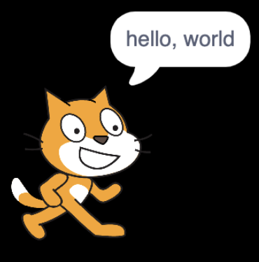


→
→
Notes:
https://scratchblocks.github.io/#?style=scratch3&script=say%20%5B%5D
https://scratchblocks.github.io/#?style=scratch3&script=say%20%5Bhello%2C%20world%5D

Slide 42
escape sequences
Notes:
try omitting \n

Slide 43
\n
\r
\"
\'
\\
…

Slide 44
header files
Notes:
try removing stdio.h

Slide 45
libraries

Slide 46
stdio.h

Slide 47
Manual Pages
manual.cs50.io

Slide 48
manual.cs50.io/#stdio.h

Slide 49
manual.cs50.io/3/printf

Slide 50
cs50.h

Slide 51
manual.cs50.io/#cs50.h

Slide 52
get_char
get_double
get_float
get_int
get_long
get_string
...

Slide 53
get_char
get_double
get_float
get_int
get_long
get_string
...

Slide 54
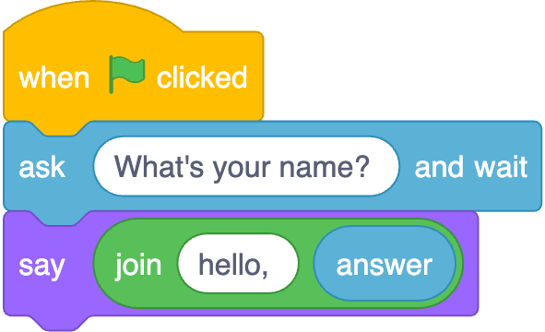
Notes:
https://scratchblocks.github.io/#?style=scratch3&script=when%20green%20flag%20clicked%0Aask%20%5BWhat's%20your%20name%3F%20%5D%20and%20wait%0Asay(join%20%5Bhello%2C%20%5D%20(answer))

Slide 55
input →
→ output
Notes:
starting today, no green flag

Slide 56
function
arguments →
→ return value

Slide 57
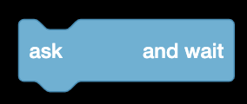


→
→
Notes:
https://scratchblocks.github.io/#?style=scratch3&script=ask%20%5B%5D%20and%20wait
https://scratchblocks.github.io/#?style=scratch3&script=ask%20%5BWhat's%20your%20name%3F%5D%20and%20wait
https://scratchblocks.github.io/#?style=scratch3&script=(answer)

Slide 58
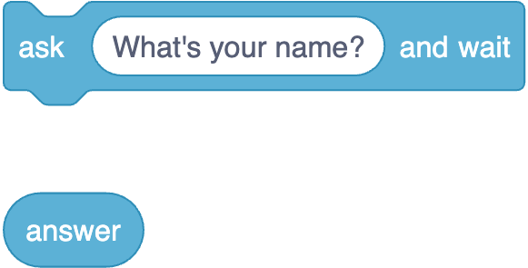
Notes:
https://scratchblocks.github.io/#?style=scratch3&script=ask%20%5BWhat's%20your%20name%3F%5D%20and%20wait%0A(answer)

Slide 59
string answer = get_string( );
printf("hello, %s", answer);

Slide 60
string answer = get_string("What's your name? ");
printf("hello, %s", answer);

Slide 61
string answer = get_string("What's your name? ");
printf("hello, %s", answer);

Slide 62
string answer = get_string("What's your name? ");
printf("hello, %s", answer);

Slide 63
string answer = get_string("What's your name? ");
printf("hello, %s", answer);

Slide 64
string answer = get_string("What's your name? ");
printf("hello, %s", answer);
Notes:
hello1.c

Slide 65
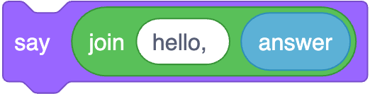
printf("hello, %s", answer);
Notes:
https://scratchblocks.github.io/#?style=scratch3&script=say%20(join%5Bhello%2C%20%5D%20(answer)%0A

Slide 66
printf("hello, %s\n", answer);

Slide 67
printf("hello, %s\n", answer);

Slide 68
printf("hello, %s\n", answer);

Slide 69
printf("hello, %s\n", answer);

Slide 70
printf("hello, %s\n", answer);
Notes:
hello2.c

Slide 71
cd
cp
ls
mkdir
mv
rm
rmdir
...

Slide 72
cd
cp
ls
mkdir
mv
rm
rmdir
...
Notes:
rm hello
mkdir hello/
mv hello.c hello
cd hello
mv hello.c old.c
mv old.c hello.c
cp hello.c backup.c
rm backup.c
mv hello.c ..
cd
rmdir hello

Slide 73
types

Slide 74
bool
char
double
float
int
long
string
...

Slide 75
bool
char
double
float
int
long
string
...

Slide 76
bool
char
double
float
int
long
string
...

Slide 77
get_char
get_double
get_float
get_int
get_long
get_string
...

Slide 78
get_char
get_double
get_float
get_int
get_long
get_string
...

Slide 79
format codes

Slide 80
%c
%f
%i
%li
%s

Slide 81
%c
%f
%i
%li
%s

Slide 82
%c
%f
%i
%li
%s

Slide 83
conditionals

Slide 84
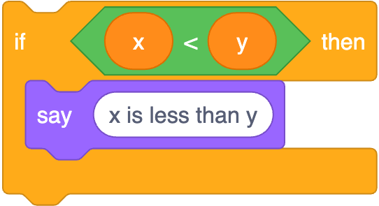
if (x < y) {
printf("x is less than y\n");
}
Notes:
https://scratchblocks.github.io/#?style=scratch3&script=if%20%3C(x)%20%3C%20(y)%3E%20then%0Asay%20%5Bx%20is%20less%20than%20y%5D

Slide 85
if (x < y) {
printf("x is less than y\n");
}

Slide 86
if (x < y) {
printf("x is less than y\n");
}

Slide 87
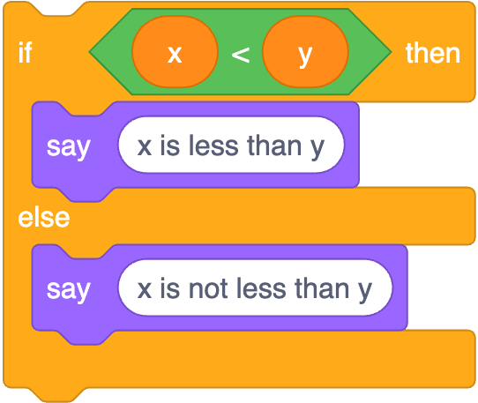
if (x < y) {
printf("x is less than y\n");
}
else
{ printf("x is not less than y\n");
}
Notes:
https://scratchblocks.github.io/#?style=scratch3&script=if%20%3C(x)%20%3C%20(y)%3E%20then%0Asay%20%5Bx%20is%20less%20than%20y%5D%0Aelse%0Asay%20%5Bx%20is%20not%20less%20than%20y%5D

Slide 88
if (x < y) {
printf("x is less than y\n");
}
else
{ printf("x is not less than y\n");
}

Slide 89
if (x < y) {
printf("x is less than y\n");
}
else
{ printf("x is not less than y\n");
}

Slide 90
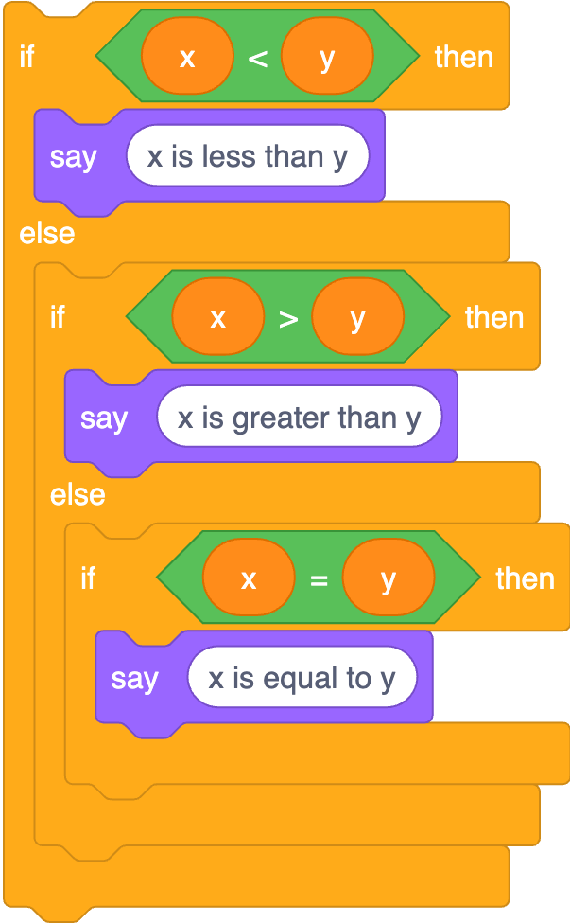
if (x < y) {
printf("x is less than y\n");
}
else if (x > y)
{ printf("x is greater than y\n");
}
else if (x == y)
{ printf("x is equal to y\n");
}
Notes:
https://scratchblocks.github.io/#?style=scratch3&script=if%20%3C(x)%20%3C%20(y)%3E%20then%0Asay%20%5Bx%20is%20less%20than%20y%5D%0Aelse%0Aif%20%3C(x)%20%3E%20(y)%3E%20then%0Asay%20%5Bx%20is%20greater%20than%20y%5D%0Aelse%0Aif%20%3C(x)%20%3D%20(y)%3E%20then%0Asay%20%5Bx%20is%20equal%20to%20y%5D

Slide 91
if (x < y) {
printf("x is less than y\n");
}
else if (x > y)
{ printf("x is greater than y\n");
}
else if (x == y)
{ printf("x is equal to y\n");
}

Slide 92
if (x < y) {
printf("x is less than y\n");
}
else if (x > y)
{ printf("x is greater than y\n");
}
else if (x == y)
{ printf("x is equal to y\n");
}

Slide 93
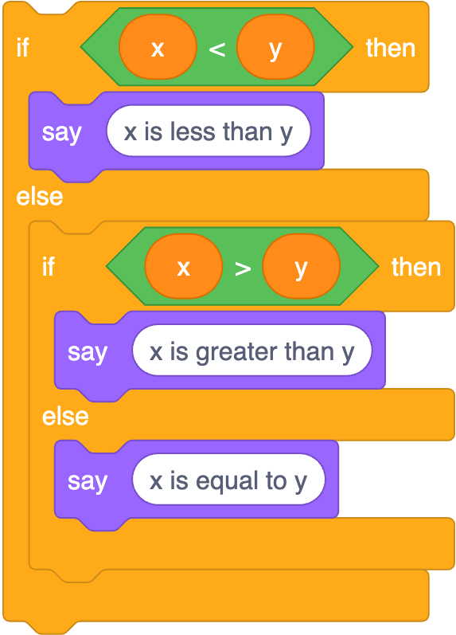
if (x < y) {
printf("x is less than y\n");
}
else if (x > y)
{ printf("x is greater than y\n");
}
else
{ printf("x is equal to y\n");
}
Notes:
https://scratchblocks.github.io/#?style=scratch3&script=if%20%3C(x)%20%3C%20(y)%3E%20then%0Asay%20%5Bx%20is%20less%20than%20y%5D%0Aelse%0Aif%20%3C(x)%20%3E%20(y)%3E%20then%0Asay%20%5Bx%20is%20greater%20than%20y%5D%0Aelse%0Asay%20%5Bx%20is%20equal%20to%20y%5D

Slide 94
operators

Slide 95
=
<
<=
>
>=
==
!=
…

Slide 96
variables

Slide 97
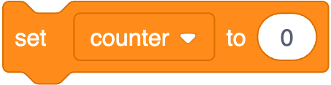
int counter = 0;
Notes:
https://scratchblocks.github.io/#?style=scratch3&script=set%20%5Bcounter%20v%5D%20to%20%5B0%5D

Slide 98
int counter = 0;

Slide 99
int counter = 0;

Slide 100
int counter = 0;

Slide 101

counter = counter + 1;
Notes:
https://scratchblocks.github.io/#?style=scratch3&script=change%20%5Bcounter%20v%5D%20by%20%5B1%5D

Slide 102
counter = counter + 1;;

Slide 103
counter += 1;

Slide 104
counter++;

Slide 105

counter--;
Notes:
https://scratchblocks.github.io/#?style=scratch3&script=change%20%5Bcounter%20v%5D%20by%20%5B-1%5D

Slide 106
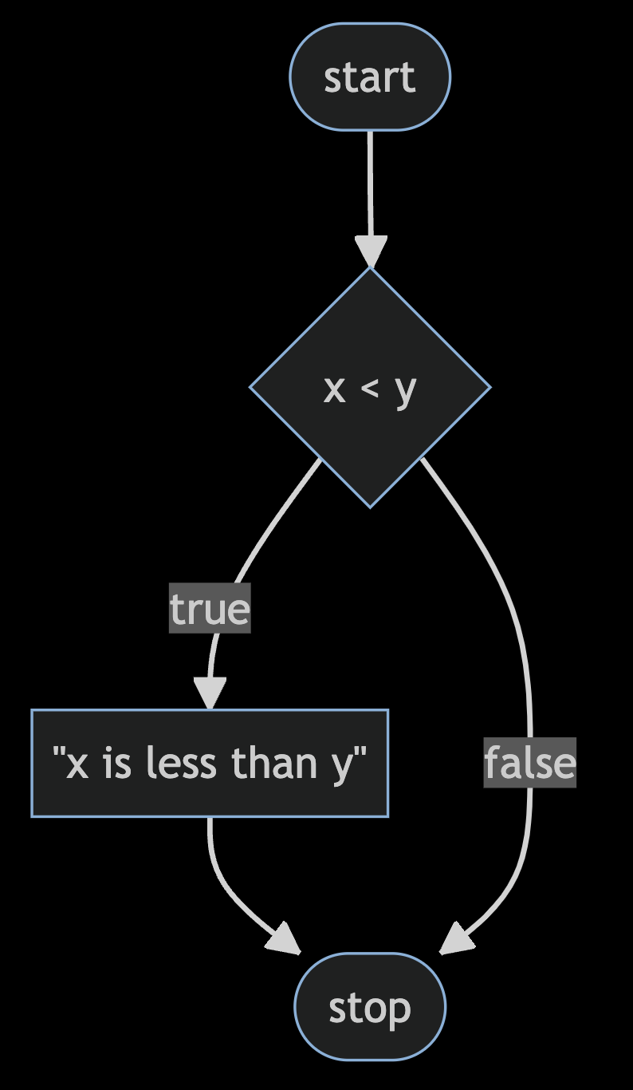
Notes:
compare0.c
https://mermaid.live/edit#pako:eNpNkMFugzAMhl_F8i5Dgheg06QBO-7UntZwsEg6UCGhidFAiHdfSMY0n-zvt39bXrExUmGOt958Ny1ZhkslNPh4e7469qBOIMteoVhneIFli2LhGbCdVNDKq8Cnx2T4NEPnoFfOAbekYYlUYB3HytBe7c5mrJN_XjfqXTT7XY8pDsoO1El_3bozgdyqQQnMfSrJ3gUKvfk-mticF91gvl-U4jRKYlV19GVpwDxYH_RddmzsH1Sh_Ig_CK9IcST9acwxuP0A4V5a9A

Slide 107
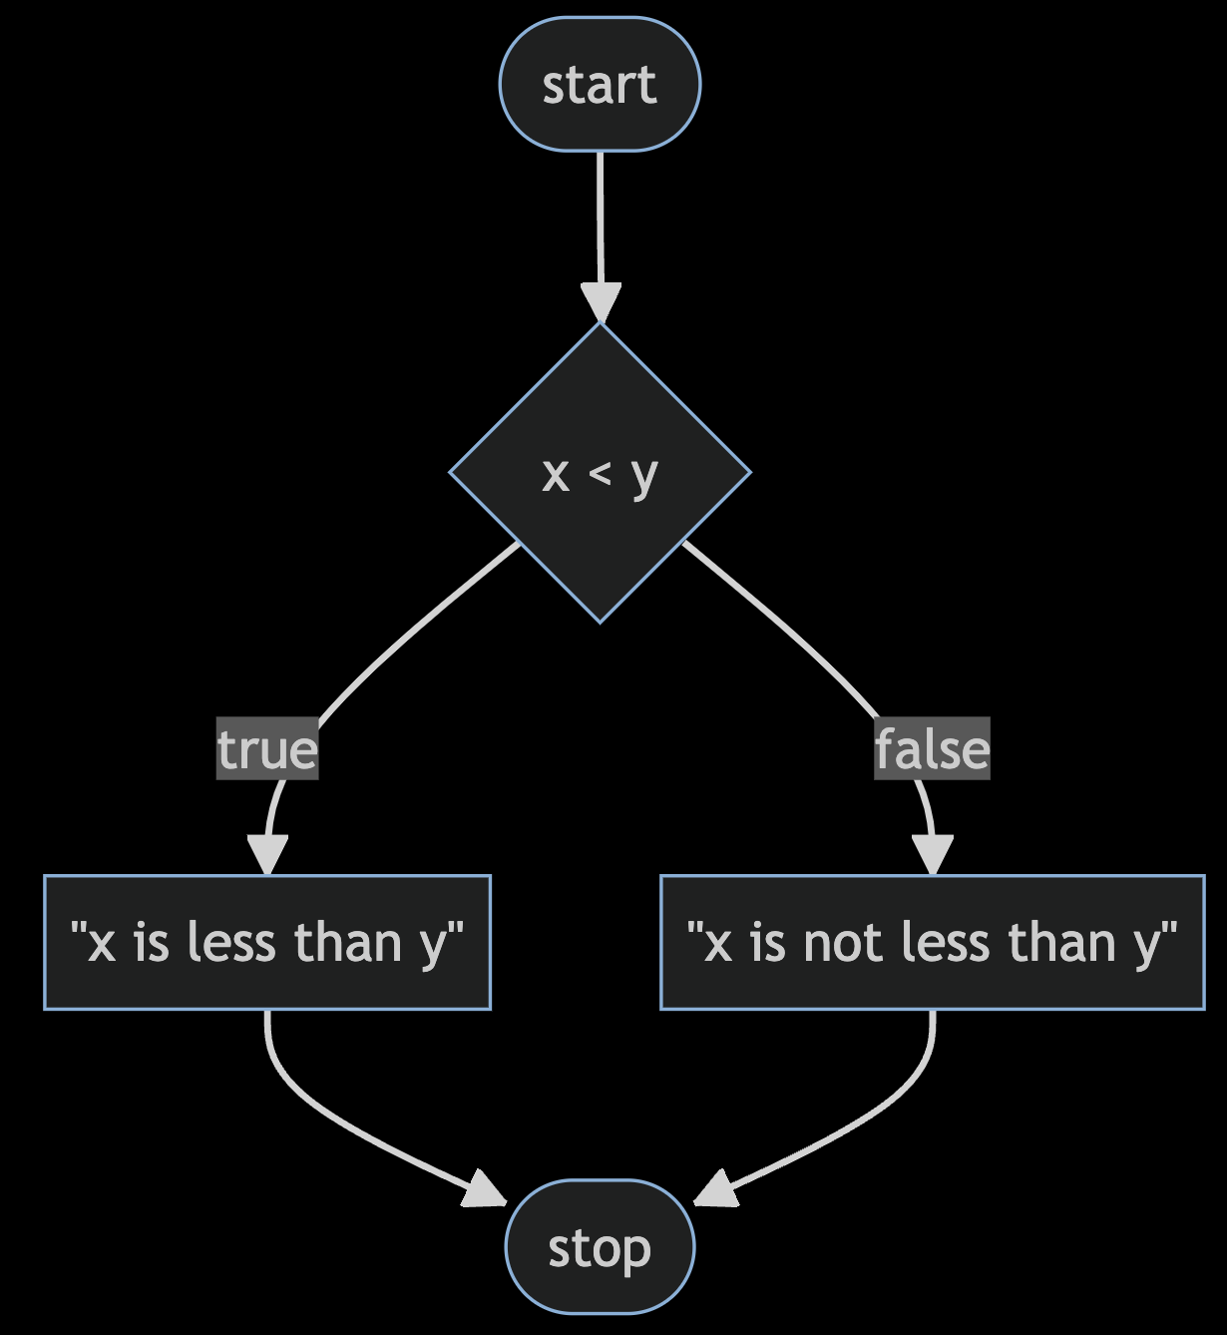
Notes:
compare1.c
https://mermaid.live/edit#pako:eNp9kMFugzAMhl_F8i6rRF-AVZXWwrGn7rSGg0XSgQoxS4xWhHj3hUSdtst8sv_f_mR7xpq1wRyvHX_VDTmBt0JZCPH6fPEShGoD2-0eDvMddjAtyTwEDcSNJnrHi8Knz5Hl5Q6th854D9KQhSmpCqs0doztxUrmodr8Yl2p8wlW_oVZln-AZQKuKWbYG9dTq8M582orlMb0RmEeUk3uplDZJfTRKHyebI35ekKG46BJTNHSh6Me87jLQy11K-x-RBPLU3pa_F2GA9l35sfg8g0ckGn4

Slide 108
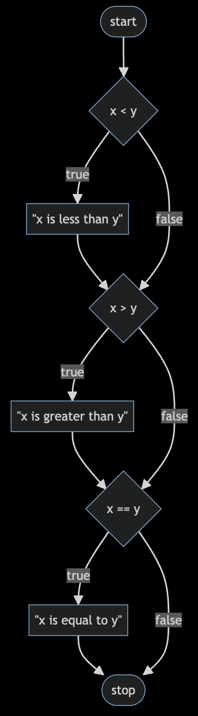
Notes:
compare2.c
https://mermaid.live/edit#pako:eNptkcFugzAMhl_F8i6rRF-ArZXWBtrLTttpDQeLpAUNCE2CVoR494WgUtCWU_L792c77jBVQmKI50L9pBlpC5-MV-DO2_PJWCckK1ivt7DrbvAKbT8Gd04DqxvpY_sTx6dro-zLDXIDhTQGbEYVtKPKMRnT9t7OHGo7odgCFS1RFy3JSv0_LfIZsaNtNhMuXuAOS5y8NlSAVX9QB-8-DiOrOlnNhjxTYUYWm_X7UONZ2Yd6xABLqUvKhfvcbvBwtJksJcfQXQXpb4686p2PGqs-2irFcGg7wKYWbmaW00VTiaGH3tVI5FbpSZT--T6u0G8ywJqqL6Xuif0vYHGQ9A

Slide 109
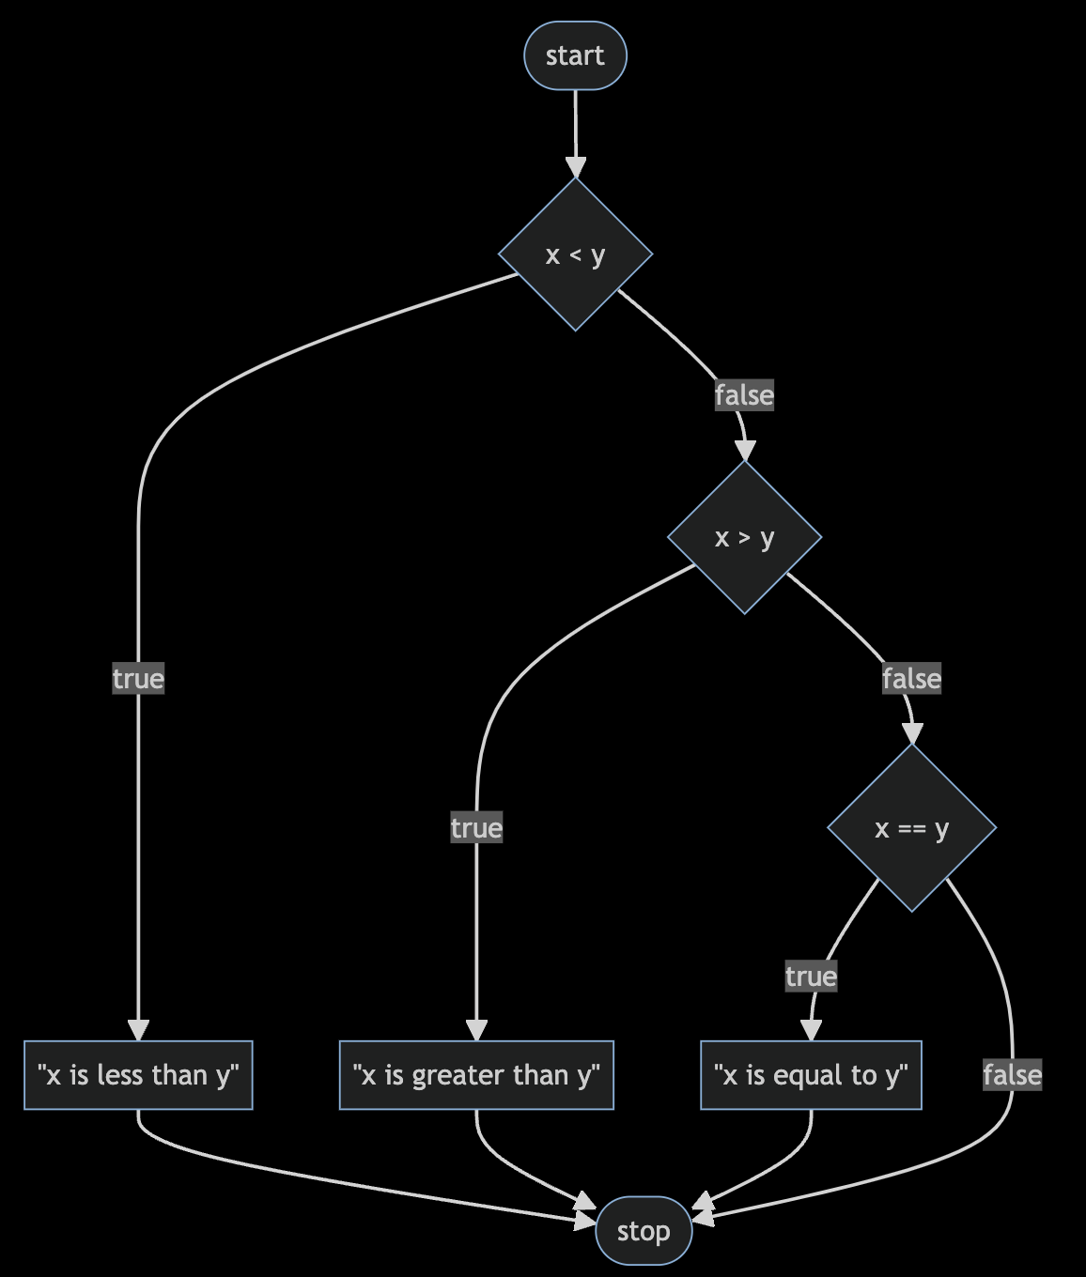
Notes:
compare3.c
https://mermaid.live/edit#pako:eNptkc9ugzAMxl_F8i6rRF-ArZXWhraXnbbTGg4WSQsqEJo_WhHi3RdAMNCWU77P9s-J3WCihMQQL7n6TlLSFj4ZL8Gft-ezsd6IV7Beb2HXPOAV6nYI7rwHVjvZx_Znjk93p-zLAzIDuTQGbEol1IPLMZ6VXSg3Qx3zzO3EZAtmtGRetSQr9f9YtsQePHazmbiHBfe45Mq7oxys-sM89tmnbgiqilcz1G-j0-Du5yIaBQZYSF1QJvx4my7I0aaykBxDfxWkbxx52fo8clZ91GWCYffMAF0l_GdZRldNBYZ9w9GNRGaVnkzZy_dhif0uA6yo_FJqLGx_AMcUkcQ

Slide 110
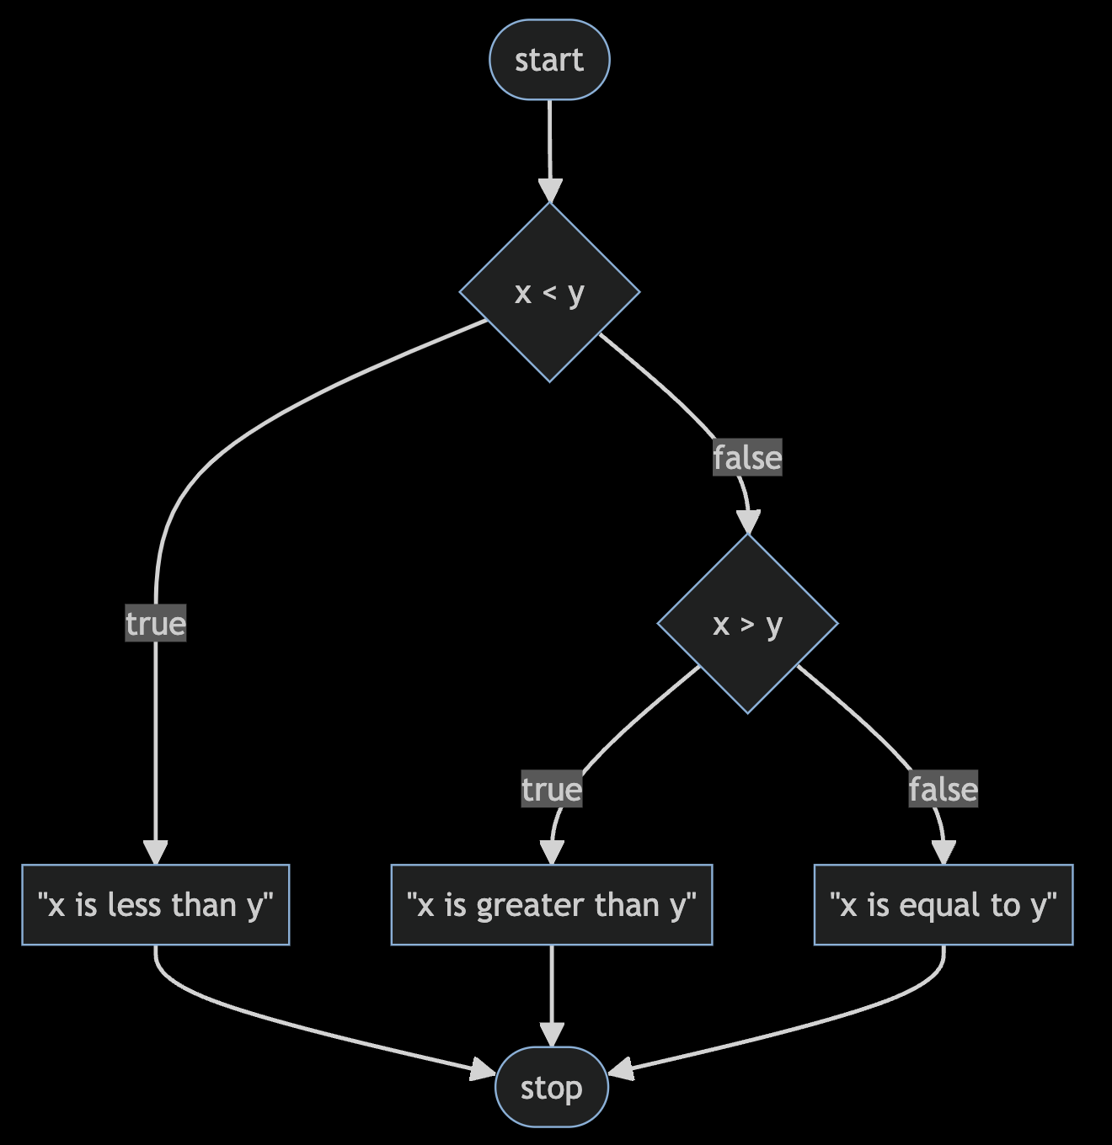
Notes:
compare4.c
https://mermaid.live/edit#pako:eNptkctOwzAQRX9lNGyolP5AQJVonYoNK1hRZzGK3SYisVM_RKMo_45jKxUReOU5M_dqHiNWWkjM8dzq76om4-CDcQXhvTyerAug3MB2u4P9eINnGKaU3AcGzngZc4cTx4er1-7pBo2FVloLriYFQ6Icy1-yM7U26Vjw3N092cqzWHtejCQnzf-2bG17XEvl1VMLTv-RHWP16zyn7stNgocEU1AsAWbYSdNRI8KuxjnJ0dWykxzz8BVkvjhyNYU68k6_D6rCfJ4lQ9-L0Dlr6GKowzy2udBCNE6bO5QxfEsXiYfJsCf1qfUinH4AYdKEwg

Slide 111
bool
char
double
float
int
long
string
...

Slide 112
bool
char
double
float
int
long
string
...

Slide 113
get_char
get_double
get_float
get_int
get_long
get_string
...

Slide 114
get_char
get_double
get_float
get_int
get_long
get_string
...
Notes:
agree{0,1,2}.c

Slide 115
loops
Notes:
cat0.c

Slide 116
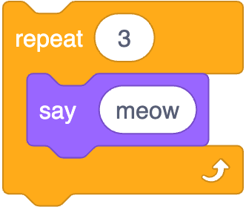
Notes:
https://scratchblocks.github.io/#?style=scratch3&script=repeat%20%5B3%5D%0Asay%5Bmeow%5D

Slide 117
int i = 3;
while (i > 0)
{
printf("meow\n");
i--;
}
Notes:
cat1.c, but use counter first

Slide 118
int i = 3;
while (i > 0)
{
printf("meow\n");
i--;
}
Notes:
cat1.c, but use counter first

Slide 119
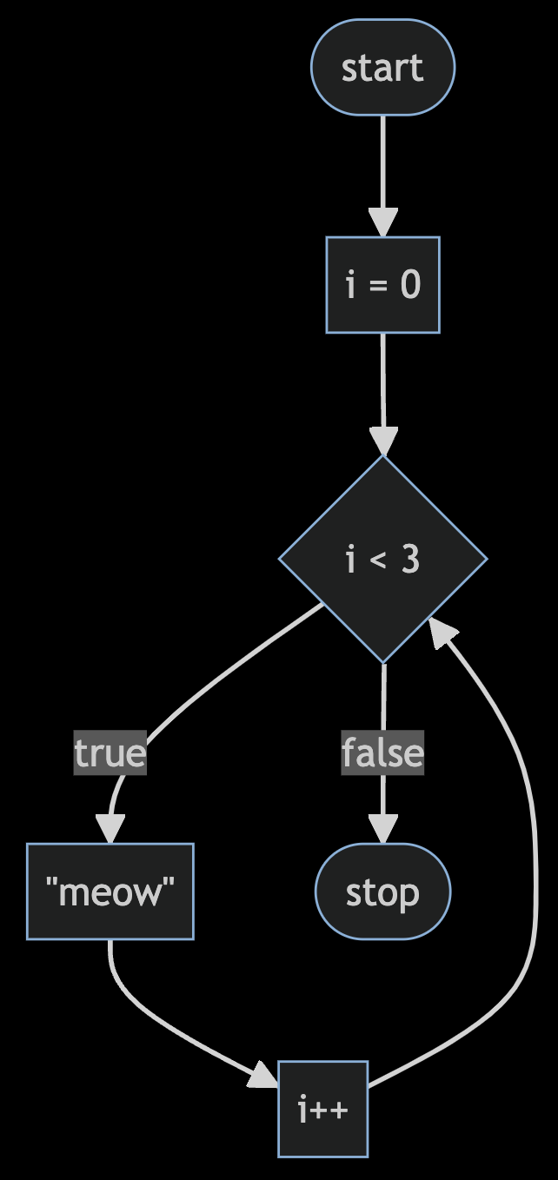
Notes:
https://mermaid.live/edit#pako:eNpNkEFvwjAMhf-KZS4gioS0WzeQgHa3ncaJpgerSUc0EnchFZqq_velCUz4ZH9-fnrygA1LhTm2F741Z3IejoWwEGo3r64-gHoBq9UW9pWGDazrtNxHdhg0vMHLmNghMPCuV3FXVAJnPz37V6P4ljqB9_MiSspKL5d3UibDJ6eWLtdk9T4l4a5eCIsZGuUMaRkyD5NaoD8rowTmoZXkvgUKOwYd9Z4_f22D-ZQpw76T5FWh6cuRwTzaP2gptWf3D1UcP9Jn4oMy7MiemB-H4x_2fV7F

Slide 120
int i = 0;
while (i < 3)
{
printf("meow\n");
i++;
}
Notes:
cat{2,3}.c

Slide 121
for (int i = 0; i < 3; i++)
{
printf("meow\n");
}
Notes:
cat4.c

Slide 122
Notes:
https://mermaid.live/edit#pako:eNpNkEFvwjAMhf-KZS4gioS0WzeQgHa3ncaJpgerSUc0EnchFZqq_velCUz4ZH9-fnrygA1LhTm2F741Z3IejoWwEGo3r64-gHoBq9UW9pWGDazrtNxHdhg0vMHLmNghMPCuV3FXVAJnPz37V6P4ljqB9_MiSspKL5d3UibDJ6eWLtdk9T4l4a5eCIsZGuUMaRkyD5NaoD8rowTmoZXkvgUKOwYd9Z4_f22D-ZQpw76T5FWh6cuRwTzaP2gptWf3D1UcP9Jn4oMy7MiemB-H4x_2fV7F

Slide 123
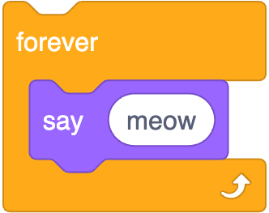
while (true)
{
printf("meow\n");
}
Notes:
https://scratchblocks.github.io/#?style=scratch3&script=forever%0Asay%5Bmeow%5D

Slide 124
while ( )
{
}

Slide 125
while (true)
{
}

Slide 126
while (true)
{
printf("meow\n");
}
Notes:
cat5.c

Slide 127
control-c

Slide 128
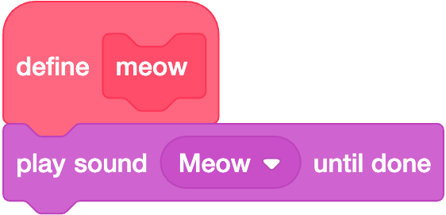

Slide 129
void meow(void)
{
printf("meow\n");
}

Slide 130
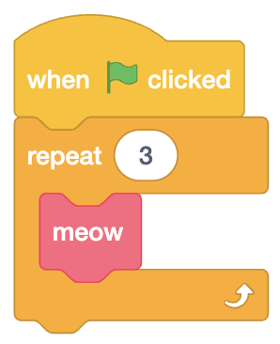

Slide 131
int main(void)
{
for (int i = 0; i < 3; i++)
{
meow();
}
}
Notes:
cat6.c

Slide 132
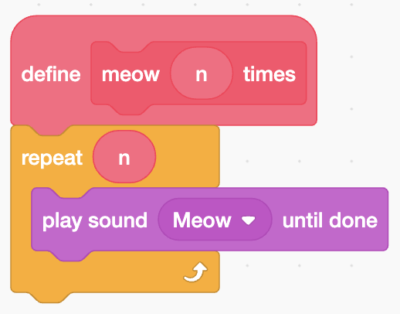

Slide 133
void meow(int n)
{
for (int i = 0; i < n; i++)
{
printf("meow\n");
}
}

Slide 134
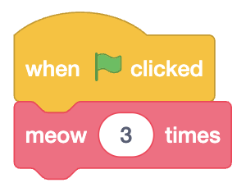

Slide 135
int main(void)
{
meow(3);
}
Notes:
cat{7,8}.c

Slide 136
scope
Notes:
cat9.c

Slide 137
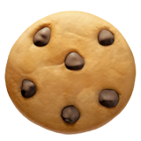
Notes:
https://emojipedia.org/cookie/

Slide 138
int main(void)
{
meow(3);
}
Notes:
cat{7,8}.c

Slide 139
Linux

Slide 140
correctness, design, style

Slide 141
function
arguments →
→ side effects

Slide 142
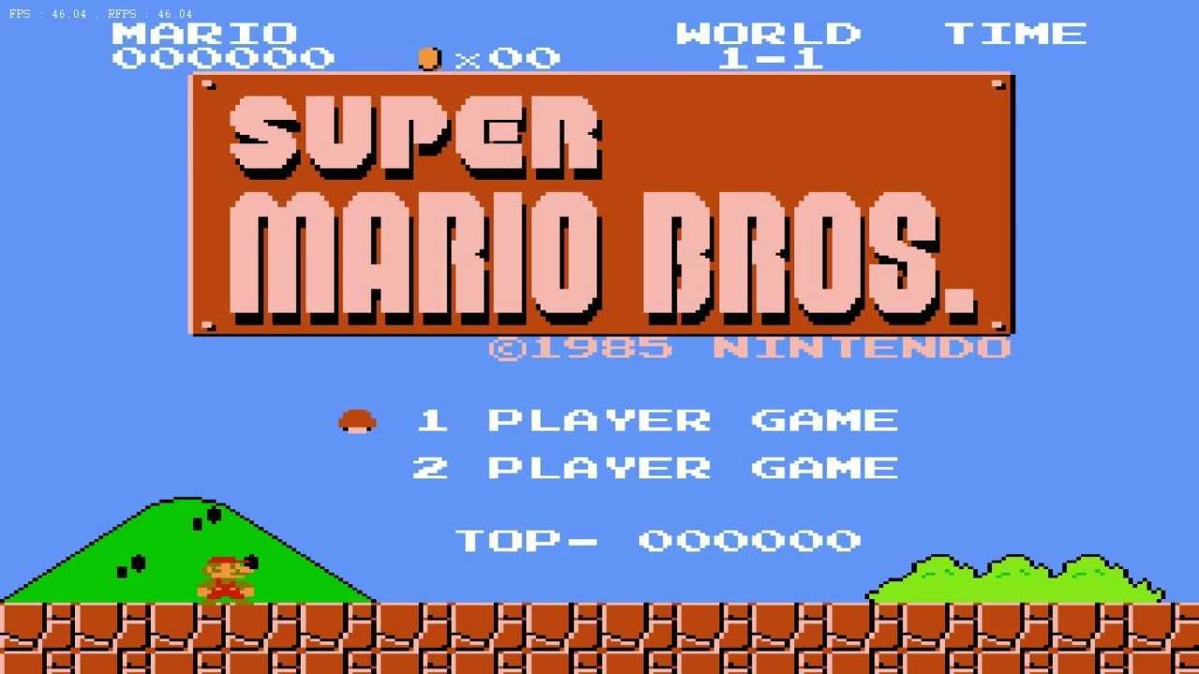

Slide 143
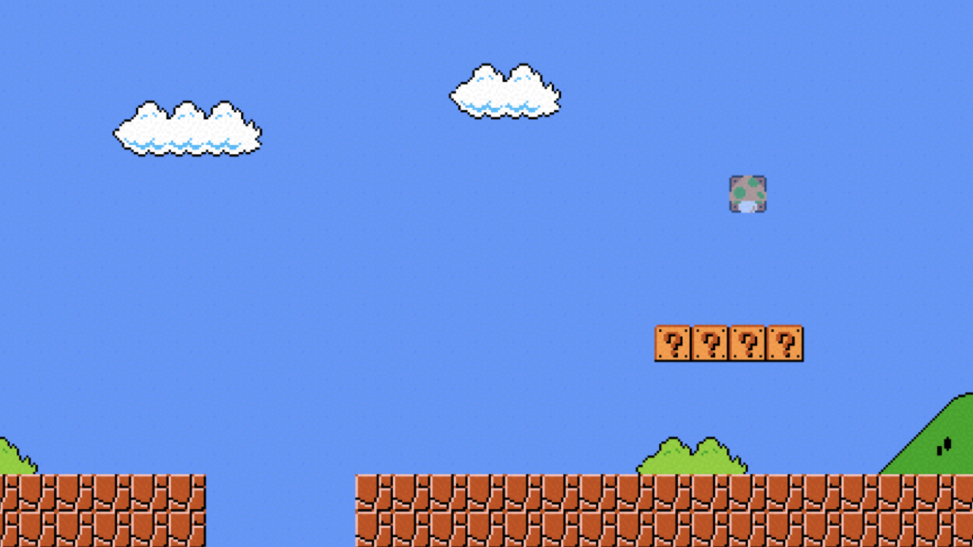

Slide 144
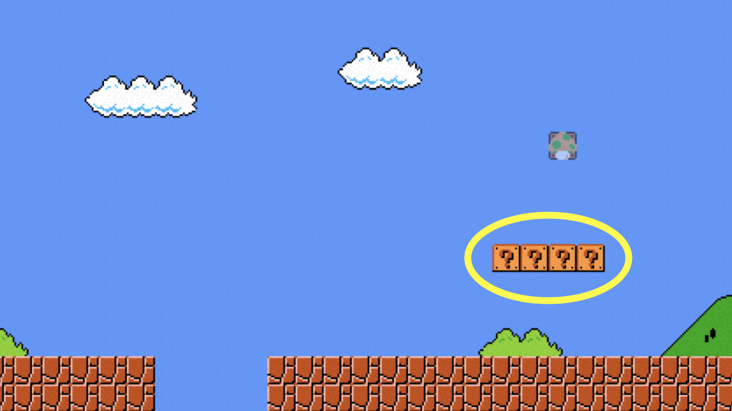
Notes:
mario{0,1}.c

Slide 145
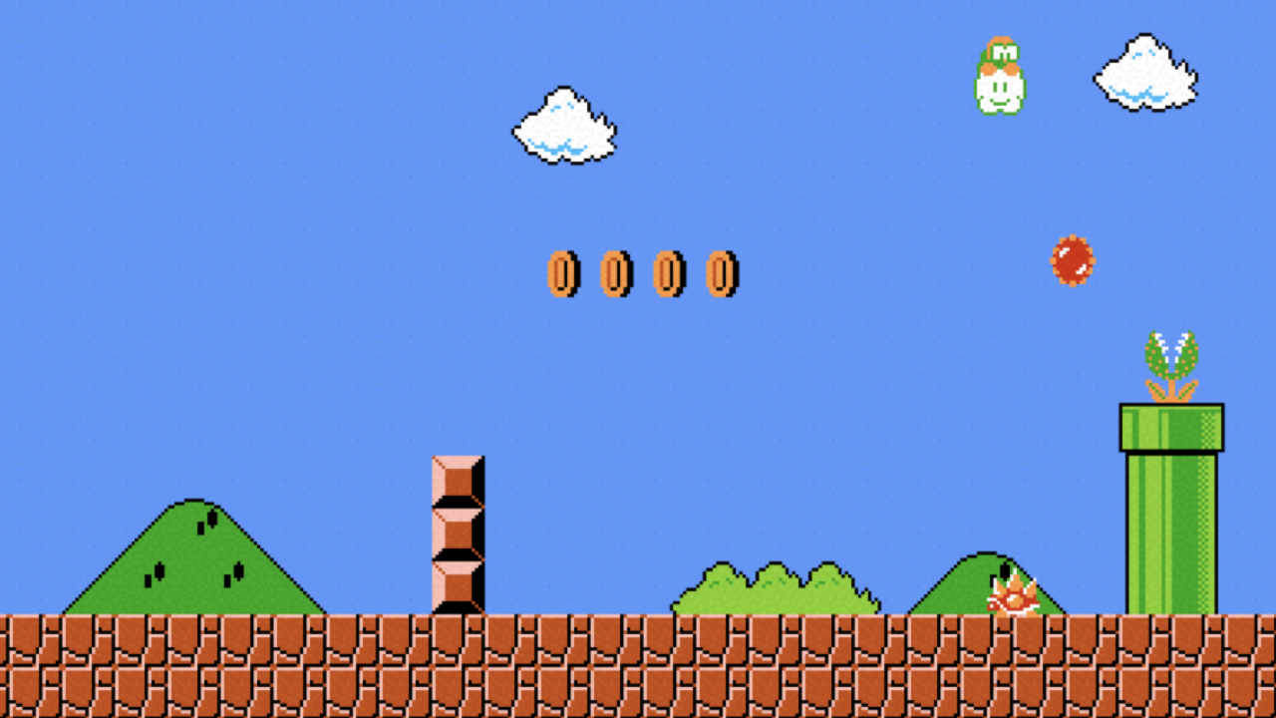

Slide 146
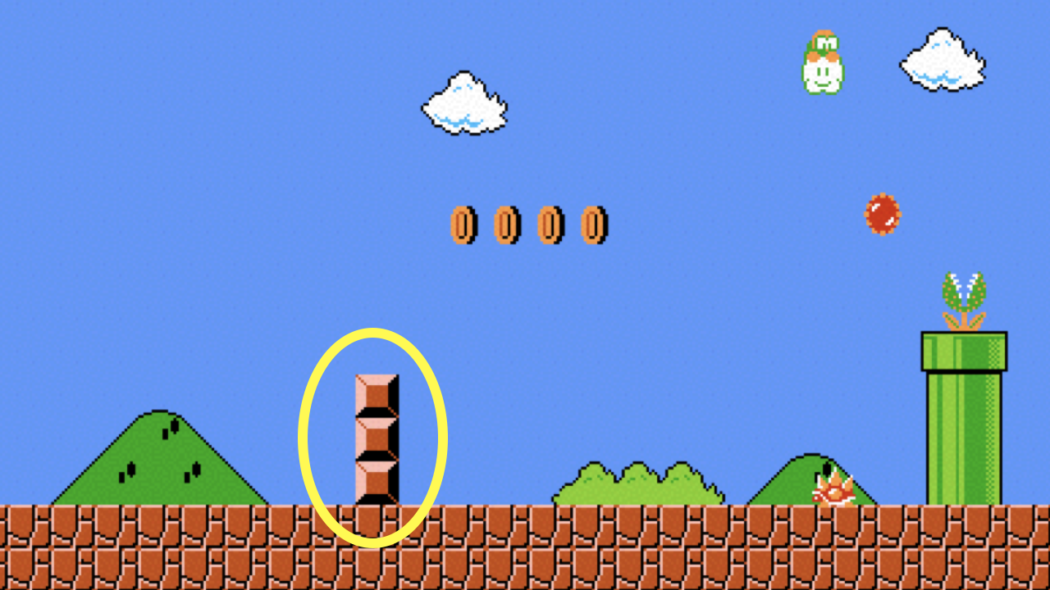
Notes:
mario2.c

Slide 147
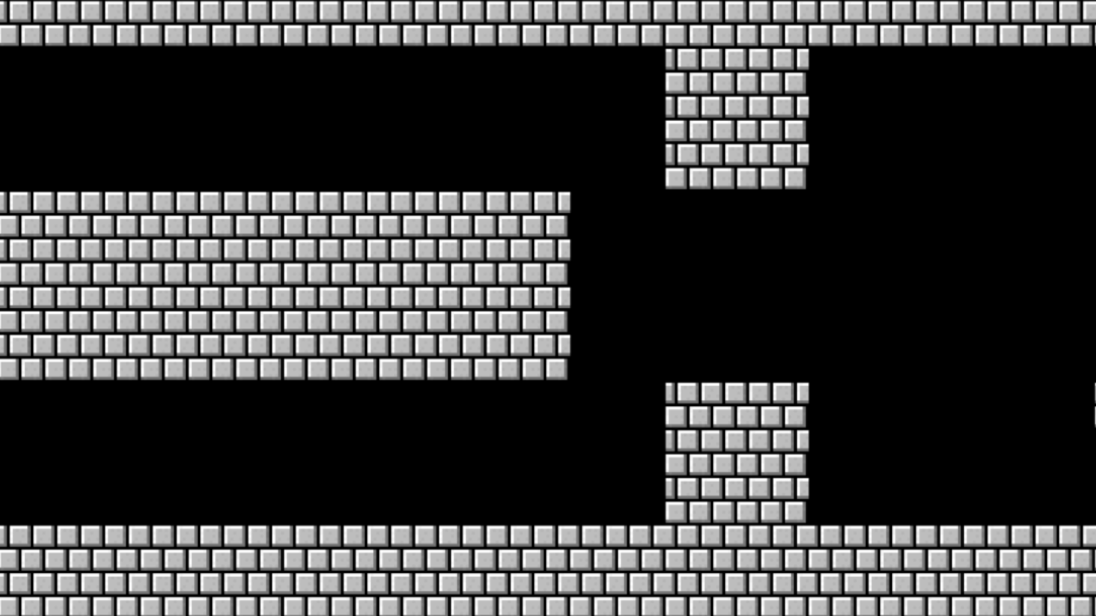

Slide 148
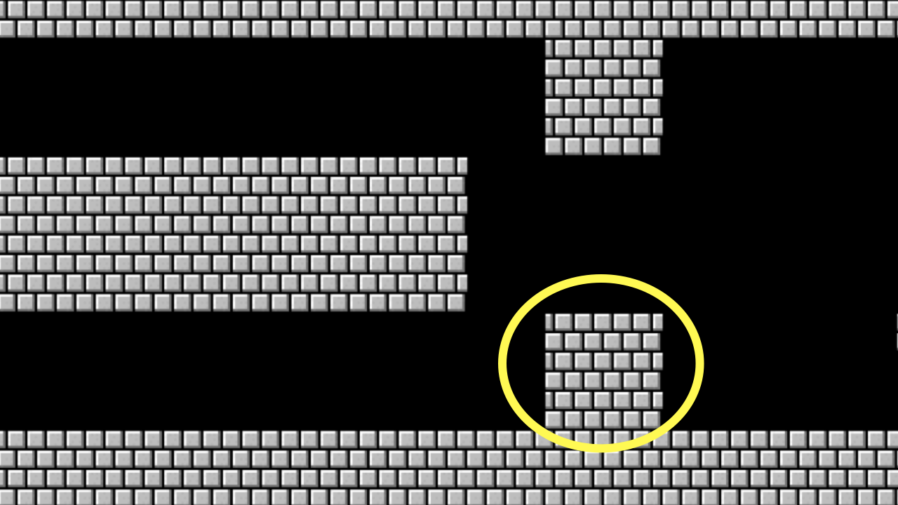
Notes:
mario{3,4,5}.c

Slide 149
constants

Slide 150
comments

Slide 151
function
arguments →
→ return value

Slide 152
+
-
*
/
%
…
Notes:
calculator*.c

Slide 153
integer overflow

Slide 154
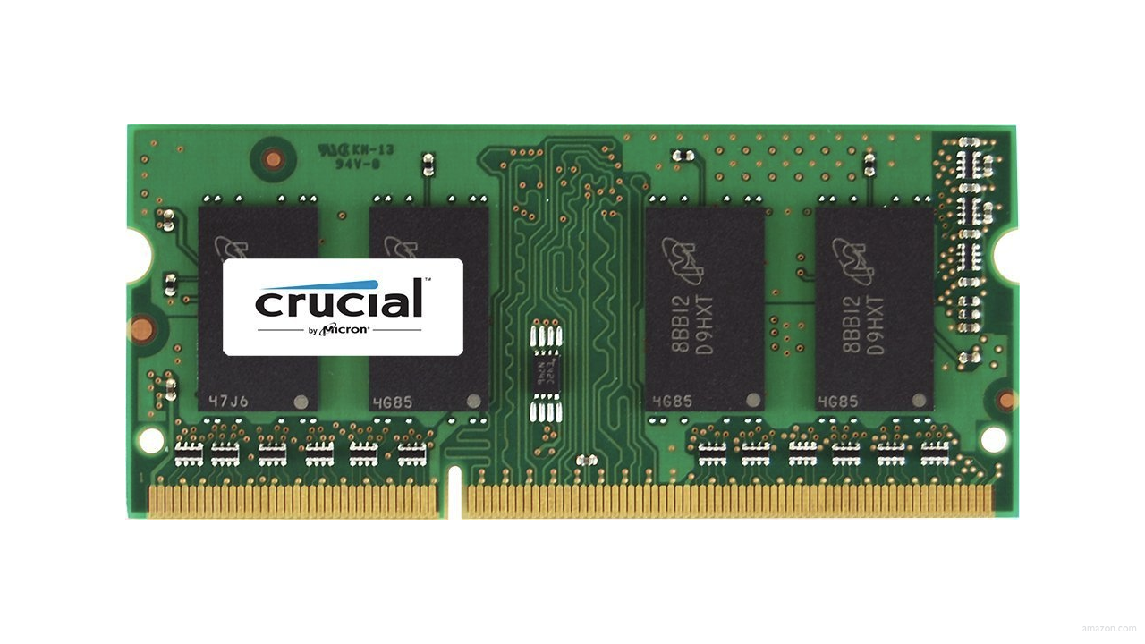

Slide 155
0000

Slide 156
0001

Slide 157
0010

Slide 158
0011

Slide 159
0100

Slide 160
0101

Slide 161
0110

Slide 162
0111

Slide 163
1000

Slide 164
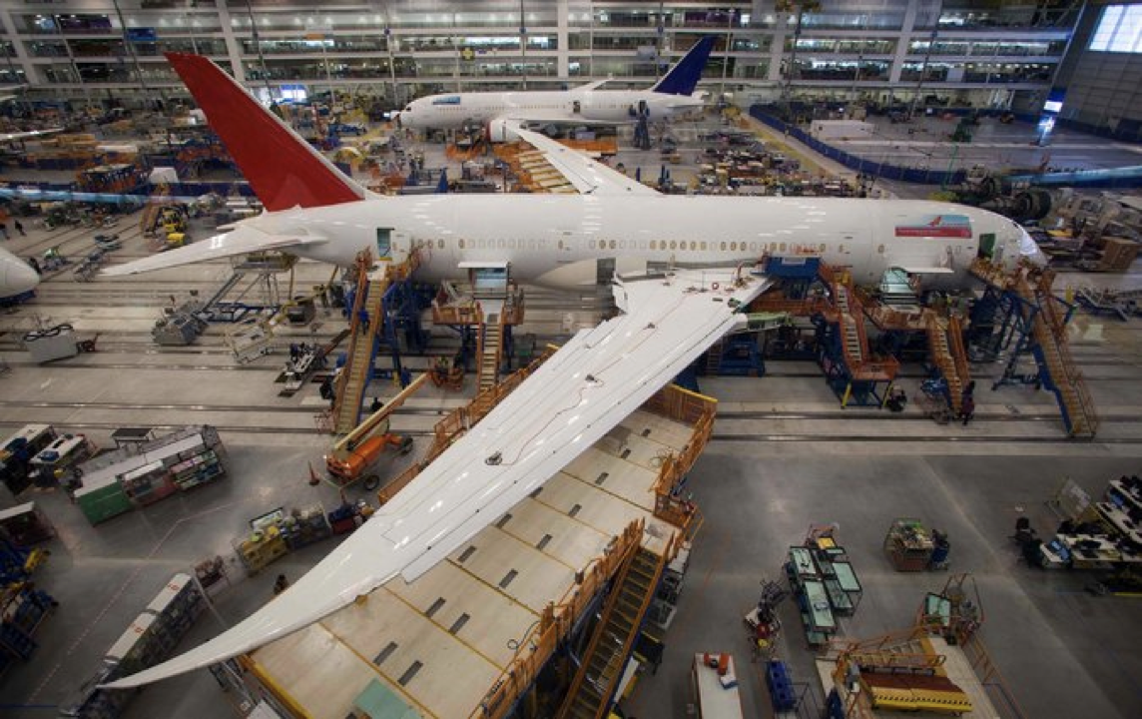
Notes:
Boeing 787
"a Model 787 airplane that has been powered continuously for 248 days can lose all alternating current (AC) electrical power due to the generator control units (GCUs) simultaneously going into failsafe mode," the memo stated. "This condition is caused by a software counter internal to the GCUs that will overflow after 248 days of continuous power... Boeing is in the process of developing a GCU software upgrade that will remedy the unsafe condition." - http://arstechnica.com/information-technology/2015/05/boeing-787-dreamliners-contain-a-potentially-catastrophic-software-bug/
A simple guess suggests the the problem is a signed 32-bit overflow as 2^31 is the number of seconds in 248 days multiplied by 100, i.e. a counter in hundredths of of a second.
https://www.i-programmer.info/news/149-security/8548-reboot-your-dreamliner-every-248-days-to-avoid-integer-overflow.html

Slide 165
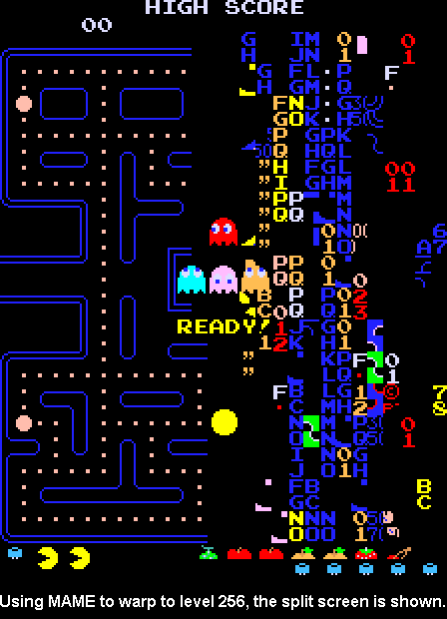
Notes:
https://pacman.fandom.com/wiki/Map_256_Glitch
"The level counter in the original Pac-Man is stored as an 8-bit integer, meaning the highest value it can hold is 255. The level counter starts with 0 internally, but for calculating the fruit counter it adds 1; however, because of overflow, adding 1 to 255 would result in 0, and the game tries to count fruits from 1, causing the game to attempt to draw 256 fruit to the screen until it overflows to 0. The result is the garbled mess on the right side of the maze, because the screen memory starts with the bottom, followed by the columns from the right side."

Slide 166
truncation

Slide 167
floating-point imprecision
Notes:
1/3

Slide 168
1999
Notes:
graduated

Slide 169
1999

Slide 170
1900

Slide 171
19 January 2038

Slide 172
13 December 1901

Slide 173
Computing Technology

