Slide 1
Computing Technology

Slide 2
data structures
Notes:
may seem arcane but lots of data structures in world
-Decide in advance how big array is – traditional approach

Slide 3
abstract data types
Notes:
Sometimes data is abstract(!)
Need flexibility on memory, type

Slide 4
queues
Notes:
- waiting in line
- Draw how queues work omg!

Slide 5
FIFO
Notes:
First in first out

Slide 6
enqueue
dequeue
Notes:
Put into the queue
Take out of the queue

Slide 7
const int CAPACITY = 50;
typedef struct
{
person people[CAPACITY];
int size;
} queue;
Notes:
Encapsulate data types in a struct
Int size keeps track of number of peeps in the queue

Slide 8
stacks
Notes:
- stack of sweaters – like stack of tshirts last in first out! (like ed’s tshirt stack)
- Gmail inbox
- 3 volunteers

Slide 9
LIFO
Notes:
Last in First out
Draw demo of this unfair queue

Slide 10

LIFO
Millwall Club chant:
No one likes us,
No one likes us,
No one likes us,
We don’t care.
Notes:
Last in First out
Draw demo of this unfair queue

Slide 11
push
pop
Notes:
Push: When we add an element, we first increment top , then place the new element at array[top] .
Pop: When we remove an element, we retrieve the element from array[top] and then decrement top

Slide 12
const int CAPACITY = 50;
typedef struct
{
person people[CAPACITY];
int size;
} stack;

Slide 13

Notes:
https://www.youtube.com/watch?v=ItAG3s6KIEI
Prof. Shannon Duvall of Elon University

Slide 14
arrays
Notes:
We will start to use these new concepts with the array

Slide 16
 | 1 | 2 | 3

Slide 17
 | 1 | 2 | 3
Notes:
Want to place another number

Slide 18
 | 1 | 2 | 3
Notes:
Computer memory context

Slide 19

 | 1 | 2 | 3 | h | e | l | l
o | , |  | w | o | r | l | d
\0
Notes:
Lots of garbage floating arounds but adjacent block is in use with hello, world

Slide 20
 | 1 | 2 | 3
Notes:
Found a slot big enough

Slide 21
 | 1 | 2 | 3
 | 1

Slide 22
 | 1 | 2 | 3
 | 1 | 2

Slide 23
 | 1 | 2 | 3
 | 1 | 2 | 3

Slide 24
 | 1 | 2 | 3
 | 1 | 2 | 3 | 4
Notes:
This is kind of a faff for the computer (inefficient)
-could have “overallocated” but this wastes memory
THIS is the tradeoff

Slide 25
 | 1 | 2 | 3 | 4
Notes:
list{0,1,2}.c
This is kind of a faff for the computer (inefficient)
-could have “overallocated” but this wastes memory
THIS is the tradeoff

Slide 26
data structures

Slide 27
struct
.
*
Notes:
-struct
-dot operator goes inside a structure
-* pointer

Slide 28
struct
->
Notes:
This is same as using a period and a star
Have a look at the list.c code examples
Particularly note use of free() with malloc()
Also realloc()
Heading towards LINKED LIST

Slide 29
linked lists
Notes:
-just using pointers to link lists in memory

Slide 31
 |  | 1 0x123

Slide 32
 |  | 1 0x123
 |  |  |  | 2 0x456

Slide 33
 |  | 1 0x123
 |  |  |  | 2 0x456
 |  |  |  |  |  | 3 0x789

Slide 34
 |  | 1 0x123
 |  |  |  | 2 0x456
 |  |  |  |  |  | 3 0x789

Slide 35
 |  | 1 0x123
 |  | 0x456 |  | 2 0x456
 |  |  |  |  |  | 3 0x789

Slide 36
 |  | 1 0x123
 |  | 0x456 |  | 2 0x456
 |  |  |  | 0x789 |  | 3 0x789

Slide 37
 |  | 1 0x123
 |  | 0x456 |  | 2 0x456
 |  |  |  | 0x789 |  | 3 0x789
 |  |  |  |  |  | 0x0

Slide 38
 |  | 1 0x123
 |  | 0x456 |  | 2 0x456
 |  |  |  | 0x789 |  | 3 0x789
 |  |  |  |  |  | NULL

Slide 39
 |  | 1 0x123
 |  | 0x456 |  | 2 0x456
0x123 |  |  |  | 0x789 |  | 3 0x789
 |  |  |  |  |  | NULL

Slide 40
 |  | 1
 |  |  |  | 2
 |  |  |  |  |  | 3
Notes:
“linked list”
-more efficient use of memory
-But, fragmentation...
-also 2x the space

Slide 41
typedef struct
{
char *name;
char *number;
} person;
Notes:
Our struct person

Slide 42
typedef struct node
{
int number;
struct node *next;
} node;
Notes:
list3.c (to show prepending)
Check out code to see creation of a linked list struct

Slide 43
Notes:
Story of creating a linked list

Slide 44
node *list;

Slide 45
node *list;
list

Slide 46
node *list = NULL;
list

Slide 47
node *list = NULL;
list

Slide 48
node *n = malloc(sizeof(node));
list

Slide 49
node *n = malloc(sizeof(node));
list
n

Slide 50
node *n = malloc(sizeof(node));
list
number
n
next

Slide 51
node *n = malloc(sizeof(node));
list
number
n
next

Slide 52
(*n).number = 1;
list
number
n
next

Slide 53
(*n).number = 1;
list
1
number
n
next

Slide 54
n->number = 1;
list
1
number
n
next

Slide 55
n->next = NULL;
list
1
number
n
next

Slide 56
n->next = NULL;
list
1
number
n
next

Slide 57
list = n;
list
1
number
n
next

Slide 58
list = n;
list
1
number
n
next

Slide 59
list
1

Slide 60
node *n = malloc(sizeof(node));
list
1

Slide 61
node *n = malloc(sizeof(node));
list
1
n

Slide 62
node *n = malloc(sizeof(node));
list
1
n

Slide 63
node *n = malloc(sizeof(node));
list
1
n

Slide 64
n->number = 2;
list
1
n

Slide 65
n->number = 2;
list
2
1
n

Slide 66
n->next = NULL;
list
2
1
n

Slide 67
n->next = NULL;
list
2
1
n

Slide 68
list
2
1
n

Slide 69
list = n;
list
2
1
n

Slide 70
list = n;
list
2
1
n

Slide 71
list = n;
list
2
1
n

Slide 72
list
2
1
n

Slide 73
n->next = list;
list
2
1
n

Slide 74
n->next = list;
list
2
1
n

Slide 75
list = n;
list
2
1
n

Slide 76
list = n;
list
2
1
n

Slide 77
list
2
1

Slide 78
list
2
1
3
Notes:
list4.c (to show printing with while loop)

Slide 79
ptr
list
2
1
3

Slide 80
ptr
list
2
1
3

Slide 81
ptr
list
2
1
3

Slide 82
ptr
list
2
1
3

Slide 83
list
2
1
3
Notes:
list5.c (for loop instead)

Slide 84
O(n²)
O(n log n)
O(n)
O(log n)
O(1)

Slide 85
list

Slide 86
list
1

Slide 87
list
2
1

Slide 88
list
2
1
3

Slide 89
O(n²)
O(n log n)
O(n)
O(log n)
O(1)

Slide 90
O(n²)
O(n log n)
O(n)
O(log n)
O(1)
Notes:
list6.c (freeing, after showing valgrind on list5)

Slide 91
O(n²)
O(n log n)
O(n) search
O(log n)
O(1) insertion

Slide 92
O(n²)
O(n log n)
O(n) search, deletion
O(log n)
O(1) insertion

Slide 93
list

Slide 94
list
1

Slide 95
2
list
1

Slide 96
2
list
1
3

Slide 97
O(n²)
O(n log n)
O(n)
O(log n)
O(1)
Notes:
list7.c (append)

Slide 98
O(n²)
O(n log n)
O(n) search, deletion, insertion
O(log n)
O(1)

Slide 99
list

Slide 100
list
2

Slide 101
list
2
1

Slide 102
4
list
2
1

Slide 103
4
list
2
3
1

Slide 104
trees
Notes:
Data structures: We have arrays, we have lists, let’s look at something called trees

Slide 105
binary search trees
Notes:
2 dimensional
Allows binary search

Slide 106
 | 1 | 2 | 3 | 4 | 5 | 6 | 7
Notes:
Now mark middle (next slide)

Slide 107
 | 1 | 2 | 3 | 4 | 5 | 6 | 7
Notes:
Now mark middle of middles (next slide)

Slide 108
 | 1 | 2 | 3 | 4 | 5 | 6 | 7

Slide 109
 | 1 | 2 | 3 | 4 | 5 | 6 | 7
Notes:
etc

Slide 110
4
2
6
1
3
5
7
Notes:
Now make it a tree (pointers useful here)

Slide 111
4
2
6
1
3
5
7
Notes:
each square is an abstraction of a node now, no need to keep drawing rects
Each box contains 2 pointers – a forward and a back!

Slide 112
typedef struct node
{
int number;
struct node *next;
} node;
Notes:
Remember: Node for linked list

Slide 113
typedef struct node
{
int number;
} node;

Slide 114
typedef struct node
{
int number;
} node;

Slide 115
typedef struct node
{
int number;
struct node *left;
struct node *right;
} node;
Notes:
Struct for a tree struct for binary search
*downside is uses more memory!

Slide 116
4
2
6
1
3
5
7

Slide 117
bool search(node *tree, int number)
{
if (tree == NULL)
{
return false;
}
else if (number < tree->number)
{
return search(tree->left, number);
}
else if (number > tree->number)
{
return search(tree->right, number);
}
else if (number == tree->number)
{
return true;
}
}
Notes:
Using recursion to search a binary search node

Slide 118
bool search(node *tree, int number)
{
if (tree == NULL)
{
return false;
}
else if (number < tree->number)
{
return search(tree->left, number);
}
else if (number > tree->number)
{
return search(tree->right, number);
}
else if (number == tree->number)
{
return true;
}
}

Slide 119
bool search(node *tree, int number)
{
if (tree == NULL)
{
return false;
}
else if (number < tree->number)
{
return search(tree->left, number);
}
else if (number > tree->number)
{
return search(tree->right, number);
}
else if (number == tree->number)
{
return true;
}
}

Slide 120
bool search(node *tree, int number)
{
if (tree == NULL)
{
return false;
}
else if (number < tree->number)
{
return search(tree->left, number);
}
else if (number > tree->number)
{
return search(tree->right, number);
}
else if (number == tree->number)
{
return true;
}
}

Slide 121
bool search(node *tree, int number)
{
if (tree == NULL)
{
return false;
}
else if (number < tree->number)
{
return search(tree->left, number);
}
else if (number > tree->number)
{
return search(tree->right, number);
}
else if (number == tree->number)
{
return true;
}
}

Slide 122
bool search(node *tree, int number)
{
if (tree == NULL)
{
return false;
}
else if (number < tree->number)
{
return search(tree->left, number);
}
else if (number > tree->number)
{
return search(tree->right, number);
}
else if (number == tree->number)
{
return true;
}
}
Notes:
Divide and conquer strategy

Slide 123
4
2
6
1
3
5
7
Notes:
Perfect balance for this tree!!
But, is there a problem...?
Need this balance

Slide 124
Notes:
What if we build a BST from scratch, starting with 2?

Slide 125
2

Slide 126
2
1
Notes:
then 1

Slide 127
2
1
3
Notes:
then 3. looks fine.

Slide 128
Notes:
what if the insertion order is 1-2-3 instead?

Slide 129
1

Slide 130
1
2

Slide 131
1
2
3
Notes:
Binary search tree can devolve into linked list – not balanced, not ideal!
Involves “balanced trees” and more pointer tricks (not for us just now)

Slide 132
dictionaries
Notes:
Dictionary another structure

Slide 134
word | definition

Slide 135
key | value

Slide 136

Notes:
https://apps.apple.com/us/app/contacts/id1069512615#?platform=iphone

Slide 137
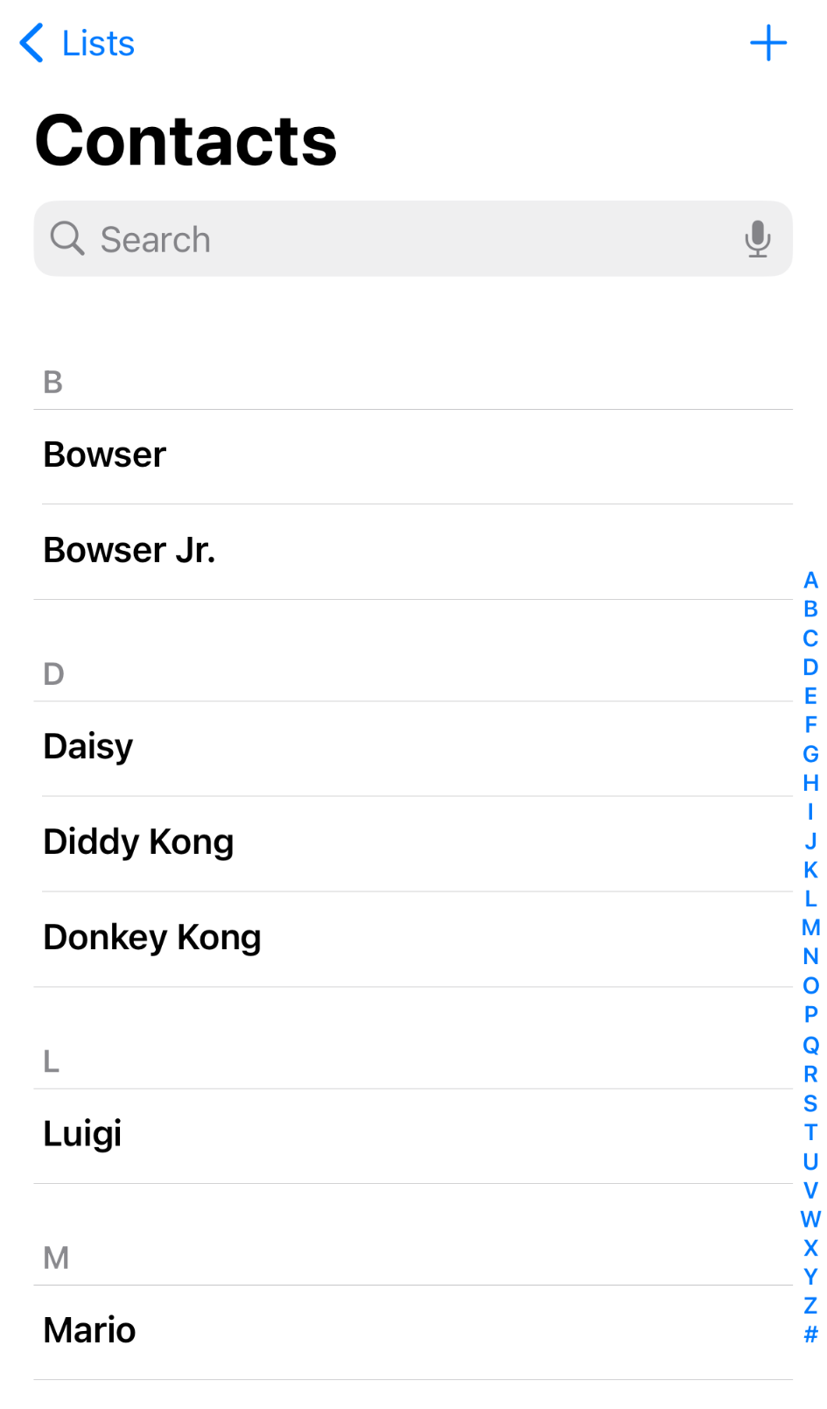
Notes:
https://nintendo.fandom.com/wiki/Nintendo_characters#Mario_series_(including_sub-franchises)

Slide 138


Slide 139
name | number

Slide 140
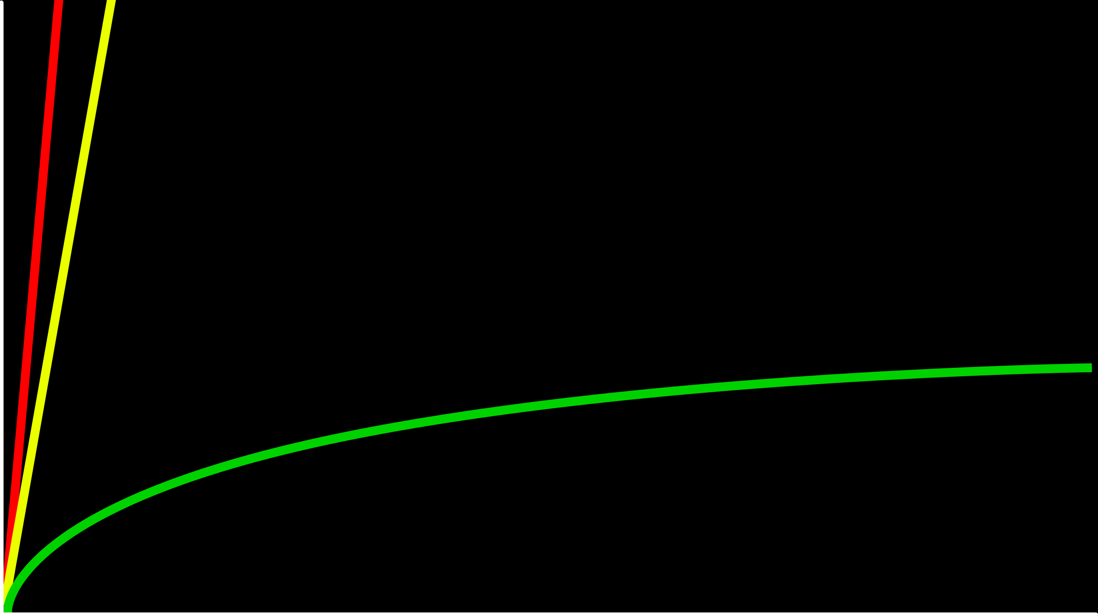
O(n)
time to solve
O(log n)
size of problem

Slide 141
O(n)
time to solve
O(log n)
O(1)
size of problem
Notes:
Constant time searching access to data!! Can we do it...?

Slide 142
hashing
Notes:
cards into buckets

Slide 143
hash function
Notes:
Decides where data goes into memory

Slide 144
hash tables

Slide 145
Notes:
Think of this like a bunch of “buckets” that reduces the scale of a sorting problem
Maybe like phone list A to Z

Slide 146
0
1
2
3
4
5
6
7
8
9
10
11
12
13
14
15
16
17
18
19
20
21
22
23
24
25

Slide 147
A
B
C
D
E
F
G
H
I
J
K
L
M
N
O
P
Q
R
S
T
U
V
W
X
Y
Z

Slide 149
Mario

Slide 150
Luigi
Mario

Slide 151
Luigi
Mario
Peach
Notes:
This allows very fast finding

Slide 152
Birdo
Daisy
Goomba
Isabelle
King Boo
Luigi
Mario
Peach
Rosalina
Shy Guy
Toad
Wario
Yoshi
Zelda

Slide 153
Birdo
Daisy
Goomba
Isabelle
King Boo
Luigi
Lakitu
Mario
Peach
Rosalina
Shy Guy
Toad
Wario
Yoshi
Zelda
Notes:
Collision of values – how to handle

Slide 154
Birdo
Daisy
Goomba
Isabelle
King Boo
Luigi
Lakitu
Link
Mario
Peach
Rosalina
Shy Guy
Toad
Wario
Yoshi
Zelda
Notes:
Hash table of linked list!!

Slide 155
Birdo
Bowser
Bowser Jr.
Daisy
Donkey Kong
Diddy Kong
Dry Bones
Goomba
Ganon
Isabelle
King Boo
K.K. Slider
Luigi
Lakitu
Link
Mario
Peach
Petey Piranha
Rosalina
Shy Guy
Spike
Toad
Toadette
Tom Nook
Wario
Waluigi
Yoshi
Zelda

Slide 156
O(n²)
O(n log n)
O(n)
O(log n)
O(1)

Slide 157
O(n²)
O(n log n)
O(n)
O(log n)
O(1)

Slide 158
typedef struct
{
char *name;
char *number;
} person;

Slide 159
typedef struct node
{
char *name; char *number;
struct node *next;
} node;
Notes:
Little bit of space for *next

Slide 160
node *table[26];
Notes:
Implement hash table in code

Slide 161
input →
→ output

Slide 162
hash function

Slide 163
Mario →
→ 12

Slide 164
Luigi →
→ 11

Slide 165
Laa
Lab
Lac
Lad
Lae
Laf
Lag
Lah
Lai
Laj
Lak
...
Lim
Lin
Lio
...
Luh
Lui
Luj
Lakitu
Link
Luigi
Notes:
17,576 buckets
Drive down probability of collisitions with dictionary keys

Slide 166
#include <ctype.h>
int hash(char *word)
{
return toupper(word[0]) - 'A';
}

Slide 167
#include <ctype.h>
int hash(const char *word)
{
return toupper(word[0]) - 'A';
}

Slide 168
#include <ctype.h>
unsigned int hash(const char *word)
{
return toupper(word[0]) - 'A';
}
Notes:
Check out the notes to explore the pros and cons of hash table building

Slide 169
tries
Notes:
Tries, short for retrieval (of data)
Try == tree of arrays

Slide 170
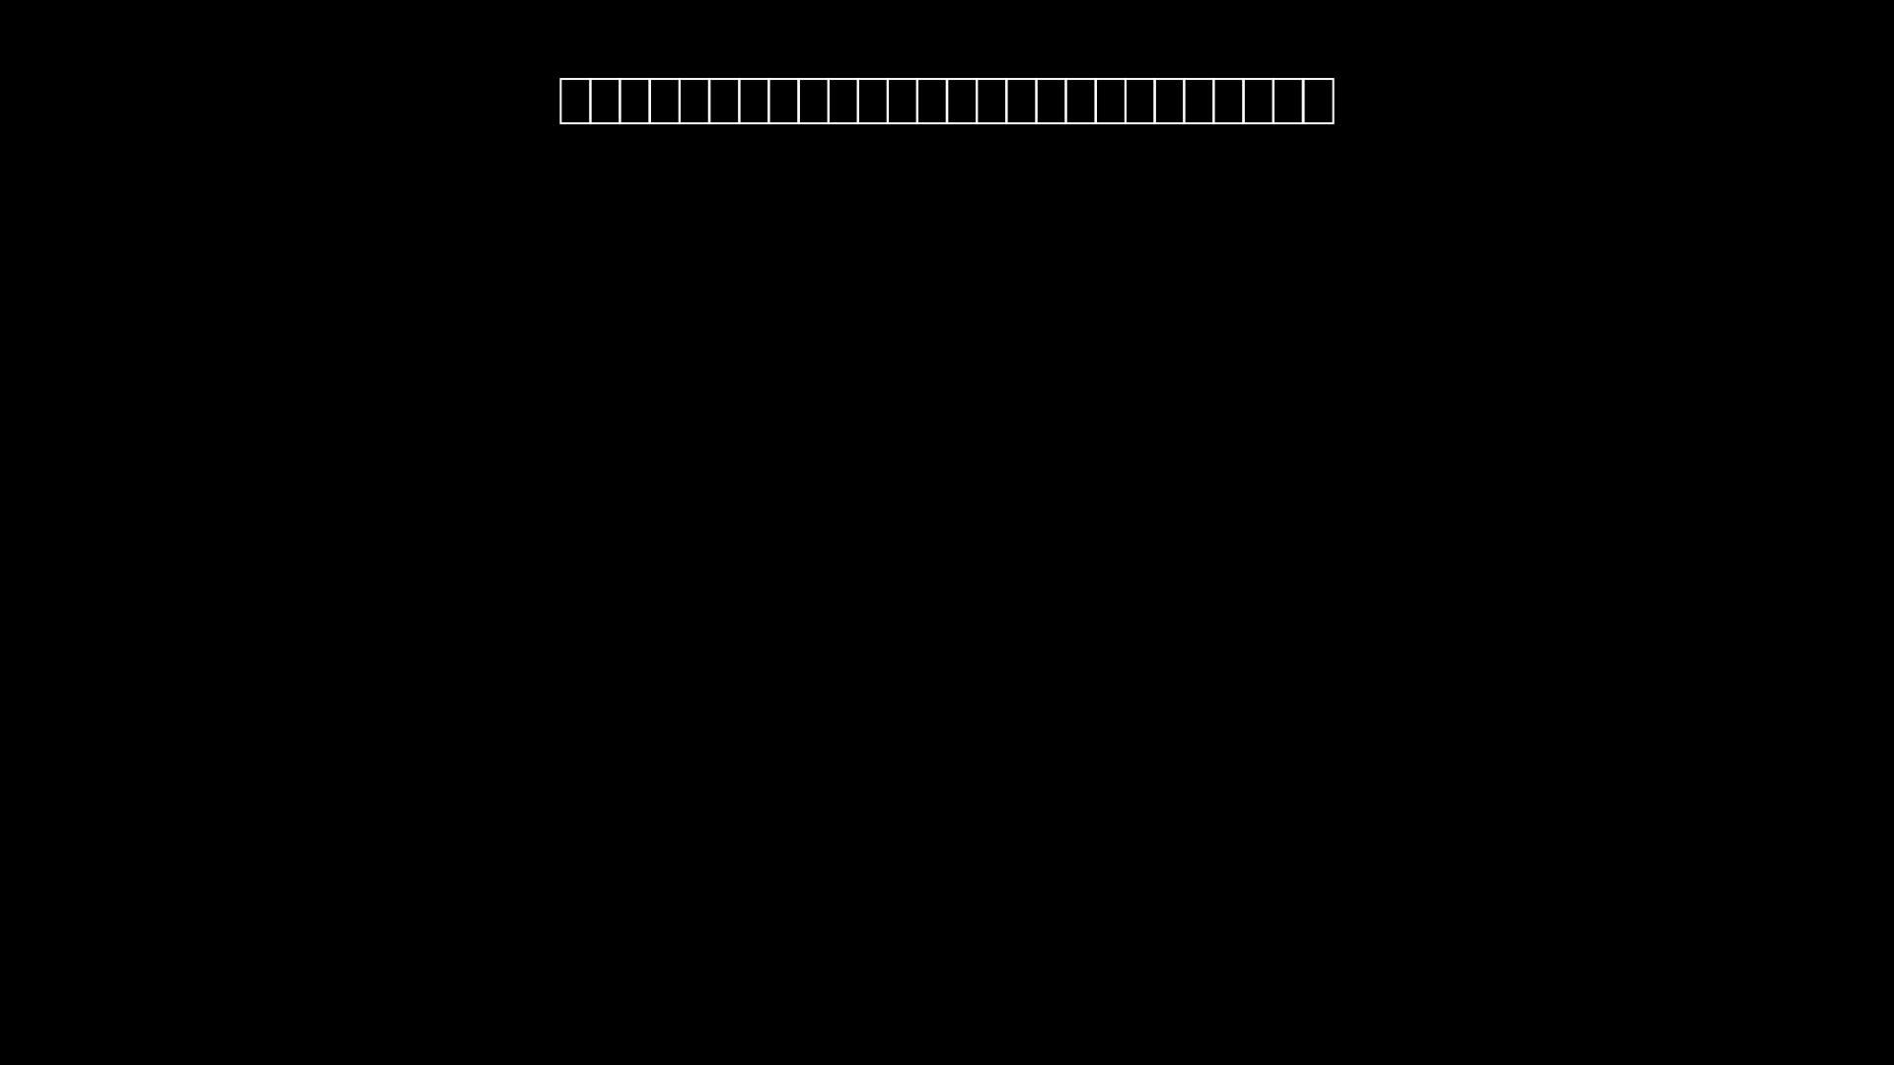
Notes:
Beginning of a try (26 spaces)
Array of pointers

Slide 171
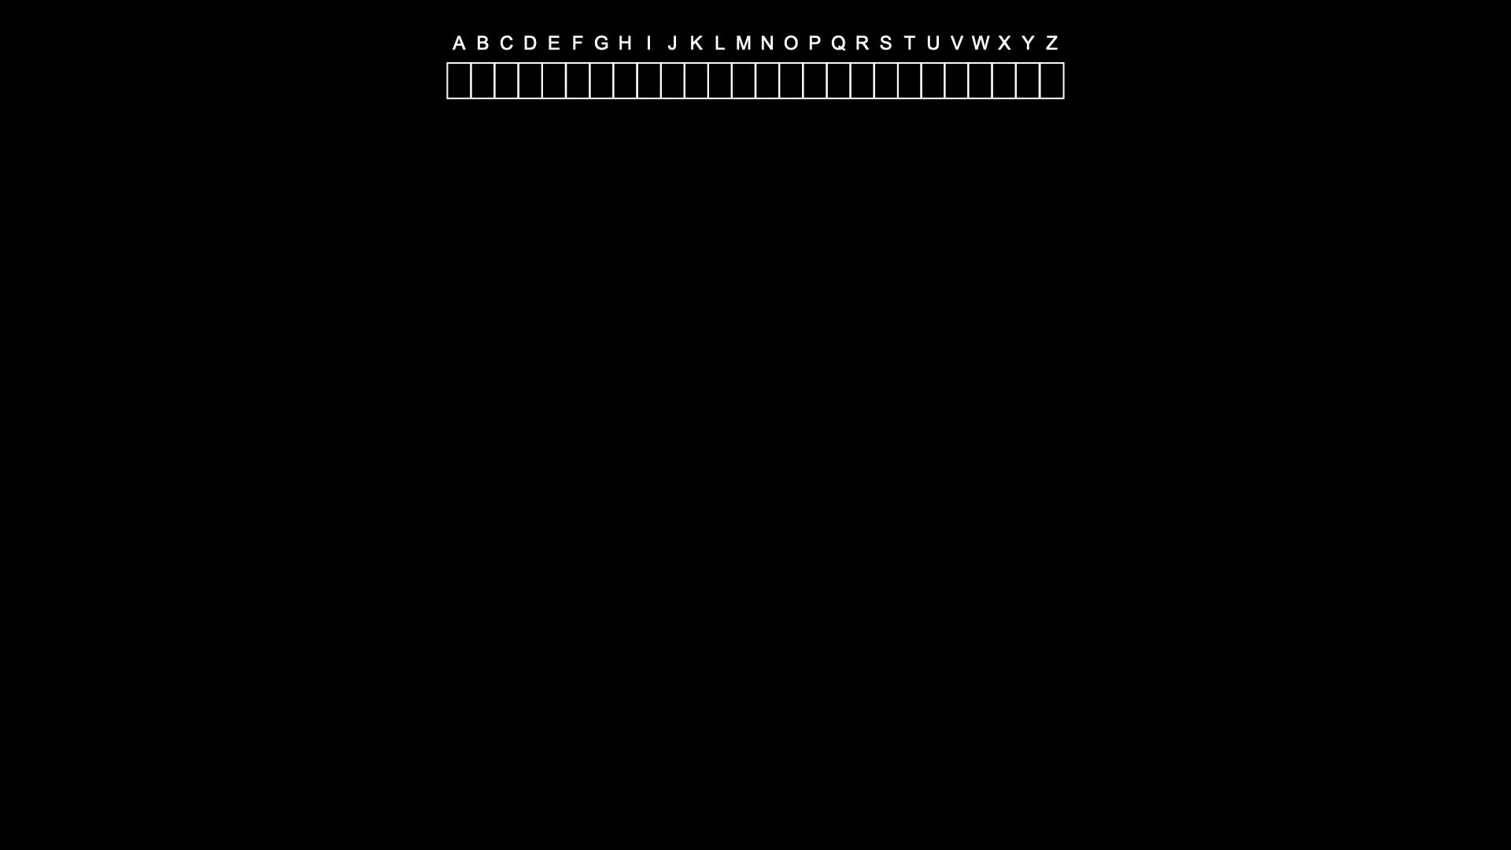
Notes:
Introduce toadette

Slide 172
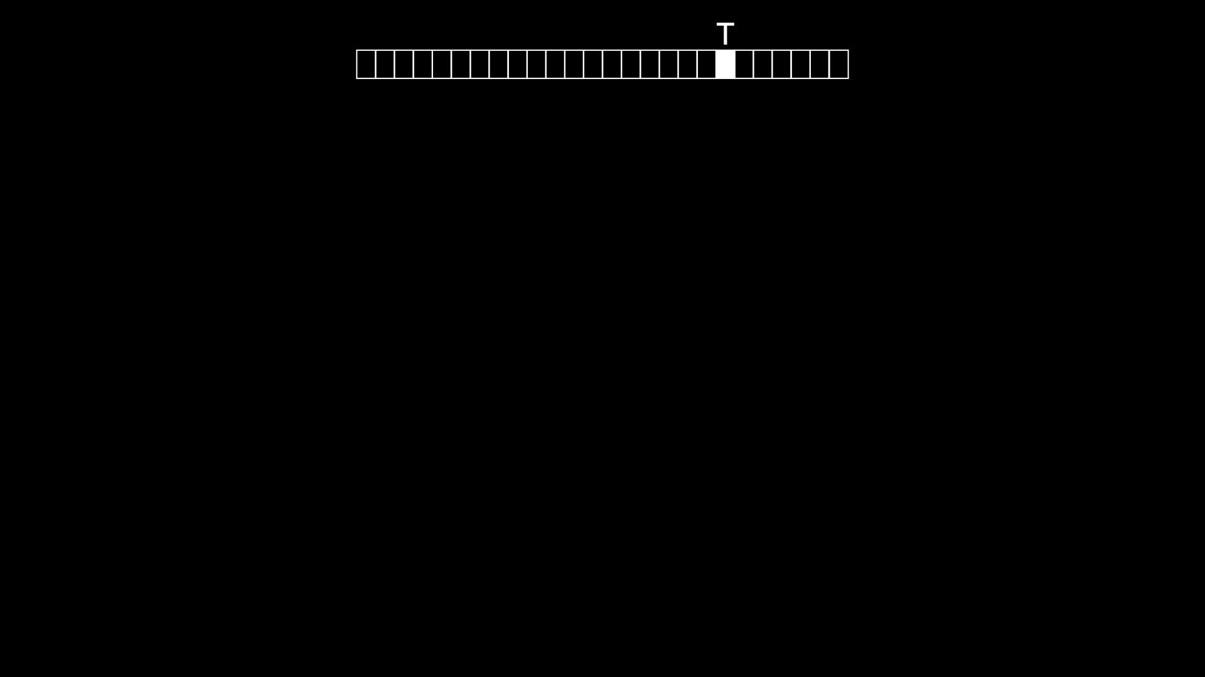

Slide 173
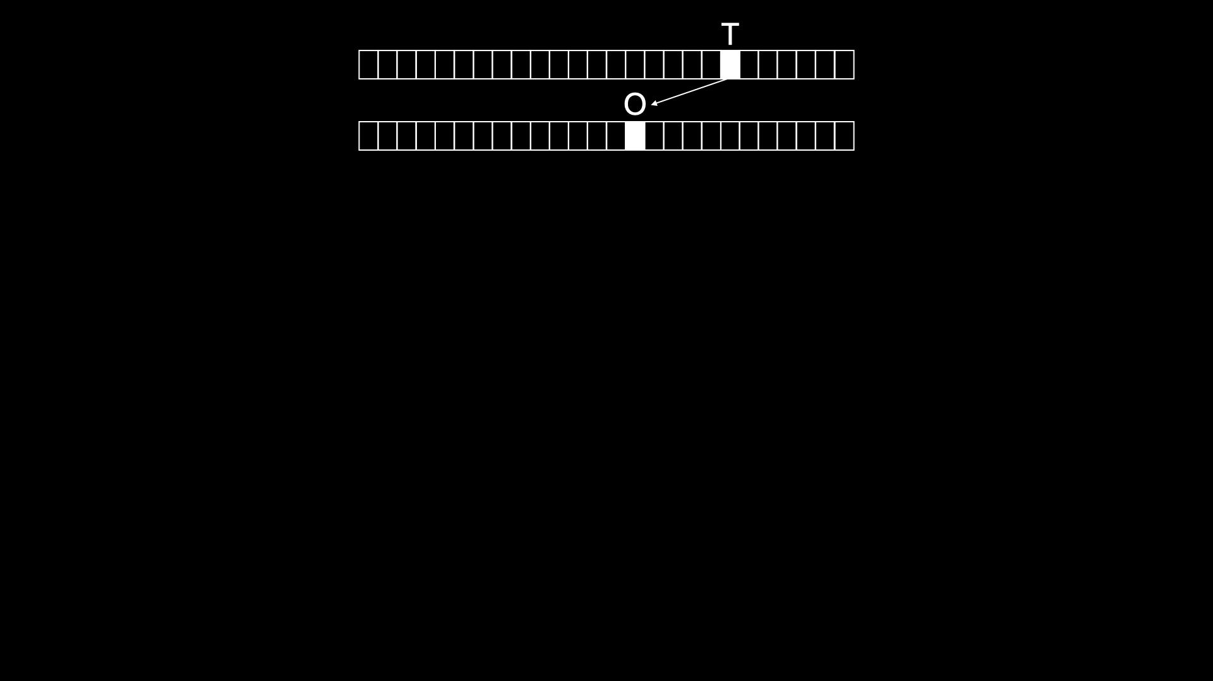
Notes:
Points to new array

Slide 174
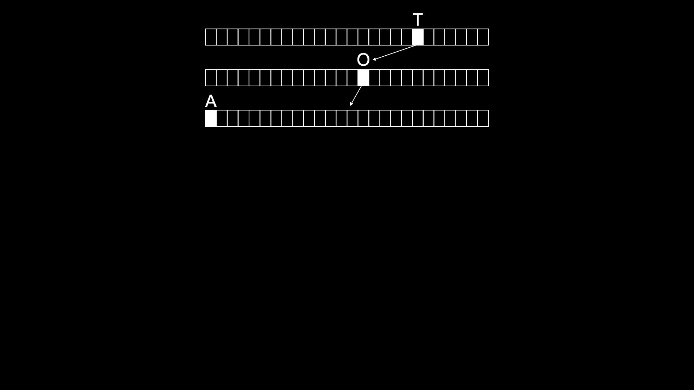

Slide 175
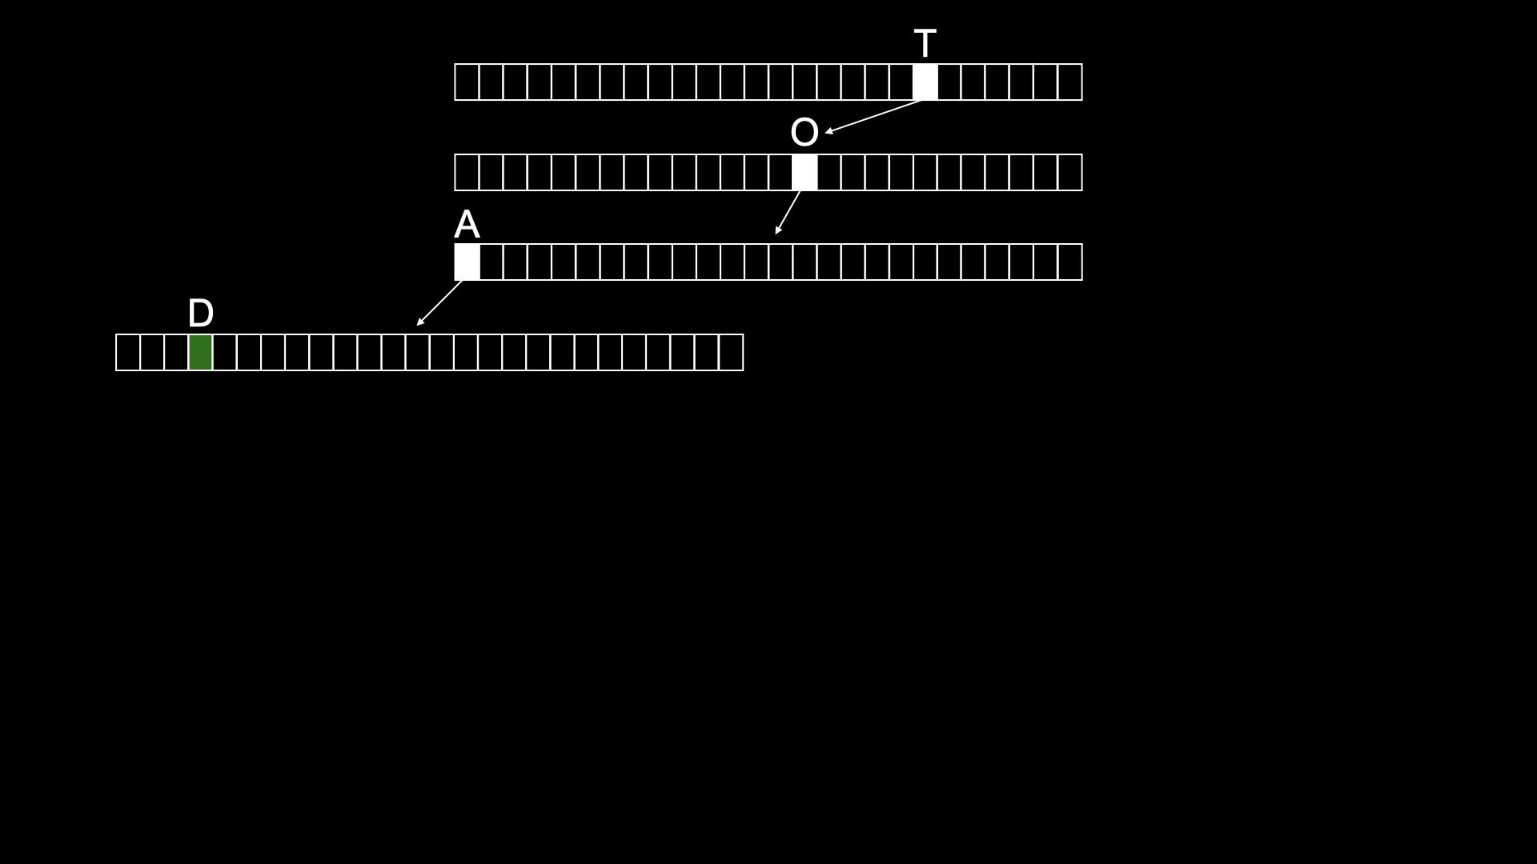
Notes:
Green, a name ends here
But, can extend it too!

Slide 176
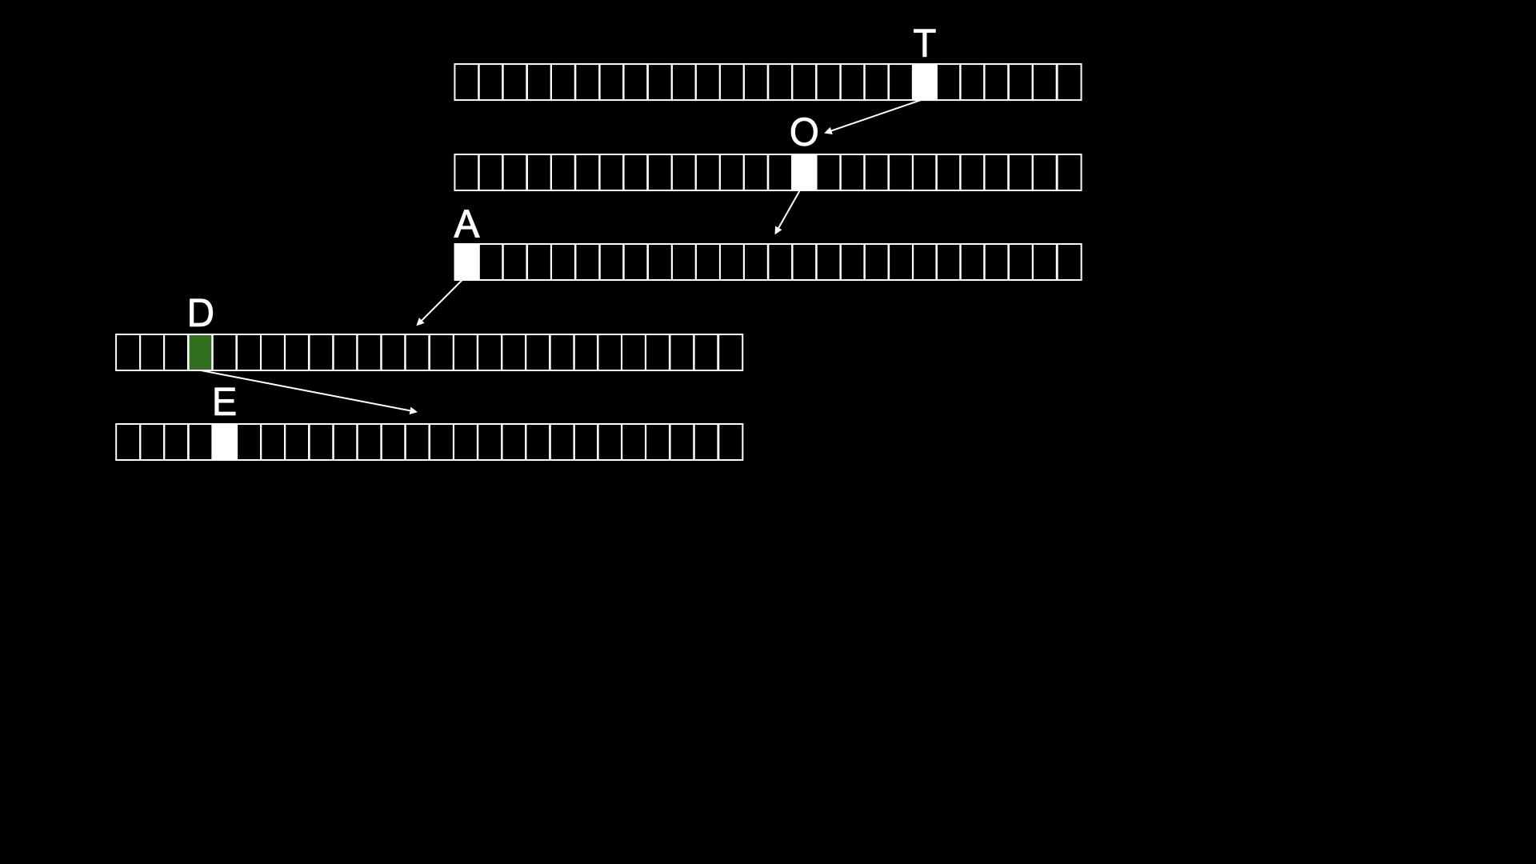

Slide 177
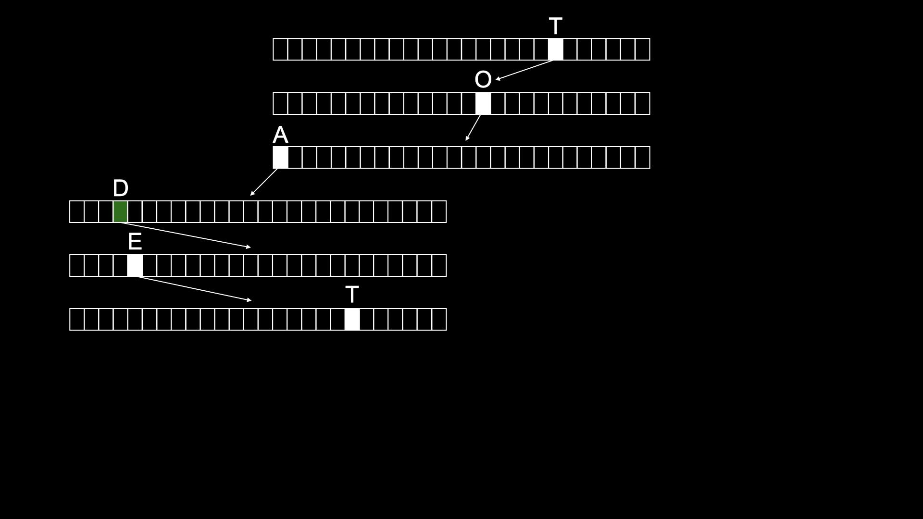

Slide 178
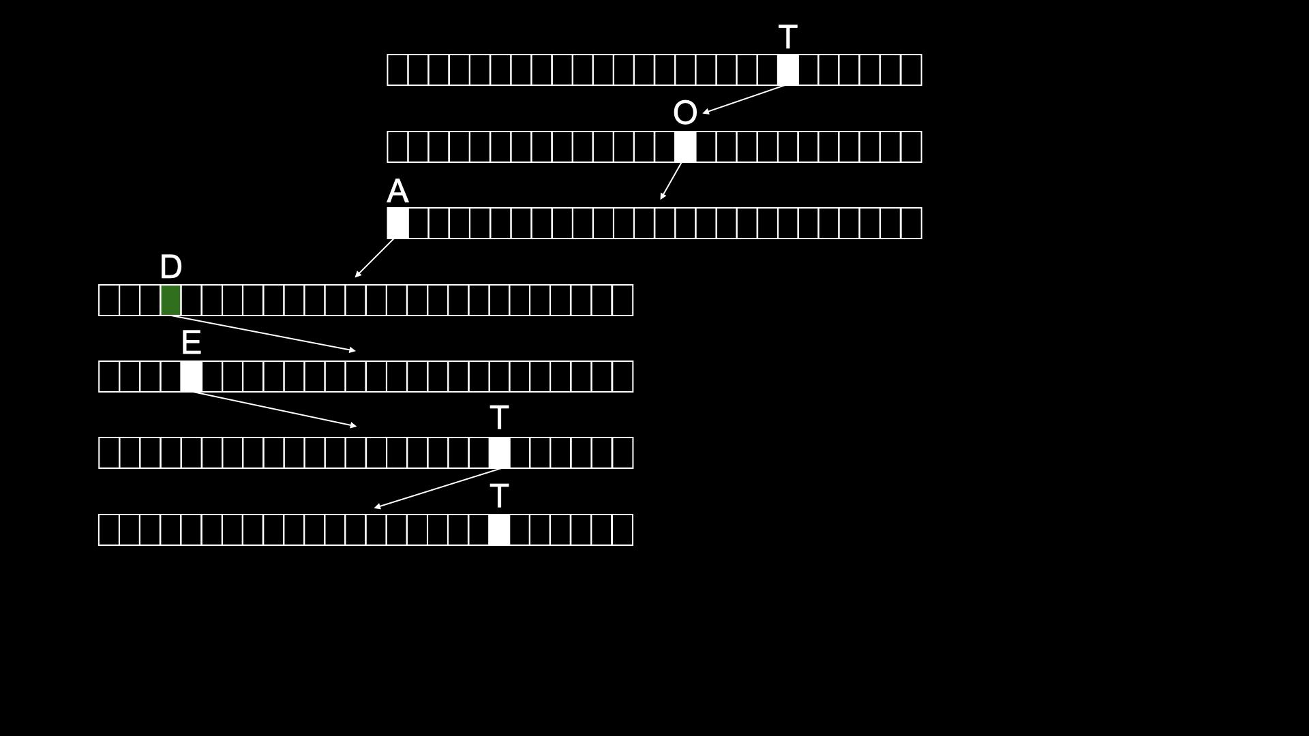

Slide 179
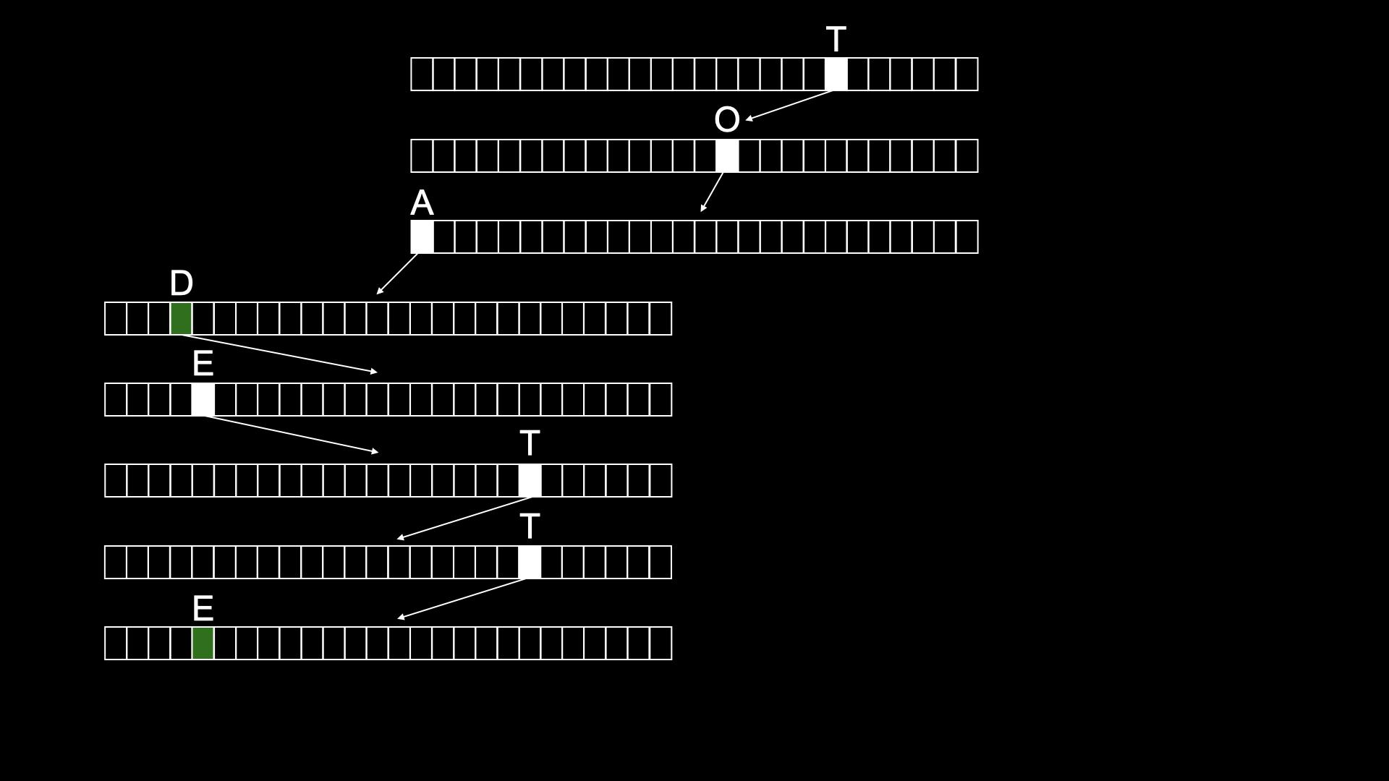
Notes:
Second end for toadette

Slide 180
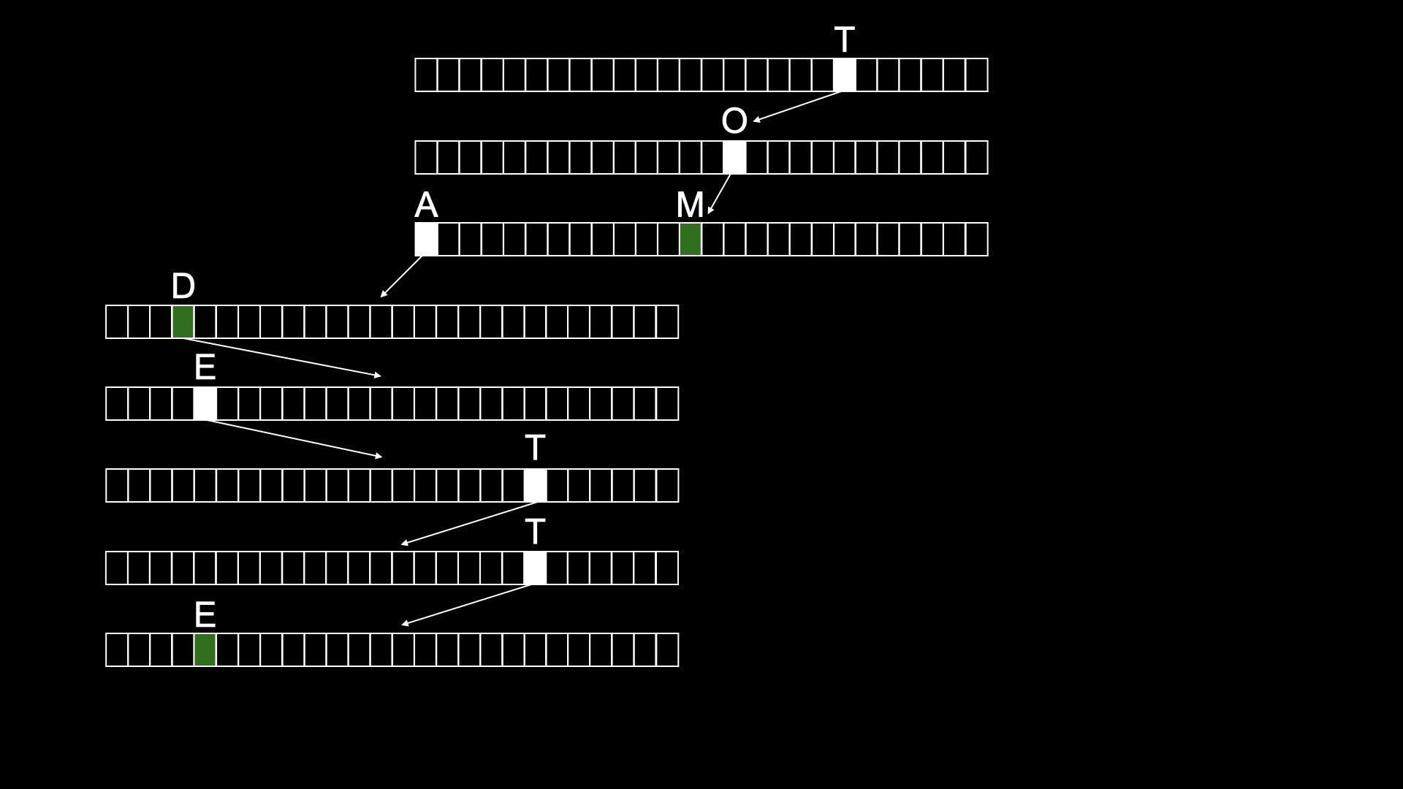
Notes:
Search time only depends on length of name itsel;f

Slide 181
typedef struct node
{
struct node *children[26];
char *number;
} node;
Notes:
don't need to bother storing name, since implicit in trie

Slide 182
node *trie;

Slide 183
O(n²)
O(n log n)
O(n)
O(log n)
O(1)
Notes:
Tries are constant time
Tradeoff is memory required for all those arrays

Slide 184
Computing Technology

