Slide 1
Hypertext Transfer Protocol (HTTP)

Slide 2
Hypertext Transfer Protocol (HTTP)
•
In addition to protocols that dictate how information is
communicated from machine to machine and application to
application (IP andTCP, respectively), it is frequently the case
that the application itself has a system of rules for how to
interpret the data that was sent.
•
HTTP is one such example of an
application layerprotocol
,
which specifically dictates the format by which clients request
web pages from a server, and the format via which servers
return information to clients.

Slide 3
Hypertext Transfer Protocol (HTTP)
•
Other application layer protocols include:
•
File Transfer Protocol (FTP)
•
Simple Mail Transfer Protocol (SMTP)
•
Data Distribution Service (DDS)
•
Remote Desktop Protocol (RDP)
•
Extensible Message and Presence Protocol (XMPP)

Slide 4


Hypertext Transfer Protocol (HTTP)
You
cats.com

Slide 5
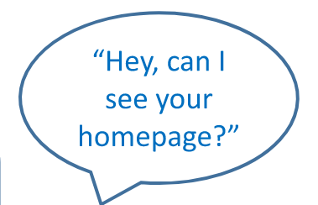
Hypertext Transfer Protocol (HTTP)
You
cats.com

Slide 6

Hypertext Transfer Protocol (HTTP)
You
cats.com

Slide 7
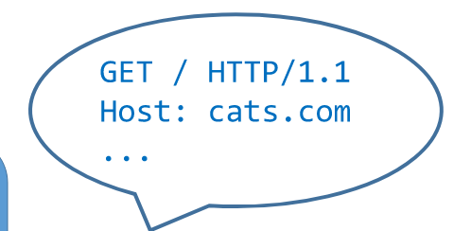
Hypertext Transfer Protocol (HTTP)
You
cats.com

Slide 8
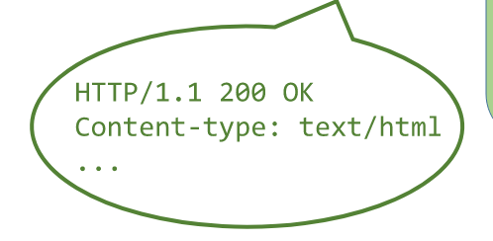
Hypertext Transfer Protocol (HTTP)
You
cats.com

Slide 9
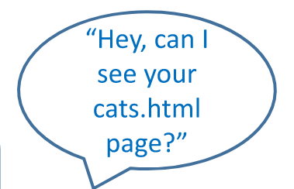
Hypertext Transfer Protocol (HTTP)
You
cats.com

Slide 10
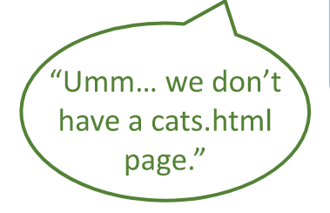
Hypertext Transfer Protocol (HTTP)
You
cats.com

