Slide 1
Computing Technology
Notes:
Point of this week – combine a web server with css, html maybe even javascript.

Slide 2
http-server
Notes:
Command to serve local web pages (used last week) – NB STATIC pages we load in browser
Javascript allows dynamic actions (e.g. autocomplete)
This all done locally
Today we move things to server side!

Slide 3
https://www.example.com/
Notes:
Slash at end indicates we want to “default page” for the website (typically index.html)

Slide 4
https://www.example.com/file.html
Notes:
Specify a specific file

Slide 5
https://www.example.com/folder/
Notes:
Specific folder

Slide 6
https://www.example.com/folder/file.html
Notes:
File in a folder

Slide 7
https://www.example.com/path
Notes:
“the path” specifying a folder/file etc

Slide 8
https://www.example.com/route
Notes:
Specify a “route” – what path do you select on the server?

Slide 9
https://www.example.com/route?key=value
Notes:
Introducing a key values – implement the “back end” for specifying inputs

Slide 10
https://www.example.com/route?key=value&key=value
Notes:
https://www.google.com/search?q=cats

Slide 11
GET /search?q=cats HTTP/2
Host: www.google.com
...
Notes:
This is what happens on the server
Could write code to do this...

Slide 12
Flask
Notes:
Framework (library) that handles routes and key/values

Slide 13
flask run
Notes:
Launch flask

Slide 14
app.py
requirements.txt
Notes:
Convention for files in flask - defaults

Slide 15
from flask import Flask
app = Flask(__name__)
@app.route("/")
def index():
return "hello, world"
Notes:
Simplest of web apps
“@” is a Python “decorator”
Defines index for web app
hello0/

Slide 16
app.py
requirements.txt
static/
templates/
Notes:
hello1/

Slide 17
from flask import Flask, render_template
app = Flask(__name__)
@app.route("/")
def index():
return render_template("index.html")
Notes:
hello2/
This creates and returns an html template to the browser
NB this associates the route (“/”) with an actual file on the server

Slide 18
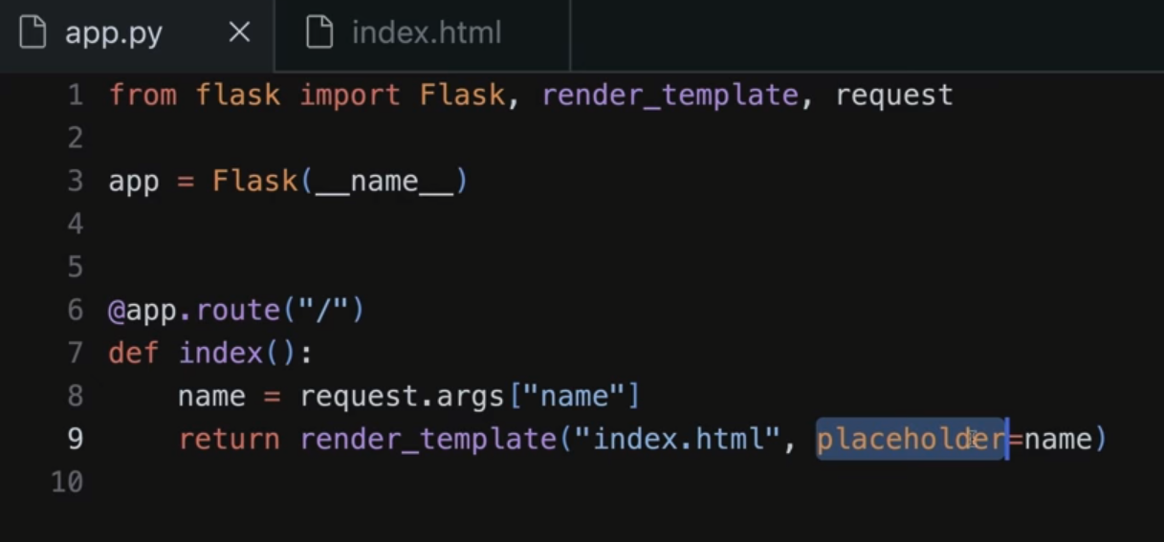
request.args
Notes:
Request variable in Flask
Stores key value pairs
Just an example because URL is hard coded and not dynamic

Slide 19
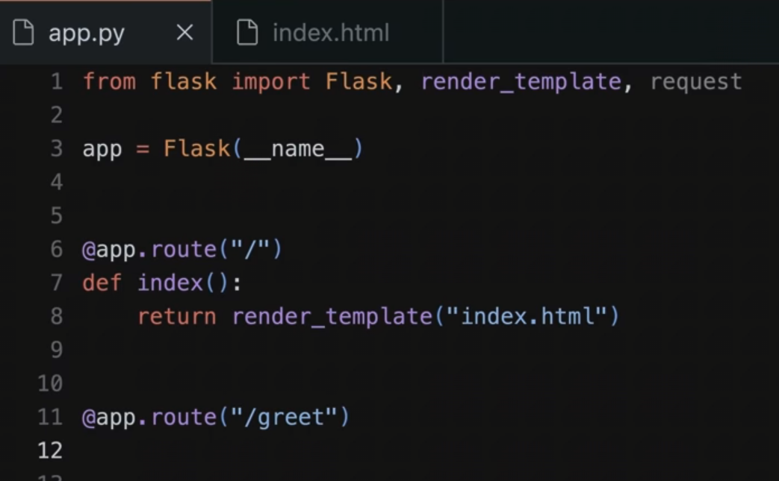
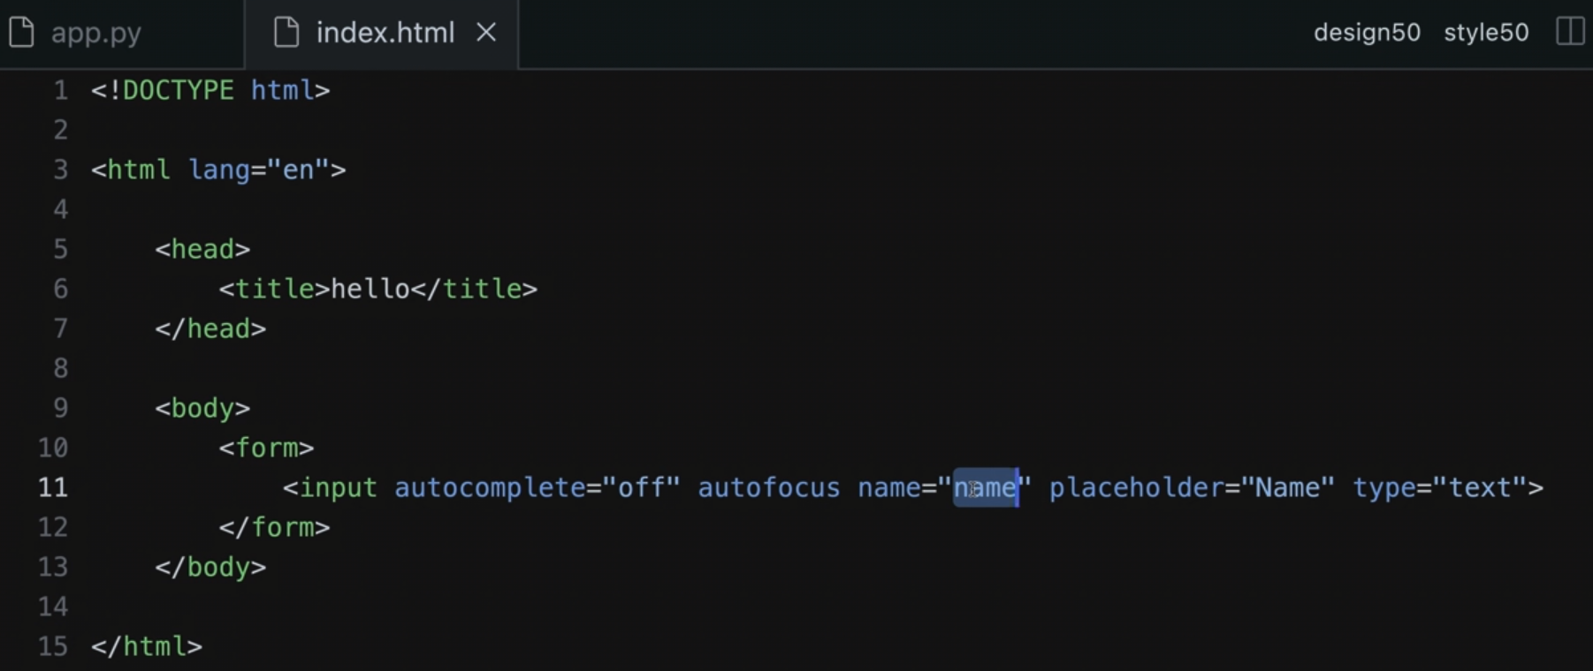
forms
Notes:
Request variable in Flask
Stores key value pairs
Just an example because URL is hard coded and not dynamic

Slide 20
Jinja
Notes:
hello{3,4,5,6,7}/
Jinja == Templating library that Flask uses – e.g. looks for variables in {{ variable }} syntax

Slide 21
request.form
Notes:
hello{8,9}/

Slide 22
jinja.palletsprojects.com/templates/
Notes:
hello10/

Slide 23

Notes:
froshims{0,1,2,3,4,5}/
Examine a web app that allows students to register for sports

Slide 24
Controller
View

Slide 25
Model
Controller
View

Slide 26
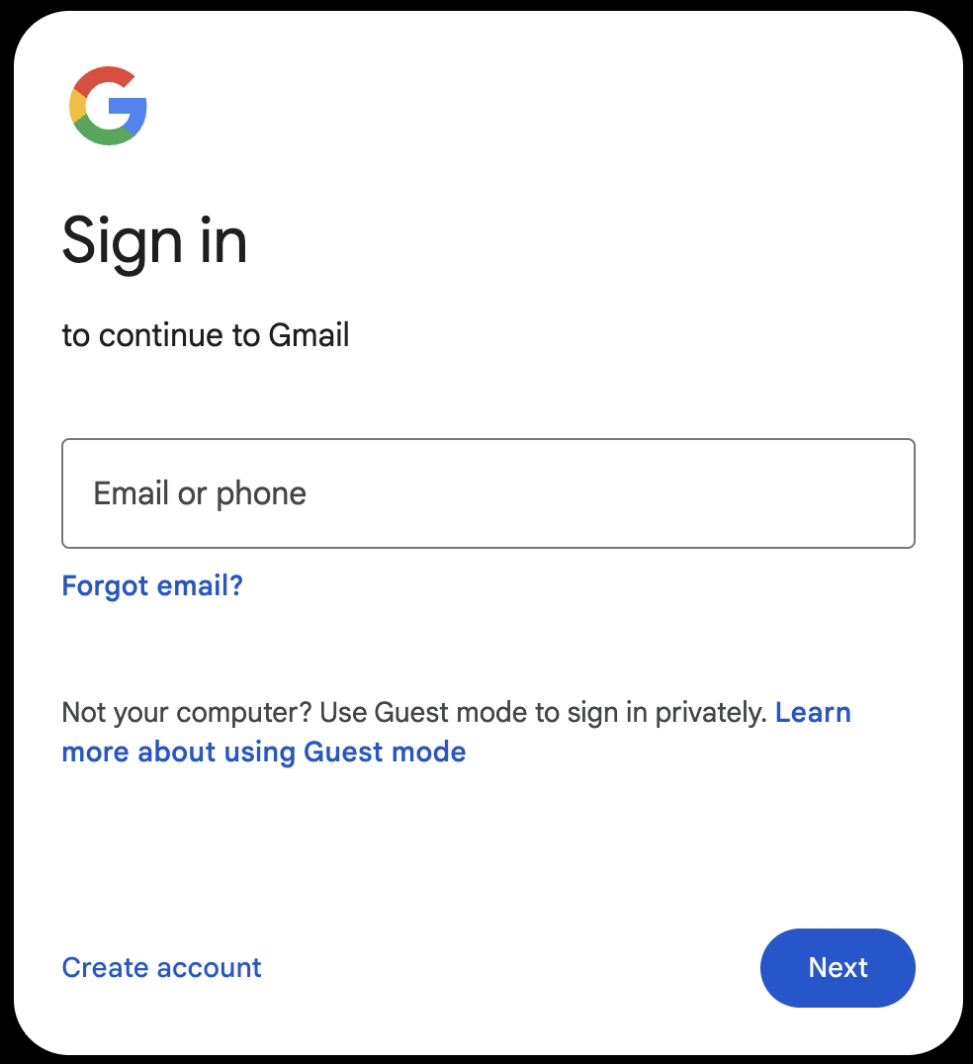
Notes:
Login / authentication

Slide 27
POST / HTTP/2
Host: accounts.google.com
...

Slide 28
HTTP/2 200
Content-Type: text/html
...

Slide 29
HTTP/2 200
Content-Type: text/html
Set-Cookie: session=value
...

Slide 30
GET / HTTP/2
Host: accounts.google.com
...

Slide 31
GET / HTTP/2
Host: accounts.google.com
Cookie: session=value
...
Notes:
hand stamp

Slide 32
session
Notes:
login/
store/
Session keeps track of whether the page has “seen” someone before

Slide 33
from cs50 import SQL
Notes:
shows{0,1}/

Slide 34
API
Notes:
shows2/
Protocol to send back snippets, e.g. from a search

Slide 35
JSON
Notes:
JSON Javascript Object Notation
Kind of like a code dictionary
Import “jasonify”

Slide 36
[
{"id": 112108, "title": "The Office", "year": 1995, "episodes": 6},
{"id": 290978, "title": "The Office", "year": 2001, "episodes": 14},
{"id": 386676, "title": "The Office", "year": 2005, "episodes": 188},
{"id": 1791001, "title": "The Office", "year": 2010, "episodes": 30},
{"id": 2186395, "title": "The Office", "year": 2012, "episodes": 8},
{"id": 8305218, "title": "The Office", "year": 2019, "episodes": 28},
{"id": 20877972, "title": "The Office", "year": 2022, "episodes": 20}
]
Notes:
shows3/

Slide 37
Computing Technology

