Slide 1
Computing Technology
Notes:
Reload codespace
Update settings.json.
Uncheck VS Code tabs except for Terminal
Hide Activity Bar
Hide Explorer
Remove comments from any pre-made code

Slide 2
This is CS50
Early Halloween candy for snacks! 🎃
If you'd like to attend our Computing Technology Lunch ... TBA

Slide 3
Computing Technology

Slide 4
data structures
Notes:
may seem arcane but lots of data structures in world

Slide 5
abstract data types

Slide 6
queues
Notes:
- waiting in line
- 3 volunteers

Slide 7
FIFO

Slide 8
enqueue
dequeue

Slide 9
const int CAPACITY = 50;
typedef struct
{
person people[CAPACITY];
int size;
} queue;

Slide 10
stacks
Notes:
- stack of sweaters
- Gmail inbox
- 3 volunteers

Slide 11
LIFO

Slide 12
push
pop

Slide 13
const int CAPACITY = 50;
typedef struct
{
person people[CAPACITY];
int size;
} stack;

Slide 14

Notes:
https://www.youtube.com/watch?v=ItAG3s6KIEI
Prof. Shannon Duvall of Elon University

Slide 15
arrays

Slide 17
 | 1 | 2 | 3

Slide 18
 | 1 | 2 | 3

Slide 19
 | 1 | 2 | 3

Slide 20

 | 1 | 2 | 3 | h | e | l | l
o | , |  | w | o | r | l | d
\0

Slide 21
 | 1 | 2 | 3

Slide 22
 | 1 | 2 | 3
 | 1

Slide 23
 | 1 | 2 | 3
 | 1 | 2

Slide 24
 | 1 | 2 | 3
 | 1 | 2 | 3

Slide 25
 | 1 | 2 | 3
 | 1 | 2 | 3 | 4

Slide 26
 | 1 | 2 | 3 | 4
Notes:
list{0,1,2}.c

Slide 27
data structures

Slide 28
struct
.
*

Slide 29
struct
->

Slide 30
linked lists

Slide 32
 |  | 1 0x123

Slide 33
 |  | 1 0x123
 |  |  |  | 2 0x456

Slide 34
 |  | 1 0x123
 |  |  |  | 2 0x456
 |  |  |  |  |  | 3 0x789

Slide 35
 |  | 1 0x123
 |  |  |  | 2 0x456
 |  |  |  |  |  | 3 0x789

Slide 36
 |  | 1 0x123
 |  | 0x456 |  | 2 0x456
 |  |  |  |  |  | 3 0x789

Slide 37
 |  | 1 0x123
 |  | 0x456 |  | 2 0x456
 |  |  |  | 0x789 |  | 3 0x789

Slide 38
 |  | 1 0x123
 |  | 0x456 |  | 2 0x456
 |  |  |  | 0x789 |  | 3 0x789
 |  |  |  |  |  | 0x0

Slide 39
 |  | 1 0x123
 |  | 0x456 |  | 2 0x456
 |  |  |  | 0x789 |  | 3 0x789
 |  |  |  |  |  | NULL

Slide 40
 |  | 1 0x123
 |  | 0x456 |  | 2 0x456
0x123 |  |  |  | 0x789 |  | 3 0x789
 |  |  |  |  |  | NULL

Slide 41
 |  | 1
 |  |  |  | 2
 |  |  |  |  |  | 3

Slide 42
typedef struct
{
string name;
string number;
} person;

Slide 43
typedef struct
{
char *name;
char *number;
} person;

Slide 44
typedef struct
{
} person;

Slide 45
typedef struct
{
} node;

Slide 46
typedef struct
{
int number;
} node;

Slide 47
typedef struct
{
int number;
node *next;
} node;

Slide 48
typedef struct node
{
int number;
node *next;
} node;

Slide 49
typedef struct node
{
int number;
struct node *next;
} node;
Notes:
list3.c (to show prepending)

Slide 51
node *list;

Slide 52
node *list;
list

Slide 53
node *list = NULL;
list

Slide 54
node *list = NULL;
list

Slide 55
node *n = malloc(sizeof(node));
list

Slide 56
node *n = malloc(sizeof(node));
list
n

Slide 57
node *n = malloc(sizeof(node));
list
number
n
next

Slide 58
node *n = malloc(sizeof(node));
list
number
n
next

Slide 59
(*n).number = 1;
list
number
n
next

Slide 60
(*n).number = 1;
list
1
number
n
next

Slide 61
n->number = 1;
list
1
number
n
next

Slide 62
n->next = NULL;
list
1
number
n
next

Slide 63
n->next = NULL;
list
1
number
n
next

Slide 64
list = n;
list
1
number
n
next

Slide 65
list = n;
list
1
number
n
next

Slide 66
list
1

Slide 67
node *n = malloc(sizeof(node));
list
1

Slide 68
node *n = malloc(sizeof(node));
list
1
n

Slide 69
node *n = malloc(sizeof(node));
list
1
n

Slide 70
node *n = malloc(sizeof(node));
list
1
n

Slide 71
n->number = 2;
list
1
n

Slide 72
n->number = 2;
list
2
1
n

Slide 73
n->next = NULL;
list
2
1
n

Slide 74
n->next = NULL;
list
2
1
n

Slide 75
list
2
1
n

Slide 76
list = n;
list
2
1
n

Slide 77
list = n;
list
2
1
n

Slide 78
list = n;
list
2
1
n

Slide 79
list
2
1
n

Slide 80
n->next = list;
list
2
1
n

Slide 81
n->next = list;
list
2
1
n

Slide 82
list = n;
list
2
1
n

Slide 83
list = n;
list
2
1
n

Slide 84
list
2
1

Slide 85
list
2
1
3
Notes:
list4.c (to show printing with while loop)

Slide 86
ptr
list
2
1
3

Slide 87
ptr
list
2
1
3

Slide 88
ptr
list
2
1
3

Slide 89
ptr
list
2
1
3

Slide 90
list
2
1
3
Notes:
list5.c (for loop instead)

Slide 91
O(n²)
O(n log n)
O(n)
O(log n)
O(1)

Slide 92
list

Slide 93
list
1

Slide 94
list
2
1

Slide 95
list
2
1
3

Slide 96
O(n²)
O(n log n)
O(n)
O(log n)
O(1)

Slide 97
O(n²)
O(n log n)
O(n)
O(log n)
O(1)
Notes:
list6.c (freeing, after showing valgrind on list5)

Slide 98
O(n²)
O(n log n)
O(n) search
O(log n)
O(1) insertion

Slide 99
O(n²)
O(n log n)
O(n) search, deletion
O(log n)
O(1) insertion

Slide 100
list

Slide 101
list
1

Slide 102
2
list
1

Slide 103
2
list
1
3

Slide 104
O(n²)
O(n log n)
O(n)
O(log n)
O(1)
Notes:
list7.c (append)

Slide 105
O(n²)
O(n log n)
O(n) search, deletion, insertion
O(log n)
O(1)

Slide 106
list

Slide 107
list
2

Slide 108
list
2
1

Slide 109
4
list
2
1

Slide 110
4
list
2
3
1

Slide 111
O(n²)
O(n log n)
O(n)
O(log n)
O(1)
Notes:
list8.c (sorted)

Slide 112
O(n²)
O(n log n)
O(n) search, deletion, insertion
O(log n)
O(1)
Notes:
list8.c (sorted)

Slide 113

Notes:
https://emojipedia.org/apple/ios-17.4/jack-o-lantern

Slide 114
trees

Slide 115
binary search trees

Slide 116
 | 1 | 2 | 3 | 4 | 5 | 6 | 7

Slide 117
 | 1 | 2 | 3 | 4 | 5 | 6 | 7

Slide 118
 | 1 | 2 | 3 | 4 | 5 | 6 | 7

Slide 119
 | 1 | 2 | 3 | 4 | 5 | 6 | 7

Slide 120
4
2
6
1
3
5
7

Slide 121
4
2
6
1
3
5
7
Notes:
each square is an abstraction of a node now, no need to keep drawing rects

Slide 122
typedef struct node
{
int number;
struct node *next;
} node;

Slide 123
typedef struct node
{
int number;
} node;

Slide 124
typedef struct node
{
int number;
} node;

Slide 125
typedef struct node
{
int number;
struct node *left;
struct node *right;
} node;

Slide 126
4
2
6
1
3
5
7

Slide 127
bool search(node *tree, int number)
{
if (tree == NULL)
{
return false;
}
else if (number < tree->number)
{
return search(tree->left, number);
}
else if (number > tree->number)
{
return search(tree->right, number);
}
else if (number == tree->number)
{
return true;
}
}

Slide 128
bool search(node *tree, int number)
{
if (tree == NULL)
{
return false;
}
else if (number < tree->number)
{
return search(tree->left, number);
}
else if (number > tree->number)
{
return search(tree->right, number);
}
else if (number == tree->number)
{
return true;
}
}

Slide 129
bool search(node *tree, int number)
{
if (tree == NULL)
{
return false;
}
else if (number < tree->number)
{
return search(tree->left, number);
}
else if (number > tree->number)
{
return search(tree->right, number);
}
else if (number == tree->number)
{
return true;
}
}

Slide 130
bool search(node *tree, int number)
{
if (tree == NULL)
{
return false;
}
else if (number < tree->number)
{
return search(tree->left, number);
}
else if (number > tree->number)
{
return search(tree->right, number);
}
else if (number == tree->number)
{
return true;
}
}

Slide 131
bool search(node *tree, int number)
{
if (tree == NULL)
{
return false;
}
else if (number < tree->number)
{
return search(tree->left, number);
}
else if (number > tree->number)
{
return search(tree->right, number);
}
else if (number == tree->number)
{
return true;
}
}

Slide 132
bool search(node *tree, int number)
{
if (tree == NULL)
{
return false;
}
else if (number < tree->number)
{
return search(tree->left, number);
}
else if (number > tree->number)
{
return search(tree->right, number);
}
else if (number == tree->number)
{
return true;
}
}

Slide 133
4
2
6
1
3
5
7

Slide 134
Notes:
What if we build a BST from scratch, starting with 2?

Slide 135
2

Slide 136
2
1
Notes:
then 1

Slide 137
2
1
3
Notes:
then 3. looks fine.

Slide 138
Notes:
what if the insertion order is 1-2-3 instead?

Slide 139
1

Slide 140
1
2

Slide 141
1
2
3

Slide 142
O(n²)
O(n log n)
O(n)
O(log n)
O(1)

Slide 143
dictionaries

Slide 145
word | definition

Slide 146
key | value

Slide 147

Notes:
https://apps.apple.com/us/app/contacts/id1069512615#?platform=iphone

Slide 148
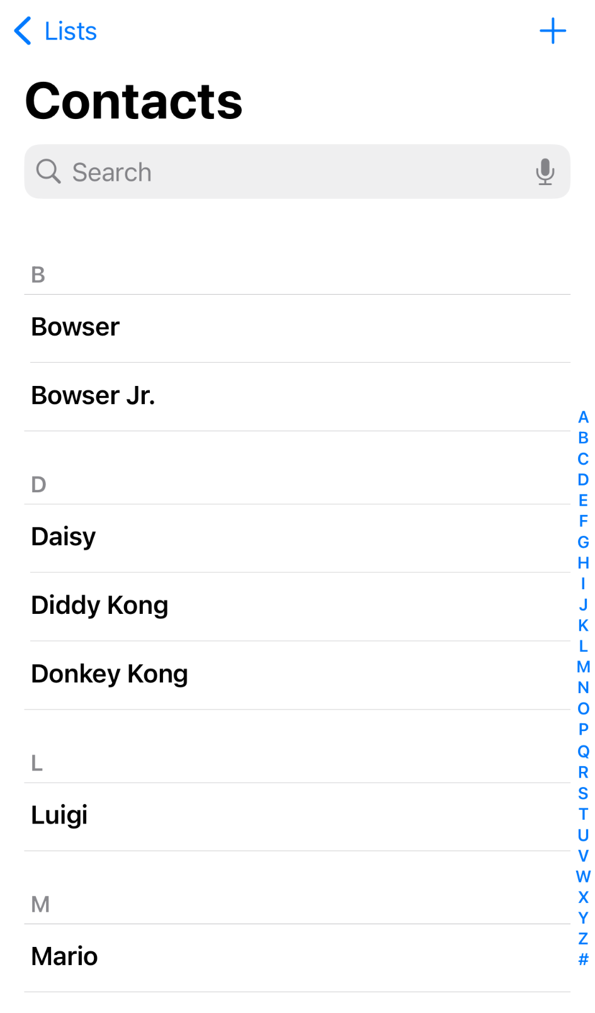
Notes:
https://nintendo.fandom.com/wiki/Nintendo_characters#Mario_series_(including_sub-franchises)

Slide 149
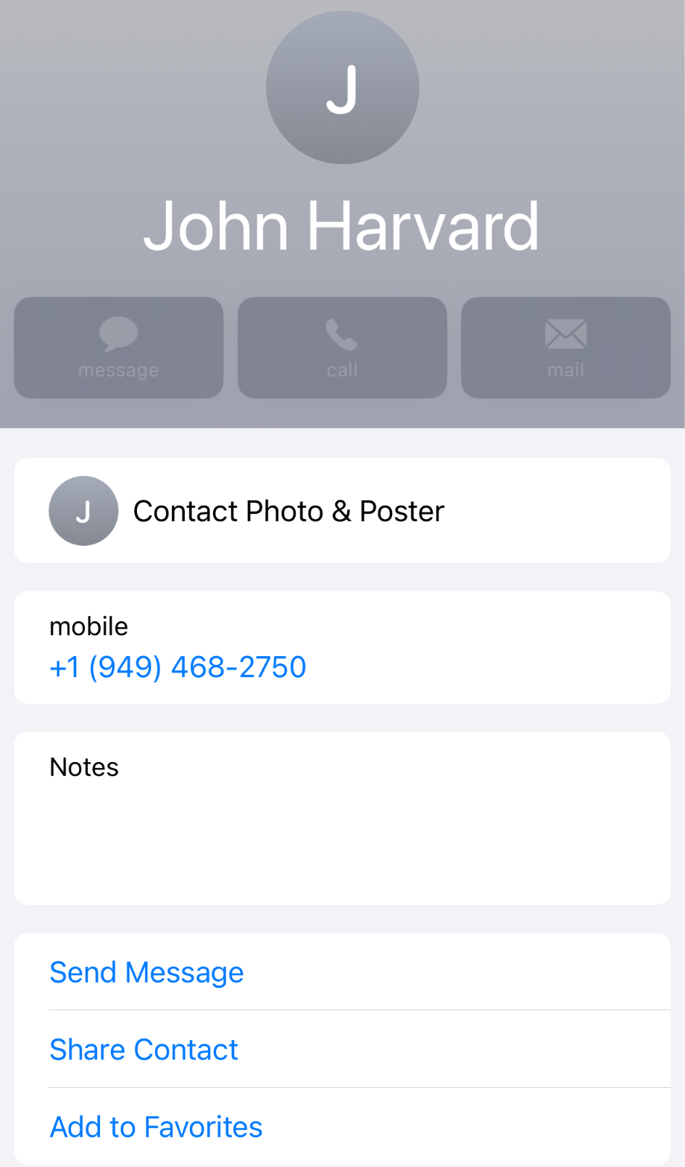

Slide 150
name | number

Slide 151
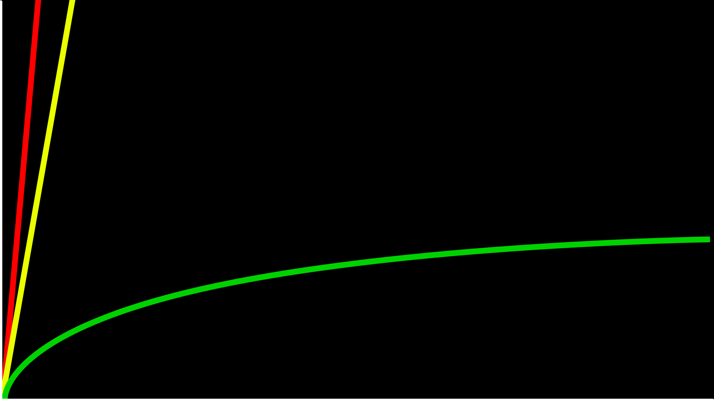
O(n)
time to solve
O(log n)
size of problem

Slide 152
O(n)
time to solve
O(log n)
O(1)
size of problem

Slide 153
hashing
Notes:
cards into buckets

Slide 154
hash function

Slide 155
hash tables

Slide 157
0
1
2
3
4
5
6
7
8
9
10
11
12
13
14
15
16
17
18
19
20
21
22
23
24
25

Slide 158
A
B
C
D
E
F
G
H
I
J
K
L
M
N
O
P
Q
R
S
T
U
V
W
X
Y
Z

Slide 160
Mario

Slide 161
Luigi
Mario

Slide 162
Luigi
Mario
Peach

Slide 163
Birdo
Daisy
Goomba
Isabelle
King Boo
Luigi
Mario
Peach
Rosalina
Shy Guy
Toad
Wario
Yoshi
Zelda

Slide 164
Birdo
Daisy
Goomba
Isabelle
King Boo
Luigi
Lakitu
Mario
Peach
Rosalina
Shy Guy
Toad
Wario
Yoshi
Zelda

Slide 165
Birdo
Daisy
Goomba
Isabelle
King Boo
Luigi
Lakitu
Link
Mario
Peach
Rosalina
Shy Guy
Toad
Wario
Yoshi
Zelda

Slide 166
Birdo
Bowser
Bowser Jr.
Daisy
Donkey Kong
Diddy Kong
Dry Bones
Goomba
Ganon
Isabelle
King Boo
K.K. Slider
Luigi
Lakitu
Link
Mario
Peach
Petey Piranha
Rosalina
Shy Guy
Spike
Toad
Toadette
Tom Nook
Wario
Waluigi
Yoshi
Zelda

Slide 167
O(n²)
O(n log n)
O(n)
O(log n)
O(1)

Slide 168
O(n²)
O(n log n)
O(n)
O(log n)
O(1)

Slide 169
typedef struct
{
char *name;
char *number;
} person;

Slide 170
typedef struct node
{
char *name; char *number;
struct node *next;
} node;

Slide 171
node *table[26];

Slide 172
input →
→ output

Slide 173
hash function

Slide 174
Mario →
→ 12

Slide 175
Luigi →
→ 11

Slide 176
Laa
Lab
Lac
Lad
Lae
Laf
Lag
Lah
Lai
Laj
Lak
...
Lim
Lin
Lio
...
Luh
Lui
Luj
Lakitu
Link
Luigi
Notes:
17,576 buckets

Slide 177
#include <ctype.h>
int hash(char *word)
{
return toupper(word[0]) - 'A';
}

Slide 178
#include <ctype.h>
int hash(const char *word)
{
return toupper(word[0]) - 'A';
}

Slide 179
#include <ctype.h>
unsigned int hash(const char *word)
{
return toupper(word[0]) - 'A';
}

Slide 180
O(n)

Slide 181
O(n/k)

Slide 182
O(n)

Slide 183
O(1)

Slide 184
tries

Slide 185
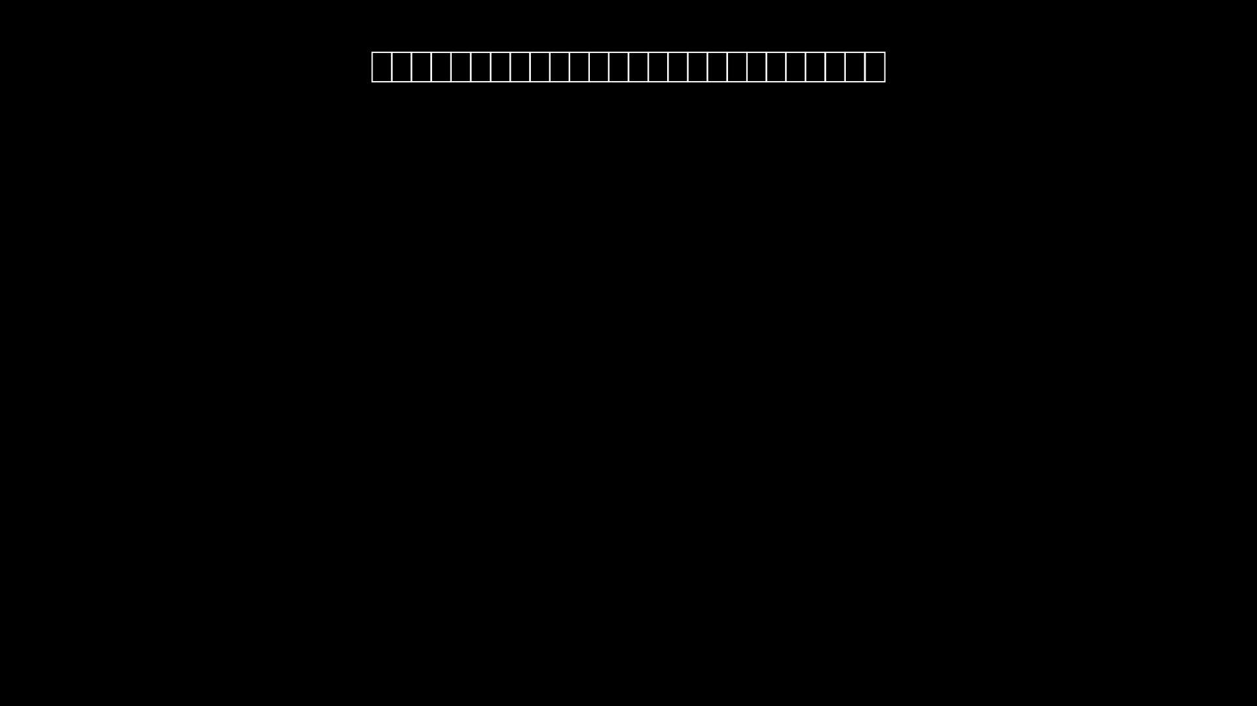

Slide 186
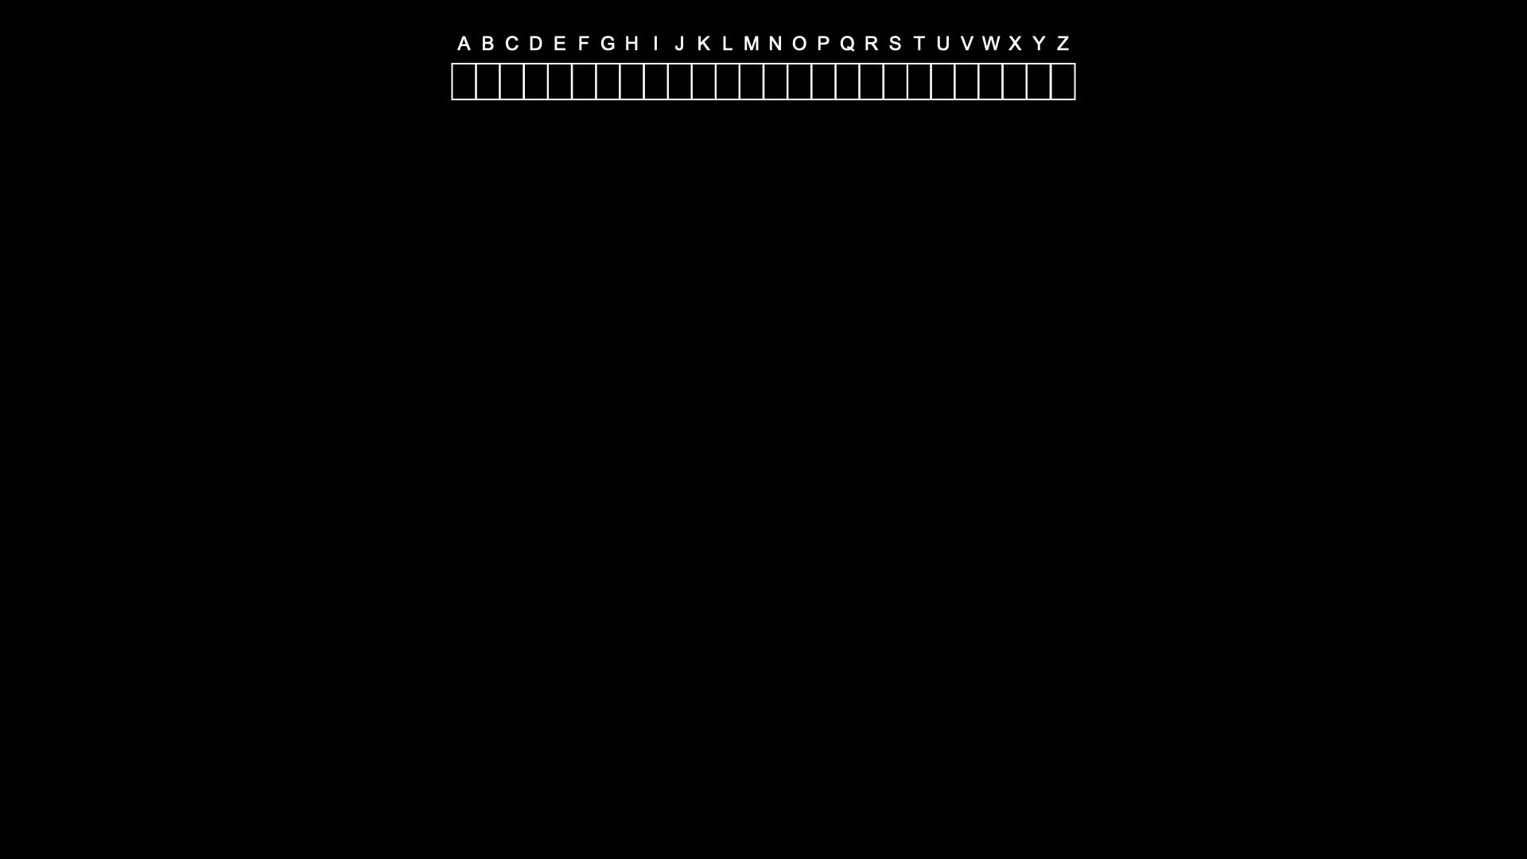

Slide 187
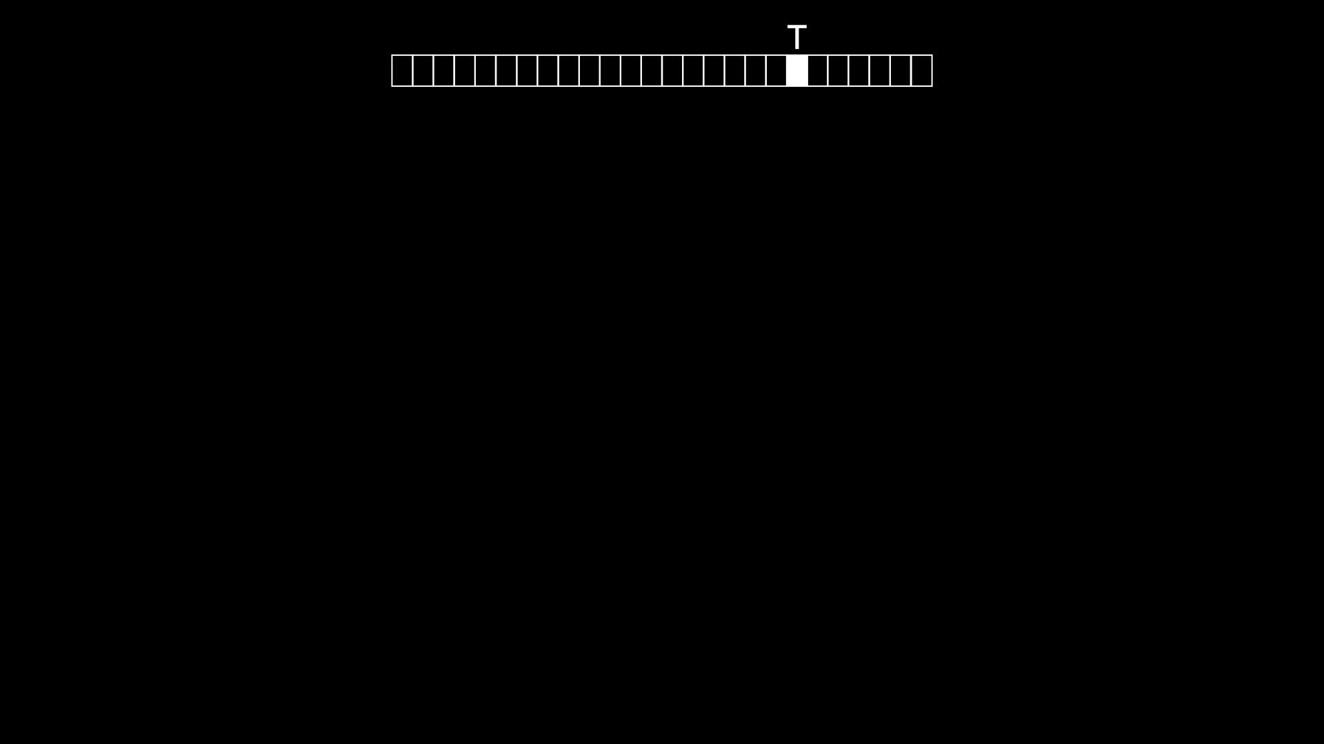

Slide 188
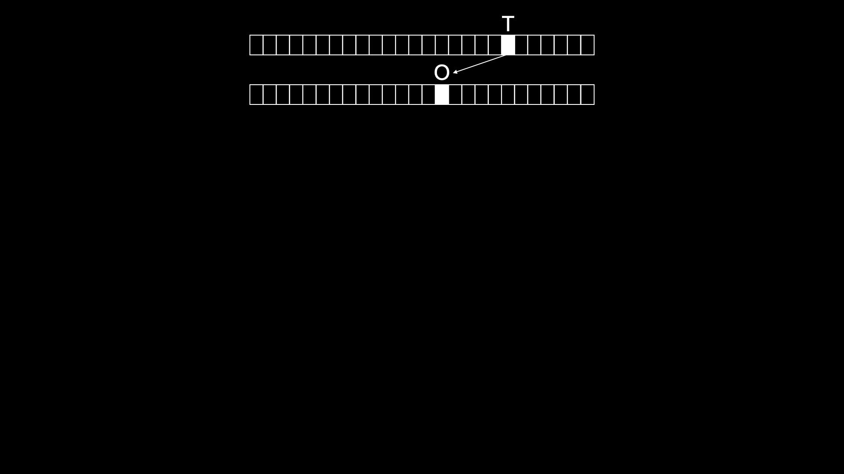

Slide 189
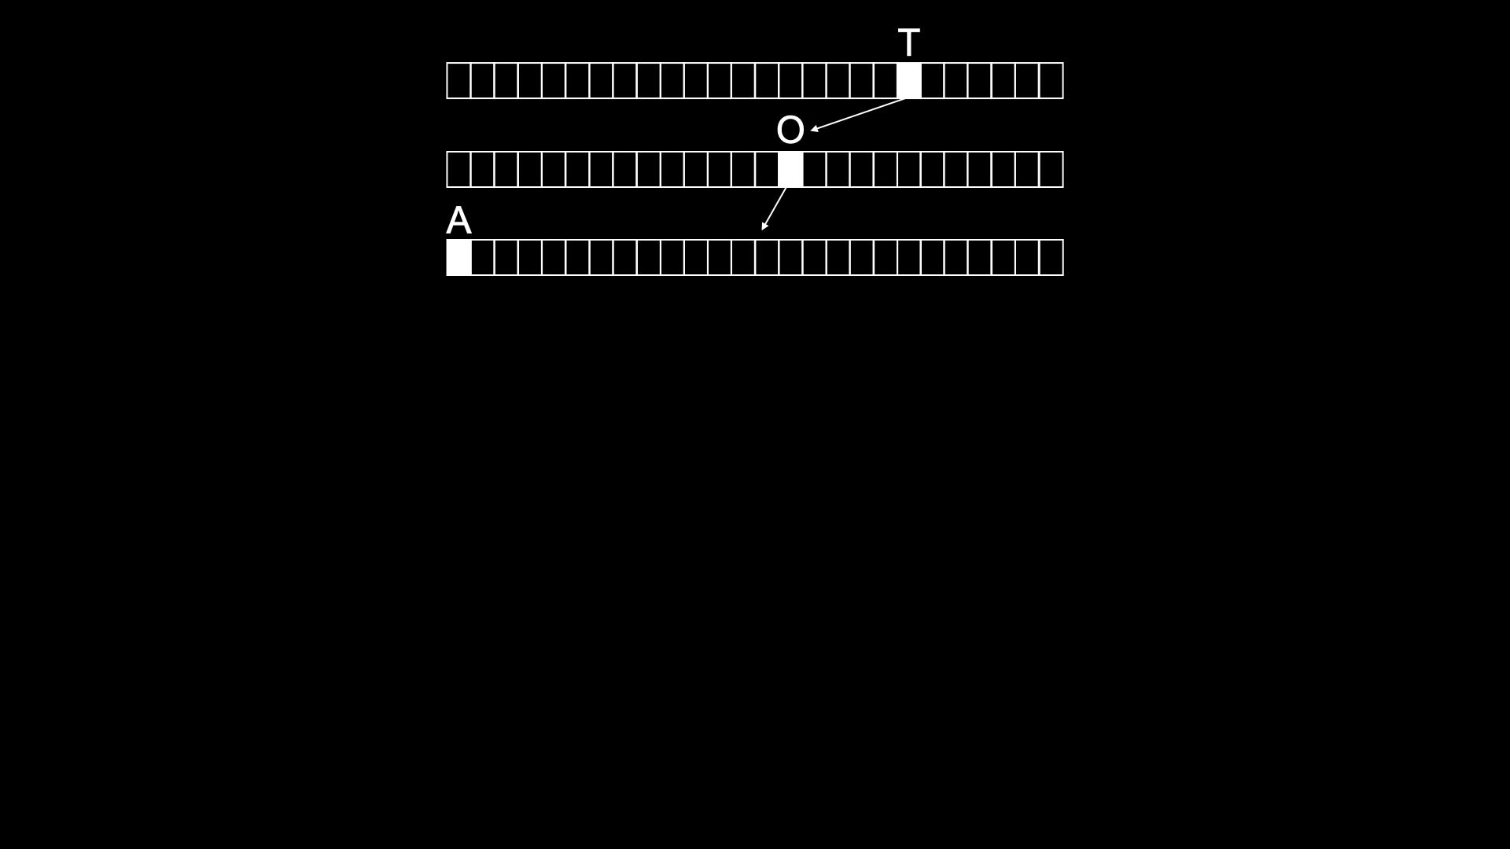

Slide 190
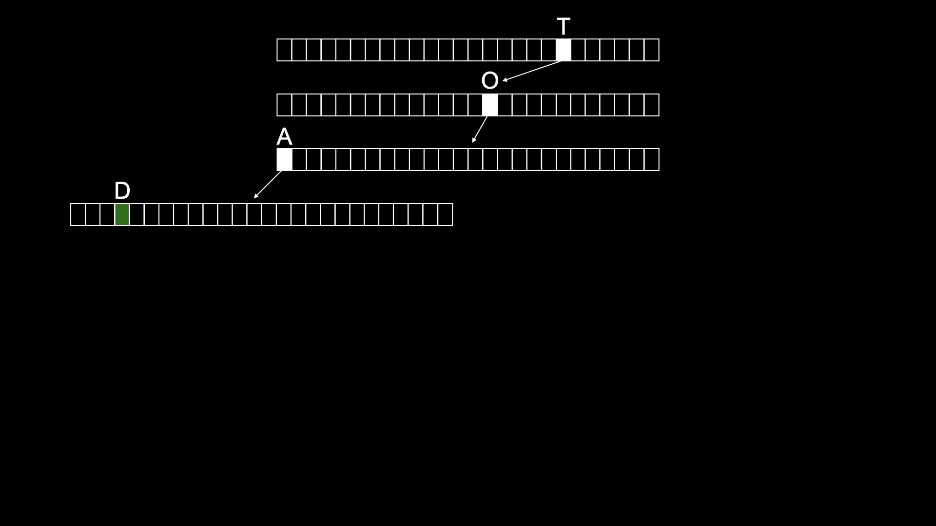

Slide 191
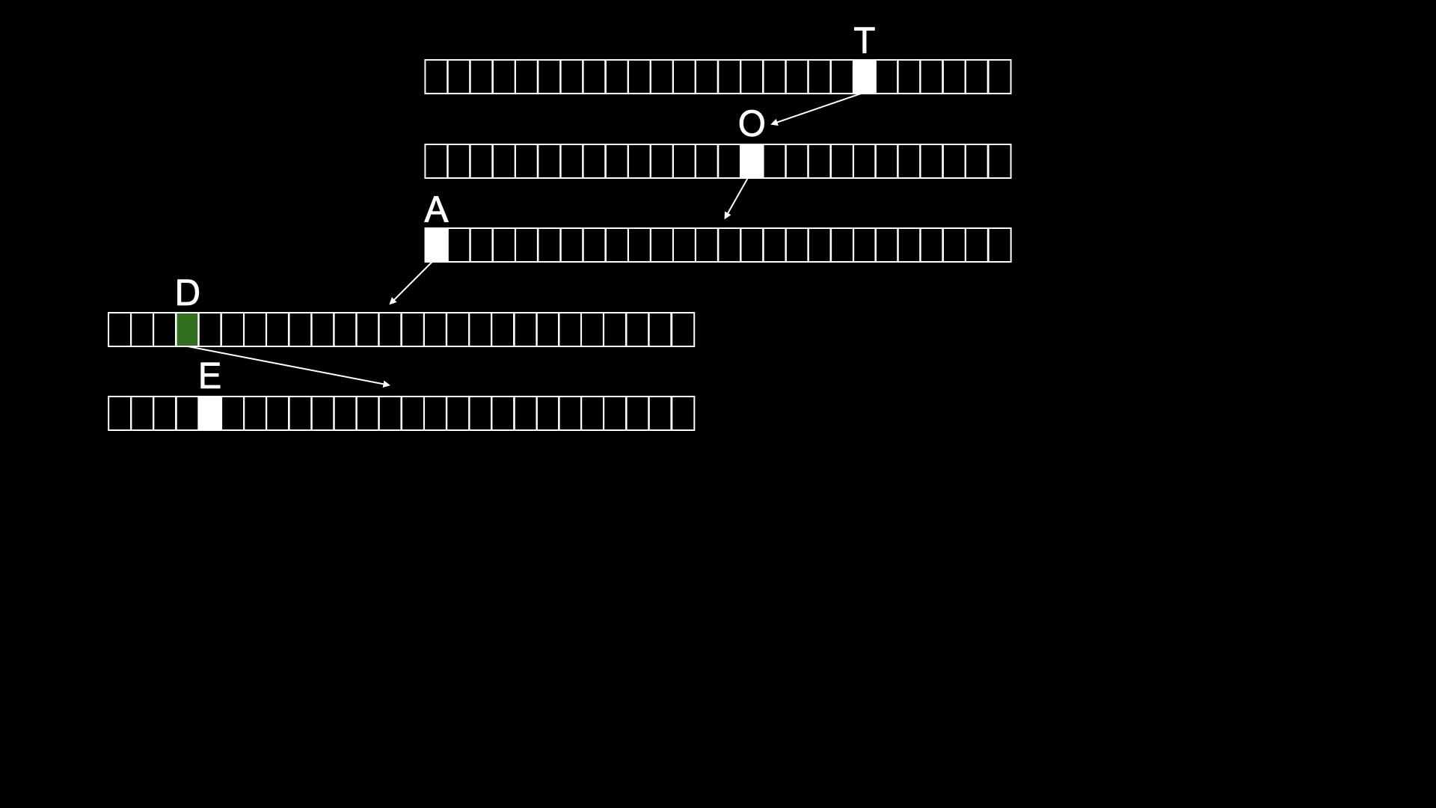

Slide 192
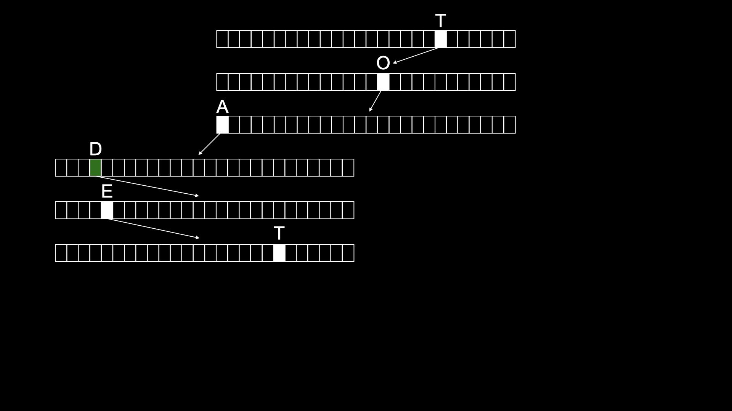

Slide 193
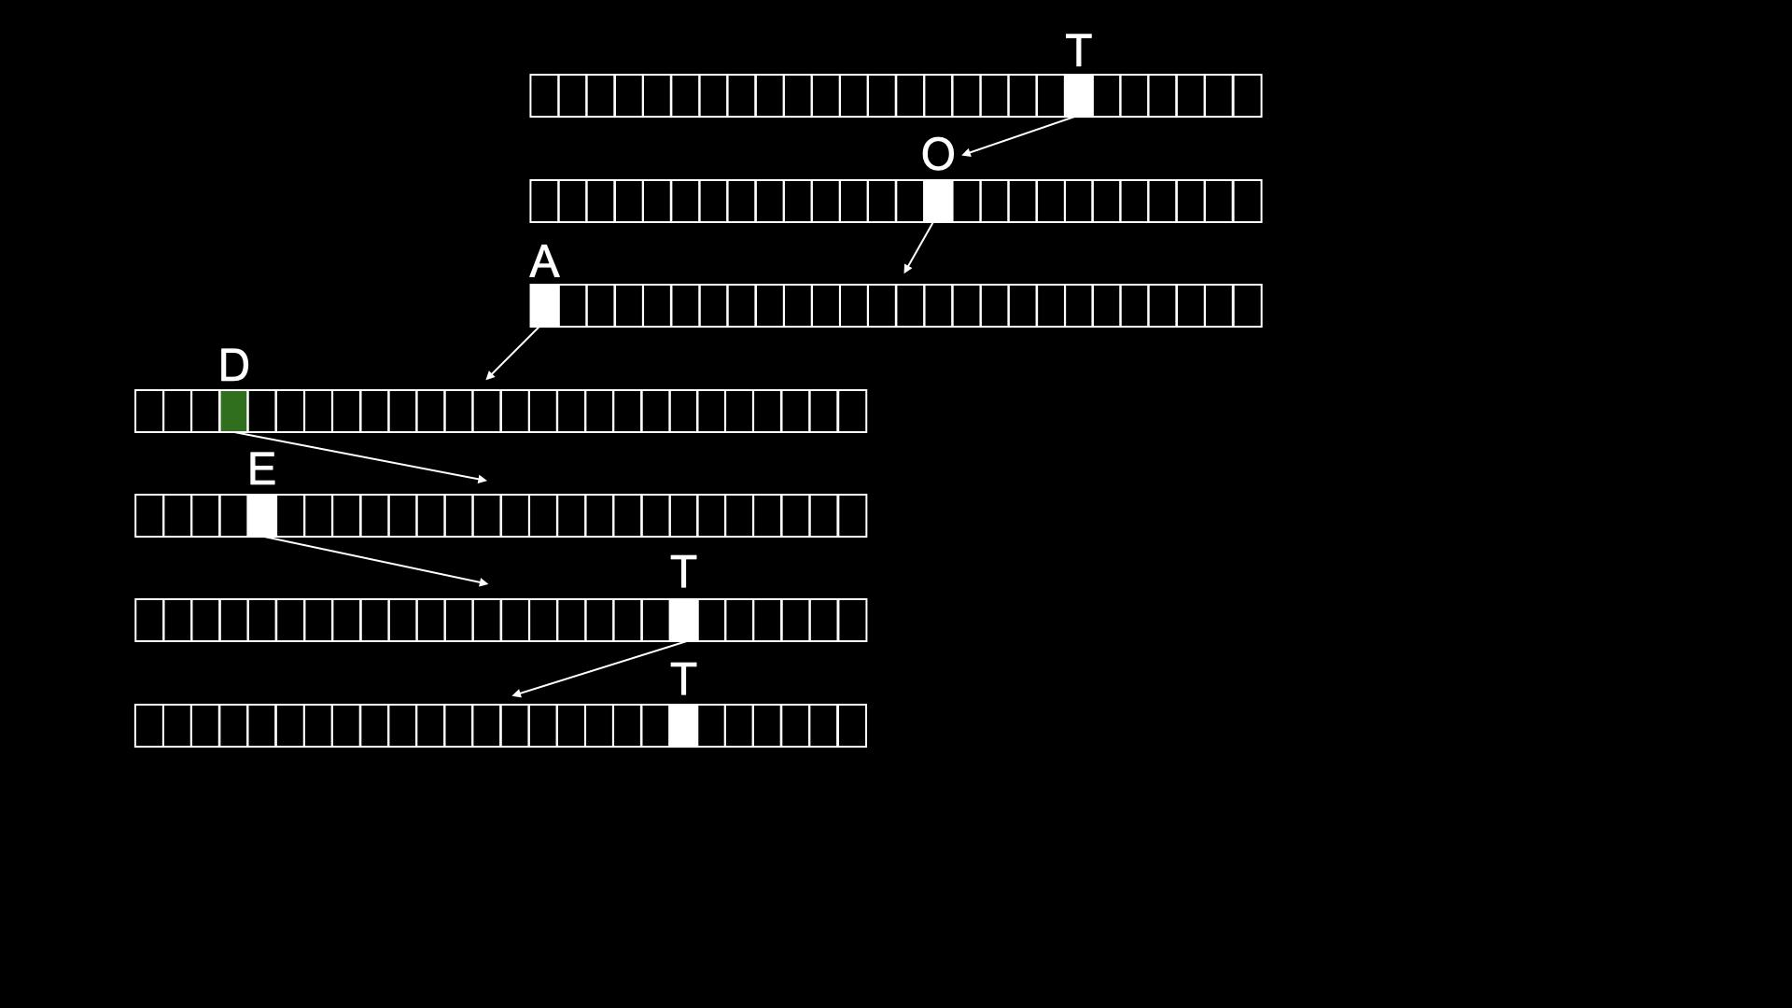

Slide 194
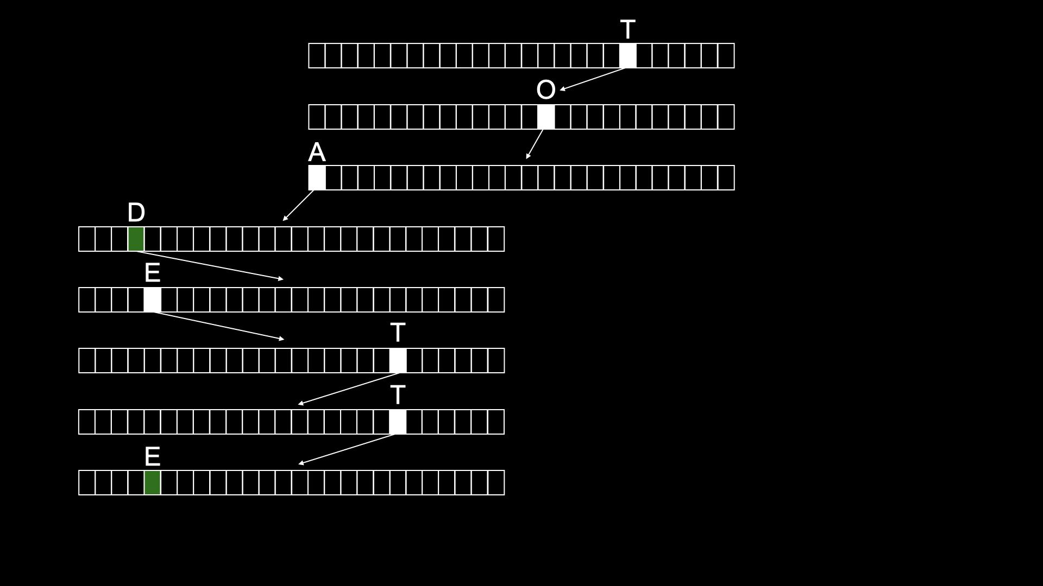

Slide 195
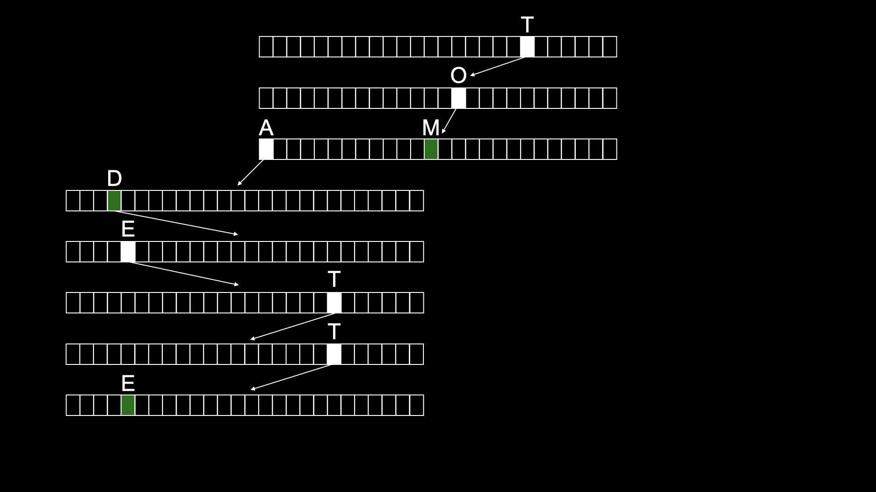

Slide 196
typedef struct node
{
struct node *children[26];
char *number;
} node;
Notes:
don't need to bother storing name, since implicit in trie

Slide 197
node *trie;

Slide 198
O(n²)
O(n log n)
O(n)
O(log n)
O(1)

Slide 199
Computing Technology

