Slide 1
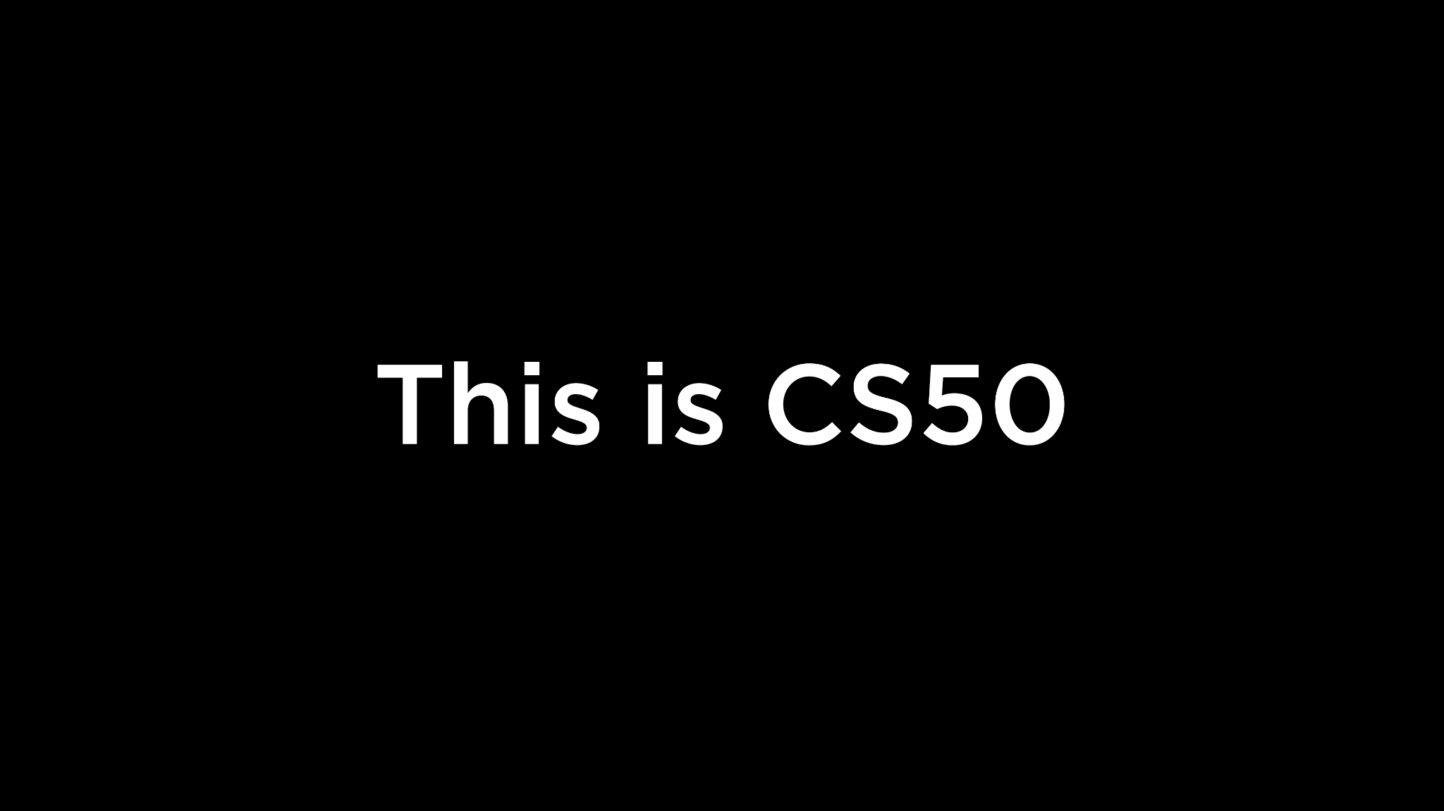

Slide 2
This is CS50
If you'd like to attend CS50's Family Lunch this Friday, RSVP at cs50.ly/lunch!
First-years' and juniors' family members welcome!
On today's menu, Fruit by the Foot! 📏
Do say hi or ask questions (or ask for stress ball 🔴) during break or after class!
What do today's binary bulbs spell?
CS50's next lecture (on AI!) is this Fri 10/25, 12pm–1pm, here in Sanders.
First-years' and juniors' family members welcome!
That'll be our last in-person lecture for a while!
(If you hear rumbling today, just the construction outside.)

Slide 4
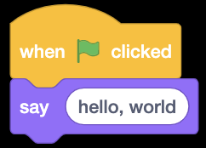

Slide 5
#include <stdio.h>
int main(void) {
printf("hello, world\n");
}

Slide 6
print("hello, world")

Slide 7
make hello
./hello

Slide 8
clang -o hello hello.c -lcs50
./hello

Slide 9
python hello.py
Notes:
1/hello0.py
6/speller/dictionary.py
6/filter/{blur,edges}.py

Slide 10
compiled, interpreted

Slide 11
functions

Slide 13

printf("hello, world");
Notes:
https://scratchblocks.github.io/#?style=scratch3&script=say%20%5Bhello%2C%20world%5D

Slide 14
printf("hello, world\n");;

Slide 15
print("hello, world");

Slide 16
libraries

Slide 17
modules, packages

Slide 18
#include <cs50.h>

Slide 19
import cs50

Slide 20
from cs50 import get_string

Slide 21
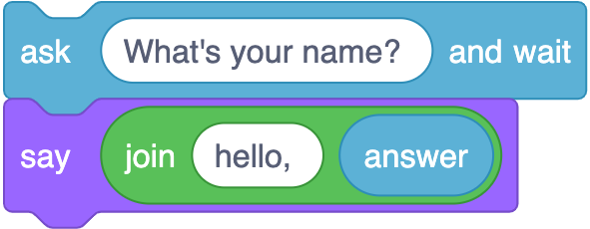
string answer = get_string("What's your name?\n");
printf("hello, %s\n", answer);
Notes:
https://scratchblocks.github.io/#?style=scratch3&script=ask%20%5BWhat's%20your%20name%3F%20%5D%20and%20wait%0Asay%20(join%5Bhello%2C%20%5D%20(answer)%0A

Slide 22
string answer = get_string("What's your name? ");
printf("hello, %s\n", answer);

Slide 23
answer = get_string("What's your name? ")
print("hello, " + answer)

Slide 24
answer = get_string("What's your name? ")
print("hello,", answer)

Slide 25
answer = get_string("What's your name? ")
print(f"hello, {answer}")

Slide 26
answer = input("What's your name? ")
print(f"hello, {answer}")
Notes:
hello{1,2,3}.py

Slide 27
positional parameters

Slide 28
named parameters
Notes:
hello4.py

Slide 29
docs.python.org

Slide 30
docs.python.org/3/library/functions.html

Slide 31
https://docs.python.org/3/library/functions.html#print

Slide 32
print(*objects, sep=' ', end='\n', file=None, flush=False)

Slide 33
print(*objects, sep=' ', end='\n', file=None, flush=False)

Slide 34
print(*objects, sep=' ', end='\n', file=None, flush=False)

Slide 35
print(*objects, sep=' ', end='\n', file=None, flush=False)

Slide 36
variables

Slide 37
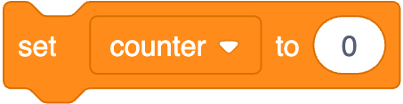
int counter = 0;
Notes:
https://scratchblocks.github.io/#?style=scratch3&script=set%20%5Bcounter%20v%5D%20to%20(0)

Slide 38
int counter = 0;

Slide 39
counter = 0

Slide 40
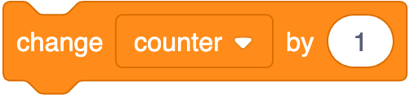
counter = counter + 1;
Notes:
https://scratchblocks.github.io/#?style=scratch3&script=change%20%5Bcounter%20v%5D%20by%20(1)

Slide 41
counter = counter + 1;

Slide 42
counter = counter + 1

Slide 43
counter += 1

Slide 44
types

Slide 45
bool
char
double
float
int
long
string
...

Slide 46
bool
float
int
str
...
Notes:
calculator{0,1}.py

Slide 47
range sequence of numbers
list sequence of mutable values
tuple sequence of immutable values
dict collection of key-value pairs
set collection of unique values
...

Slide 48
range sequence of numbers
list sequence of mutable values
tuple sequence of immutable values
dict collection of key-value pairs
set collection of unique values
...

Slide 49
get_char
get_double
get_float
get_int
get_long
get_string
...

Slide 50
get_float
get_int
get_string

Slide 51
from cs50 import get_float from cs50 import get_int from cs50 import get_string

Slide 52
from cs50 import get_float, get_int, get_string

Slide 53
conditionals

Slide 54
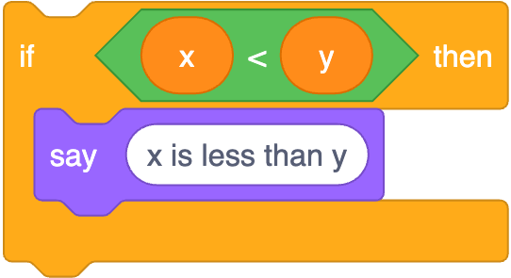
if (x < y) {
printf("x is less than y\n");
}
Notes:
https://scratchblocks.github.io/#?style=scratch3&script=if%20%3C(x)%20%3C%20(y)%3E%20then%0Asay%20%5Bx%20is%20less%20than%20y%5D

Slide 55
if (x < y) {
printf("x is less than y\n");
}

Slide 56
if x < y:
print("x is less than y")

Slide 57
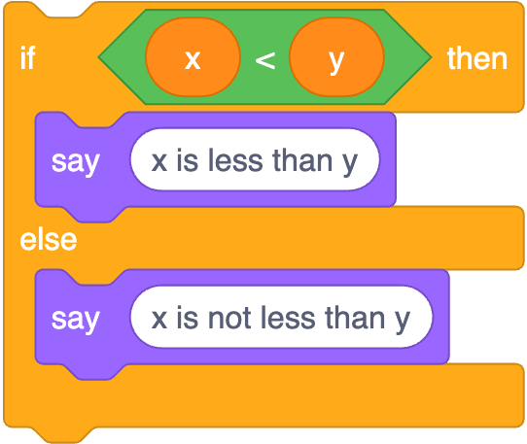
if (x < y) {
printf("x is less than y\n");
}
else
{ printf("x is not less than y\n");
}
Notes:
https://scratchblocks.github.io/#?style=scratch3&script=if%20%3C(x)%20%3C%20(y)%3E%20then%0Asay%20%5Bx%20is%20less%20than%20y%5D%0Aelse%0Asay%20%5Bx%20is%20not%20less%20than%20y%5D

Slide 58
if (x < y) {
printf("x is less than y\n");
}
else
{ printf("x is not less than y\n");
}

Slide 59
if x < y:
print("x is less than y")
else: print("x is not less than y")

Slide 60
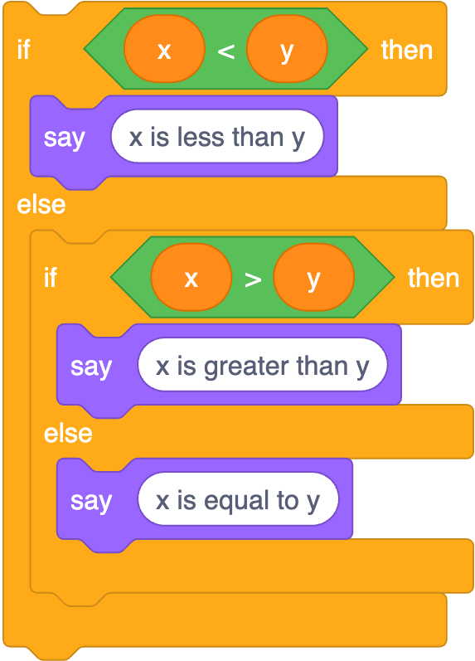
if (x < y) {
printf("x is less than y\n");
}
else if (x > y)
{ printf("x is greater than y\n");
}
else
{ printf("x is equal to y\n");
}
Notes:
https://scratchblocks.github.io/#?style=scratch3&script=if%20%3C(x)%20%3C%20(y)%3E%20then%0Asay%20%5Bx%20is%20less%20than%20y%5D%0Aelse%0Aif%20%3C(x)%20%3E%20(y)%3E%20then%0Asay%20%5Bx%20is%20greater%20than%20y%5D%0Aelse%0Asay%20%5Bx%20is%20equal%20to%20y%5D

Slide 61
if (x < y) {
printf("x is less than y\n");
}
else if (x > y)
{ printf("x is greater than y\n");
}
else
{ printf("x is equal to y\n");
}

Slide 62
if x < y:
print("x is less than y")
elif x > y: print("x is greater than y")
else: print("x is equal to y")
Notes:
1/compare3.py

Slide 63
str
Notes:
4/compare.py
1/agree{0,1}.py

Slide 64
object-oriented programming

Slide 65
OOP

Slide 66
docs.python.org/3/library/stdtypes.html#string-methods
Notes:
1/agree2.py
4/copy.py
2/uppercase{0,1}.py

Slide 67
loops

Slide 68
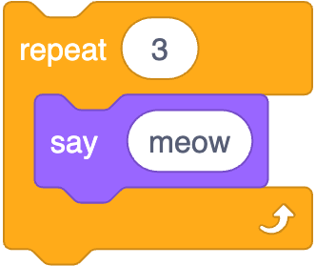
int i = 0;
while (i < 3)
{
printf("meow\n");
i++;
}
Notes:
https://scratchblocks.github.io/#?style=scratch3&script=repeat%20%5B3%5D%0Asay%5Bmeow%5D

Slide 69
int i = 0;
while (i < 3)
{
printf("meow\n");
i++;
}

Slide 70
i = 0
while i < 3:
print("meow")
i += 1

Slide 71
for (int i = 0; i < 3; i++)
{
printf("meow\n");
}

Slide 72
for (int i = 0; i < 3; i++)
{
printf("meow\n");
}

Slide 73
for i in [0, 1, 2]:
print("meow")

Slide 74
for i in range(3):
print("meow")

Slide 75
for _ in range(3):
print("meow")

Slide 76
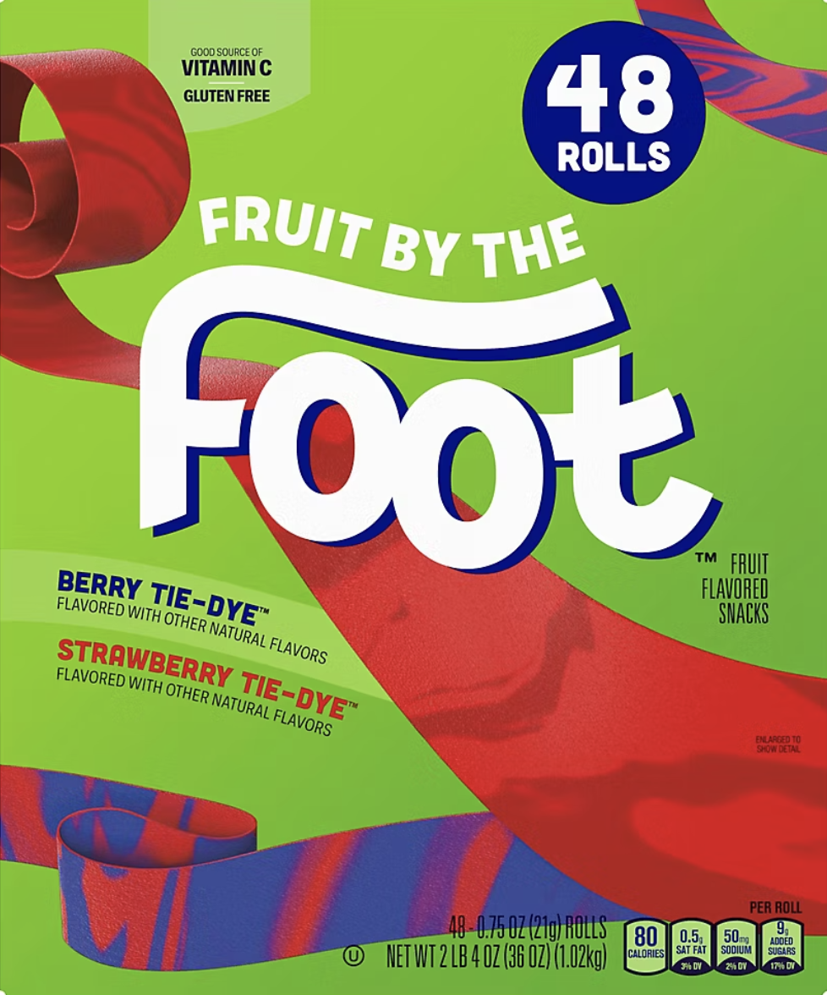

Slide 77
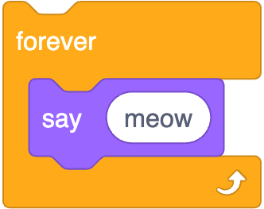
while (true)
{
printf("meow\n");
}
Notes:
https://scratchblocks.github.io/#?style=scratch3&script=forever%0Asay%5Bmeow%5D

Slide 78
while (true)
{
printf("meow\n");
}

Slide 79
while True:
print("meow")
Notes:
meow{0,1,2,3,4,5,6}.py

Slide 80
truncation
Notes:
calculator2.py, with 1/3
not an issue with /

Slide 81
floating-point imprecision
Notes:
calculator3.py, with 1/3

Slide 82
integer overflow
Notes:
not an issue

Slide 83
exceptions
Notes:
integer{0,1,2,3,4}.py

Slide 84
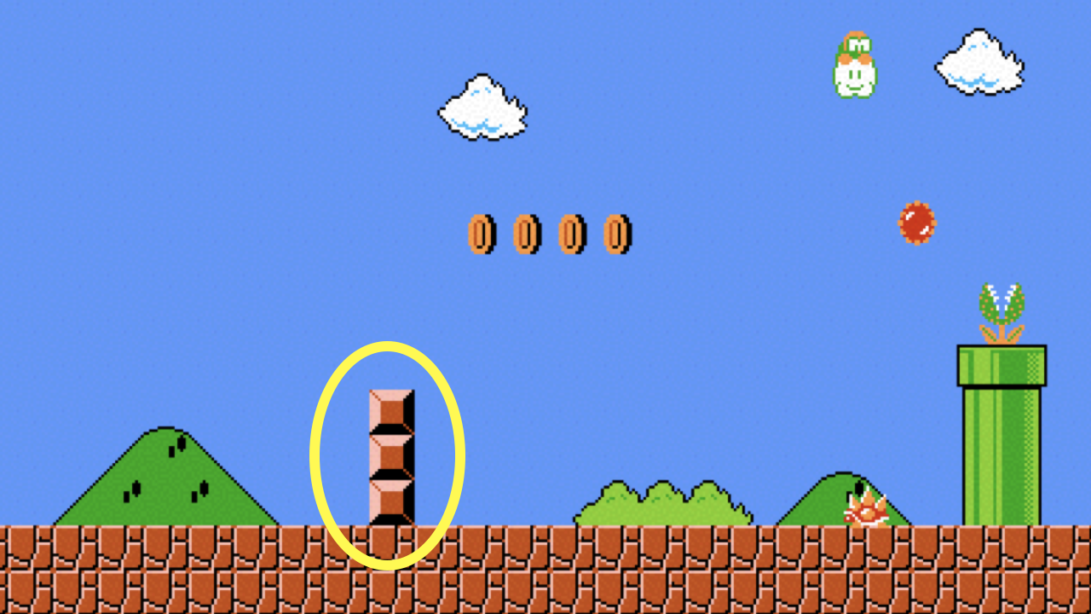
Notes:
mario{0,1}.py

Slide 85
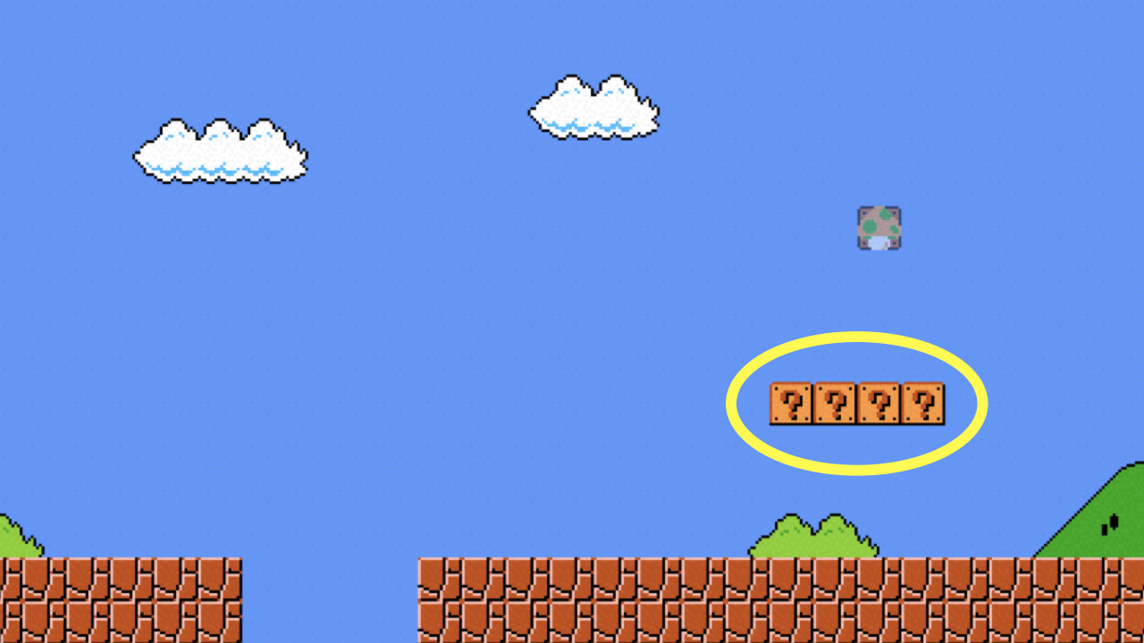
Notes:
mario{2,3}.py

Slide 86
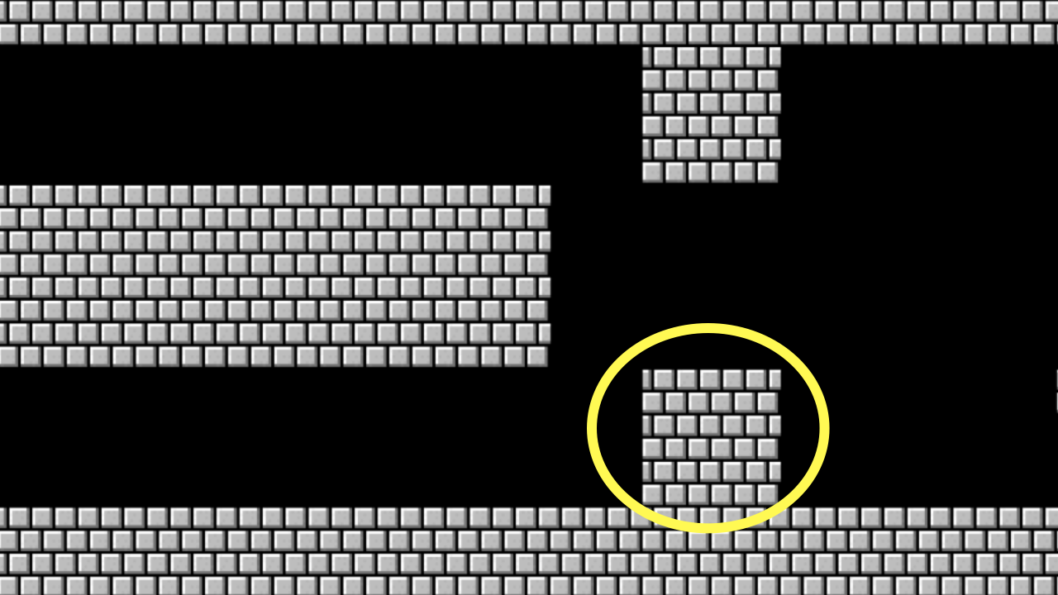
Notes:
mario{4,5}.py

Slide 87
list

Slide 88
docs.python.org/3/library/stdtypes.html#sequence-types-list-tuple-range

Slide 89
len

Slide 90
docs.python.org/3/library/functions.html#len
Notes:
2/scores{0,1,2}.py
3/phonebook{0,1}.py

Slide 91
dict

Slide 92
key | value

Slide 93
docs.python.org/3/library/stdtypes.html#mapping-types-dict
Notes:
phonebook{2,3,4}.py

Slide 94
sys

Slide 95
docs.python.org/3/library/sys.html
Notes:
2/greet{0,1,2}.py
2/exit.py

Slide 96
csv

Slide 97
docs.python.org/3/library/csv.html
Notes:
4/phonebook{0,1,2}.py

Slide 98
pip
Notes:
pip install cowsay
moo{0,1}.py
pip install qrcode
qr.py

