Slide 1


Slide 2
http-server

Slide 3
https://www.example.com/

Slide 4
https://www.example.com/file.html

Slide 5
https://www.example.com/folder/

Slide 6
https://www.example.com/folder/file.html

Slide 7
https://www.example.com/path

Slide 8
https://www.example.com/route

Slide 9
https://www.example.com/route?key=value

Slide 10
https://www.example.com/route?key=value&key=value
Notes:
https://www.google.com/search?q=cats

Slide 11
GET /search?q=cats HTTP/2
Host: www.google.com
...

Slide 12
Flask

Slide 13
flask run

Slide 14
app.py
requirements.txt

Slide 15
from flask import Flask
app = Flask(__name__)
@app.route("/")
def index():
return "hello, world"
Notes:
hello0/

Slide 16
app.py
requirements.txt
static/
templates/
Notes:
hello1/

Slide 17
from flask import Flask, render_template
app = Flask(__name__)
@app.route("/")
def index():
return render_template("index.html")
Notes:
hello2/

Slide 18
request.args

Slide 19
Jinja
Notes:
hello{3,4,5,6,7}/

Slide 20
request.form
Notes:
hello{8,9}/

Slide 21
jinja.palletsprojects.com/templates/
Notes:
hello10/

Slide 22

Notes:
froshims{0,1,2,3,4,5}/

Slide 23
Controller
View

Slide 24
Model
Controller
View

Slide 25
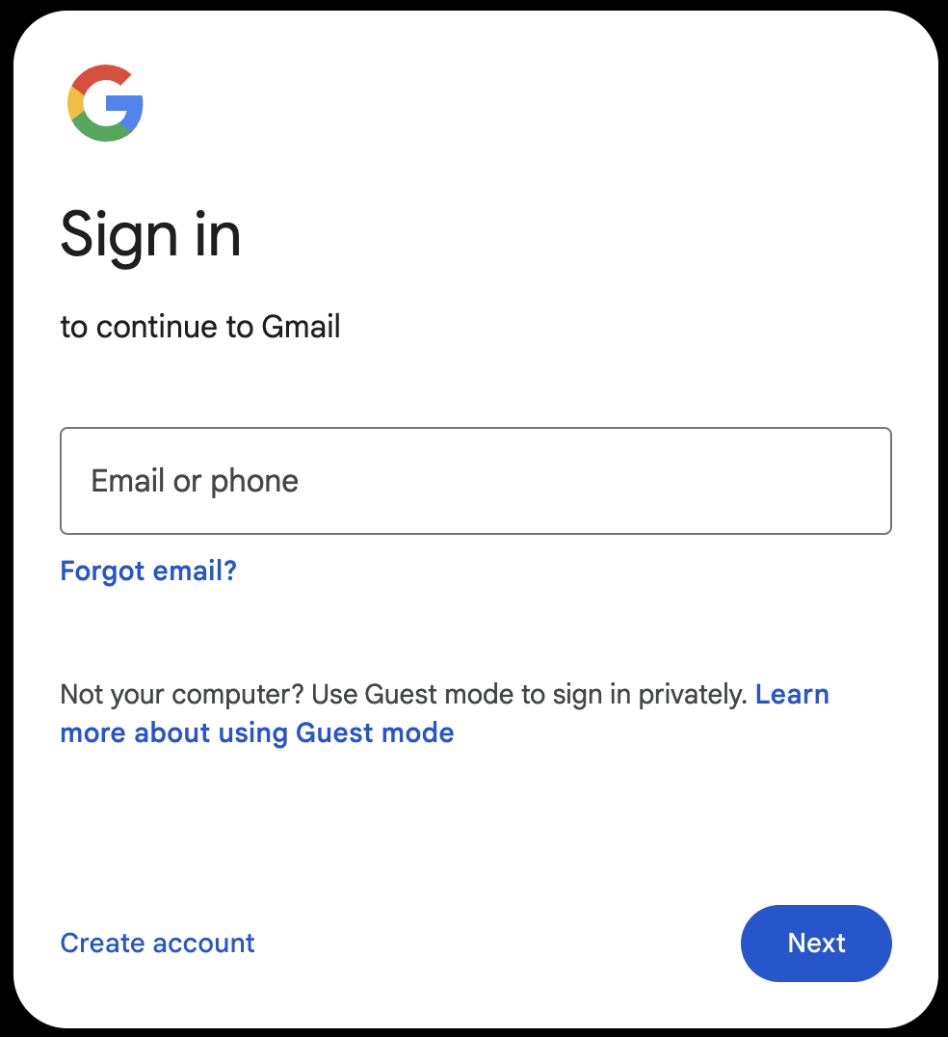

Slide 26
POST / HTTP/2
Host: accounts.google.com
...

Slide 27
HTTP/2 200
Content-Type: text/html
...

Slide 28
HTTP/2 200
Content-Type: text/html
Set-Cookie: session=value
...

Slide 29
GET / HTTP/2
Host: accounts.google.com
...

Slide 30
GET / HTTP/2
Host: accounts.google.com
Cookie: session=value
...
Notes:
hand stamp

Slide 31
session
Notes:
login/
store/

Slide 32
from cs50 import SQL
Notes:
shows{0,1}/

Slide 33
API
Notes:
shows2/

Slide 34
JSON

Slide 35
[
{"id": 112108, "title": "The Office", "year": 1995, "episodes": 6},
{"id": 290978, "title": "The Office", "year": 2001, "episodes": 14},
{"id": 386676, "title": "The Office", "year": 2005, "episodes": 188},
{"id": 1791001, "title": "The Office", "year": 2010, "episodes": 30},
{"id": 2186395, "title": "The Office", "year": 2012, "episodes": 8},
{"id": 8305218, "title": "The Office", "year": 2019, "episodes": 28},
{"id": 20877972, "title": "The Office", "year": 2022, "episodes": 20}
]
Notes:
shows3/

