Slide 1
Flight Plan for Data Security: Safeguarding your Dataset with Dynamic Object-Level Security
José Calheiros, Diogo Martins
Notes:
Pastas
Fechar o navigation Pane
Ter os separadores das pastas já abertos
Janelas
Browser – SQL Bits
Vscode
Tabular Editor
Management Studio – Ter as queries prontas

Slide 2


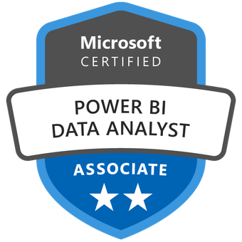



Who are we?
Diogo Martins
BI Specialist @ DevScope
José Calheiros
BI Specialist @ DevScope

Slide 3


Agenda
Introduction
Project Requirements
Object-level Security
Project Security Architecture
Powershell to modify model.bim
Use Cases
Dynamic OLS from Table Metadata
Dynamic Schema Update from Database Schema
Dynamic OLS and Schema

Slide 4

Introduction
Project Requirements
End user App
Customizable fields and permissions
Self Service Reporting
Real-Time data, permissions and schema

Slide 5




Introduction
Object-level Security
“Object-level security (OLS) enables model authors to secure specific tables or columns from report viewers” – Microsoft Documentation
Dynamic
Row-level Security
Dynamic
Object-level Security
Notes:
Explain briefly what OLS is
RLS has native dynamic security however OLS does not
Show on Tabular Editor OLS
Explain the default logic of OLS
Talk about metadata information

Slide 6








Introduction
Project Security Architecture
Servers
Power BI Service
Semantic Model
Power BI Service
Reports
Lakehouse
BIM – Model
Report 1
Semantic Model
Report 2
Security Processing

Slide 7

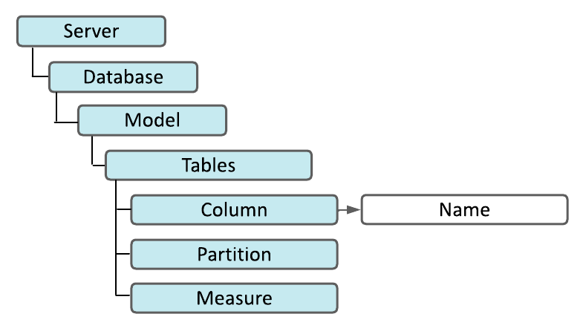
Powershell to modify model.bim
Connect to model.bim file
Access a specific Column
Change its name
Notes:
UC01

Slide 8
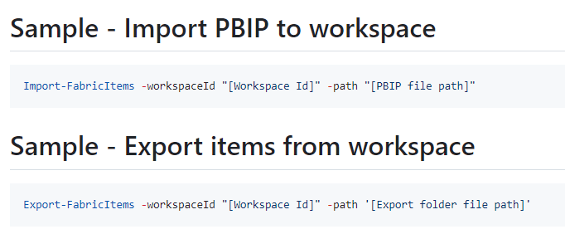

Deploying with Microsoft Fabric API’s
Microsoft Fabric API
Works with Fabric Items
Fabric Item CRUD API
FabricPS-PBIP PSModule
PowerShell 7
Facilitates working with Fabric API
Notes:
GitHub Setup

Slide 9

Demo Architecture
Local/Cloud Server
Fabric API
Power BI Service
Export Items
Azure SQL
Power BI Report
Powershell Script
Semantic Model
Import Items
BIM – Model
Power BI Report
Notes:
Explain what are items and parts
CRUD API lets:
Create / Get / Delete / Update / List Items
Get / Update Item Definition

Slide 10
Using Fabric API to Import and Export model.bim
Use Powershell 7
Install Azure Powershell module
Authenticate to tenant
Import and export semantic model
Notes:
UC 02
VS Code / Tabular Editor / SQL

Slide 11
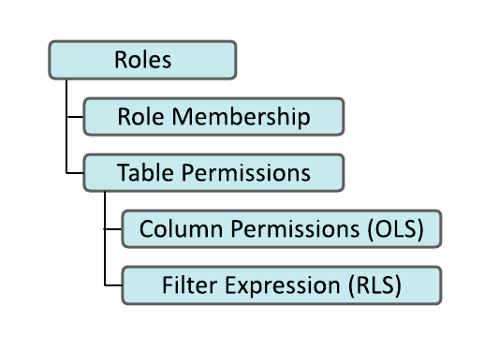
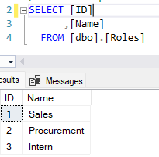
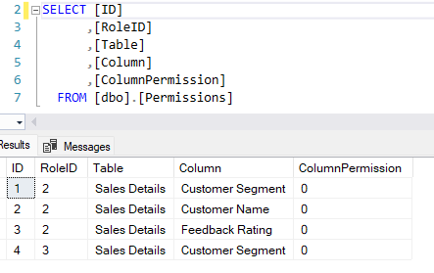
Dynamic Object-Level Security
Query permissions metadata in Database
Manipulate OLS using PowerShell
Deploy manipulated TOM to Fabric
Notes:
UC – 03
VS Code / Tabular Editor / SSMS

Slide 12
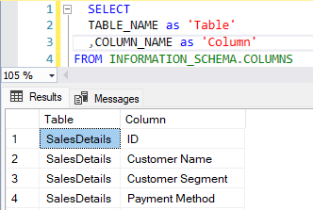
Dynamic Schema Update
Query the Database Table Schema
Iterate columns in Tabular model
Insert and Delete Columns
Notes:
UC – 04
VS Code / Tabular Editor / SSMS
Insere os que não existem no modelo
Apaga os que não existem nos metadados
Reminder do “SELECT * FROM SALESDETAILS”

Slide 13
Dynamic Schema and OLS
Implement Dynamic Schema
Implement Dynamic OLS
Notes:
UC – 05
VS Code / Tabular Editor / SSMS

Slide 14
Final Remarks
PowerShell
Working on a generic PowerShell module
Python in Fabric Notebooks
Script JSON ready
Number of roles created

Slide 15



Our Linktree!
GitHub
Diogo Martins - LinkedIn
José Calheiros - LinkedIn

