Slide 1

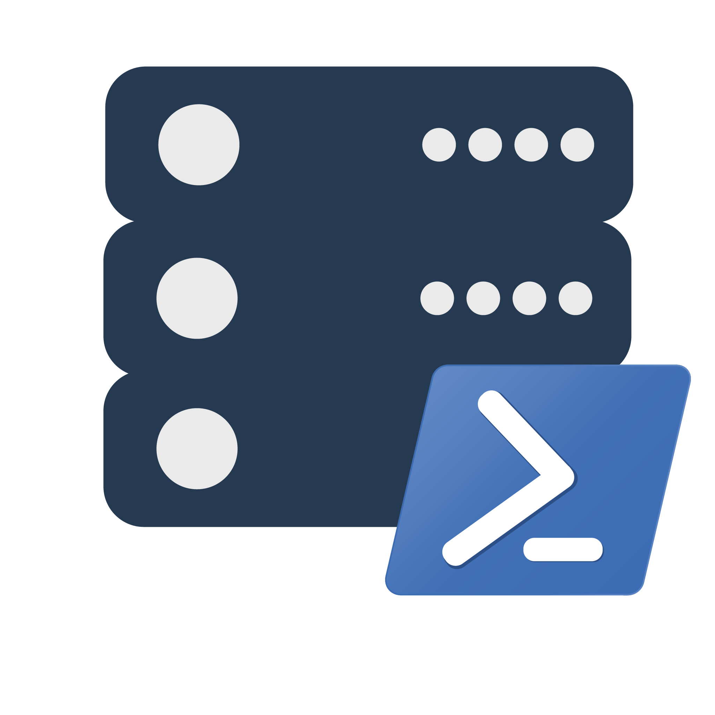
dbatools 💜 Replication
Jess Pomfret
Jpomfret7@gmail.com

Slide 2
dbatools 💜 Replication

Slide 3



Jess Pomfret (She/Her)
Data Platform Engineer
Open Source Contributor
dbatools, dbachecks, SqlServerDsc
Passionate about SQL Server, PowerShell & Proper Football
jpomfret7@gmail.com
linkedin.com/in/jpomfret/
jpomfret.bsky.social

Slide 4

Agenda
What is dbatools?
What is replication?

Slide 5
Agenda
dbatools and replication!

Slide 6
Warnings
Preview
Feature
This is not a Replication best practice session
I’m definitely not a replication expert!
Notes:
We will cover what replication is and how it works

Slide 7
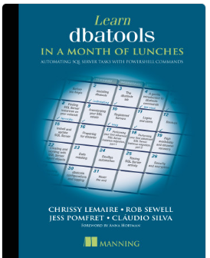
dbatools
Open-source PowerShell Module
Written by the community
650+ commands
https://dbatools.io/
https://github.com/dataplat/dbatools

Slide 8
Replication
Replication copies and synchronises database objects and data from one database to another.
http://msdn.microsoft.com/en-us/library/ms151198.aspx
Around since SQL Server 6.0
Three flavours
Snapshot
Transactional
Merge

Slide 9
How does replication work?
Publisher
Publication
Articles
Subscribers
Subscription
Articles
Distributor
Log Reader Agent
Snapshot Agent
Distribution Agent
Slide designed by
William Durkin
Notes:
- publisher (the system that wishes to publish its data)
- publication (the group of DB-Objects that should be replicated)
- articles (the db-objects themselves)
- subscriptions (the systems that will receive the published articles)
- distributor (the system responsible for delivering the publications/articles)
- additional components
- logreader (reads DML/DDL commands from the publication DB pertaining to published articles) <- this is the heart of replication
- snapshot (performs the initial export of published articles - uses bcp) also used for snapshot replication
Log reader – used for change data capture too!

Slide 10
Snapshot Replication
Publication
Distribution
Subscription
JS
JS
JS
JS
BCP
BCP
Publisher
Database
Distributor
Database
Subscriber
Database
Snapshot Agent
Distribution Agent
Slide designed by
William Durkin

Slide 11
Transactional Replication
Publication
Distribution
Subscription
Publisher
Database
Distributor
Database
Subscriber
Database
LDF
Log Reader Agent
Distribution Agent
Slide designed by
William Durkin

Slide 12
Merge Replication
Publication/Subscription
Publication/Subscription
Merge Agent
Publisher
Database
Subscriber
Database
Distribution
Distributor
Database
Slide designed by
William Durkin

Slide 13
dbatools commands for replication
Distribution
Publications
Articles
Subscriptions
Enable-DbaReplDistributor
Publishing
Disable-DbaReplDistributor
Enable-DbaReplPublishing
Disable-DbaReplPublishing
New-DbaReplPublication
Remove-DbaReplPublication
Get-DbaReplArticle
Get-DbaReplArticleColumn
Add-DbaReplArticle
Remove-DbaReplArticle
New-DbaReplCreationScriptOptions
Get-DbaReplDistributor
Get-DbaReplPublication
New-DbaReplSubscription
Get-DbaReplSubscription
Remove-DbaReplSubscription
Get-DbaReplServer
Misc
Find-DbaCommand –Tag Replication

Slide 14
Demo Time
Demo Files available here:
https://github.com/jpomfret/dbatools-replication
dbatools PR:
https://github.com/dataplat/dbatools/pull/8958
Notes:
620

Slide 15
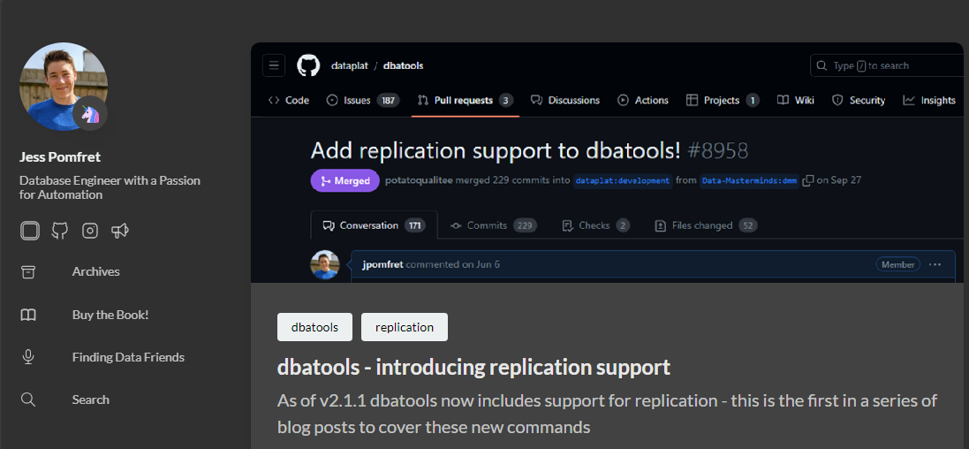
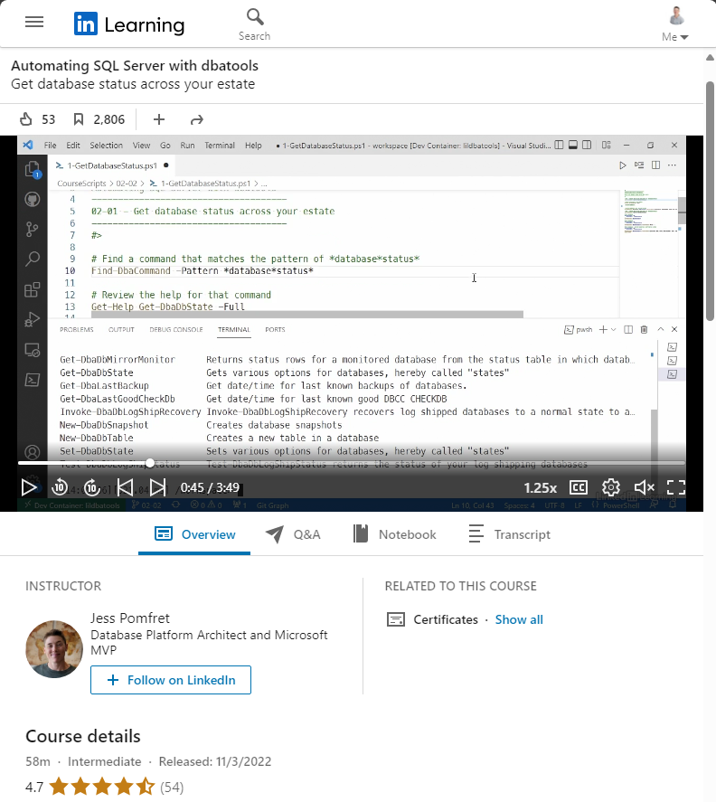
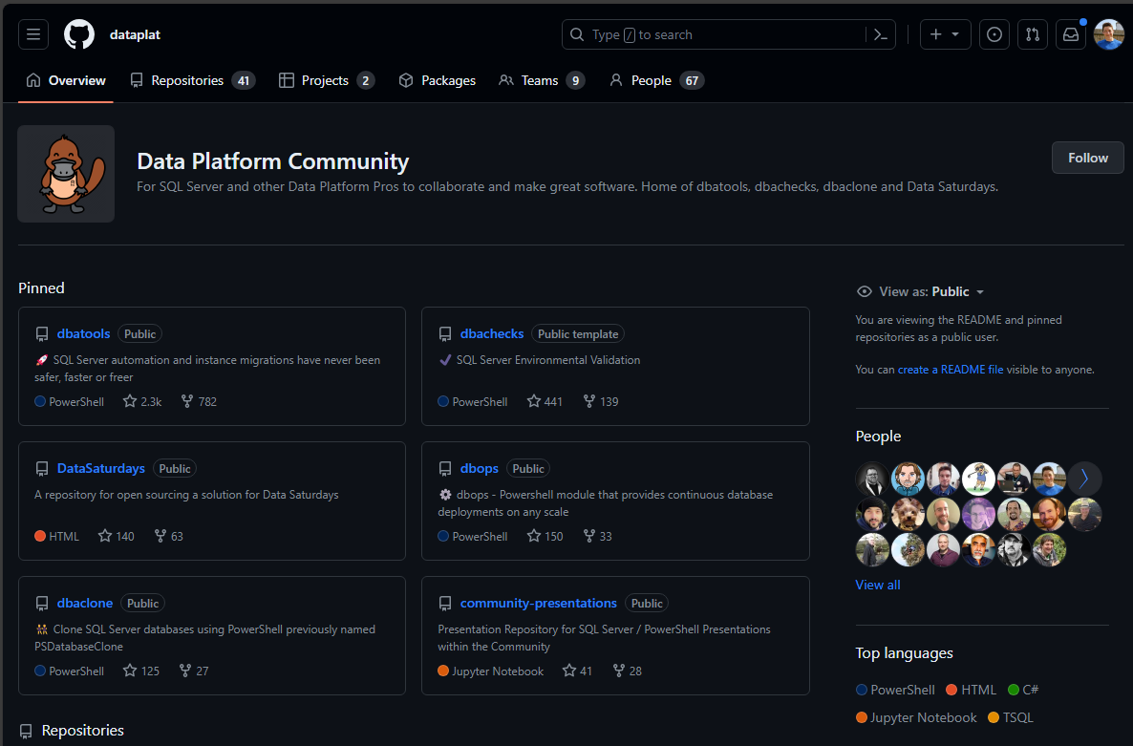
I want to learn more!

Slide 16
Questions & Feedback
https://github.com/jpomfret/dbatools-replication
Jess Pomfret
(she/her)
jpomfret7@gmail.com
JessPomfret.com

