Slide 1
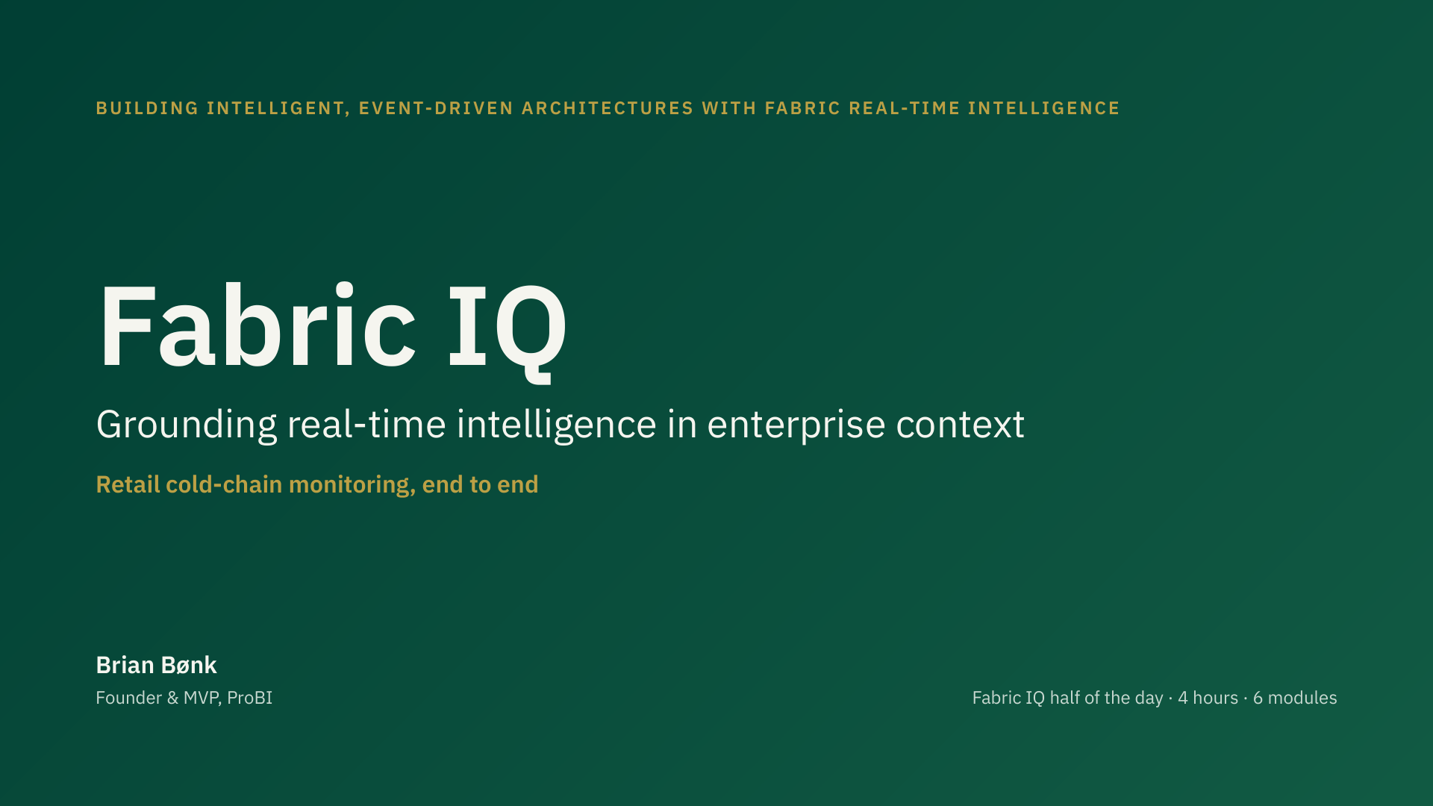
Notes:
holds speaker notes.
Images reference the repo's own assets/screenshots and artifacts/WorkspaceIcon files. -->
<link rel="stylesheet" href="https://fonts.googleapis.com/css2?family=IBM+Plex+Sans:wght@400;500;600;700&display=swap"><link rel="stylesheet" href="https://fonts.googleapis.com/css2?family=JetBrains+Mono:wght@400;600&display=swap">
<style>
:root{--z:1}
html,body{margin:0;background:#1a1f1d}
body{display:flex;flex-direction:column;align-items:center;gap:24px;padding:24px 0}
section{position:relative;width:1920px;height:1080px;overflow:hidden;box-sizing:border-box;flex-shrink:0;
zoom:var(--z);font-family:'IBM Plex Sans',Arial,sans-serif;color:#14231E;background:#F6F5EF;display:flex;flex-direction:column}
section *{box-sizing:border-box;margin:0}
section div{min-width:0}
section div:not([style*="display"]){display:flex;flex-direction:column}
section h1{font-size:96px;font-weight:600;line-height:1.1}
section h2{font-size:64px;font-weight:600;line-height:1.15}
section h3{font-size:44px;font-weight:600;line-height:1.2}
section p{font-size:32px;font-weight:400;line-height:1.4}
section ul,section ol{padding-left:1.1em}
section li{margin:0}
section b{font-weight:700}
section a{color:inherit}
section img{display:block}
section table{border-collapse:collapse;width:100%}
section td,section th{padding:.35em .6em;border-bottom:1px solid rgba(20,35,30,.12);vertical-align:top}
section aside{display:none}
x-icon{display:inline-block;flex-shrink:0;background-color:currentColor;-webkit-mask-repeat:no-repeat;mask-repeat:no-repeat;-webkit-mask-position:center;mask-position:center;-webkit-mask-size:contain;mask-size:contain}
x-icon[name="Lightbulb"]{-webkit-mask-image:url("data:image/svg+xml;utf8,<svg xmlns='http://www.w3.org/2000/svg' viewBox='0 0 24 24' fill='none' stroke='%23000' stroke-width='2' stroke-linecap='round' stroke-linejoin='round'><path d='M9 18h6M10 21h4M12 3a6 6 0 0 0-4 10.5c.7.7 1 1.5 1 2.5h6c0-1 .3-1.8 1-2.5A6 6 0 0 0 12 3z'/></svg>");mask-image:url("data:image/svg+xml;utf8,<svg xmlns='http://www.w3.org/2000/svg' viewBox='0 0 24 24' fill='none' stroke='%23000' stroke-width='2' stroke-linecap='round' stroke-linejoin='round'><path d='M9 18h6M10 21h4M12 3a6 6 0 0 0-4 10.5c.7.7 1 1.5 1 2.5h6c0-1 .3-1.8 1-2.5A6 6 0 0 0 12 3z'/></svg>")}x-icon[name="Book"]{-webkit-mask-image:url("data:image/svg+xml;utf8,<svg xmlns='http://www.w3.org/2000/svg' viewBox='0 0 24 24' fill='none' stroke='%23000' stroke-width='2' stroke-linecap='round' stroke-linejoin='round'><path d='M12 6c-1.5-1.5-4-2-8-2v15c4 0 6.5.5 8 2 1.5-1.5 4-2 8-2V4c-4 0-6.5.5-8 2zM12 6v15'/></svg>");mask-image:url("data:image/svg+xml;utf8,<svg xmlns='http://www.w3.org/2000/svg' viewBox='0 0 24 24' fill='none' stroke='%23000' stroke-width='2' stroke-linecap='round' stroke-linejoin='round'><path d='M12 6c-1.5-1.5-4-2-8-2v15c4 0 6.5.5 8 2 1.5-1.5 4-2 8-2V4c-4 0-6.5.5-8 2zM12 6v15'/></svg>")}x-icon[name="CheckCircle"]{-webkit-mask-image:url("data:image/svg+xml;utf8,<svg xmlns='http://www.w3.org/2000/svg' viewBox='0 0 24 24' fill='none' stroke='%23000' stroke-width='2' stroke-linecap='round' stroke-linejoin='round'><circle cx='12' cy='12' r='9'/><path d='M8 12.5l2.5 2.5L16 9.5'/></svg>");mask-image:url("data:image/svg+xml;utf8,<svg xmlns='http://www.w3.org/2000/svg' viewBox='0 0 24 24' fill='none' stroke='%23000' stroke-width='2' stroke-linecap='round' stroke-linejoin='round'><circle cx='12' cy='12' r='9'/><path d='M8 12.5l2.5 2.5L16 9.5'/></svg>")}x-icon[name="Warning"]{-webkit-mask-image:url("data:image/svg+xml;utf8,<svg xmlns='http://www.w3.org/2000/svg' viewBox='0 0 24 24' fill='none' stroke='%23000' stroke-width='2' stroke-linecap='round' stroke-linejoin='round'><path d='M12 3L2.5 20h19L12 3zM12 10v4M12 17.5v.5'/></svg>");mask-image:url("data:image/svg+xml;utf8,<svg xmlns='http://www.w3.org/2000/svg' viewBox='0 0 24 24' fill='none' stroke='%23000' stroke-width='2' stroke-linecap='round' stroke-linejoin='round'><path d='M12 3L2.5 20h19L12 3zM12 10v4M12 17.5v.5'/></svg>")}x-icon[name="Play"]{-webkit-mask-image:url("data:image/svg+xml;utf8,<svg xmlns='http://www.w3.org/2000/svg' viewBox='0 0 24 24' fill='%23000'><path d='M7 4l13 8-13 8z'/></svg>");mask-image:url("data:image/svg+xml;utf8,<svg xmlns='http://www.w3.org/2000/svg' viewBox='0 0 24 24' fill='%23000'><path d='M7 4l13 8-13 8z'/></svg>")}
x-shape{display:block;flex-shrink:0}
x-shape[kind="arrow-down"]{clip-path:polygon(30% 0,70% 0,70% 60%,100% 60%,50% 100%,0 60%,30% 60%)}
x-shape[kind="arrow-up"]{clip-path:polygon(50% 0,100% 40%,70% 40%,70% 100%,30% 100%,30% 40%,0 40%)}
x-shape[kind="arrow-right"]{clip-path:polygon(0 30%,60% 30%,60% 0,100% 50%,60% 100%,60% 70%,0 70%)}
x-shape[kind="ellipse"]{border-radius:50%}
x-connector{display:block;position:relative;height:24px;flex-shrink:0;align-self:center;border:0!important}
x-connector::before{content:"";position:absolute;left:0;right:12px;top:50%;height:4px;margin-top:-2px;background:currentColor}
x-connector::after{content:"";position:absolute;right:0;top:50%;margin-top:-10px;border-left:18px solid currentColor;border-top:10px solid transparent;border-bottom:10px solid transparent}
#nav{position:fixed;left:0;right:0;bottom:0;padding:8px 16px;font:14px/1.4 'IBM Plex Sans',Arial,sans-serif;color:#c9d8d0;background:rgba(1,63,52,.92);display:flex;gap:16px;justify-content:center}
@media print{
html,body{background:none;display:block;padding:0;gap:0}
section{zoom:1;page-break-after:always;break-after:page}
#nav{display:none}
}
@page{size:1920px 1080px;margin:0}
</style>
</head>
<body>
<section data-section="Kickoff, scenario framing and live environment setup" id="cover" data-transition="push" style="background:linear-gradient(135deg, #013f34 0%, #125b44 100%)">
<div id="97a4783d" style="position:absolute; top:128px; left:128px; width:1664px; height:34px; display:flex; flex-direction:row; align-items:center; justify-content:space-between">
<p style="font-family:'IBM Plex Sans', Arial, sans-serif; font-size:24px; font-weight:600; letter-spacing:3px; text-transform:uppercase; color:#bca045">Building intelligent, event-driven architectures with Fabric Real-Time Intelligence</p>
</div>
<div id="1df5fbe7" style="position:absolute; top:358px; left:128px; width:1664px; height:313px; display:flex; flex-direction:column; gap:28px">
<h1 style="font-family:'IBM Plex Sans', Arial, sans-serif; font-size:150px; font-weight:600; line-height:1; color:#f6f5ef">Fabric IQ</h1>
<p style="width:1400px; font-family:'IBM Plex Sans', Arial, sans-serif; font-size:52px; line-height:1.2; color:#f6f5ef">Grounding real-time intelligence in enterprise context</p>
<p style="font-family:'IBM Plex Sans', Arial, sans-serif; font-size:32px; font-weight:600; color:#bca045">Retail cold-chain monitoring, end to end</p>
</div>
<div id="17b5a563" style="position:absolute; top:868px; left:128px; width:1664px; height:84px; display:flex; flex-direction:row; align-items:end; justify-content:space-between">
<div style="display:flex; flex-direction:column; gap:6px">
<p style="font-family:'IBM Plex Sans', Arial, sans-serif; font-size:32px; font-weight:600; color:#f6f5ef">Brian Bønk</p>
<p style="font-family:'IBM Plex Sans', Arial, sans-serif; font-size:24px; color:#c9d8d0">Founder & MVP, ProBI</p>
</div>
<p style="font-family:'IBM Plex Sans', Arial, sans-serif; font-size:24px; color:#c9d8d0">Fabric IQ half of the day · 4 hours · 6 modules</p>
</div>
<aside>Kickoff (5 min). Welcome the room, introduce yourself, and set expectations: this is the second half of the day, built directly on top of what Johan just covered.

Slide 2
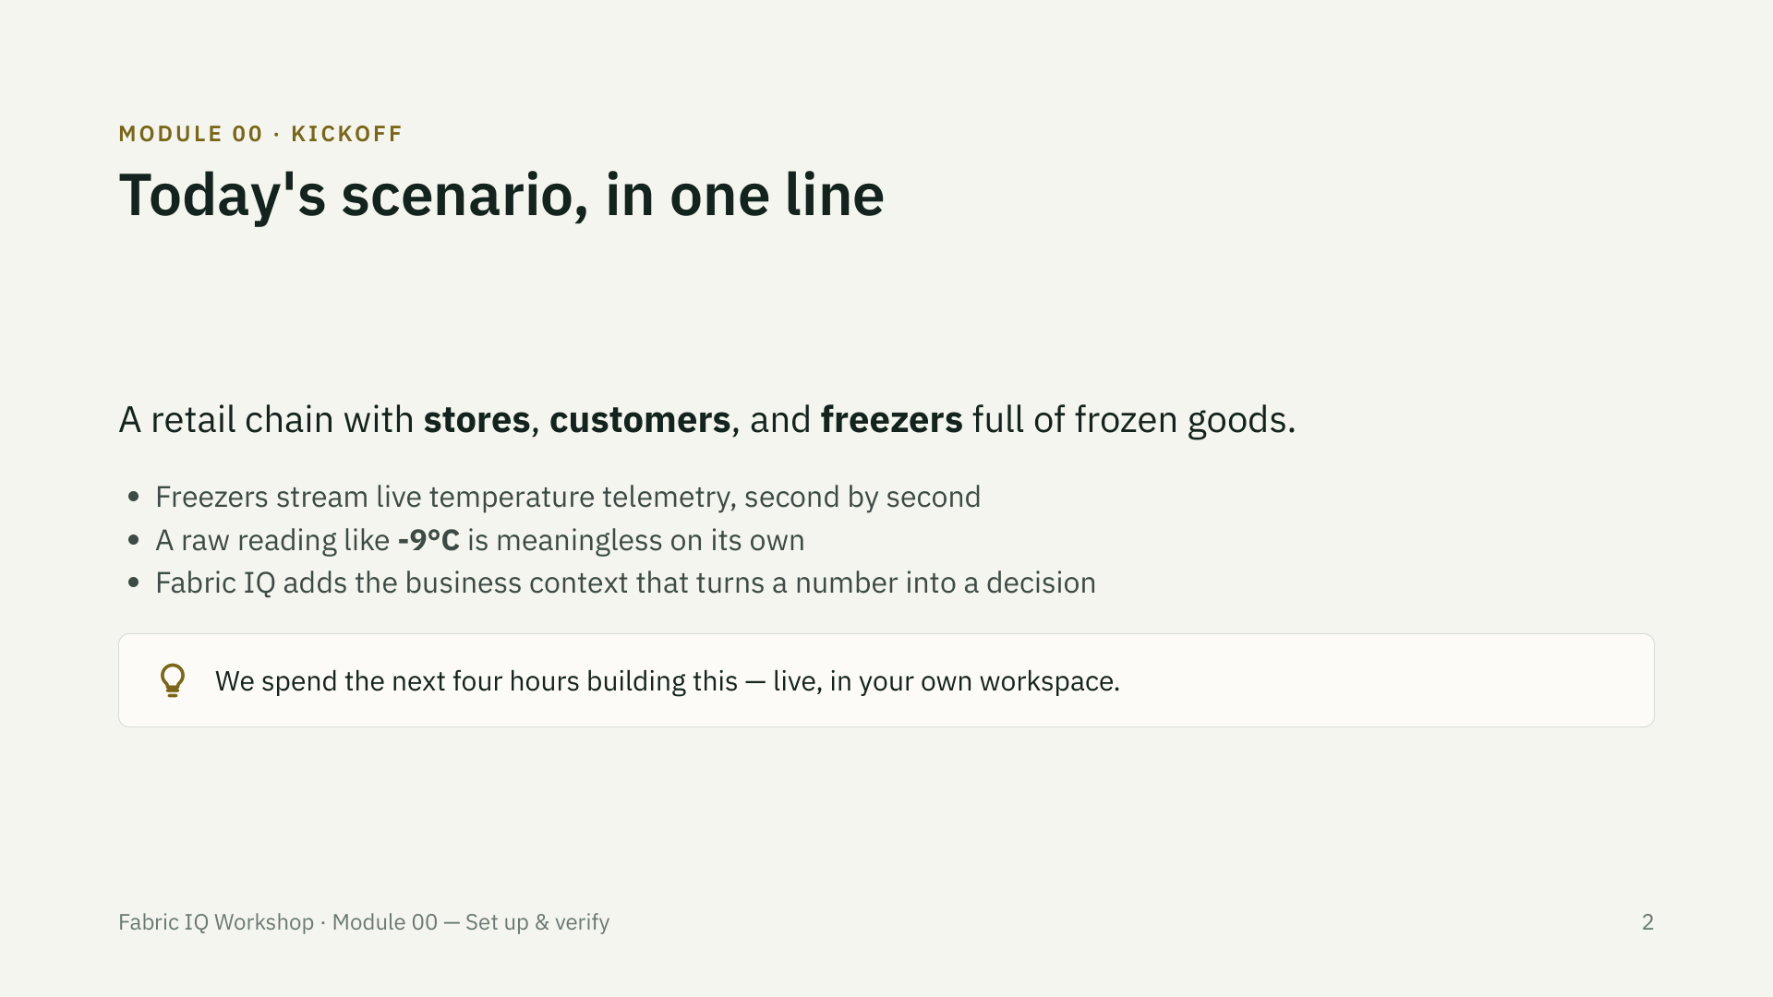

Slide 3
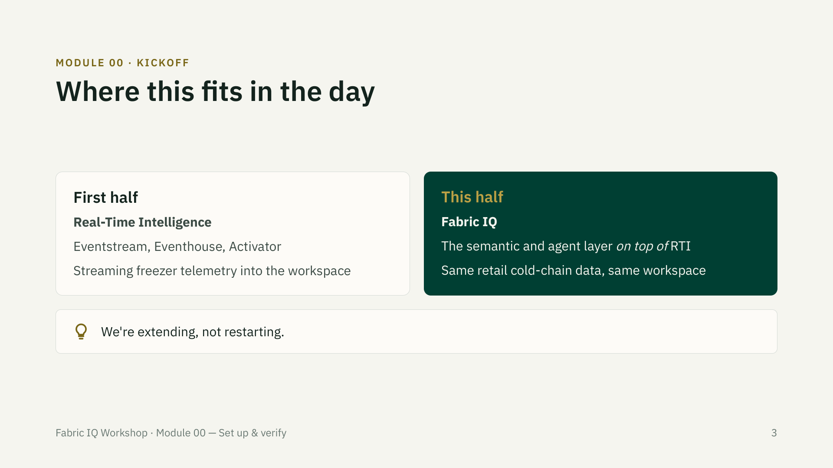
Notes:
Reassure the room this isn't a context switch — it's the next layer on the same stack they just built.

Slide 4
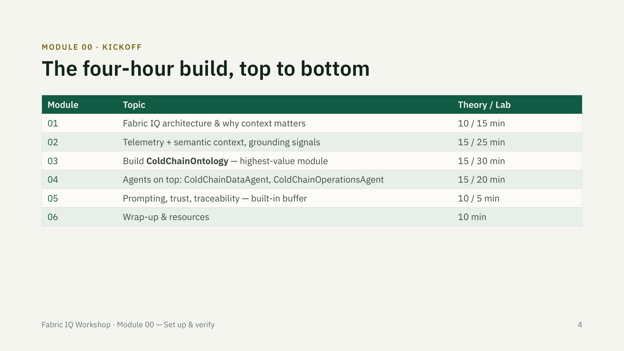

Slide 5
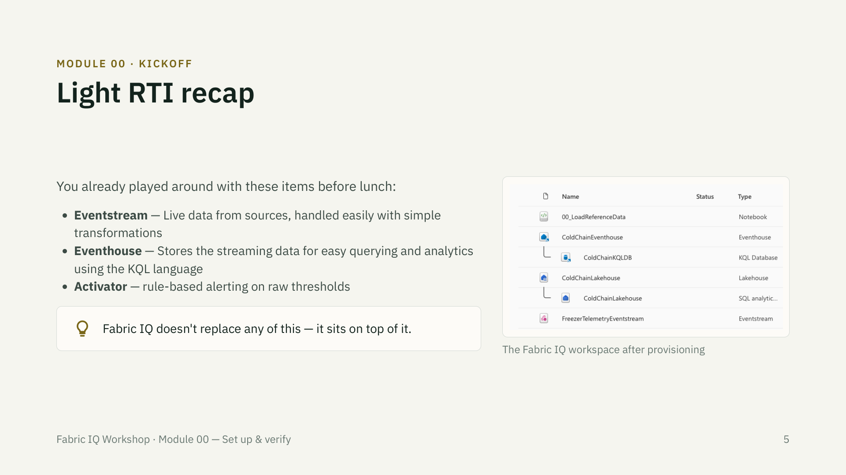

Slide 6
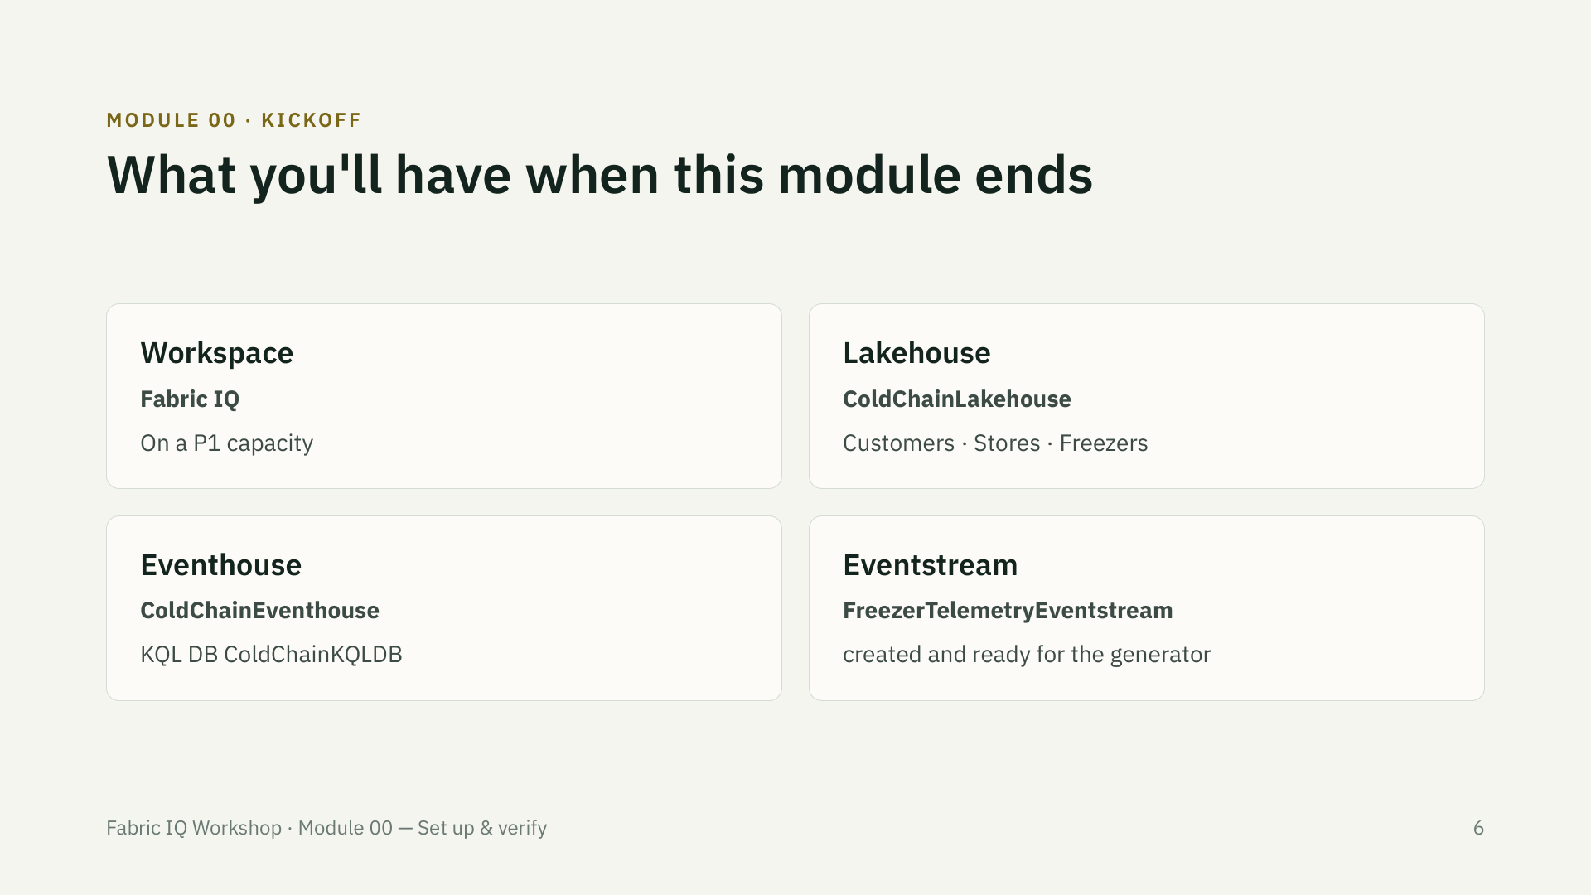

Slide 7
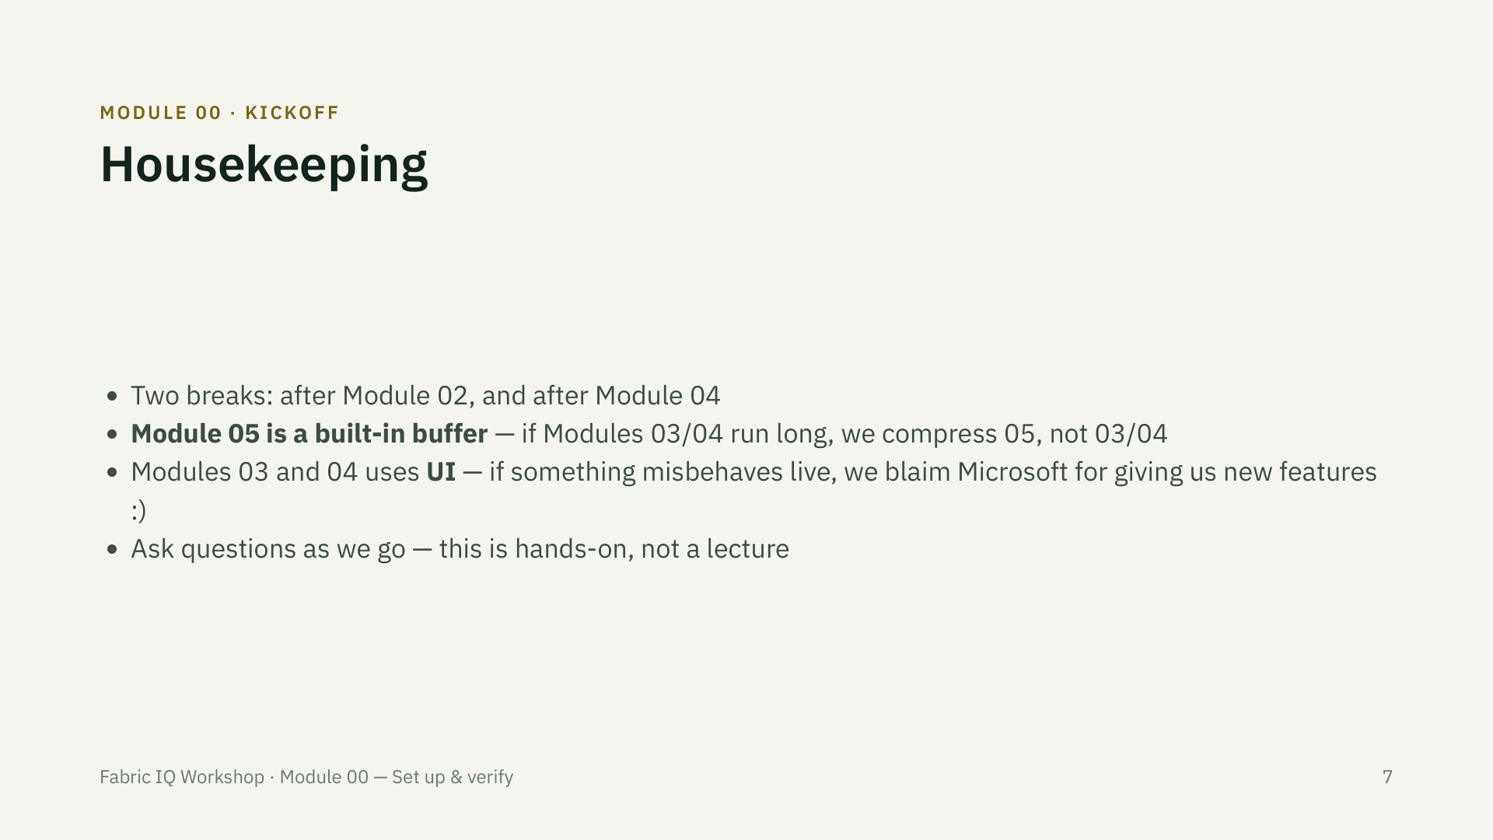

Slide 8
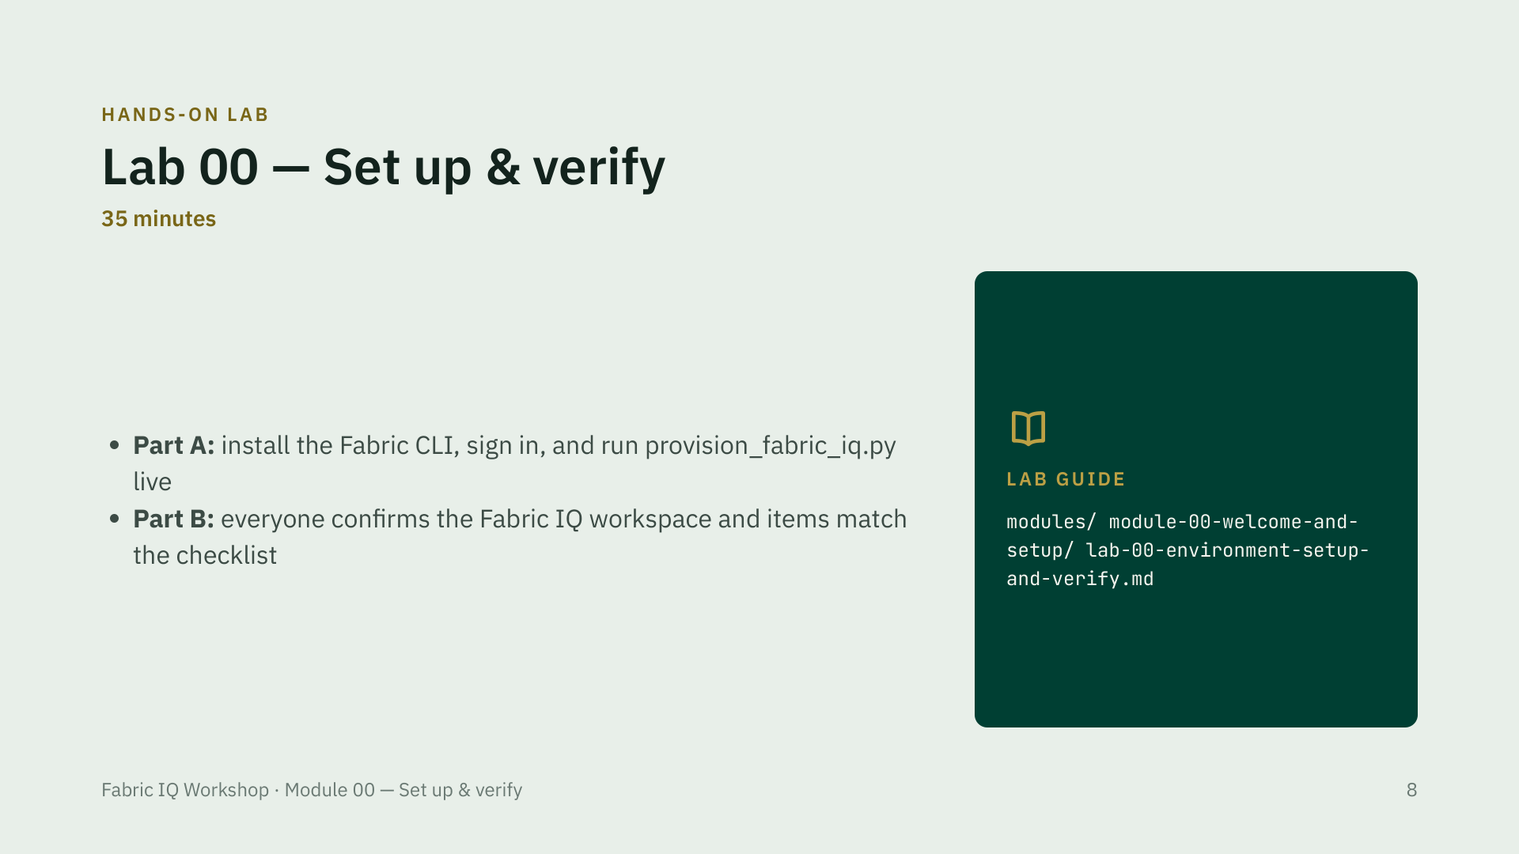
Notes:
Walk the room during Part A — most first-time issues are either a blocked VPN/proxy or a trial capacity slipping through. A trial capacity is a hard stop: pair that attendee with a neighbor immediately rather than let them try to troubleshoot it, since it traces back to a tenant-admin setting in PREREQUISITES.md that can't be fixed live. Attendees who pre-ran setup finish Part B early — point them ahead to Module 01 or have them help a neighbor instead of waiting idle.

Slide 9
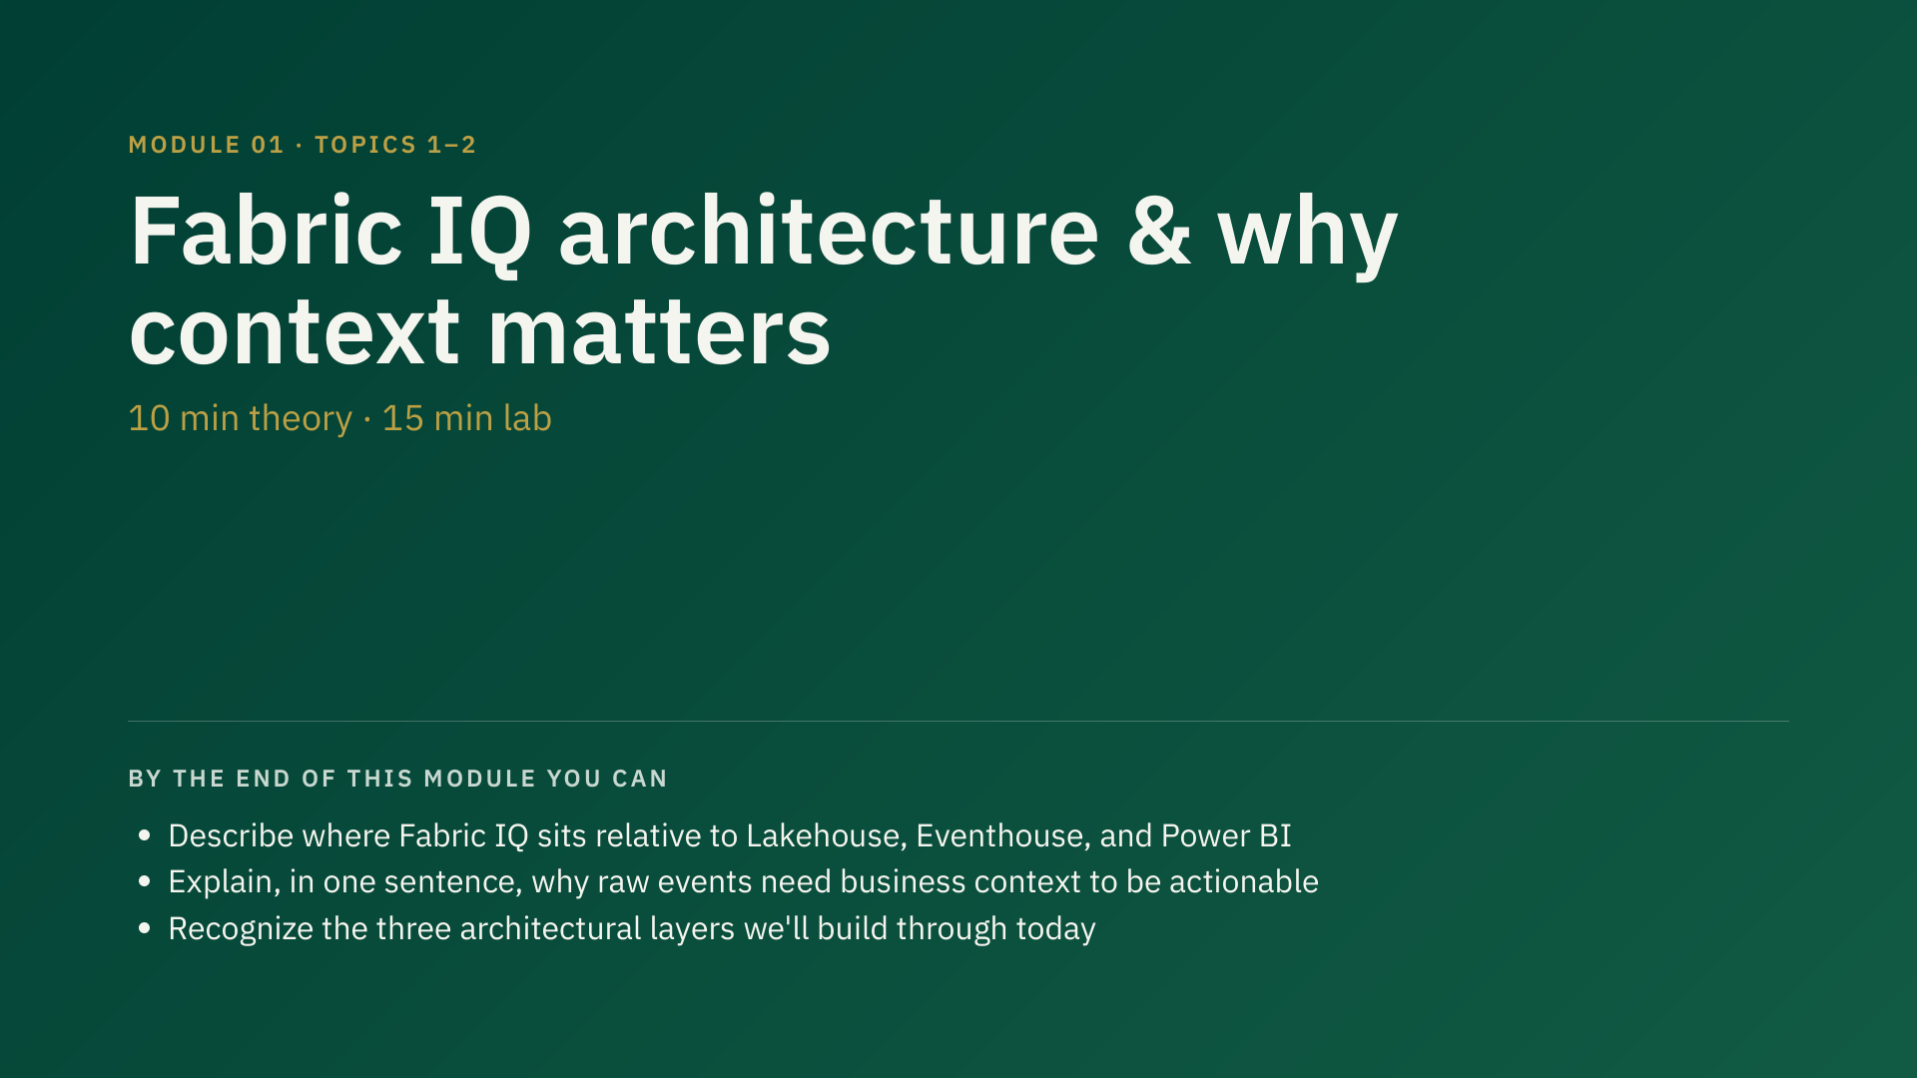
Notes:
25 min total — 10 min theory, 15 min lab. Keep this tight; the real depth comes in Modules 02-04.

Slide 10
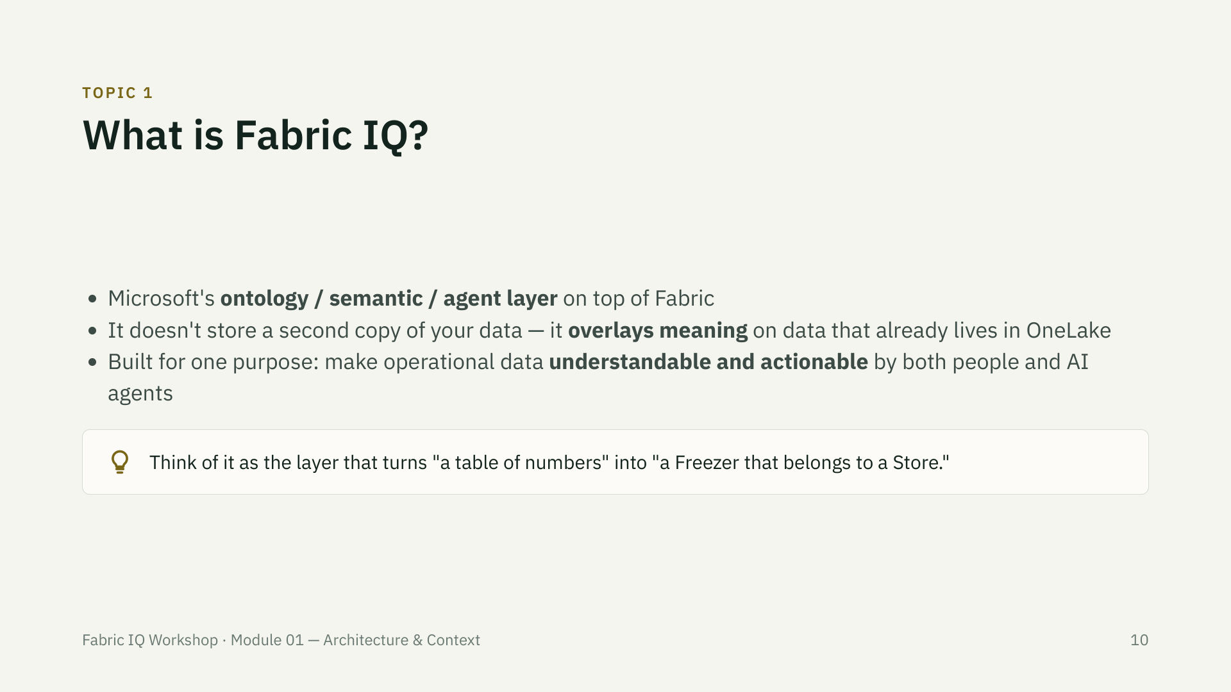

Slide 11
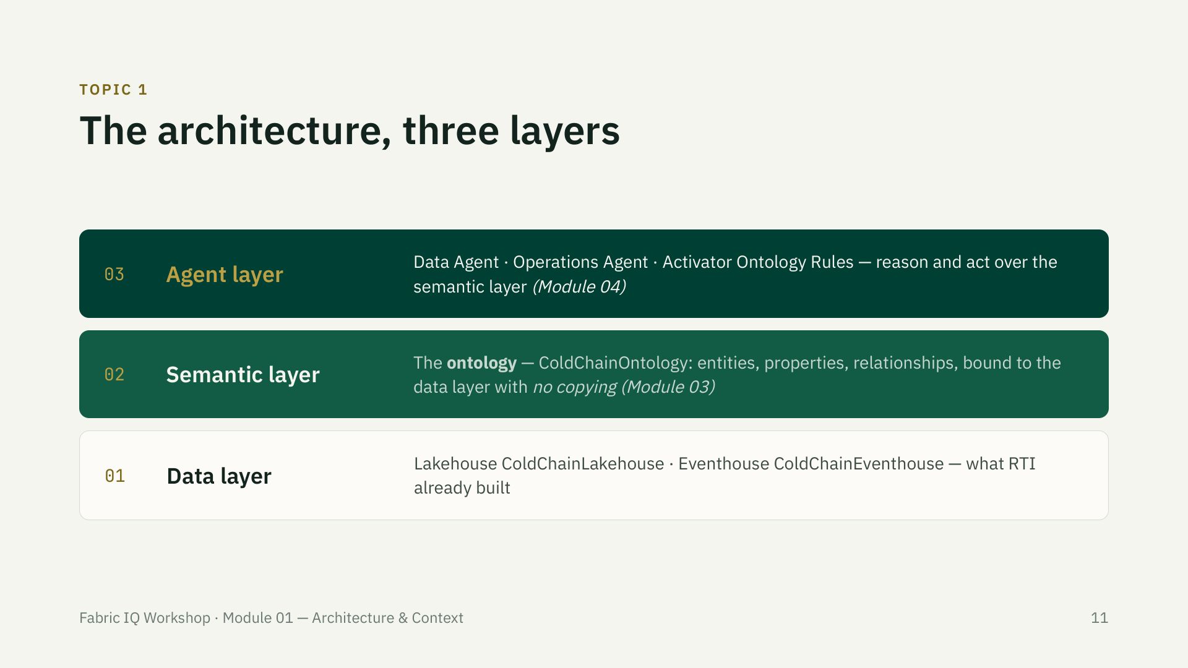

Slide 12
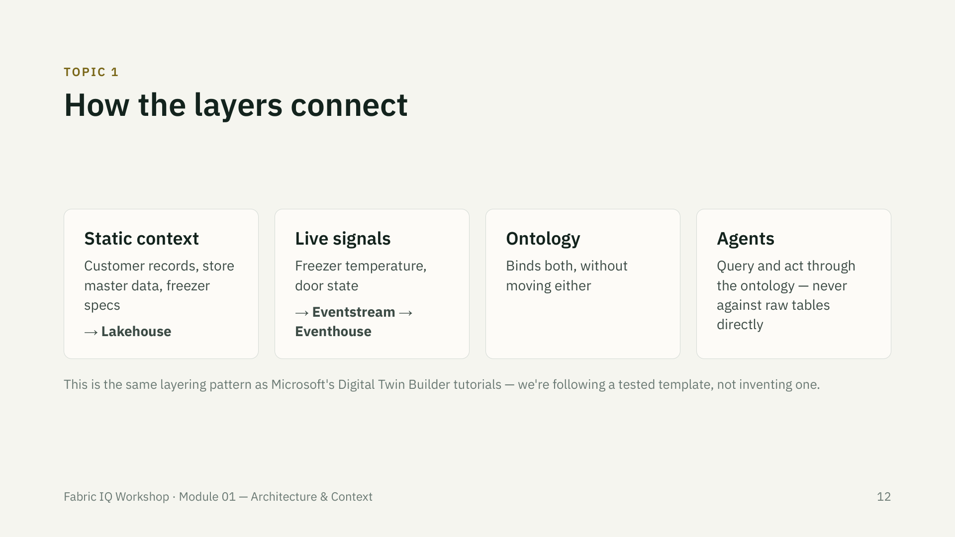

Slide 13
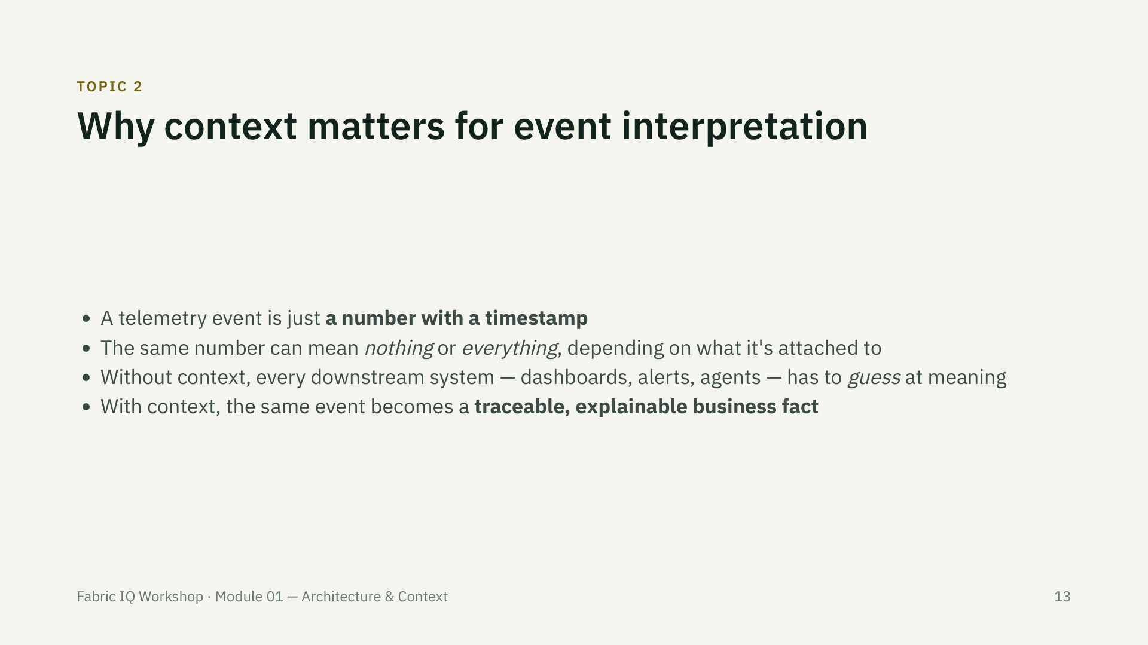

Slide 14
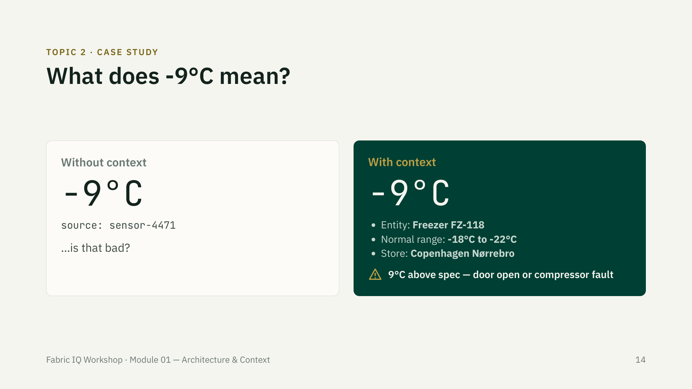
Notes:
This is the single idea to hammer home before lunch — everything else today builds on it. If a room only remembers one slide, make it this one.

Slide 15
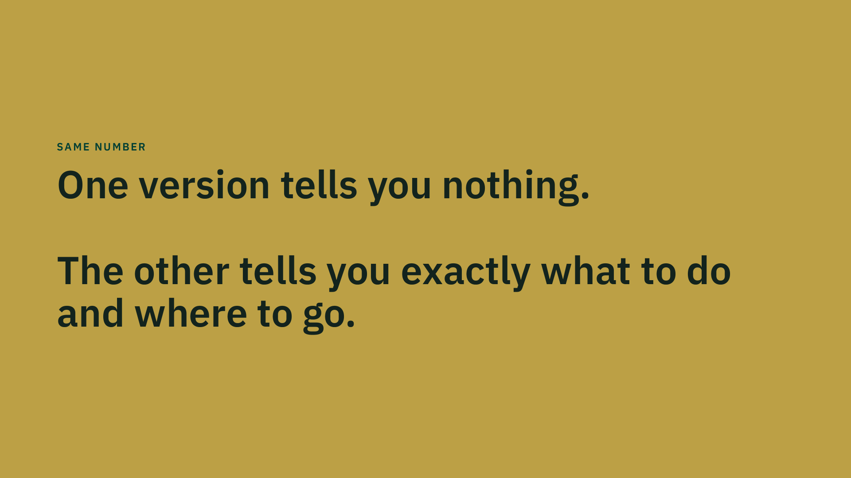

Slide 16
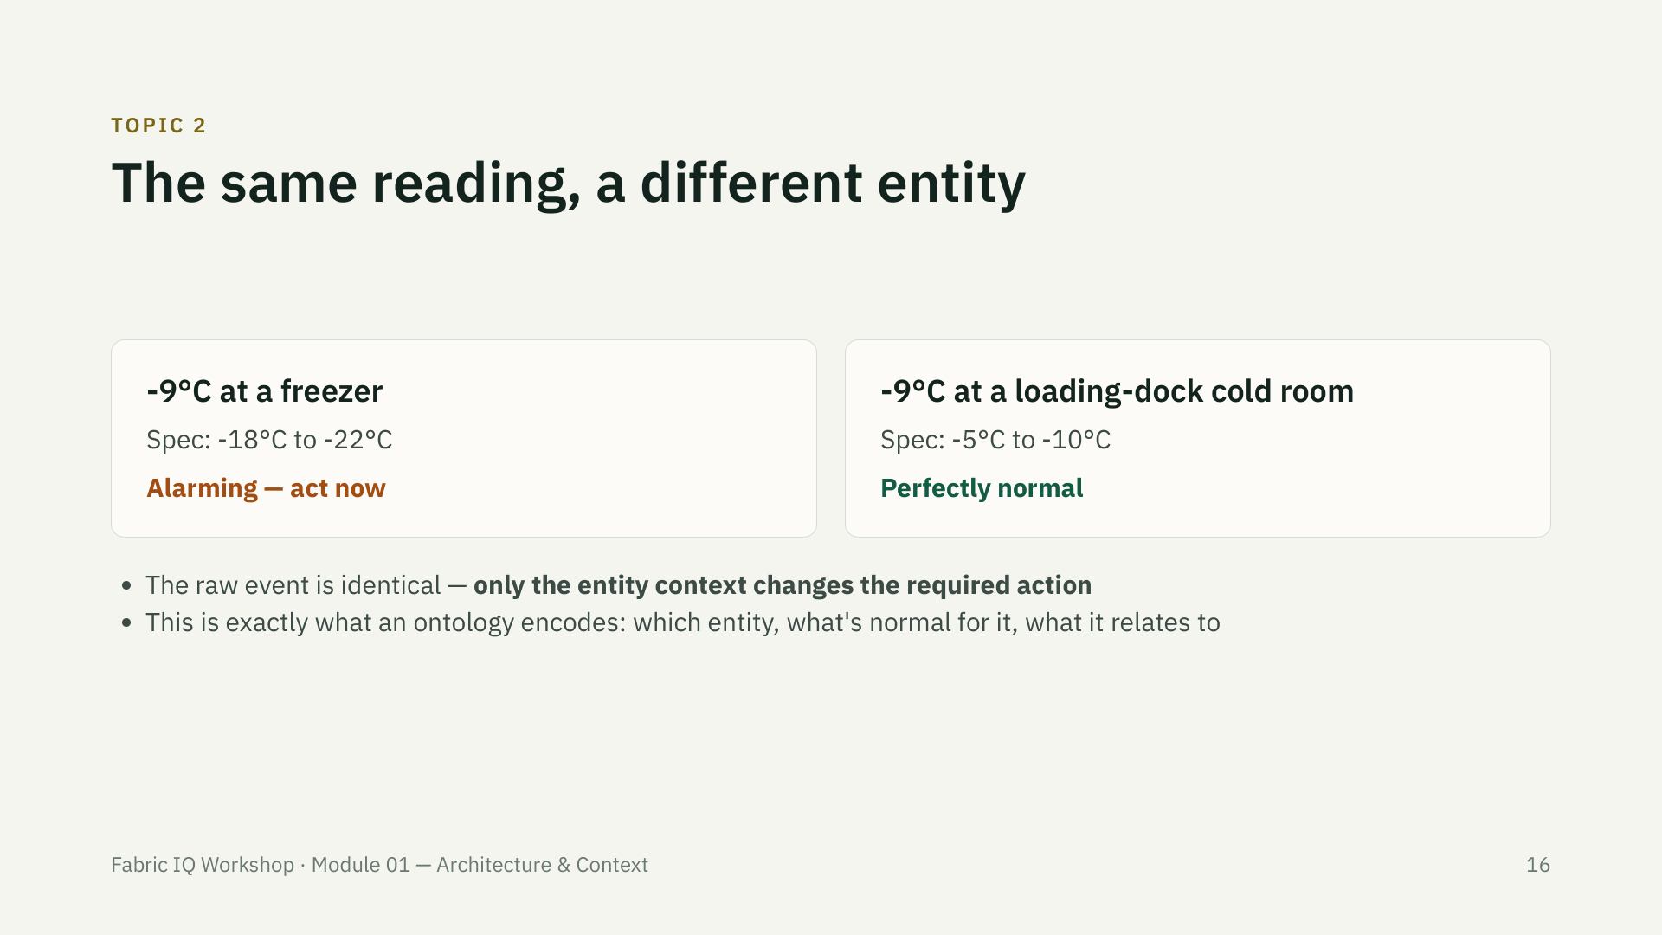

Slide 17
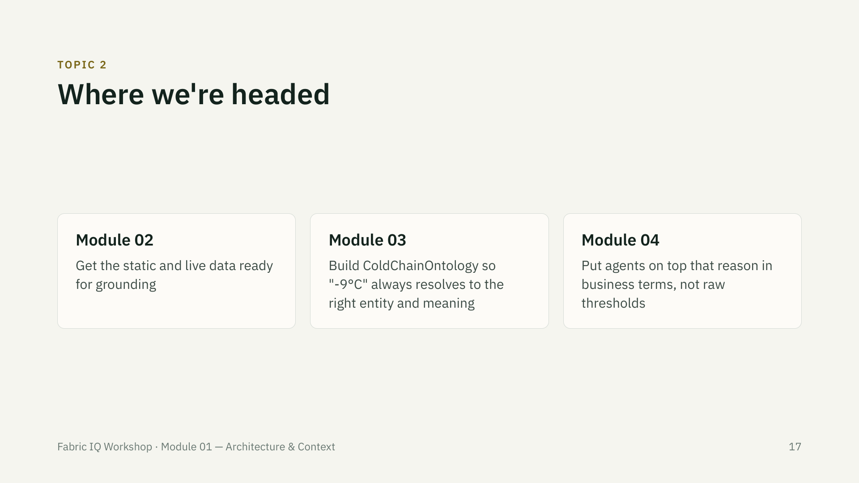

Slide 18
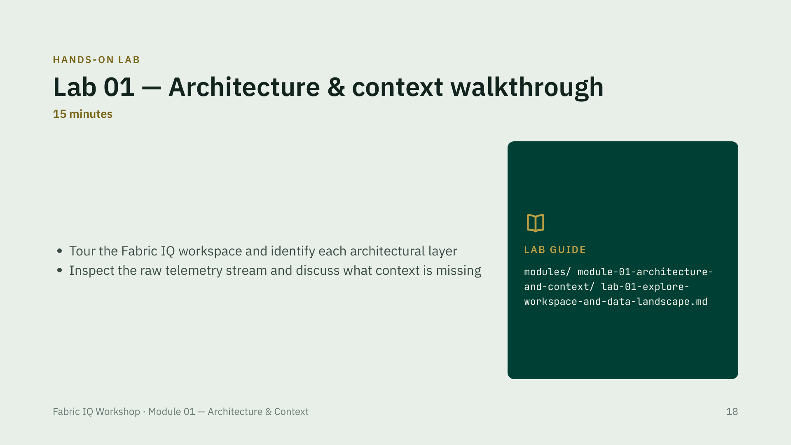

Slide 19
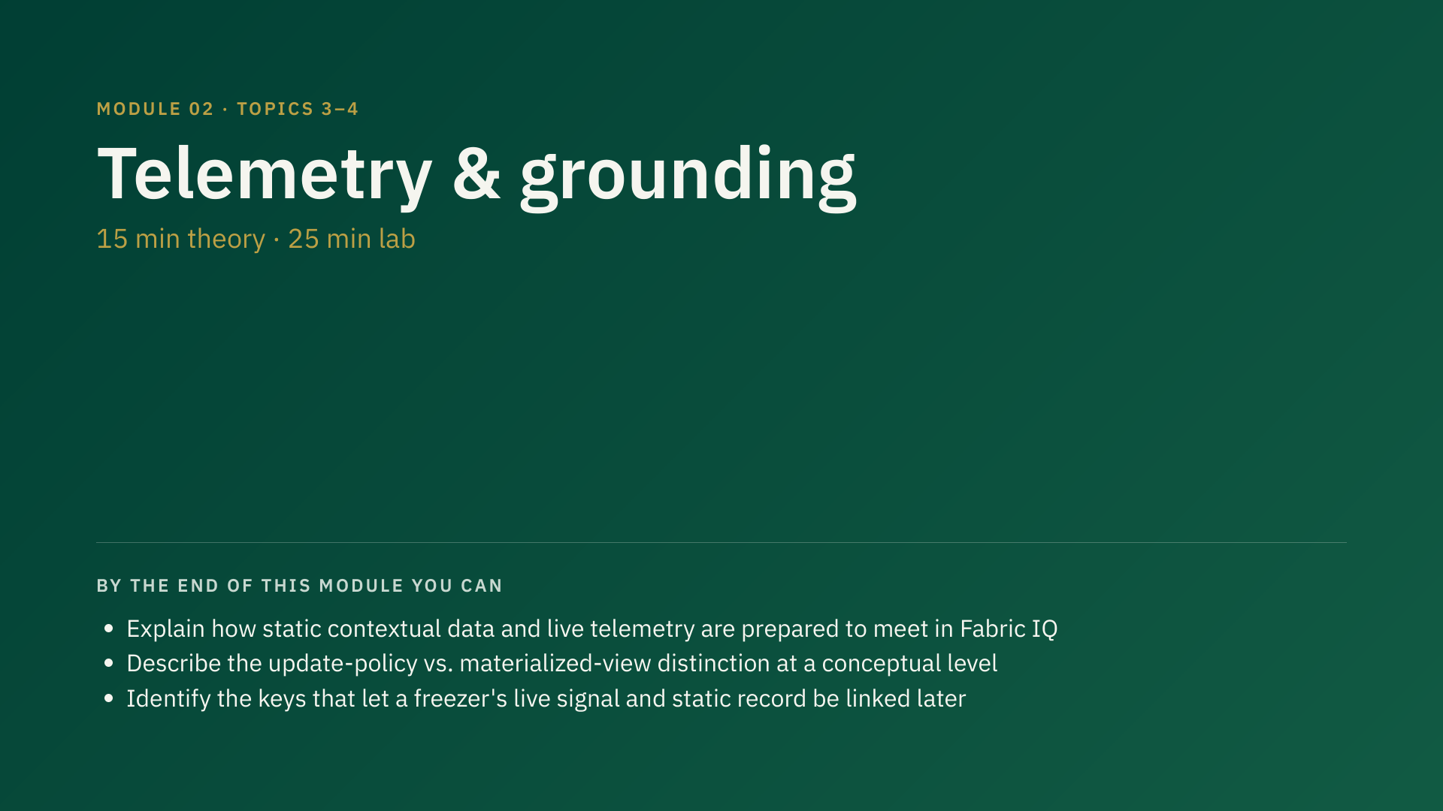
Notes:
40 min total — 15 min theory, 25 min lab. This module prepares the data both sides (static + live) need before we can build the ontology in Module 03.

Slide 20
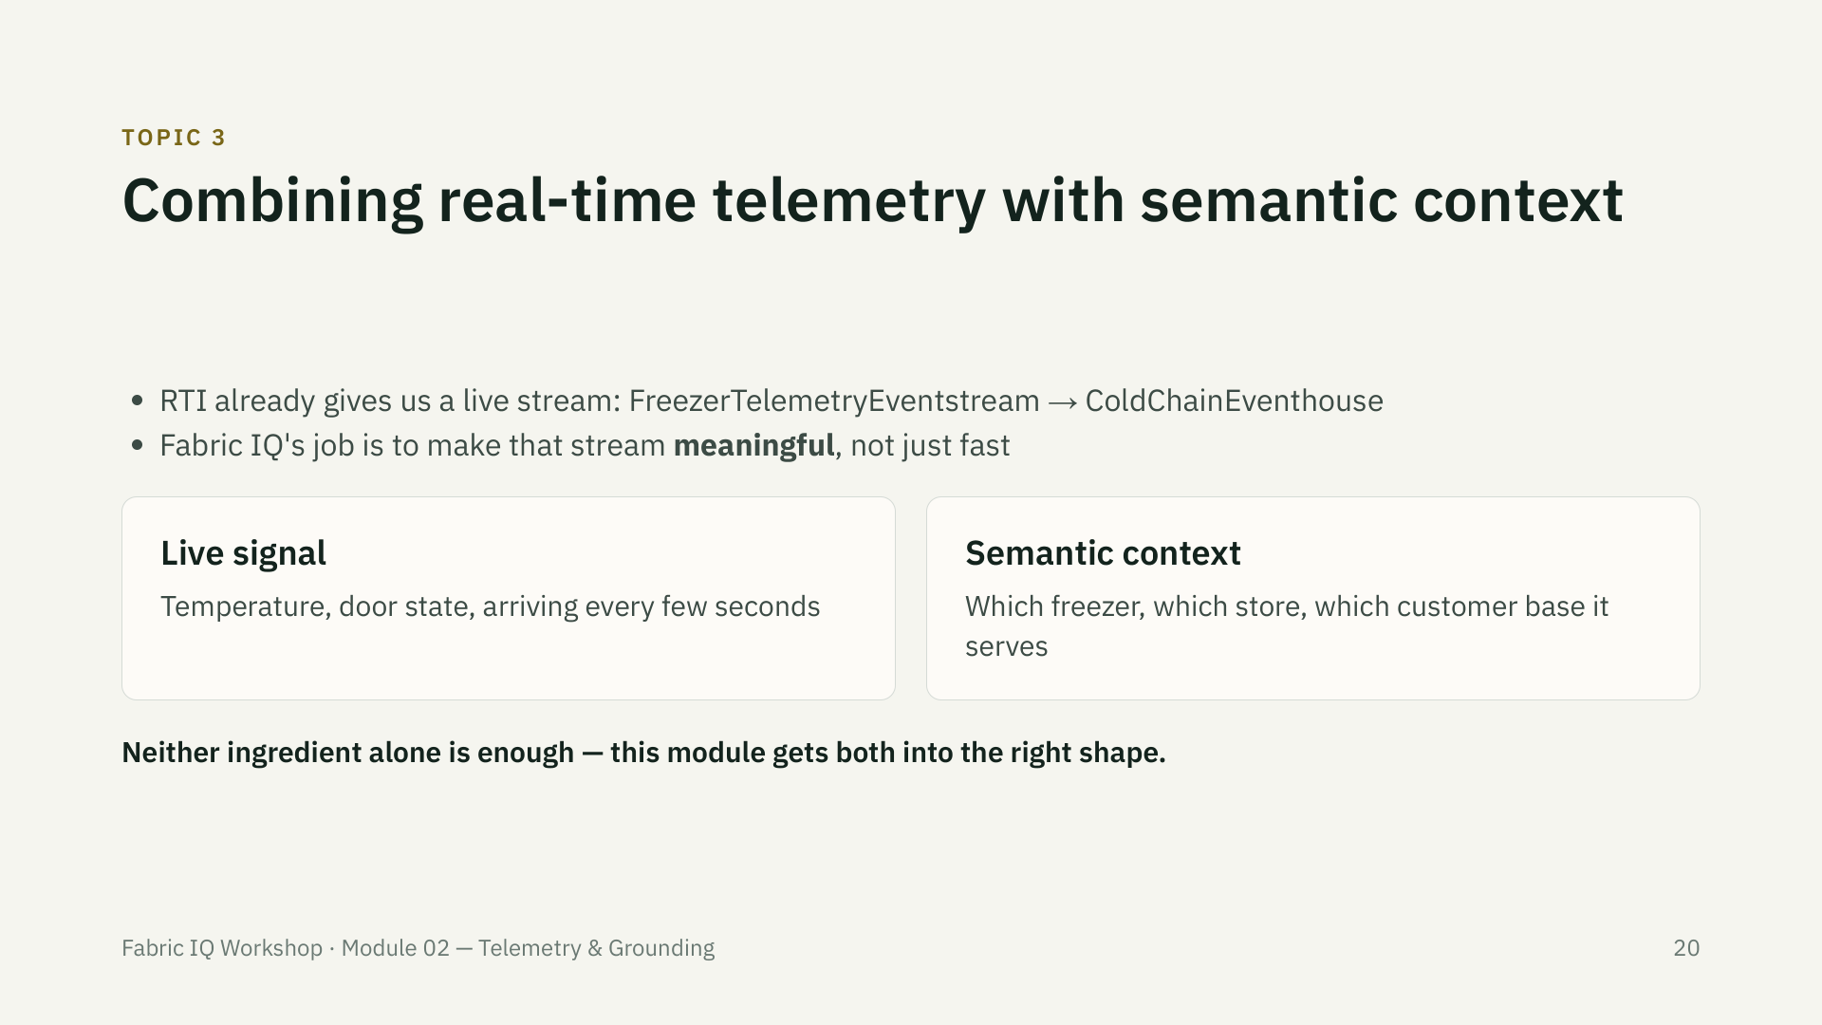

Slide 21
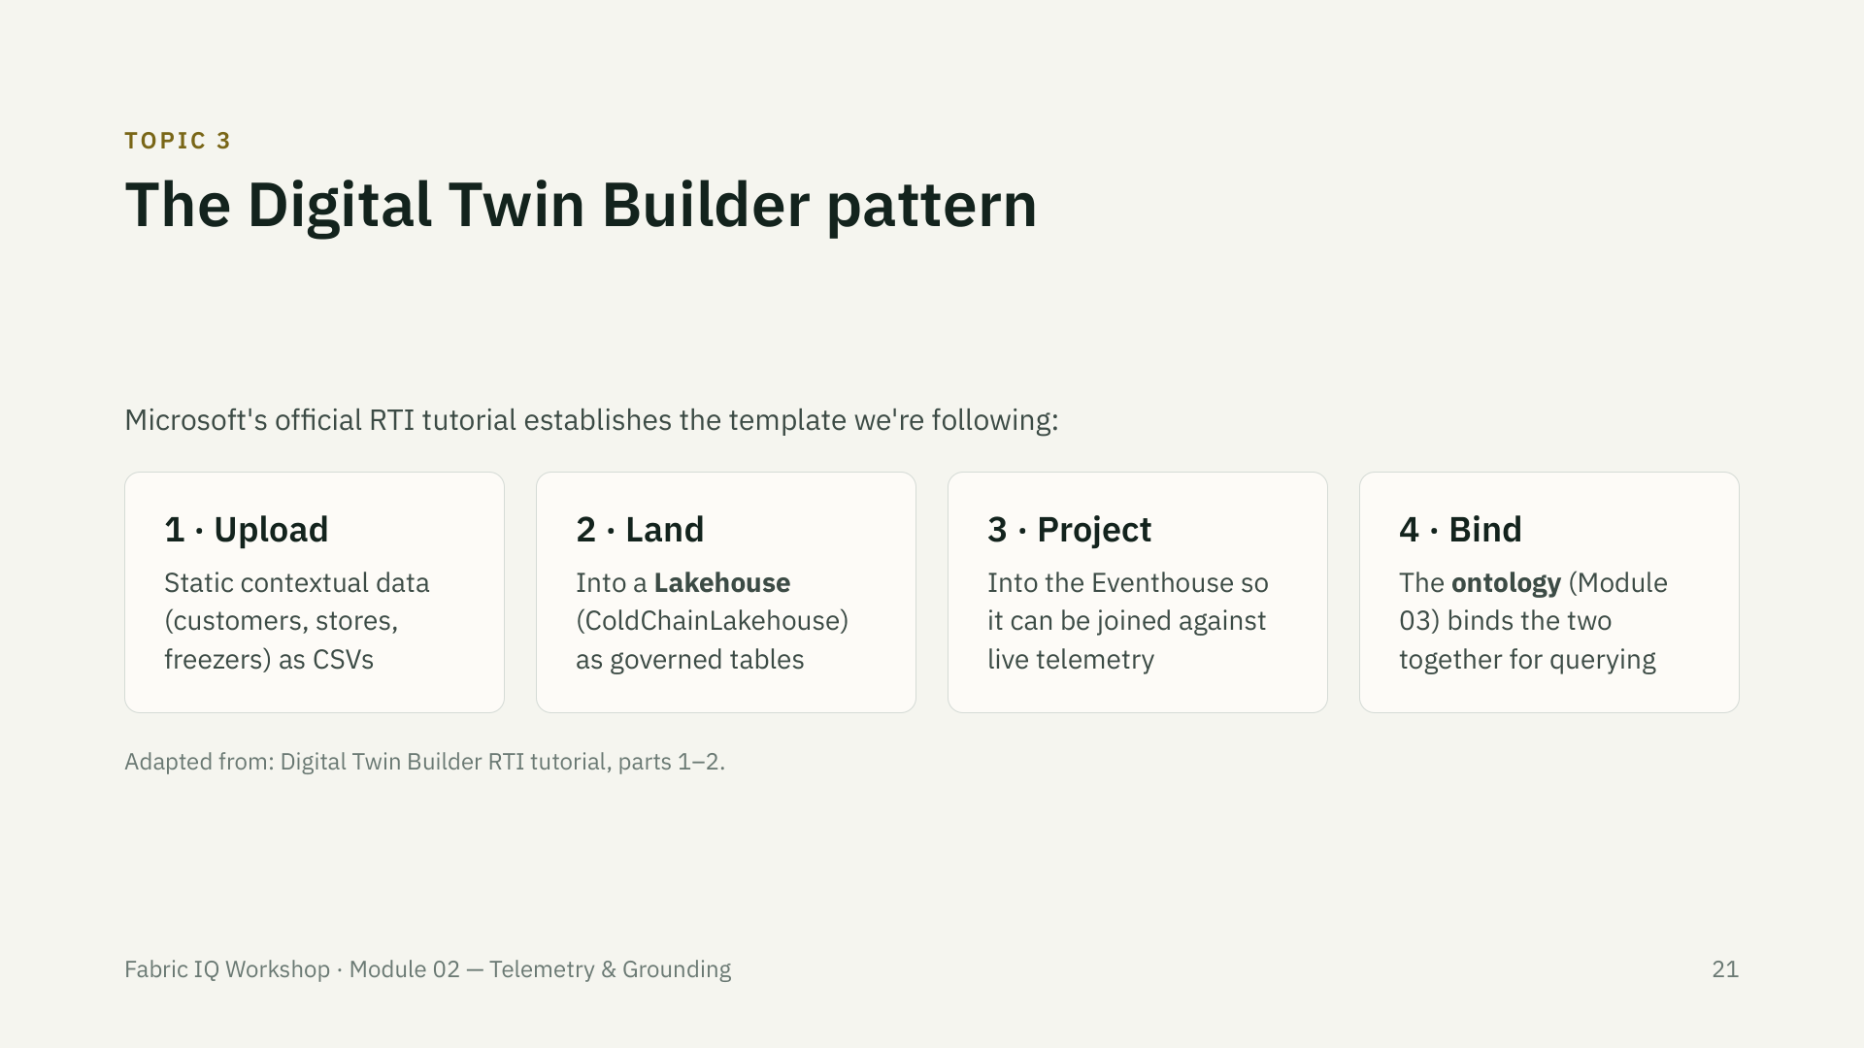

Slide 22
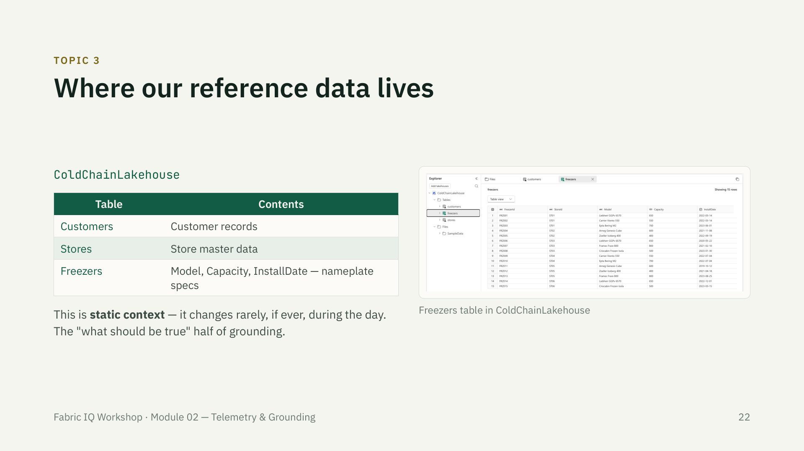

Slide 23
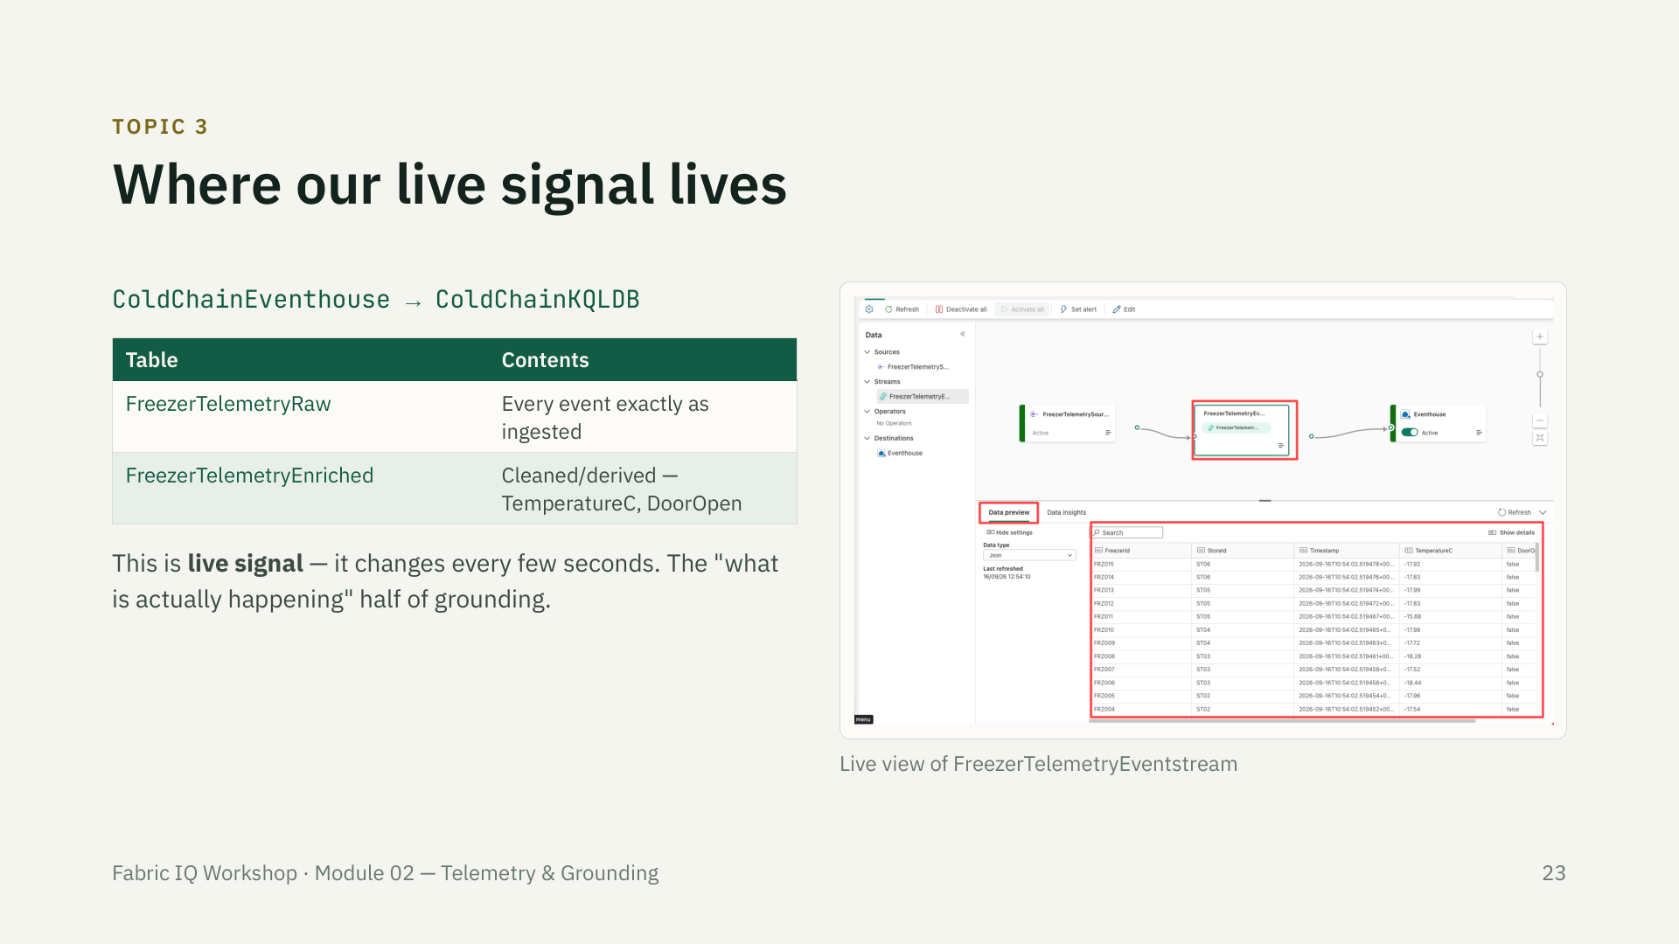

Slide 24
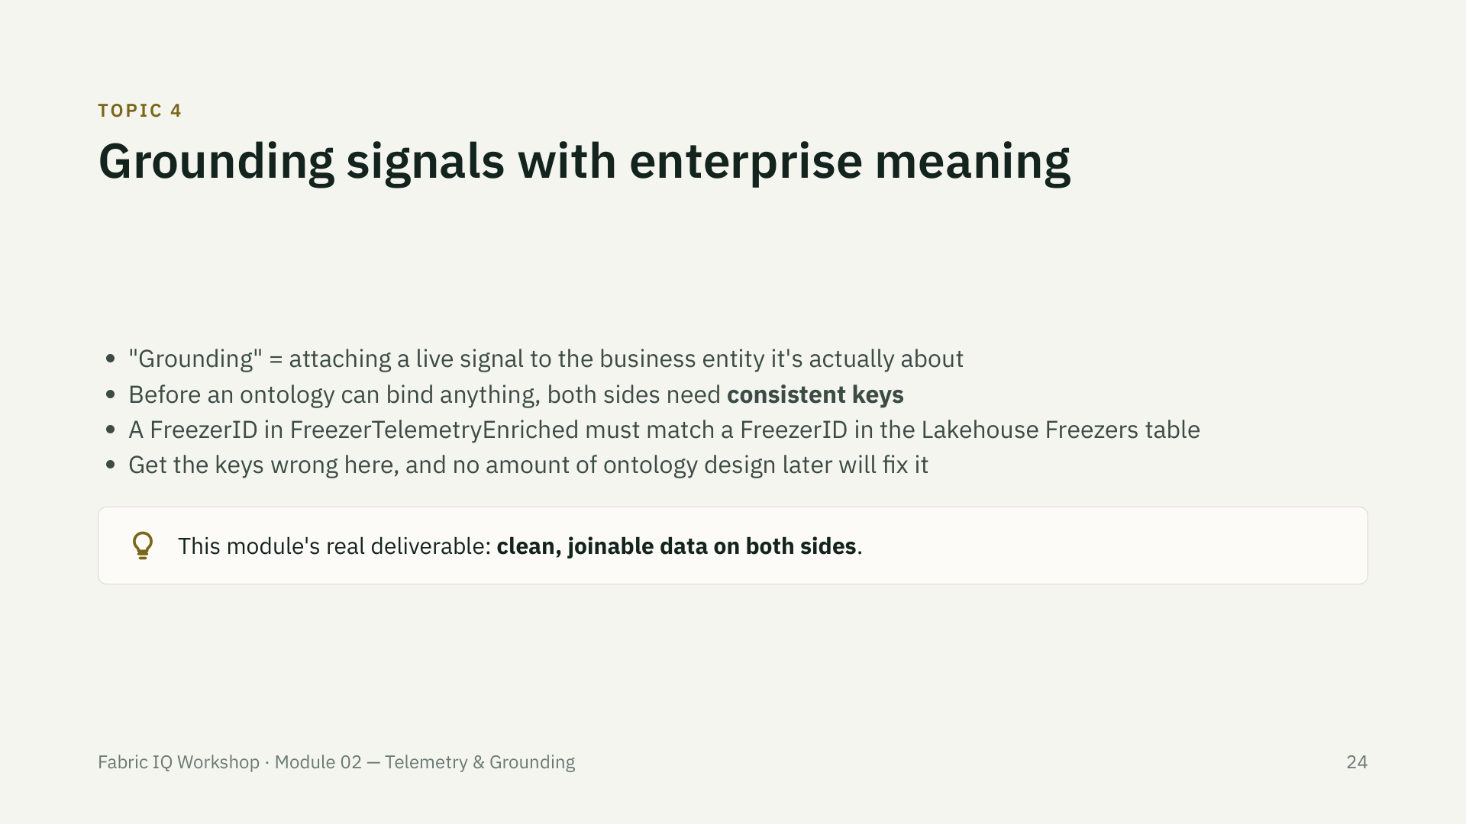

Slide 25
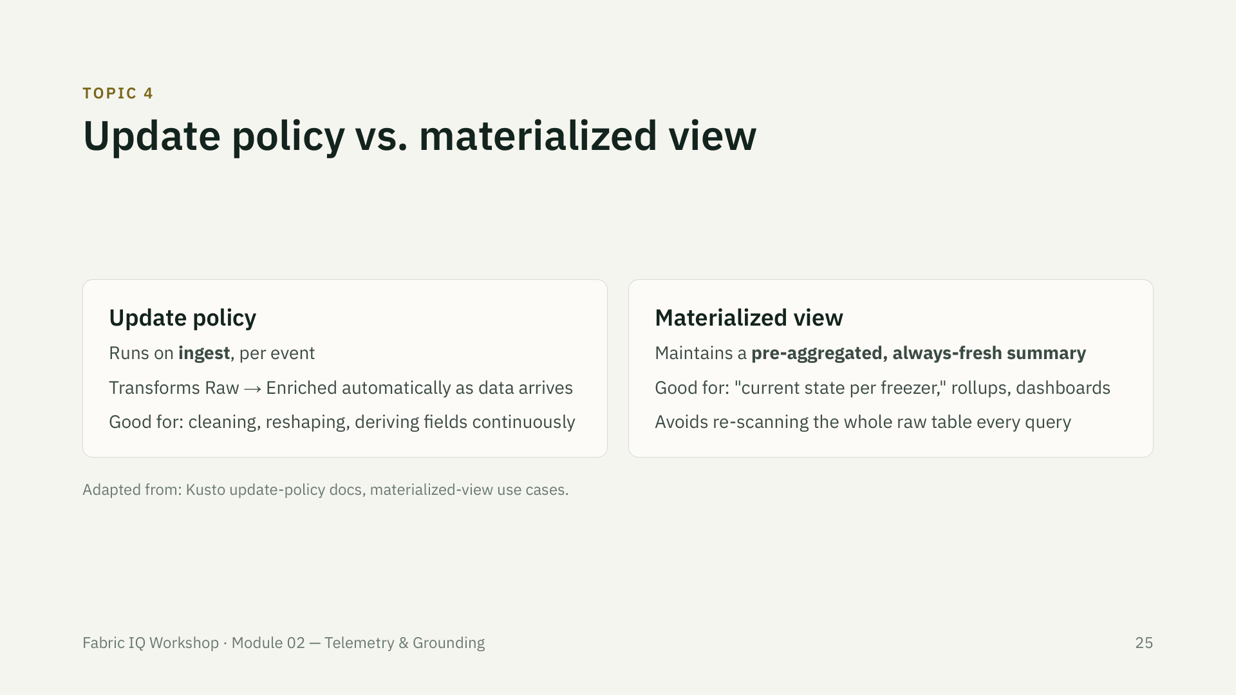

Slide 26
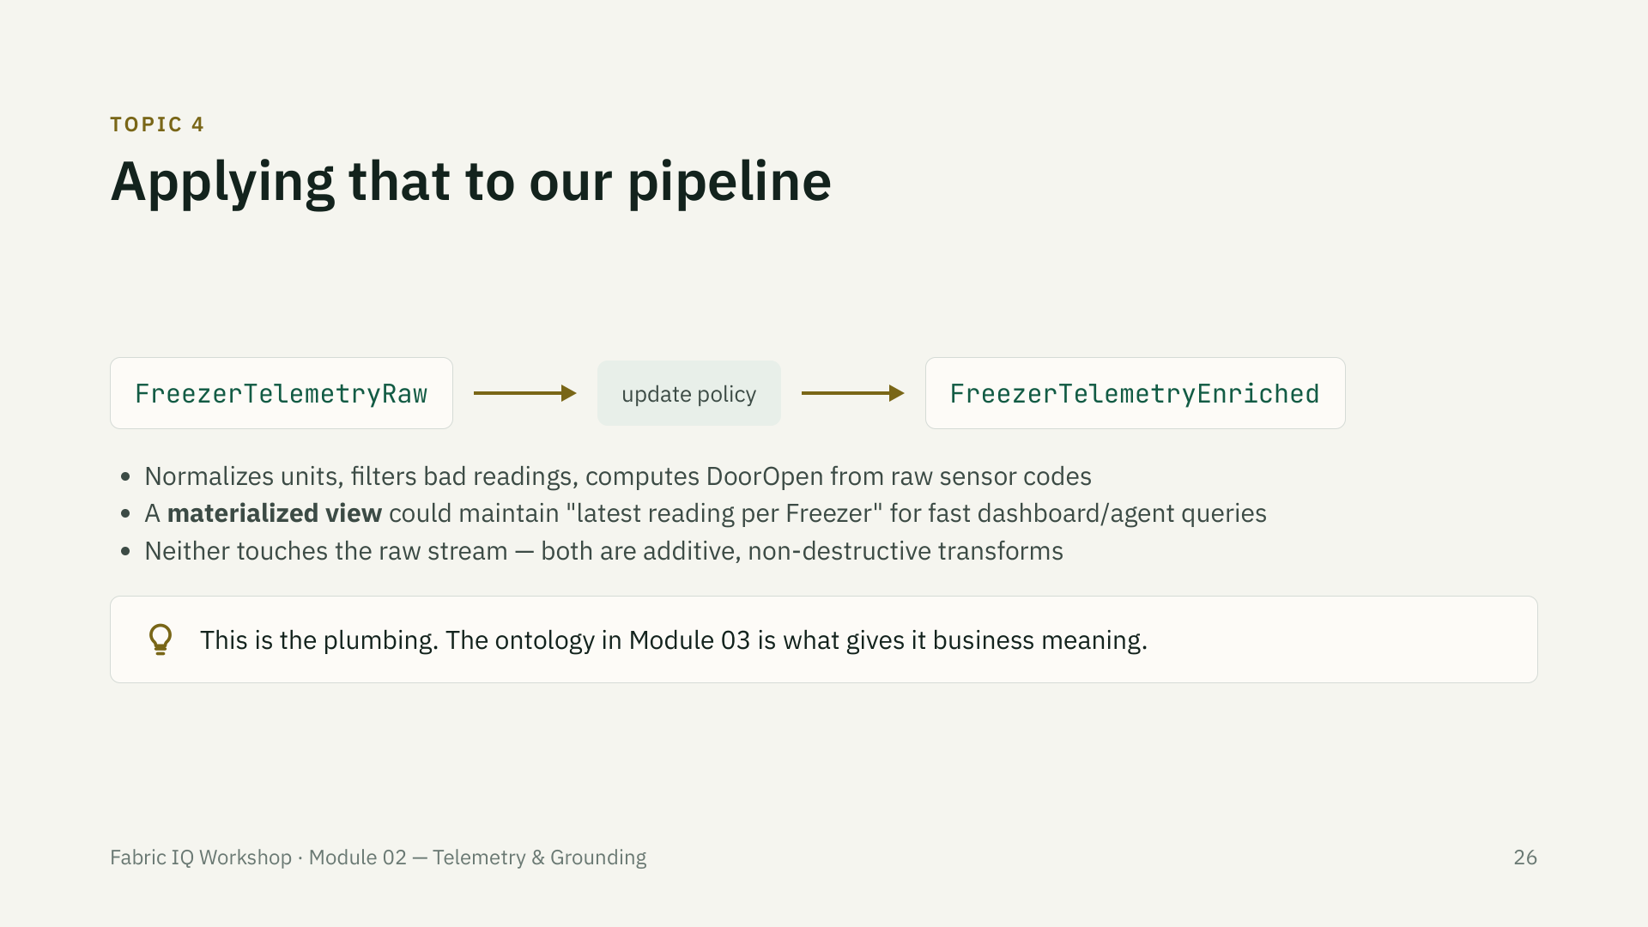

Slide 27
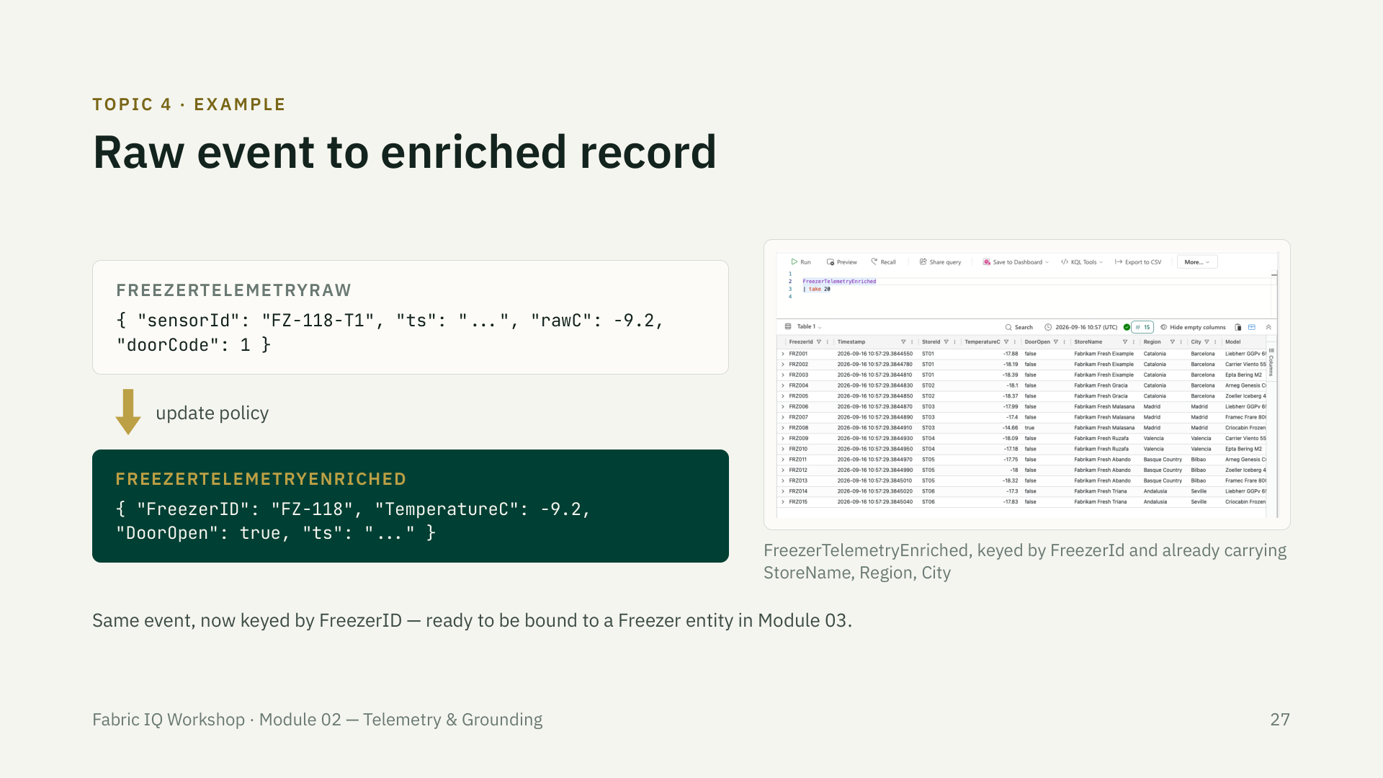

Slide 28
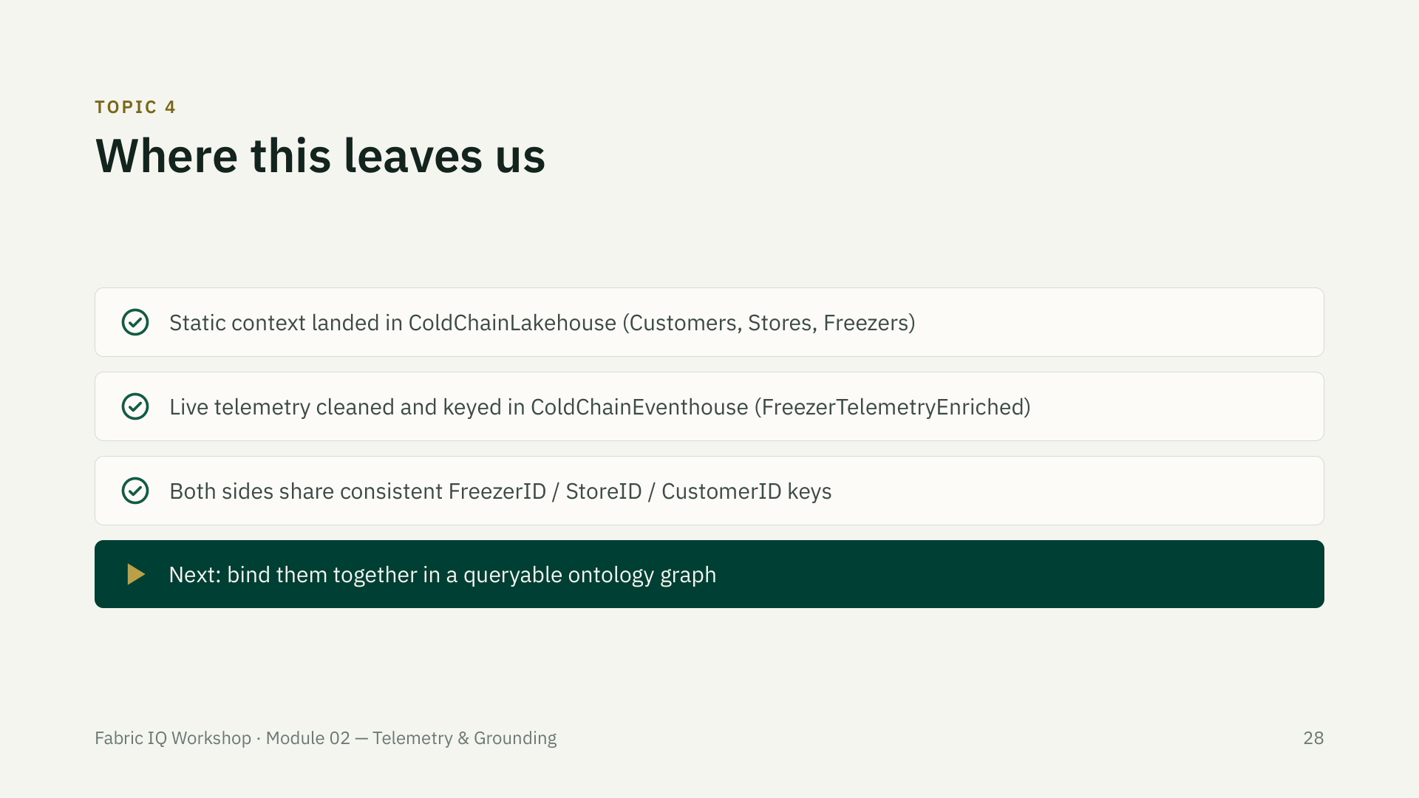

Slide 29
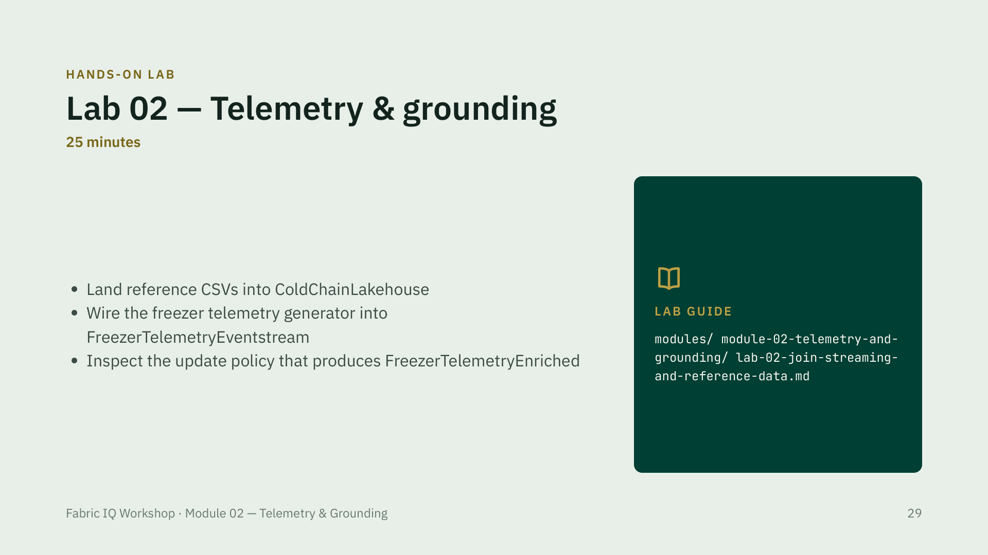

Slide 30
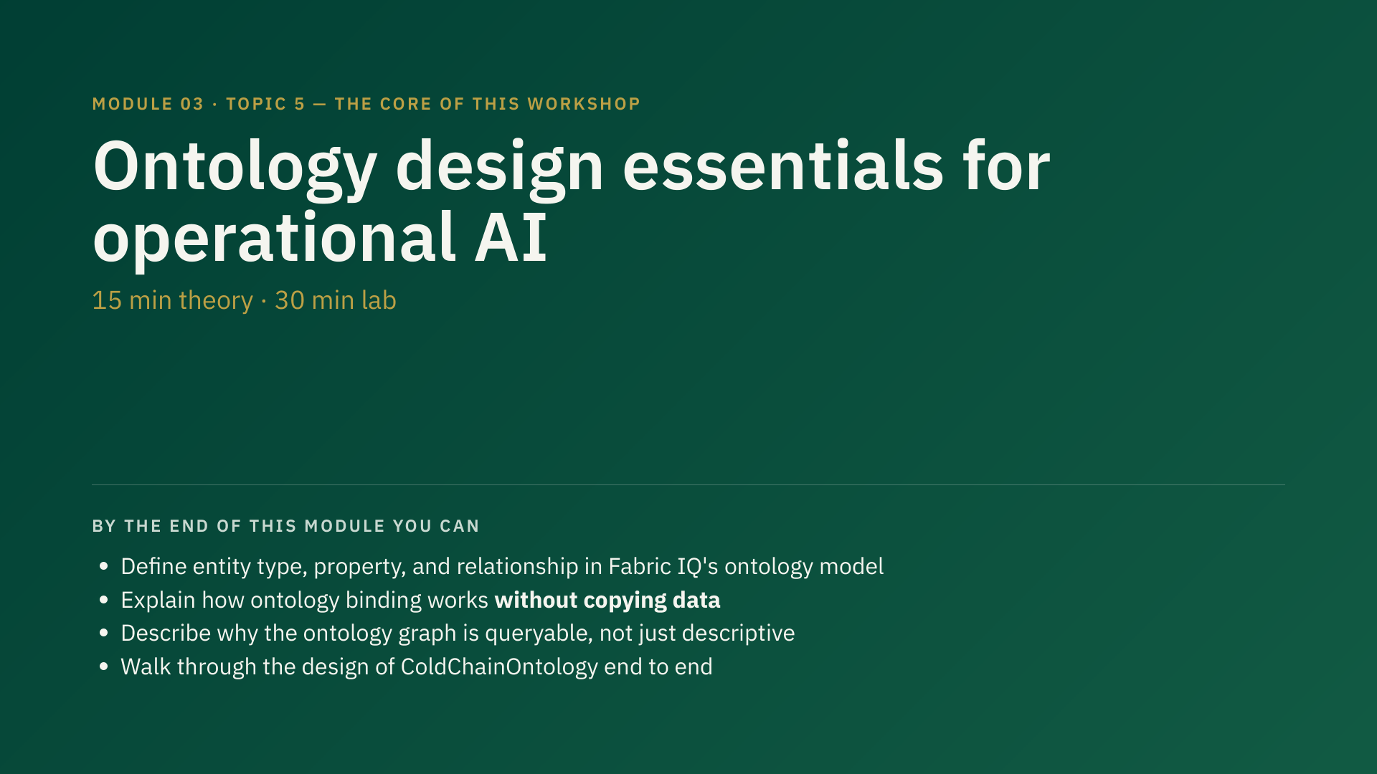
Notes:
45 min total — 15 min theory, 30 min lab. This is the highest-risk module (preview UI) and the core learning objective of the whole afternoon. Do not let this get compressed — if anything runs long, it's Module 05 that flexes, not this one. Have the screenshot fallback sequence open in a browser tab before you start, per risk-fallback-plan.md.

Slide 31
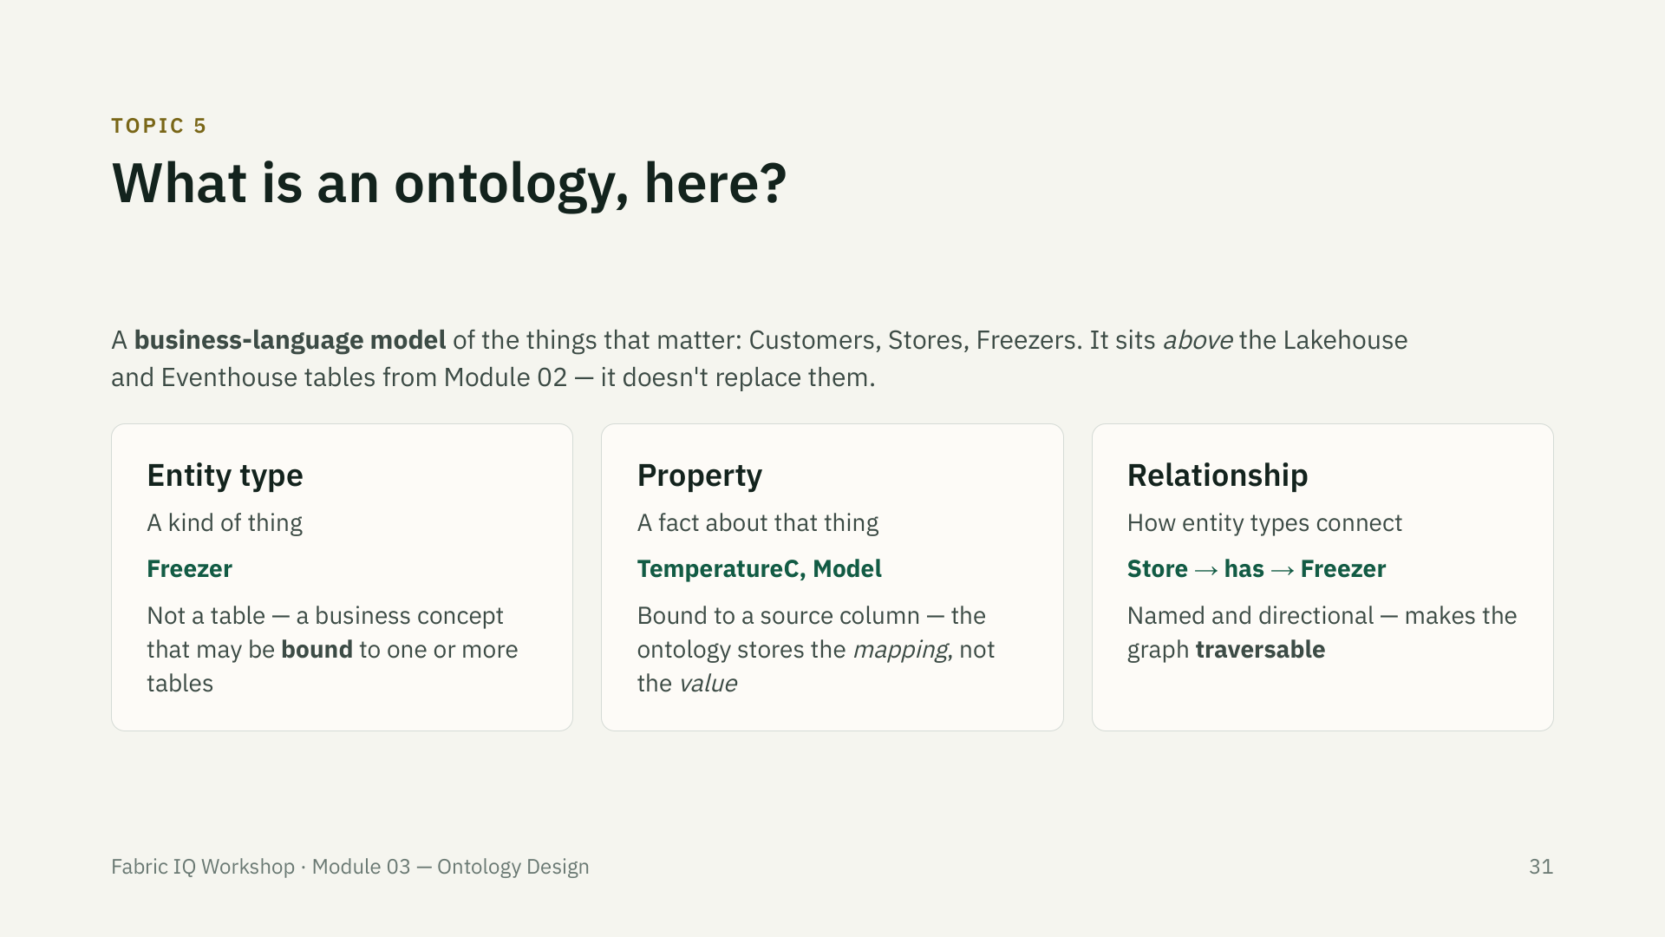

Slide 32
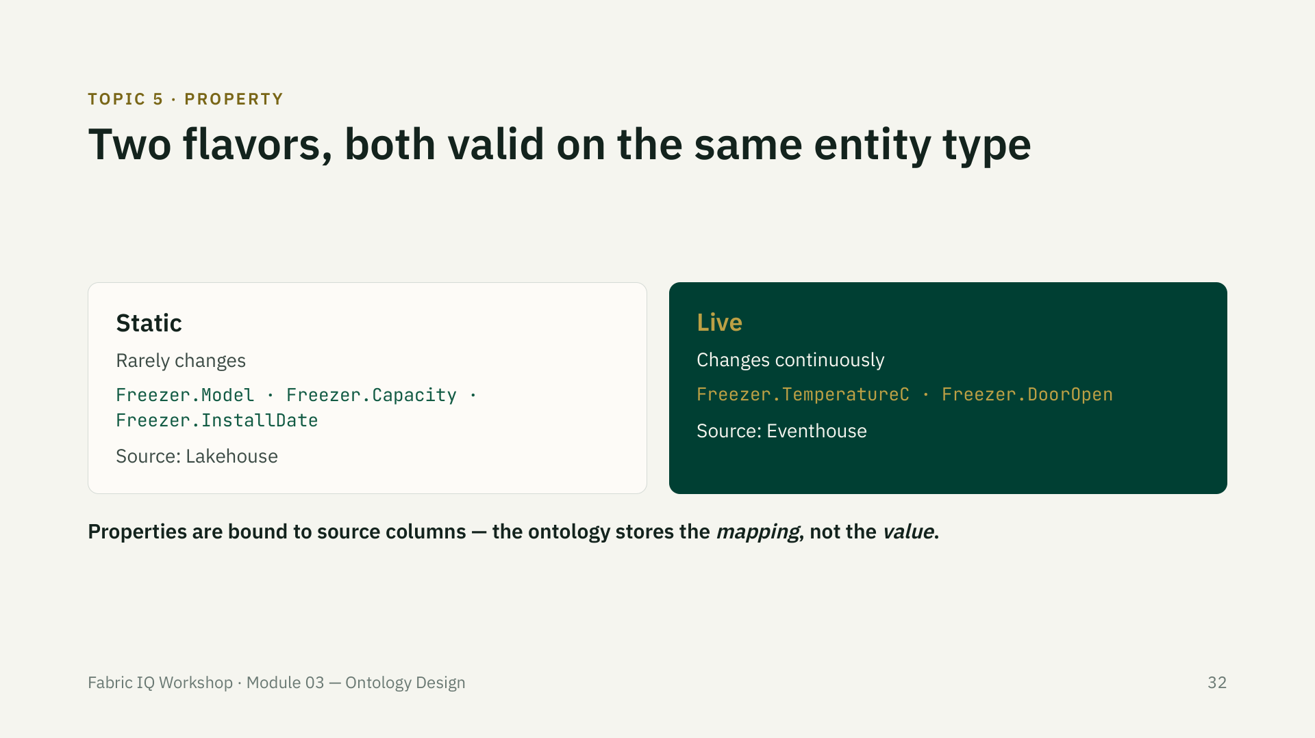

Slide 33
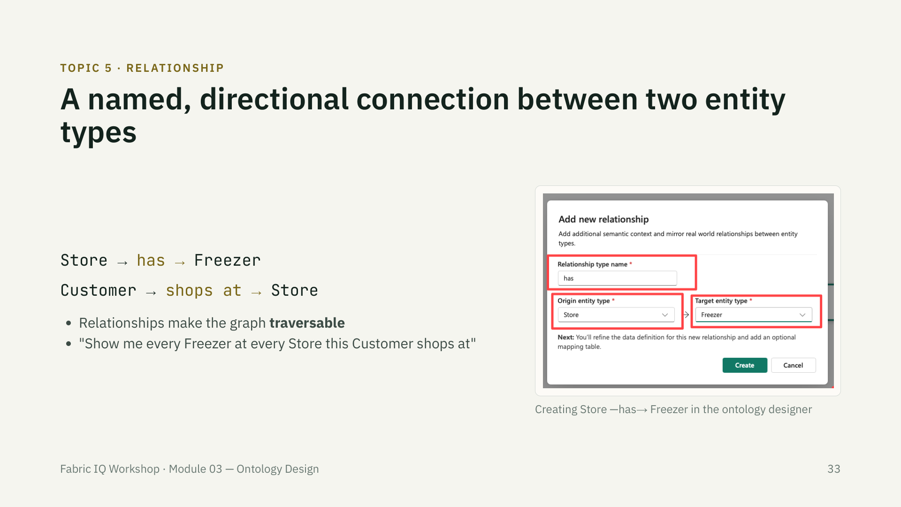

Slide 34
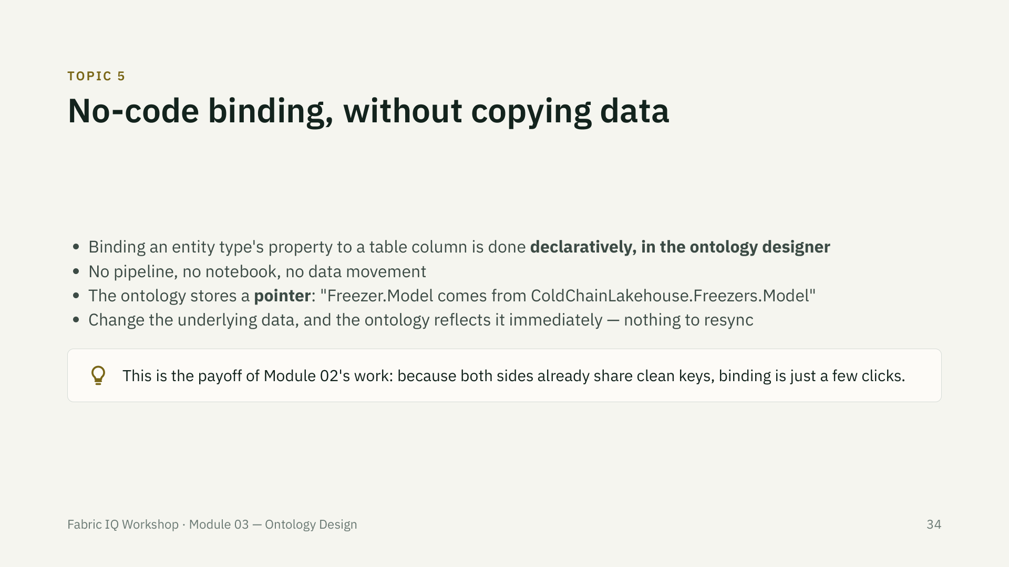

Slide 35
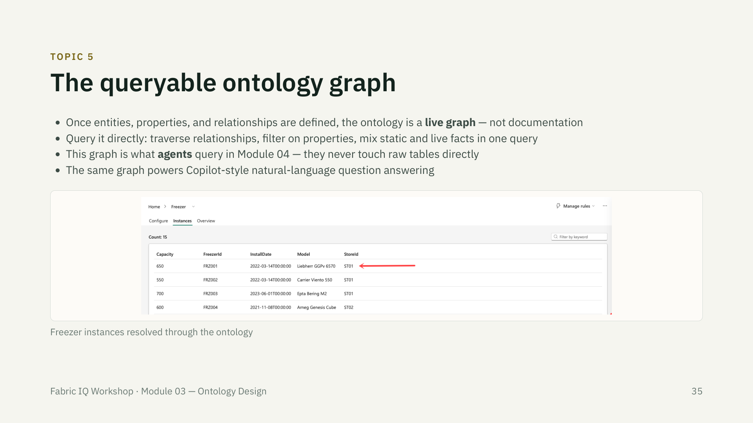

Slide 36
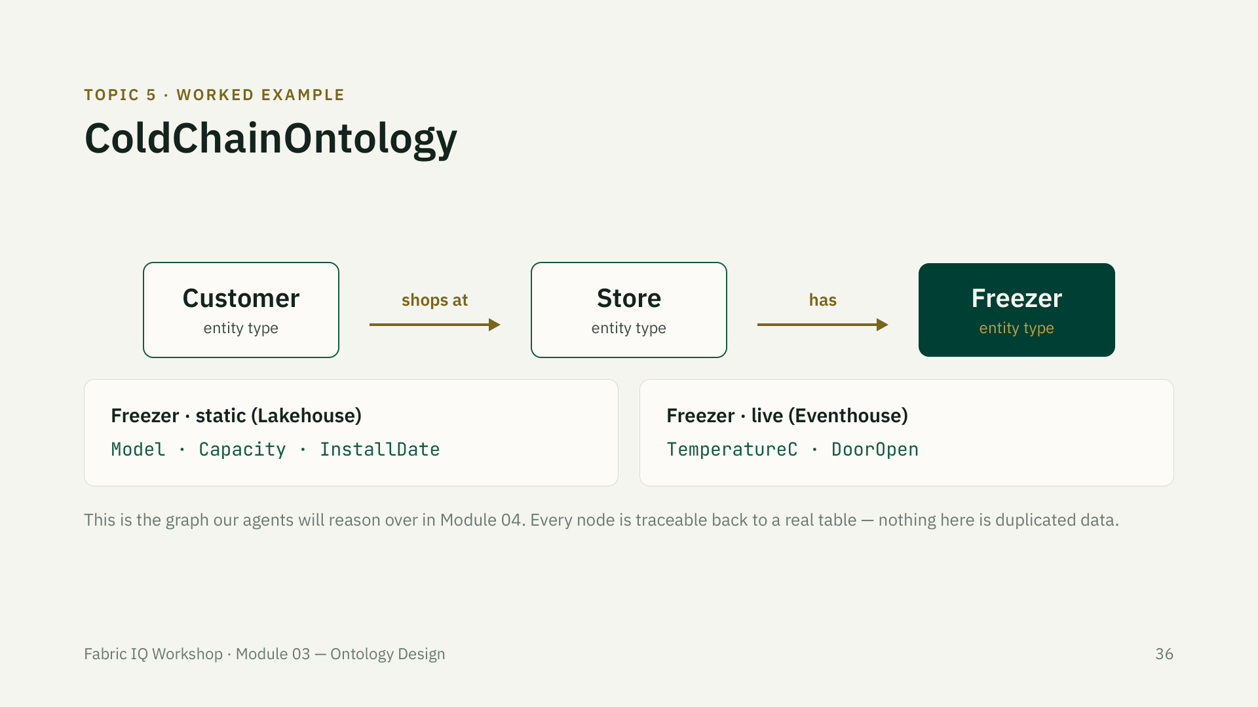

Slide 37
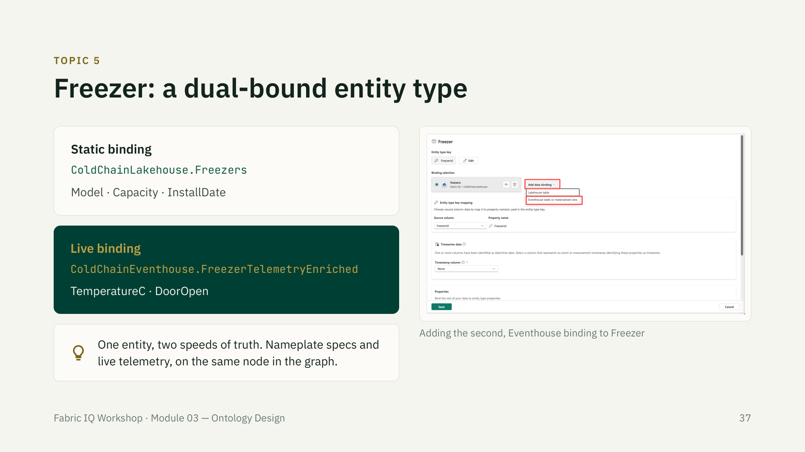

Slide 38
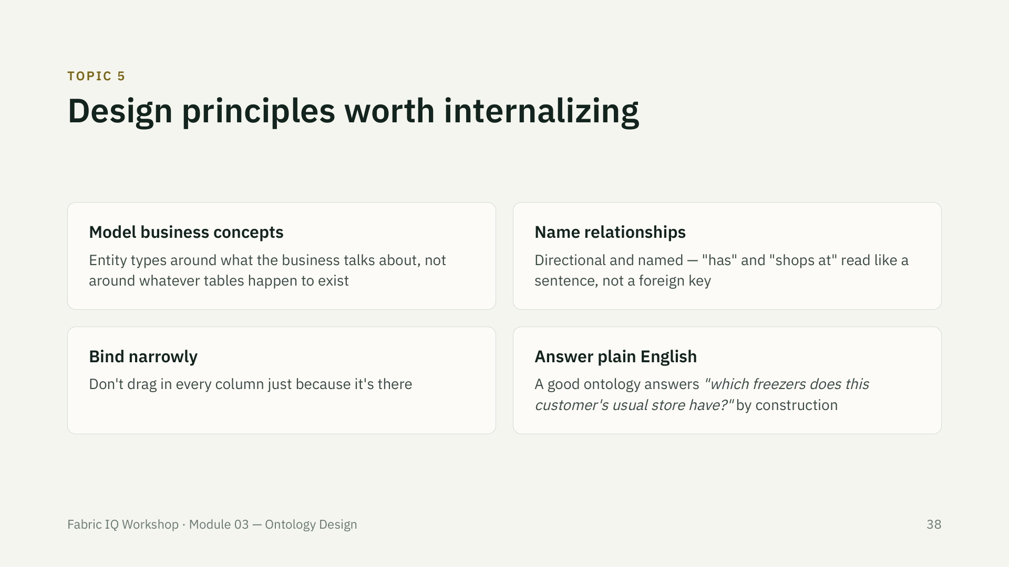

Slide 39
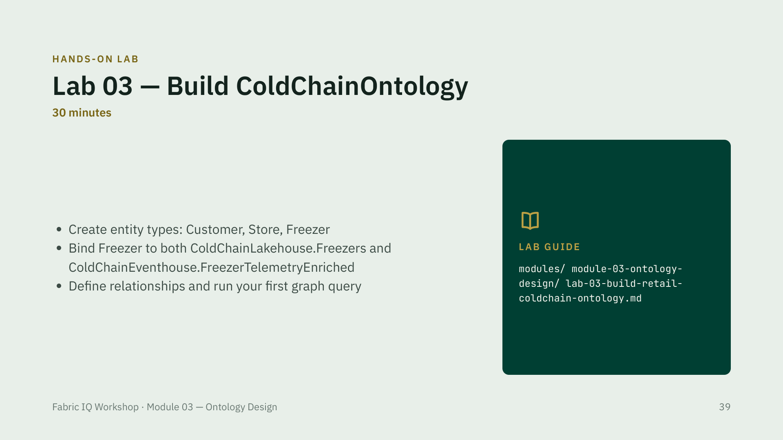
Notes:
If the ontology designer misbehaves live, switch to the fallback screenshot sequence — see risk-fallback-plan.md. Don't skip the graph query at the end; it's what makes the payoff concrete before Module 04.

Slide 40
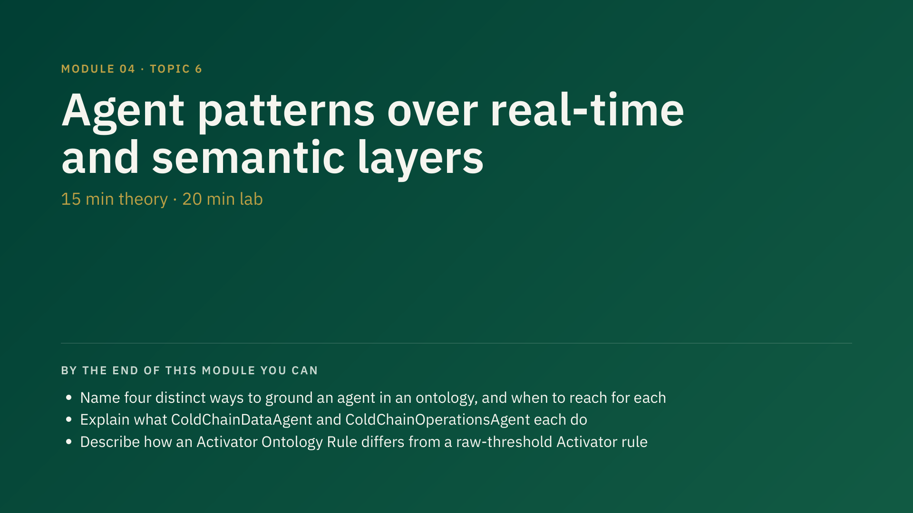
Notes:
35 min total — 15 min theory, 20 min lab. Second highest-risk module (preview UI: Data Agent, Operations Agent, Activator ontology rules). Fallback screenshot sequence should be ready.

Slide 41
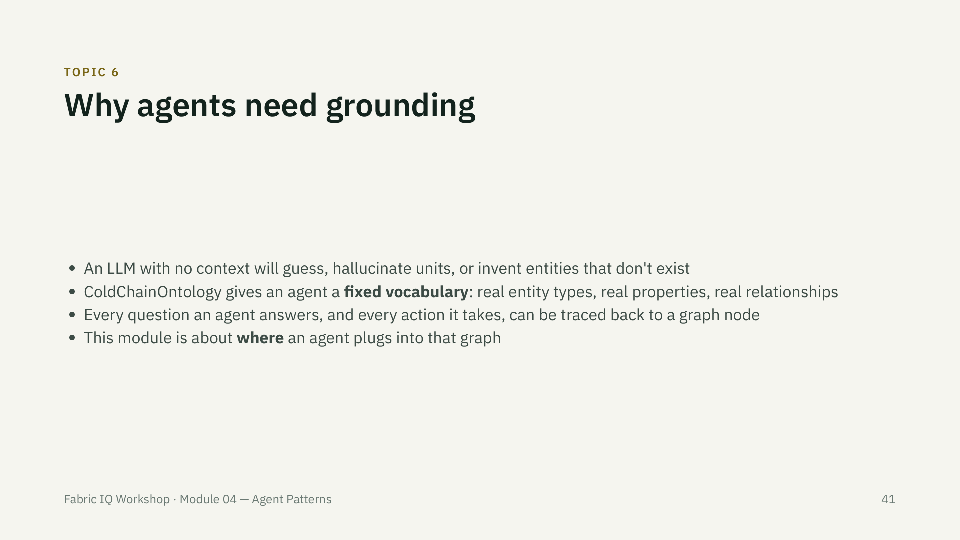

Slide 42
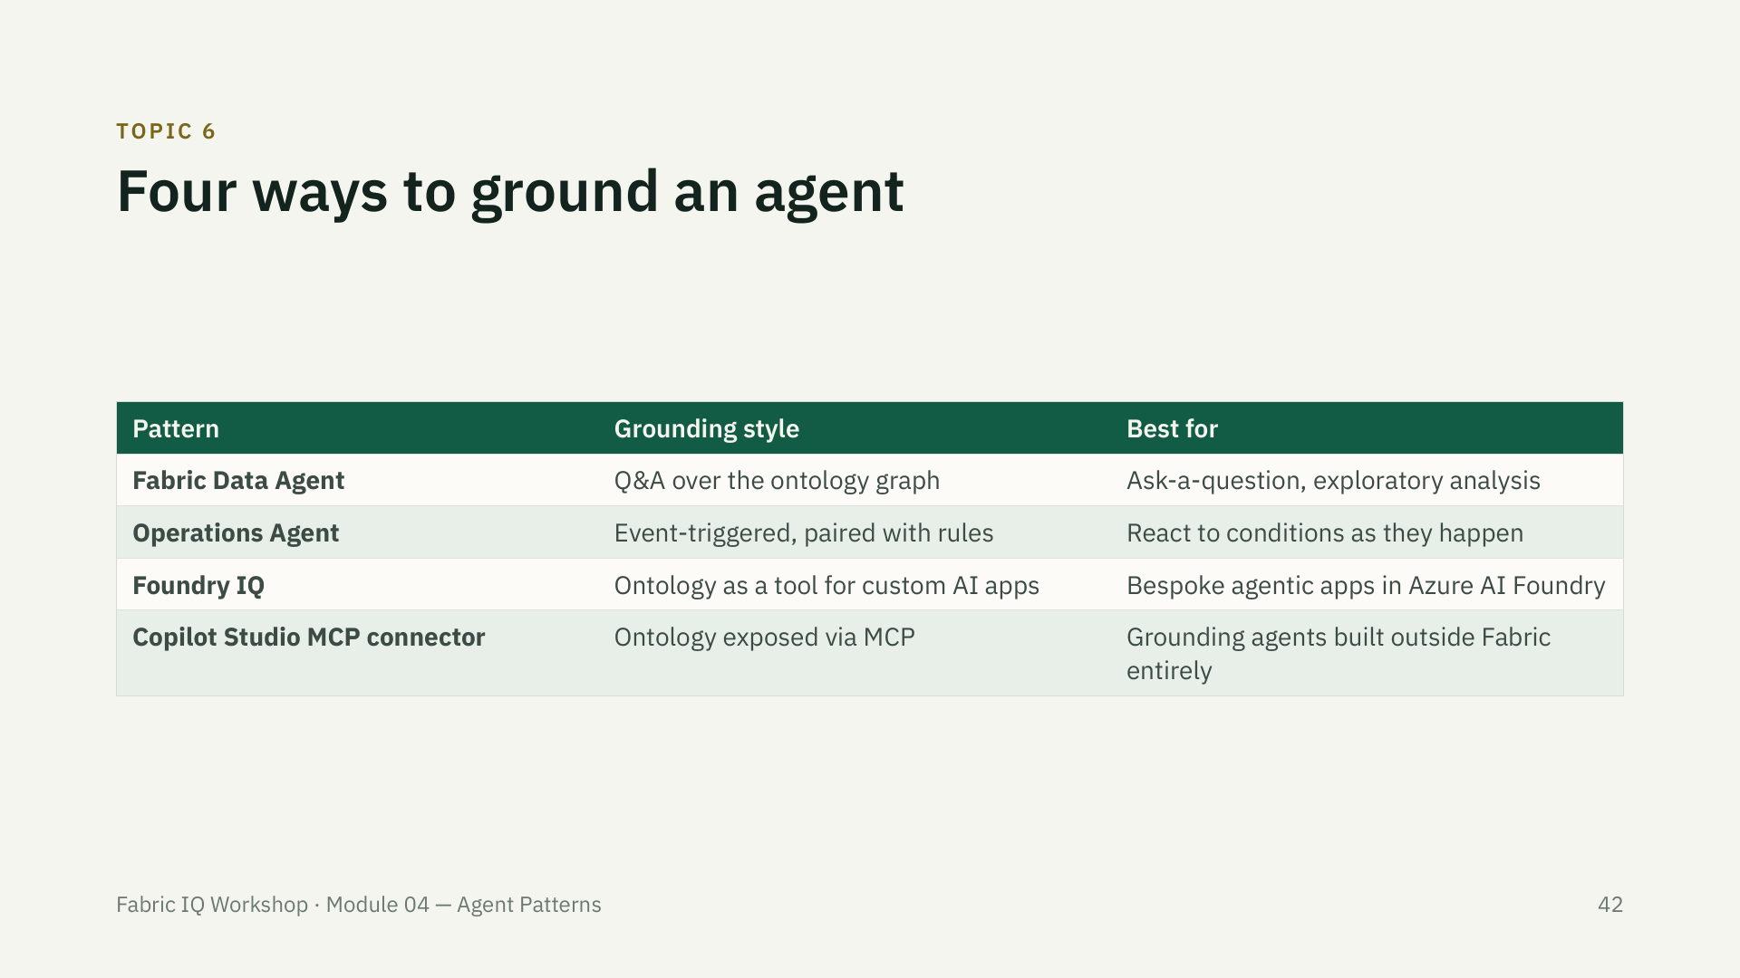

Slide 43
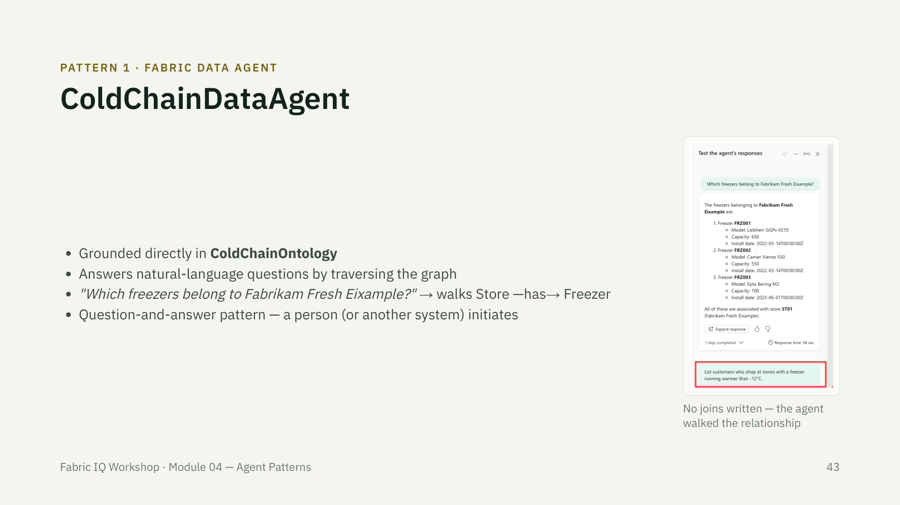

Slide 44
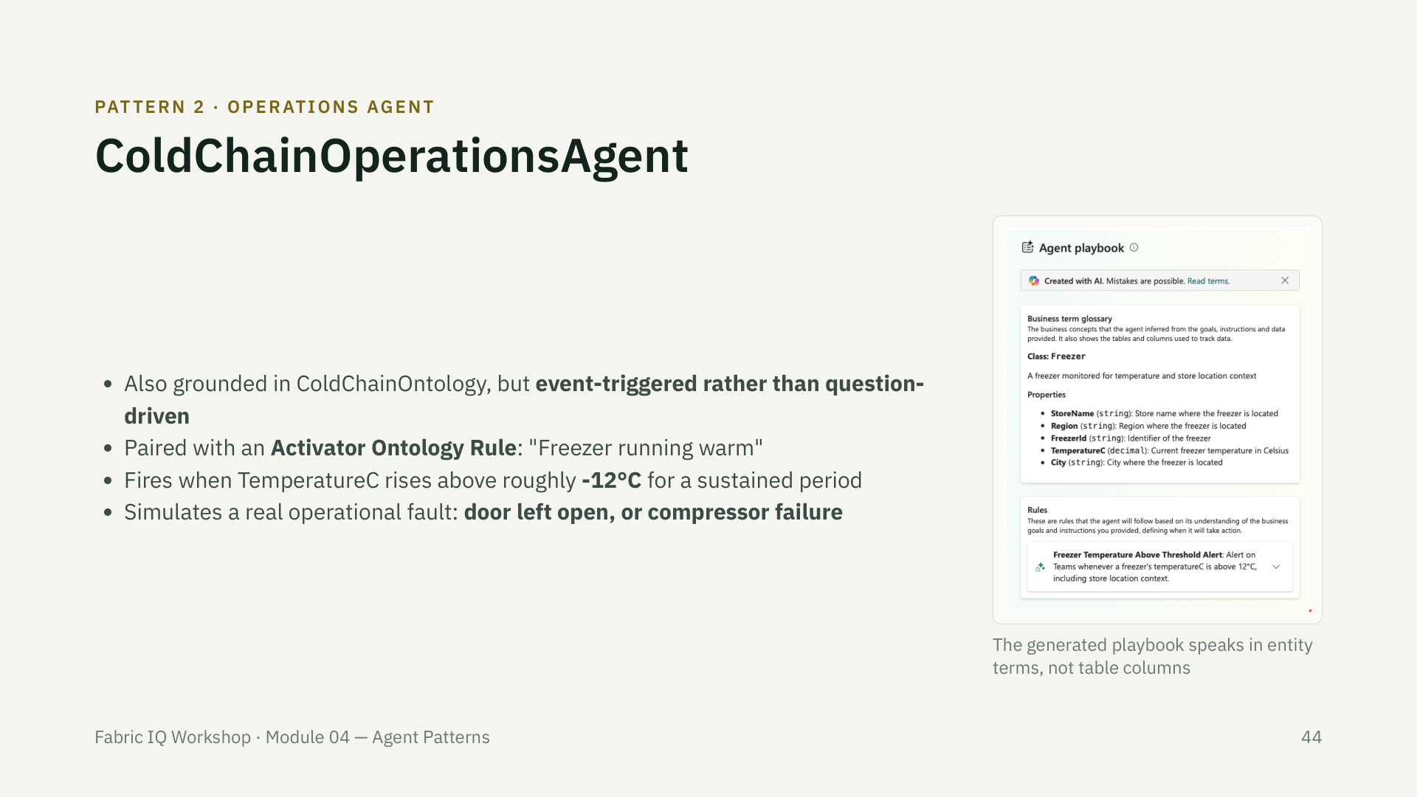

Slide 45
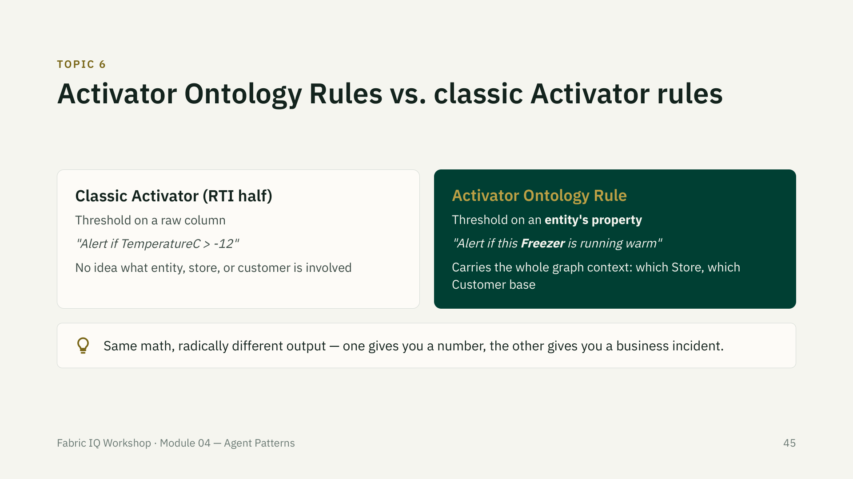

Slide 46
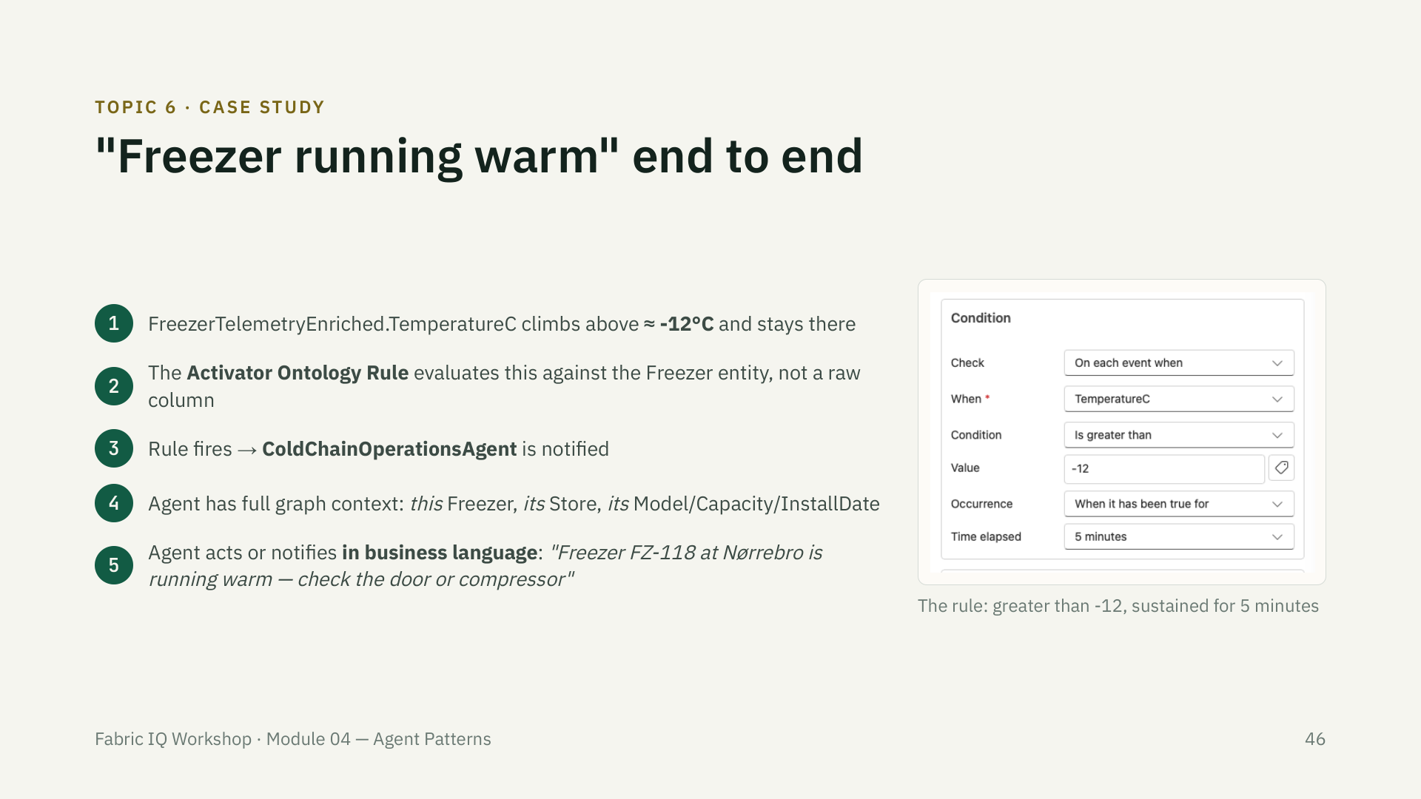
Notes:
This is the payoff slide for the whole day — walk it slowly. It ties together Module 01's -9°C example, Module 02's grounding work, and Module 03's ontology.

Slide 47
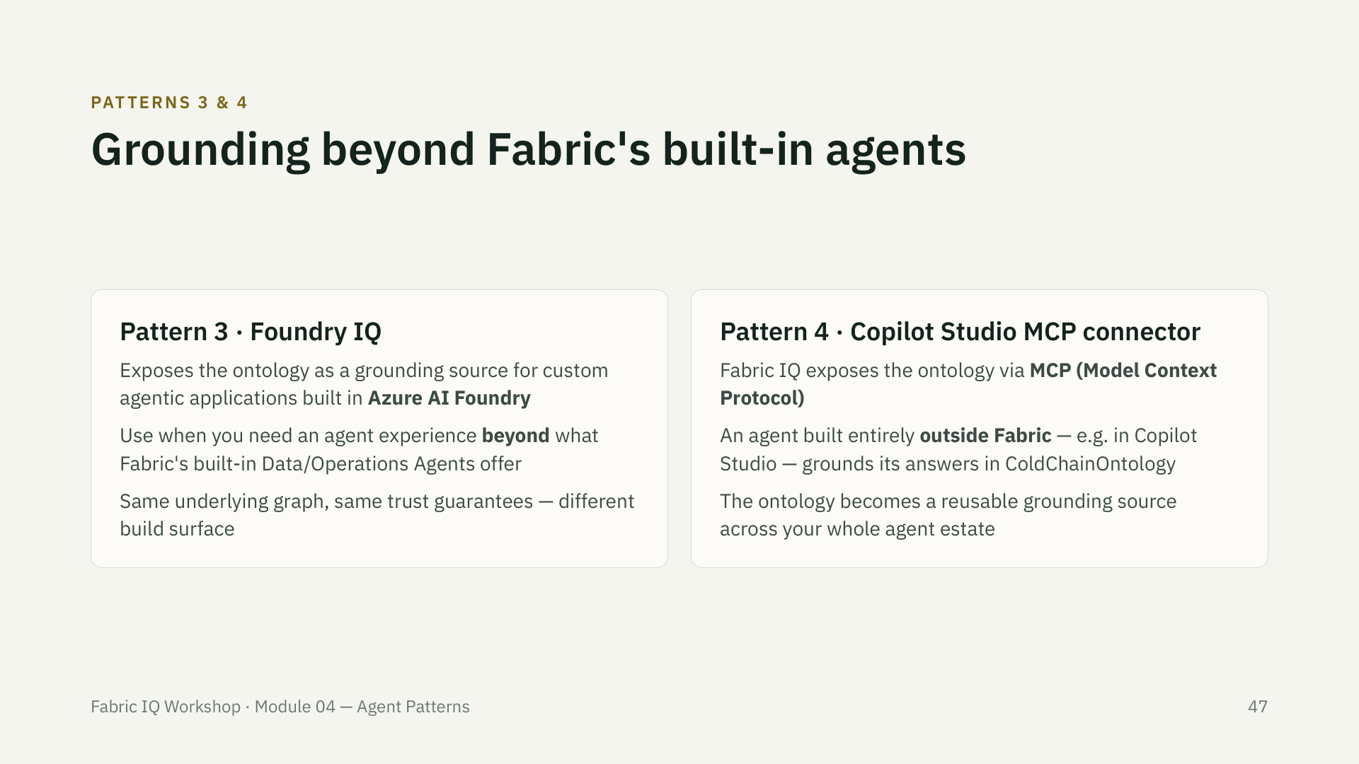

Slide 48
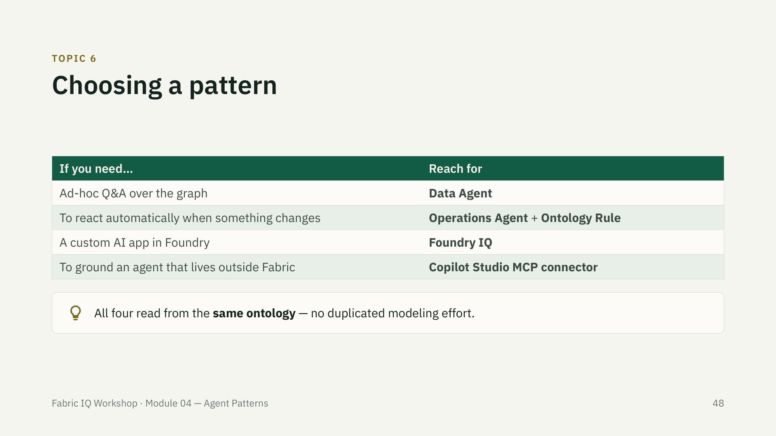

Slide 49

Notes:
If the generator hasn't produced a warm reading naturally, use the manual override step in the lab to force one — don't burn lab time waiting on randomness.

Slide 50
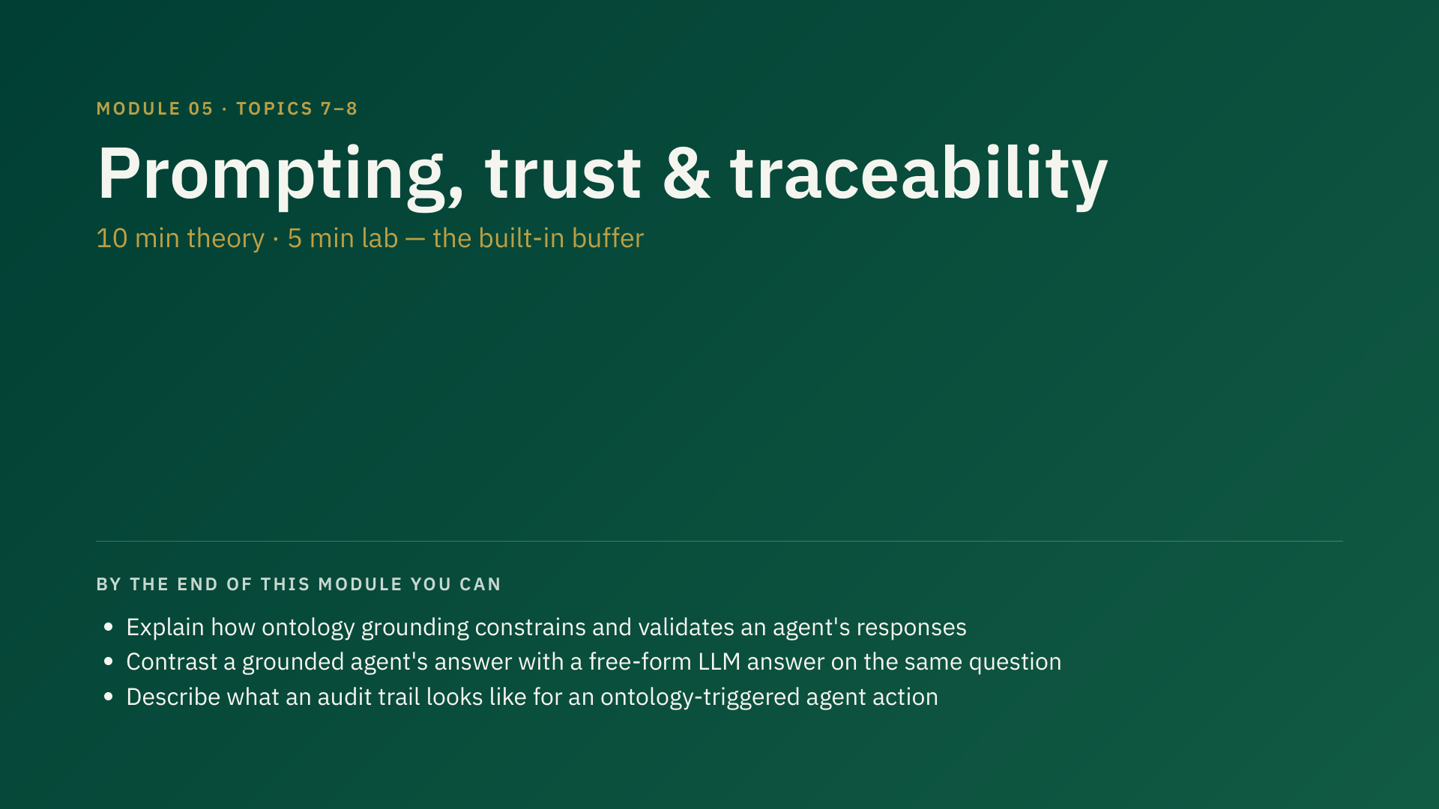
Notes:
15 min total — 10 min theory, 5 min lab (cut from 35/15/20 to fund Module 00's expanded live setup — see docs/agenda.md). This is still the designated timing buffer on top of that: if Modules 03/04 ran long, compress this module's already-short lab into a facilitator-led walkthrough rather than cutting content from 03/04. Do not skip this module's ideas, though — trust/traceability is the responsible-AI payoff of the whole day.

Slide 51
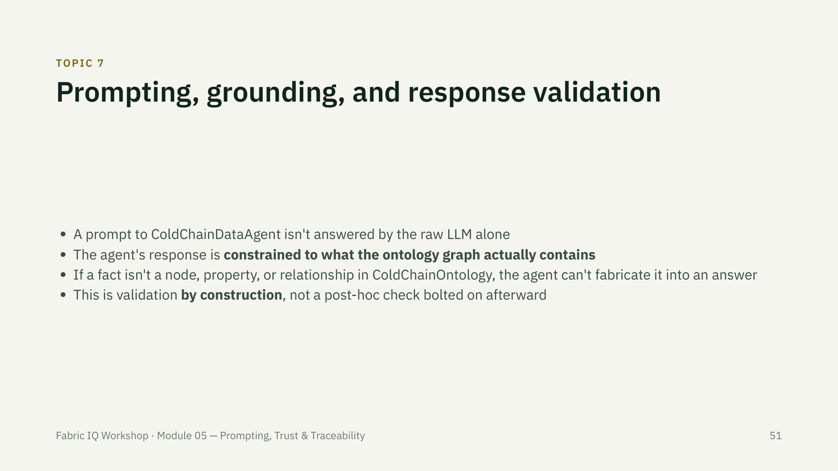

Slide 52


Slide 53


Slide 54


Slide 55

Notes:
Compare this to a raw-threshold alert: "value exceeded -12" — no entity, no store, no traceable business meaning.

Slide 56


Slide 57


Slide 58

Notes:
If time is short (per the buffer note), run this as a facilitator-led walkthrough on the instructor workspace rather than fully hands-on — the ideas matter more than everyone clicking through it individually.

Slide 59

Notes:
10 min, theory only, no lab. Keep this brisk — energy is low at the end of a 4-hour session.

Slide 60


Slide 61


Slide 62


Slide 63


Slide 64


Slide 65


