Slide 1
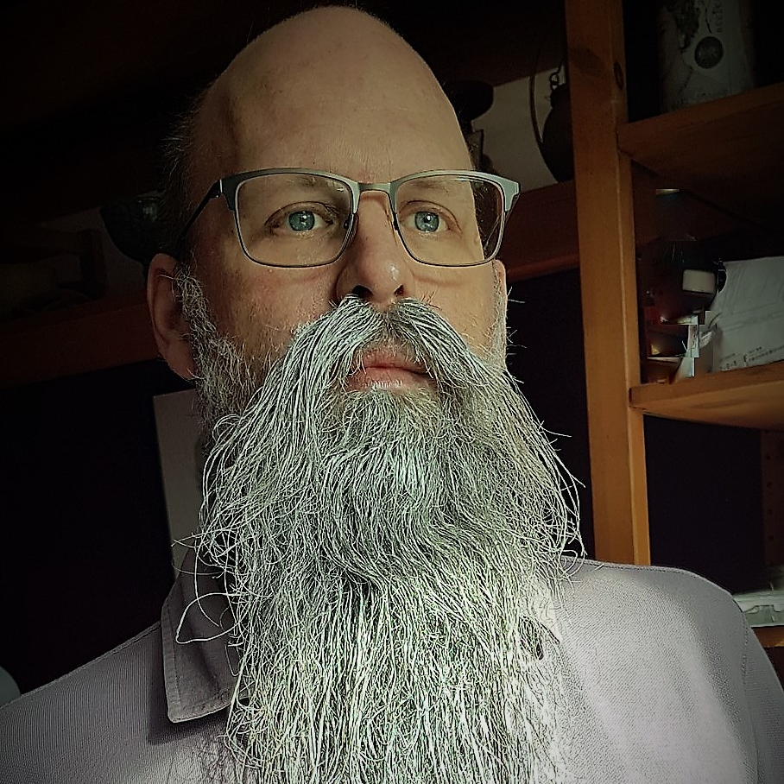
Rob Sewell
Bearded Consultant
Automator
Trainer
Dual MVP
Consultant Sewells Consulting Ltd
dbatoolsMoL dbachecks
ADSNotebooks PowerShell Community
Data Community
beard.media\book
@sqldbawithbeard
blog.robsewell.com

Slide 2
Rob Sewell
Bearded Consultant
Automator
Trainer
Dual MVP
Consultant Sewells Consulting Ltd
dbatoolsMoL dbachecks
ADSNotebooks PowerShell Community
Data Community
beard.media\book
@sqldbawithbeard
blog.robsewell.com
Notes:
OBS:SpeakerCircle

Slide 3
Rob Sewell
Bearded Consultant
Automator
Trainer
Dual MVP
Consultant Sewells Consulting Ltd
dbatoolsMoL dbachecks
ADSNotebooks PowerShell Community
Data Community
beard.media\book
@sqldbawithbeard
blog.robsewell.com
Notes:
OBS:SpeakerCircleandSide

Slide 4
Do all the things you would normally do

Slide 5
Do All the things you would normally do

Slide 6
Except that!!
No animations
they don’t look as good as you think

Slide 8
Andre is awesome

Slide 9
Ben is also awesome

