Slide 1
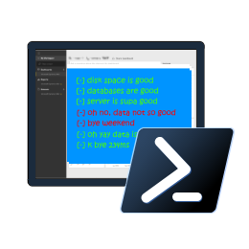

Reliable, Repeatable, Configurable & Automated Validation with
PowerShell dbachecks
Rob Sewell @sqldbawithbeard https://sqldbawithAbeard.com

Slide 2
Speaker Questionnaire
Name : Rob
Occupation : DBA, Automator, Do-er, Trainer
Interests : PowerShell, Automation And SQL (PaaS geddit?)
Interesting Fact : Beard. (Still) Plays Cricket, Flies Drone
Speaker : SQL Saturdays, SQL Relay, PowerShell Events
Community : SQL South West , SQL Sat Exeter , PowerShell VG, PowerShell Conference EU Organiser, dbareports, dbatools, dbachecks, MVP

Slide 3
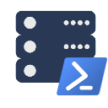





Contact Me
Quick Poll
@sqldbawithbeard
robsewellsqldba
sqldbawithAbeard.com
mrrobsewell@outlook.com
RobSewell.info

Slide 4

Check Lists
Photo by Glenn Carstens-Peters on Unsplash

Slide 5
What is Pester?
Test Runner for PowerShell
A Unit Testing Framework
An Infrastructure Testing Framework
https://github.com/pester
Notes:
https://www.youtube.com/watch?v=lNCR5yLSwi0 -- Test your Powershell with Pester and PSScriptAnalyzer
“Untested Code is Broken Code”
Infrastructure Testing with Pester - https://www.youtube.com/watch?v=zSEK74_fsLw
Pester is a unit-testing framework for PowerShell, and perhaps the first open-source software product that ships with Windows itself!
Author Adam Bertram will walk you through the Pester philosophy, syntax, and numerous real-world examples in this "Agile-published" book.
The Pester Book
https://leanpub.com/creatinghtmlreportsinwindowspowershell
https://leanpub.com/powershell-scripting-toolmaking
https://leanpub.com/pesterbook

Slide 6
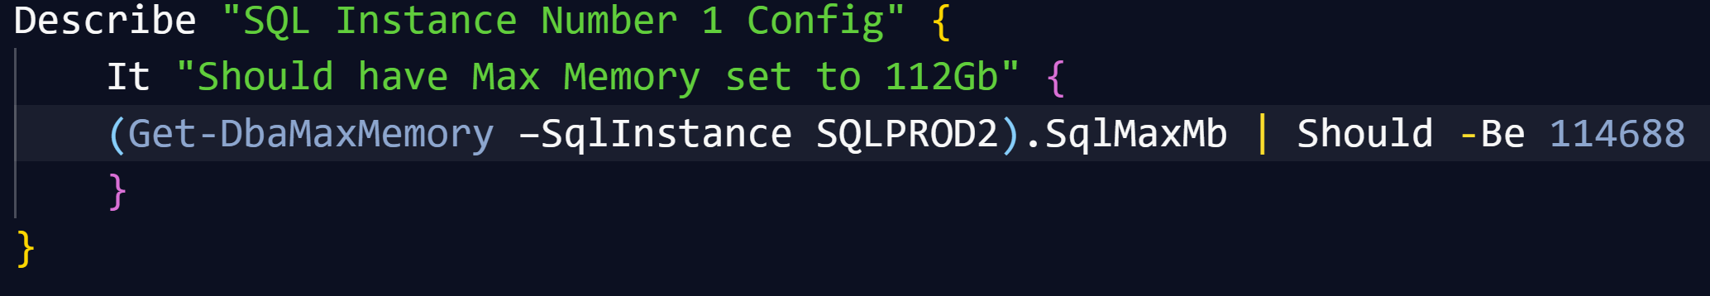
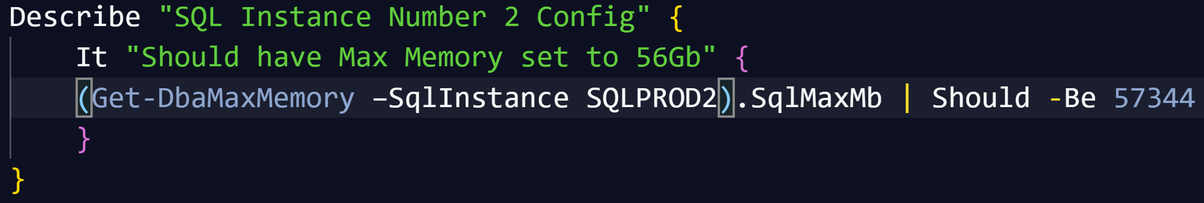
Pester
Writing Pester Tests for one SQL instance is easy
Writing slightly different Pester Tests for slightly different instances is copy and paste
It is possible to parameterize Pester tests (but not so easy to say!)

Slide 7

Challenges & Goals

Slide 8
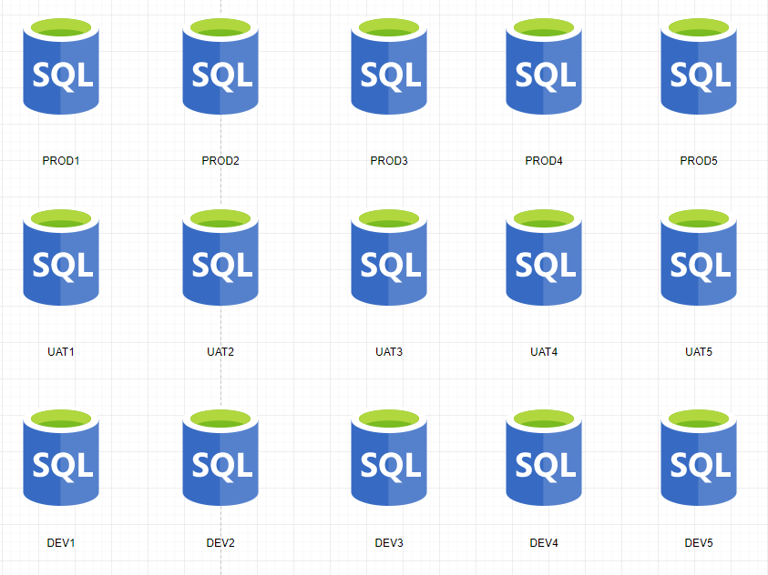
Main Challenge - Configuration
We wanted to be able to check a SQL environment like Production, UAT, DEV – horizontal
We wanted to be able to check all the
SQL Environments for a whole application
– vertical
We wanted to be able to check the SQL estate for a solution or system – block

Slide 9
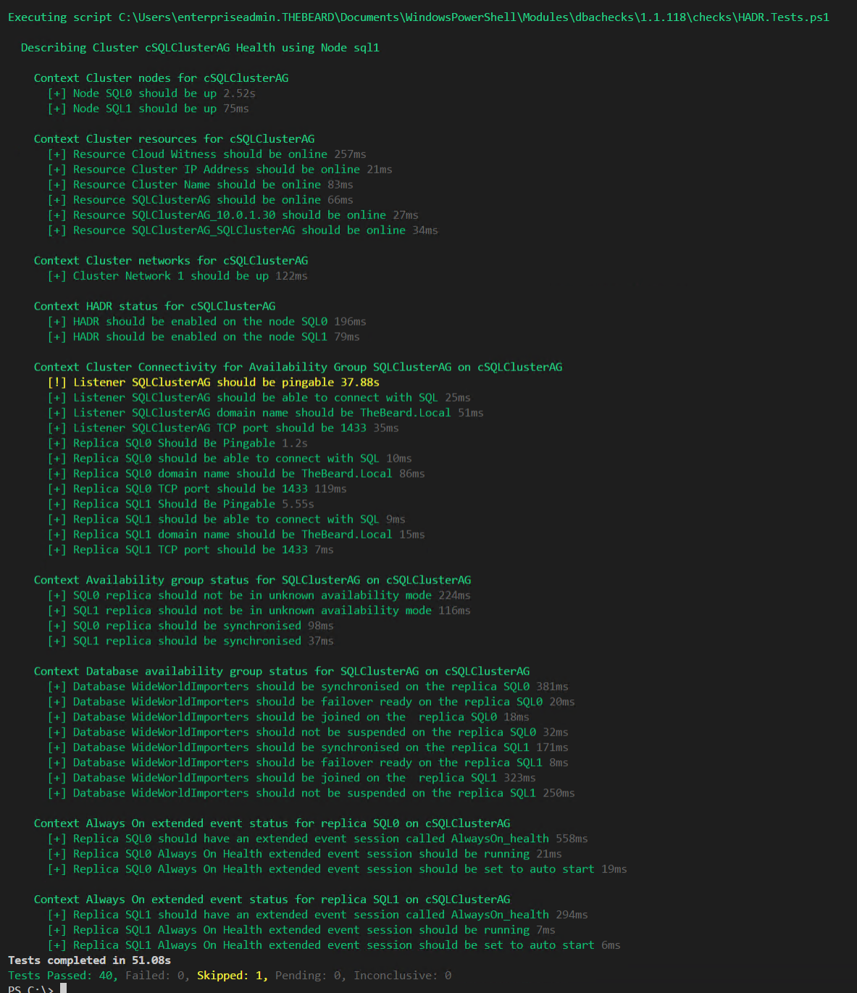
Challenge - Output
DBAs may need
output instantly

Slide 10
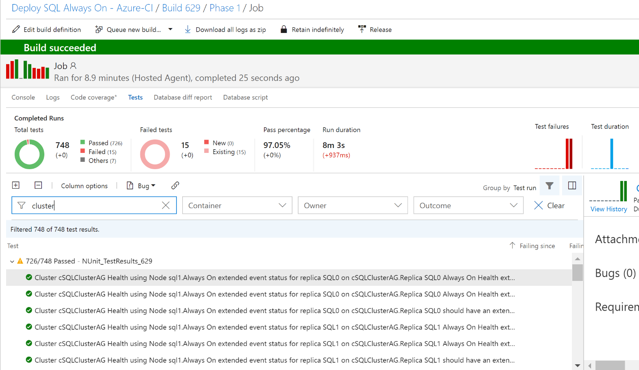
Challenge - Output
DBAs may want to automate and integrate with other solutions (DevOps, Daily Checks, Incident Response, Maintenance Windows)

Slide 11
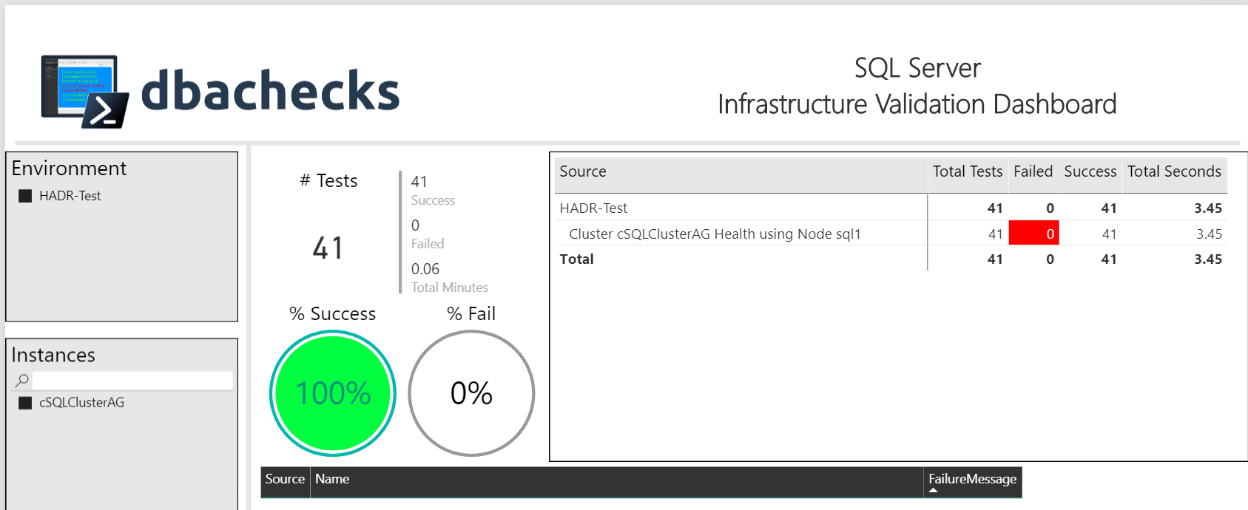
Challenge - Output
Management want output they understand
– (and with pretty interactive pictures !)

Slide 12
Our Goal
Create redistributable, easily configurable Pester tests using industry leaders checklists
Enable output to suit the requirements of different types of end users human and machine
Capability to provide response/resolution ?

Slide 13
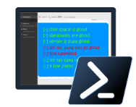
dbachecks
dbachecks is a framework created by and for SQL Server pros who need to validate their environments.
This open source module allows
us to crowdsource our checklists using Pester tests.
Notes:
Basically, we all share similar checklists and mostly just the server names and RPO/RTO/etc change.

Slide 14
System Requirements
Minimum
Recommended
Client
PowerShell v4
Modules
dbatools
Pester
PSFramework
Client
PowerShell v5.1
Server
Everything dbatools supports
From SQL2000 to SQL vNext

Slide 15
Install is easy
PowerShell Gallery
Install-Module dbachecks
Install-Module dbachecks –Scope CurrentUser
* Automatically installs required modules

Slide 16
Need an offline install?
Save-Module dbachecks, dbatools, Pester, PSFramework

Slide 17
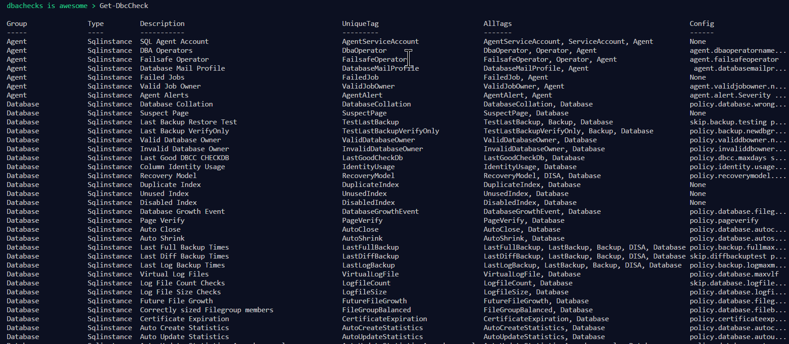
Get-DbcCheck - What Checks Are Available?

Slide 18
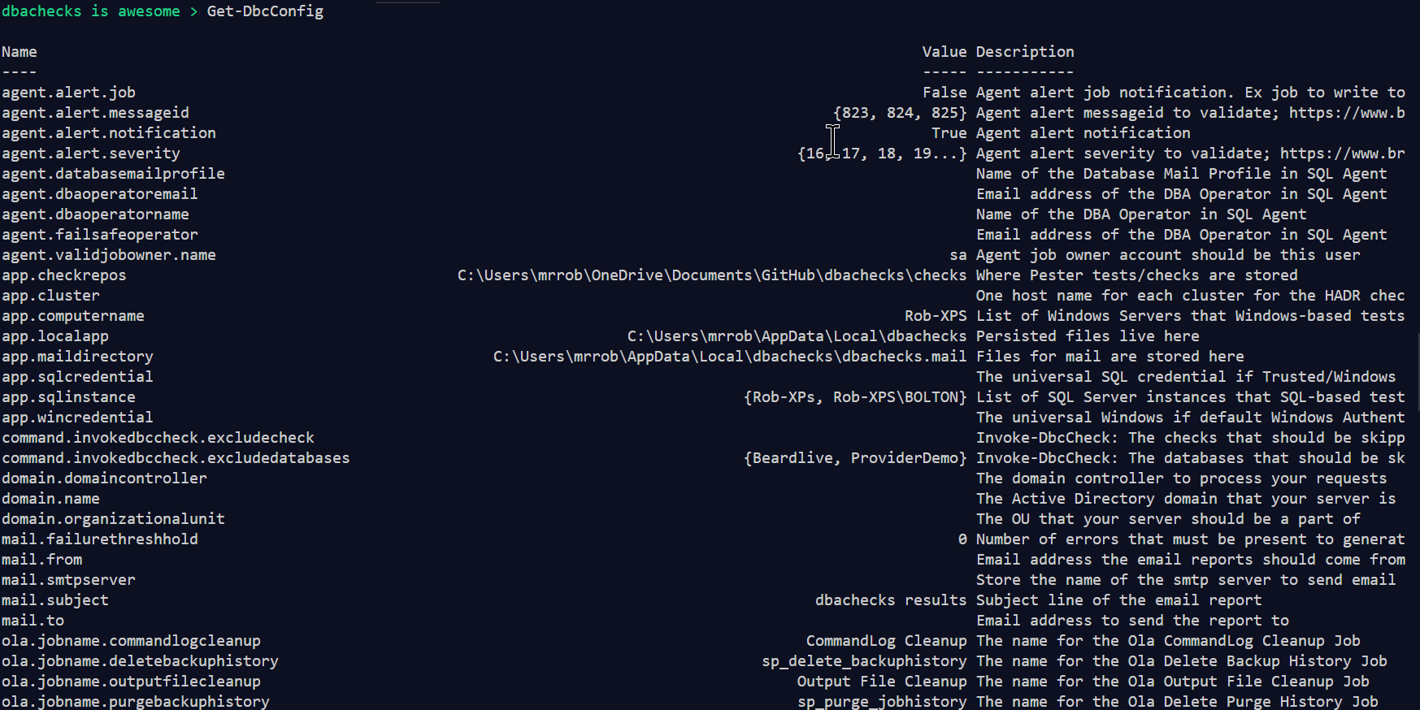
Get-DbcConfig - What Configs Are Available?

Slide 19
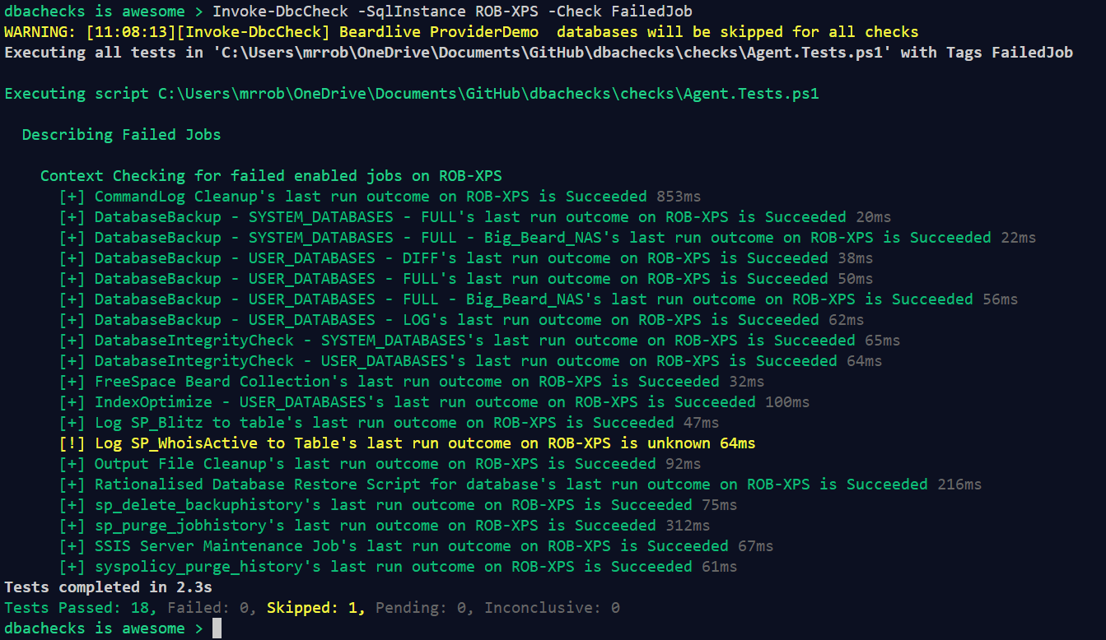
Invoke-DbcCheck – Run A Check

Slide 20
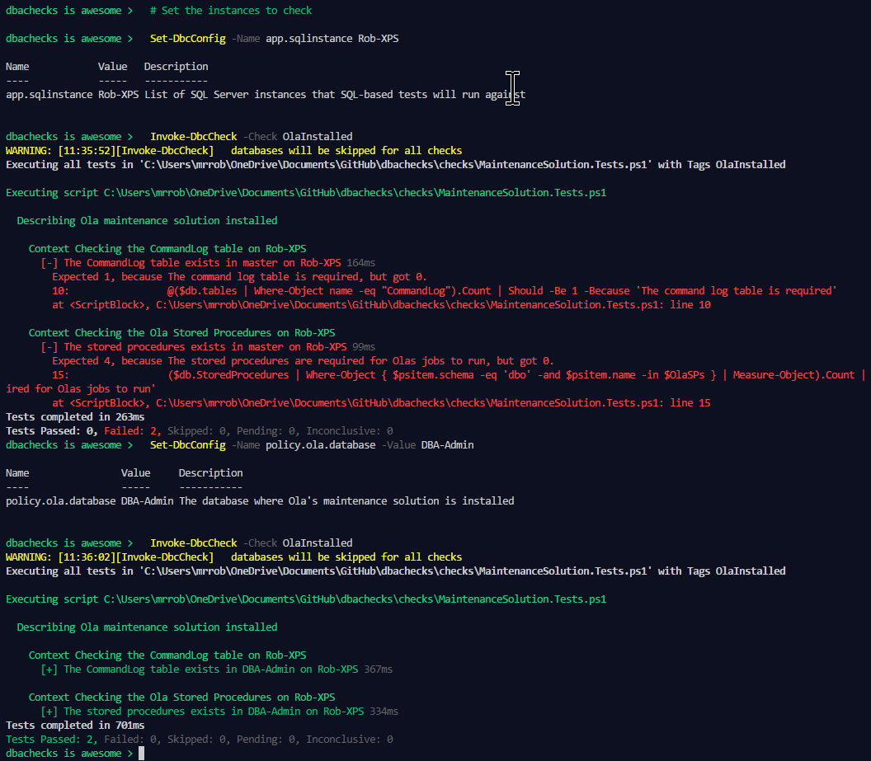
Set-DbcConfig – Config a Check
> # Set the instances to check
> Set-DbcConfig -Name app.sqlinstance Rob-XPS
> Invoke-DbcCheck -Check OlaInstalled
> Set-DbcConfig -Name policy.ola.database -Value DBA-Admin
> Invoke-DbcCheck -Check OlaInstalled

Slide 21
Export-DbcConfig/Import-DbcConfig
Export-DbcConfig –Path C:\Users\Beard\git\PesterConfigs\Application1_PROD.json
Export-DbcConfig -Path C:\Users\Hair\git\PesterConfigs\Client1_System2_Quick.json
Import-DbcConfig -Path Git:\PesterConfigs\Application1_PROD.json
Invoke-DbcCheck
Import-DbcConfig -Path Git:\PesterConfigs\Client1_System2_Quick.json
Invoke-DbcCheck

Slide 22
Start-DbcPowerBi
Import-DbcConfig –path Git:\PesterConfigs\App1_Dev.json
Invoke-DbcCheck -Show Summary -PassThru | Update-DbcPowerBiDataSource –Environment Development
Import-DbcConfig –path Git:\PesterConfigs\App1_Test.json
Invoke-DbcCheck -Show Summary -PassThru | Update-DbcPowerBiDataSource –Environment Test
Import-DbcConfig –path Git:\PesterConfigs\App1_PROD.json
Invoke-DbcCheck -Show Summary -PassThru | Update-DbcPowerBiDataSource –Environment Production
Start-DbcPowerbi

Slide 23
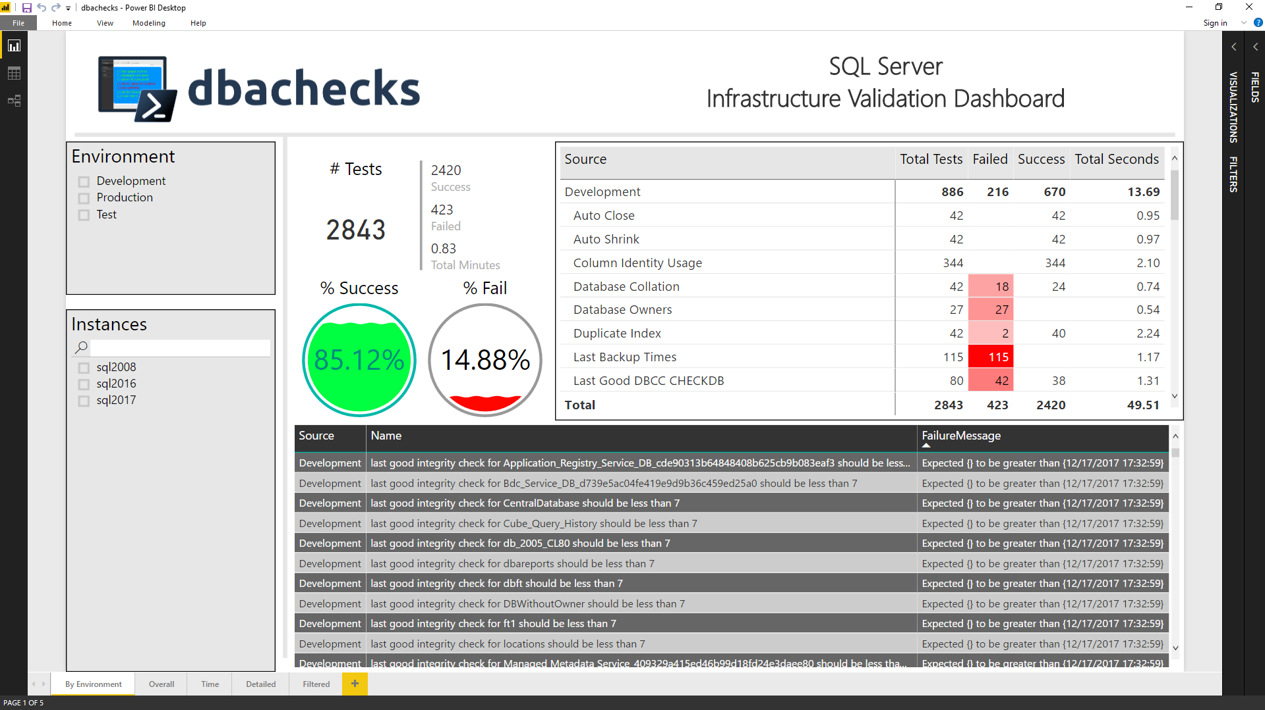
Start-DbcPowerBi

Slide 24

Hey Beardy !
MUST BE TIME FOR A DEMO

Slide 25
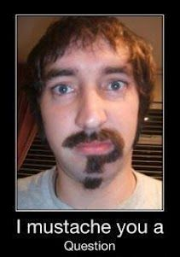
Questions?
?
?
?
?
?
?
?
?
?
?
?
?
?
?
?
?
Rob Sewell @sqldbawithbeard https://sqldbawithAbeard.com

Slide 26
Contact Me
Quick Poll
@sqldbawithbeard
robsewellsqldba
sqldbawithAbeard.com
mrrobsewell@outlook.com
RobSewell.info

