Slide 1


Administrating SQL Server with PowerShell dbatools
Rob Sewell @sqldbawithbeard https://sqldbawithAbeard.com

Slide 2
Speaker Questionnaire
Name : Rob
Occupation : DBA, Automator, Do-er, Trainer
Interests : PowerShell, Automation And SQL (PaaS geddit?)
Interesting Fact : Beard. (Still) Plays Cricket, Flies Drone
Speaker : SQL Saturdays, SQL Relay, PowerShell Events
Community : SQL South West , SQL Sat Exeter , PowerShell VG, PowerShell Conference EU Organiser, dbareports, dbatools, dbachecks, MVP

Slide 3





Contact Me
Quick Poll
@sqldbawithbeard
robsewellsqldba
sqldbawithAbeard.com
mrrobsewell@outlook.com
RobSewell.info

Slide 4
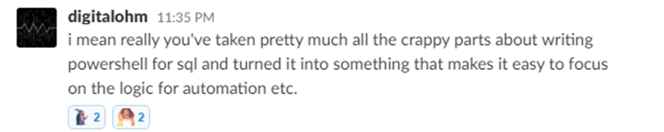
What is dbatools? Well basically ...

Slide 5
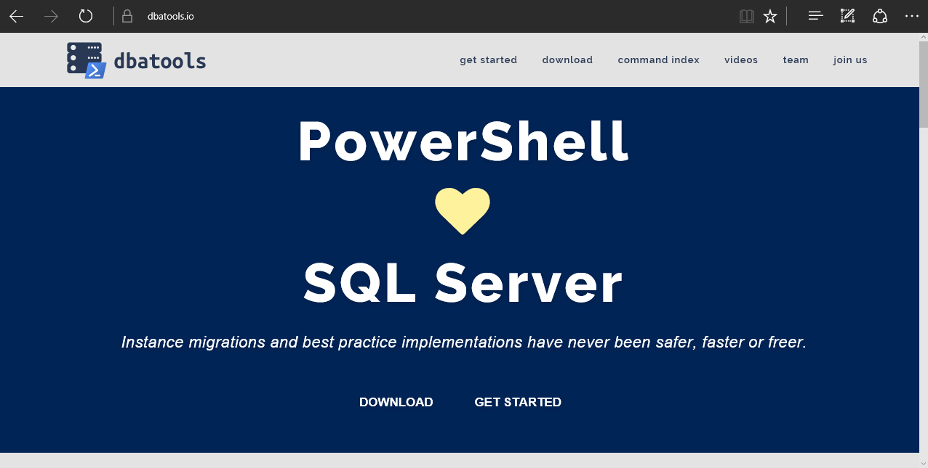
dbatools

Slide 6
requirements
Minimum
Client
PowerShell v3
SQL Server Management Studio / SMO 2008 R2
Server
SQL Server 2000
No PowerShell for pure SQL commands
Remote PowerShell enabled for Windows commands
Recommended
Client
PowerShell v5.1

Slide 7









Sponsors – Go and See them and say thank you

Slide 8
Support
SQL Server 2000 – 2017 *
Express – Enterprise Edition
Clustered and stand-alone instances
Windows and SQL authentication
Default and named instances
Multiple instances on one server
Notes:
* Azure

Slide 9
installation
PowerShell Gallery
Install-Module dbatools
Install-Module dbatools –Scope CurrentUser
Website
Dbatools.io/download
OffLine
Dbatools.io/offline

Slide 10
Get-Help
Extensive documentation within each command Get-Help Start-DbaMigration –Detailed
Extensive documentation on dbatools.io
dbatools.io/Start-DbaMigration
dbatools.io/Repair-DbaOrphanUser
Some commands have videos
dbatools.io/youtube

Slide 11
Buckle Up !! It‘s demo time

Slide 12
Questions?
?
?
?
?
?
?
?
?
@sqldbawithbeard
robsewellsqldba
?
?
?
?
?
?
?
?
sqldbawithAbeard.com

