Slide 1



Cloudy with a Chance of Data
John Deardurff
Website: SQLMCT.com
Twitter: @SQLMCT
Email: JoDeardu@Microsoft.com
June 18th, 2020

Slide 2






Cloudy with a Chance of Data
IaaS
PaaS
SaaS
What is Azure?
Cloud Models
On-Premises vs Cloud
Cloud Data Platform
Managing Azure

Slide 3

What is the Cloud

Slide 4

Benefits of Microsoft Azure?
Rapid Elasticity
Reduced Capital Expenses
Managed Services
Global Datacenters
Improved Agility
Measured Services

Slide 5
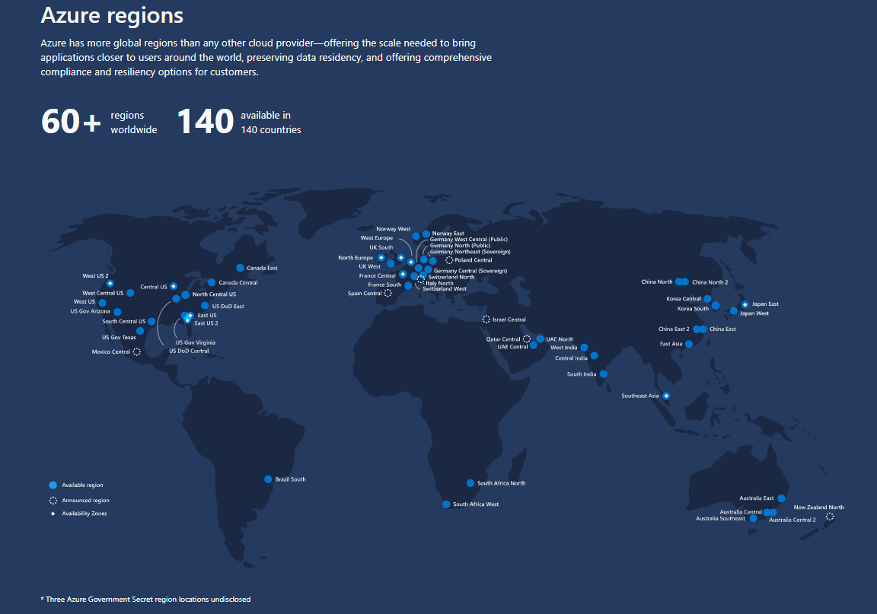
Benefits of Microsoft Azure?
Rapid Elasticity
Reduced Capital Expenses
Managed Services
Global Datacenters
Improved Agility
Measured Services

Slide 6
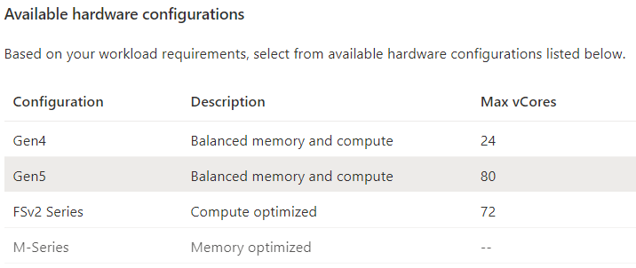
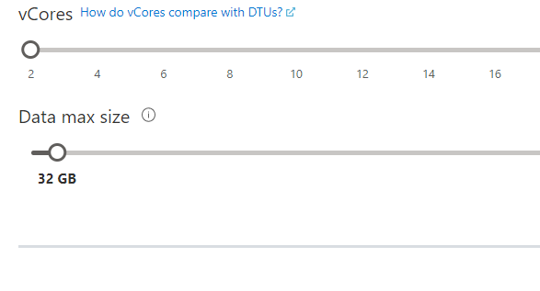
Benefits of Microsoft Azure?
Rapid Elasticity
Reduced Capital Expenses
Managed Services
Global Datacenters
Improved Agility
Measured Services

Slide 7
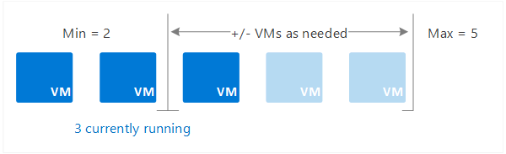
Benefits of Microsoft Azure?
Rapid Elasticity
Reduced Capital Expenses
Managed Services
Global Datacenters
Improved Agility
Measured Services

Slide 8
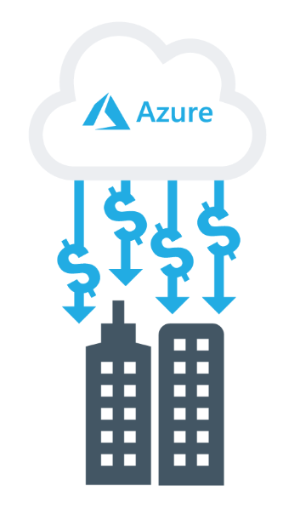
Benefits of Microsoft Azure?
Rapid Elasticity
Reduced Capital Expenses
Managed Services
Global Datacenters
Improved Agility
Measured Services

Slide 9
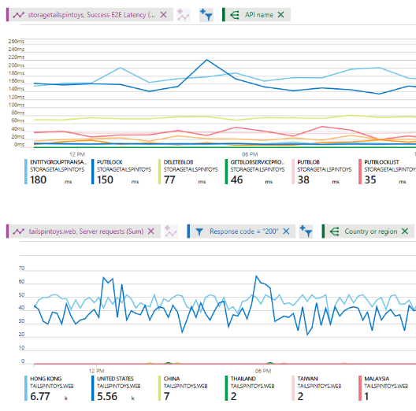
Benefits of Microsoft Azure?
Rapid Elasticity
Reduced Capital Expenses
Managed Services
Global Datacenters
Improved Agility
Measured Services

Slide 10
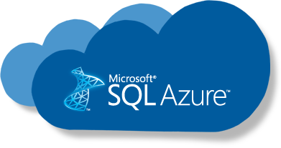
Benefits of Microsoft Azure?
Rapid Elasticity
Reduced Capital Expenses
Managed Services
Global Datacenters
Improved Agility
Measured Services

Slide 11
Benefits of Microsoft Azure?
Rapid Elasticity
Reduced Capital Expenses
Managed Services
Global Datacenters
Improved Agility
Measured Services

Slide 12
On-Premises vs Cloud
On-Premises
Microsoft Azure
Physical
Virtual
IaaS
PaaS
SaaS
Notes:
Explain the different examples of SaaS, PaaS, and IaaS services, and ask students to suggest others:
Microsoft Office 365 is a good example of a SaaS offering. It is a fully functional, ready-to-use collection of software applications that are available from the cloud.
Azure Web apps and Azure SQL Database are good examples of a PaaS service. Both offer a platform for building custom applications and solutions, but do not require management at the operating-system level.
Note: Azure SQL Database sometimes is described as a Database-as-a-Service offering. This term represents a database-specific subset of PaaS solutions. Similarly, you might encounter terms such as Disaster Recovery-as-a-Service in reference to Azure Site Recovery or Identity-as-a-Service in relation to Azure Active Directory.
Azure Virtual Machines constitute a good example of an IaaS solution. They allow you to host Windows and Linux servers in the cloud and retain full control over their operating systems.
10979D
1: Getting started with Microsoft Azure

Slide 13


On-Premise or On-Premises
VS
Premise
An Idea
Premises
A Location

Slide 14
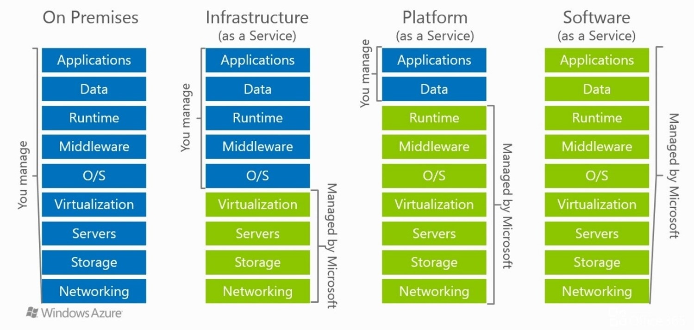
Cloud Models

Slide 15
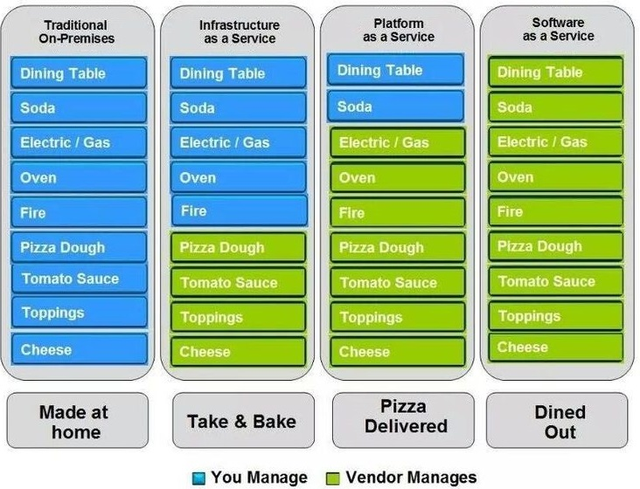
Pizza as a Service

Slide 16
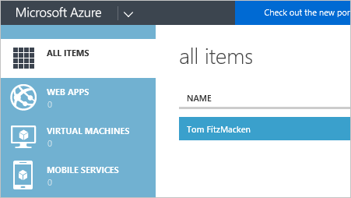
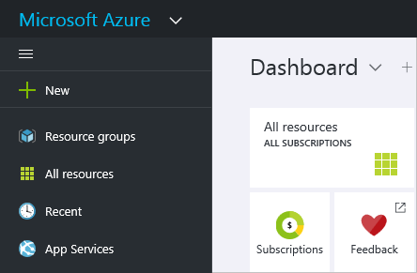
Services Manager vs Resource Manager
Azure Services Manager
Retired 1/8/2018
Azure Resources Manager
Portal.Azure.Com

Slide 17
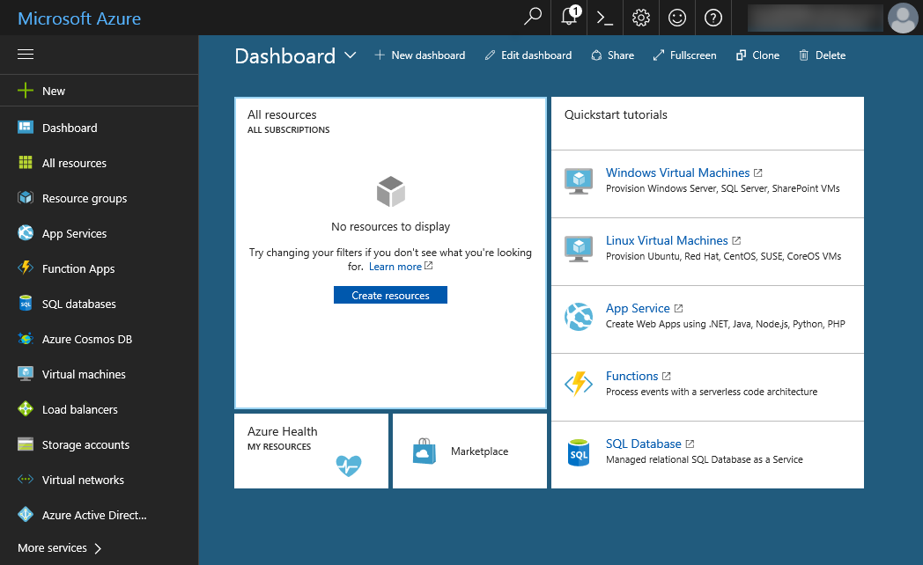
The Azure portal – Portal.Azure.Com
Notes:
Present this topic by performing the demonstration’s first task at the end of this lesson, and use the slide to summarize the key points that you show in the demonstration.
Note: It is possible that the Azure portal will have changed when you teach the course. If this is the case, explain to the students the differences between what they see and what the slide shows.
10979D
1: Getting started with Microsoft Azure

Slide 18
Other Client Tools
Windows PowerShell with Azure PowerShell modules
Azure CLI
Visual Studio with Azure SDK
Azure Cloud Shell

Slide 19
Microsoft Azure SQL Resources
Azure SQL documentation
aka.ms/azuresqldocs
Try the Azure SQL Workshop
aka.ms/sqlworkshops
How to choose tool
aka.ms/chooseazuresql

Slide 20
Cloud data offerings
IaaS
SQL Server in Azure VM
Azure SQL Database
Azure SQL Data Warehouse
Azure Data Lake Store
SQL Server in Azure VM
Azure Data Factory
Azure HDInsight
Power BI and Excel

Slide 21
Cloud data offerings
PaaS
SQL Server in Azure VM
Azure SQL Database
Azure SQL Data Warehouse
Azure Data Lake Store
Azure SQL Database
Azure Data Factory
Azure HDInsight
Power BI and Excel

Slide 22
Cloud data offerings
PaaS
SQL Server in Azure VM
Azure SQL Database
Azure SQL Data Warehouse
Massive Parallel Processing
Azure Data Lake Store
Azure SQL Data Warehouse
Azure Data Factory
Azure HDInsight
Power BI and Excel

Slide 23

Cloud data offerings
PaaS
SQL Server in Azure VM
Azure SQL Database
Azure SQL Data Warehouse
Azure Data Lake Store
Azure Data Lake Store
Azure Data Factory
Azure HDInsight
Power BI and Excel

Slide 24

Cloud data offerings
PaaS
SQL Server in Azure VM
Azure SQL Database
Azure SQL Data Warehouse
Azure Data Lake Store
Azure Data Factory
Azure Data Factory
Azure HDInsight
Power BI and Excel

Slide 25

Cloud data offerings
PaaS
SQL Server in Azure VM
Azure SQL Database
Azure SQL Data Warehouse
Map Reduce, Pig, Hive, Hbase, Storm, Spark
Azure Data Lake Store
Azure HDInsight
Azure Data Factory
Azure HDInsight
Power BI and Excel

Slide 26


Cloud data offerings
SaaS
SQL Server in Azure VM
Azure SQL Database
Azure SQL Data Warehouse
Azure Data Lake Store
Power BI
Excel
Azure Data Factory
Azure HDInsight
Power BI and Excel

Slide 27
Demonstration
SQL in an Azure VM and an Azure SQL Database

