Slide 1
Row Level Security John Deardurff

Slide 2

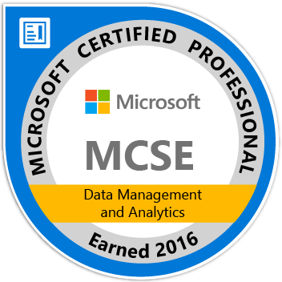
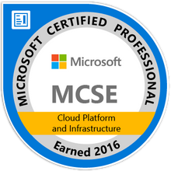
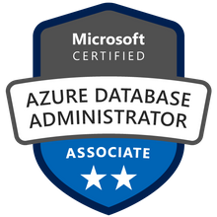
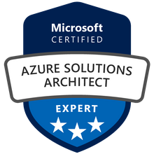


John Deardurff
Customer Engineer (Global Technical Team)
Microsoft Certified Trainer (Regional Lead)
MVP: Data Platform (2016 – 2018)
Twitter: @SQLMCT
Website: www.SQLMCT.com

Slide 3



Questions for the Database Administrator
Is your data important?
Is your data compliant?
Is your data secure?

Slide 4
What does this session cover?
What is Row-Level Security?
Row-Level Security Scenarios
Demo: Implementing Row-Level Security
Questions?

Slide 5
What is Row-Level Security?
A security feature available in SQL Server 2016 or later that will restrict access to specific rows in a table based on values in a column.

Slide 6



Row-Level Security scenarios
A hospital can restrict doctors and nurses to only view data about their specific patients.
A bank can restrict access to data based on the location of their branch offices.
A bicycle company can restrict sales leads to only specific salespeople.

Slide 7


Salespeople for the Adventure Works Bicycle Company
Jack
Diane

Slide 8
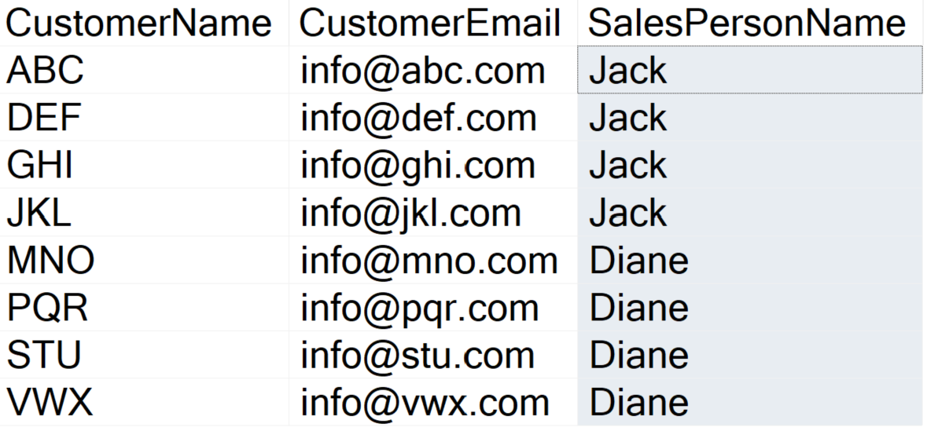
Salespeople for the Adventure Works Bicycle Company
Jack
Diane

Slide 9
Salespeople for the Adventure Works Bicycle Company
Jack
Diane

Slide 10
Salespeople for the Adventure Works Bicycle Company
Jack
Diane

Slide 11
Salespeople for the Adventure Works Bicycle Company
Jack
Diane

Slide 12
Demonstration

Slide 13
Knowledge Check
What SQL Object is used to create a filter for Row-Level Security?
What SQL Object is used to apply the filter for Row-Level Security?

Slide 14
In this session we covered…
What is Row-Level Security?
The Purpose of Row-Level Security
Demo: Implementing Row-Level Security
Knowledge Check

Slide 15
Questions?

