Slide 1
Functions and Grouping

Slide 2
What does this session cover?
What is a Function?
Character string functions
Date and Time functions
Aggregate Functions
Logical Query Processing
Grouping Results
Filtering Grouped Results

Slide 3

What is a Function?
Allows code to perform specific tasks.
Coffee
Function Name
Parameters or Arguments

Slide 4
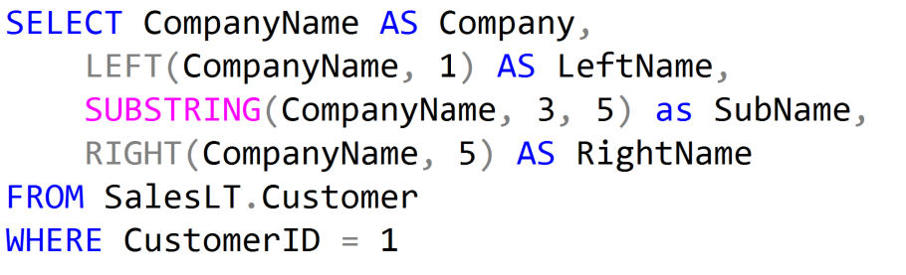

Character String Functions

Slide 5
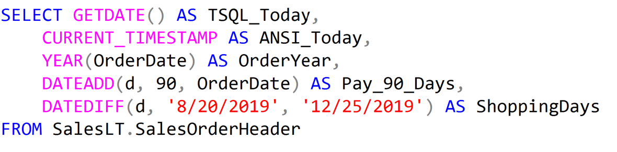
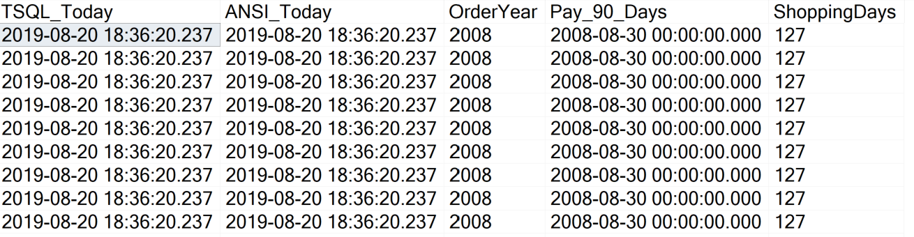
Data and Time Functions

Slide 6
Logical Query Processing
The order in which a query is written is not the order in which it is processed.
Order | Element | Expression | Role
5 | SELECT | <select list> | Defines which columns to return
1 | FROM | <table source> | Defines table(s) to query
2 | WHERE | <search condition> | Filters rows using a predicate
3 | GROUP BY | <group by list> | Arranges rows by groups
4 | HAVING | <search condition> | Filters groups using a predicate
6 | ORDER BY | <order by list> | Sorts the output

Slide 7
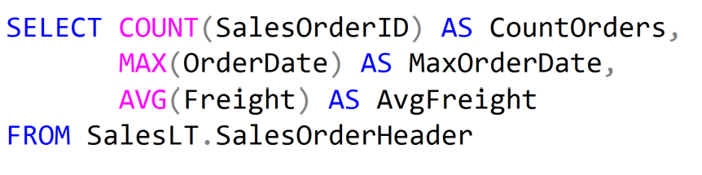
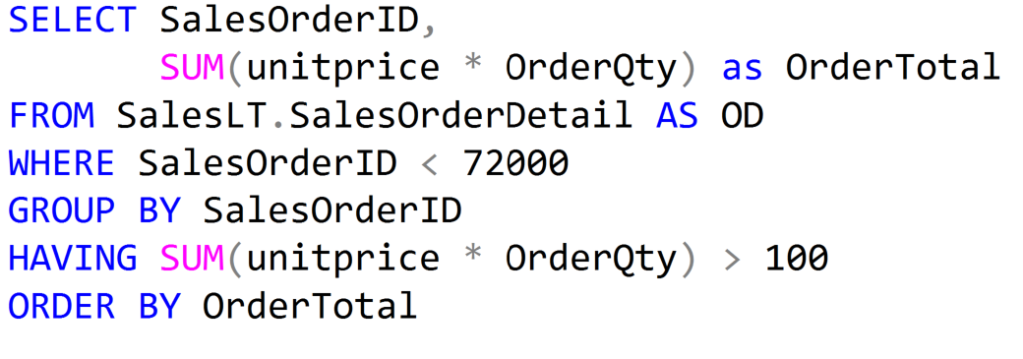
Aggregate Functions and Group By Examples
Aggregate Functions
Group By and Having

Slide 8
Demonstration

Slide 9
Questions?

Slide 10
Knowledge Check
What is the difference between the GetDate function and the Current_TimeStamp function?
How many parameters are in the Substring function?
What statement is used to filter records after they have been grouped?
Notes:
What are the two store types that query store has?
Plan Store
Runtime Stats Store
What are the two QDS cleanup stages?
The two QDS cleanup stages are:
1. In the first stage, old runtime stats are cleaned.
2. In the second stage, queries together with associated plans and statistics are deleted.

Slide 11
Lesson Summary
In this lesson we discussed:
What is a Function?
Character string functions
Date and Time functions
Aggregate Functions
Logical Query Processing
Grouping Results
Filtering Grouped Results

