Slide 1
Data Manipulation Language

Slide 2
What does this session cover?
SQL Statement Categories
What is DML?
Inserting Records into a table
IDENTITY and SEQUENCES
Updating Records in a table
Deleting Records in a table
DELETE vs DROP vs TRUNCATE

Slide 3
SQL Statement Categories?
DML (Manipulation) | DCL (Control) | DDL (Definition) | TCL (Transactional)
INSERT | GRANT | CREATE | BEGIN
UPDATE | DENY | ALTER | COMMIT
DELETE | REVOKE | DROP | ROLLBACK
SELECT (DQL) |  | TRUNCATE | SAVE

Slide 4
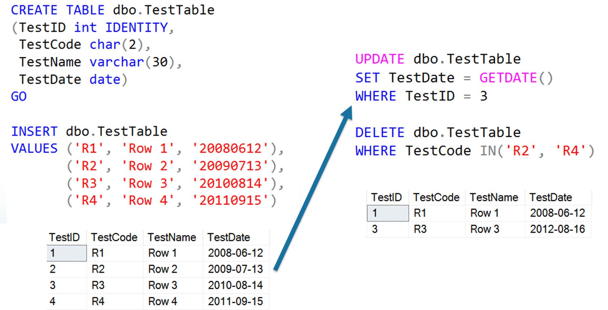
Data Manipulation Language

Slide 5
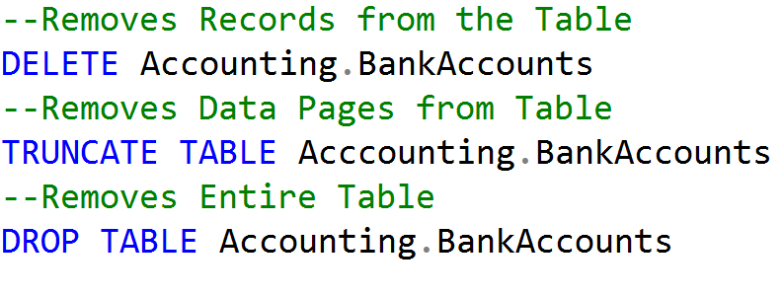
DELETE vs TRUNCATE vs DROP

Slide 6
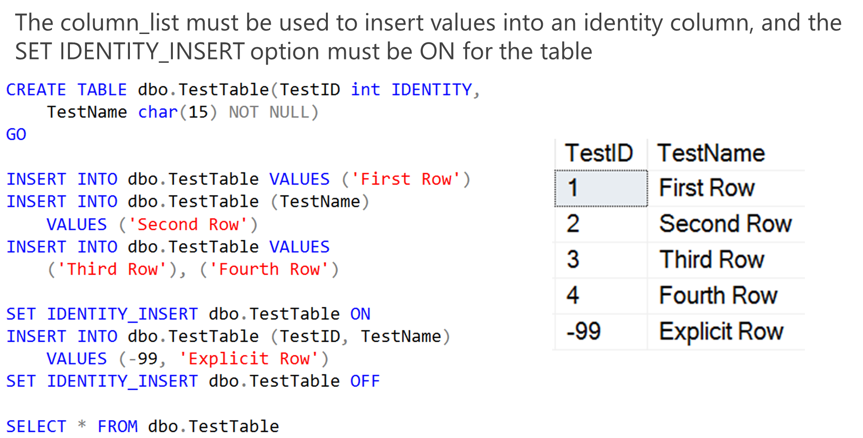
Inserting values into IDENTITY Columns

Slide 7
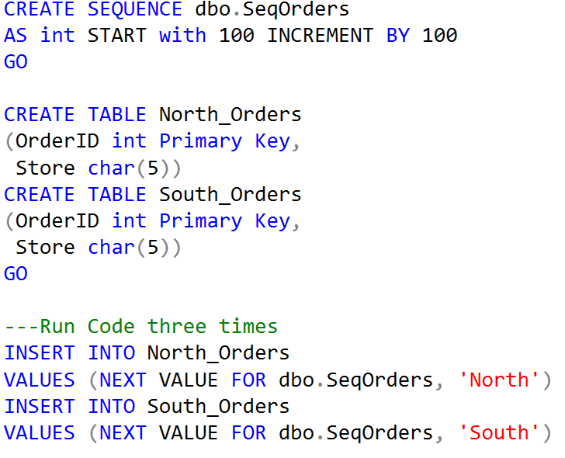
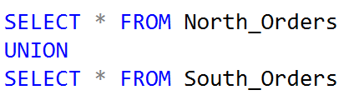
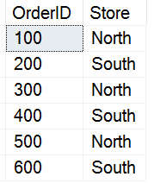
Inserting values using SEQUENCES
Sequences allow the ability to increment numbers across more than one table.

Slide 8
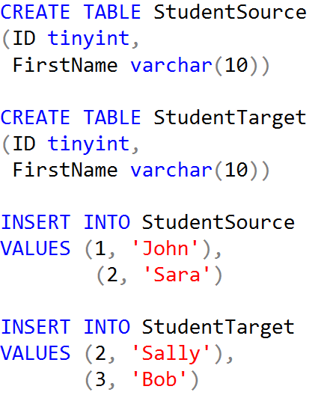


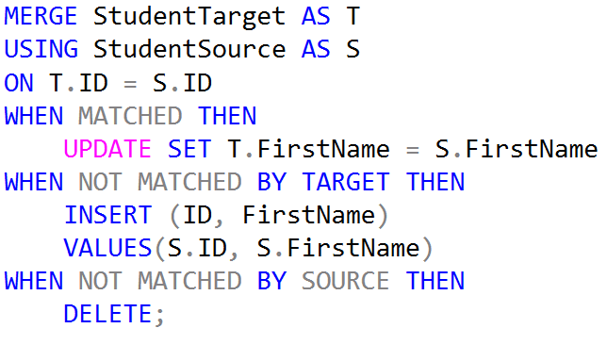

Using MERGE
Student Target
Demo Setup
Student Source
Student Target
Results

Slide 9
Demonstration

Slide 10
Questions?

Slide 11
Knowledge Check
What is the difference between an IDENTITY and a SEQUENCE?
Why should you use a WHERE statement with every UPDATE or DELETE statement?
What is the difference between DELETE and TRUNCATE?
Notes:
What are the two store types that query store has?
Plan Store
Runtime Stats Store
What are the two QDS cleanup stages?
The two QDS cleanup stages are:
1. In the first stage, old runtime stats are cleaned.
2. In the second stage, queries together with associated plans and statistics are deleted.

Slide 12
Lesson Summary
In this lesson we discussed:
SQL Statement Categories
What is DML?
Inserting Records into a table
IDENTITY and SEQUENCES
Updating Records in a table
Deleting Records in a table
DELETE vs DROP vs TRUNCATE

