Slide 1
Create and Modify Objects

Slide 2
What does this session cover?
Scalar Functions
Views
User-Defined Functions
Derived Tables
Common Table Expressions
Stored Procedure

Slide 3
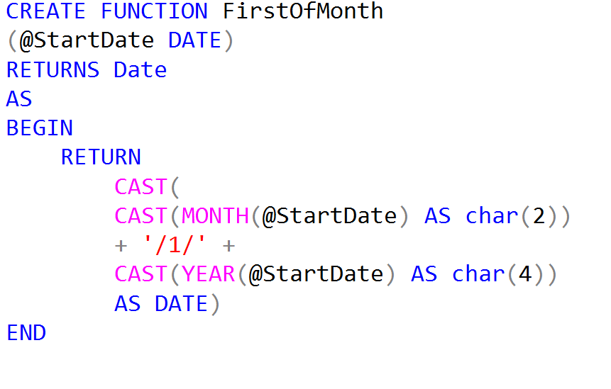
Creating Scalar Functions?

Slide 4
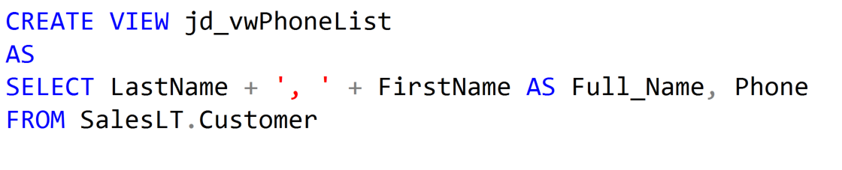
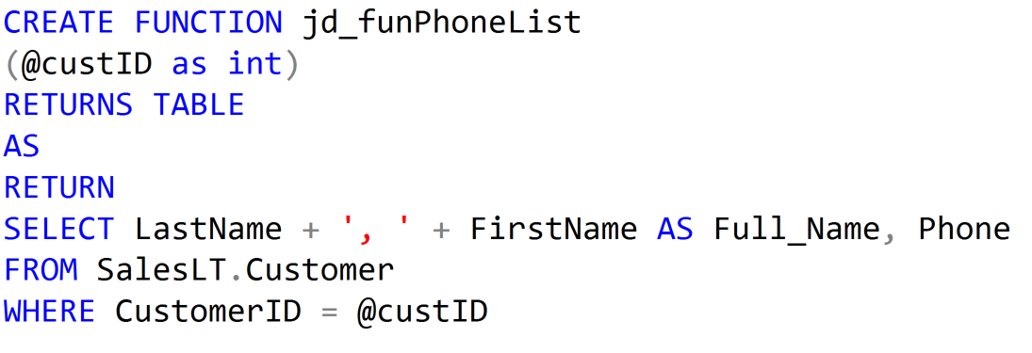
Creating Views and Table-Valued Functions?
User-Defined View
Table-Valued Function

Slide 5
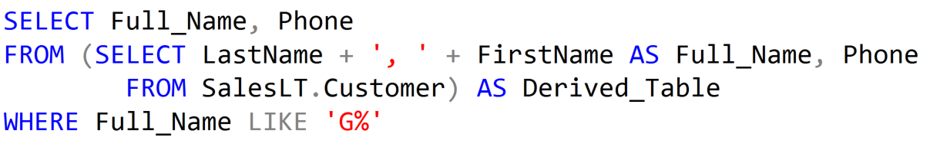
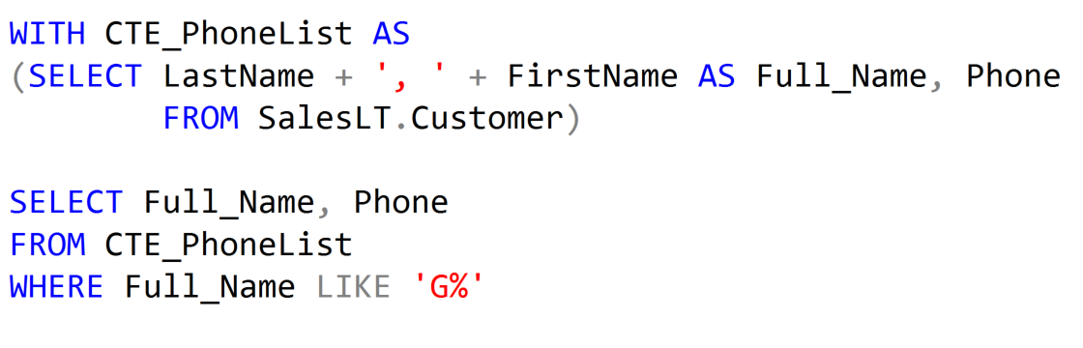
Derived Tables and Common Table Expressions
Derived Table
Common Table Expression

Slide 6
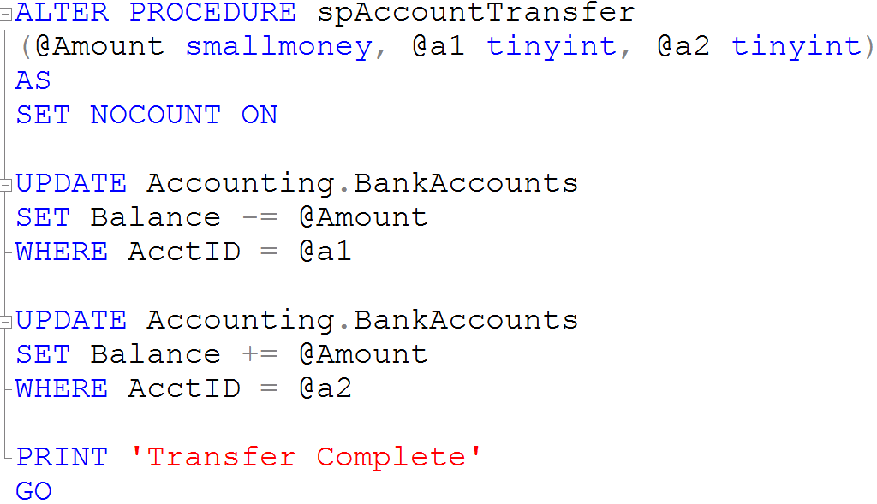
Creating a Stored Procedure

Slide 7
Demonstration

Slide 8
Questions?

Slide 9
Lesson Knowledge Check
What is the difference between a View and a Table-Valued Function?
What is the difference between a Derived Table and a CTE?
What is a benefit of using Stored Procedures?
Notes:
What are the two store types that query store has?
Plan Store
Runtime Stats Store
What are the two QDS cleanup stages?
The two QDS cleanup stages are:
1. In the first stage, old runtime stats are cleaned.
2. In the second stage, queries together with associated plans and statistics are deleted.

Slide 10
Lesson Summary
In this lesson we discussed:
Scalar Functions
Views
User-Defined Functions
Derived Tables
Common Table Expressions
Stored Procedure

