Slide 1
Inside Transactions

Slide 2
What does this session cover?
What are Transactions?
Auto-Commit vs Explicit Transactions
ACID Properties of a Transaction
How Data is modified in a Transaction
Working with Transactions
What are Locks?

Slide 3
What is a Transaction?
A transaction is a series of one or more statements that need to operate as a single logical unit of work.
To qualify as a transaction, the logical unit of work must possess all four of the ACID properties.

Slide 4
Transactions must pass the ACID test
Atomicity – All or Nothing
Consistent – Only valid data
Isolated – No interference
Durable – Data is recoverable

Slide 5


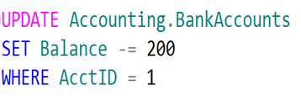
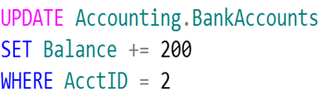
Logical Units of Work – Auto Commit Transactions
$200
John
Jane
Transaction 1
Transaction 2

Slide 6
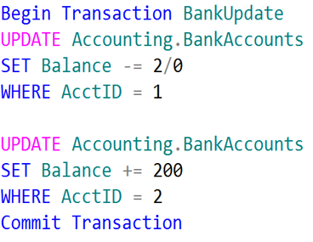
Logical Unit of Work – Explicit Transactions
John
Jane
$200

Slide 7

SQL Server Disk I/O (Write-Ahead Logging)
4
1. Data modification is sent to buffer cache in memory.
1
2
4. Log cache record is flushed to the transaction log
2. Modification is recorded in the log cache.
3
5. At checkpoint, dirty data pages are written to the database file.
Data Page
Data Row
3. Data pages are located or read into the buffer cache and then modified.
Data Row
5
Data Row
Free Space
Notes:
This section describes the role of the write-ahead transaction log in recording data modifications to disk. SQL Server uses a write-ahead logging (WAL) algorithm, which guarantees that no data modifications are written to disk before the associated log record is written to disk. This maintains the ACID properties for a transaction.
To understand how the write-ahead log works, it is important for you to know how modified data is written to disk. SQL Server maintains a buffer cache into which it reads data pages when data must be retrieved. When a page is modified in the buffer cache, it is not immediately written back to disk; instead, the page is marked as dirty. A data page can have more than one logical write made before it is physically written to disk. For each logical write, a transaction log record is inserted in the log cache that records the modification. The log records must be written to disk before the associated dirty page is removed from the buffer cache and written to disk. The checkpoint process periodically scans the buffer cache for buffers with pages from a specified database and writes all dirty pages to disk. Checkpoints save time during a later recovery by creating a point at which all dirty pages are guaranteed to have been written to disk.
Writing a modified data page from the buffer cache to disk is called flushing the page. SQL Server has logic that prevents a dirty page from being flushed before the associated log record is written. Log records are written to disk when the log buffers are flushed. This happens whenever a transaction commits or the log buffers become full.
Key Points:
SQL Server uses the buffer pool to minimize the amount of disk I/O that must be done against the data file. When a page is required for a read or write operation, the buffer pool is checked first. If the page is already in the buffer pool, the operation can be satisfied from memory only.
When a modification happens, the change is made to the data page in memory first, and then a log record is written to the transaction log file. The page will not be written out to disk until the CHECKPOINT process comes through and flushes changes out to the data file. If the SQL Server process is shut down unexpectedly and the memory space is lost, SQL Server uses the transaction log to bring the data file up to date with any changes that were committed before the crash but not persisted to disk. This is called recovery.
To optimize the I/O, SQL Server will attempt to gather pages together so that larger chunks of a file can be read or written in a single operation. For reads, SQL Server has a read ahead mechanism that will read contiguous pages from an object in a single request if needed by a query. For writes, SQL Server will gather together a chunk of contiguous pages that have been modified so they can be written in a single request.
Additional Reading:
SQL Server Transaction Log Architecture and Management Guide
From <https://docs.microsoft.com/en-us/sql/relational-databases/sql-server-transaction-log-architecture-and-management-guide?view=sql-server-ver15>
ACID properties
From <https://docs.microsoft.com/en-us/previous-versions/office/developer/server-technologies/aa480356(v=msdn.10)>
Write-Ahead Transaction Log
From <https://docs.microsoft.com/en-us/sql/relational-databases/sql-server-transaction-log-architecture-and-management-guide?view=sql-server-ver15#WAL>
Writing Pages
From <https://docs.microsoft.com/en-us/sql/relational-databases/writing-pages?view=sql-server-ver15>
Analyzing I/O Characteristics and Sizing Storage Systems for SQL Server Database Applications
From <https://docs.microsoft.com/en-us/previous-versions/sql/sql-server-2008/ee410782(v=sql.100)>

Slide 8
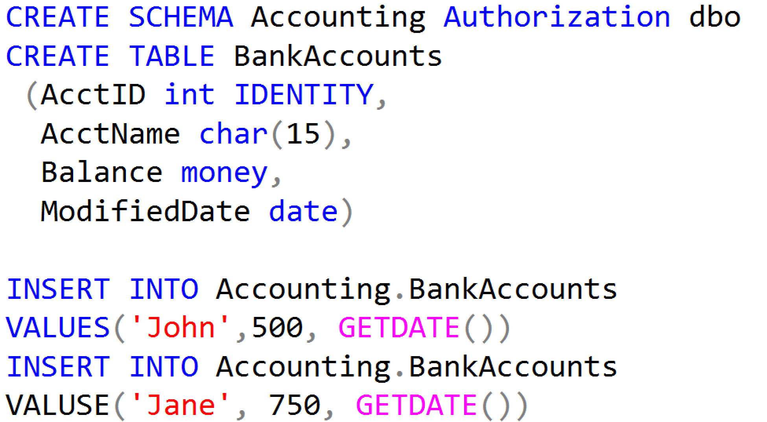
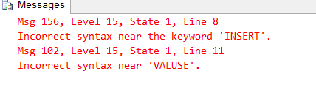
Working with Transactions

Slide 9
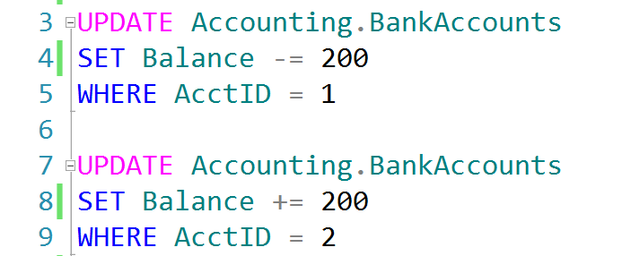
Auto-Commit Transactions without Error Handling
AdventureWorks.ldf
Checkpoint
AdventureWorks.mdf

Slide 10
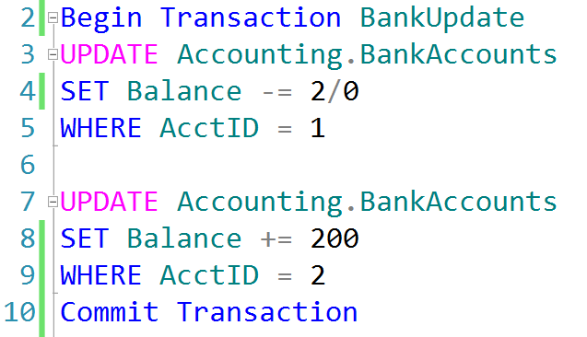
Explicit Transactions without Error Handling
AdventureWorks.ldf
Checkpoint
AdventureWorks.mdf

Slide 11
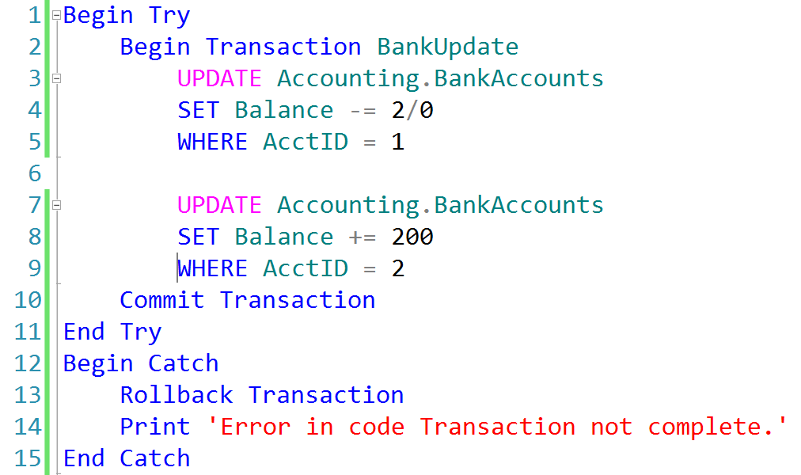
Explicit Transactions with Error Handling
AdventureWorks.ldf
AdventureWorks.mdf
Checkpoint

Slide 12
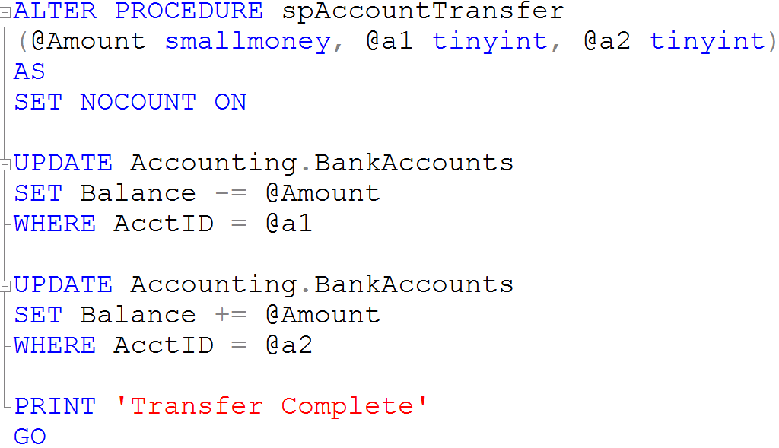
Creating a Stored Procedure

Slide 13
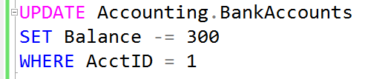


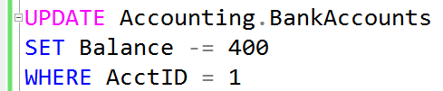
What is a Lock?
Transaction 1
Transaction 2
TSQL2012.mdf

Slide 14
Demonstration

Slide 15
Questions?

Slide 16
Lesson Knowledge Check
What are the ACID properties of a Transaction?
What is the purpose of the Transaction Log?
What is a Lock?
Notes:
What are the two store types that query store has?
Plan Store
Runtime Stats Store
What are the two QDS cleanup stages?
The two QDS cleanup stages are:
1. In the first stage, old runtime stats are cleaned.
2. In the second stage, queries together with associated plans and statistics are deleted.

Slide 17
Lesson Summary
In this lesson we discussed:
What are Transactions?
Auto-Commit vs Explicit Transactions
ACID Properties of a Transaction
How Data is modified in a Transaction
Working with Transactions
What are Locks?

