Slide 1
Writing T-SQL Queries

Slide 2
What does this session cover?
What is SQL?
Structure of object names
What are columns and records?
Structure of a SELECT statement
Sorting Records using the ORDER BY statement
Filtering Records using the WHERE statement
Concatenation and Aliases

Slide 3
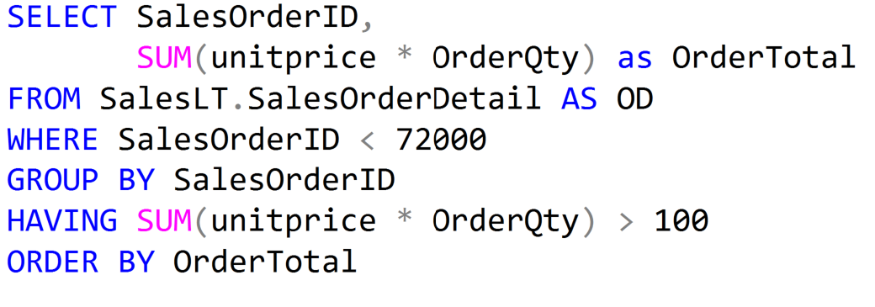
What is SQL?
Structured Query Language
Microsoft Database Server

Slide 4
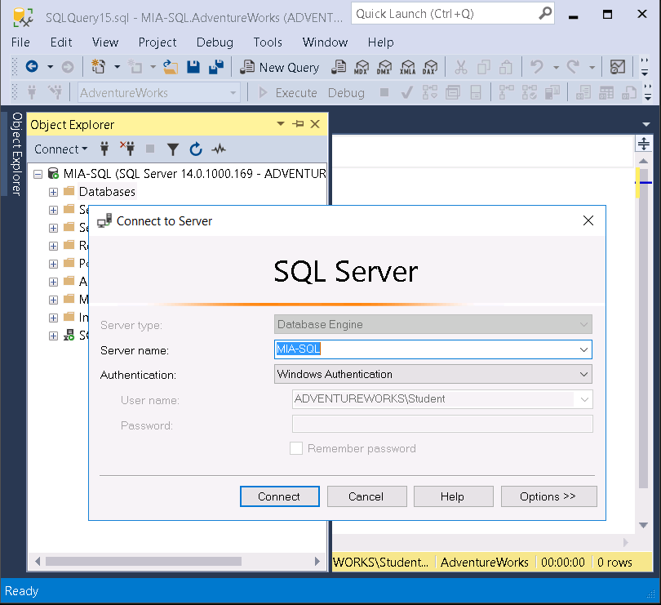
Client / Server Architecture
Requests Data
Relational Engine
SQLOS
Storage Engine
Provides Data
The Database Engine
Client
Server

Slide 5
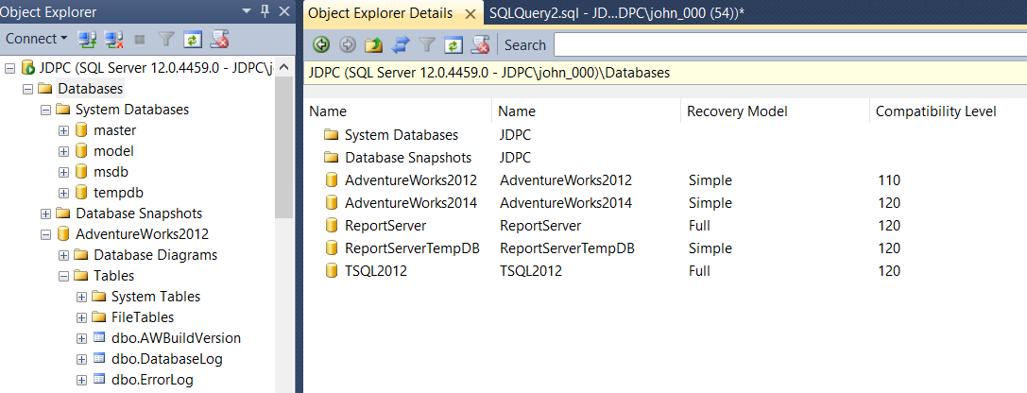
SQL Server Management Studio

Slide 6
System Databases
System Databases | Description
master | Stores all system-level configuration
msdb | Holds SQL Server Agent configuration including job, backup and restore history
model | Is the template for new databases
tempdb | Holds temporary data like temporary tables, table variables, hash tables and the row version store
resource | Hidden read-only database that contains system objects that are mapped to the sys schema of databases

Slide 7
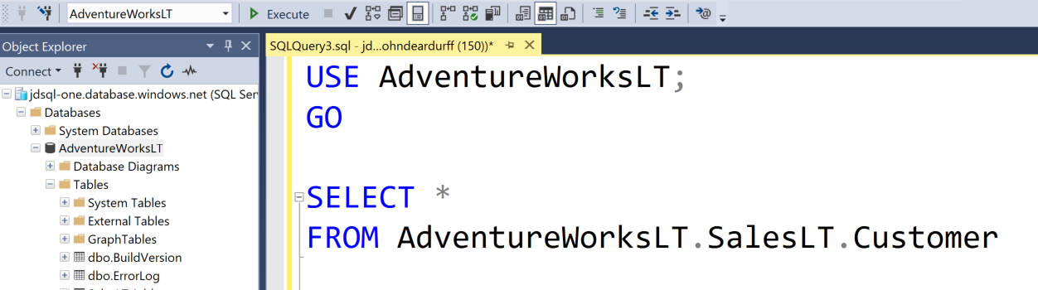
SQL Editor Toolbar and Query Editor Window
Available Databases
Execute (F5)
Parse
Intellisense
Comments
Indents
Three places where database names can be referenced.

Slide 8
The Four-Part Name of an Object
Server
Database
Schema
Object
Server.Database.Schema.Object

Slide 9

Understanding Entities
ProductID
Name
ProductNumber
StandardCost
ListPrice
Size
Weight
An entity is an object with properties

Slide 10
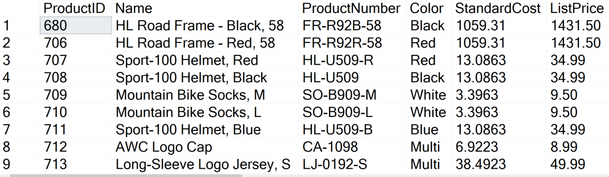
Understanding Columns and Records
Columns
Records

Slide 11
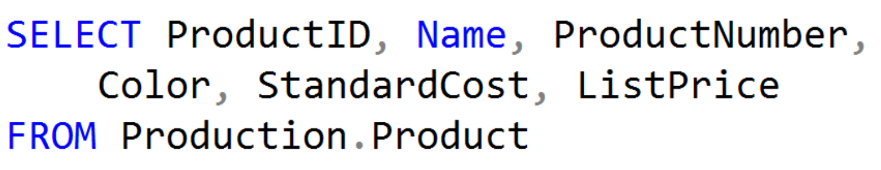
Using the SELECT statement
Column List
Return All Records from Table

Slide 12
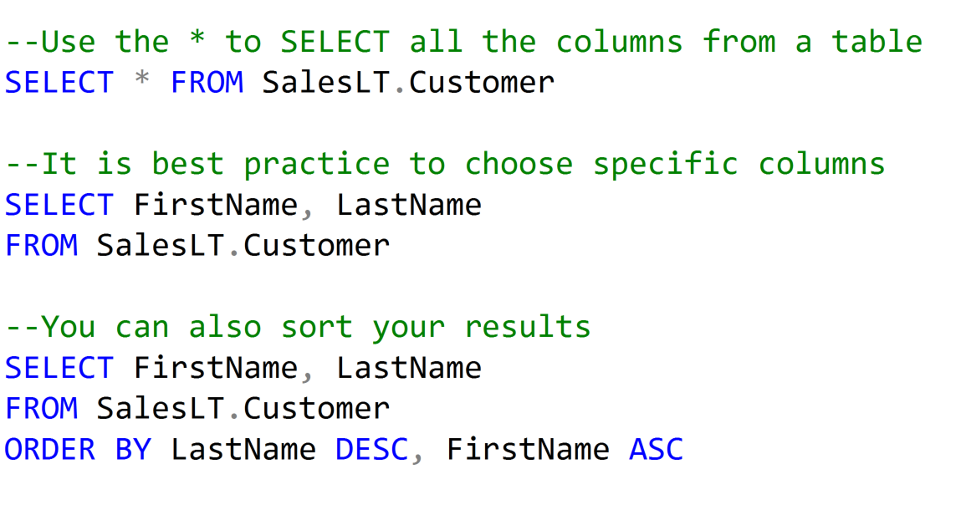
Using the SELECT statement

Slide 13
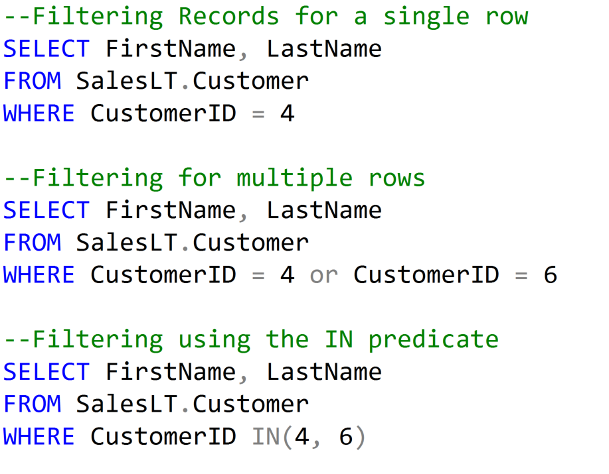
Filtering Records with the WHERE statement

Slide 14
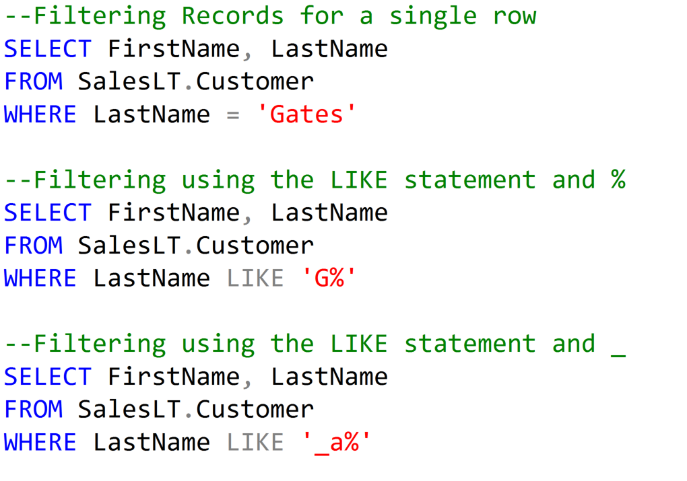
Filtering Records with the WHERE statement

Slide 15
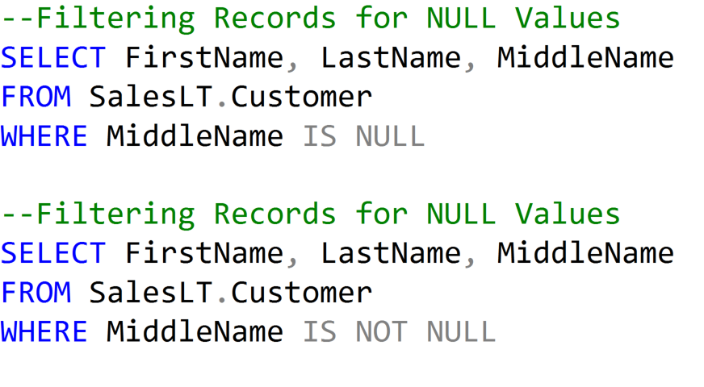
Filtering Records with the WHERE statement

Slide 16
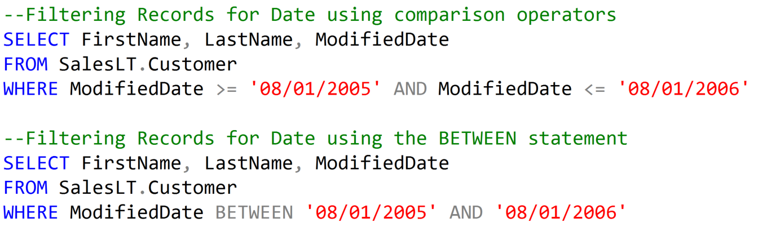
Filtering Records with the WHERE statement

Slide 17
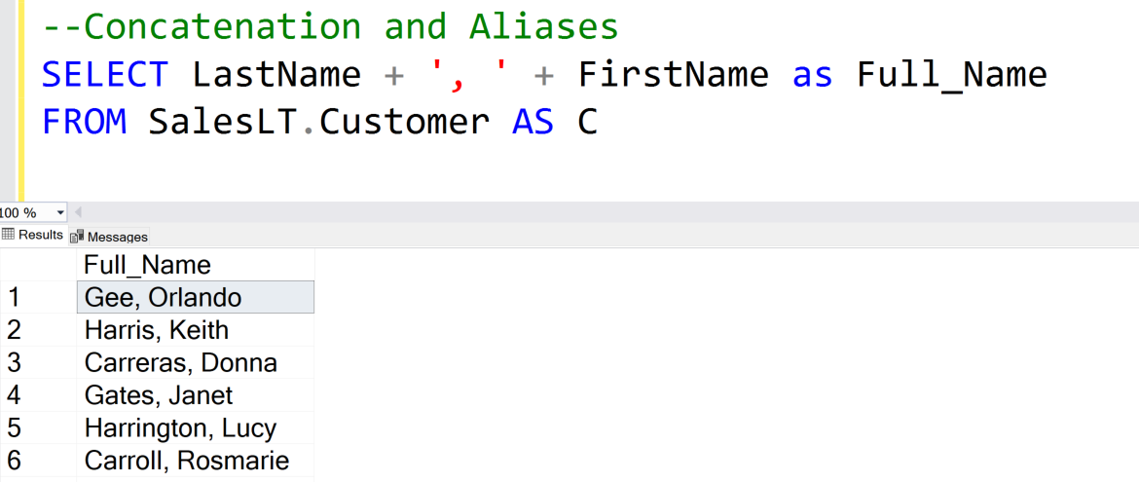
Concatenation and Aliases

Slide 18
Demonstration

Slide 19
Questions?

Slide 20
Lesson Knowledge Check
What is the * used for in a SELECT statement?
Which statement is used to filter records?
Which statement is used to sort records?
Notes:
What are the two store types that query store has?
Plan Store
Runtime Stats Store
What are the two QDS cleanup stages?
The two QDS cleanup stages are:
1. In the first stage, old runtime stats are cleaned.
2. In the second stage, queries together with associated plans and statistics are deleted.

Slide 21
Lesson Summary
In this lesson we discussed:
What is SQL?
Structure of object names
What are field and records?
Structure of a SELECT statement
Sorting Records using the ORDER BY statement
Filtering Records using the WHERE statement
Concatenation and Aliases

