Slide 1
Working with Multiple Tables

Slide 2
What does this session cover?
Selecting from Multiple Tables
Finding Table Relationships
Parent vs Child Tables
Inner Joins
Outer Joins

Slide 3
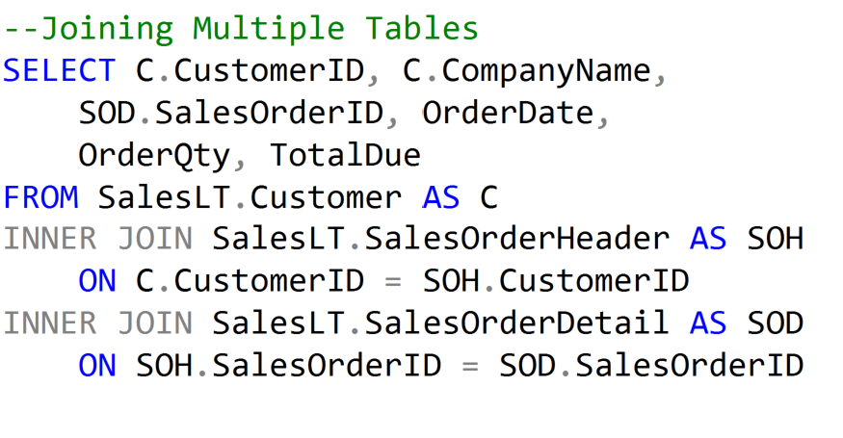
Selecting from Multiple Tables

Slide 4
Join Types
Customers
Orders
Parent
Table
Child
Table
Left Outer
All customers whether the placed an order or not.
Right Outer
All orders whether there was a customer or not.
Inner
Only Customers who have been placed an Order

Slide 5
Finding relationships
Customers
CustomerID
FirstName
LastName
Company Name
Phone
Orders
OrderID
CustID
ProductID
Qty
OrderDate
Products
ProductID
ProductName
Price
Primary Key within a table is the unique identifier
Primary Key within a relationship is the best describer of the connecting field
Foreign Key within a relationship connects a Child table to a Parent Table

Slide 6
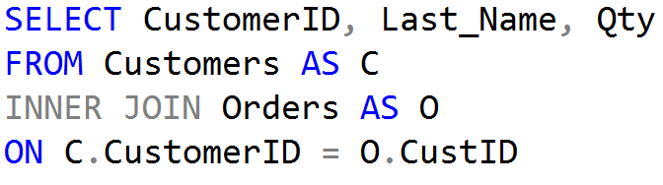
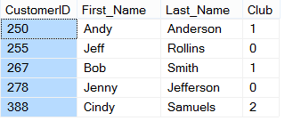
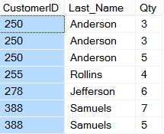
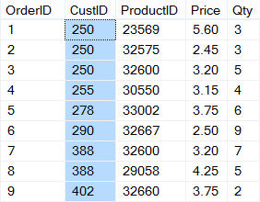
Inner Joins
CUSTOMERS
ORDERS

Slide 7
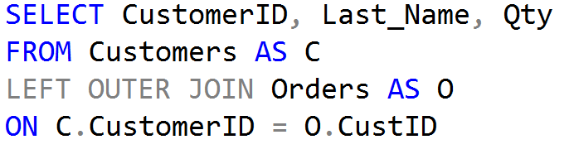
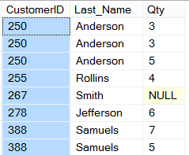
Left Outer Joins
CUSTOMERS
ORDERS

Slide 8
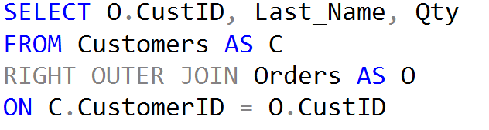
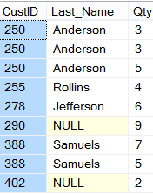
Right Outer Joins
CUSTOMERS
ORDERS

Slide 9
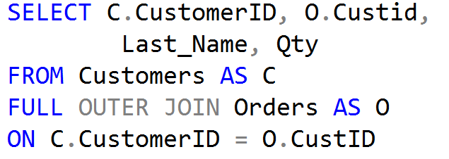
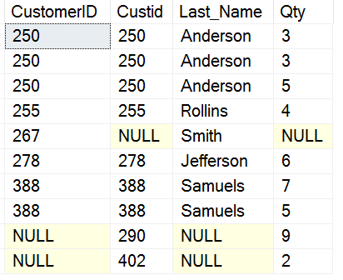
Full Outer Joins
CUSTOMERS
ORDERS

Slide 10
Demonstration

Slide 11
Questions?

Slide 12
Knowledge Check
Which join type selects only records that match between both tables?
Which join selects all the records from the parent table?
Why would a right outer join be used?
Notes:
What are the two store types that query store has?
Plan Store
Runtime Stats Store
What are the two QDS cleanup stages?
The two QDS cleanup stages are:
1. In the first stage, old runtime stats are cleaned.
2. In the second stage, queries together with associated plans and statistics are deleted.

Slide 13
Lesson Summary
In this lesson we discussed:
Selecting from Multiple Tables
Finding Table Relationships
Parent vs Child Tables
Inner Joins
Outer Joins

