Slide 1
Clustered and Non-Clustered Indexes

Slide 2
What does this session cover?
How is data stored?
Heaps vs Clustered Indexes
Non-Clustered Indexes
Included Columns

Slide 3
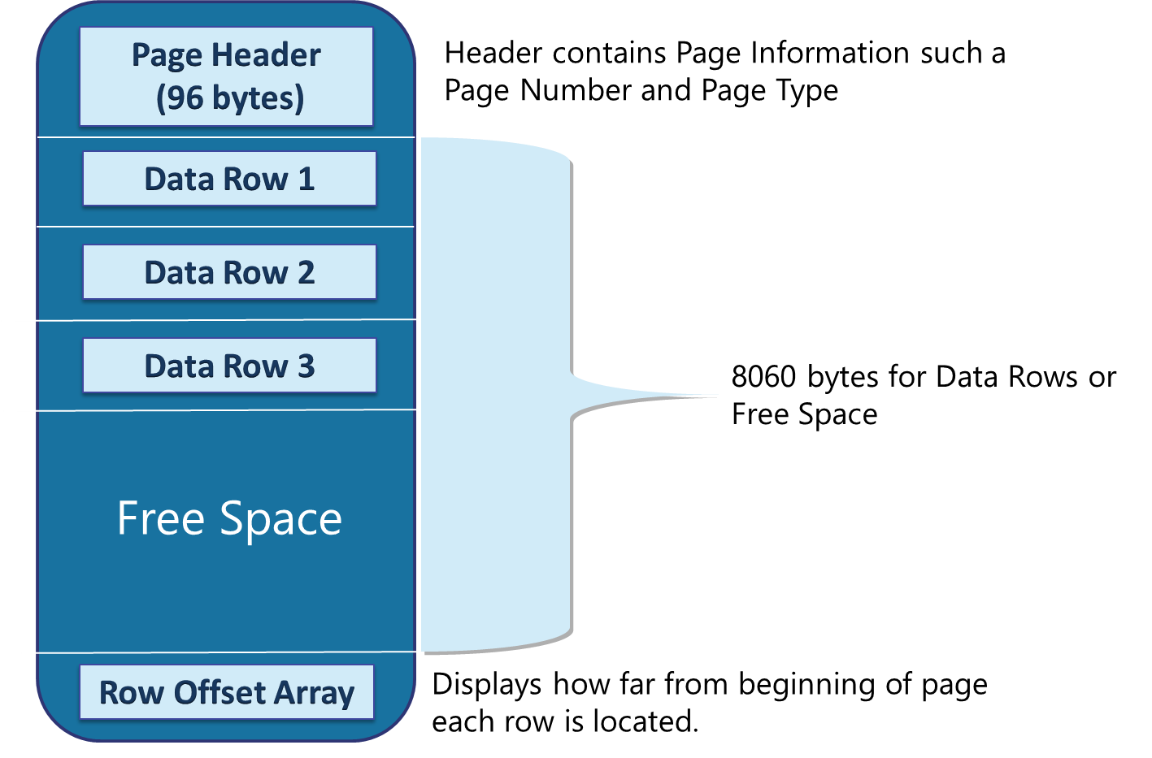
Rows stored in a data page

Slide 4
How data is stored in a database
Data Row
Data Row
Data Row
Free Space
Data Row
Free Space
Data Row
Data Row
Data Row
Data Row
Free Space
Data Row
Free Space
Free Space
Free Space
Free Space
Data Row
Data Row
Data Row
Data Row
Data Row
Data Row
Free Space
Data Row
Data Row
Data Row
Data Row
Free Space
Data Row
Data Row
Free Space
Free Space
Primary Data File (.mdf)
Secondary Data File (.ndf)
Extent: Eight contiguous 8kb pages
Notes:
Provide an overview of how the data is stored on SQL Server. Describe each of the three data file types and the basic internal layout of the data files. Stress that the file extension .mdf is not mandatory to use but is highly recommended.
Describe the difference between uniform and mixed extents. Note that continued support for mixed extents adds complexity to the database engine for no real benefit. The size of an extent (64 KB) is so small that the original benefit from the mixed extent design is now irrelevant.
Briefly explain that all transactions are written to the log file using the WAL mechanism to ensure the integrity of the database in case of a failure and to support rollbacks of transactions. Explain that data changes occur in the buffer pool and are not written immediately to the data files.
Avoid discussing filegroups at this point, as they will be covered later.
20462C
3: Working with Databases and Storage

Slide 5
How data is stored in data pages
Heap
Data stored in a Heap is not stored in any order and normally does not have a Primary Key.
Data Row 8
Data Row 2
Data Row 7
Data Row 6
Data Row 5
Data Row 4
Data Row 1
Data Row 3
Data Row 9
Clustered Index data is stored in sorted order by the Clustering key. In many cases, this is the same value as the Primary Key.
Clustered Index
Data Row 1
Data Row 4
Data Row 7
Data Row 2
Data Row 5
Data Row 8
Data Row 3
Data Row 6
Data Row 9

Slide 6
Characteristics of a Good Clustering Key
Small
Unique
Static
Increasing
Use a data type with a small number of bytes to conserve space in tables and indexes
Avoids SQL adding a 4-byte uniquifier
Allows data to stay constant without constant changes which could lead to page splits
Allows better write performance and reduces fragmentation issues
Notes:
What are the two store types that query store has?
Plan Store
Runtime Stats Store
What are the two QDS cleanup stages?
The two QDS cleanup stages are:
1. In the first stage, old runtime stats are cleaned.
2. In the second stage, queries together with associated plans and statistics are deleted.

Slide 7
Non-Clustered Indexes
Root
AZ - IN
ND - WA
A Non–Clustered Index is built separate from the table
CA 3
IL 7
IN 9
FL 4
IN 1
KS 6
GA 10
IN 5
VA 8
Root
The table is stored in either a Clustered Index or Heap
1-5
6-10
1 John IN
4 Heather FL
7 Gary IL
2 Sharon NV
5 Enrique IN
8 Sidney VA
3 Armando CA
6 Bob KS
9 Frank IN

Slide 8
Demonstration

Slide 9
Questions?

Slide 10
Knowledge Check
What is the difference between a Heap and a Clustered Index?
How many Clustered Indexes can you have on a table?
What properties make up a good Clustering Key?

Slide 11
Lesson Summary
In this lesson we discussed:
How is data stored?
Heaps vs Clustered Indexes
Non-Clustered Indexes
Included Columns

