Slide 1
Reading Execution Plans

Slide 2
What does this session cover?
How Queries are Processed
What is an Execution Plan?
Execution Plan Table Operators
Execution Plan Join Operators
Cardinality Estimator and Statistics

Slide 3
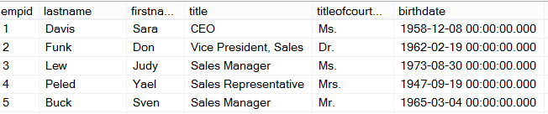
How Queries are Processed
Ad Hoc Query
Stored Procedure
First Execution
or Recompile
Syntax
Parse
Execution Context
Resolve
(Binding)
Compile
Optimize
Estimated
Execution Plan
Procedure Cache
Compile
Compile
Actual
Run Time
Execute
Execute
Execute
Execute
SQL
SQL
Sets
Sets

Slide 4
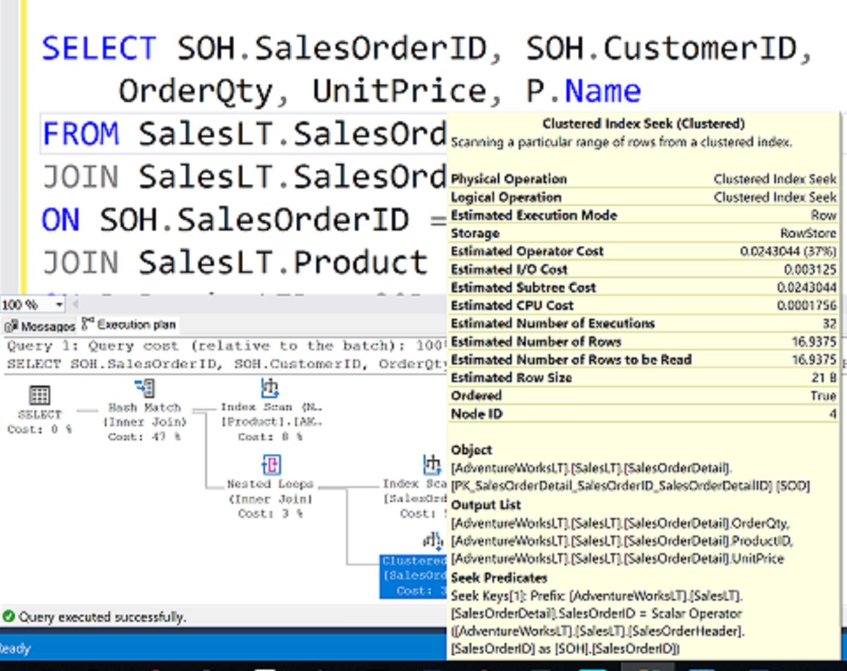
What is an Execution Plan?

Slide 5
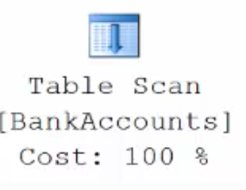
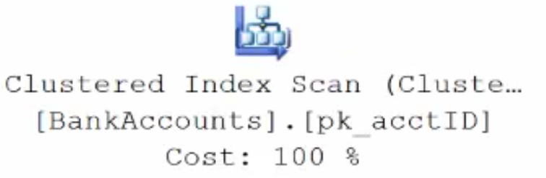
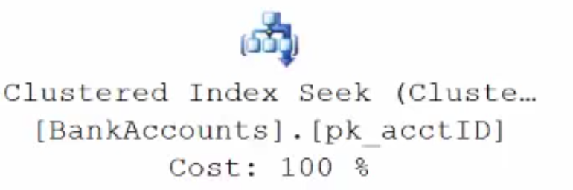
Execution Plan Table Operators
Data stored in a Heap is not stored in any order and normally does not have a Primary Key.
Clustered Index data is stored in sorted order by the Clustering key. In many cases, this is the same value as the Primary Key.
Using a WHERE statement on an Index could possibly have the Execution Plan seek the Index instead of scan.

Slide 6
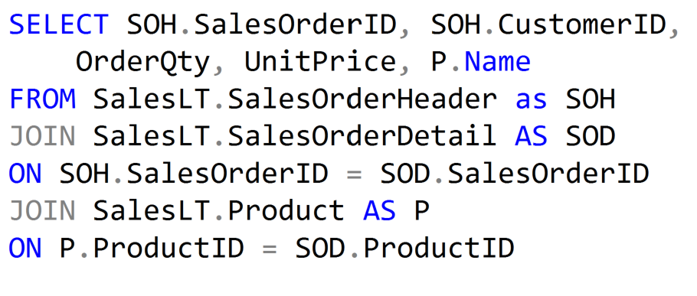
Execution Plan Join Operators (Code)

Slide 7



Execution Plan Join Operators
A Merge Join is useful if both table inputs are in the same sorted order on the same value.
A Hash Match is used when the tables being joined are not in the same sorted order.
A Nested Loop is use when a small (outer) table is used to lookup a value in a larger (inner) table.

Slide 8
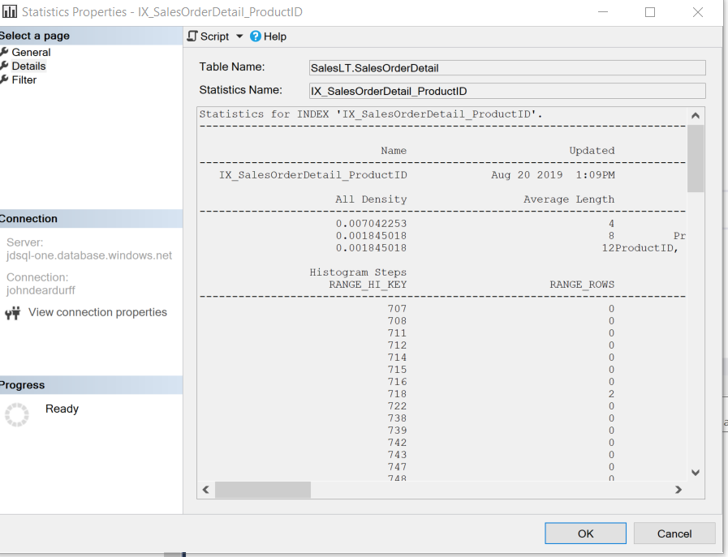
Cardinality and Statistics

Slide 9
Demonstration

Slide 10
Questions?

Slide 11
Knowledge Check
If data is stored in a Heap, what type of table operator will be used to retrieve data?
Which is better, a SCAN or a SEEK operator?
What does the query optimizer use to estimate the number of rows that will be returned?
Notes:
What are the two store types that query store has?
Plan Store
Runtime Stats Store
What are the two QDS cleanup stages?
The two QDS cleanup stages are:
1. In the first stage, old runtime stats are cleaned.
2. In the second stage, queries together with associated plans and statistics are deleted.

Slide 12
Lesson Summary
In this lesson we discussed:
How Queries are Processed
What is an Execution Plan?
Execution Plan Table Operators
Execution Plan Join Operators
Cardinality Estimator and Statistics

