Slide 1
Inside Transactions

Slide 2
What does this session cover?
What are Transactions?
Auto-Commit vs Explicit Transactions
ACID Properties of a Transaction
How Data is modified in a Transaction
Working with Transactions
What are Locks?

Slide 3
What is a Transaction?
A transaction is a series of one or more statements that need to operate as a single logical unit of work.
To qualify as a transaction, the logical unit of work must possess all four of the ACID properties.

Slide 4


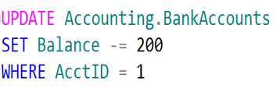
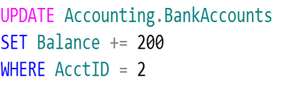
Logical Units of Work – Auto Commit Transactions
$200
John
Jane
Transaction 1
Transaction 2

Slide 5
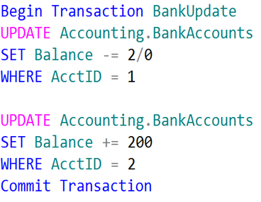
Logical Unit of Work – Explicit Transactions
John
Jane
$200

Slide 6
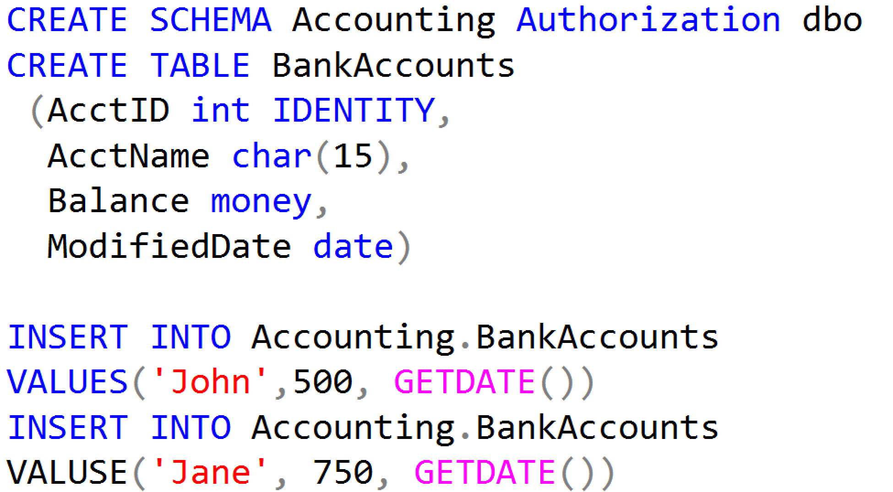
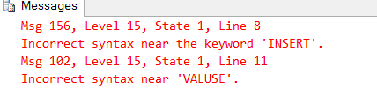
Working with Transactions

Slide 7
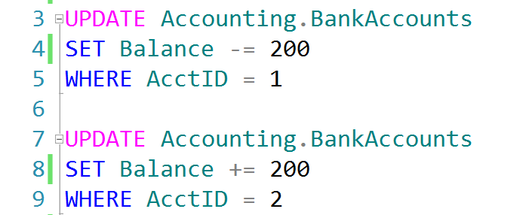
Auto-Commit Transactions without Error Handling
AdventureWorks.ldf
Checkpoint
AdventureWorks.mdf

Slide 8
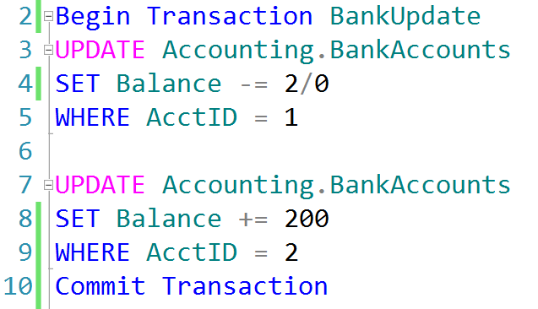
Explicit Transactions without Error Handling
AdventureWorks.ldf
Checkpoint
AdventureWorks.mdf

Slide 9
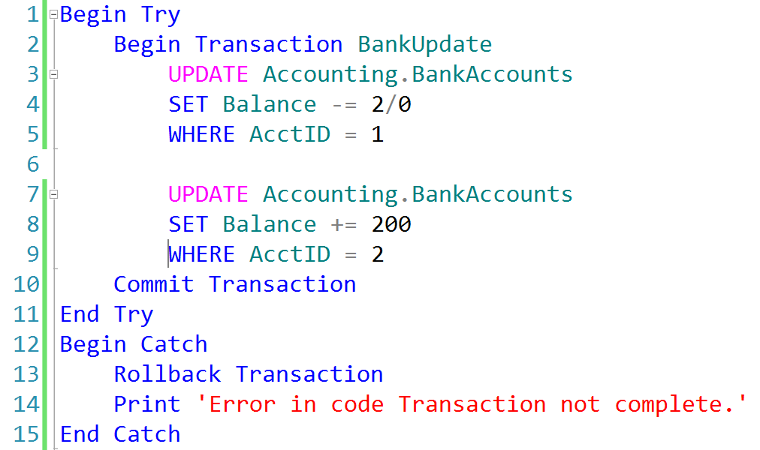
Explicit Transactions with Error Handling
AdventureWorks.ldf
AdventureWorks.mdf
Checkpoint

Slide 10
Transactions must pass the ACID test
Atomicity – All or Nothing
Consistent – Only valid data
Isolated – No interference
Durable – Data is recoverable

Slide 11
How Data is Modified in SQL Server
3. Modification is written to transaction log.
3
1. Data modification is sent to buffer cache in memory.
1
4. Checkpoint looks for committed transactions.
4
2. Data pages are located or read into the buffer cache and then modified.
2
Data Page
5. At checkpoint, dirty data pages are written to the database file.
Data Row
Data Row
5
Data Row
Free Space

Slide 12
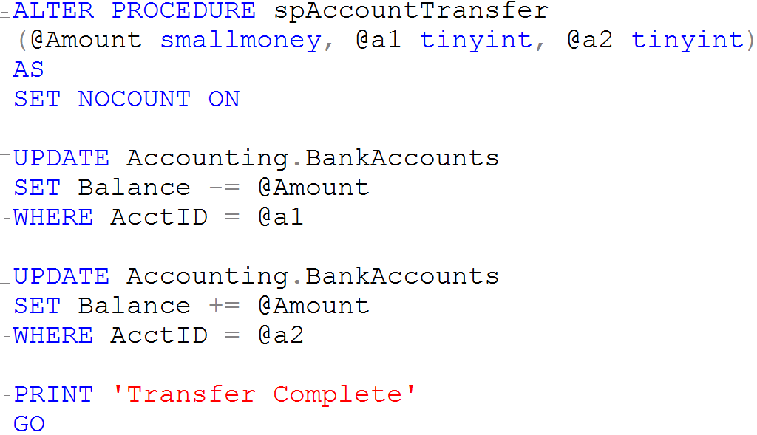
Creating a Stored Procedure

Slide 13
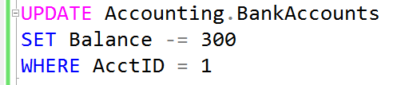


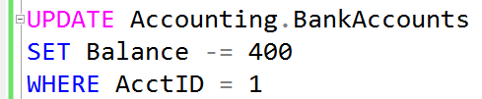
What is a Lock?
Transaction 1
Transaction 2
TSQL2012.mdf

Slide 14
Demonstration

Slide 15
Questions?

Slide 16
Lesson Knowledge Check
What are the ACID properties of a Transaction?
What is the purpose of the Transaction Log?
What is a Lock?
Notes:
What are the two store types that query store has?
Plan Store
Runtime Stats Store
What are the two QDS cleanup stages?
The two QDS cleanup stages are:
1. In the first stage, old runtime stats are cleaned.
2. In the second stage, queries together with associated plans and statistics are deleted.

Slide 17
Lesson Summary
In this lesson we discussed:
What are Transactions?
Auto-Commit vs Explicit Transactions
ACID Properties of a Transaction
How Data is modified in a Transaction
Working with Transactions
What are Locks?

