Slide 1
Writing T-SQL and Query Performance Tuning

Slide 2







John Deardurff
Customer Engineer (Global Technical Team)
Microsoft Certified Trainer (Regional Lead)
MVP: Data Platform (2016 – 2018)
Twitter: @SQLMCT
Website: www.SQLMCT.com
GitHub: github.com\SQLMCT

Slide 3
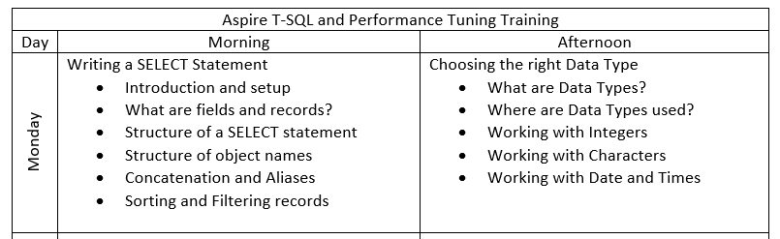
Day One

Slide 4
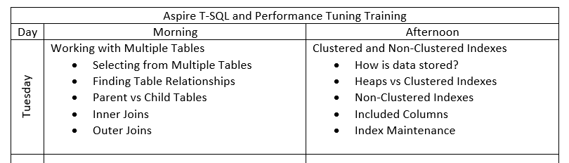
Day Two

Slide 5
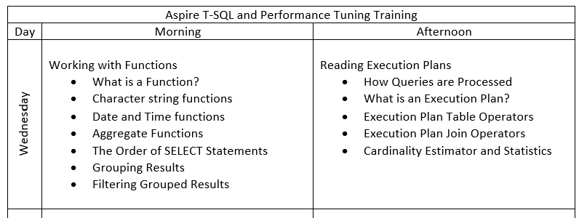
Day Three

Slide 6
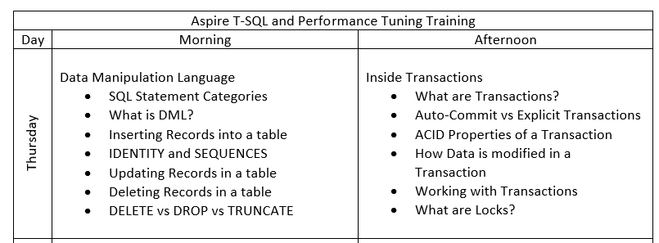
Day Four

Slide 7
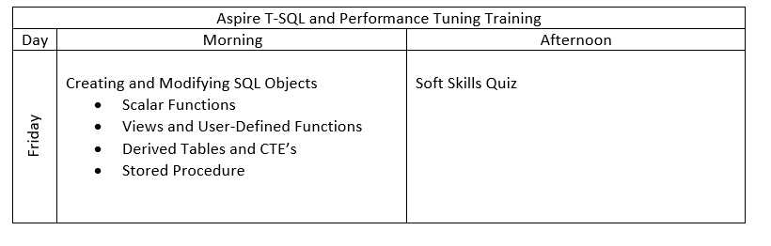
Day Five

Slide 8
Notes:
Note: This should be the final slide for each presentation.

