Slide 1
Waits, Queues, and the Task Execution Model John Deardurff

Slide 2
What does this session cover?
A Closer look at SQLOS
Waits and Queues
Thread Scheduling
Task Execution Model
Monitoring Waits

Slide 3
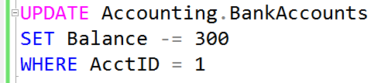
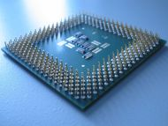
Query Process
Relational Engine
Resource Access
SQLOS
Storage Engine
Data Access
The Database Engine

Slide 4
SQLOS Provides Many Functions
Thread Scheduling
Memory Management
Transaction Management
Exception Handling
Locking Framework
Deadlock Detection

Slide 5
Preemptive vs. Cooperative Scheduling
Windows uses Preemptive scheduling
Is driven by the view of prioritized computation
Means that a low-priority process is pre-empted out of the processor by a high-priority process
SQL Server uses Cooperative scheduling
Means that the priority of a process doesn’t matter
Is where a process is not preempted, and executes until it explicitly yields the processor
Notes:
Try not to spend too much time here. Content in later slides is more important.
Technically, Resource Governor enables some processes to be treated preemptively and take priority over a process that is running in a lower-priority resource group. However, discussing this at this point is unlikely to be helpful to students who are new to the topic. Students who have some experience of Resource Governor might raise the point.
10987B
1: SQL Server Architecture, Scheduling, and Waits

Slide 6
Thread States and Queues
Runnable
Running
Suspended
The thread is currently in the Runnable Queue waiting to execute. (First In, First Out).
One active thread executing on a processor.
Placed on a Waiter List waiting for a resource other than a processor. (No specific order).
Notes:
10987B
1: SQL Server Architecture, Scheduling, and Waits

Slide 7
SQL Server Execution Model
Runnable List
Status: runnable
CPU available
Start
CPU
Status: running
Complete
Quantum exhausted
End
Resource blocked
Waiter List
Status: suspended
Resource available
Notes:
It’s worth spending some time on this slide to make sure that the students grasp these concepts because an understanding of them is critical for the rest of this course. Try to avoid discussing wait types here because the next lesson covers the topic in detail.
10987B
1: SQL Server Architecture, Scheduling, and Waits

Slide 8
Total Query Response Time
The full cycle between the several task states, for how many times it needs to cycle, is what we experience as the total query response time.
CPU Time (RUNNING)
Total Query Response Time
Signal Wait Time (RUNNABLE)
Resource Wait Time (SUSPENDED)

Slide 9
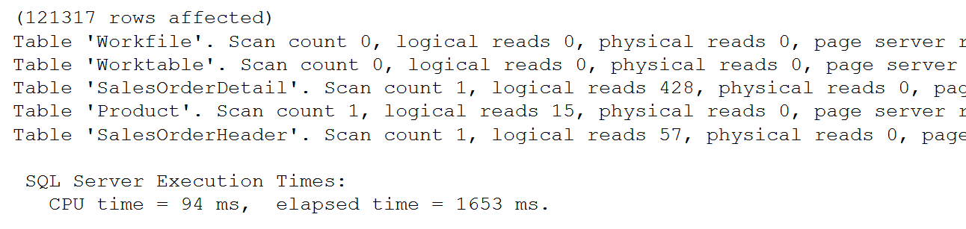
SET STATISTICS IO, TIME ON
SET STATISTICS IO ON
GO
SET STATISTICS TIME ON
SELECT SOH.SalesOrderID, SOH.CustomerID,
OrderQty, UnitPrice, P.Name
FROM Sales.SalesOrderHeader AS SOH
JOIN Sales.SalesOrderDetail AS SOD
ON SOH.SalesOrderID = SOD.SalesOrderID
JOIN Production.Product AS P
ON P.ProductID = SOD.ProductID
SET STATISTICS IO, TIME OFF
Used to identify physical reads and logical reads for a query
Notes:
SET STATISTICS IO (Transact-SQL) - SQL Server | Microsoft Docs
Causes SQL Server to display information about the amount of disk activity generated by Transact-SQL statements.
SET STATISTICS TIME (Transact-SQL) - SQL Server | Microsoft Docs
Displays the number of milliseconds required to parse, compile, and execute each statement.

Slide 10
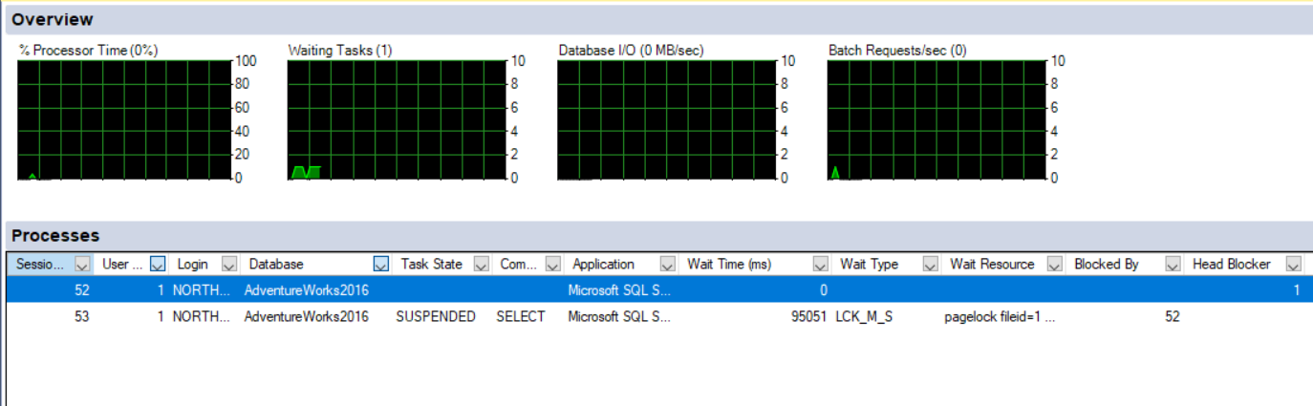
Activity Monitor

Slide 11
Dynamic Management Objects for Waits
Session CPU time and memory usage: sys.dm_exec_sessions
Status and session owner of request: sys.dm_exec_requests
Actual query text of waiting task: sys.dm_exec_sql_text
Active wait duration and type: sys.dm_os_waiting_tasks

Slide 12
Dynamic Management Objects for Waits
--Waiting tasks
SELECT w.session_id, w.wait_duration_ms, w.wait_type,
w.blocking_session_id, w.resource_description,
s.program_name, t.text, t.dbid, s.cpu_time,
s.memory_usage
FROM sys.dm_os_waiting_tasks as w
INNER JOIN sys.dm_exec_sessions as s
ON w.session_id = s.session_id
INNER JOIN sys.dm_exec_requests as r
ON s.session_id = r.session_id
OUTER APPLY sys.dm_exec_sql_text (r.sql_handle) as t
WHERE s.is_user_process = 1;
Notes:
10987B
1: SQL Server Architecture, Scheduling, and Waits

Slide 13
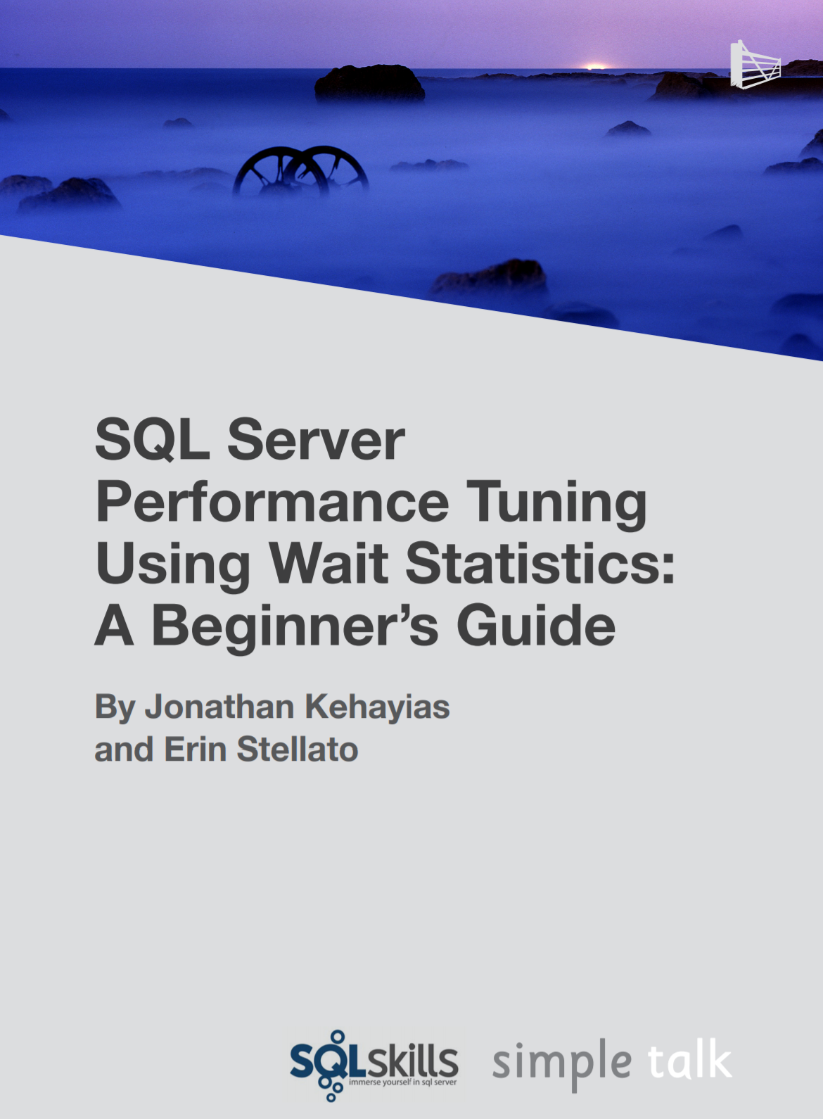
Troubleshooting Wait Types
Aaron Bertrand – Top Wait Types https://sqlperformance.com/2018/10/sql-performance/top-wait-stats
Paul Randal – SQL Skills Wait Types Library https://www.sqlskills.com/help/waits/
Notes:
10987B
1: SQL Server Architecture, Scheduling, and Waits

Slide 14
Demonstration

