Slide 1

WorkshopPLUS – SQL Server: Performance Tuning and Optimization
{ |  | }
 | SQL Server
Epicor
November 14th – 17th
9:00 am – 3:00 pm EST

Slide 2







John Deardurff
Cloud Solution Architect (Data & AI)
Microsoft Certified Trainer (Regional Lead)
MVP: Data Platform (2016 – 2018)
Email: John.Deardurff@Microsoft.com
Twitter: @SQLMCT
Website: www.SQLMCT.com
GitHub: github.com\SQLMCT

Slide 3
Agenda Day 1
Module 2: SQL Server I/O and Database Structure
SQL OS
Task Scheduling
Waits and Queues
Disk I/O
Page Structure
Data File Structure
Module 1: SQL Server Architecture, Scheduling and Waits

Slide 4
Agenda Day 2
Module 2: SQL Server I/O and Database Structure
SQL Server Transactions
Transaction Isolation Levels
Module 4: SQL Server Concurrency and Transactions
Windows Memory Management
SQL Server Memory Management
Troubleshooting SQL Server Memory
TempDB File Structure
Module 3: SQL Server Memory
Log File Structure

Slide 5
Agenda Day 3
SQL Server Partitioned Tables and Indexes
SQL Server Index Monitoring and Fragmentation
Module 4: SQL Server Concurrency and Transactions
SQL Server Index Internals & Indexing Strategies
SQL Server Locking
Module 5: SQL Server Index Structure
Blocking and Deadlocking

Slide 6
Agenda Day 4
SQL Server Plan Cache Internals
Query Store
Query Store Troubleshooting
Module 6: SQL Server Statistics Structure
SQL Server Query Execution
SQL Server Query Plan Analysis
SQL Server Intelligent Query Processing
Module 8: SQL Server Plan Caching and Query Store
SQL Server Statistics Internals
SQL Server Cardinality Estimation
SQL Server Statistics Maintenance
Module 7: SQL Server Query Execution and Plans

Slide 7
Additional Review
Module 9: SQL Server Query Tuning
Sargable expressions
Query Hints
Module 10: SQL Server Performance Tools
Resource Governor
Query Troubleshooting
Extended Events

Slide 8
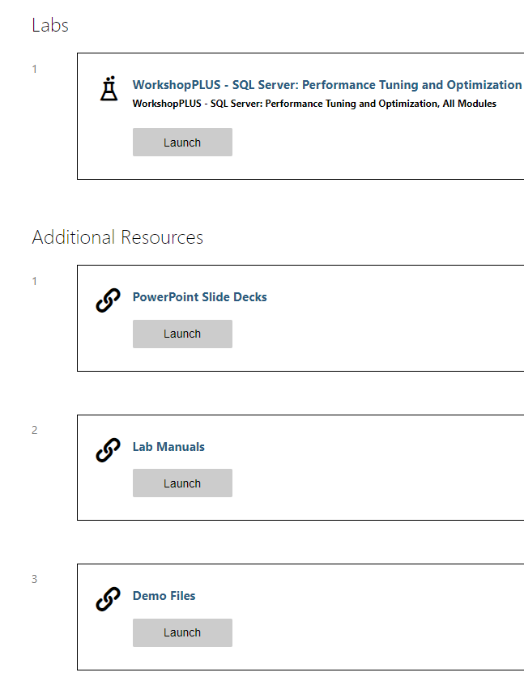
Class Resources
Virtual Lab Environment, Slides Decks, Lab Manuals, and Demo Files
Notes:
http://aka.ms/premiereducation redirects to https://mslearningcampus.com/User/Login?ReturnUrl=%2f
##########

Slide 9
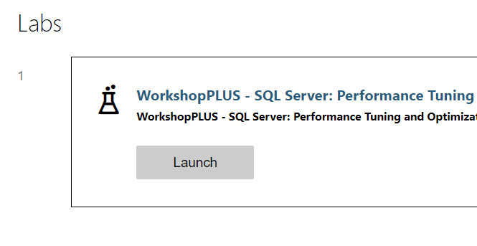
Launch Lab
In the Labs section, click Launch
Notes:
http://aka.ms/premiereducation redirects to https://mslearningcampus.com/User/Login?ReturnUrl=%2f
##########

Slide 10
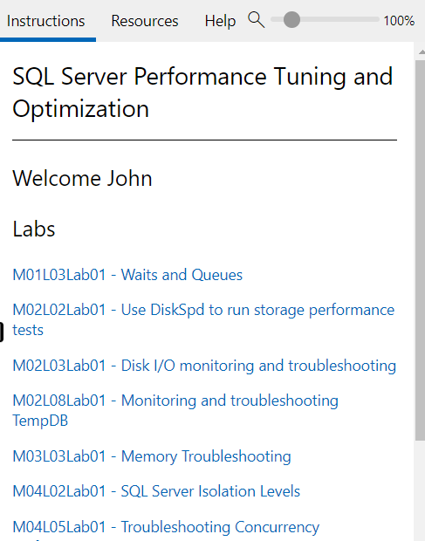
Lab environment
Lab Instructions are shown on the right side of the virtual machine.

Slide 11
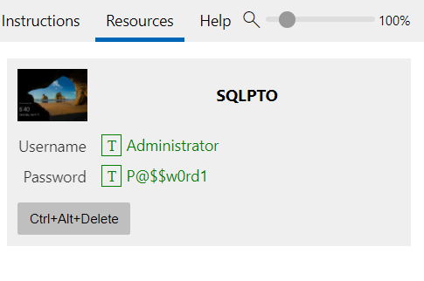
Lab environment
Use the Ctrl+Alt+Delete button to logon to the virtual machine.
You can click on the T next to Username and Password to paste in the virtual machine.

Slide 12
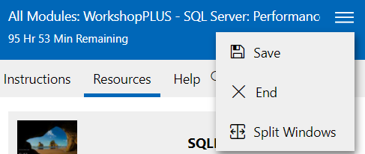
Lab Time Remaining
Ensure you select Save before leaving the Lab environment.
You can save up to 5 labs for up to 7 days.
The lab environment is available for 180 days.
Split Windows will allow you to move the instructions to a separate screen.

Slide 13
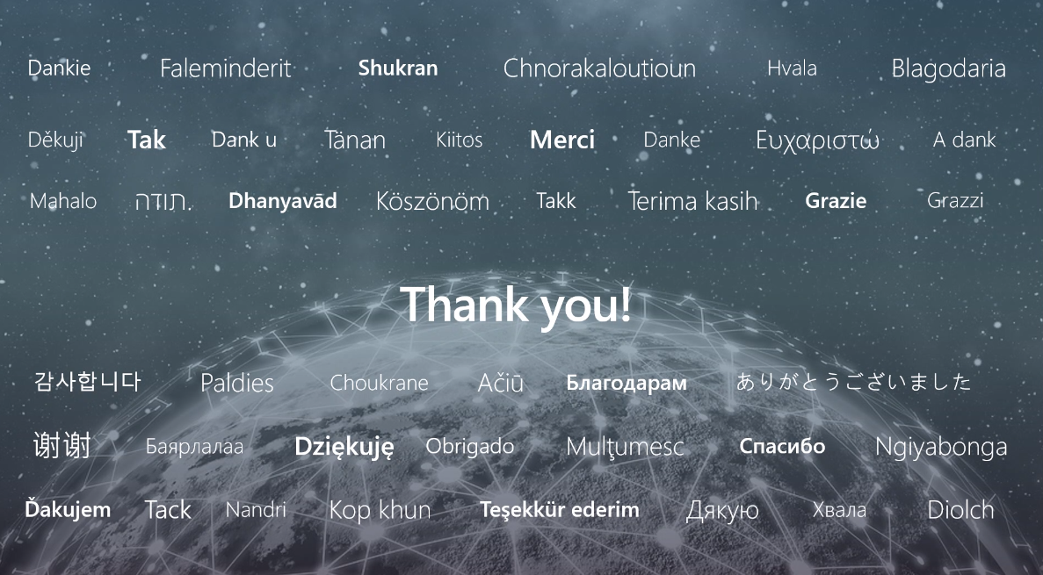

Slide 14
Microsoft

