Slide 1
Introduction to Locking Granularity and Escalation

Slide 2







John Deardurff
Microsoft Customer Engineer (Global Technical Team)
Microsoft Certified Trainer (Regional Lead)
MVP: Data Platform (2016 – 2018)
Email: John.Deardurff@Microsoft.com
Twitter: @SQLMCT
Website: www.SQLMCT.com
GitHub: github.com\SQLMCT

Slide 3
What does this session cover?
Locks, Blocks, and Deadlocks
Locking Escalation
Locking Granularity and Hierarchies

Slide 4
Locks, Blocks, and Deadlocks

Slide 5
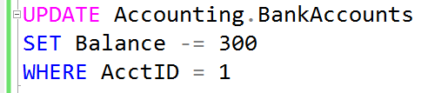


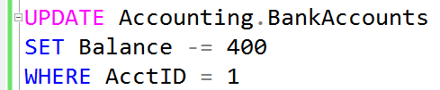
What is a Lock?
Transaction 1
Transaction 2
TSQL2012.mdf

Slide 6
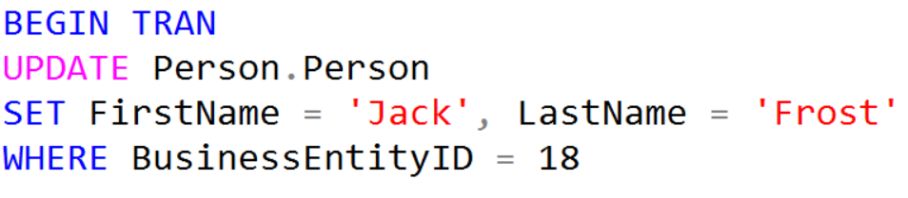


What is Blocking?
Transaction 1
Transaction 2
Blocked

Slide 7
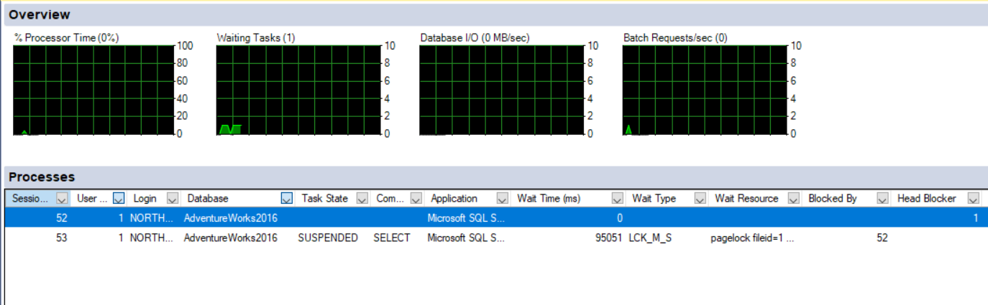
Activity Monitor

Slide 8
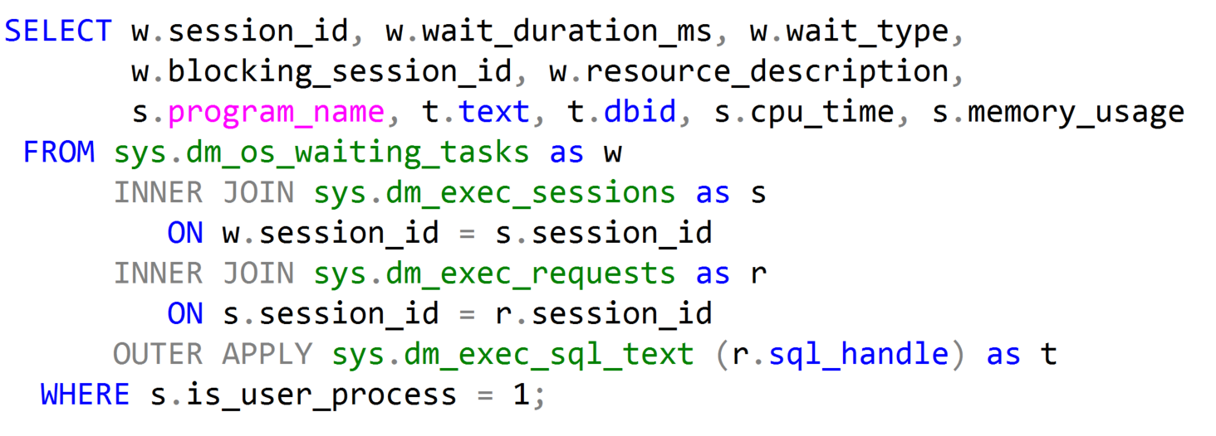
Waiting Tasks DMV
Notes:
Key Points:
Use sys.dm_os_waiting_tasks to show the waiter list at the current moment. sys.dm_exec_requests contains all requests (running, runnable, waiting) that are in-flight, and joining both these DMVs allows us to find what is causing blocking at a given point in time.
Additional Reading:
SQL Swiss Army Knife #11.1 - Locking, blocking and active transactions (http://blogs.msdn.com/b/blogdoezequiel/archive/2012/09/18/sql-swiss-army-knife-11-1-locking-blocking-and-active-transactions.aspx)
Key Points:
The overwhelming majority of scenarios we focus our attention on Resource waits, which may indicate bottlenecks that we have to deal with.
SQL Server bottlenecks may present themselves in different ways:
We might face CPU contention with high CPU consumption and this will have an effect on waits.
Or we might face a situation where available memory is low, also leading to specific wait types.
Disk I/O is also very important, because disk high latencies can slow down any and all operations in SQL Server, and there are specific waits that allow us to scope further actions.
Network I/O should not be overlooked. We might have low bandwidth available, or clients may not be consuming data as fast as SQL Server can provide it – all these have specific cumulative waits in SQL Server.
Then there is transactional locking and blocking, which is paramount for our workload performance, as it represents contention on queries.
The order listed above is not arbitrary. This is the order in which we usually start troubleshooting SQL Server bottlenecks.
Please check if this should be the “waits” list
This sentence reads wrong. Consider changing to “Of all the scenarios that are available, we focus our attention on..”?
Global: Please avoid using first person “we”, “I”, or “our”. Always use “you” or “Microsoft” if that is applicable.

Slide 9
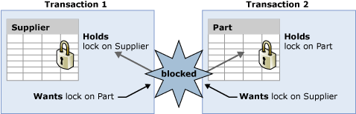
What Is a Deadlock?
A deadlock occurs when two or more tasks permanently block each other by having a lock on a resource that the other tasks are trying to access
Transaction 1 holds a lock on the Supplier table and requires a lock on the Part table. Transaction 2 holds a lock on the Part table and wants a lock on the Supplier table
Both the tasks cannot continue until a resource is available and the resources cannot be released until a task continues, and therefore a deadlock state exists
Notes:
What is a deadlock?
A deadlock exists when the following four conditions exist simultaneously:
No pre-emption
Incremental allocation of resources (Locks are acquired as needed, rather than acquiring them all before beginning the transaction)
Incompatible use of resources (Here, compatibility refers to the one defined in our lock compatibility table)
Cycle When the lock monitor initiates deadlock search for a particular thread, it identifies the resource on which the thread is waiting. The lock monitor then finds the owner(s) for that particular resource and recursively continues the deadlock search for those threads until it finds a cycle. A cycle identified in this manner forms a deadlock.
Deadlocking is not specific to SQL Server or even to relational databases. Any system that must manage shared resources among multiple users, threads, or processes may be susceptible to deadlocks.
Each user session might have one or more tasks running on its behalf where each task might acquire or wait to acquire a variety of resources. The following types of resources can cause blocking that could result in a deadlock:
Locks
Worker threads
Memory
Parallel query execution-related resources
Multiple Active Result Sets (MARS) resources
SQL Server always resolves deadlocking by choosing a victim and therefore, breaking the cycle. Most often, you can address deadlocking by using methods such as a nolock hint to address a deadlocking situation with item 2 in the list above (worker threads), you first need to understand what is being locked and in what order.
© 2016 Microsoft Corporation Microsoft Confidential 9

Slide 10
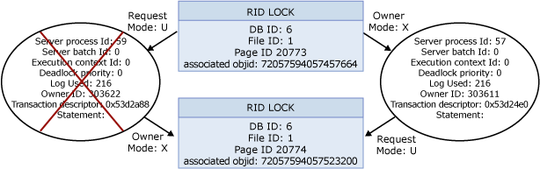
Deadlock Analysis
System Health Session:
xml_deadlock_report
Profiler:
Lock:Deadlock Graph event
Notes:
To view deadlock information, the Database Engine provides monitoring tools in the form of trace flag 1222 and the xml_deadlock_report event in the system_health xevent session or Deadlock Graph event in a Profiler trace.
Starting in Microsoft SQL Server 2008, the deadlock graph can be extracted from the system_health extended event session using the following query:
SELECT XEventData.XEvent.value('(data/value)[1]', 'varchar(max)') as DeadlockGraph
FROM
(SELECT CAST(target_data as xml) as TargetData
FROM sys.dm_xe_session_targets st
JOIN sys.dm_xe_sessions s on s.address = st.event_session_address
WHERE name = 'system_health') AS Data
CROSS APPLY TargetData.nodes ('//RingBufferTarget/event') AS XEventData
(XEvent)
WHERE XEventData.XEvent.value('@name', 'varchar(4000)') = 'xml_deadlock_report'
You can extract this data and save it as an .xdl file which can be viewed graphically in Microsoft SQL Server 2014 Management Studio. On a SQL Server 2014 instance, you can view the deadlock graph directly from SQL Server Management Studio without having to run the above query:
In the Object Explorer, go to Management > Extended Events > system_health.
Right-click package0.event_file and choose View Target Data. Scroll through the events until you find an xml_deadlock_report event.
Highlight the event and click the Deadlock tab to view the graph.
Profiler deadlock graph event
This is an event in SQL Server Profiler that presents a graphical depiction of the tasks and resources involved in a deadlock.
References:
For more information, see: Detecting and Ending Deadlocks - http://msdn.microsoft.com/en-us/library/ms178104.aspx
For more information, see: An XEvent a Day (13 of 31) – The system_health Session - http://www.sqlskills.com/blogs/jonathan/post/An-XEvent-a-Day-(13-of-31)-The-system_health-Session.aspx
© 2016 Microsoft Corporation Microsoft Confidential 10

Slide 11
Resolution and Avoidance
SQL Server automatically selects the transaction that is the cheapest to roll back
Use SET DEADLOCK_PRIORITY to change the likelihood of a batch being chosen as a victim
Access the resources in the same order
Make the transactions simple and shorten the length of the transactions
Use error handlers to capture deadlocks
Notes:
Although deadlocks cannot be completely avoided, following certain coding conventions can minimize the chance of generating a deadlock. Minimizing deadlocks can increase transaction throughput and reduce system overhead because fewer transactions are:
Rolled back, undoing all the work performed by the transaction.
Resubmitted by applications because they were rolled back when deadlocked.
To help minimize deadlocks:
Access objects in the same order.
Avoid user interaction in transactions.
Keep transactions short and in one batch.
Use a lower isolation level.
Use a row versioning-based isolation level.
Set READ_COMMITTED_SNAPSHOT database option ON to enable read-committed transactions to use row versioning.
Use snapshot isolation.
Use bound connections.
Access Objects in the Same Order
If all concurrent transactions access objects in the same order, deadlocks are less likely to occur. For example, if two concurrent transactions obtain a lock on the Supplier table and then on the Part table, one transaction is blocked on the Supplier table until the other transaction is completed. After the first transaction commits or rolls back, the second continues, and a deadlock does not occur. Using stored procedures for all data modifications can standardize the order of accessing objects.
Avoid User Interaction in Transactions
Avoid writing transactions that include user interaction, because the speed of batches running without user intervention is much faster than the speed at which a user must manually respond to queries, such as replying to a prompt for a parameter requested by an application. For example, if a transaction is waiting for user input and the user goes to lunch or even home for the weekend, the user delays the transaction from completing. This degrades system throughput because any locks held by the transaction are released only when the transaction is committed or rolled back. Even if a deadlock situation does not arise, other transactions accessing the same resources are blocked while waiting for the transaction to complete.
© 2016 Microsoft Corporation Microsoft Confidential 11

Slide 12
Locking Granularity and Hierarchies

Slide 13
Locking Granularity
Many items can be locked in SQL Server
Databases
Schema
Objects
Some objects can be locked at different levels of granularity
SQL Server will automatically choose the granularity of the lock based on the estimated cost
Concurrency Cost
Locking Cost
Cost
Row
Page
Table
Notes:
SQL Server locks resources in order to help protect them from concurrent users. Locks can be acquired on many different resources such as:
A database
A database file
An entire table, including all data and indexes
An 8 kilobyte (KB) data page or index page
A row within an index
Metadata information
Internal storage structures, such as heap or B-tree (HoBT) structures
Allocation units
A lock resource defined by an application
Multi-granular locking
To minimize the cost of locking, SQL Server locks resources automatically at a level appropriate to the task. SQL Server has multi-granular locking that allows different types of resources to be locked by a transaction
Locking at a larger granularity, such as tables is expensive in terms of concurrency because locking an entire table restricts access to any part of the table by other transactions but has a lower overhead because fewer locks are being maintained.
Locking at a smaller granularity, such as rows, increases concurrency, but has a higher overhead because more locks must be held if many rows are locked
The Database Engine often needs to acquire locks at multiple levels of granularity to fully help protect a resource. This group of locks at multiple levels of granularity is called a lock hierarchy

Slide 14
Lock Granularity and Hierarchies
Resource | Description
RID | A row identifier used to lock a single row within a heap.
KEY | A row lock within an index used to protect key ranges.
PAGE | An 8kb page in a database, such as data or index pages.
EXTENT | A contiguous group of eight pages, such as data or index pages.
HoBT | A heap or B-tree. A lock protecting heap data pages in a table that does not have a clustered index or the pages of a B-tree index.
TABLE | The entire table, including all data and indexes.
FILE | A database file.
ALLOCATION_UNIT | An allocation unit.
DATABASE | The entire database.

Slide 15
Lock Hierarchy with Intent locks
SQL Server uses intent locks to protect parent-level object in the hierarchy by placing an intent shared (IS) or Intent exclusive (IX) lock.
Intent locks are acquired before a lock placed at the lower level.
Intent locks serve two purposes:
Prevent other transactions from modifying parent-level object
Improve the efficiency of the SQL Server Database Engine
Notes:
The example provided in the slide shows, if one transaction (T1) holds an exclusive lock at the table level, and another transaction (T2) holds an exclusive lock at the row level, each of the transactions believe that they have exclusive access to the resource. In this scenario, because T1 believes that it locks the entire table, it might inadvertently make changes to the same row that T2 thought it has locked exclusively.
In a multi-granular locking environment, there must be a way to effectively overcome this problem. The solution is intent lock.
Intent Locks
The SQL Server Database Engine uses intent locks to protect placing a shared (S) lock or exclusive (X) lock on a resource lower in the lock hierarchy. Intent locks are named intent locks because they are acquired before a lock at the lower level, and therefore signal intent to place locks at a lower level.
Intent locks serve two purposes:
To prevent other transactions from modifying the higher-level resource in a way that would invalidate the lock at the lower level.
To improve the efficiency of the SQL Server Database Engine in detecting lock conflicts at the higher level of granularity.
For example, a shared intent lock placed at the table level means that a transaction intends on placing shared (S) locks on pages or rows within that table. Setting an intent lock at the table level prevents another transaction from subsequently acquiring an exclusive (X) lock on the table containing that page.
Intent locks improve performance because SQL Server examines intent locks only at the table level to determine whether a transaction can safely acquire a lock on that table. This removes the requirement to examine every row or page lock on the table to determine whether a transaction can lock the entire table.
References https://docs.microsoft.com/en-us/sql/relational-databases/sql-server-transaction-locking-and-row-versioning-guide?view=sql-server-ver15

Slide 16
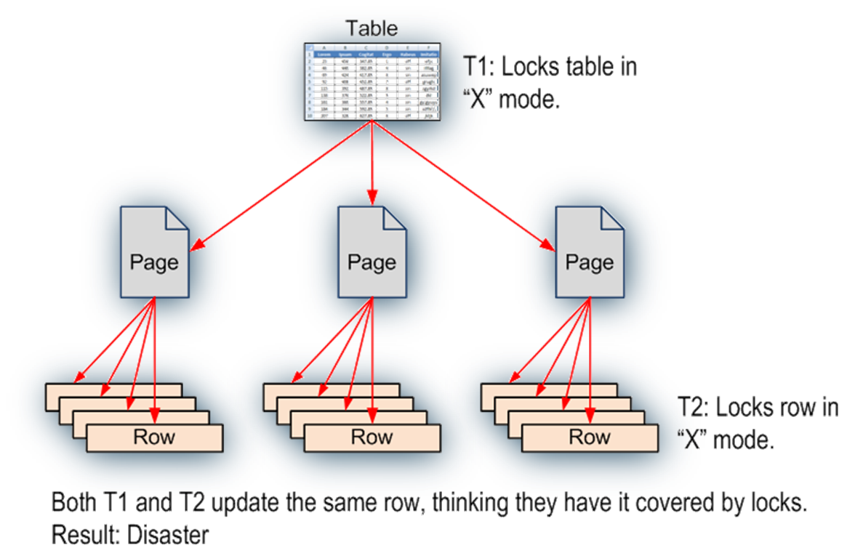
Establish Lock Hierarchy with Intent Locks
To acquire a fine granular lock, you must acquire intent locks on all the higher levels in the hierarchy
Notes:
The example provided in the slide shows, if one transaction (T1) holds an exclusive lock at the table level, and another transaction (T2) holds an exclusive lock at the row level, each of the transactions believe that they have exclusive access to the resource. In this scenario, because T1 believes that it locks the entire table, it might inadvertently make changes to the same row that T2 thought it has locked exclusively. In a multi-granular locking environment, there must be a way to effectively overcome this problem. The solution is intent lock.
An Intent lock is used to establish a lock hierarchy. SQL Server Database Engine acquires low-level locks and also places intent locks on the objects that contain the lower-level objects as follows:
When locking rows or index key ranges, intent lock is acquired on the pages that contain the rows or keys
When locking pages, intent lock is acquired on the higher-level objects that contain the pages. In addition to the intent lock on the object, intent page locks are requested on the following objects:
Leaf-level pages of non-clustered indexes
Data pages of clustered indexes
Heap data pages
An intent lock indicates that SQL Server wants to acquire a shared (S) lock or an exclusive (X) lock on some of the resources lower down in the hierarchy. For example, a shared intent lock placed at the table level means that a transaction intends on placing shared (S) locks on pages or rows within that table. Setting an intent lock at the table level prevents another transaction from subsequently acquiring an exclusive (X) lock on the table containing that page. Intent locks improve performance because SQL Server examines intent locks only at the table level to determine whether a transaction can safely acquire a lock on that table. This removes the requirement to examine every row or page lock on the table to determine whether a transaction can lock the entire table

Slide 17
Lock Mode - Standard
Lock Mode | Description
Schema-Stability (Sch-S) | Used when compiling queries
Schema Modification (Sch-M) | Used when a table data definition language operation (for example, dropping a table) is being performed
Shared (S) | Used for read operations that do not change or update data, such as a SELECT statement
Update (U) | Used on resources that can be updated. Prevents a common form of deadlock that occurs when multiple sessions are reading, locking, and potentially updating resources later
Exclusive (X) | Used for data-modification operations, such as INSERT, UPDATE, or DELETE. Ensures that multiple updates cannot be made to the same resource at the same time
Notes:
The SQL Server Database Engine locks resources by using different lock modes that determine how the resources can be accessed by concurrent transactions. Some locks allow concurrent access to the resource, while others do not. For example, a Shared lock is used to help protect a resource that is being used for read-only access. Since the resource is only going to be read, several concurrent users can have Shared locks on the same resource. If a transaction wants to modify the data, it must first acquire an Exclusive lock. This prevents anyone from reading or writing to the resource, while the transaction is in progress. When an Exclusive lock is in place, no other locks can be granted on the resource.
Lock modes :
Schema modification (Sch-M) locks are taken during a table data definition language (DDL) operation. A Sch-M lock prevents concurrent access to the table. This lock blocks all outside operations until the lock is released. You must use Sch- M locks to prevent access to affected tables by concurrent operations
Schema stability (Sch-S) locks are taken when compiling and running queries. Sch-S locks do not block any transactional locks, including exclusive (X) locks. Transactions continue to run while a query is being compiled
Shared (S) locks allow concurrent transactions to read (SELECT) a resource under pessimistic concurrency control. However, no other transactions can modify the data while shared (S) locks exist on the resource
Update (U) locks prevent a common form of deadlock. Only one transaction can obtain an update (U) lock to a resource at a time. If a transaction modifies a resource, the update (U) lock is converted to an exclusive (X) lock
Exclusive (X) locks prevent access to a resource by concurrent transactions. With an exclusive (X) lock, by default, no other transactions can modify data
Intent shared (IS) lock helps protect requested or acquired shared locks on some resources lower in the hierarchy
Intent exclusive (IX) lock helps protect requested or acquired exclusive locks on some resources lower in the hierarchy. IX is a superset of IS, and it also helps protect requesting shared locks on lower-level resources

Slide 18
Lock Mode - Special
Lock Mode | Description
Intent Shared (IS) | Have or will request shared lock(s) at a finer level
Intent Update (IU) | Have or will request update lock(s) at a finer level
Intent Exclusive (IX) | Have or will request exclusive lock(s) at a finer level
Shared Intent Update (SIU) | Have shared lock with intention to acquire update lock at a finer level
Shared Intent Exclusive (SIX) | Have shared lock with intention to acquire exclusive lock at a finer level
Update Intent Exclusive (UIX) | Have update lock with intention to acquire exclusive lock at a finer level
Bulk Update (BU) | Used when bulk copying data into a table and either TABLOCK hint is specified or the table lock on bulk load table option is set
Notes:
The SQL Server Database Engine locks resources by using different lock modes that determine how the resources can be accessed by concurrent transactions. Some locks allow concurrent access to the resource, while others do not. For example, a Shared lock is used to help protect a resource that is being used for read-only access. Since the resource is only going to be read, several concurrent users can have Shared locks on the same resource. If a transaction wants to modify the data, it must first acquire an Exclusive lock. This prevents anyone from reading or writing to the resource, while the transaction is in progress. When an Exclusive lock is in place, no other locks can be granted on the resource.
Lock modes :
Schema modification (Sch-M) locks are taken during a table data definition language (DDL) operation. A Sch-M lock prevents concurrent access to the table. This lock blocks all outside operations until the lock is released. You must use Sch- M locks to prevent access to affected tables by concurrent operations
Schema stability (Sch-S) locks are taken when compiling and running queries. Sch-S locks do not block any transactional locks, including exclusive (X) locks. Transactions continue to run while a query is being compiled
Shared (S) locks allow concurrent transactions to read (SELECT) a resource under pessimistic concurrency control. However, no other transactions can modify the data while shared (S) locks exist on the resource
Update (U) locks prevent a common form of deadlock. Only one transaction can obtain an update (U) lock to a resource at a time. If a transaction modifies a resource, the update (U) lock is converted to an exclusive (X) lock
Exclusive (X) locks prevent access to a resource by concurrent transactions. With an exclusive (X) lock, by default, no other transactions can modify data
Intent shared (IS) lock helps protect requested or acquired shared locks on some resources lower in the hierarchy
Intent exclusive (IX) lock helps protect requested or acquired exclusive locks on some resources lower in the hierarchy. IX is a superset of IS, and it also helps protect requesting shared locks on lower-level resources

Slide 19
Lock Compatibility
 | Existing Granted Mode
Requested Mode | IS | S | U | IX | SIX | X
Intent shared (IS) | Yes | Yes | Yes | Yes | Yes | No
Shared (S) | Yes | Yes | Yes | No | No | No
Update (U) | Yes | Yes | No | No | No | No
Intent exclusive (IX) | Yes | No | No | Yes | No | No
Shared with intent exclusive (SIX) | Yes | No | No | No | No | No
Exclusive (X) | No | No | No | No | No | No
Notes:
Lock Compatibility determines whether multiple lock requests for the same resource can be granted concurrently. If a transaction requests a lock on a resource that has locks in place and are compatible with the requested lock, the lock will be granted. If the locks already in place are not compatible with the requested lock, the request will not be granted and the transaction will be blocked until the lock becomes available or the transaction times out while waiting.
An intent exclusive (IX) lock is compatible with an IX lock mode because IX means that the intention is to update only some of the rows, rather than all of them. Other transactions that attempt to read or update some of the rows are also permitted as long as they are not the same rows being updated by other transactions.
IX locks can be applied at any level of granularity above the leaf level. If a row is locked, SQL Server will apply intent locks at both the page and the table level. If a page is locked, SQL Server will apply an intent lock at the table level.
SIX locks imply that there is a shared access to a resource and that there are X locks placed at a lower level in the hierarchy. SQL Server never asks for SIX locks directly; they are always the result of a conversion. For example, suppose a transaction scanned a page by using an S lock and then subsequently decided to perform a row-level update. The row would obtain an X lock but now the page would require an IX lock. The resultant mode on the page would be SIX.
For more information on Lock Compatibility, refer: http://msdn.microsoft.com/en-us/library/ms186396.aspx

Slide 20
Dynamic locking
Row locking is not always the right choice
Scanning 100 million rows means 100 million calls to the lock manager
Page, Partition or Table locking can be more efficient
SQL Server chooses lock granularity (Row, Page, Table) at run time based on input from the Query Optimizer
Least-expensive method is chosen
Available resources at the time of execution may have an impact
Incorrect estimates could lead to making the wrong choice
One Table lock is cheaper and easier to manage than thousands of Row locks
Notes:
Key Points
Dynamic locking has the following advantages:
Simplified database administration. Database administrators do not have to adjust lock escalation thresholds.
Increased performance. The SQL Server Database Engine minimizes system overhead by using locks appropriate to the task.
Application developers can concentrate on development. The SQL Server Database Engine adjusts locking automatically.
===============
More Information
===============
When modifying individual rows, SQL Server typically takes row locks to maximize concurrency (for example, OLTP and order-entry applications).
When scanning larger volumes of data, it would be more appropriate to take page or table locks to minimize the cost of acquiring locks (for example, Decision Support System (DSS), data warehouse, and reporting).
Allowing SQL Server to use locks dynamically is the recommended configuration.
However, you can set locks and override the ability of SQL Server to allocate lock resources dynamically.
When the server is started with locks set to 0, the lock manager acquires sufficient memory from the Database Engine for an initial pool of 2,500 lock structures. As the lock pool is exhausted, additional memory is acquired for the pool.
Generally, if more memory is required for the lock pool than is available in the Database Engine memory pool, and more computer memory is available (the max server memory threshold has not been reached), the Database Engine allocates memory dynamically to satisfy the request for locks.
However, if allocating that memory would cause paging at the operating system level (for example, if another application is running on the same computer as an instance of SQL Server and using that memory), more lock space is not allocated.
The dynamic lock pool does not acquire more than 60% of the memory allocated to the Database Engine. After the lock pool has reached 60% of the memory acquired by an instance of the Database Engine, or no more memory is available on the computer, further requests for locks generates an error.
The locks option also affects when lock escalation occurs. When locks are set to 0, lock escalation occurs when the memory used by the current lock structures reaches 40% of the Database Engine memory pool. When locks are not set to 0, lock escalation occurs when the number of locks reaches 40% of the value specified for locks.
For more information on Configure the locks Server Configuration Option, refer: https://docs.microsoft.com/en-us/sql/database-engine/configure-windows/configure-the-locks-server-configuration-option?redirectedfrom=MSDN&view=sql-server-ver15

Slide 21
Lock escalation
Lock manager attempts to replace many row or page locks with a single table-level lock.
One Table lock is faster and easier to manage than thousands of Row locks.
One Table lock requires less memory than many Row Locks. (96 bytes per lock)
It never converts row locks to page locks.
Lock de-escalation never occurs.
Lock Escalation behavior can be controlled.
ALTER TABLE Table_name SET ( LOCK_ESCALATION = { AUTO | TABLE | DISABLE } )
Notes:
Key Points:
To prevent a situation where locking is using too many resources, SQL Server has introduced the lock escalation feature.
Escalation Always Happen from Row->Table or Page -> Table
When a single Transact-SQL (T-SQL) statement requires 5,000 row locks then it convert it to a single table or index Lock
In SQL Server 2019 (15.x), the LOCK_ESCALATION option of ALTER TABLE can disfavor table locks, and enable HoBT locks on partitioned tables. This option is not a locking hint but can be used to reduce lock escalation.
===============
More Information
===============
When the lock count for a transaction is a multiple of the escalation threshold, the lock manager attempts to escalate the locks. The number of locks held may continue to increase after the escalation attempt (for example, because new tables are accessed, or the previous lock escalation attempts failed due to incompatible locks held by another SPID (server process ID)).
The lock manager checks the lock memory that it is using and if it is more than 40% of the allocated buffer pool memory of SQL Server, it tries to find a scan where no escalation has already been performed. The lock manager repeats this search operation until all scans have been escalated or until the memory consumption drops.
Lock escalation thresholds
Lock escalation can be triggered in any of the following situations:
When a single Transact-SQL (T-SQL) statement acquires at least 5,000 locks on a single table or index
When the number of locks in an instance of the Database Engine exceeds memory or configuration thresholds
If locks cannot be escalated because of lock conflicts, the Database Engine periodically triggers lock escalation at every 1,250 new locks acquired
Lock escalation behavior can be influenced by the trace flag -T1211. This disables the lock escalation for the instance. Enabling -T1211 does not prevent SQL Server from choosing page or table lock rather than row lock.
Disables lock escalation based on memory pressure, or based on number of locks. The SQL Server Database Engine will not escalate row or page locks to table locks.
Starting with SQL Server 2008, lock escalation can also be controlled using ALTER TABLE (T-SQL Syntax).
In the ALTER TABLE (T-SQL Syntax), lock escalation can be set to specify the allowed methods of lock escalation for a table as follows:
ALTER TABLE Table_name SET ( LOCK_ESCALATION = { AUTO | TABLE | DISABLE } )
AUTO: This option enables SQL Server Database Engine to select the lock escalation granularity that is appropriate for the table schema.
If the table is partitioned, lock escalation will be at the Partition level.
If the table is not partitioned, lock escalation will be at the Table level.
TABLE: Lock escalation will be done at table-level granularity regardless whether the table is partitioned or not partitioned. This behavior is the same as in SQL Server 2005. TABLE is the default value.
DISABLE: Prevents lock escalation in most cases. Table-level locks are not completely disallowed. For example, when you are scanning a table that has no clustered index under the serializable isolation level, Database Engine must take a table lock to help protect data integrity.
Lock:Escalation Profiler event class
Starting in SQL Server 2008, the Lock:Escalation event class was enhanced to provide additional diagnostic information. The EventSubClass column provides the reason for the lock escalation and the Type column provides the granularity details.
References:
For more information on Lock Escalation, refer:
https://docs.microsoft.com/en-us/previous-versions/sql/sql-server-2008-r2/ms184286(v=sql.105)?redirectedfrom=MSDN
For more information on Lock:Escalation Event Class, refer: https://docs.microsoft.com/en-us/sql/relational-databases/event-classes/lock-escalation-event-class?redirectedfrom=MSDN&view=sql-server-ver15

Slide 22
Locking Hints
Override the default behavior of the query optimizer
Table hints are specified in the FROM clause of the DML statement
Affect only the table or view referenced in that clause
Locking method can be used at various levels as shown below
Granularity Level hints | ROWLOCK, PAGLOCK and TABLOCK
Isolation LEVEL hints | HOLDLOCK/SERIALIZABLE, NOLOCK/ READUNCOMMITTED, READCOMMITTED,REPEATABLEREAD, READCOMMITTED
UPDLOCK | Use update lock rather than shared lock when reading
XLOCK | Use exclusive lock instead
READPAST | Skips currently locked rows
Notes:
Key Points:
Locking hints can be specified for individual table references in the SELECT, INSERT, UPDATE, and DELETE statements.
The hints specify the type of locking or row versioning the instance of the SQL Server Database Engine uses for the table data.
Table-level locking hints can be used when a finer control of the types of locks acquired on an object is required. These locking hints override the current transaction isolation level for the session.
Hints take away the ability of SQL Server to adjust its behavior based on changing conditions on the server and thus, must be used sparingly and only when absolutely necessary.
Queries that use hints must be monitored closely and tested periodically to verify that the hint is still required and is behaving as intended.
Syntax : WITH ( <table_hint> [ [, ]...n ] )
Example : SELECT StartDate, ComponentID FROM Production.BillOfMaterials WITH( INDEX (FIBillOfMaterialsWithComponentID) )
Note: The following table hints are allowed with and without the WITH keyword: NOLOCK, READUNCOMMITTED, UPDLOCK, REPEATABLEREAD, SERIALIZABLE, READCOMMITTED, TABLOCK, TABLOCKX, PAGLOCK, ROWLOCK, NOWAIT, READPAST, XLOCK, SNAPSHOT, and NOEXPAND. Omitting the WITH keyword is a deprecated feature.
Example : FROM t (TABLOCK)
===============
More Information
===============
All lock hints are propagated to all the tables and views that are accessed by the query plan, including tables and views referenced in a view. Also, SQL Server performs the corresponding lock consistency checks.
Lock hints like ROWLOCK, UPDLOCK, AND XLOCK that acquire row-level locks, might place locks on index keys rather than the actual data rows. For example, if a table has a non-clustered index and a SELECT statement using a lock hint is handled by a covering index, a lock is acquired on the index key in the covering index rather than on the data row in the base table.
If a table contains computed columns that are computed by expressions or functions accessing columns in other tables, the table hints are not used on those tables and are not propagated. For example, a NOLOCK table hint is specified on a table in the query. This table has computed columns that are computed by a combination of expressions and functions that access columns in another table. The tables referenced by the expressions and functions do not use the NOLOCK table hint when accessed.
References : https://docs.microsoft.com/en-us/sql/t-sql/queries/hints-transact-sql-table?view=sql-server-ver15

Slide 23
Demonstration

Slide 24
Questions?

