Slide 1
Transactions and Isolation Levels John Deardurff

Slide 2



Transactions and Isolation Levels
John Deardurff
Website: SQLMCT.com
Twitter: @SQLMCT
Github: github.com/SQLMCT

Slide 3
What does this session cover?
What are Transactions?
How Data is Modified in SQL Server
Auto-Commit vs Explicit Transactions
ACID properties of Transactions
Transaction and Exception Handling
Transaction Isolation Levels

Slide 4
What are Transactions? John Deardurff

Slide 5
What is a Transaction?
A transaction is a series of one or more statements that need to operate as a single logical unit of work.
To qualify as a transaction, the logical unit of work must possess all four of the ACID properties.

Slide 6
Transactions must pass the ACID test
Atomicity – All or Nothing
Consistent – Only valid data
Isolated – No interference
Durable – Data is recoverable

Slide 7


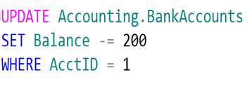
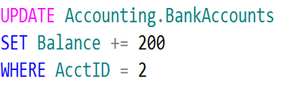
Logical Units of Work – Auto Commit Transactions
$200
John
Jane
Transaction 1
Transaction 2

Slide 8
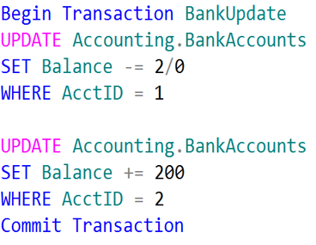
Single Logical Unit of Work – Explicit Transactions
John
Jane
$200

Slide 9
How Data Is Modified in SQL Server
3. Modification is written to transaction log.
3
1. Data modification is sent to buffer cache in memory.
1
4. Checkpoint looks for committed transactions.
4
2. Data pages are located or read into the buffer cache and then modified.
2
Data Page
5. At checkpoint, dirty data pages are written to the database file.
Data Row
Data Row
5
Data Row
Free Space
Notes:
Provide an overview of how the data is stored on SQL Server. Describe each of the three data file types and the basic internal layout of the data files. Stress that the file extension .mdf is not mandatory to use but is highly recommended.
Describe the difference between uniform and mixed extents. Note that continued support for mixed extents adds complexity to the database engine for no real benefit. The size of an extent (64 KB) is so small that the original benefit from the mixed extent design is now irrelevant.
Briefly explain that all transactions are written to the log file using the WAL mechanism to ensure the integrity of the database in case of a failure and to support rollbacks of transactions. Explain that data changes occur in the buffer pool and are not written immediately to the data files.
Avoid discussing filegroups at this point, as they will be covered later.
20462C
3: Working with Databases and Storage

Slide 10
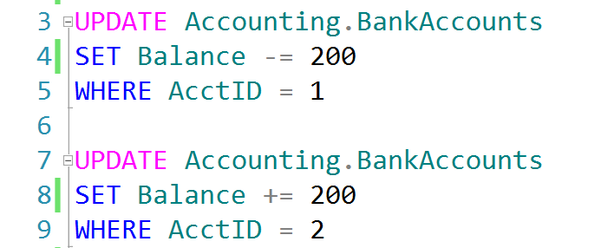
Auto-Commit Transactions without Error Handling
AdventureWorks.ldf
Checkpoint
AdventureWorks.mdf
John, don’t forget to demonstrate
SET XACT_ABORT ON

Slide 11
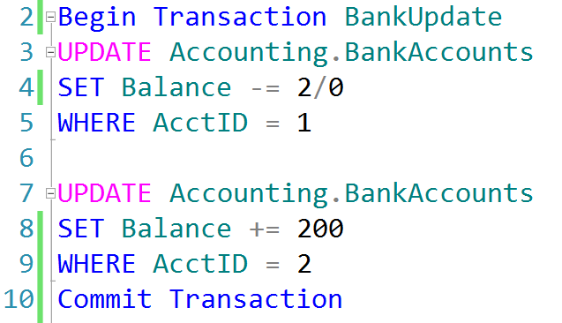
Explicit Transactions without Error Handling
AdventureWorks.ldf
Checkpoint
AdventureWorks.mdf

Slide 12
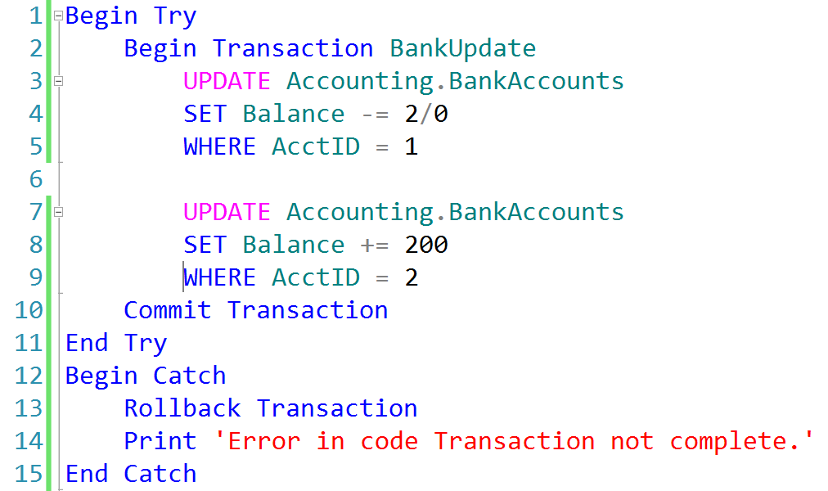
Explicit Transactions with Error Handling
AdventureWorks.ldf
AdventureWorks.mdf
Checkpoint

Slide 13
What is a Transaction?
A transaction is a series of one or more statements that need to operate as a single logical unit of work.
To qualify as a transaction, the logical unit of work must possess all four of the ACID properties.

Slide 14
Transactions and Error Handling John Deardurff

Slide 15
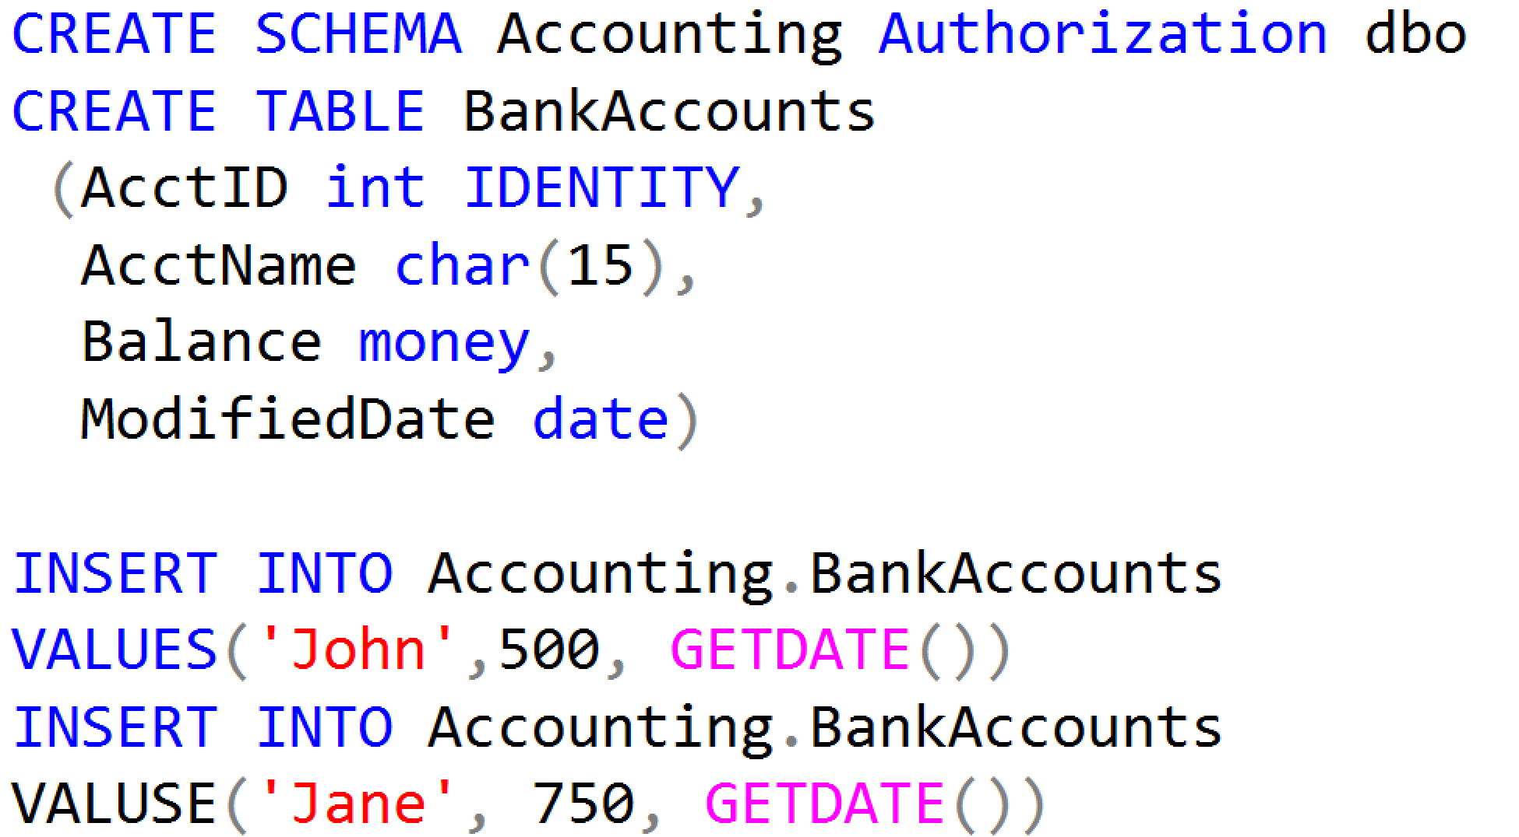
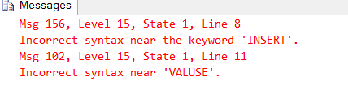
Working with Transactions

Slide 16
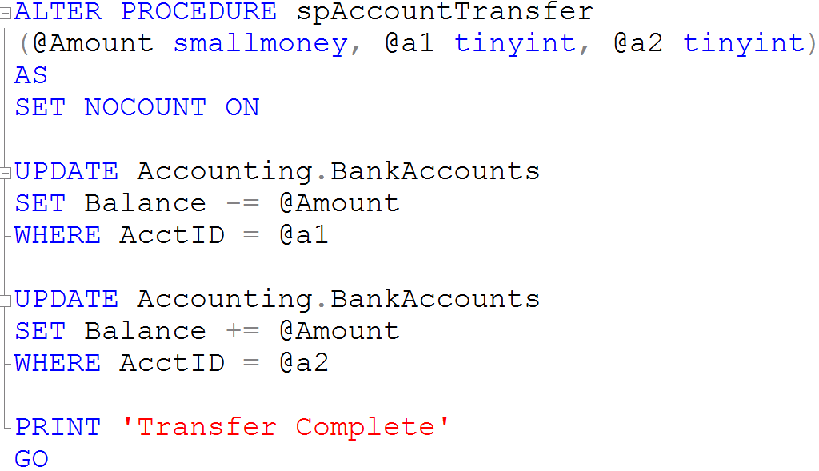
Creating Stored Procedures

Slide 17
Demonstration

Slide 18
Transactions Isolation Levels John Deardurff

Slide 19
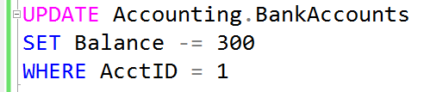


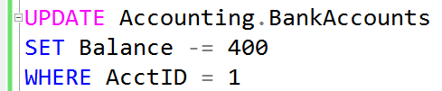
What is a Lock?
Transaction 1
Transaction 2
TSQL2012.mdf

Slide 20
What Problems does Locking Prevent?
Lost Updates
Uncommitted dependency (dirty read)
Inconsistent analysis (non-repeatable reads)
Phantom reads
Notes:
Question: Has your organization experienced concurrency problems with database applications? If so, what behavior did you see?
Answer: Answers will vary.
References:
Concurrency Problems: http://go.microsoft.com/fwlink/?LinkID=233921
Concurrency Effects: http://go.microsoft.com/fwlink/?LinkID=233922
Locking in the Database Engine: http://go.microsoft.com/fwlink/?LinkID=233923

Slide 21
Transaction Isolation Levels
Isolation Levels | Dirty Read | Lost Updates | Nonrepeatable Read | Phantom Reads
Read uncommitted | Yes | Yes | Yes | Yes
Read committed (default) | No | Yes | Yes | Yes
Repeatable read | No | No | No | Yes
Serializable | No | No | No | No
Snapshot | No | No | No | No
Notes:
Discuss the effects that each of the transaction isolation levels has on data access. Be sure that students understand the READ COMMITTED isolation level, and that it is the default transaction isolation level.
References:
SET TRANSACTION ISOLATION LEVEL (Transact-SQL): http://go.microsoft.com/fwlink/?LinkID=233927
Transaction Isolation Levels: http://go.microsoft.com/fwlink/?LinkID=209385

Slide 22
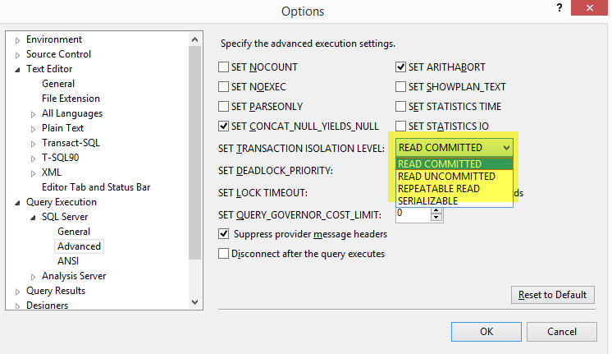
Transaction Isolation Levels
Isolation Levels

Slide 23
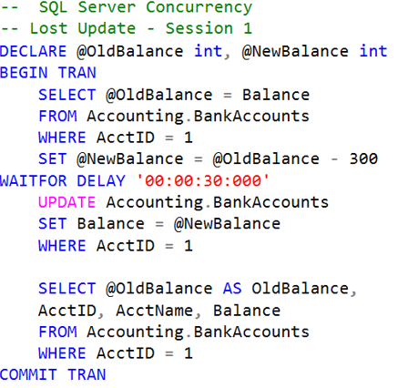
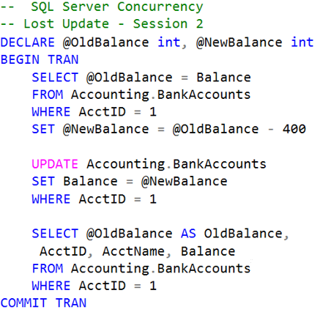


Lost Updates

Slide 24
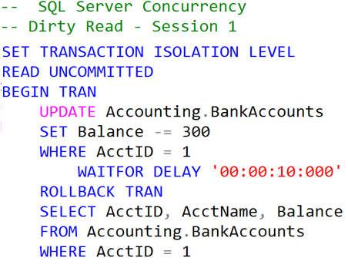

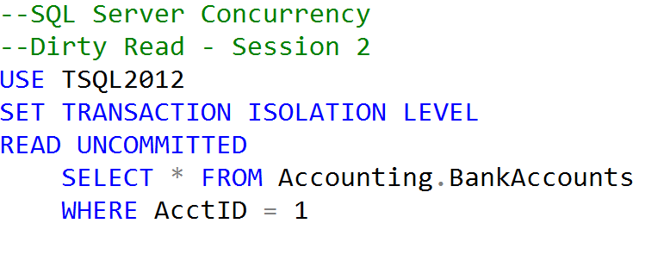

Uncommitted dependency (dirty read)
Clean Read
Dirty Read

Slide 25
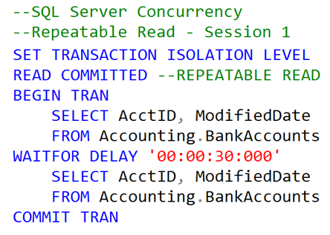
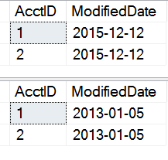
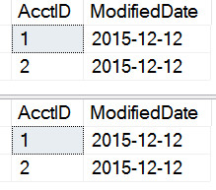
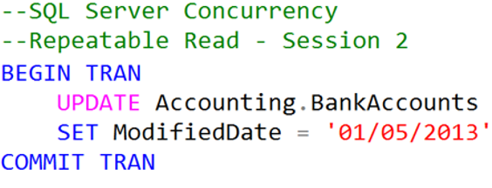
Inconsistent analysis (non-repeatable read)
Dates Change
Dates Remain
READ COMMITTED
REPEATABLE READ

Slide 26
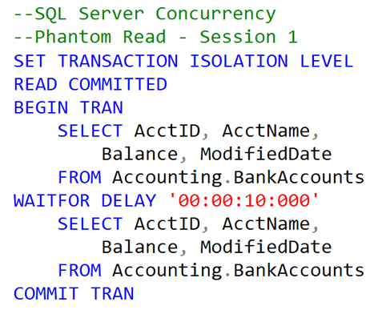
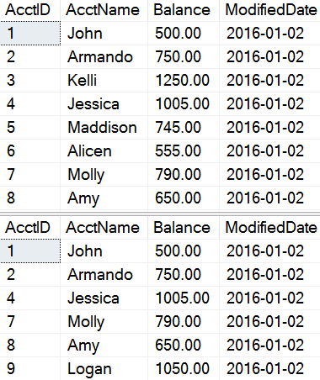
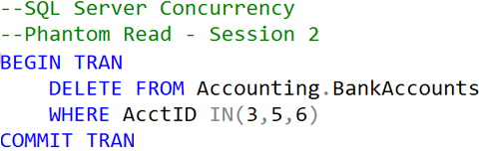
Phantom Reads
Original records
Missing records

Slide 27

QUESTIONS

