Slide 1
TempDB Improvements John Deardurff

Slide 2
What does this session cover?
Optimizing the TempDB Database
TempDB Performance Improvements
What is the TempDB?
Types of TempDB Contention
Notes:
This post will describe how a SQL Server will PROCESS a query. The first time through running an Ad Hoc query or Stored Procedure, SQL Server will go through each of the following steps.
The first step is to Parse the statement into keywords, expressions, and operators. This is where the syntax of your query statement is checked for accuracy. Both the first and second steps are where you will find syntax errors. In most cases, these errors are caused by misspellings or putting commas in the wrong place.
The second step is to Resolve object names (Tables, Views, Columns, etc.) to see if they exist. This step also resolves aliases of columns and tables, as well as, resolves data types and performs implicit data type conversions. This is also where user permissions are checked and if any cached plans exist. As a side note, if you read other blog posts, this step is technically called the Binding phase. I personally call this step the Resolving phase to help spell the word PROCESS as a memorization tool and also to fit the steps on a single slide during presentations.
The third step is to Optimize the query. This is where the query optimizer will find different ways of locating data from your tables based on available indexes and/or statistics. Once it figures a good enough plan to retrieve your result set using the least amount of resources, it will create an Execution Plan. Errors would only occur during this stage if there is a lack of hardware resources. Most compile errors happen at the next step.
The fourth step is to Compile the Execution Plan and store it in the Procedure Cache for future use.
Finally, the Execution Plan is passed to the Storage Engine to Execute the query and hopefully return the desired SQL Sets. This is where Run-Time errors will occur that need to be managed by using Exception Handling. (SQL Sets are normally called recordsets or rowsets, but I’m making a blog post on the PROCESS of queries not the PBOCERS of queries).
Additional submissions of the query from a Stored Procedure, will check the Procedure Cache for existing or similar Execution Plans that could be re-used for the query. If this is the case, the existing Execution Plan will be used to retrieve the SQL Sets using the Execution Context of the Stored Procedure.
It is possible for an Ad Hoc query to also re-use an existing plan from the procedure cache if the only thing that has changed in the query is the parameter value. Example: If a query had been written WHERE ProductID = 732 and was re-written WHERE ProductID = 738 the execution plan could be re-used, but if anything else changed, even by adding a space, the optimizer would compile a new execution plan.
One final thing. You will notice that you can have both an Estimated Execution Plan and an Actual Execution Plan. The difference is the first will show you what the plan would look like before the plan is compiled and the second will additionally add the values of actually running the plan that was placed in the procedure cache and executed.

Slide 3
What is the TempDB database?

Slide 4
What is the TempDB database?
System database
Available to all users with the same structure as user databases.
Operations are minimally logged.
Re-created every time SQL Server is started.
Workload
Used for temporary (non-durable) storage.
Object and data frequently being created and destroyed.
Very high concurrency.
Backup and restore operations are not allowed on TempDB.
Notes:
Operations within TempDB are minimally logged so that transactions can be rolled back. TempDB is re-created every time SQL Server is started so that the system always starts with a clean copy of the database. Temporary tables and stored procedures are dropped automatically on disconnect, and no connections are active when the system is shut down. Therefore, there is never anything in TempDB to be saved from one session of SQL Server to another. Backup and restore operations are not allowed on TempDB.
TempDB Database
From <https://docs.microsoft.com/en-us/sql/relational-databases/databases/tempdb-database?view=sql-server-ver15#memory-optimized-tempdb-metadata>

Slide 5
What is stored in TempDB?
Temporary user objects
Global or local temporary tables and indexes
Temporary stored procedures
Table variables
Tables returned in table-valued functions
Internal objects
Worktables to store intermediate results for spools, cursors, sorts, and temporary LOB storage.
Work files for hash join or hash aggregate operations.
Version stores
Common row version store and online-index-build version store
Version stores can be moved to user databases by enabling Accelerated Database Recovery (ADR) in SQL Server 2019
Notes:
Temporary user objects that are explicitly created, such as:
Global or local temporary tables and indexes
Temporary stored procedures
Table variables
Tables returned in table-valued functions, or cursors
Internal objects that are created by the database engine. These include:
Work tables to store intermediate results for spools, cursors, sorts, and temporary large object (LOB) storage.
Work files for hash join or hash aggregate operations.
Intermediate sort results for operations such as creating or rebuilding indexes (if SORT_IN_TEMPDB is specified), or certain GROUP BY, ORDER BY, or UNION queries.
Version stores, which are a collection of data pages that hold the data rows that are required to support the features that use row versioning. There are two version stores: a common version store and an online-index-build version store. The version stores contain:
Row versions that are generated by data modification transactions in a database that uses read-committed using row versioning isolation or snapshot isolation transactions.
Row versions that are generated by data modification transactions for features, such as: online index operations, Multiple Active Result Sets (MARS), and AFTER triggers.
How (and When) To: Memory Optimized TempDB Metadata
From <https://channel9.msdn.com/Shows/Data-Exposed/How-and-When-To-Memory-Optimized-TempDB-Metadata?term=tempdb&lang-en=true>
It Just Runs Faster: SQL Server 2019 TempDB Improvements
From <https://channel9.msdn.com/Shows/Data-Exposed/It-Just-Runs-Faster-SQL-Server-2019-TempDB-Improvements>

Slide 6
Types of TempDB Database Contention

Slide 7
Types of TempDB Contention
Object allocation contention
Metadata contention
The wait type is PAGELATCH_EX on sysschobjs in TempDB.
These pages might be PFS (2:1:1) or SGAM (2:1:3) pages in TempDB.
The wait type is PAGELATCH_UP on pages in TempDB.
Temp Table Cache Contention
The wait type is CMEMTHREAD or SOS_CACHESTORE spinlock waits.
This could indicate other issues besides TempDB Temp Table caching.
Notes:
* As a general rule:
If the number of logical processors is less than or equal to eight (8), use the same number of data files as logical processors.
If the number of logical processors is greater than eight (8), use eight data files. If contention continues, increase the number of data files by multiples of four (4) up to the number of logical processors until the contention is reduced to acceptable levels.
Alternatively, make changes to the workload or code.
Physical Properties of TempDB in SQL Server
From <https://docs.microsoft.com/en-us/sql/relational-databases/databases/tempdb-database?view=sql-server-ver15#physical-properties-of-tempdb-in-sql-server>

Slide 8
The Roles of Allocation Pages
PFS and IAM pages are used to determine if a new page or extent is needed
GAM and SGAM pages are used to allocate extents
Notes:
Temporary user objects that are explicitly created, such as:
Global or local temporary tables and indexes
Temporary stored procedures
Table variables
Tables returned in table-valued functions, or cursors
Internal objects that are created by the database engine. These include:
Work tables to store intermediate results for spools, cursors, sorts, and temporary large object (LOB) storage.
Work files for hash join or hash aggregate operations.
Intermediate sort results for operations such as creating or rebuilding indexes (if SORT_IN_TEMPDB is specified), or certain GROUP BY, ORDER BY, or UNION queries.
Version stores, which are a collection of data pages that hold the data rows that are required to support the features that use row versioning. There are two version stores: a common version store and an online-index-build version store. The version stores contain:
Row versions that are generated by data modification transactions in a database that uses read-committed using row versioning isolation or snapshot isolation transactions.
Row versions that are generated by data modification transactions for features, such as: online index operations, Multiple Active Result Sets (MARS), and AFTER triggers.
How (and When) To: Memory Optimized TempDB Metadata
From <https://channel9.msdn.com/Shows/Data-Exposed/How-and-When-To-Memory-Optimized-TempDB-Metadata?term=tempdb&lang-en=true>
It Just Runs Faster: SQL Server 2019 TempDB Improvements
From <https://channel9.msdn.com/Shows/Data-Exposed/It-Just-Runs-Faster-SQL-Server-2019-TempDB-Improvements>

Slide 9
Database Page Layout
TempDB.mdf
0 | Header
1 | PFS
2 | GAM
3 | SGAM
… | IAM/Data /Index
8088 | PFS
… | IAM/Data /Index
511232 | GAM
511233 | SGAM
Address is DBID:FileID:Page#
2:1:1
Page Free Space
Tracks next
8,087 Pages
Notes:
SQL Server databases have at least one data file called the Primary data file, which will typically have a .mdf extension. They can also have secondary data files with .ndf extensions. This is the default naming convention, but any file extensions the user specifies will be accepted.
When a database has multiple files, the files are numbered from 1 to n, n being the total number of files. Each file consists of a collection of pages numbered from 0 to n-1, n being the number of pages in the file (total number of pages will depend on the size of the file).
The special Object Allocation pages mentioned on the previous slide will always appear in the same location in each data file contained in a database. A PFS page is the first page after the file header page in a data file and is marked as page 1. Following the PFS page is a GAM, marked as page 2, followed by an SGAM, marked as page 3. After the first PFS, there will be a new PFS page after every 8,087 pages. There is a new GAM for each 63,904 extents after the first GAM on page 2, and a new SGAM each 63,904 extents after the first SGAM on page 3.
The SQL Server engine addresses each of these pages using a combination of database id, file id, and page number. For example, the SGAM page in the first data file of a user database with a database id of 5 will be notated as 5:1:3. This becomes important when troubleshooting any type of page-related wait as the wait resource will be listed using this notation.
Additional Reading:
Database Files and Filegroups
From <https://docs.microsoft.com/en-us/sql/relational-databases/databases/database-files-and-filegroups?view=sql-server-ver15>

Slide 10
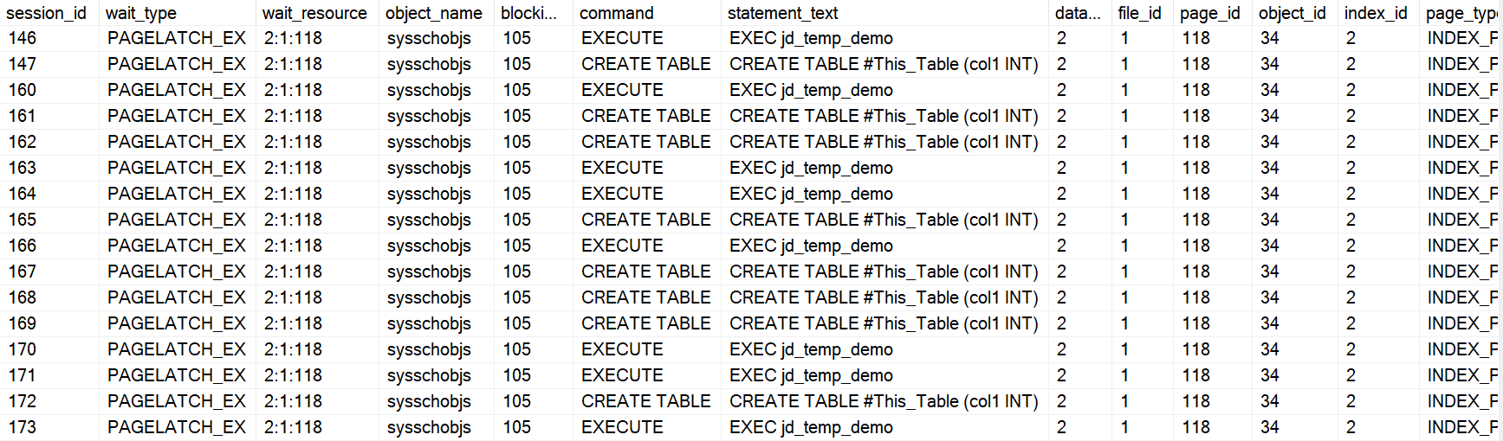
Metadata Contention
The wait type is PAGELATCH_EX on sysschobjs in TempDB..
Notes:
* As a general rule:
If the number of logical processors is less than or equal to eight (8), use the same number of data files as logical processors.
If the number of logical processors is greater than eight (8), use eight data files. If contention continues, increase the number of data files by multiples of four (4) up to the number of logical processors until the contention is reduced to acceptable levels.
Alternatively, make changes to the workload or code.
Physical Properties of TempDB in SQL Server
From <https://docs.microsoft.com/en-us/sql/relational-databases/databases/tempdb-database?view=sql-server-ver15#physical-properties-of-tempdb-in-sql-server>

Slide 11
Optimizing the TempDB Database

Slide 12
TempDB File Placement
File | Logical name | Physical name | Initial size | File growth
Primary data | tempdev | tempdb.mdf | 8 MB | Autogrow by 64 MB until the disk is full
Secondary data files* | temp# | tempdb_mssql_#.ndf | 8 MB | Autogrow by 64 MB until the disk is full
Log | templog | templog.ldf | 8 MB | Autogrow by 64 megabytes to a maximum of 2 terabytes
If the number of logical processors is less than or equal to eight (8), use the same number of data files as logical processors.
If the number of logical processors is greater than eight (8), use eight data files.
Alternatively, make changes to the workload or code.
If contention continues, increase the number of data files by multiples of four (4) up to the number of logical processors
Notes:
* As a general rule:
If the number of logical processors is less than or equal to eight (8), use the same number of data files as logical processors.
If the number of logical processors is greater than eight (8), use eight data files. If contention continues, increase the number of data files by multiples of four (4) up to the number of logical processors until the contention is reduced to acceptable levels.
Alternatively, make changes to the workload or code.
Physical Properties of TempDB in SQL Server
From <https://docs.microsoft.com/en-us/sql/relational-databases/databases/tempdb-database?view=sql-server-ver15#physical-properties-of-tempdb-in-sql-server>

Slide 13
Optimizing TempDB performance
Consider instant file initialization
Pre-allocate space for all TempDB files
Divide TempDB into multiple data files of equal size
Put the TempDB database on a fast I/O subsystem
Use disk striping if there are many directly attached disks.
Put the TempDB database on separate disks from user databases
Notes:
If possible, use database instant file initialization to improve the performance of data file grow operations.
Preallocate space for all TempDB files by setting the file size to a value large enough to accommodate the typical workload in the environment.
The TempDB database should be set to autogrow, but this should be used to increase disk space for unplanned exceptions.
Data files should be of equal size within each filegroup, as SQL Server uses a proportional-fill algorithm that favors allocations in files with more free space.
Dividing TempDB into multiple data files of equal size provides a high degree of parallel efficiency in operations that use TempDB.
Put the TempDB database on a fast I/O subsystem. Use disk striping if there are many directly attached disks. Individual or groups of TempDB data files do not necessarily need to be on different disks or spindles unless you are also encountering I/O bottlenecks.
Put the TempDB database on disks that differ from those that are used by user databases.
Performance improvements in TempDB for SQL Server
From <https://docs.microsoft.com/en-us/sql/relational-databases/databases/tempdb-database?view=sql-server-ver15#performance-improvements-in-tempdb-for-sql-server>

Slide 14
TempDB Database Performance Improvements

Slide 15
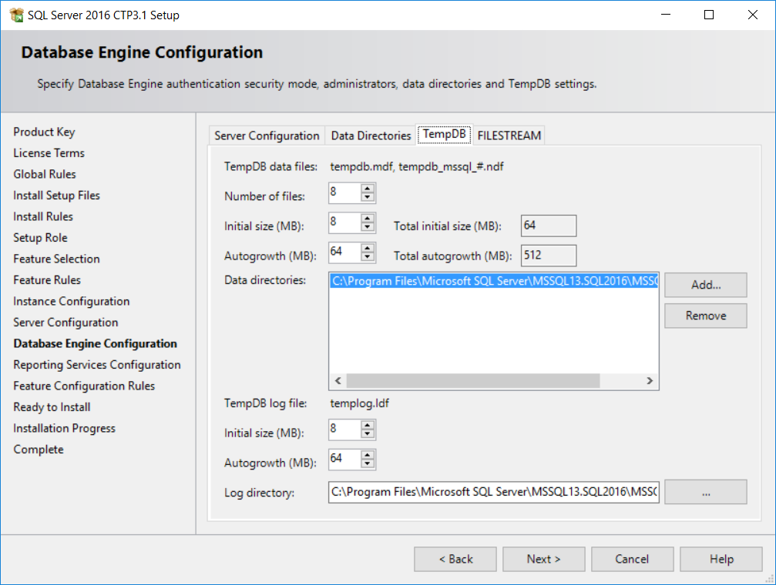
Performance improvements in TempDB (2016)
Setup adds multiple TempDB data files during instance installation.
By default, setup adds as many TempDB data files as the logical processor count or eight, whichever is lower.
Notes:
SQL 2016 - It Just Runs Faster: Automatic TEMPDB Configuration
From <https://docs.microsoft.com/en-us/archive/blogs/bobsql/sql-2016-it-just-runs-faster-automatic-tempdb-configuration>

Slide 16
Performance improvements in TempDB (2016)
Trace Flags behavior enabled by default for TempDB
Temporary tables and table variables are cached.
Improved allocation page latching.
Logging overhead for TempDB is reduced.
1117 (Grow all files in a filegroup evenly)
1118 (Avoid mixed extents and only use full extents)
PAGELATCH_SH on metadata allocation instead of PAGELATCH_EX
Notes:
Temporary tables and table variables are cached. Caching allows operations that drop and create the temporary objects to execute very quickly and reduces page allocation contention.
Allocation page latching protocol is improved to reduce the number of UP (update) latches that are used.
Logging overhead for TempDB is reduced to reduce disk I/O bandwidth consumption on the TempDB log file.
Setup adds multiple TempDB data files during a new instance installation. This task can be accomplished with the new UI input control on the Database Engine Configuration section and a command-line parameter /SQLTEMPDBFILECOUNT. By default, setup adds as many TempDB data files as the logical processor count or eight, whichever is lower.
When there are multiple TempDB data files, all files autogrow at same time and by the same amount depending on growth settings. Trace flag 1117 is no longer required.
All allocations in TempDB use uniform extents. Trace flag 1118 is no longer required.
For the primary filegroup, the AUTOGROW_ALL_FILES property is turned on and the property cannot be modified.
TempDB Database
From <https://docs.microsoft.com/en-us/sql/relational-databases/databases/tempdb-database?view=sql-server-ver15#memory-optimized-tempdb-metadata>

Slide 17
Performance improvements in TempDB (2019)
Default
Temp table cache improvements
Concurrent PFS updates
Opt-in
Memory-Optimized TempDB Metadata
TEMPDB Files, Trace Flags, and Updates by Pam Lahoud
How (and When) To: Memory Optimized TempDB
Notes:
Share this link: https://techcommunity.microsoft.com/t5/sql-server/tempdb-files-and-trace-flags-and-updates-oh-my/ba-p/385937
Share this video: https://www.youtube.com/watch?v=g4aemv5O9as&t=1s
Memory-Optimized TempDB Metadata
System tables involved in managing temporary table metadata can be moved into latch-free non-durable memory-optimized tables.
Considerations
This configuration change requires a restart of the service to take effect.
A single transaction may not access memory-optimized tables in more than one database. This means that any transactions that involve a memory-optimized table in a user database will not be able to access TempDB system views in the same transaction.
Queries against memory-optimized tables do not support locking and isolation hints, so queries against memory-optimized TempDB catalog views will not honor locking and isolation hints.
Columnstore indexes cannot be created on temporary tables when Memory-Optimized TempDB Metadata is enabled.
Due to the limitation on columnstore indexes, use of the sp_estimate_data_compression_savings system stored procedure with the COLUMNSTORE or COLUMNSTORE_ARCHIVE data compression parameter is not supported when Memory-Optimized TempDB Metadata is enabled.
How (and When) To: Memory Optimized TempDB Metadata
From <https://channel9.msdn.com/Shows/Data-Exposed/How-and-When-To-Memory-Optimized-TempDB-Metadata?term=tempdb&lang-en=true>

Slide 18
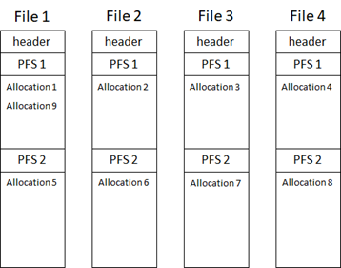
Concurrent PFS Pages in TempDB (2019)
With this change, not only will increasing the number of files help with PFS contention but also increasing the size of the files.
New algorithm uses round robin between files, and between PFS pages within the files.
Notes:
There are some cases where having multiple files alone does not completely address PFS contention. For these cases, we have implemented a fix where we not only round robin between the files, we also round robin between the PFS pages within the files, allowing us to spread the object allocations across all the files and within the files themselves.
TEMPDB – Files and Trace Flags and Updates, Oh My!
From <https://techcommunity.microsoft.com/t5/sql-server/tempdb-files-and-trace-flags-and-updates-oh-my/ba-p/385937>

Slide 19
PFS Page Allocation (Single File: Pre-2019)
File 1
Header
PFS 1
Allocation 1 Allocation 2 Allocation 3 Allocation 4
PFS 2
Point of Allocation Contention
Notes:
SQL Server databases have at least one data file called the Primary data file, which will typically have a .mdf extension. They can also have secondary data files with .ndf extensions. This is the default naming convention, but any file extensions the user specifies will be accepted.
When a database has multiple files, the files are numbered from 1 to n, n being the total number of files. Each file consists of a collection of pages numbered from 0 to n-1, n being the number of pages in the file (total number of pages will depend on the size of the file).
The special Object Allocation pages mentioned on the previous slide will always appear in the same location in each data file contained in a database. A PFS page is the first page after the file header page in a data file and is marked as page 1. Following the PFS page is a GAM, marked as page 2, followed by an SGAM, marked as page 3. After the first PFS, there will be a new PFS page after every 8,087 pages. There is a new GAM for each 63,904 extents after the first GAM on page 2, and a new SGAM each 63,904 extents after the first SGAM on page 3.
The SQL Server engine addresses each of these pages using a combination of database id, file id, and page number. For example, the SGAM page in the first data file of a user database with a database id of 5 will be notated as 5:1:3. This becomes important when troubleshooting any type of page-related wait as the wait resource will be listed using this notation.
Additional Reading:
Database Files and Filegroups
From <https://docs.microsoft.com/en-us/sql/relational-databases/databases/database-files-and-filegroups?view=sql-server-ver15>

Slide 20
PFS Page Round Robin (Multiple Files: Pre-2019)
File 1
File 2
File 3
File 4
Header
PFS 1
Allocation 1 Allocation 5
PFS 2
Header
PFS 1
Allocation 2 Allocation 6
PFS 2
Header
PFS 1
Allocation 3
PFS 2
Header
PFS 1
Allocation 4
PFS 2
Notes:
SQL Server databases have at least one data file called the Primary data file, which will typically have a .mdf extension. They can also have secondary data files with .ndf extensions. This is the default naming convention, but any file extensions the user specifies will be accepted.
When a database has multiple files, the files are numbered from 1 to n, n being the total number of files. Each file consists of a collection of pages numbered from 0 to n-1, n being the number of pages in the file (total number of pages will depend on the size of the file).
The special Object Allocation pages mentioned on the previous slide will always appear in the same location in each data file contained in a database. A PFS page is the first page after the file header page in a data file and is marked as page 1. Following the PFS page is a GAM, marked as page 2, followed by an SGAM, marked as page 3. After the first PFS, there will be a new PFS page after every 8,087 pages. There is a new GAM for each 63,904 extents after the first GAM on page 2, and a new SGAM each 63,904 extents after the first SGAM on page 3.
The SQL Server engine addresses each of these pages using a combination of database id, file id, and page number. For example, the SGAM page in the first data file of a user database with a database id of 5 will be notated as 5:1:3. This becomes important when troubleshooting any type of page-related wait as the wait resource will be listed using this notation.
Additional Reading:
Database Files and Filegroups
From <https://docs.microsoft.com/en-us/sql/relational-databases/databases/database-files-and-filegroups?view=sql-server-ver15>

Slide 21
PFS Page Round Robin (Multiple Files: 2019)
File 1
File 2
File 3
File 4
Header
PFS 1
Allocation 1
PFS 2
Allocation 5
Header
PFS 1
Allocation 2
PFS 2
Allocation 6
Header
PFS 1
Allocation 3
PFS 2
Allocation 7
Header
PFS 1
Allocation 4
PFS 2
Allocation 8
Notes:
SQL Server databases have at least one data file called the Primary data file, which will typically have a .mdf extension. They can also have secondary data files with .ndf extensions. This is the default naming convention, but any file extensions the user specifies will be accepted.
When a database has multiple files, the files are numbered from 1 to n, n being the total number of files. Each file consists of a collection of pages numbered from 0 to n-1, n being the number of pages in the file (total number of pages will depend on the size of the file).
The special Object Allocation pages mentioned on the previous slide will always appear in the same location in each data file contained in a database. A PFS page is the first page after the file header page in a data file and is marked as page 1. Following the PFS page is a GAM, marked as page 2, followed by an SGAM, marked as page 3. After the first PFS, there will be a new PFS page after every 8,087 pages. There is a new GAM for each 63,904 extents after the first GAM on page 2, and a new SGAM each 63,904 extents after the first SGAM on page 3.
The SQL Server engine addresses each of these pages using a combination of database id, file id, and page number. For example, the SGAM page in the first data file of a user database with a database id of 5 will be notated as 5:1:3. This becomes important when troubleshooting any type of page-related wait as the wait resource will be listed using this notation.
Additional Reading:
Database Files and Filegroups
From <https://docs.microsoft.com/en-us/sql/relational-databases/databases/database-files-and-filegroups?view=sql-server-ver15>

Slide 22
Metadata Contention
The wait type is PAGELATCH_EX on sysschobjs in TempDB..
Notes:
* As a general rule:
If the number of logical processors is less than or equal to eight (8), use the same number of data files as logical processors.
If the number of logical processors is greater than eight (8), use eight data files. If contention continues, increase the number of data files by multiples of four (4) up to the number of logical processors until the contention is reduced to acceptable levels.
Alternatively, make changes to the workload or code.
Physical Properties of TempDB in SQL Server
From <https://docs.microsoft.com/en-us/sql/relational-databases/databases/tempdb-database?view=sql-server-ver15#physical-properties-of-tempdb-in-sql-server>

Slide 23
Identifying Metadata Contention
SELECT er.session_id, er.wait_type, er.wait_resource,
OBJECT_NAME(page_info.[object_id],page_info.[database_id]) as [object_name],
er.blocking_session_id, er.command,
SUBSTRING(st.text, (er.statement_start_offset/2) + 1,
((CASE statement_end_offset
WHEN -1 THEN DATALENGTH(ST.text)
ELSE er.statement_end_offset END
- er.statement_start_offset)/2) + 1) AS statement_text,
page_info.database_id,
page_info.[file_id],
page_info.page_id,
page_info.[object_id],
page_info.index_id,
page_info.page_type_desc
FROM sys.dm_exec_requests AS er
CROSS APPLY sys.dm_exec_sql_text(er.sql_handle) as st
CROSS APPLY sys.fn_PageResCracker(er.page_resource) AS r
CROSS APPLY sys.dm_db_page_info(r.db_id, r.file_id, r.page_id,'DETAILED') AS page_info;
Notes:
* As a general rule:
If the number of logical processors is less than or equal to eight (8), use the same number of data files as logical processors.
If the number of logical processors is greater than eight (8), use eight data files. If contention continues, increase the number of data files by multiples of four (4) up to the number of logical processors until the contention is reduced to acceptable levels.
Alternatively, make changes to the workload or code.
Physical Properties of TempDB in SQL Server
From <https://docs.microsoft.com/en-us/sql/relational-databases/databases/tempdb-database?view=sql-server-ver15#physical-properties-of-tempdb-in-sql-server>

Slide 24
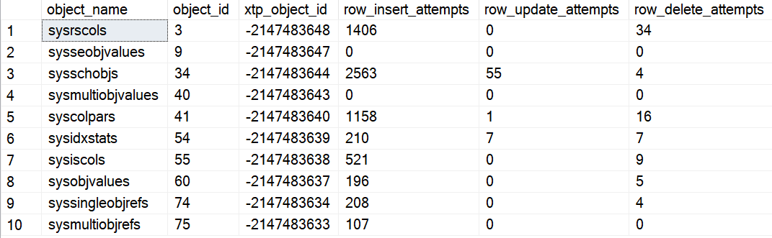
TempDB Memory Optimized Metadata Tables
Enable Memory Optimized TempDB Metadata Tables
Search for Memory Optimized Tables
ALTER SERVER CONFIGURATION SET MEMORY_OPTIMIZED TEMPDB_METADATA = ON;
SELECT OBJECT_NAME(object_id) as [object_name], * FROM sys.dm_db_xtp_object_stats;
Notes:
* As a general rule:
If the number of logical processors is less than or equal to eight (8), use the same number of data files as logical processors.
If the number of logical processors is greater than eight (8), use eight data files. If contention continues, increase the number of data files by multiples of four (4) up to the number of logical processors until the contention is reduced to acceptable levels.
Alternatively, make changes to the workload or code.
Physical Properties of TempDB in SQL Server
From <https://docs.microsoft.com/en-us/sql/relational-databases/databases/tempdb-database?view=sql-server-ver15#physical-properties-of-tempdb-in-sql-server>

Slide 25


