Slide 1
Data Virtualization with PolyBase in SQL Server 2019
John Deardurff

Slide 2

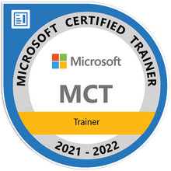
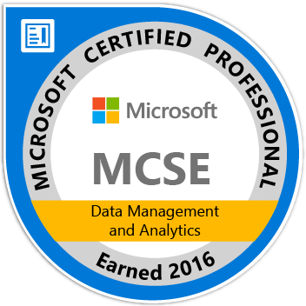
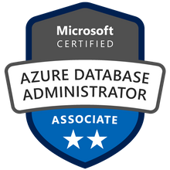
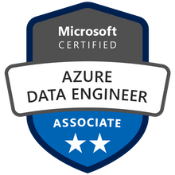
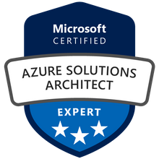

John Deardurff
Microsoft Customer Engineer (Global Technical Team)
Microsoft Certified Trainer (Regional Lead)
MVP: Data Platform (2016 – 2018)
Email: John.Deardurff@Microsoft.com
Twitter: @SQLMCT
Website: www.SQLMCT.com
GitHub: github.com\SQLMCT
Notes:
While all this has been running, several other parts of SQLOS have been active:
Monitoring: DMVs, Extended Events (xEvents), and so on.
Deadlock Monitor thread: Monitors for and deals with deadlocks.
Lazy Writer threads: Clock sweeping the buffer pool to maintain the free lists and responsible for writing dirty pages to disk between checkpoints.
Scheduler Monitor thread: Monitors scheduler health and detects issues such as non-yielding scenarios.
Resource Monitor thread: Monitors available memory from operating system and internal to SQL Server and notifies the Clerks.
The Hosting APIs for external components interface with Microsoft Data Access Components (MDAC) and common language runtime (CLR).
The Storage Engine manages all data access, both through transaction-based commands (with the Transaction Manager) and bulk operations such as backup, bulk insert, and certain Database Console Command (DBCC) commands.
Access Methods is an important component of the Storage Engine, and contains components to open a table, retrieve qualified data, and update data.
The Access Methods code does not actually retrieve the pages, it will make a request to the Buffer Manager, which holds a copy of the requested data pages in memory (and if the requested page is not in memory, it will retrieve it from disk). By memory, we mean specifically the Buffer Pool, which is part of the SQLOS.
The Transaction Manager ensures that transactions adhere to the ACID properties: atomicity, consistency, isolation, and durability.
It also outlines the boundaries of statements that must be grouped together to form an operation, and it allows “nested” transactions by managing savepoints, if any. Furthermore, it also coordinates with the Lock Manager regarding when locks can be released, based on the isolation level in effect. It also coordinates with Access Methods to determine when old versions of rows are no longer needed and can be removed from the version store.
The File Manager handles actual physical access to data and log files, as well as access to backup devices.
Also included in the storage engine are components for controlling utilities such as Bulk Load, DBCC commands, and Backup/Restore operations.
The SQLOS layer handles activities that are normally considered to be operating system-like responsibilities, such as Thread Scheduling, Synchronization services (latching and deadlock detection), Memory management (including the Buffer Pool), Lock management, I/O management (which establish the completion routines for read/write operations from memory to disk and vice-versa) , and Monitoring (such as DMVs and xEvents).
Locking is a crucial function of a multi-user Remote Desktop Management Services (RDMS) such as SQL Server, even if you are operating an optimistic concurrency model such as snapshot isolation level, to help ensure the isolation and consistency properties of ACID. This is handled by the Lock Manager, whose main job is to provide hierarchical access to data in a concurrent fashion (as allowed by the Isolation Level of the transaction), by managing compatibility between the lock types. It also resolves deadlocks (with the aid of the Deadlock Monitor thread), and escalates locks if needed. Other components such as the other threads in the figure will be explained in an upcoming lesson in this module.

Slide 3
Upcoming SQL Talks
May 3rd – Erin Stellato (Azure Data Studio)
May 10th – Niko Neugebauer (Managed Instances)
May 17th - Kevin Barlett (Kubernetes)

Slide 4
Agenda
What is Data Virtualization PolyBase?
Install and configure PolyBase.
Using PolyBase for Data Virtualization

Slide 5
What is Data Virtualization with PolyBase?
PolyBase enables your instance to query remote data with T-SQL directly from SQL Server.
Connect to SQL Server, Azure Storage, Oracle, Teradata, MongoDB, Hadoop clusters, and Cosmos DB without the need for additional client connection software.
You can connect to additional providers using third-party ODBC drivers.
Allows T-SQL queries to join the data from external sources to relational tables
Data virtualization allows the data to stay in its original location and format
Minimizes the need for ETL processes for data movement.
Notes:
SQL Server Certificates and Asymmetric Keys: https://docs.microsoft.com/en-us/sql/relational-databases/security/sql-server-certificates-and-asymmetric-keys?view=sql-server-ver15
Certificates
A certificate is a digitally signed document that consists of a public/private key pair. You make the public part of the key available to anyone with whom you want to securely communicate, but you must keep the private part of the key secure and accessible only by you. You can use digital certificates to authenticate and/or encrypt messages between two parties. These certificates contain information that can either verify the sender of a message or encrypt and decrypt algorithms.
Authentication
Messages signed with your private key identify you as the sender of the message. A third party can use your public key to ensure that the message was signed by the person or organization named in the certificate and not someone impersonating you.
Encryption
You can also use certificates to encrypt and decrypt information. If a message is encrypted by using a public key, it can only be decrypted by using the corresponding private key. Similarly, if data is encrypted by using the private key, it can only be decrypted by using the public key.
This mechanism helps ensure that only services to which you make your public key available can decrypt the messages that you send. For example, if you send information over a public network such as the Internet, that information can be decrypted only by organizations that have a copy of your public key. If they then want to send you secure information, they can encrypt the information by using your public key, and only you can decrypt it by using your private key.

Slide 6
Supported PolyBase Platforms
SQL Server 2016 (13.x) (Windows only)
SQL Server 2019 (15.x) and later versions (Windows and Linux)
SQL Server Analytics Platform System
Azure Synapse Analytics
Only supports connectors for Hadoop and Azure Blob Storage
Additional connectors for SQL Server, Oracle, Teradata, and MongoDB
Notes:
SQL Server Certificates and Asymmetric Keys: https://docs.microsoft.com/en-us/sql/relational-databases/security/sql-server-certificates-and-asymmetric-keys?view=sql-server-ver15
Certificates
A certificate is a digitally signed document that consists of a public/private key pair. You make the public part of the key available to anyone with whom you want to securely communicate, but you must keep the private part of the key secure and accessible only by you. You can use digital certificates to authenticate and/or encrypt messages between two parties. These certificates contain information that can either verify the sender of a message or encrypt and decrypt algorithms.
Authentication
Messages signed with your private key identify you as the sender of the message. A third party can use your public key to ensure that the message was signed by the person or organization named in the certificate and not someone impersonating you.
Encryption
You can also use certificates to encrypt and decrypt information. If a message is encrypted by using a public key, it can only be decrypted by using the corresponding private key. Similarly, if data is encrypted by using the private key, it can only be decrypted by using the public key.
This mechanism helps ensure that only services to which you make your public key available can decrypt the messages that you send. For example, if you send information over a public network such as the Internet, that information can be decrypted only by organizations that have a copy of your public key. If they then want to send you secure information, they can encrypt the information by using your public key, and only you can decrypt it by using your private key.

Slide 7
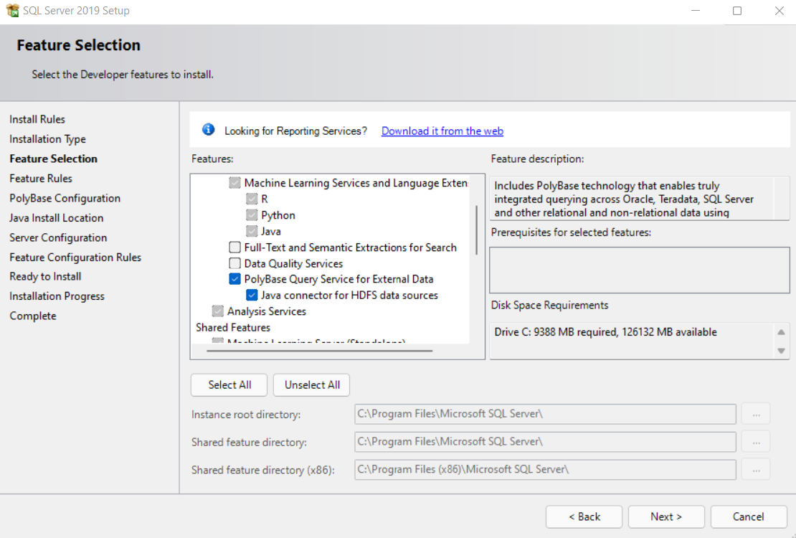
Installing PolyBase
Notes:
Overview of key management for Always Encrypted: https://docs.microsoft.com/en-us/sql/relational-databases/security/encryption/overview-of-key-management-for-always-encrypted?view=sql-server-ver15

Slide 8
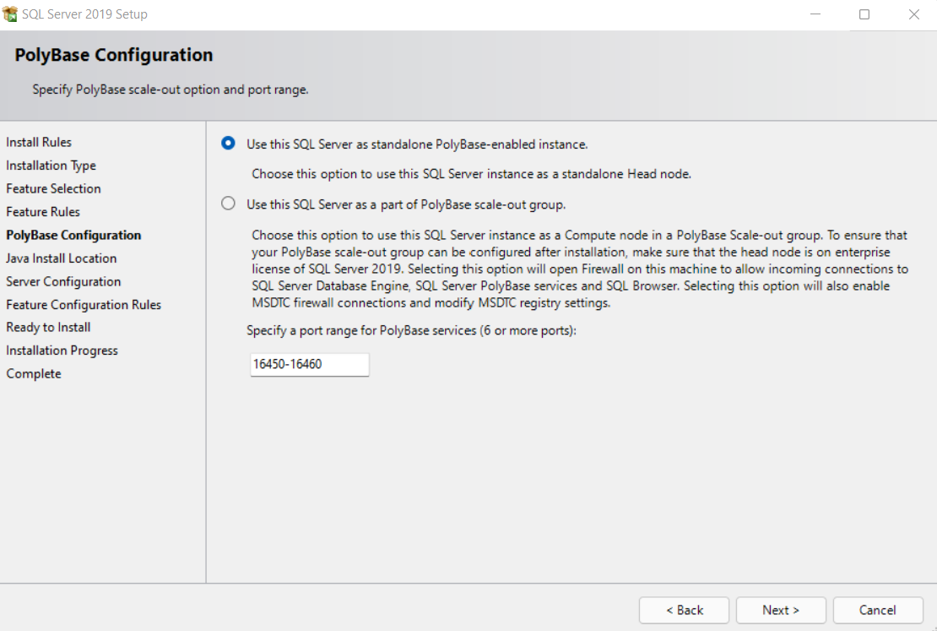
PolyBase Configuration
PolyBase scale-out groups will be retired July 2022.
Scale-out group functionality will be removed from the product in SQL Server 2022.
PolyBase data virtualization will continue to be fully supported as a scale-up feature in SQL Server.
Notes:
Overview of key management for Always Encrypted: https://docs.microsoft.com/en-us/sql/relational-databases/security/encryption/overview-of-key-management-for-always-encrypted?view=sql-server-ver15

Slide 9
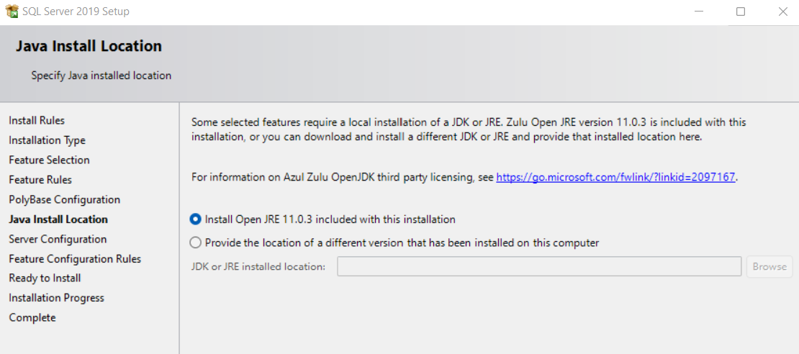
Installing Open Java
Notes:
Overview of key management for Always Encrypted: https://docs.microsoft.com/en-us/sql/relational-databases/security/encryption/overview-of-key-management-for-always-encrypted?view=sql-server-ver15

Slide 10
Enable PolyBase
USE MASTER
GO
EXEC sp_configure
@configname = 'polybase enabled',
@configvalue = 1;
GO
RECONFIGURE
GO
EXEC sp_configure
@configname = 'hadoop connectivity',
@configvalue = 7;
GO
RECONFIGURE
GO
Notes:
Overview of key management for Always Encrypted: https://docs.microsoft.com/en-us/sql/relational-databases/security/encryption/overview-of-key-management-for-always-encrypted?view=sql-server-ver15

Slide 11
Create Credentials
-- Create a master key.
-- Only necessary if one does not already exist.
-- Required to encrypt the credential secret.
CREATE MASTER KEY;
--Create a database scoped credential
--IDENTITY: Provide any string.
--SECRET: Provide your Azure storage account key.
CREATE DATABASE SCOPED CREDENTIAL AzureStorageCredential
WITH
IDENTITY = 'user',
SECRET = '<azure_storage_account_key>'
;
Notes:
Overview of key management for Always Encrypted: https://docs.microsoft.com/en-us/sql/relational-databases/security/encryption/overview-of-key-management-for-always-encrypted?view=sql-server-ver15

Slide 12
Create External Objects
CREATE EXTERNAL DATA SOURCE AzureStorage_west_public
WITH
(
TYPE = Hadoop
, LOCATION = 'wasbs://contosoretaildw- tables@contosoretaildw.blob.core.windows.net/’
--, CREDENTIAL = AzureStorageCredential);
CREATE EXTERNAL FILE FORMAT TextFileFormat
WITH
( FORMAT_TYPE = DELIMITEDTEXT
, FORMAT_OPTIONS ( FIELD_TERMINATOR = '|'
, STRING_DELIMITER = ''
, DATE_FORMAT = 'yyyy-MM-dd HH:mm:ss.fff'
, USE_TYPE_DEFAULT = FALSE));
Notes:
Overview of key management for Always Encrypted: https://docs.microsoft.com/en-us/sql/relational-databases/security/encryption/overview-of-key-management-for-always-encrypted?view=sql-server-ver15

Slide 13
Create External Table
CREATE EXTERNAL TABLE [asb].DimCurrency
([CurrencyKey] [int] NOT NULL,
[CurrencyLabel] [nvarchar](10) NOT NULL,
[CurrencyName] [nvarchar](20) NOT NULL,
[CurrencyDescription] [nvarchar](50) NOT NULL,
[ETLLoadID] [int] NULL,
[LoadDate] [datetime] NULL,
[UpdateDate] [datetime] NULL)
WITH
( LOCATION='/DimCurrency/'
, DATA_SOURCE = AzureStorage_west_public
, FILE_FORMAT = TextFileFormat
, REJECT_TYPE = VALUE
, REJECT_VALUE = 0);
Notes:
Overview of key management for Always Encrypted: https://docs.microsoft.com/en-us/sql/relational-databases/security/encryption/overview-of-key-management-for-always-encrypted?view=sql-server-ver15

Slide 14
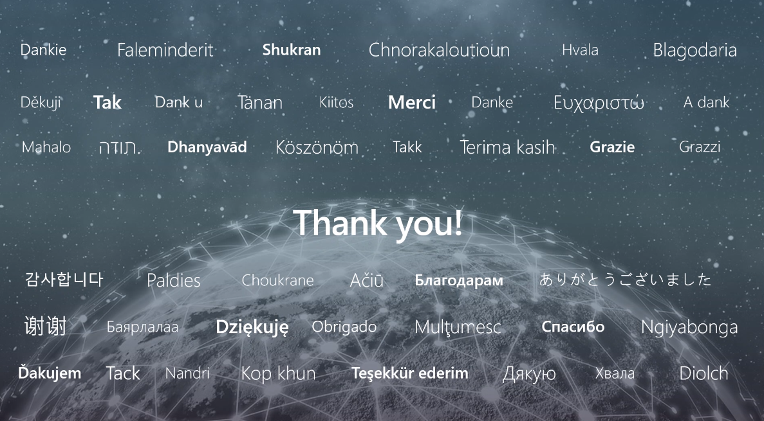

Slide 15
Microsoft

