Slide 1
Activate Performance Tuning and Optimization County of Fresno August 16th – 18th

Slide 2

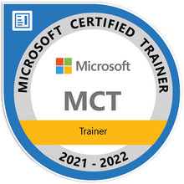
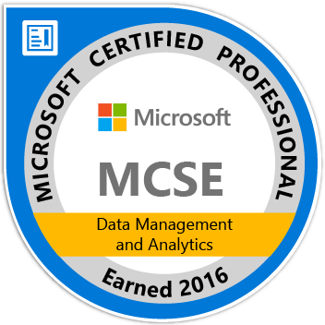
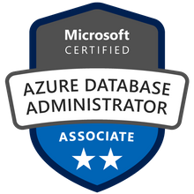



John Deardurff
Microsoft Customer Engineer (Global Technical Team)
Microsoft Certified Trainer (Regional Lead)
MVP: Data Platform (2016 – 2018)
Email: John.Deardurff@Microsoft.com
Twitter: @SQLMCT
Website: www.SQLMCT.com
GitHub: github.com\SQLMCT

Slide 3
Agenda Day 1
SQL Operating System
Waits and Queues
Module 2: SQL Server Architecture
Module 1: Introduction to Azure SQL
Basic Concepts of Azure SQL
SQL Server I/O
Azure SQL Databases

Slide 4
Agenda Day 2
Module 3: SQL Server Transactions and Concurrency
SQL Server Transactions
SQL Server Locking
Module 4: SQL Server Indexing and Statistics
SQL Server Indexing
Blocking and Deadlocking
Indexing Strategies and Monitoring
SQL Server Statistics

Slide 5
Agenda Day 3
Module 5: SQL Server Query Execution and Plans
SQL Server Query Execution and Plan Analysis
SQL Server Plan Cache Internals
Troubleshooting with Query Store
Module 6: Azure SQL Performance Tuning
Query Performance Insights
Automatic Tuning in Azure SQL
Intelligent Query Processing

Slide 6
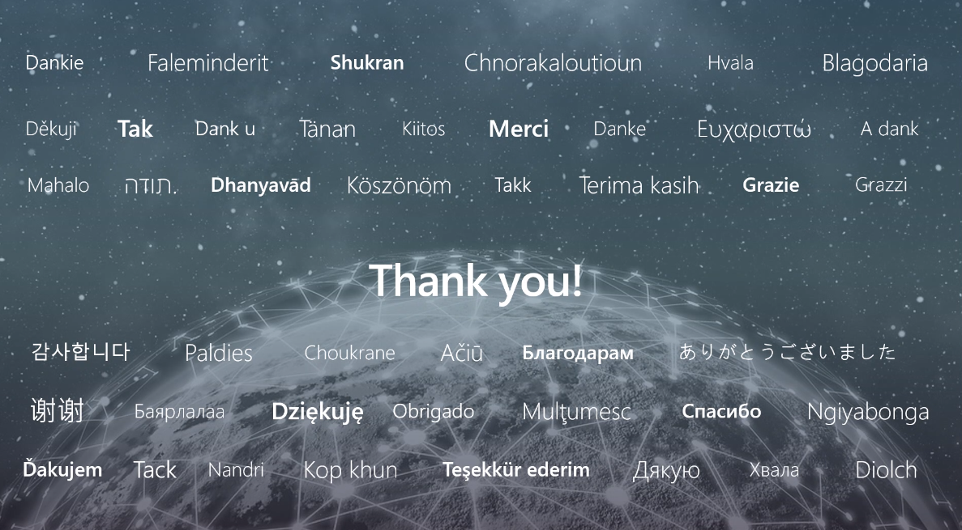

Slide 7
Microsoft

