Slide 1
Intelligent Query Processing

Slide 2







John Deardurff
Microsoft Customer Engineer (Global Technical Team)
Microsoft Certified Trainer (Regional Lead)
MVP: Data Platform (2016 – 2018)
Email: John.Deardurff@Microsoft.com
Twitter: @SQLMCT
Website: www.SQLMCT.com
GitHub: github.com\SQLMCT

Slide 3
Get started with SQL Server 2019
Download and try it: http://aka.ms/ss19
Use our free training: https://aka.ms/sqlworkshops
Use examples through our https://aka.ms/SQL2019Notebooks
Learn from videos: https://aka.ms/sql2019learning
Read what’s new for SQL 2019: documentation
Watch how to Modernize SQL Server: check out the video
One shortcut to rule them all: https://aka.ms/SQLShortcuts
Get the book: https://aka.ms/sql2019book

Slide 4
Intelligent Query Processing
Interleaved Execution
Memory Grant Feedback
Adaptive Joins
Intelligent Query Processing
Adaptive Query Processing
Batch Mode
Row Mode
Table Variable Deferred Compilation
Batch Mode On Rowstore Indexes
Scalar UDF Inlining
Approximate Query Processing
Approximate Count Distinct
Azure SQL Database
http://aka.ms/IQP
SQL Server 2017
SQL Server 2019
Notes:
Parameter-sensitive? GLOBAL query
GLOBAL: Do not capitalize generic terms. Please note that we do not capitalize terms unless they are from the UI or are feature or product names. Please consider lowercasing such terms throughout this document.
GLOBAL: Please avoid using first person (“we”, “I”) Always use “you” or “Microsoft” if that is applicable.
…have a lot of …?

Slide 5
Adaptive Query Processing (2017)
Interleaved Execution
Memory Grant Feedback
Adaptive Joins
Adaptive Query Processing
Batch Mode
Addresses performance issues related to the cardinality estimation of an execution plan.
These options can provide improved join type selection, row-calculations for Multi-Statement Table-Valued Functions, and memory allocation of row storage.
Notes:
Parameter-sensitive? GLOBAL query
GLOBAL: Do not capitalize generic terms. Please note that we do not capitalize terms unless they are from the UI or are feature or product names. Please consider lowercasing such terms throughout this document.
GLOBAL: Please avoid using first person (“we”, “I”) Always use “you” or “Microsoft” if that is applicable.
…have a lot of …?

Slide 6
Batch Mode Adaptive Joins (2017)
Interleaved Execution
Memory Grant Feedback
Adaptive Joins
Adaptive Query Processing
Batch Mode
This feature enables the choice of either the Hash or the Nested Loop join type.
Decision is deferred until statement execution.
No need to use join hints in queries.
Notes:
Parameter-sensitive? GLOBAL query
GLOBAL: Do not capitalize generic terms. Please note that we do not capitalize terms unless they are from the UI or are feature or product names. Please consider lowercasing such terms throughout this document.
GLOBAL: Please avoid using first person (“we”, “I”) Always use “you” or “Microsoft” if that is applicable.
…have a lot of …?

Slide 7
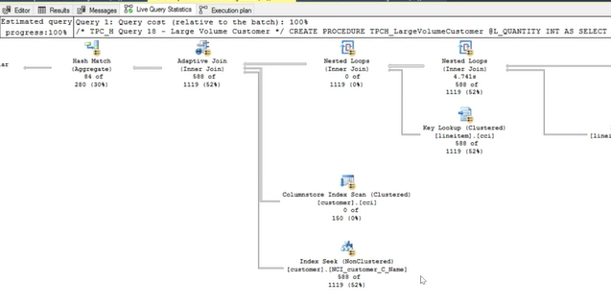
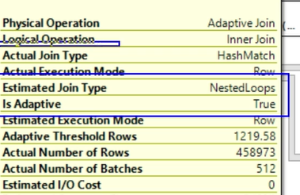
Batch Mode Adaptive Joins (2017)
Adaptive Joins
Notes:
Parameter-sensitive? GLOBAL query
GLOBAL: Do not capitalize generic terms. Please note that we do not capitalize terms unless they are from the UI or are feature or product names. Please consider lowercasing such terms throughout this document.
GLOBAL: Please avoid using first person (“we”, “I”) Always use “you” or “Microsoft” if that is applicable.
…have a lot of …?

Slide 8
Batch Mode Adaptive Joins (2017)
Adaptive Joins
Enabled by default in Compatibility level 140 or higher.
To disable change compatibility level to 130 or lower
You can enable/disable it at the database level in SQL Server 2017.
ALTER DATABASE SCOPED CONFIGURATION SET DISABLE_BATCH_MODE_ADAPTIVE_JOINS = ON|OFF;
Azure SQL Database, SQL Server 2019 and higher
ALTER DATABASE SCOPED CONFIGURATION SET BATCH_MODE_ADAPTIVE_JOINS = ON|OFF;
You can disable it at statement scope if necessary.
<statement>
OPTION (USE HINT('DISABLE_BATCH_MODE_ADAPTIVE_JOINS'));
Notes:
Parameter-sensitive? GLOBAL query
GLOBAL: Do not capitalize generic terms. Please note that we do not capitalize terms unless they are from the UI or are feature or product names. Please consider lowercasing such terms throughout this document.
GLOBAL: Please avoid using first person (“we”, “I”) Always use “you” or “Microsoft” if that is applicable.
…have a lot of …?

Slide 9
Interleaved Execution (2017)
Interleaved Execution
Memory Grant Feedback
Adaptive Joins
Adaptive Query Processing
Batch Mode
Previously, when a Multi-Statement Table-Valued Function was executed, it used a fixed row estimate of 100 rows.
Now execution is paused so a better cardinality estimate can be captured.
Notes:
Parameter-sensitive? GLOBAL query
GLOBAL: Do not capitalize generic terms. Please note that we do not capitalize terms unless they are from the UI or are feature or product names. Please consider lowercasing such terms throughout this document.
GLOBAL: Please avoid using first person (“we”, “I”) Always use “you” or “Microsoft” if that is applicable.
…have a lot of …?

Slide 10
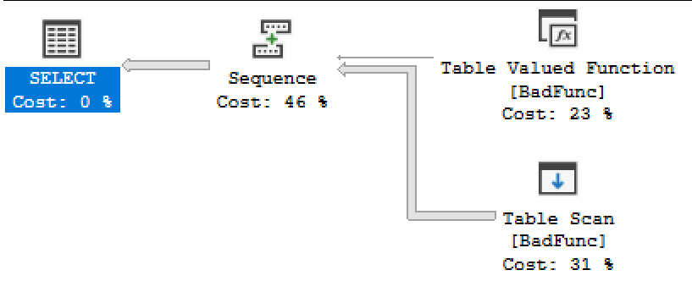
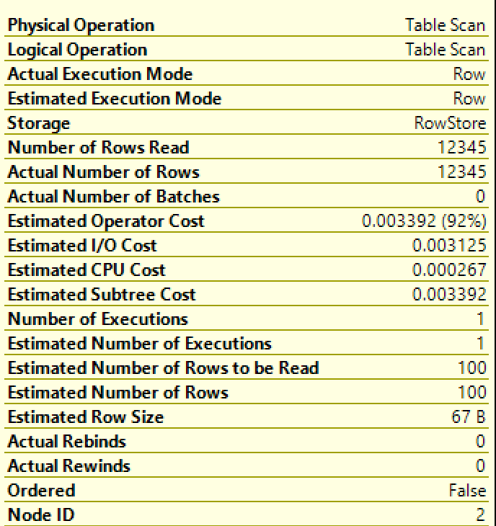
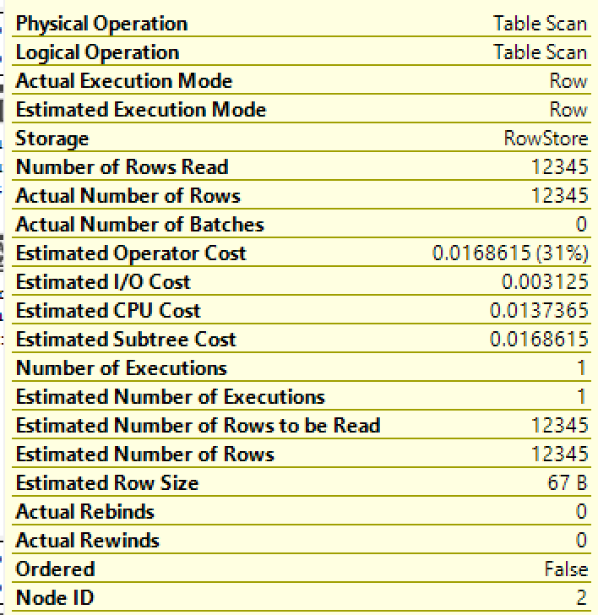
Interleaved Execution (2017)
Interleaved Execution
Compatibility Level 120/130
Compatibility Level 140 or higher
During optimization if SQL Server encounter a read-only multi-statement table-valued function (MSTVF), it will pause optimization, execute the applicable subtree, capture accurate cardinality estimates, and then resume optimization for downstream operations.
Notes:
Parameter-sensitive? GLOBAL query
GLOBAL: Do not capitalize generic terms. Please note that we do not capitalize terms unless they are from the UI or are feature or product names. Please consider lowercasing such terms throughout this document.
GLOBAL: Please avoid using first person (“we”, “I”) Always use “you” or “Microsoft” if that is applicable.
…have a lot of …?

Slide 11
Interleaved Execution (2017)
Interleaved Execution
Enabled by default in Compatibility level 140 or higher.
To disable change compatibility level to 130 or lower
You can enable/disable it at the database level in SQL Server 2017.
ALTER DATABASE SCOPED CONFIGURATION SET DISABLE_INTERLEAVED_EXECUTION_TVF = ON|OFF;
Azure SQL Database, SQL Server 2019 and higher
ALTER DATABASE SCOPED CONFIGURATION SET INTERLEAVED_EXECUTION_TVF = ON|OFF;
You can disable it at statement scope if necessary.
<statement>
OPTION (USE HINT('DISABLE_INTERLEAVED_EXECUTION_TVF'));
Notes:
Parameter-sensitive? GLOBAL query
GLOBAL: Do not capitalize generic terms. Please note that we do not capitalize terms unless they are from the UI or are feature or product names. Please consider lowercasing such terms throughout this document.
GLOBAL: Please avoid using first person (“we”, “I”) Always use “you” or “Microsoft” if that is applicable.
…have a lot of …?

Slide 12
Batch Mode Memory Grant Feedback (2017)
Interleaved Execution
Memory Grant Feedback
Adaptive Joins
Adaptive Query Processing
Batch Mode
When compiling an execution plan, the query engine estimates how much memory is needed to store rows during join and sort operations.
Too much memory allocation may impact performance of other operations. Not enough will cause a spill over to disk.
This feature recalculates memory on first execution and updates the cached plan.
Notes:
Parameter-sensitive? GLOBAL query
GLOBAL: Do not capitalize generic terms. Please note that we do not capitalize terms unless they are from the UI or are feature or product names. Please consider lowercasing such terms throughout this document.
GLOBAL: Please avoid using first person (“we”, “I”) Always use “you” or “Microsoft” if that is applicable.
…have a lot of …?

Slide 13
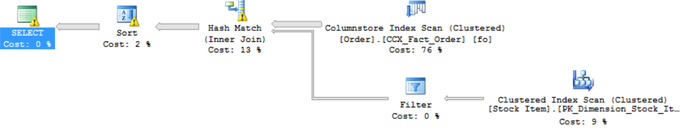
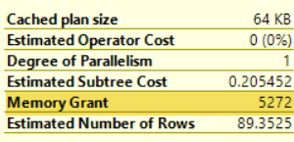
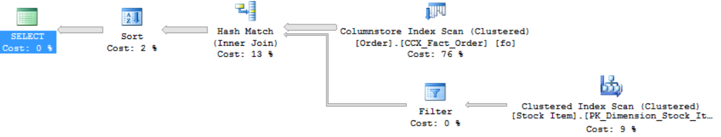
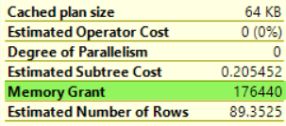
Batch Mode Memory Grant Feedback (2017)
First Execution (Spills detected; feedback generated)
Memory Grant Feedback (Batch Mode)
Second Execution (Memory grant adjusted)
Notes:
Parameter-sensitive? GLOBAL query
GLOBAL: Do not capitalize generic terms. Please note that we do not capitalize terms unless they are from the UI or are feature or product names. Please consider lowercasing such terms throughout this document.
GLOBAL: Please avoid using first person (“we”, “I”) Always use “you” or “Microsoft” if that is applicable.
…have a lot of …?

Slide 14
Batch Mode Memory Grant Feedback (2017)
Memory Grant Feedback (Batch Mode)
Enabled by default in Compatibility level 140 or higher.
To disable change compatibility level to 130 or lower
You can enable/disable it at the database level in SQL Server 2017.
ALTER DATABASE SCOPED CONFIGURATION SET DISABLE_BATCH_MODE_MEMORY_GRANT_FEEDBACK=ON|OFF;
Azure SQL Database, SQL Server 2019 and higher
ALTER DATABASE SCOPED CONFIGURATION SET BATCH_MODE_MEMORY_GRANT_FEEDBACK = ON|OFF;
You can disable it at statement scope if necessary.
<statement>
OPTION (USE HINT ('DISABLE_BATCH_MODE_MEMORY_GRANT_FEEDBACK'))
Notes:
Parameter-sensitive? GLOBAL query
GLOBAL: Do not capitalize generic terms. Please note that we do not capitalize terms unless they are from the UI or are feature or product names. Please consider lowercasing such terms throughout this document.
GLOBAL: Please avoid using first person (“we”, “I”) Always use “you” or “Microsoft” if that is applicable.
…have a lot of …?

Slide 15
Row Mode Memory Grant Feedback
Interleaved Execution
Memory Grant Feedback
Adaptive Joins
Adaptive Query Processing
Batch Mode
Row Mode
Row Mode is just like Batch Mode, but different.
Notes:
Parameter-sensitive? GLOBAL query
GLOBAL: Do not capitalize generic terms. Please note that we do not capitalize terms unless they are from the UI or are feature or product names. Please consider lowercasing such terms throughout this document.
GLOBAL: Please avoid using first person (“we”, “I”) Always use “you” or “Microsoft” if that is applicable.
…have a lot of …?

Slide 16
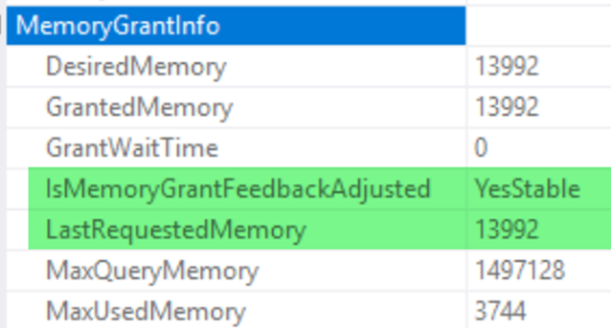
Row Mode Memory Grant Feedback
Expands on the batch mode memory grant feedback feature by also adjusting memory grant sizes for row mode operators.
Memory Grant Feedback (Row Mode)
Two new query plan attributes will be shown for actual post-execution plans.
Notes:
Parameter-sensitive? GLOBAL query
GLOBAL: Do not capitalize generic terms. Please note that we do not capitalize terms unless they are from the UI or are feature or product names. Please consider lowercasing such terms throughout this document.
GLOBAL: Please avoid using first person (“we”, “I”) Always use “you” or “Microsoft” if that is applicable.
…have a lot of …?

Slide 17
Row Mode Memory Grant Feedback
Memory Grant Feedback (Row Mode)
Enabled by default in Compatibility level 150 or higher.
To disable change compatibility level to 140 or lower
You can enable/disable it at the database level
ALTER DATABASE SCOPED CONFIGURATION SET ROW_MODE_MEMORY_GRANT_FEEDBACK = ON|OFF;
You can disable it at statement scope if necessary.
<statement>
OPTION (USE HINT ('DISABLE_ROW_MODE_MEMORY_GRANT_FEEDBACK'));
Notes:
Parameter-sensitive? GLOBAL query
GLOBAL: Do not capitalize generic terms. Please note that we do not capitalize terms unless they are from the UI or are feature or product names. Please consider lowercasing such terms throughout this document.
GLOBAL: Please avoid using first person (“we”, “I”) Always use “you” or “Microsoft” if that is applicable.
…have a lot of …?

Slide 18
Intelligent Query Processing
Interleaved Execution
Memory Grant Feedback
Adaptive Joins
Intelligent Query Processing
Adaptive Query Processing
Batch Mode
Row Mode
Table Variable Deferred Compilation
Batch Mode On Rowstore Indexes
Scalar UDF Inlining
Approximate Query Processing
Approximate Count Distinct
Azure SQL Database
http://aka.ms/IQP
SQL Server 2017
SQL Server 2019
Notes:
Parameter-sensitive? GLOBAL query
GLOBAL: Do not capitalize generic terms. Please note that we do not capitalize terms unless they are from the UI or are feature or product names. Please consider lowercasing such terms throughout this document.
GLOBAL: Please avoid using first person (“we”, “I”) Always use “you” or “Microsoft” if that is applicable.
…have a lot of …?

Slide 19
Intelligent Query Processing (2019)
Intelligent Query Processing
Table Variable Deferred Compilation
Batch Mode On Rowstore Indexes
Scalar UDF Inlining
Approximate Query Processing
Approximate Count Distinct
Notes:
Parameter-sensitive? GLOBAL query
GLOBAL: Do not capitalize generic terms. Please note that we do not capitalize terms unless they are from the UI or are feature or product names. Please consider lowercasing such terms throughout this document.
GLOBAL: Please avoid using first person (“we”, “I”) Always use “you” or “Microsoft” if that is applicable.
…have a lot of …?

Slide 20
Table Variable Deferred Compilation
Intelligent Query Processing
Table Variable Deferred Compilation
Batch Mode On Rowstore Indexes
Scalar UDF Inlining
Approximate Query Processing
Approximate Count Distinct
Queries that contain table variables will defer the compilation of the execution plan until the first execution of the query statement. This allows the execution plan to use the actual cardinality of the table variable instead of a one row guess.
Notes:
Parameter-sensitive? GLOBAL query
GLOBAL: Do not capitalize generic terms. Please note that we do not capitalize terms unless they are from the UI or are feature or product names. Please consider lowercasing such terms throughout this document.
GLOBAL: Please avoid using first person (“we”, “I”) Always use “you” or “Microsoft” if that is applicable.
…have a lot of …?

Slide 21
Table Variable Deferred Compilation
Table Variable Deferred Compilation
Enabled by default in Compatibility level 150 or higher.
To disable change compatibility level to 140 or lower
You can enable/disable it at the database level
ALTER DATABASE SCOPED CONFIGURATION SET DEFERRED_COMPILATION_TV = ON|OFF;
You can disable it at statement scope if necessary.
<table variable declaration>
<data inserted into table variable >
<statement that uses the table variable>
OPTION (USE HINT('DISABLE_DEFERRED_COMPILATION_TV'));
Notes:
Parameter-sensitive? GLOBAL query
GLOBAL: Do not capitalize generic terms. Please note that we do not capitalize terms unless they are from the UI or are feature or product names. Please consider lowercasing such terms throughout this document.
GLOBAL: Please avoid using first person (“we”, “I”) Always use “you” or “Microsoft” if that is applicable.
…have a lot of …?

Slide 22
Batch Mode on Rowstore Indexes
Intelligent Query Processing
Table Variable Deferred Compilation
Batch Mode On Rowstore Indexes
Scalar UDF Inlining
Approximate Query Processing
Approximate Count Distinct
Allows batch mode execution for analytic workloads without requiring of columnstore indexes.
Notes:
Parameter-sensitive? GLOBAL query
GLOBAL: Do not capitalize generic terms. Please note that we do not capitalize terms unless they are from the UI or are feature or product names. Please consider lowercasing such terms throughout this document.
GLOBAL: Please avoid using first person (“we”, “I”) Always use “you” or “Microsoft” if that is applicable.
…have a lot of …?

Slide 23
Batch Mode on Rowstore Indexes
Batch Mode On Rowstore Indexes
Enabled by default in Compatibility level 150 or higher.
To disable change compatibility level to 140 or lower
You can enable/disable it at the database level
ALTER DATABASE SCOPED CONFIGURATION SET BATCH_MODE_ON_ROWSTORE = ON|OFF;
You can enable/disable it at statement scope if necessary.
<statement>
OPTION(RECOMPILE, USE HINT('ALLOW_BATCH_MODE'));
<statement>
OPTION(RECOMPILE, USE HINT('DISALLOW_BATCH_MODE'));
Notes:
Parameter-sensitive? GLOBAL query
GLOBAL: Do not capitalize generic terms. Please note that we do not capitalize terms unless they are from the UI or are feature or product names. Please consider lowercasing such terms throughout this document.
GLOBAL: Please avoid using first person (“we”, “I”) Always use “you” or “Microsoft” if that is applicable.
…have a lot of …?

Slide 24
Scalar User-Defined Function Inlining
Intelligent Query Processing
Table Variable Deferred Compilation
Batch Mode On Rowstore Indexes
Scalar UDF Inlining
Approximate Query Processing
Approximate Count Distinct
The goal of the scalar User-Defined Function Inlining feature is to improve performance of queries that invoke T-SQL scalar UDFs, where UDF execution is the main bottleneck.
Notes:
Parameter-sensitive? GLOBAL query
GLOBAL: Do not capitalize generic terms. Please note that we do not capitalize terms unless they are from the UI or are feature or product names. Please consider lowercasing such terms throughout this document.
GLOBAL: Please avoid using first person (“we”, “I”) Always use “you” or “Microsoft” if that is applicable.
…have a lot of …?

Slide 25
Scalar User-Defined Function Inlining
Scalar UDF Inlining
The goal of the scalar User-Defined Function Inlining feature is to improve performance of queries that invoke T-SQL scalar UDFs, where UDF execution is the main bottleneck.
Scalar UDFs are automatically transformed into scalar expressions or scalar subqueries that are substituted in the calling query in place of the UDF operator.
These expressions and subqueries are then optimized. As a result, the query plan will no longer have a user-defined function operator, but its effects will be observed in the plan, like views or inline TVFs.
Notes:
Parameter-sensitive? GLOBAL query
GLOBAL: Do not capitalize generic terms. Please note that we do not capitalize terms unless they are from the UI or are feature or product names. Please consider lowercasing such terms throughout this document.
GLOBAL: Please avoid using first person (“we”, “I”) Always use “you” or “Microsoft” if that is applicable.
…have a lot of …?

Slide 26
Scalar User-Defined Function Inlining
Scalar UDF Inlining
Enabled by default in Compatibility level 150 or higher.
To disable change compatibility level to 140 or lower
You can enable/disable it at the database level
ALTER DATABASE SCOPED CONFIGURATION SET TSQL_SCALAR_UDF_INLINING = ON|OFF;
You can disable it at statement scope if necessary.
<statement>
OPTION (USE HINT('DISABLE_TSQL_SCALAR_UDF_INLINING'));
Notes:
Parameter-sensitive? GLOBAL query
GLOBAL: Do not capitalize generic terms. Please note that we do not capitalize terms unless they are from the UI or are feature or product names. Please consider lowercasing such terms throughout this document.
GLOBAL: Please avoid using first person (“we”, “I”) Always use “you” or “Microsoft” if that is applicable.
…have a lot of …?

Slide 27
Approximate Query Processing
Intelligent Query Processing
Table Variable Deferred Compilation
Batch Mode On Rowstore Indexes
Scalar UDF Inlining
Approximate Query Processing
Approximate Count Distinct
Approximate Query Processing is a new feature family that will be used to aggregate large datasets where performance is more critical than absolute precision. Currently only one supported function (APPROX_COUNT_DISTINCT).
Notes:
Parameter-sensitive? GLOBAL query
GLOBAL: Do not capitalize generic terms. Please note that we do not capitalize terms unless they are from the UI or are feature or product names. Please consider lowercasing such terms throughout this document.
GLOBAL: Please avoid using first person (“we”, “I”) Always use “you” or “Microsoft” if that is applicable.
…have a lot of …?

Slide 28
Approximate Count Distinct
Intelligent Query Processing
Table Variable Deferred Compilation
Batch Mode On Rowstore Indexes
Scalar UDF Inlining
Approximate Query Processing
Approximate Count Distinct
A new aggregate function APPROX_COUNT_DISTINCT that returns the approximate number of unique non-null values in a group.
Notes:
Parameter-sensitive? GLOBAL query
GLOBAL: Do not capitalize generic terms. Please note that we do not capitalize terms unless they are from the UI or are feature or product names. Please consider lowercasing such terms throughout this document.
GLOBAL: Please avoid using first person (“we”, “I”) Always use “you” or “Microsoft” if that is applicable.
…have a lot of …?

Slide 29
Approximate Count Distinct
It returns the approximate number of unique non-null values in a group.
It is designed to provide aggregations across large data sets where responsiveness is more critical than absolute precision.
Its implementation guarantees up to a 2% error rate within a 97% probability.
Requires less memory than an exhaustive COUNT DISTINCT operation so it is less likely to spill memory to disk compared to COUNT DISTINCT.
Approximate Count Distinct
SELECT APPROX_COUNT_DISTINCT(O_OrderKey) AS Approx_Distinct_OrderKey
FROM dbo.Orders;
Notes:
Parameter-sensitive? GLOBAL query
GLOBAL: Do not capitalize generic terms. Please note that we do not capitalize terms unless they are from the UI or are feature or product names. Please consider lowercasing such terms throughout this document.
GLOBAL: Please avoid using first person (“we”, “I”) Always use “you” or “Microsoft” if that is applicable.
…have a lot of …?

Slide 30
Intelligent Query Processing
Interleaved Execution
Memory Grant Feedback
Adaptive Joins
Intelligent Query Processing
Adaptive Query Processing
Batch Mode
Row Mode
Table Variable Deferred Compilation
Batch Mode On Rowstore Indexes
Scalar UDF Inlining
Approximate Query Processing
Approximate Count Distinct
Azure SQL Database
SQL Server 2017
SQL Server 2019
Notes:
Parameter-sensitive? GLOBAL query
GLOBAL: Do not capitalize generic terms. Please note that we do not capitalize terms unless they are from the UI or are feature or product names. Please consider lowercasing such terms throughout this document.
GLOBAL: Please avoid using first person (“we”, “I”) Always use “you” or “Microsoft” if that is applicable.
…have a lot of …?

Slide 31
Questions?

