Slide 1
Waits, Queues, and the Task Execution Model John Deardurff

Slide 2
What does this session cover?
A Closer look at SQLOS
Waits and Queues
Thread Scheduling
Task Execution Model
Monitoring Waits

Slide 3
Inside the Database Engine
Protocols
Shared Memory / TCP / Named Pipes
Relational Engine
Storage Engine
Parser and Algebrizer
Query Optimizer
Access Methods
Pages
Records
Indexes
LOB
Versioning
Allocation
Utilities DBCC
Bulk Load
Backup
Restore
Buffer Manager
Database Engine
File Manager
Query Compiler
Query Executor
Transaction Services
SQLOS API
Monitoring
Synchronization
Deadlock Monitor
Lazy
Writer
XEvents
Lock Manager
Thread Scheduling
I/O
Resource
Management
Resource Monitor
Scheduler Monitor
Buffer Pool
Memory Manager
Notes:
While all this has been running, several other parts of SQLOS have been active:
Monitoring: DMVs, Extended Events (xEvents), and so on.
Deadlock Monitor thread: Monitors for and deals with deadlocks.
Lazy Writer threads: Clock sweeping the buffer pool to maintain the free lists and responsible for writing dirty pages to disk between checkpoints.
Scheduler Monitor thread: Monitors scheduler health and detects issues such as non-yielding scenarios.
Resource Monitor thread: Monitors available memory from operating system and internal to SQL Server and notifies the Clerks.
The Hosting APIs for external components interface with Microsoft Data Access Components (MDAC) and common language runtime (CLR).
The Storage Engine manages all data access, both through transaction-based commands (with the Transaction Manager) and bulk operations such as backup, bulk insert, and certain Database Console Command (DBCC) commands.
Access Methods is an important component of the Storage Engine, and contains components to open a table, retrieve qualified data, and update data.
The Access Methods code does not actually retrieve the pages, it will make a request to the Buffer Manager, which holds a copy of the requested data pages in memory (and if the requested page is not in memory, it will retrieve it from disk). By memory, we mean specifically the Buffer Pool, which is part of the SQLOS.
The Transaction Manager ensures that transactions adhere to the ACID properties: atomicity, consistency, isolation, and durability.
It also outlines the boundaries of statements that must be grouped together to form an operation, and it allows “nested” transactions by managing savepoints, if any. Furthermore, it also coordinates with the Lock Manager regarding when locks can be released, based on the isolation level in effect. It also coordinates with Access Methods to determine when old versions of rows are no longer needed and can be removed from the version store.
The File Manager handles actual physical access to data and log files, as well as access to backup devices.
Also included in the storage engine are components for controlling utilities such as Bulk Load, DBCC commands, and Backup/Restore operations.
The SQLOS layer handles activities that are normally considered to be operating system-like responsibilities, such as Thread Scheduling, Synchronization services (latching and deadlock detection), Memory management (including the Buffer Pool), Lock management, I/O management (which establish the completion routines for read/write operations from memory to disk and vice-versa) , and Monitoring (such as DMVs and xEvents).
Locking is a crucial function of a multi-user Remote Desktop Management Services (RDMS) such as SQL Server, even if you are operating an optimistic concurrency model such as snapshot isolation level, to help ensure the isolation and consistency properties of ACID. This is handled by the Lock Manager, whose main job is to provide hierarchical access to data in a concurrent fashion (as allowed by the Isolation Level of the transaction), by managing compatibility between the lock types. It also resolves deadlocks (with the aid of the Deadlock Monitor thread), and escalates locks if needed. Other components such as the other threads in the figure will be explained in an upcoming lesson in this module.

Slide 4
Preemptive vs. Cooperative Scheduling
Windows uses Preemptive scheduling
Is driven by the view of prioritized computation
Means that a low-priority process is pre-empted out of the processor by a high-priority process
SQL Server uses Cooperative scheduling
Means that the priority of a process doesn’t matter
Is where a process is not preempted, and executes until it explicitly yields the processor
Notes:
Try not to spend too much time here. Content in later slides is more important.
Technically, Resource Governor enables some processes to be treated preemptively and take priority over a process that is running in a lower-priority resource group. However, discussing this at this point is unlikely to be helpful to students who are new to the topic. Students who have some experience of Resource Governor might raise the point.
10987B
1: SQL Server Architecture, Scheduling, and Waits

Slide 5
Thread States and Queues
Runnable
Running
Suspended
The thread is currently in the Runnable Queue waiting to execute. (First In, First Out).
One active thread executing on a processor.
Placed on a Waiter List waiting for a resource other than a processor. (No specific order).
Notes:
10987B
1: SQL Server Architecture, Scheduling, and Waits

Slide 6
SQL Server Execution Model
Runnable List
Status: runnable
CPU available
Start
CPU
Status: running
Complete
Quantum exhausted
End
Resource blocked
Waiter List
Status: suspended
Resource available
Notes:
It’s worth spending some time on this slide to make sure that the students grasp these concepts because an understanding of them is critical for the rest of this course. Try to avoid discussing wait types here because the next lesson covers the topic in detail.
10987B
1: SQL Server Architecture, Scheduling, and Waits

Slide 7
Total Query Response Time
The full cycle between the several task states, for how many times it needs to cycle, is what we experience as the total query response time.
CPU Time (RUNNING)
Total Query Response Time
Signal Wait Time (RUNNABLE)
Resource Wait Time (SUSPENDED)

Slide 8
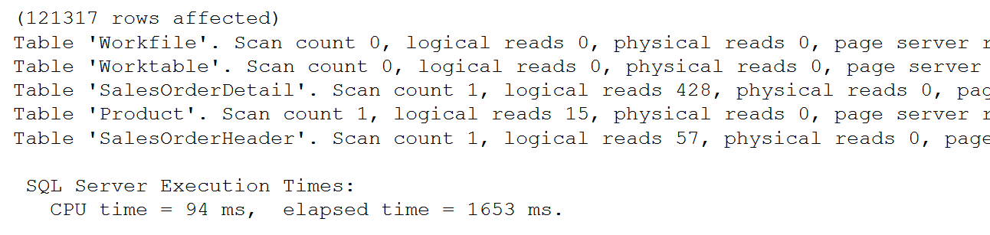
SET STATISTICS IO, TIME ON
SET STATISTICS IO ON
GO
SET STATISTICS TIME ON
SELECT SOH.SalesOrderID, SOH.CustomerID,
OrderQty, UnitPrice, P.Name
FROM Sales.SalesOrderHeader AS SOH
JOIN Sales.SalesOrderDetail AS SOD
ON SOH.SalesOrderID = SOD.SalesOrderID
JOIN Production.Product AS P
ON P.ProductID = SOD.ProductID
SET STATISTICS IO, TIME OFF
Used to identify physical reads and logical reads for a query
Notes:
SET STATISTICS IO (Transact-SQL) - SQL Server | Microsoft Docs
Causes SQL Server to display information about the amount of disk activity generated by Transact-SQL statements.
SET STATISTICS TIME (Transact-SQL) - SQL Server | Microsoft Docs
Displays the number of milliseconds required to parse, compile, and execute each statement.

Slide 9
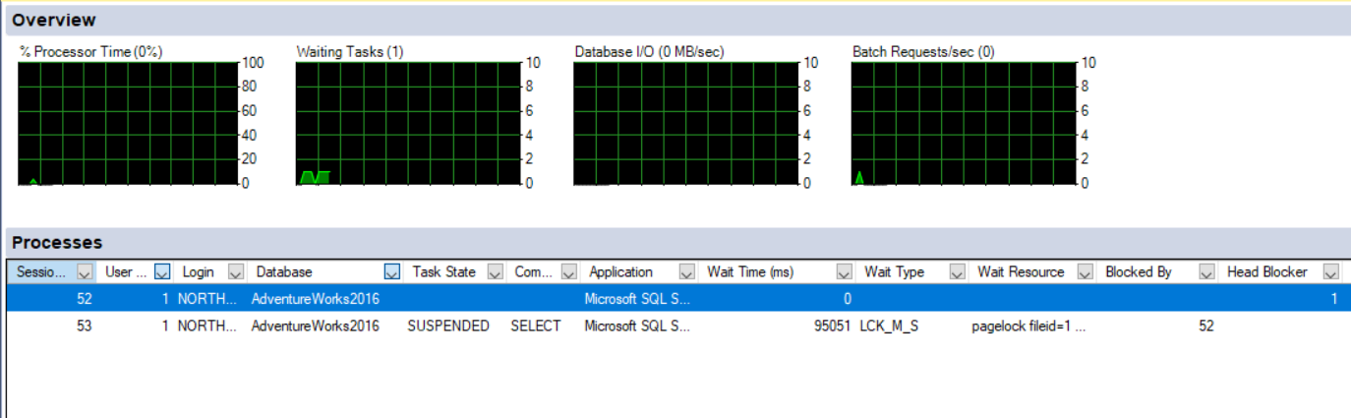
Activity Monitor

Slide 10
Dynamic Management Objects for Waits
Session CPU time and memory usage: sys.dm_exec_sessions
Status and session owner of request: sys.dm_exec_requests
Actual query text of waiting task: sys.dm_exec_sql_text
Active wait duration and type: sys.dm_os_waiting_tasks

Slide 11
Dynamic Management Objects for Waits
--Waiting tasks
SELECT w.session_id, w.wait_duration_ms, w.wait_type,
w.blocking_session_id, w.resource_description,
s.program_name, t.text, t.dbid, s.cpu_time,
s.memory_usage
FROM sys.dm_os_waiting_tasks as w
INNER JOIN sys.dm_exec_sessions as s
ON w.session_id = s.session_id
INNER JOIN sys.dm_exec_requests as r
ON s.session_id = r.session_id
OUTER APPLY sys.dm_exec_sql_text (r.sql_handle) as t
WHERE s.is_user_process = 1;
Notes:
10987B
1: SQL Server Architecture, Scheduling, and Waits

Slide 12
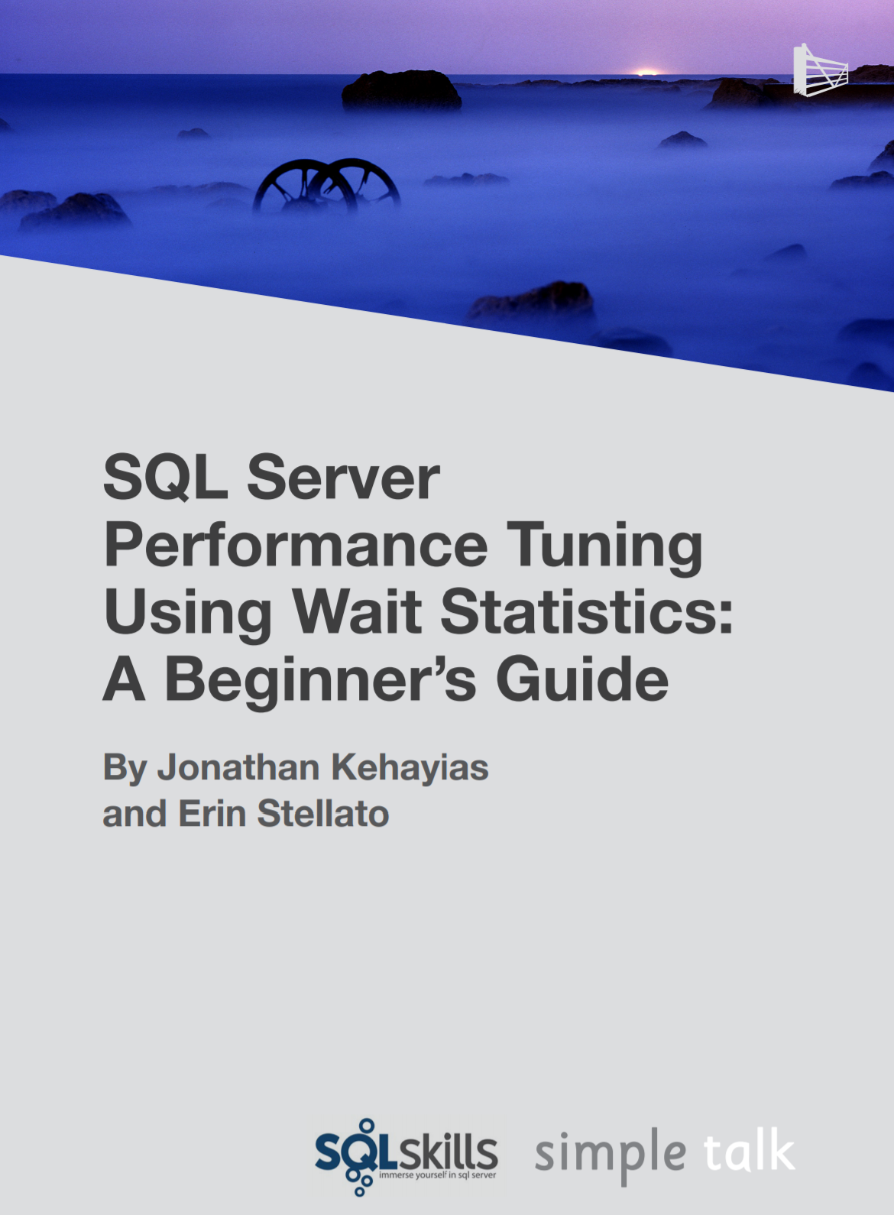
Troubleshooting Wait Types
Aaron Bertrand – Top Wait Types https://sqlperformance.com/2018/10/sql-performance/top-wait-stats
Paul Randal – SQL Skills Wait Types Library https://www.sqlskills.com/help/waits/
Notes:
10987B
1: SQL Server Architecture, Scheduling, and Waits

Slide 13
Demonstration

