Slide 1
Activate Azure SQL Performance Tuning and Optimization Ceridian January 16th – 19th ^{9:00am – 5:00pm EST}

Slide 2

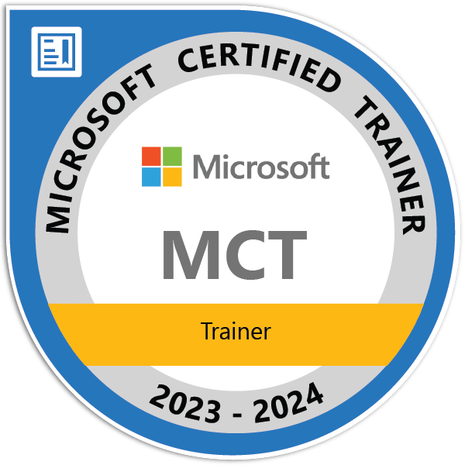



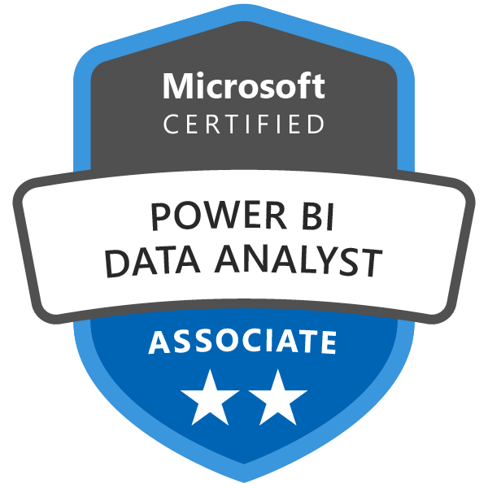

John Deardurff
Cloud Solution Architect - Engineer (Data & AI)
Microsoft Certified Trainer (Regional Lead)
MVP: Data Platform (2016 – 2018)
Email: John.Deardurff@Microsoft.com
Twitter: @SQLMCT
Website: www.SQLMCT.com
GitHub: github.com\SQLMCT

Slide 3
Engagement Overview
Activate Azure SQL Performance Tuning and Optimization offering is intended to educate customers how to optimize their Azure SQL VM performance configurations. The program is designed to educate, to discuss customer needs and test the new features.
This service is not only for DBAs, but also every role that could take advantage of this Activate would participate of this delivery.

Slide 4
Engagement Overview
Scoping Call
Educate
Proof of Concept to implement performance features in Azure SQL VM
Close out

Slide 5
Scoping Questions?
What are the days and times for the engagement?
(Can be 3 or 4 days)
What is the goal for this engagement?
Is there a current Azure SQL Environment?
Azure SQL DB
Azure SQL VM
Azure SQL MI

Slide 6
Agenda Day 1
SQL Operating System
Waits and Queues
Module 2: SQL Server Architecture
Module 1: Introduction to Azure SQL
Basic Concepts of Azure SQL
Azure SQL Databases
Database I/O

Slide 7
Agenda Day 2
SQL Server Transactions
SQL Server Locking
Blocking and Deadlocking
Module 3: Transactions and Concurrency
Module 4: SQL Server Indexing
Indexing Internals and Strategies
Index Monitoring and Fragmentation
Statistics Overview

Slide 8
Agenda Day 3
Module 5: SQL Server Query Execution and Plans
SQL Server Query Execution and Plan Analysis
SQL Server Plan Cache Internals
Troubleshooting with Query Store
Module 6: Azure SQL Performance Tuning
Query Performance Insights
Automatic Tuning in Azure SQL

Slide 9
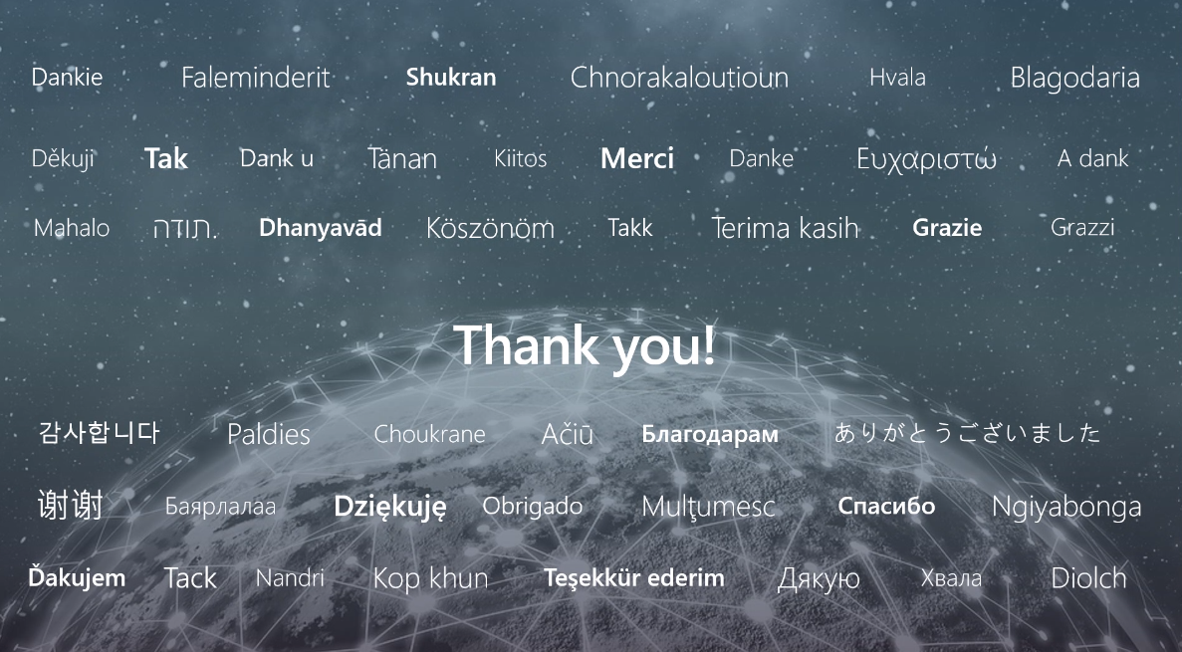

Slide 10
Microsoft

