Slide 1
Accelerated Database Recovery

Slide 2







John Deardurff
Microsoft Customer Engineer (Global Technical Team)
Microsoft Certified Trainer (Regional Lead)
MVP: Data Platform (2016 – 2018)
Email: John.Deardurff@Microsoft.com
Twitter: @SQLMCT
Website: www.SQLMCT.com
GitHub: github.com\SQLMCT

Slide 3
Get started with SQL Server 2019
Download and try it: http://aka.ms/ss19
Use our free training: https://aka.ms/sqlworkshops
Use examples through our https://aka.ms/SQL2019Notebooks
Learn from videos: https://aka.ms/sql2019learning
Read what’s new for SQL 2019: documentation
Watch how to Modernize SQL Server: check out the video
One shortcut to rule them all: https://aka.ms/SQLShortcuts
Get the book: https://aka.ms/sql2019book

Slide 4
Accelerated Database Recovery
Accelerated Database Recovery is a new SQL Server Engine feature that greatly improves database availability by completely redesigning the current SQL Server recovery process.
Instantaneous Transaction Rollback
Aggressive Log Truncation
Benefits of Accelerated Database Recovery
Fast & Consistent Database Recovery
Available in Standard Edition

Slide 5
How to enable ADR?
Azure SQL Database
It’s ON by default.
SQL Server 2019
ALTER DATABASE <db_name> SET ACCELERATED_DATABASE_RECOVERY = ON
(PERSISTENT_VERSION_STORE_FILEGROUP = [VersionStoreFG])
Notes:
https://docs.microsoft.com/en-us/sql/relational-databases/accelerated-database-recovery-management?view=sql-server-ver15

Slide 6
Current Database Recovery Process
Phase 1: Analysis
Determines the state of each transaction in the system at the time SQL Server stopped.
Phase 2: Redo
Returns the database to the state it was in at the time the SQL Server stopped.
[DB is PARTIALLY available after Redo]
Phase 3: Undo
Rolls back any uncommitted transaction(s) individually.
[DB is FULLY available after Undo]
Log
Start
Oldest
uncommitted Tx
(XACT_BEGIN_LSN)
Checkpoint
(or oldest dirty page LSN)
Log
End
Notes:
Analysis phase
Forward scan of the transaction log from the beginning of the last successful checkpoint (or the oldest dirty page LSN) until the end, to determine the state of each transaction at the time SQL Server stopped.
Redo phase
Forward scan of the transaction log from the oldest uncommitted transaction until the end, to bring the database to the state it was at the time of the crash by redoing all committed operations.
Undo phase
For each transaction that was active as of the time of the crash, traverses the log backwards, undoing the operations that this transaction performed.
https://docs.microsoft.com/en-us/azure/sql-database/sql-database-accelerated-database-recovery

Slide 7
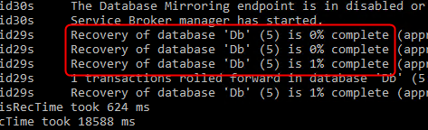
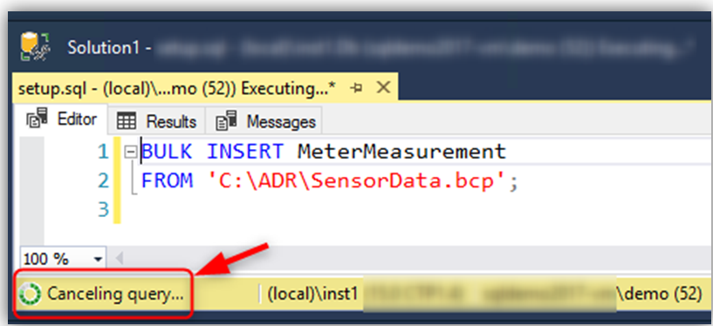

Most common implications
Recovery time is roughly proportional to the longest running transaction.
Rolling back large batch operations (such as bulk insert) takes a long time.
Transaction log may run out of space during long-running transactions.

Slide 8
Accelerated Database Recovery Components
Persisted Version Store
The version can be stored in-row or off-row within the database, it will vary according to the row size;
Versions have the previous state of the data and the Transact-ID of the version;
Fast UNDO, instead of rolling back the active transactions (traditional recovery process) the row version is marked as Terminated.
Persists row versions in the database itself rather than TempDB.
PVS
Persisted Version Store
Logical Revert
sLog
Special
In-Memory Log Stream
Cleaner

Slide 9
Accelerated Database Recovery Components
Logical Revert
Asynchronous process that performs row-level version-based Undo;
Keeps track of all terminated transactions;
Performs rollback using recent committed transactions from PVS;
Release all locks immediately after transaction termination.
PVS
Persisted Version Store
Logical Revert
sLog
Special
In-Memory Log Stream
Cleaner

Slide 10
Accelerated Database Recovery Components
sLog
Secondary in-memory log stream that stores log records for non-versioned operations (e.g.: metadata cache invalidation, lock acquisitions);
Persisted on disk by been serialized during SQL checkpoint;
Is periodically truncated as transactions commits;
It accelerates the redo and undo by processing only the non-versioned operations;
PVS
Persisted Version Store
Logical Revert
sLog
Special
In-Memory Log Stream
Cleaner

Slide 11
Accelerated Database Recovery Components
Cleaner
Asynchronous process that periodically cleans row versions that are not needed.
PVS
Persisted Version Store
Logical Revert
sLog
Special
In-Memory Log Stream
Cleaner

Slide 12
Accelerated Database Recovery process
Phase 1: Analysis
Regular Analysis + Reconstructs sLog
Phase 2b: Redo
Phase 2a: Redo from sLog
Phase 2b: Redo from Transaction Log
Phase 2a: Redo from sLog
Non-versioned operations since oldest uncommitted transaction
Starts from last checkpoint
[DB is FULLY available and all locks
are released after Redo]
Only needs to scan log since last checkpoint. Instant Undo by using sLog and Persisted Version Store (PVS) with Logical Revert.
Phase 3: Undo from sLog
sLog Records
Transaction Log
sLog (in memory)
Log Record for non-versioned operation.
Persisted to disk as part of checkpoint.
Log
Start
Oldest
uncommitted Tx
(XACT_BEGIN_LSN)
Checkpoint
(or oldest dirty page LSN)
Log
End
Notes:
Analysis phase
The process remains the same as today with the addition of reconstructing sLog and copying log records for non-versioned operations.
Redo phase
Broken into two phases (P)
Phase 1
Redo from sLog (oldest uncommitted transaction up to last checkpoint). Redo is a fast operation as it only needs to process a few records from the sLog.
Phase 2
Redo from Transaction Log starts from last checkpoint (instead of oldest uncommitted transaction)
Undo phase
The Undo phase with ADR completes almost instantaneously by using sLog to undo non-versioned operations and Persisted Version Store (PVS) with Logical Revert to perform row level version-based Undo.
https://docs.microsoft.com/en-us/azure/sql-database/sql-database-accelerated-database-recovery

Slide 13
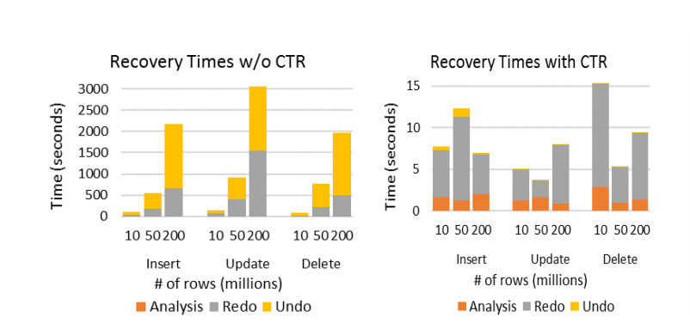
Recovery Time Comparison
Constant Time Recovery in SQL Server
Notes:
Constant Time Recovery in SQL Server (microsoft.com) https://www.microsoft.com/en-us/research/uploads/prod/2019/06/p700-antonopoulos.pdf

Slide 14
Accelerated Dabase Recovery FAQ
Will my database be larger?
Yes. Monitor to determine difference.
Will it affect performance?
It depends. Write-heavy (OLTP) workloads are most susceptible.
How is PVS different than the version store in TempDB?
PVS stores versions in the user database rather than TempDB
If ADR is enabled, PVS is used to support SNAPSHOT and READ_COMMITTED_SNAPSHOT_ISOLATION transactions
How does this affect Availability Groups?
PVS and log records replicate to secondaries, secondary communicates oldest versions needed to primary
ADR can speed up failover because Undo becomes fast
If the secondary must be restarted without ADR, TempDB is lost so versions are lost and queries must wait for data to commit on primary, with ADR, versions are persisted, so no delay before queries can be served
According to the CTR whitepaper, 50 million modifications add 1GB to database.
According to the CTR whitepaper, 13.8% utilization for Update heavy workloads, 2.4% for normal workloads.
Notes:
Constant Time Recovery in SQL Server (microsoft.com) https://www.microsoft.com/en-us/research/uploads/prod/2019/06/p700-antonopoulos.pdf

Slide 15
Demo Time

Slide 16
Questions?

