Slide 1
Working with Data Types

Slide 2
What does this session cover?
What are Data Types?
The Importance of Data Types
Character Data Types
Integer Data Types
Data and Time Data Types
Data Type Conversion

Slide 3
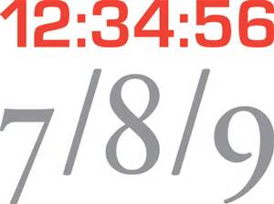
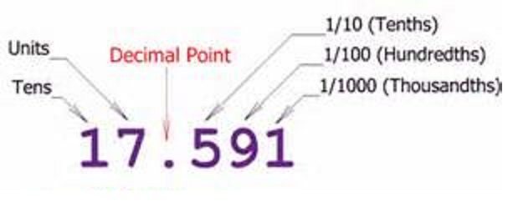
SQL Server Data Types
Data types determine what kind of data can be held:
Integers, characters, dates, money, decimals, etc.
12
34
$34.56
SQL
FUN

Slide 4
Why Data Types matter
Used for Columns, Variables, Expressions, & Parameters
Fundamental to writing queries in T-SQL
Fundamental to designing tables.
Choosing the right data type ensures data integrity and accuracy by creating a constraint on data input
Choosing the right data type can save hard drive space, space in memory, and bandwidth on your network

Slide 5
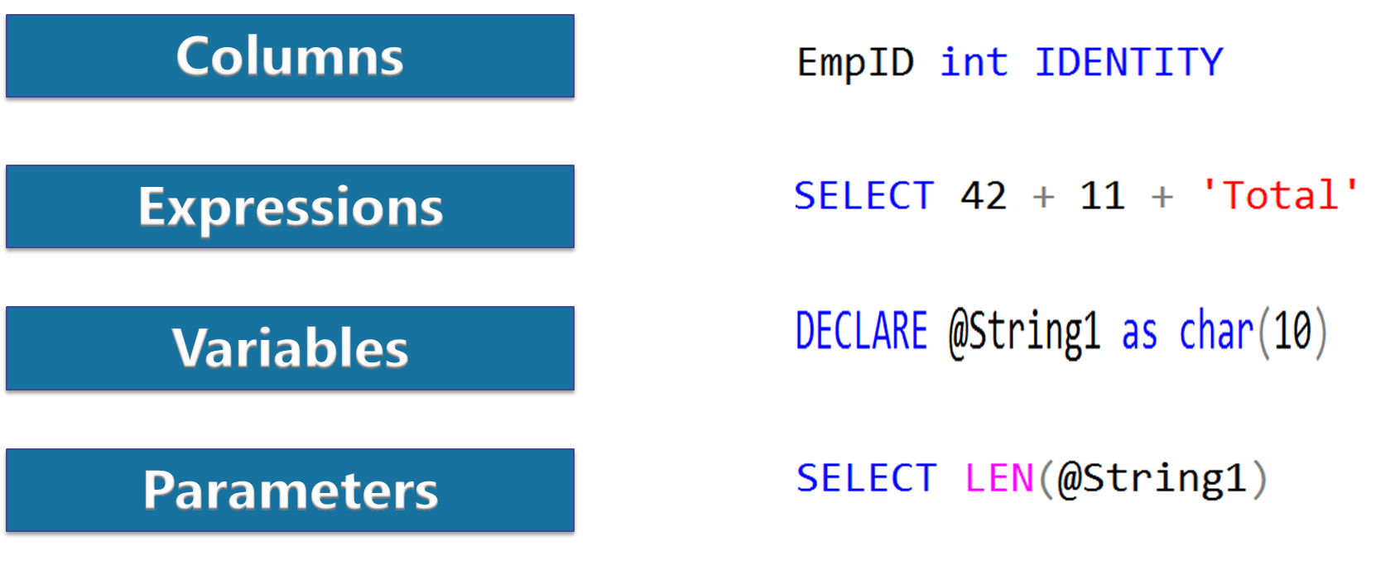
Data Type usage

Slide 6
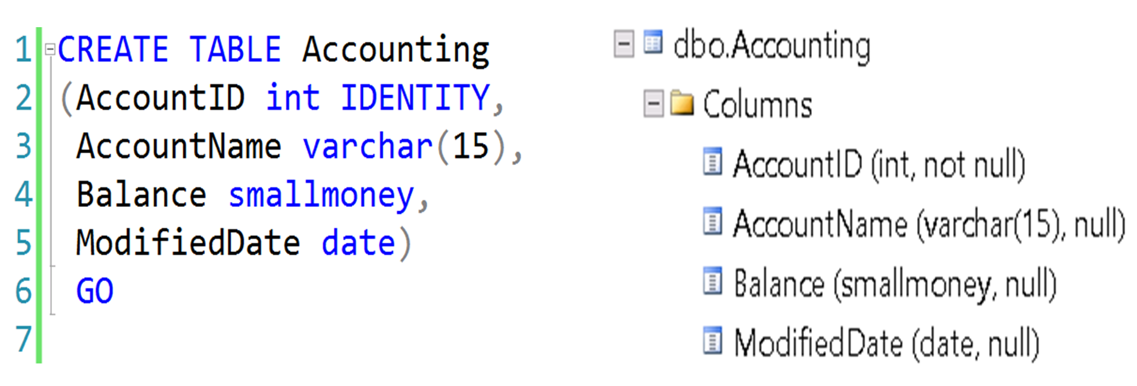
Using Data Type with Columns

Slide 7
Character Data Types
Data Type | Range | Storage
CHAR(n), NCHAR(n) | 1-8000 characters 1-4000 characters | bytes 2*n bytes
VARCHAR(n), NVARCHAR(n) | 1-8000 characters 1-4000 characters | n+2 bytes (2*n) +2 bytes
VARCHAR(MAX), NVARCHAR(MAX) | 1-2^31-1 characters | Actual length + 2

Slide 8
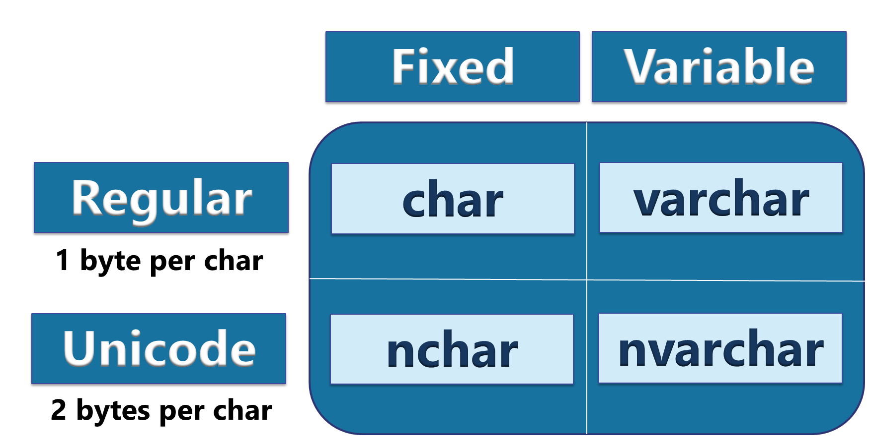
Character Data Types

Slide 9
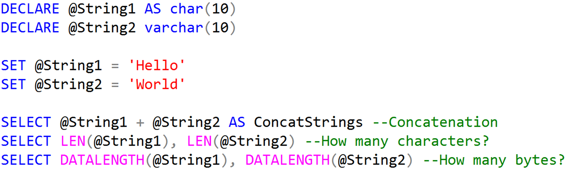
Character Data Types Example

Slide 10
Integer Data Types
Data type | Range | Storage (bytes)
tinyint | 0 to 255 | 1
smallint | -32,768 to 32,767 | 2
int | 2^31 (-2,147,483,648) to 2^31-1 (2,147,483,647) | 4
Bigint | -2^63 - 2^63-1 (+/- 9 quintillion) | 8
bit | 1, 0 or NULL | 1

Slide 11
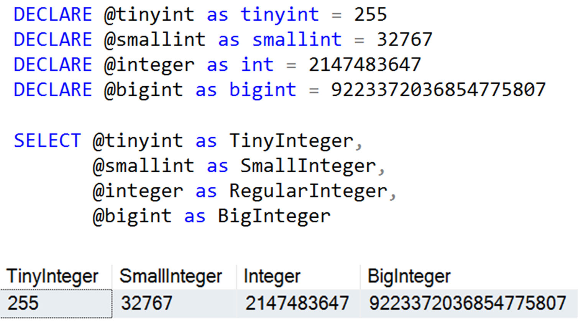
Integer Data Types Example

Slide 12
Additional Number Data Types
Data type | Range | Storage (bytes)
decimal/numeric | 10^38 +1 through 10^38 – 1 when maximum precision is used | 5-17
money | -922,337,203,685,477.5808 to 922,337,203,685,477.5807 | 8
smallmoney | - 214,748.3648 to 214,748.3647 | 4
float /real | Approximate data type for floating point numeric data | 4-8

Slide 13
Date and Time Data Types
Data Type | Storage (bytes) | Date Range | Accuracy
DATETIME | 8 | January 1, 1753 to December 31, 9999 | 3-1/3 milliseconds
SMALLDATETIME | 4 | January 1, 1900 to June 6, 2079 | 1 minute
DATETIME2 | 6 to 8 | January 1, 0001 to December 31, 9999 | 100 nanoseconds
DATE | 3 | January 1, 0001 to December 31, 9999 | 1 day
TIME | 3 to 5 |  | 100 nanoseconds
DATETIMEOFFSET | 8 to 10 | January 1, 0001 to December 31, 9999 | 100 nanoseconds

Slide 14
Date and Time Data Types
Older version of SQL Server supported only DATETIME and SMALLDATETIME
DATE, TIME, DATETIME2, and DATETIMEOFFSET were introduced in 2008
SQL Server doesn’t allow an option for explicitly entering a date or time.
Dates and Times are entered as literal characters and implicitly converted

Slide 15
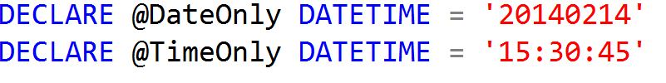

Date and Time Data Types
DATETIME, SMALLDATETIME, DATETIME2, and DATETIMEOFFSET include both date and time data
If only date is specified, time set to midnight (all zeroes)
If only time is specified, date set to base date (January 1, 1900)

Slide 16
Data Type Precedence
Data type precedence determines the data type to convert when different types are combined.
Data types with a lower precedence can be implicitly converted to a data type with a higher precedence.
The CAST or CONVERT function must be used to explicitly convert from a higher precedence to a lower one.
CHAR -> VARCHAR -> NCHAR -> NVARCHAR -> BIT -> TINYINT -> SMALLINT -> INT -> BIGINT -> MONEY -> DECIMAL -> TIME -> DATE -> DATETIME2 -> XML

Slide 17
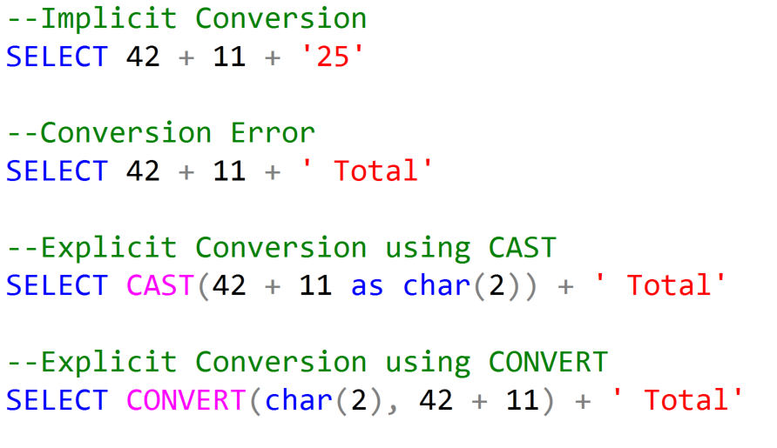
Data Type Conversions

Slide 18
Demonstration

Slide 19
Questions?

Slide 20
Lesson Knowledge Check
What is the difference between char and nchar?
Which is the maximum value for a smallint?
What are two functions that can convert data types?
Notes:
What are the two store types that query store has?
Plan Store
Runtime Stats Store
What are the two QDS cleanup stages?
The two QDS cleanup stages are:
1. In the first stage, old runtime stats are cleaned.
2. In the second stage, queries together with associated plans and statistics are deleted.

Slide 21
Lesson Summary
In this lesson we discussed:
What are Data Types?
The importance of Data Types
Character Data Types
Integer Data Types
Data and Time Data Types
Data Type Conversion

